Slide 1
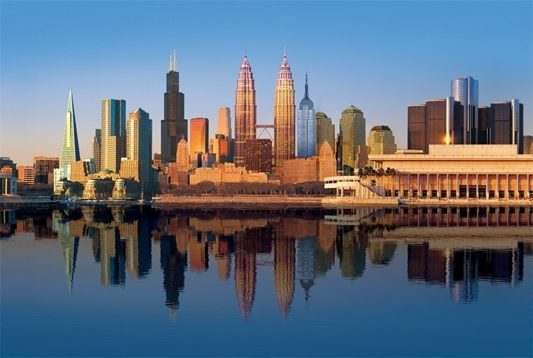
The Role of Smart Buildings Improving Energy Efficiency with Integrated Control Tech
Association of Defense Communities
Geoff Prosch
Director, Federal Government Relations
Notes:
Introductions
Today I’m going to focus my remarks on smart buildings and their role in improving energy efficiency, lowering greenhouse gas emissions, and interacting with a smart electricity grid.

Slide 2
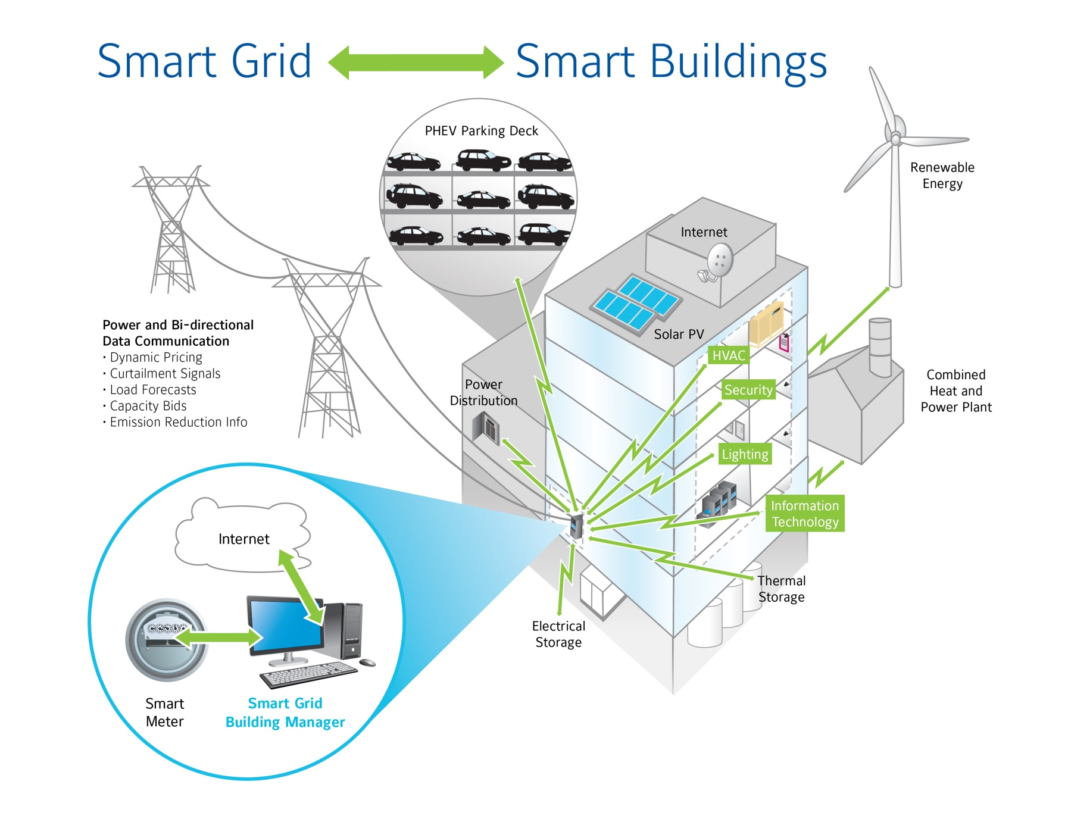
A smart grid needs smart buildings
Notes:
There is a lot of talk about the smart grid these days. And the vision for a more automated, decentralized energy delivery network which will improve reliability, lower costs, and allow us to use more renewable energy.
You can’t really have a smart grid without smart buildings. We won’t achieve the benefits promised by the smart grid vision unless there are smart buildings and devices on the customer side of the meter.
This diagram shows some of the basic functionality that can be created through smart building technology.
We’re going to be focusing on three areas of opportunity. 1) Integrating systems to provide smarter control 2) Diagnosing problems to eliminate energy waste, and 3) Making buildings more responsive to the smart grid in a way that is automated but also empowering for the building owner.

Slide 3
Notes:
Today I’m going to walk you through “a day in the life” of a smart building. We’re going to start the previous night at about 8pm.
It’s a typical summer day in a part of the country where the utility is facing capacity constraints. Our building is a 500,000 sq/ft tenant-occupied office building—but you could imagine it as a large headquarters building on a department of defense installation.

Slide 4
Notes:
At 8pm, the building dials up the weather service and gets a forecast for the next day: hot and humid. There’s going to be a big cooling load tomorrow. The system also downloads the pricing schedule for tomorrow from the utility. Now this building happens to have a thermal storage system that makes ice at night. It can melt that ice to cool the air in the building when the energy price is high and when the capacity is most needed. It looks at the thermal profile and price and figures out how much ice to make. Seems advanced right…but actually we’ve been doing that for years in San Francisco at a Marriott Hotel using information from the utility there.
Note: --Yellow line is the electricity price
--Red line is the smart building energy profile
--Green shaded area is a typical profile

Slide 5
Notes:
At 4am, the equipment in the building will diagnose itself and find a problem in a chiller valve. The system notifies the building operator on a cell phone reporting something needs to happen and asking for permission to send out a work order for repairs.

Slide 6
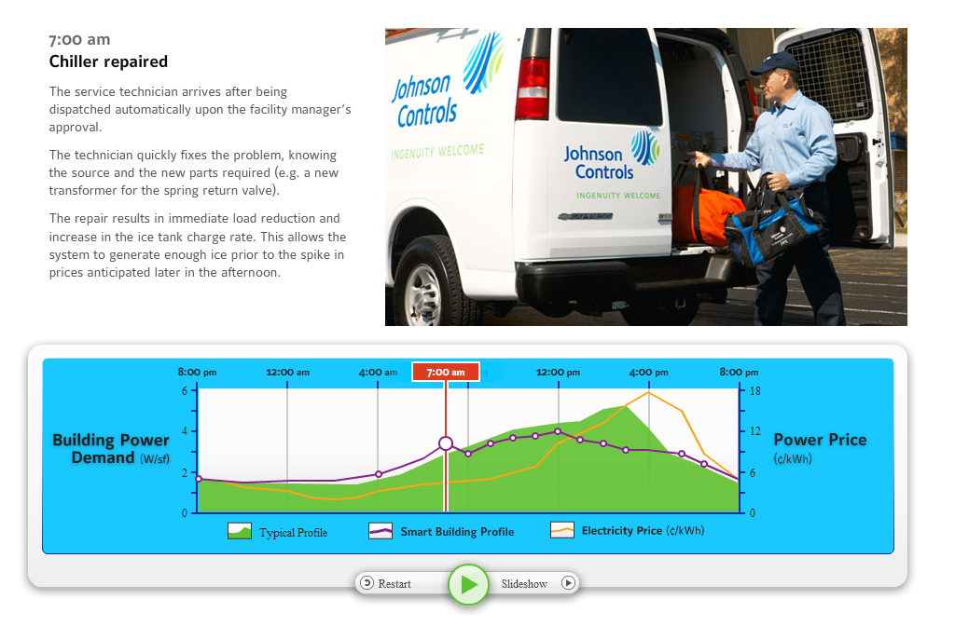
Notes:
At 7am, the technician arrives to solve the problem—because the system diagnosed the problem before the tenants arrive. There is no disruption.
Based on the information he has received from the building controls, he has the correct repair part and can expedite the repair.

Slide 7
Notes:
At 8am, the employees start to show up and in the future many will be plugging their electric vehicles into the building. Now they’re going to have to recharge those vehicles, but its going to be a hot day, so we’re going to want to recharge those vehicles when the energy prices are low and there is excess capacity in the grid. The smart grid will be sophisticated and allow us to charge the vehicles when there is excess capacity, when the voltage is on the high side or when there is wind power that can be stored. Some day we may use some of that stored energy in the vehicle to power the building.

Slide 8
Notes:
At 9am, people start going to meetings. And in a smart building, the scheduling system for the conference rooms, can be used to adjust the temperature and ventilation . And there will be a lot of sensors. So if too many people show up the system will increase the ventilation. If the meeting ends early, the ventilation system will automatically adjust to save energy.

Slide 9
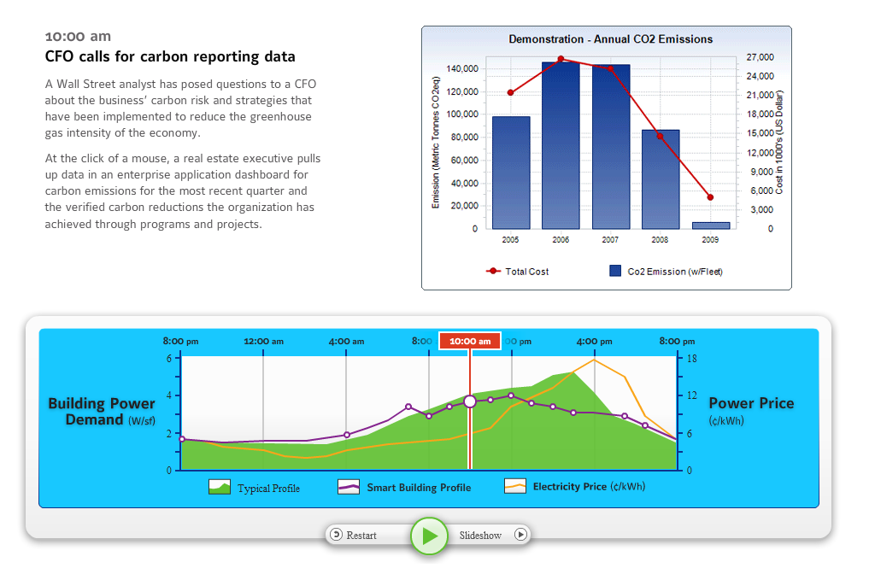
Notes:
At 10 o’clock the CFO gets a call from an investment analyst asking about the CO2 emission profile and carbon risk. The system that manages building energy usage can convert that data into CO2 emissions reports for all the company’s smart buildings. The system can also generate a projection of their carbon emissions for the year. The same management system catalogues energy efficiency projects underway to reduce the carbon footprint of global operations.

Slide 10
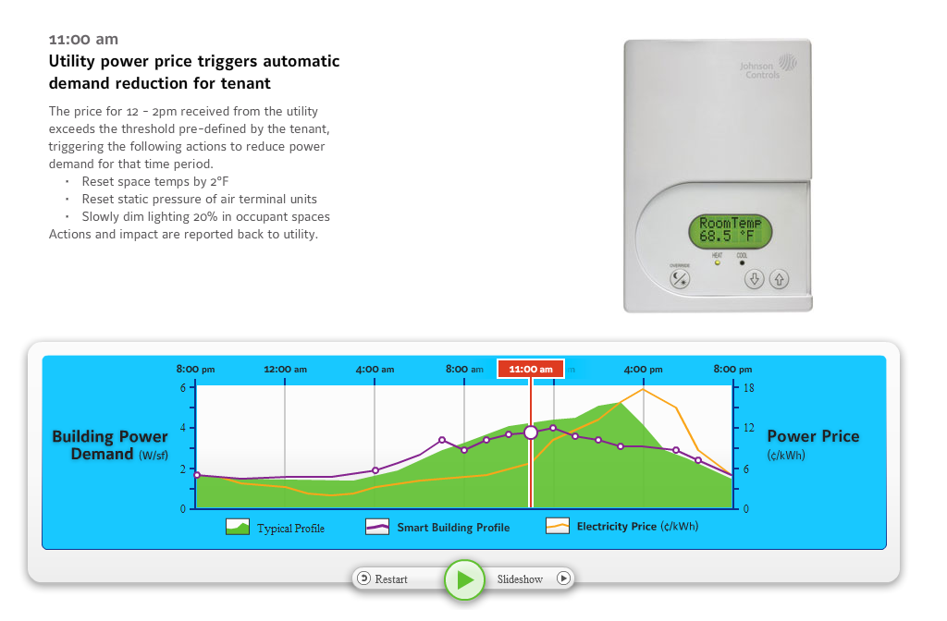
Notes:
At 11 o’clock, the building receives confirmation that at noon the electricity price will exceed 15 cents per KW hour.
The tenants within this building have agreed to reduce energy when it hits 15 cents KW/hour. They’re going to be compensated by the utility for these reductions. In this particular example, the tenants agreed to increase temperature by a couple degrees, reset the pressure blowing into the building to save fan energy, and dim the lights slightly. And everything that’s happening in the building is going to be communicated back to the utility. The change is measured, verified, and communicated back to the utility vice the building energy management system.

Slide 11
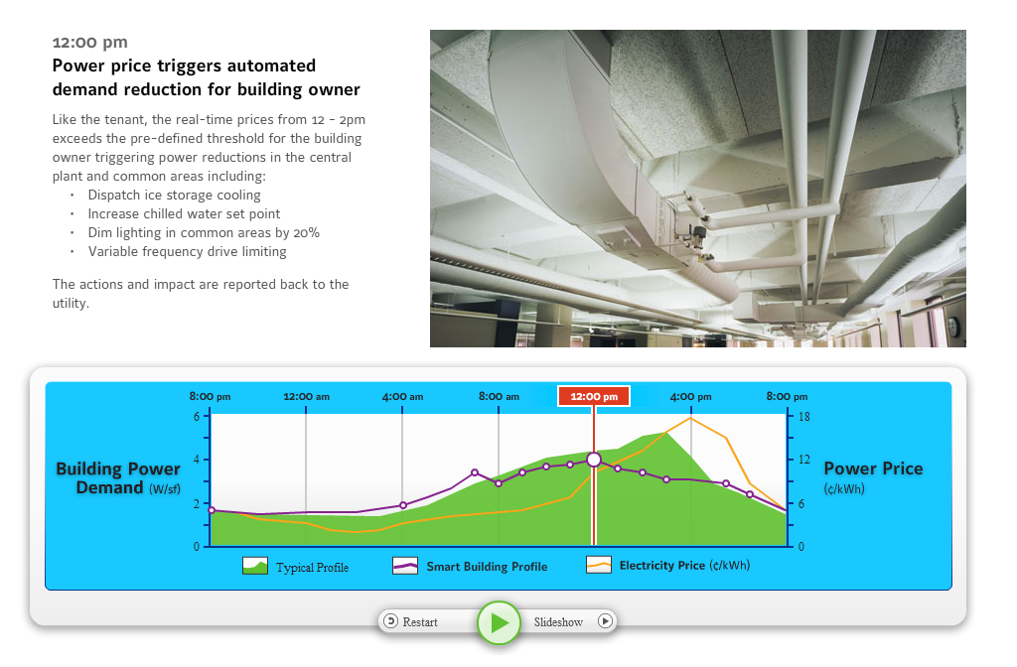
Notes:
At 12 o’clock, these actions are triggered. At the central plant level, the building uses some that ice and initiates ice storage cooling instead of running the electric chillers. Thermostat and lighting systems are adjusted in common areas. Lights are dimmed 20%.

Slide 12
Notes:
At 1pm, the power price triggers more aggressive automated reductions for the tenants. Indoor temperature is increased by 4 degrees F. Lights are dimmed 40%. The load is reduced for non-critical electric equipment.

Slide 13
Notes:
When we go into this more aggressive demand response mode at 2pm, laptops can be just like plug-in hybrid vehicles. Every laptop has a battery, many of which are fully charged. In this example, at 2 o’clock laptops in the building are automatically run off battery power. Smart buildings will enable battery driven devices such as laptop computers and hybrid vehicles to replace power from the grid.

Slide 14
Notes:
At 5:30pm, employees start leaving the office. When employees forget to turn off the lights, the system will do it for them. In addition to the lights, it may also adjust temperatures and put computer monitors into power down mode.

Slide 15
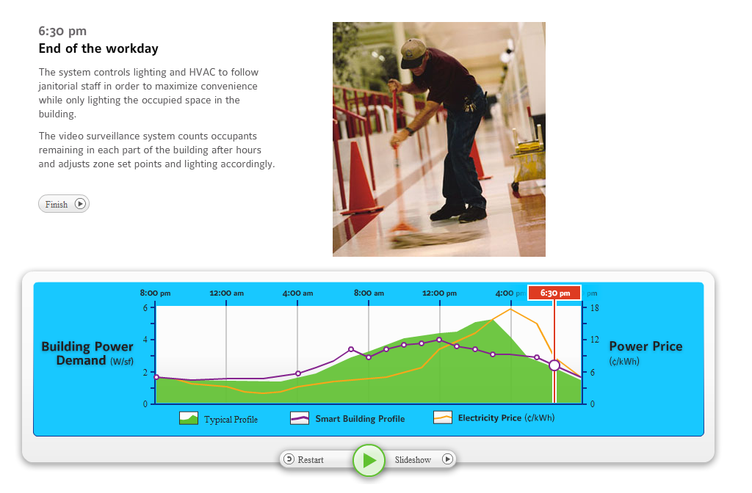
Notes:
Finally at 6:30pm, the system helps the janitorial staff to do their job without wasting a lot of energy in unoccupied areas.
Where janitorial staff are working, lighting and HVAC systems remain on.
At 8pm, the system starts “smart planning for tomorrow”.

Slide 16
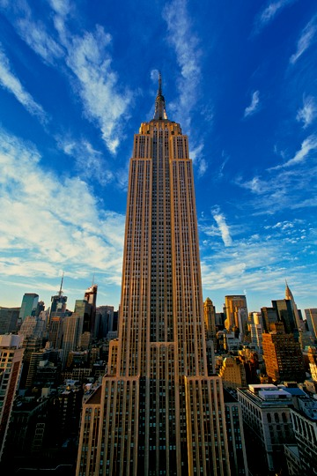
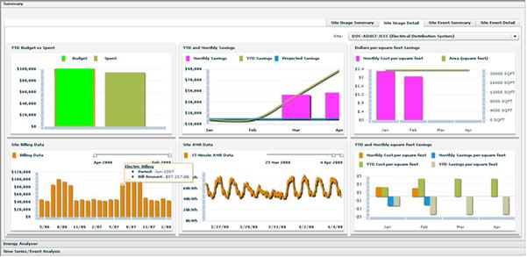
Case Study: Empire State Building
More than half the energy savings exist within tenant spaces – can’t ignore them!
Sub-metering and web application provides tenants with energy information, feedback, analysis, and tips
Allows new lease structures to align tenant and landlord incentives
Tenant Energy Management System
Notes:
The Empire State Building is a major whole building retrofit project that is currently underway. This historic building was built in 1931 in the height of the Depression. One of the components of the project is to is to upgrade all the technology in the building to use digital controls. The neatest feature is called the Tenant Energy Management. Every tenant in this 102-story building is going to have their own dashboard. It’s sort of like the dashboard in the Hybrid Vehicle which tells you the miles per gallon your getting in real time. This is like a Hybrid Vehicle display for your building. A champion from each tenant organization logs in and sees exactly how much energy they’re using. The system also gives tips and coaching on how to further save energy. We think this will get all the occupants involved in saving energy in the building.

Slide 17
Case Study: Empire State Building
More than half the energy savings exist within tenant spaces – can’t ignore them!
Submetering and web application provides tenants with energy information, feedback, analysis, and tips
Allows new lease structures to align tenant and landlord incentives
RESULTS
38% energy savings, guaranteed
Simple payback under 3 years
Anticipate LEED Gold certification
Energy Star Top 10% of U.S. office buildings
33% reduction in cooling load
Savings of $4.4 million annually
Notes:
The results of this project are pretty significant. This building is going to save at least 38% of its energy through the course of the retrofit with a simple payback on the incremental cost that is only 3 years, well within the typical threshold for the commercial real estate sector. The building will also be LEED Gold certified and will rank in the top 10% amongst all commercial buildings in the U.S. We’re proving that you can teach an old dog new tricks. This is a very good example of what’s possible through technology.

Slide 18
Notes:
Keep in mind: this presentation just scratches the surface of the opportunity for smart buildings.
Today you’ve seen some specific examples of how a smart building of the future will operate. But you’ve also seen examples of how many of these capabilities are already in place today. Continuous building diagnostics at one site. Automated demand response at another. It’s just not yet at the scale we need. If we can line these up to get scale for these solutions—for example by demonstrating these technologies on a broad scale across defense communities--we could realize the significant benefits.
With that, I thank you and look forward to your questions.

Slide 19
Questions & Answers
18

