Slide 1
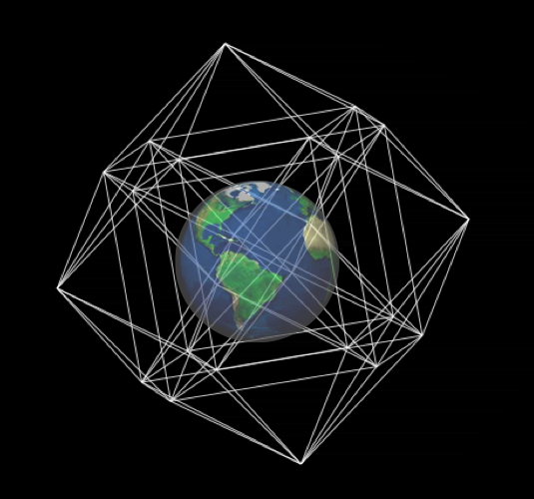
The Role Of Libraries In Improving Data Access And Use in Developing Regions
The Case for International Sharing of Scientific Data: A Focus on Developing Countries
Stephen M. Griffin/NAS Symposium/April 18-19, 2011/Washington, DC USA

Slide 2
Opening Statement
Notes:
This talk will explore potential roles for libraries in improving access, use and sharing of large stores of data in support of e-Science and other data intensive scholarly inquiry. The focus is on developing regions and countries
Brief Description
Contemporary research and scholarship is increasingly characterized by the use large-scale datasets and computationally intensive tasks. Vast amounts of data are used by scientists to better map the cosmos, build more accurate earth system models, examine in finer detail the structures of living organisms, and gain new insights into the behaviors of societies and individuals in a complex world. Similarly, humanists are rapidly integrating newly digitized corpora, digital representations of cultural artifacts, and spatial and temporal indexed data into their scholarly endeavors.
Datasets used are often huge by any measure. Many require elaborate preparation for use. As examples, data are captured by digital instruments and recording devices including telescopes, particle accelerators, seismic sensors, environmental recorders, medical diagnostic machines, and other high-throughput digital devices. Data produced by such instruments can amount to petabytes of data.
Three-dimensional representations of cultural artifacts can require terabytes of data, depending upon the fidelity desired.
Researchers studying social media and networks routinely sample and analyze billions of interactions. More raw digital data is now being produced than can be physically stored and this disparity will almost certainly continue to increase.
Much has been accomplished by the libraries and information sciences communities over the past decade to establish basic principles, standards, object representations, descriptive metadata and reference models needed to gain interoperability, scalability, access, and long-term preservation and archiving of digital content.
Already libraries have undergone significant transformation over the past several decades by converting collections and holdings to digital forms in prescribed formats with appropriate descriptive metadata. In addition, they have been confronted with a deluge of new “born digital” data from a variety of sources. These data are often in the form of new media that is unique to digital representation. Most would agree that taken together, libraries have risen to the task of integrating new digital content into their collections. Libraries now play a central role in providing enhanced access to large digital collections across many topic domains for a wide variety of users.
However, the prospect of libraries taking responsibility for very large-scale raw data sets and a multitude of derivative forms of data associated with eScience and data-intensive scholarship was not seriously considered until the past several years.
As a result, there is lively debate and controversy over how libraries, and particularly “research” libraries, should participate in providing data, tools and infrastructure in support of data-intensive research.
The challenges for libraries to take a major role in this regard are daunting. In addition to tasks inherent in the information lifecycle there other changes requiring new technology infrastructures, additional local expertise and a broader spectrum of user services. [The data may arrive in complex, unstructured form from remote and sometimes unknown or unreliable sources. Researchers may request new or hybrid forms of datasets along with new sophisticated tools for data retrieval and analysis, visualization and rendering, and potentially many other tools and services.]
What all of this means for libraries in terms of computational, storage and communication infrastructure is an open and unanswered question.
Even more uncertain than the data management and technology implications is what the new circumstances will imply in terms of human resources and staffing for libraries. Certainly new expertise will be necessary. This points to the question of whether graduate schools of library and information science are adequately preparing students for the realities that await them in the networked, digital world of knowledge resources.
For developing countries all of the above apply, only there will be other barriers to overcome that are not present in the more developed areas. But perhaps there are unique opportunities for developing countries as well – as they are starting from a different point and one that is not burdened by entrenched practices.
This presentation will consider some of the issues. The topic is broad, but one accompanied by considerable passion and pressing concern.

Slide 3
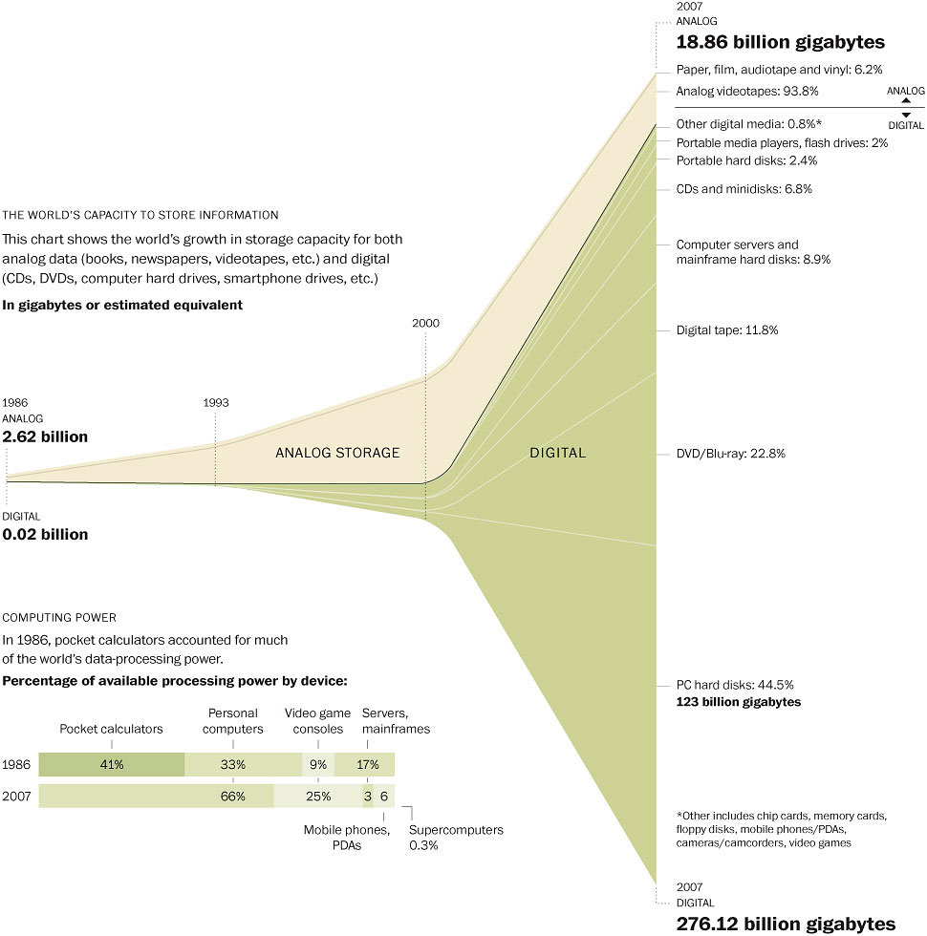
Notes:
Source: Science Magazine 11 February 2011
The World's Technological Capacity to Store, Communicate, and Compute Information: Martin Hilbert1, and Priscila López
Visualization: Washington Post
Global information production far exceeds available storage. The 2010 International Data Corporation 2010 Digital Universe Study, sponsored by EMC states that in 2009 the amount of information produced was 800,000 petabytes and that by 2020 the Digital Universe will be 44 TIMES greater than 2009.
While some researchers are interested in issues related to information production and use (to better understand social, economic and technical dimensions), the focus of today’s talk is scientific and research datasets which are only a small, but important part of the data being produced. Scientific and research data must be carefully managed, maintained and preserved and these are tasks which necessarily must involve libraries and librarians..
Several important points are not illustrated in the visualization that shows the dramatic transition in both the amount and storage capacity of digital information. What is not communicated by the visualization is the relatively rapid deterioration of media for storing digital data. Data stored on optical and magnetic media is likely to be corrupted and unreadable after several decades, depending on various factors. This means that developing capabilities for preservation and archiving of digital information is of critical importance. The Library of Congress’ National Digital Information Infrastructure Preservation Program is on of the leading activities focusing on developing means for accomplishing this. [www.digitalpreservation.gov]

Slide 4
New Methods of Research and
Scholarship Have Emerged
eScience*
Computationally intensive science using distributed network environments for immense datasets that require grid computing; the term sometimes includes technologies that enable distributed collaboration.
Data-Driven Science*
A rapidly growing set of applications in which analysis of large amounts of data drives the next steps taken by the scientist, e.g., running new simulations, doing additional measurements, extending the analysis to larger data collections.
Data-Intensive Research
Research based in part on the exploration, manipulation and analysis of massive and diverse datasets. Collaboration within and across disciplines may take a key role. Interoperable and highly contextualized datasets may be essential to success.
*Christine Borgman and Paul Young
Notes:
eScience is a natural evolution of computational science – massive simulations of phenomena of scientific interest and importance. Scientific visualizations of data is an essential tool for understanding results. Grid computing is frequently involved and necessary. As with all science, goals include insight, inference, deep understanding and increased predictive capability.
Data-driven science is a more recent new research paradigm, complementing and validating large-scale simulations.
Data-Intensive Research offers new means for scientific research but also broadens the scope of potential inquiry to scholarly domains beyond the sciences, including the humanities. Second-order effects associated with the massive uptake of digital technologies by individuals and societies have resulted in new areas of inquiry for social scientists. Examples include combining geographic information systems technologies (GIS) with spatial indexed data and temporal indexed data to produce historic mappings and timelines. Computer vision techniques are being applied to recover details of material culture artifacts. Multispectral analysis is in widespread use to enhance and make legible inscriptions on ancient manuscripts. Computer graphics technologies are used in constructing virtual places and spaces, enabling visual analyses of text corpora, and combining millions of photographs on the world wide web to create accurate renderings of historic structures.
Often, these efforts are characterized by significant interdisciplinary collaboration. (next slide) Efforts are also frequently performed in combination: observation/experiment -> simulation –> calibration (finding parameter settings consistent with observations) -> validation.
A significant number of reports have endorsed the importance of eScience and data-intensive research. A few are noted below, along with quotes from them.
National Science Board report Long-Lived Digital Data Collections: Enabling Research and Education in the 21st Century, 2005
“It is exceedingly rare that fundamentally new approaches to research and education arise. Information technology has ushered in such a fundamental change. Digital data collections are at the heart of this change. They enable analysis at unprecedented levels of accuracy and sophistication and provide novel insights through innovative information integration. Through their very size and complexity, such digital collections provide new phenomena for study. At the same time, such collections are a powerful force for inclusion, removing barriers to participation at all ages and levels of education.”
http://www.nsf.gov/pubs/2005/nsb0540/
NSF/JISC Workshop: The Future of Scholarly Communication:
Building the Infrastructure for Cyberscholarship, APRIL 2007
Data-driven scholarship is technically difficult. Many of the collections are huge and diverse as measured by any standards and they often have complex internal structure. There are challenges in reconciling these two parameters, scale and complexity, particularly when the research questions to be asked of the data are not known in advance. Fewer people appreciate that the combination of large-scale digitization of books, scholarly journals online, and huge data sets provides opportunities for new methodologies for scholarship and research in all academic disciplines.
http://www.sis.pitt.edu/~repwkshop/
------
Libraries must play a major role. Data is at the heart of these new research methodologies. Data quality is essential and all of the issues associated with managing analog knowledge resources are present in managing digital resources, only in the case of digital resources the issues are multiplied.
--------------------------------------------
The UK National e-Science Centre’s definition places collaborative work as central to eScience. “The large scale science that will increasingly be carried out through distributed global collaborations enabled by the Internet. Typically, a feature of such collaborative scientific enterprises is that they will require access to very large data collections, very large scale computing resources...”

Slide 5
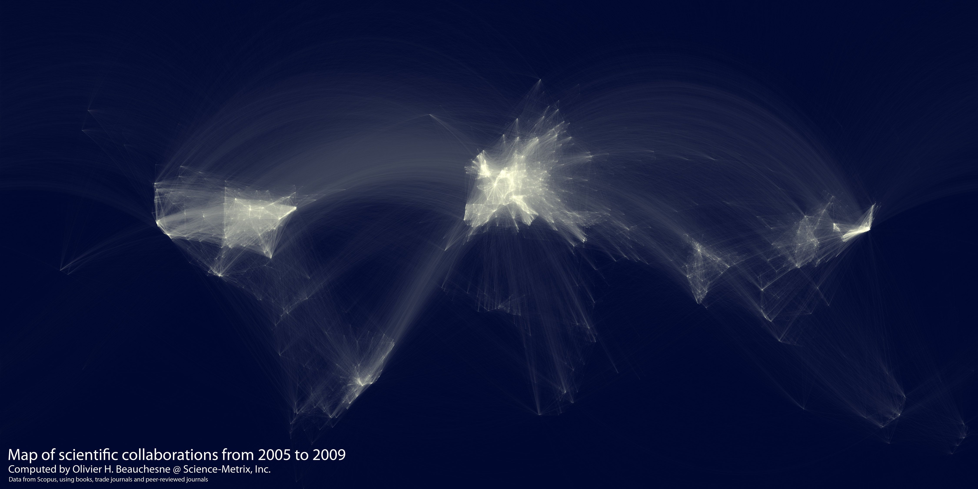
Map of Scientific Collaborations
Notes:
The UK National eScience Centre’s definition places collaborative work as central to eScience. “The large scale science that will increasingly be carried out through distributed global collaborations enabled by the Internet. Typically, a feature of such collaborative scientific enterprises is that they will require access to very large data collections, very large scale computing resources...”

Slide 6
Visualizations of results is an essential tool for understanding the output of high performance computer simulations and the analyses of vast quantities of large-scale, complex datasets
Notes:
Recent developments in visualization involve real-time analysis, visualizations, and storage for massively streaming data from sensors and other high-throughput instruments.

Slide 7
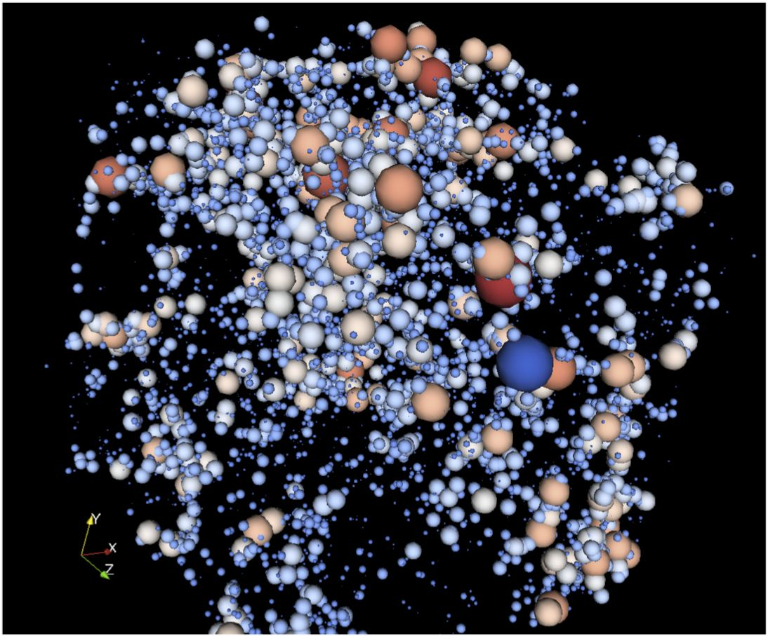
Visualization of dark matter clusters using Los Alamos RoadRunner Petaflop Computer
Notes:
Visualization of dark matter clusters from the RoadRunner Universe MC^3 cosmology simulation. Clusters of dark matter particles (halos) can be calculated as the simulation is running, greatly reducing the necessary storage space, instead of writing the full resolution data to storage and calculating the clusters in post-analysis."

Slide 8
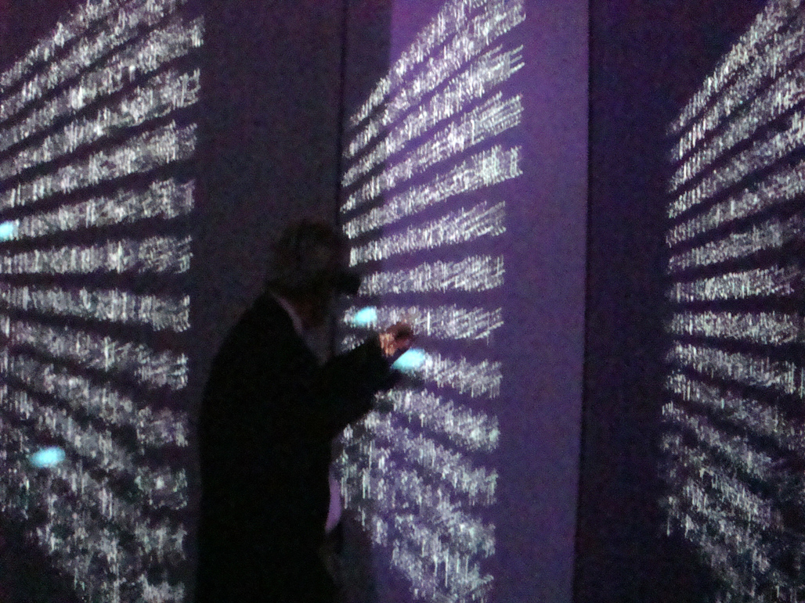
13th Century Buddhist Canon in Immersive Environment
Notes:
Digitization of 160,465 pages of rubbings made from 80,233 printing blocks carved in the 13th century in Korea.
(b) A total of nearly 52,000,000 glyphs (“Chinese characters”) of which 13,000 are “user defined” ancient forms not found in the computer fonts.
1504 colophons with titles, translators, dates, places, and other information.
Digitized version of The Korean Buddhist Canon: A Descriptive Catalogue, a 720 page paper publication.
from the Electronic Atlas Initiative (www.ecai.org)
(immersion facility at City University of Hong Kong)

Slide 9
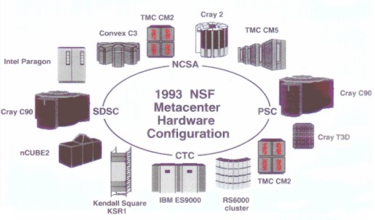
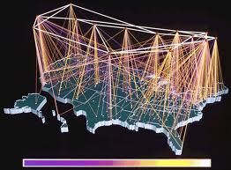
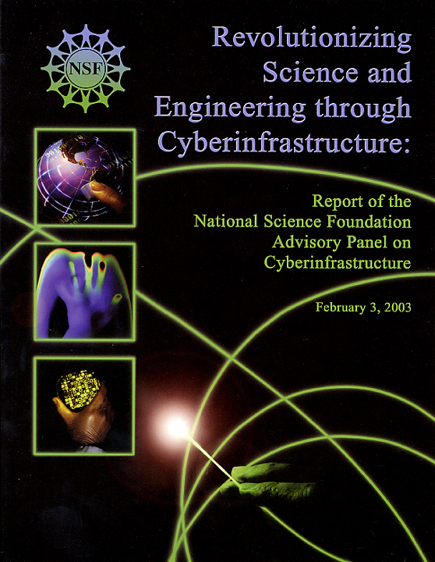
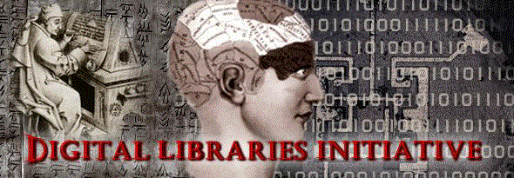
Important Early Programs at NSF
Supercomputer Centers Program
NSFnet
The Digital Libraries Initiative
Cyberinfrastructure
Notes:
Advanced Scientific Computing
NSFnet
Digital Libraries Initiative DLI
- research to enhance creation, access, and usability of globally distributed content-of-value
- new information technologies, data representations, interoperability, collections, data-rich applications in many domains (DLI-2 had PIs from 33 academic departments)
Cyberinfrastructure Program (ongoing)
http://www.nsf.gov/dir/index.jsp?org=OCI

Slide 10
Researchers’ Needs for Data-Intensive Research
Useful and Easily Accessible Data
Application tool sets
Local high performance ICT Infrastructure and data services
Internet Connectivity to remote resources (cloud services)
Opportunities and Resources for Collaborative and Interdisciplinary Work
Participation In Scholarly Communication Processes
(journal access and opportunities for publication)
researchers in developing countries are at a disadvantage...
Notes:
Data resources may be large, distributed, autonomous, diverse, and dynamic. In many developing countries data-driven research requires the researcher to be in close physical proximity to the data. Researchers in these regions may have access to the internet but bandwidth may vary greatly. Proximity to a high bandwidth hub is essential. Intranet bandwidth on university campuses or within institutional networks is generally is sufficient for use of local data resources. In mature economies, connectivity allows for geographically distributed repositories with varying degrees of collective functionalities. Federated distributed repositories have high degrees of interoperability.
Internet connectivity does not mean access to scientific datasets; bandwidth varies greatly according to location and services available. Statistics for internet users often include cell phone and other handheld devices. (1995: 90M Mobile subscriptions; 2010: 5.2B mobile subscriptions (4.5B users); 2011 World Population: 6.9B)
Full Participation in scholarly communication processes is essential to researchers. A primary concern for researchers in developing countries is not only one of limited access to data resources, but one of isolation – being left out of the scholarly communication processes and informal dialogues that accompany the global mainstream disciplinary research enterprise. Without access to desired datasets and resources researchers in developing countries will leave – the country’s intellectual capital will decrease and its prospects for future prosperity will diminish. Intellectual capital plays an essential role in improving a countries economic circumstances and the overall quality of life of its people.

Slide 11
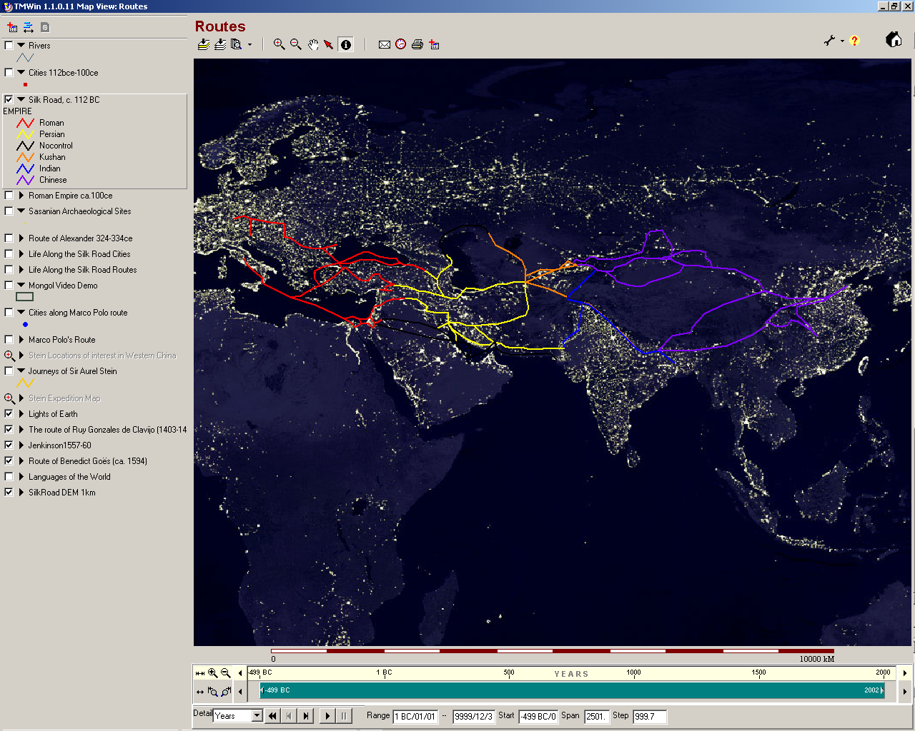
Need to Combine Many Data Types
Across Space and Time
Notes:
Interoperability of data, systems and networks is essential to conduct innovative research. Distributed repositories that link diverse and often heterogeneous datasets serve broad range of users. To accomplish this, research data must be wisely prepared and formatted at the earliest stages of the information lifecycle to facilitate building highly functional collections as the data accumulates and is integrated and connected to other resources. This is most quickly and efficiently achieved by working within an international context involving both formal and informal arrangements.

Slide 12
Some Consequences/New Roles
National libraries
University and Research Libraries
Public Libraries
Special Topic Libraries
School and Education Libraries
Private Libraries
Archives
eScience, data-driven research and data-intensive research will have a major impact on all aspects of a libraries activities including collections, services, research infrastructure, staffing, professional development and more
... will be expected to carry the load
Notes:
Supporting data-intensive research will have a significant impact on many aspects of a Library’s operations: collections, services, research infrastructure, and human resources. In terms of the information lifecycle there will be new responsibilities and priorities. A few are listed here:
Data Creation and Acquisition Considerations
close attention to the selection and evaluation of new data
partnering arrangements
multi-sector support
multi-lingual content
cross-domain and interdisciplinary research data
Data Management
data set integration for structured and unstructured data
metadata standards
interoperable architecture and repository infrastructures
data archiving services
Maintenance
Security
Classification/tagging
Workflow
Data Use Considerations
user metadata and annotation tools
reformatting tools and services
allowing for complex derivatives of raw data (computational artifacts)
fundamental search and retrieval
data assets browser and discovery tools
promoting data reuse and repurposing policies and practices
standard data analysis and visualization tools
agreement on extent of application support and toolsets
Data Curation Considerations
ensuring the validity, scope, format consistency, authenticity, authority, persistence, reliability, integrity, provenance, preservation and archiving of data

Slide 13
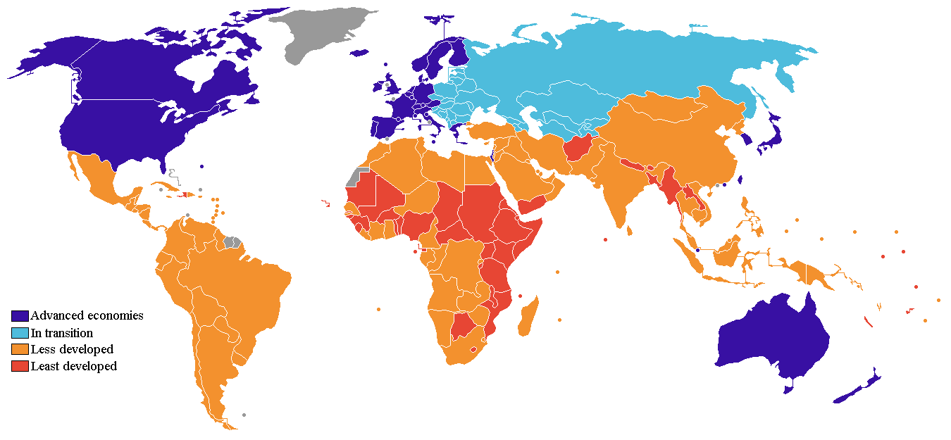
Developing Countries: One View
Source: Forbes Magazine/World Bank
Notes:
The designation of a developing region or country is not uniformly used and is determined by many different measures by different parties.
Developing country is generally used to describe a nation with a low level of material well-being. Since no single definition of developed country is recognized internationally, the levels of development may vary widely within so-called developing countries. Some developing countries have high average standards of living.
source: Wikipedia
But according to the United Nations Statistics Division, there is no established convention for the designation of "developed" and "developing" countries or areas in the United Nations system.

Slide 14
Role of Libraries in Enabling
Data-Intensive Research (1)
role priority
manage data acquisition
and physical data storage
make data useful
higher
facilitate scholarly communication
manage consortia
arrangements, partnering and
information exchange
perform data life-cycle
and curation services
support outreach and training
provide and maintain ICT
infrastructure
lower
applications support
and tool building
less
more
resource requirements
Notes:
For libraries in developing countries numerous tradeoffs must be made in determining resource requirements and priorities. This slide shows some of them.

Slide 15
Role of Libraries in Enabling
Data-Intensive Research (2)
Out of Reach for Now
- peer relationships for data sharing and access to distributed resources
- remote information harvesting
advanced content management of complex large-scale data sets
research tools & support
- state-of-the art ICT infrastructures
full staffing in critical specialty areas
grid access, cloud services
information infrastructure and staff to support preservation, archiving and data curation
- full participation in the ongoing international dialogue
manage data acquisition
and physical data storage
make data useful
manage consortia
arrangements, partnering and
information exchange
facilitate scholarly communication
perform data life-cycle
and curation services
outreach and training
participate in local governance of data resources
provide and maintain ICT
infrastructure
applications support
and tool building
Notes:
Challenges confronting libraries in developing countries include the following (non-inclusive):
bottlenecks in key specialties such as security (especially security), information management, advanced content management, and real-time processing (International Data Corporation Digital Universe 2010 Report)
multi-linguality
out-dated ICT and data infrastructure; limited support and maintenance
low internet bandwidth
sense of geographic isolation
limited funds to support professional development and participation in community conferences, working groups, etc.
In general:
information Integration, synthesis and use will be limited in scale, especially when the data is from multiple sources in variety of forms
information harvesting is dependent upon internet connectivity and staff quality-control
information parsing requires specialized systems and technical expertise
information conversion to new repository models requires technical expertise and full awareness of external practices

Slide 16
Local activities that would help...
increase staff dialog in all institutional and technical matters
- form working and discussion groups that meet regularly
strive to build sense of local community and institutional pride
pursue excellence and recognition in specific areas
create new collections and services
create and “publish” a new journal highlighting local research
enhance outreach to the larger regional and global communities
- support staff attendance and participation in relevant conferences and professional training events
establish exchange programs
expand efforts to convert digital holdings to current standards and forms; build new tools and resources
pursue internal and external support from public and private sources
(i.e. UNESCO, US AID, EU, NGOs, private foundations)
Notes:
Some International Activities of Note:
The World Summit Award (WSA) is a global activity to select and promote the world's best e-Content and most innovative ICT applications. It offers a worldwide platform for all who value the creative use of ICTs and who are committed to making today’s information society more inclusive.
WSA is based on a unique mechanism of a global contest supported by national selections of best practice and a sequence of content-focused national and international events, content conferences and promotional exhibitions.
WSA was initiated by Austria in 2003 in the framework of the United Nations' World Summit on the Information Society (WSIS) and is organized by a global partner network, coordinated by the International Center for New Media. WSA partners come from governments, private sector and civil society in over 160 UN member states.
WSA implements the UN agenda for the development of the information society and supports specifically the UN Millennium Development Goals of ending poverty, hunger and disease, providing education for all, saving the environment and giving a fair share to women through the use of ICTs.
EIFL is an international not-for-profit organization based in Europe with a global network of partners. We run a wide range of programs and events designed to increase access to knowledge
Working in collaboration with libraries in more than 45 developing and transition countries in Africa, Asia and Europe, EIFL enables access to knowledge for education, learning, research and sustainable community development.
http://www.eifl.net/
FUNREDES is a Non-Governmental Organization, dedicated to the dissemination of New Information and Communication Technologies (NICT) in developing countries, especially in Latin America and the Caribbean. The in collaboration with International Organizations, NGO's, the States, Administrations, and public or private institutions, with the objective of contributing to regional development and integration.
http://www.funredes.org/english/index.php3
Digital Links is a social enterprise that provides IT equipment and solutions for education, small businesses and health units in the world’s poorest areas.

Slide 17
Positive Global Developments
The emergence of a culture of sharing has accompanied the growth of the internet and new communities involved in creation and management of digital content and resources. The digital libraries community has been particularly instrumental. At the same time there has been a general movement toward openness of internet-based content and resources (when appropriate and legal). For example:
Open Data
Open Access Journals*
Open Repositories and Archives
Open Source Software
Open Architectures
Open Educational Resources
Open and Transparent Governance
Open Scholarly and Practitioner Communities
Notes:
Notes:
1) open access does not necessarily mean “free”
2) The culture of sharing that has accompanied the growth of internet-based digital content has also demonstrated a unique ability to self-organize to address very difficult challenges– some of considerable scope requiring years of effort. The challenges include technical, organizational and social.

Slide 18
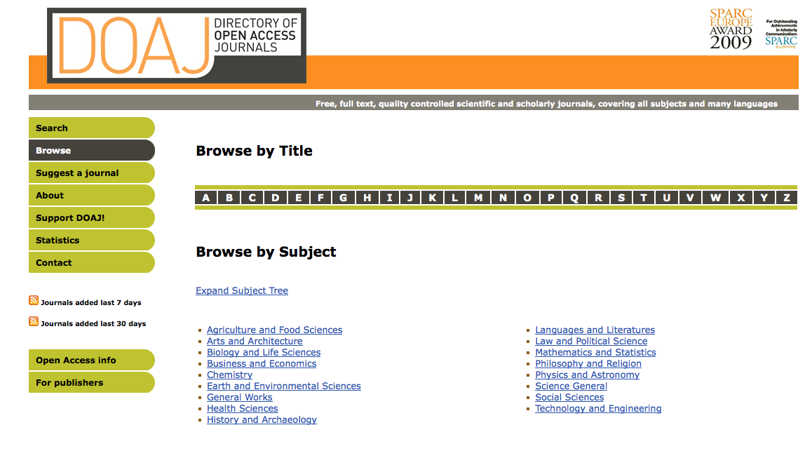
On-Line, Open Access Journals
6300 journals from more than 110 countries in more than 50 languages in the DOAJ. More than 2500 journals are providing metadata on article level, which means that more than 540.000 articles are searchable from DOAJ
http://www.doaj.org/
Notes:
Access to scientific journals and opportunities to publish the results of their work is essential for researchers. For now, low-bandwidth connectivity suffices for most on-line journals. However, when journals and documents become “actively formatted” (linked to other papers, datasets, software, ...) access to broadband wide-area networks will be essential.

Slide 19
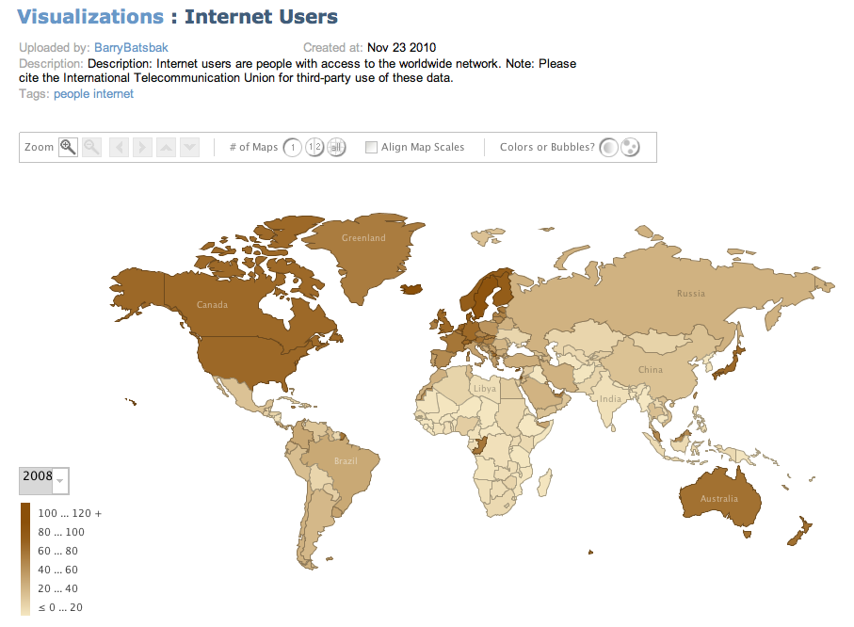
http://www-958.ibm.com/software/data/cognos/manyeyes/visualizations/internet-users-4
Data Source: http://data.worldbank.org/indicator/IT.NET.USER.P2
Notes:
This slide links to an interactive visualization showing internet penetrations to more than 100 countries.

Slide 20
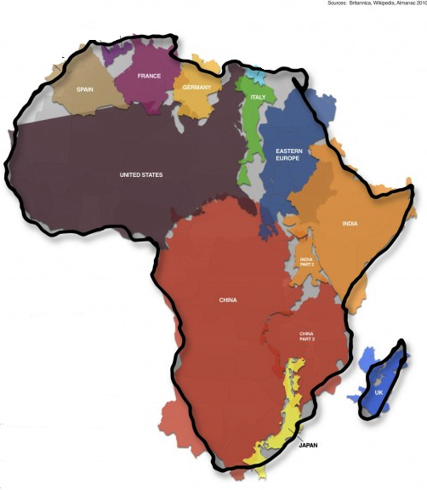
Size of Africa Compared to Other Countries
France
Spain
Germany
Spain
Eastern Europe
USA
India
China
China
United Kingdom
Public Domain Image
Notes:
The sheer size of some regions presents obstacles to providing ICT infrastructure to remote areas.

Slide 21
Internet Connections Information and Major Organizational Efforts.

Slide 22
World Telecommunication/ICT Development Report 2010  Monitoring the WSIS targets, 9th Edition, 2010
Target 3: Connect scientific and research centres with ICTs
International National Research and Education Networks (NRENs) Are Essential to Creating a Global Scientific Research Enterprise
By 2010, around 62 percent of countries had a national research and educational network
The band-width of countries’ national research and educational networks ranges from just a few Megabits to over 10 Gigabits
http://www.itu.int/pub/D-IND-WTDR-2010/en
Notes:
Telecommunication providers continue to mount new efforts to extend internet connectivity to developing regions.

Slide 23
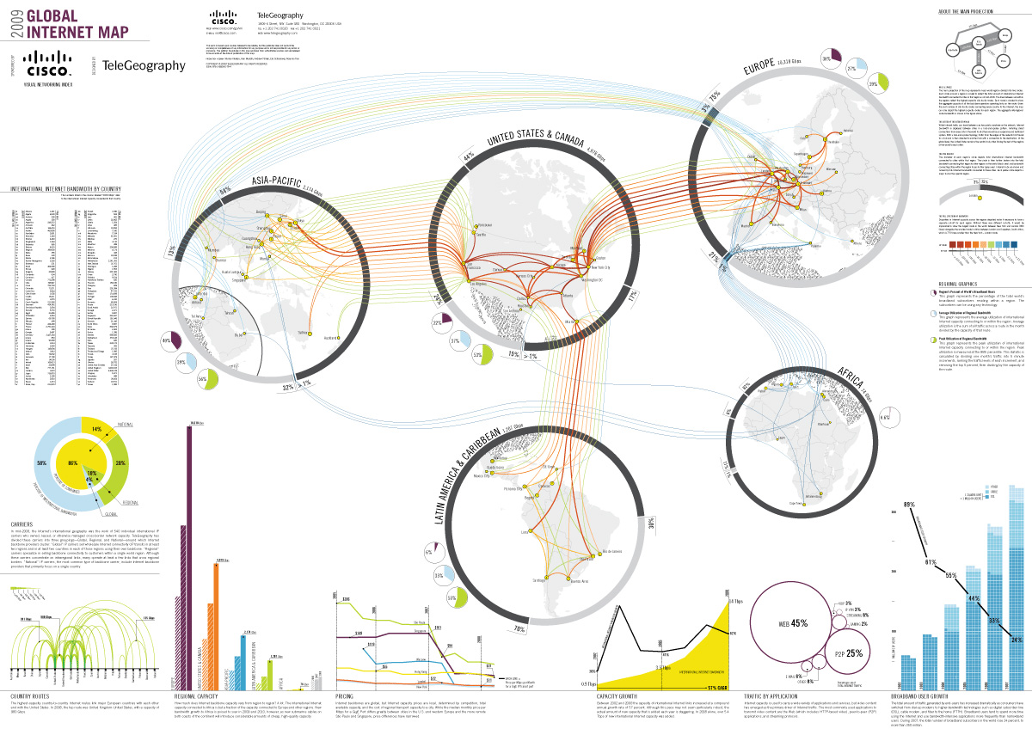
Notes:
http://alhaqqagency.wordpress.com/2010/01/07/global-internet-map-2009/
Annual Cisco Visual Networking Index Forecast Projects Global IP Traffic to Increase More Than Fourfold by 2014
The Global Information Technology Report 2010-2011 World Economic Forum (cisco)

Slide 24
Notes:
GÉANT
GÉANT2 is the high-bandwidth, academic Internet serving Europe’s research and education community. Connecting over 30 million researchers with a multi-domain topology spanning 34 European countries and links to a number of other world regions, GÉANT2 is at the heart of global research networking.
GÉANT2 is co-funded by the European Commission and Europe's national research and education networks, and is managed by DANTE.
In addition to its pan-European reach, the GÉANT network has extensive links to networks in other world regions including North America, Latin America, North Africa and the Middle East, South Africa and Kenya, the South Caucasus, Central Asia and the Asia-Pacific Region. Work is also on-going to connect to the Caribbean and to improve links to and within Southern and Eastern Africa.
The global reach of the GÉANT network enables scientists and academics in Europe to exchange data and collaborate with their peers across the world through links to 59 National Research and Education Networks. With plans for regional research and education networks to be established in the Caribbean and Sub-Saharan Africa, GÉANT’s global connectivity will continue to grow to reach all of the following regions:

Slide 25
Internet2 International Partnerships

Slide 26
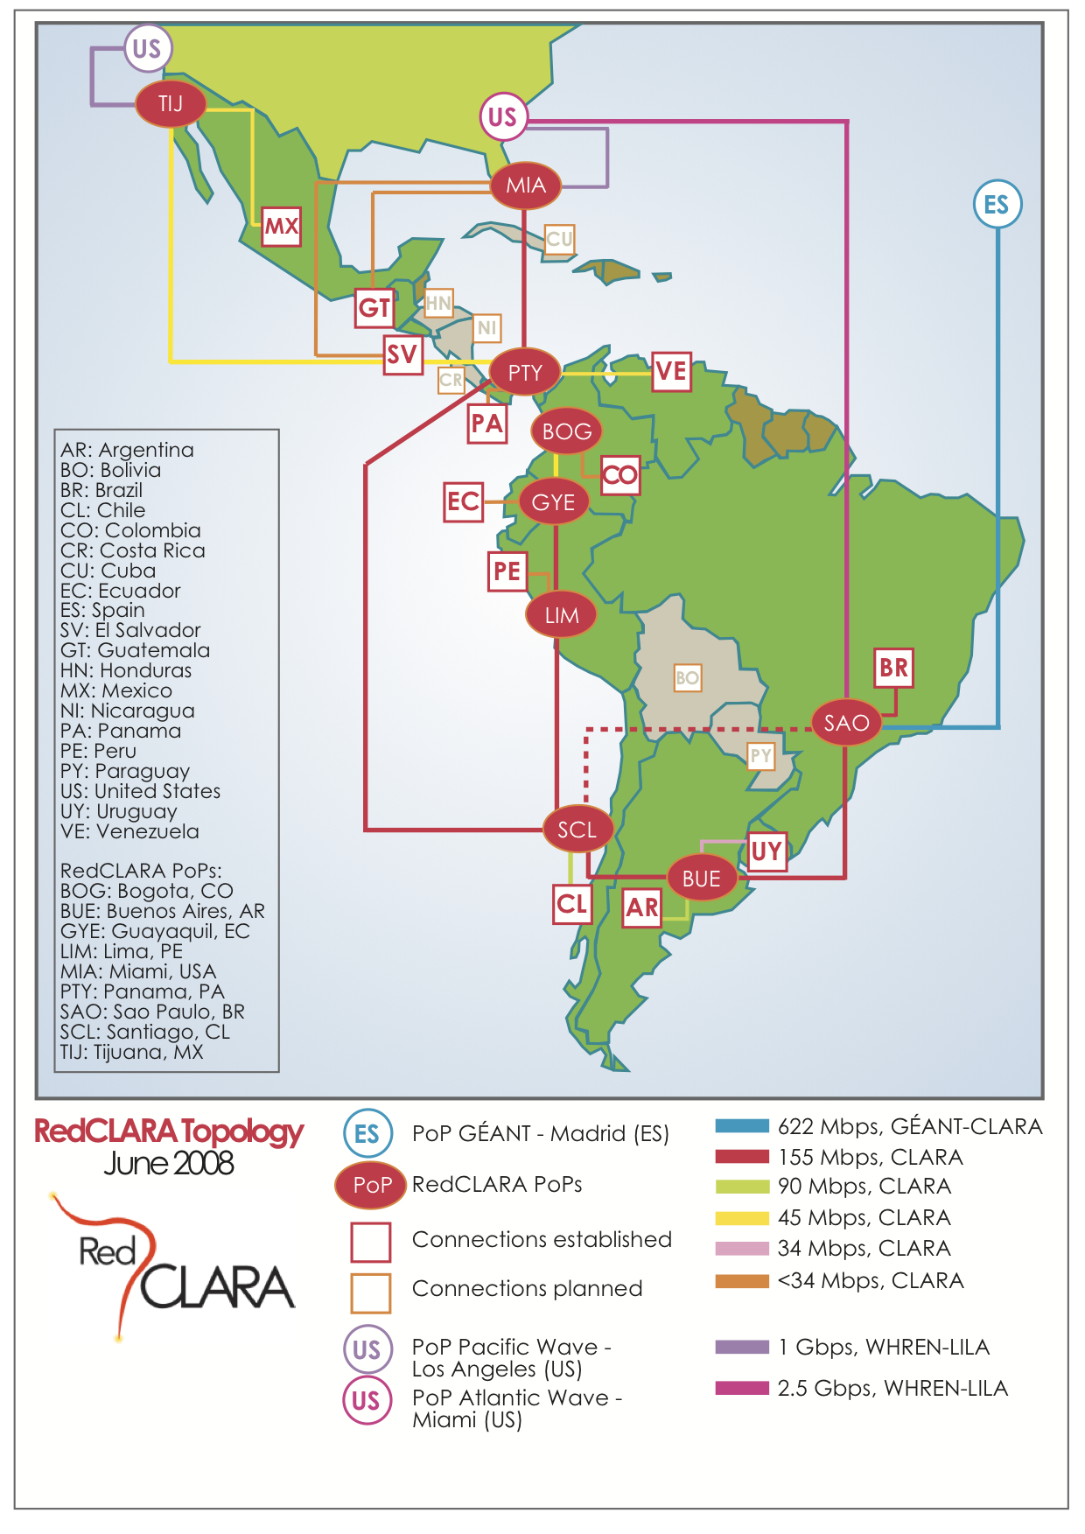
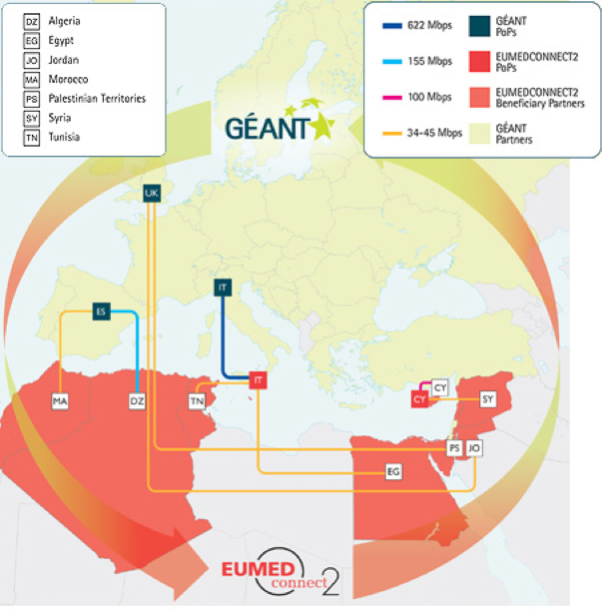
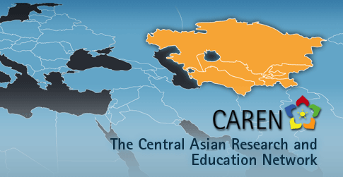
Networks of NRENs

Slide 27
NSF International Research Network Connections Program
An Office of Cyberinfrastructure program funding projects to provide network connections and services linking U.S. research networks with peer networks in other parts of the world
ACE (America Connects to Europe)
multi-gigabit bandwidth and services
Americas Lightpaths: Increasing the Rate of Discovery and Enhancing Education across the Americas
operation of network infrastructure between the US and Western Hemisphere
GLORIAD (Global Ring Network for Advanced Applications Development)
cooperative partnerships with its longstanding partners across the globe
TransLight/Pacific Wave
unified distributed exchange service for Research and Education (R&E) networking in the Asia-Pacific hemisphere
TransPAC3 - Asia-US High Performance International Networking
multi-gigabit bandwidth and services
Notes:
http://www.irnclinks.net/
The GLORIAD project will include cooperative partnerships with its longstanding partners in Russia (Kurchatov Institute), Korea (KISTI), China (Chinese Academy of Sciences), the Netherlands (SurFnet), the Nordic countries (NORDUnet and ICELINK), Canada (CANARIE), and Hong Kong (HKOEP). In addition, it develops new partnerships with Egypt (ENSTINet and TEGROUP), India (Tata and the National Knowledge Network), Singapore (SINGAREN), and Vietnam (VinAREN), and further cooperation with STARLight, TRANSPAC, National Lambda Rail (NLR), and Internet2.

Slide 28
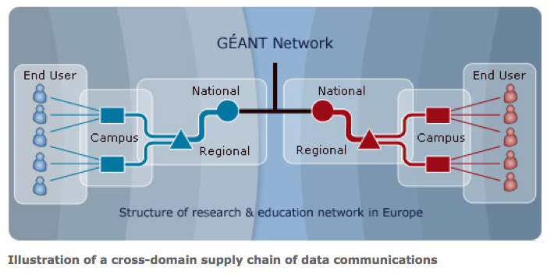
Where Should Libraries Be
in this Scheme
Hierarchy: National (NREN), Regional, Campus, End Users
http://www.geant.net/Network/RandE/Pages/home.aspx
Notes:
Libraries can play a role at almost every point – personal archives are now becoming an active area of research.

Slide 29
Final Thoughts

Slide 30
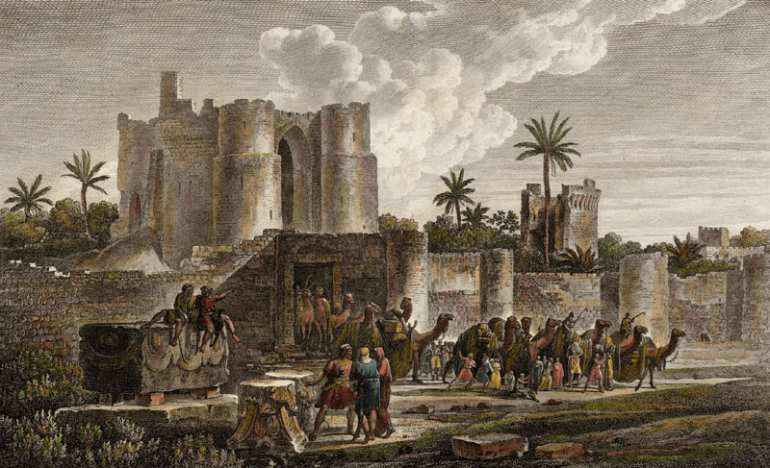
The Library at Alexandria, Egypt
New Library
Ancient Library
circa 300 BCE
today
Notes:
Much of what has been learned about managing knowledge throughout the centuries is still applicable today.
Digital representation of information has enabled highly functional and vast, dynamic knowledge spaces and new forms of research and scholarship. New data objects and collections allow analyses at unprecedented levels of accuracy and facilitate insight into opaque volumes of data. New connections between disparate sources can be made and new relationships within otherwise opaque datasets can be established with greater ease allowing for new insights. The grand scale of size and degree of complexity of digital collections suggest new phenomena for study and new scholarly methods to apply.
At the same time, universal access to open collections is a powerful force for inclusion, removing barriers to participation for people of all ages around the world. With support, libraries in developing regions and countries can play a central role in providing access to and sharing of scientific data without diminishing the valuable services they provide to scholars and users with other interests.

Slide 31
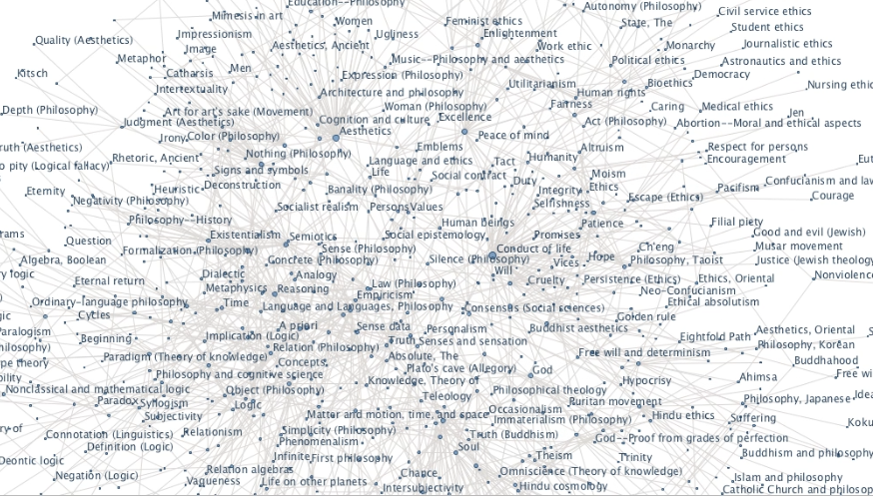
Thank You
Notes:
This slide is an interactive network visualization of the Library of Congress Subject Headings – Philosophy
http://www-958.ibm.com/software/data/cognos/manyeyes/visualizations/library-of-congress-subject-headin-3

