Slide 1
US biosafety experiences during the last two decades: Lessons and achievements PETER PALESE MOUNT SINAI SCHOOL OF MEDICINE, New York
BIOSECURITY, ISTANBUL, JULY 11, 2011

Slide 2
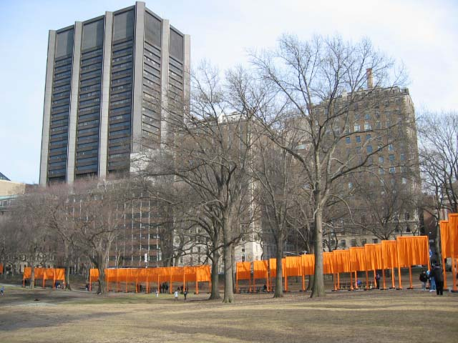

Slide 3
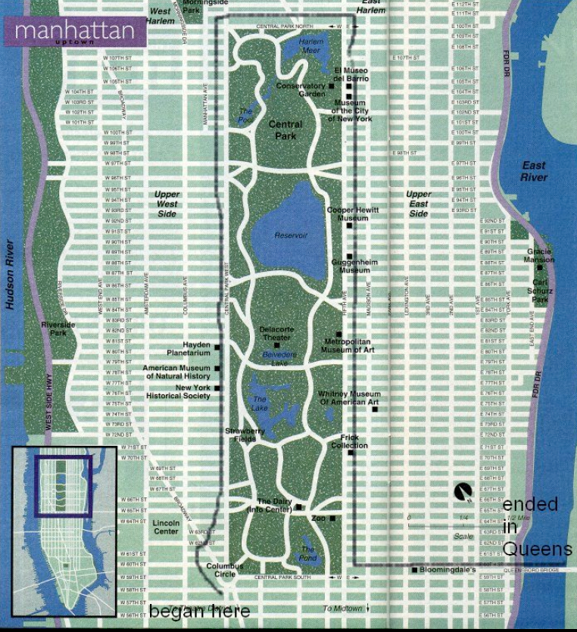

Slide 4
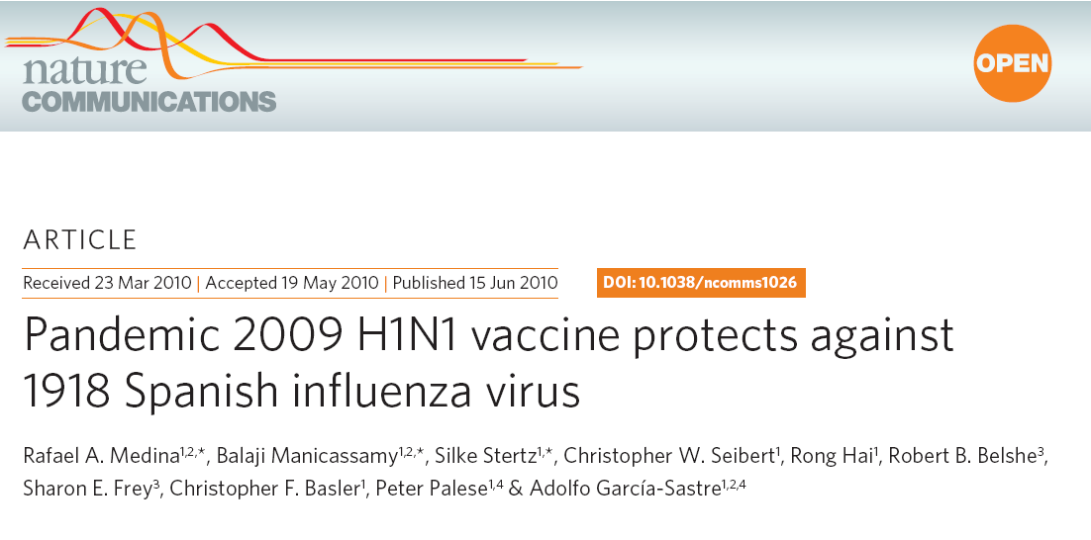

Slide 5
Biosafety in Microbiological and Biomedical Laboratories 5th Edition
U.S. Department of Health and Human Services
Public Health ServiceCenters for Disease Control and Prevention
National Institutes of Health
HHS Publication No. (CDC) 21-1112Revised December 2009

Slide 6
CDC WEBSITE FOR LABORATORY BIOSAFETY
http://www.cdc.gov/biosafety/index.htm

Slide 7
Laboratory Associated Infections
1930-1978 (4079, 168 deaths) Pyke, R.M. Ann. Rev. Microbiol. 33,41,1979
Brucella, Coxiella, hep. B, Salmomella, Francisella
1978-1999 (1267, 22 deaths) Harding, A.L. and Byers, K.B. ASM Press 2000.
Mycobacterium, Coxiella, Hantaviruses, Arboviruses, hep. B.

Slide 8
In Response to 2001 Events the US Federal Government Initiated in 2003 Construction
National Biocontainment Laboratories (NBL), BSL-2, 3, and 4
Regional Biocontainment Laboratories (RBL), BSL-2 and 3.

Slide 9
How do we decide on the Biosafety Level for an Experiment?
Hazard of Agent (NIH risk group)
Laboratory procedures involved
Staff involved
Propose biosafety lebvel
Get permission from local Institutional Biosafety Committee

Slide 10
Recommended Biosafety Levels for Infectious Agents
BSL-1: Not known to consistently cause disease in healthy adults
BSL-2: Agents associated with human disease (percutaneous injury, ingestion, membrane exposure)
BSL-3: Indigenous or exotic agents causing serious disease via inhaltion
BSL-4: Dangerous/exotic agents transmitted via aerosol (no vaccine, no treatment available)

Slide 11
HHS Select Agents AND TOXINS
Abrin
Botulinum neurotoxins
Botulinum neurotoxin producing species of Clostridium
Cercopithecine herpesvirus 1 (Herpes B virus)
Clostridium perfringens epsilon toxin
Coccidioides posadasii/Coccidioides immitis
Conotoxins
Coxiella burnetii
Crimean-Congo haemorrhagic fever virus
Diacetoxyscirpenol
Eastern Equine Encephalitis virus
Ebola virus
Francisella tularensis
Lassa fever virus
Marburg virus
Monkeypox virus
Reconstructed replication competent forms of the 1918 pandemic influenza virus containing any portion of the coding regions of all eight gene segments (Reconstructed1918 Influenza virus)
Ricin Updated May 2010

Slide 12
CONTINUED:
Rickettsia prowazekii
Rickettsia rickettsii
Saxitoxin
Shiga-like ribosome inactivating proteins
Shigatoxin
South American Haemorrhagic Fever viruses Flexal Guanarito Junin Machupo Sabia
Staphylococcal enterotoxins
T-2 toxin
Tetrodotoxin
Tick-borne encephalitis complex (flavi) viruses Central European Tick-borne encephalitis Far Eastern Tick-borne encephalitis Kyasanur Forest disease Omsk Hemorrhagic Fever Russian Spring and Summer encephalitis
Variola major virus (Smallpox virus)
Variola minor virus (Alastrim)
Yersinia pestis

Slide 13
Notes:
13

Slide 14
Biological science provides our primary, continuing defense against diseases, natural or man-made, with knowledge that can be translated into effective countermeasures such as vaccines and new therapies. Any regulation that unnecessarily hinders this research is a real and unnecessary threat to our health, our economy, and our national security.
David R. Franz, Susan A. Ehrlich, Arturo Casadevall, Michael J. Imperiale and Paul S. Keim. Biosecurity and Bioterrorism: Biodefense Strategy, Practice, and Science. September 2009, 7(3): 243-244. doi:10.1089/bsp.2009.0047

