Slide 1
Highlights of the Sigma Xi Postdoc Survey
Geoff Davis
March 8, 2012

Slide 2
Goals
Many calls for changes to postdoc experience
Goal:
Look at prevalence of "best practices"
See which practices make the biggest difference

Slide 3
Logistics
Conducted in 2004-5
Population: 22,400 postdocs at 18 of 20 largest postdoc employing institutions
38% response rate (~8500 responses)

Slide 4
Acknowledgments
Thanks to our sponsors!
Funded by
Alfred P. Sloan Foundation
Wertheim Fellowship, Harvard University
Help from
National Postdoc Association
Science's Next Wave
National Bureau of Economic Research

Slide 5
Approach
Postdoc management varies by PI
  Considerable variation in practices

Slide 6
Approach
Postdoc management varies by PI
  Considerable variation in practices
Survey asked postdocs about
  practices in place
  measures of success

Slide 7
Approach
Postdoc management varies by PI
  Considerable variation in practices
Survey asked postdocs about
  practices in place
  measures of success
Looked at practices associated with success

Slide 8
Measuring success
Ideal measure:
Track down people 10 years after their postdoc, see how they've done

Slide 9

Measuring success
http://www.flickr.com/photos/68751915@N05/6757871357/sizes/l/in/photostream/

Slide 10
Aside
NAS could do this going forward without too much effort.
Let's discuss during Q&A

Slide 11
Alternative measures
Looked for proxies for longer term success
Used 4 different measures

Slide 12

Satisfaction
http://www.flickr.com/photos/aidanmorgan/4156520524/sizes/l/in/photostream/

Slide 13

Advisor relations
http://www.flickr.com/photos/mikebaird/2127310513/sizes/l/in/photostream/

Slide 14
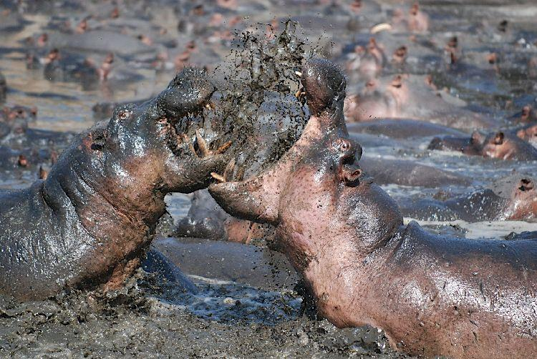
Absence of conflict
http://www.flickr.com/photos/nilsrinaldi/5158417146/sizes/l/in/photostream/

Slide 15
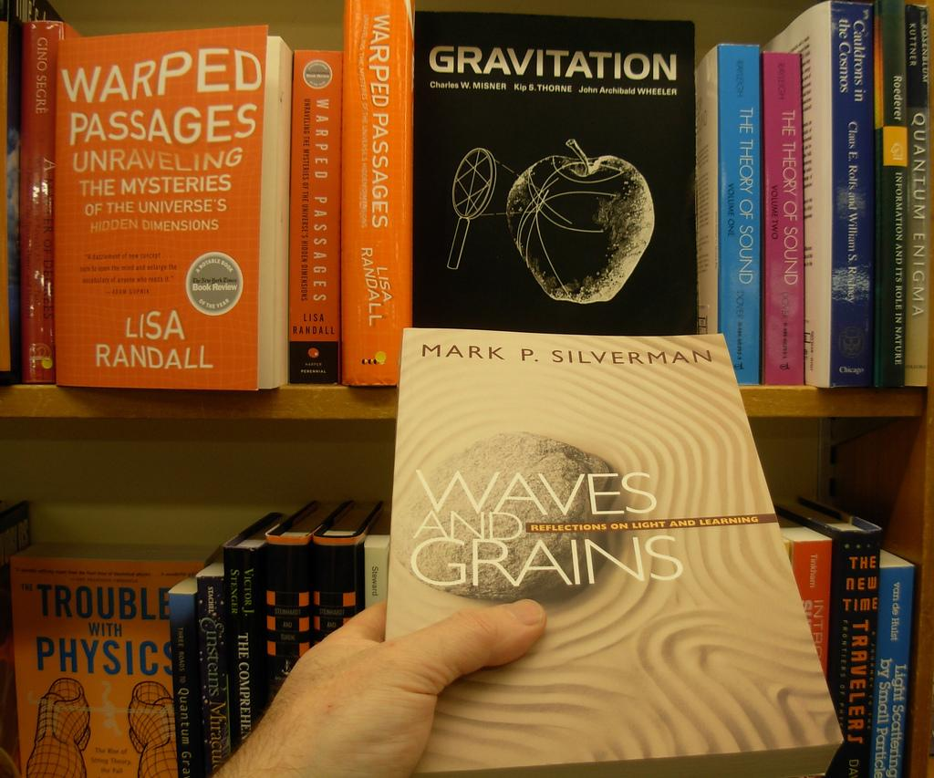
Publications
http://www.flickr.com/photos/brewbooks/1797567938/sizes/l/in/photostream/

Slide 16
Predicting success
How well do various factors predict success?
Field of research
Institution
Demographic factors:
  Sex, citizenship, minority status
Time as a postdoc
"Working conditions"

Slide 17
Working conditions
5 broad measures
Inspired by recommendations of NAS and others

Slide 18

Salary
http://www.flickr.com/photos/68751915@N05/6793821977/sizes/l/in/photostream/
Notes:
log(annual salary), full-time people only

Slide 19

Benefits
http://www.flickr.com/photos/68751915@N05/6793821977/sizes/l/in/photostream/
Notes:
Count of different benefits received (health insurance, retirement plan, etc)

Slide 20

Independence
http://www.flickr.com/photos/elpadawan/3039599855/sizes/l/in/photostream/
Notes:
Dummy variable, 1 if fellowship, 0 other type of funding

Slide 21
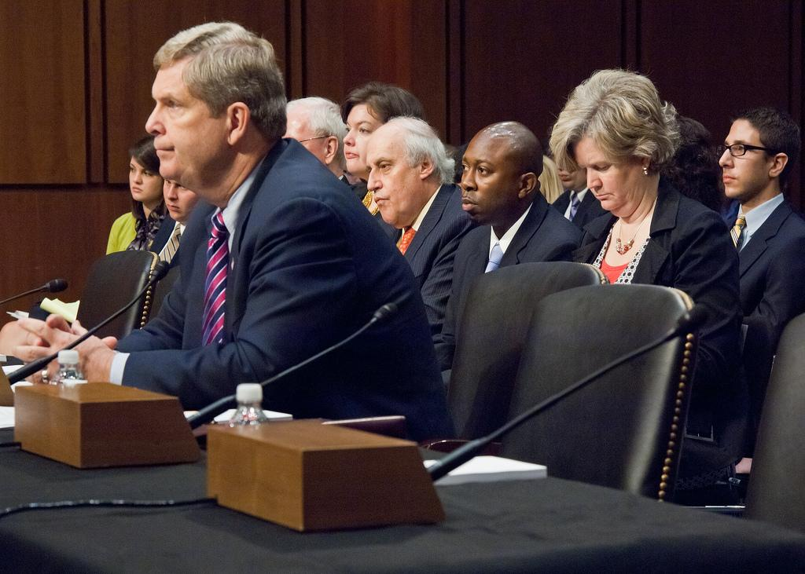
Structured oversight
http://www.flickr.com/photos/usdagov/5763009068/sizes/l/in/photostream/
Notes:
Count of administrative measures in place
* Individual development plans
* Formal reviews
* Policies (authorship / misconduct / IP / etc)
* Letters of appointment

Slide 22

Training
http://www.flickr.com/photos/caguard/6847058521/sizes/l/in/photostream/
Notes:
Count of areas in which postdoc reports receiving training
Grant writing, project/lab management, exposure to non-academic careers, negotiation, conflict resolution, English language, etc

Slide 23
Method
Regress outcome measures on inputs
Gauge relative contributions to success of
  working conditions
  demographic factors
  etc

Slide 24
Impact?
Who is most satisfied, productive, etc?
People with
independent funding?
high salaries?
lots of benefits?
lots of structured oversight?
many types of training?

Slide 25
Training
 | High training | Low training
% satisfied | 83% | 56%
Advisor grade | 3.4 | 2.7
% reporting conflicts | 10% | 17%
Publications / year | 1.3 | 1.1

Slide 26
Oversight
 | High structure | Low structure
% satisfied | 80% | 60%
Advisor grade | 3.4 | 2.7
% reporting conflicts | 9% | 21%
Publications / year | 1.4 | 1.2

Slide 27
Benefits
 | Highest 25% | Lowest 25%
% satisfied | 76% | 62%
Advisor grade | 3.2 | 2.9
% reporting conflicts | 11% | 18%
Publications / year | 1.3 | 1.2
Most of these differences go away in the regressions - probably due to other factors
Notes:
Differences go away in regressions - probably due to other factors

Slide 28
Independent funding
 | Fellowship | Other
% satisfied | 74% | 70%
Advisor grade | 3.0 | 3.1
% reporting conflicts | 14% | 14%
Publications / year | 1.1 | 1.2

Slide 29
Salary
 | Highest 25% | Lowest 25%
% satisfied | 71% | 68%
Advisor grade | 3.0 | 3.1
% reporting conflicts | 16% | 13%
Publications / year | 1.2 | 1.2

Slide 30
Take home #1
Training & oversight are important
http://www.flickr.com/photos/caguard/6847058521/sizes/l/in/photostream/
http://www.flickr.com/photos/usdagov/5763009068/sizes/l/in/photostream/

Slide 31
Specific measures
Used similar procedure to gauge impact of specific measures
One measure had significant impact on all 4 outcomes:
Research / development plans
Specifically, written plans that spelled out both PI and postdoc expectations

Slide 32
Plans
With plans:
40% less likely to be dissatisfied
30% less likely to have conflicts
submitted 14% more papers
(after controlling for field, institution, demographics)

Slide 33
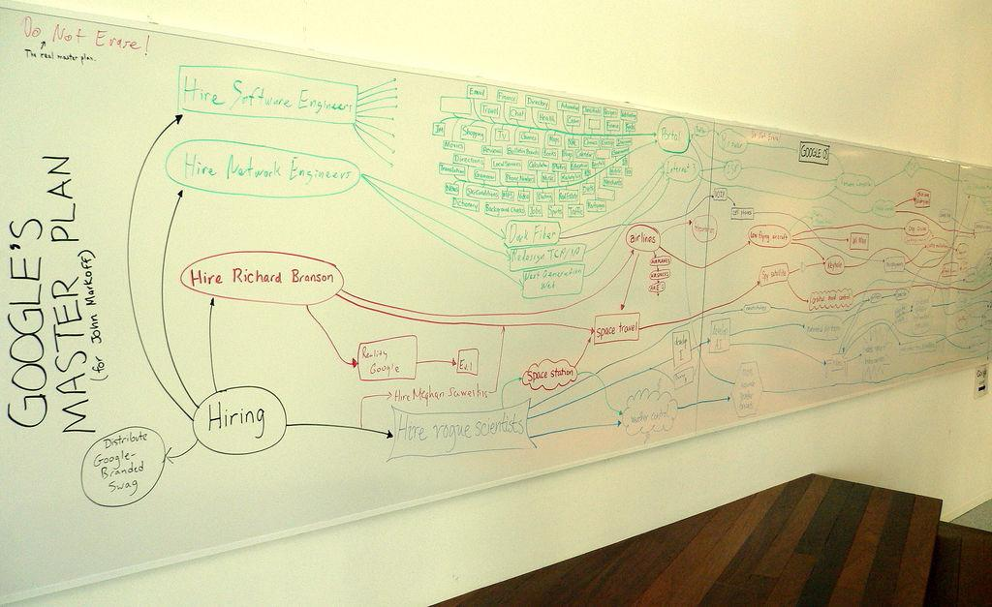
Take home #2
Plans = very important
http://www.flickr.com/photos/jurvetson/21470089/sizes/l/in/photostream/

Slide 34
Recap
NAS resources best invested in improving
Oversight of postdocs
Transferable skills training
Research / development plans particularly promising
Details: Geoff Davis, "Improving the Postdoctoral Experience: An Empirical Approach." In R. Freeman and D. Goroff (Eds.), Science and engineering careers in the United States: an analysis of markets, Chicago, IL: NBER/University of Chicago Press, 2009.

Slide 35
Additional materials

Slide 36
Best types of training
SIAM's Mathematics in Industry project
SIAM interviewed lots of people in industry to find out what they were looking for
Nice summary of skills, both hard and soft
Useful model - come talk to us!

Slide 37
Measuring career success
The NAS could link postdoc conditions to career success
Ingredients:
Forthcoming NSF survey of recent doctorates
Survey of Doctorate Recipients (ongoing longitudinal survey of PhDs)
Link the two - talk to Emilda Rivers at NSF
Drawback: you'll get results in 2025

Slide 38
Why plans?
Expectation setting device
  Postdocs without plans were much more likely to report PI had not lived up to expectations
Contract
  People more likely to live up to explicit (esp. written) commitments
Forces postdocs to take responsibility for careers early
  More time to take advantage of training opportunities
Time management device
  Mechanism for focusing effort

