Slide 1
Workforce Demand and Career Opportunities in University and Research Libraries
NAS Symposium on Digital Curation
Anne R. Kenney
July 19, 2012

Slide 2
What I’ll Cover
Work in the research library community
Requisite skill sets
Analysis of job postings
Recommendations moving forward

Slide 3
Digital Curation: A Growing Focus Area
Digital Hegemony
Digital Production and Dissemination
Digitization
Special Collections
Big Science, Digital Humanities
Open Access
Federal Mandates, NSF Data Requirements
Repository Development
Digital Preservation

Slide 4
ARL Activities
2006, E-Science Task Force established
2009/10, ARL E-Science survey and report; Special Collections in the Digital Age Working Group
2010, ARL Guide for Research Libraries: The NSF Data Sharing Policy
2011, Digital Curation for Preservation Report
2011/12, E-Science Institute, ARL/DLF/DuraSpace E-Science Institute
2012, Fall Forum on 21st Century Workforce; potential partnership with SAA
From E-Science to E-Research

Slide 5
7 New Roles for Librarians*
Acquisitions and Rights Advisors
Instructional Partners in Learning Spaces
Observers/anthropologists of Information Users and Producers
Systems Builders
Content Producers and Disseminators
Organizational Designers
Collaborative Network Creators and Participants
Walters and Skinner, New Roles for New Times:
Digital Curation for Preservation, ARL, Mar 2001

Slide 6
Digital Curators in the Sciences*
Creation of research data and information objects
Curation and management of research data and information objects
Collaboration in virtual communities
Walters and Skinner, New Roles for New Times:
Digital Curation for Preservation, ARL, Mar 2001

Slide 7
Digital Curators in the Humanities*
Creation of humanities scholarship
Curation of data and information objects
Addressing the white space: space and services for information processing, federation of resources, digitization, and preservation
Walters and Skinner, New Roles for New Times:
Digital Curation for Preservation, ARL, Mar 2001

Slide 8
Recommended Courses for eScience Professionals*
Digital data curation
Database design and management
Project management
Essentials of scientific research
Overview of cyberinfrastructure
Geographically distributed collaboration
Web content management and web interaction design
Scripting or practical introductory programming
Data mining
Information system management and server administration
From Youngseek Kim, et al, “Education for eScience Professionals”, IJDC 6:1 (2011) http://www.ijdc.net/index.php/ijdc/article/view/168

Slide 9
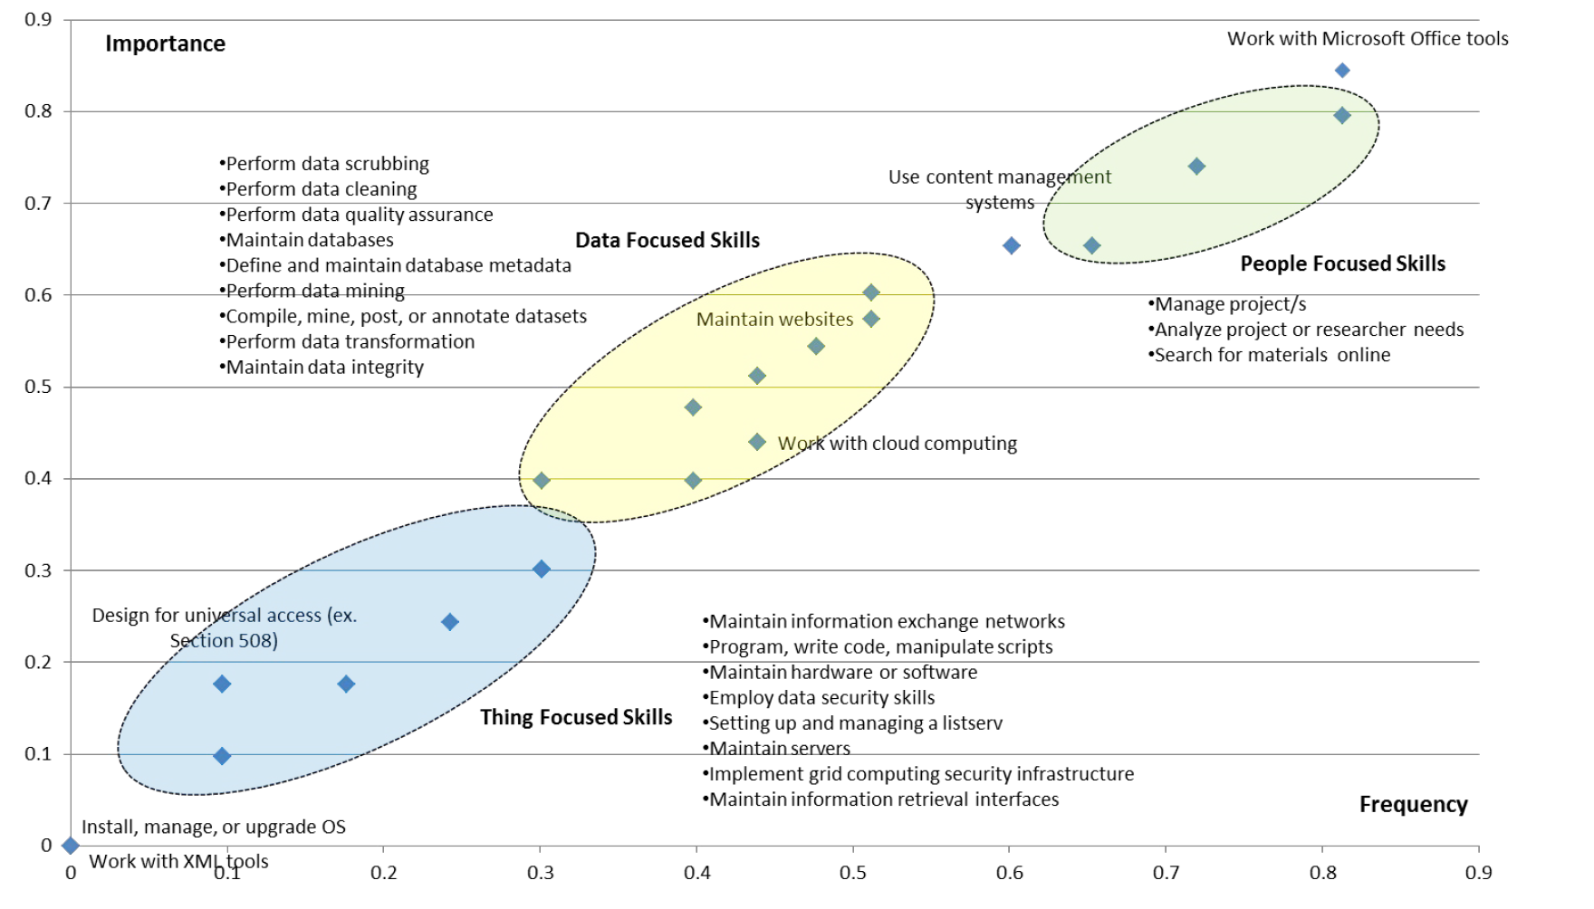
Ratings of importance and frequency of eScience internship tasks
From Youngseek Kim, et al, “Education for eScience Professionals”, IJDC 6:1 (2011) http://www.ijdc.net/index.php/ijdc/article/view/168

Slide 10
Most significant skills gaps in supporting evolving researchers’ information needs
Ability to advise on preserving research outputs
Knowledge to advise on data management and curation, including ingest, discovery, access, dissemination, preservation, and portability
Knowledge to support researchers in complying with the various mandates of funders, including open access requirements
Knowledge to advise on potential data manipulation tools used in the discipline/subject
Mary Auckland, “Re-skilling for Research,” RLUK, January 2012

Slide 11
Most significant skills gaps (continued)
Knowledge to advise on data mining
Knowledge to advocate, and advise on, the use of metadata
Ability to advise on the preservation of project records, e.g. correspondence
Knowledge of sources of research funding to assist researchers to identify potential funders
Skills to develop metadata schema, and advise on discipline/subject standards and practices, for individual research projects
Mary Auckland, “Re-skilling for Research,” RLUK, January 2012

Slide 12
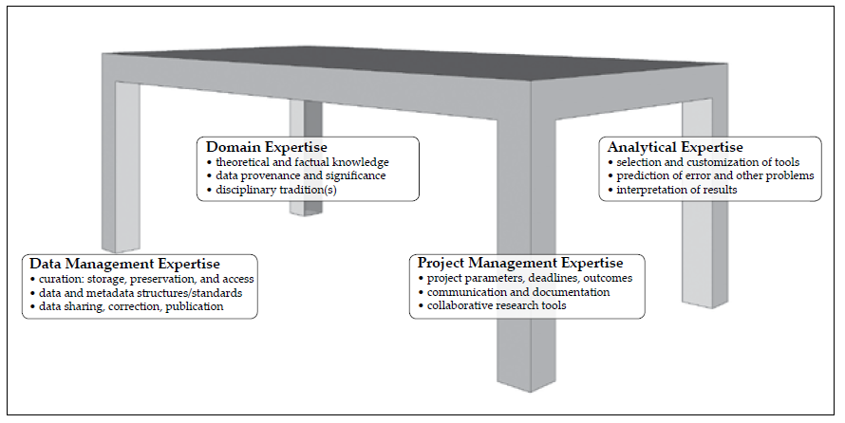
Requisite Expertise for Digital Humanities and Social Sciences
Requisite Expertise
Domain/subject expertise
Analytical expertise
Data expertise
Project management expertise
Williford and Henry, “One Culture: Computationally Intensive Research in the Humanities and Social Sciences,” CLIR, 2012

Slide 13
Recommendations for Research Libraries
Recruit/develop staff expertise in data management, data analysis, management of collaborative projects
Contribute to the peer review of new forms of online scholarship
Offer consultation services
Encourage cross-disciplinary engagement through public programs and workshops
Partner with other institutions to promote preservation and access for publications and data
Williford and Henry, “One Culture: Computationally Intensive Research in the Humanities and Social Sciences,” CLIR, 2012

Slide 14
Research Library Staffing Needs
ARL Jobs Announcements database
ARL/UF Position description database (under construction)
Tito Sierra study on ARL Library hiring in 2011
Further analysis of job titles database

Slide 15
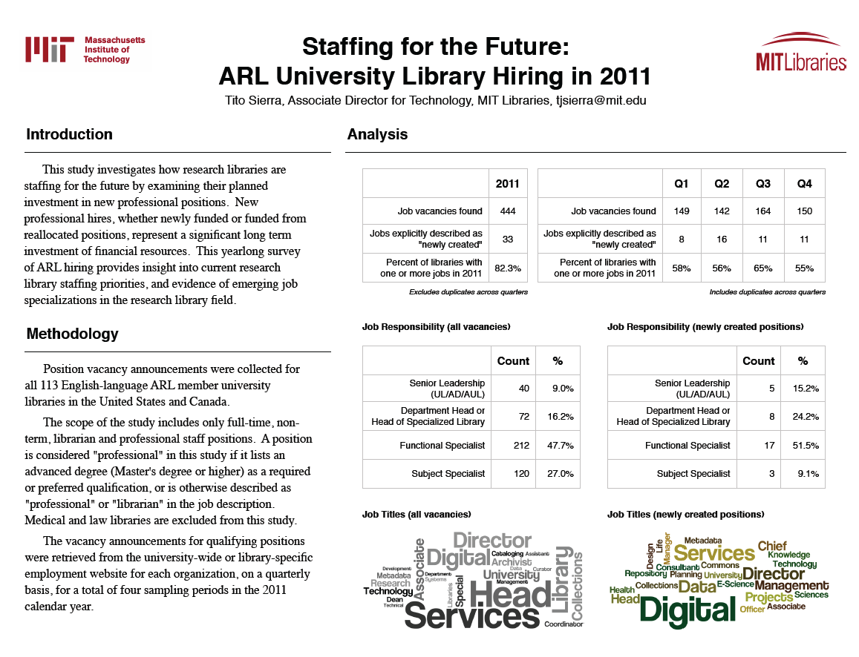

Slide 16
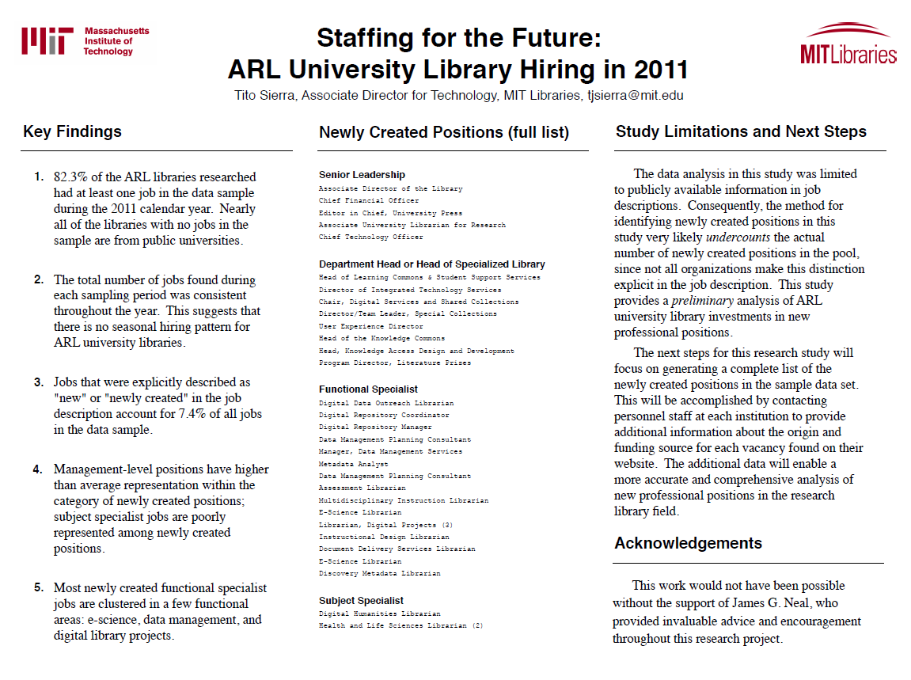

Slide 17
Jobs Database Analysis
505 job postings
68 positions (13.5%) have “data,” “E-science,” or “digital” in the position title
53 have “digital” in the position title
17 have “metadata” in their position title
9 have “data” in their position title
6 have “digital humanities” in their position title
4 E-Science Librarian positions
4 Digital Archivist positions
2 Social Sciences Data Librarians
1 each for “data curation” and “digital curation”

Slide 18
Jobs Database Analysis
New Positions | New Management Positions
Digital Collections Strategist Digital User Experience Specialist Digital Data Outreach Librarian Data Management Planning Consultant Data Visualization Coordinator E-Learning Librarian Scientific Data Curator | Associate Dean for Digital Scholarship and Technology Services Associate Vice President Digital Programs and Services Associate Director for Digital Initiatives Associate University Librarian for Digital Scholarship Services

Slide 19
Qualifications for New Positions
Of the 68 positions, 38 of 68 positions (55%) mention MLS/MLIS degree in the qualifications
Only 3 of 505 positions list “digital curation” in the qualifications
Typical range of skill expectations for digital humanities and e-science librarians
Management skills, subject knowledge, communication skills, technical skills, metadata skills
E-science: technical knowledge on use and archiving of digital data, repositories, e-science issues, ontologies
Digital humanities: research methods and process, trends, scholarly communication, digital scholarship, digitization, digital media, data mining/modeling, visualization

Slide 20
E-Science Librarian Data Responsibilities
Work with university’s primary research community and other librarians to develop and support services for documenting and distributing research data.
Conduct research on methodologies and tools for data information systems.
Develop services to enhance access to data.
Develop and maintain awareness of data centered initiatives in the life sciences.
Build partnership relationships with relevant campus, state, and national data organizations.
Maintain awareness of tools and algorithms for computationally centered, data-driven science (data mining, visualization, text mining, etc.)

Slide 21
Digital Humanities Librarian Responsibilities
Create, deliver, curate and preserve digital assets and tools.
Assist with planning, implementation and production of digital collections and scholarly initiatives, especially project design, digitization workflows, and content and delivery systems.
Develop and deliver repository and scholarly communication services.
Articulate relationship between new technologies and humanities scholarship to the community of humanists.
Advise faculty on creation of digital objects and provide technical support for use of analytical tools.
Serve as agent between content providers and library’s repository.

Slide 22
Conclusion
Growth area in research libraries, with sciences more clearly defined but increasing interest in digital humanities
MLS/MLIS not the only path
Qualifications for new positions not well codified
Digital curation not common in qualifications nomenclature
Redeployment/retraining of existing staff critical

