Slide 1
Digital Curation as a Core Competency
Symposium on Digital Curation in the Era of Big Data: Career Opportunities & Educational Requirements
July 19, 2012
Dean Elizabeth D. Liddy
iSchool, Syracuse University

Slide 2
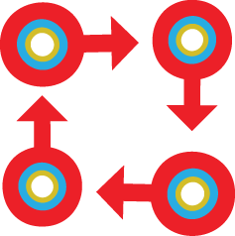
Two Perspectives
Pure Curation
Data Life Cycle

Slide 3
Evolution of the Field

Slide 6
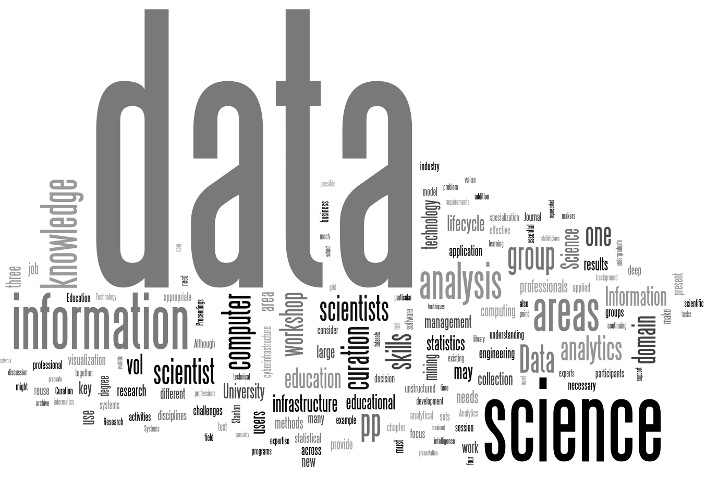
Stanton, Palmer, Blake & Allard. “Interdisciplinary Data Science Education” in Special Issues in Data Management Book Series.

Slide 7
5 Stages of the Data Life Cycle
Data Archiving / Preservation
Data Presentation / Visualization
Data Analytics
Data Management
Data Collection

Slide 8
5 Stages of the Data Life Cycle
Data Archiving / Preservation
Data Presentation / Visualization
Data Analytics
Data Management
Data Collection

Slide 9
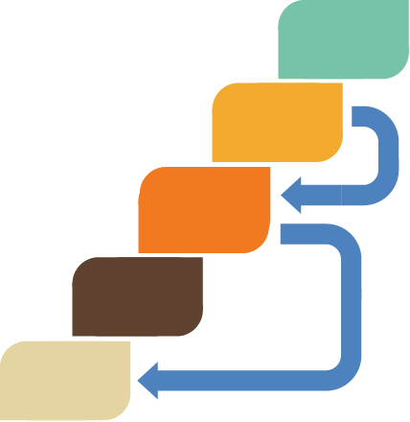
5 Stages of the Data Life Cycle
Data Archiving / Preservation
Data Presentation / Visualization
Data Analytics
Data Management
Data Collection

Slide 10
5 Stages of the Data Life Cycle
Data Archiving / Preservation
Data Presentation / Visualization
Data Analytics
Data Management
Data Collection

Slide 11
1. Data Collection Competencies
Elicit & understand user requirements based on their tasks or overall goals of organization.
Search & retrieve data which will be useful in response to needs.
Create or manage automated systems for continuous collection of raw data.
Select appropriate data & data sets within these sources.
Document the context from which the data is selected or retrieved.
Import raw data into a local repository or warehouse, which may need to be built.
Clean the raw data for processing.

Slide 12
2. Data Management Competencies
Select an appropriate representation approach, i.e. metadata schema, to be developed or extended for the particular data.
Transform incoming data into an acceptable initial format.
Perform metadata assignment – either automatically, semi-automatically, or manually.
If appropriate, organize tagged data, either by designing & constructing a database or utilizing an existing database schema for storing the data.
Develop access approaches for initial users as well as future users.

Slide 13
3. Data Analytics Competencies
Develop optimal research design.
Select the correct sampling technique.
Construct meaningful hypotheses for focused analysis.
Select & run a data mining approach for unexpected learnings.
Understand the range of machine learning approaches for various information extraction algorithms for analyzing unstructured data, particularly textual data.
Conduct or oversee algorithmic programming (R, Python, Processing, etc.).
Run statistical analyses of multiple types on appropriately selected data sets.
Evaluate uncertainty in the data & conduct & report accurate risk analyses.

Slide 14
4. Data Presentation & Visualization Competencies
Conduct the optimal information design process so that the data facilitates decision support.
Contextualize & communicate findings in a story-like format that is clearest to understand.
Evaluate the power & appropriateness of multiple visualization & graphical algorithms.
Select, run, & evaluate visualization programs that make complex ideas accessible to the end user.

Slide 15
5. Data Archiving / Preservation Competencies
Select a storage location & access path which will facilitate future access, re-purposing and reuse by both internal & external users.
Evaluate benefits & challenges of local / cluster / cloud storage.
Create a rich and accurate collection-level description.
Inaugurate continual practices of reviewing & checking on the ‘health & safety’ of the data.

Slide 16
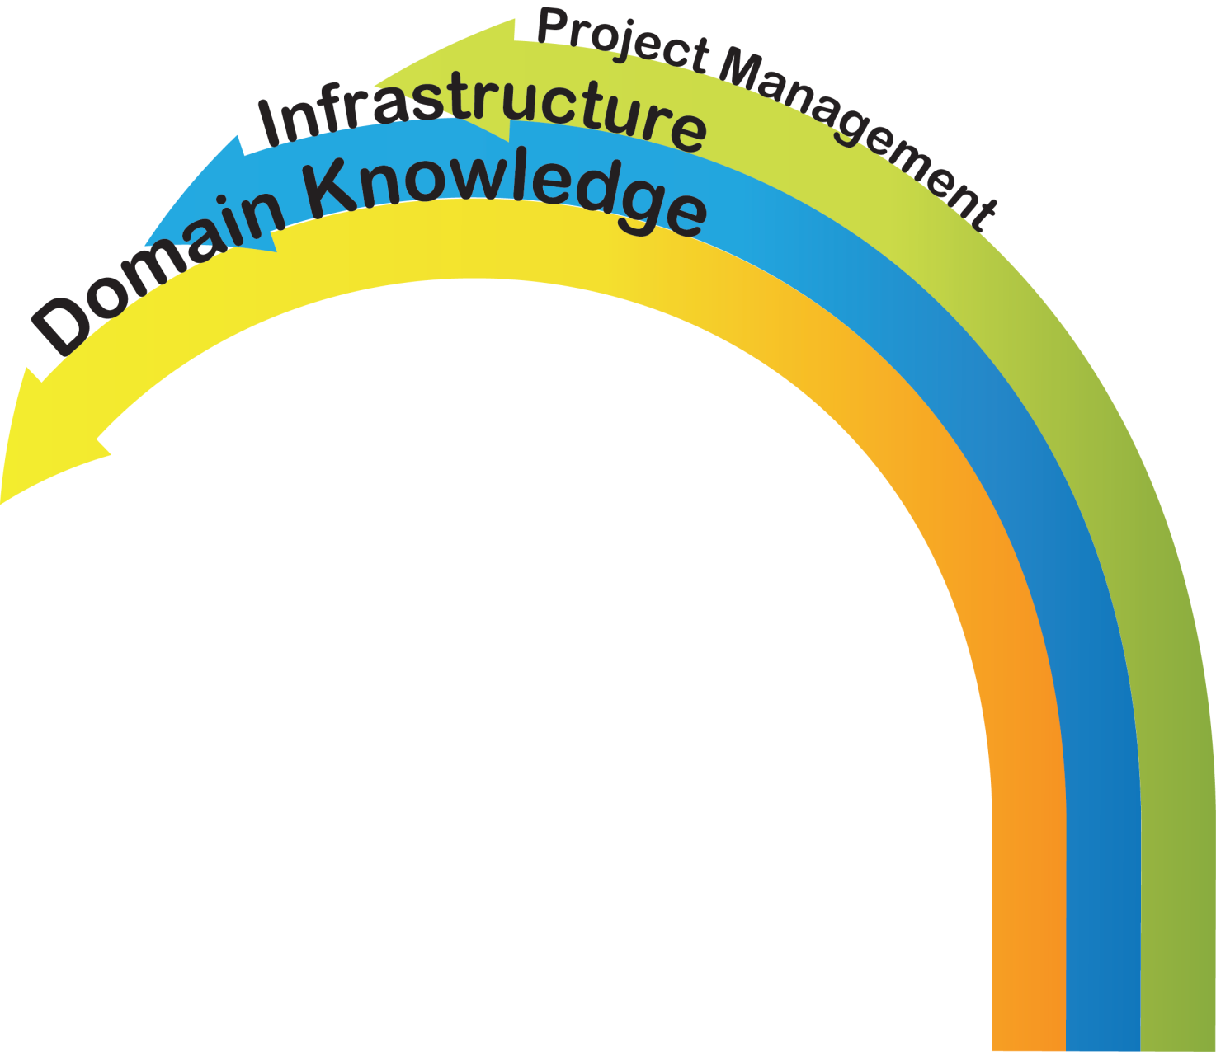
Three Additional Vital Competencies
Data Archiving / Preservation
Data Presentation / Visualization
Data Analytics
Data Management
Data Collection

Slide 17
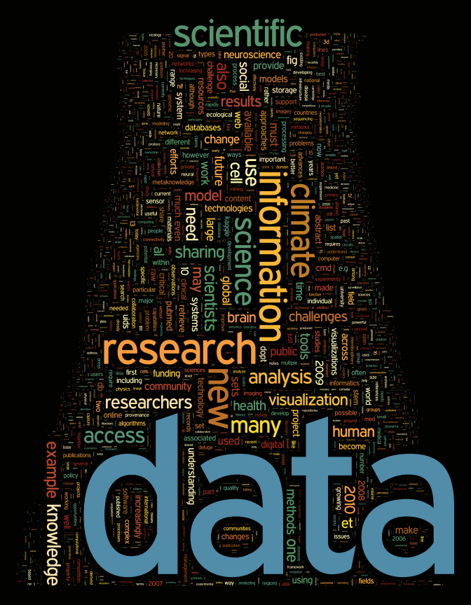
Interdisciplinary Data Science Education

