Slide 1
Beyond the article: Scholarly publishing and “data management”
Gerry Grenier
Senior Director, Publishing Technologies, IEEE
Chair, STM Futures Lab Committee

Slide 2
Agenda
Report from “STM Future Lab”
Recent NISO activity
IEEE-specific activities

Slide 3
Three framing aspects of “Data management” discussion
Data submitted along with a journal article
“Supplemental material”
Linking between “Big Data” to and from related journal articles
Data hosted outside of the publisher
Data hosting via publisher repositories

Slide 4
STM’s “Future Lab” Outlook on Data
International STM Association (http://stm-assoc.org)
The leading global trade association for academic and professional publishers
> 120 member publishing companies and societies
Members collectively publish nearly 66% of all journal articles

Slide 5
Annual brainstorm to identify trends in STM publishing
18 contributing members of the committee including:
Societies (IEEE, AIP, ACS, IOP, RSC)
Traditional publishers (Wiley, Nature, Elsevier, Springer, OUP, Thomson-Reuters, Taylor & Francis)
Open Access publisher (Hindawi)
Committee meets annually to develop “STM Trend Watch”
December 2012
Notes:
a fun process in which every member in our committee compares their own top-3 trends for the next year with each other – we usually have between 16 and 20 participants, all from a good sample of multi-sized, cross-disciplinary publishing companies and each working at senior levels in business and technology development. This initially leads to a long list of potentially important trends. After several rounds of discussion, in which we compare, regroup and cluster certain trends, we come to an overall view for the main top-3 trends. This approach follows the Delphi method, which is a forecasting technique relying on panels of experts. The Delphi technique is based on the concept of ‘collective intelligence’ and was originally developed in the ‘40s and ‘50s during the Cold War to make future scenarios for the impact of technology on warfare.

Slide 6
Data management issues emerged as a major theme two years running
Sense is that we see data management as looming large issue, but our actions are still in formative stage
Data discoverability
Interfaces to data
Guidelines for:
Re-use and sharing
Editorial policies
Citation
Database versioning
Curation
Data peer review
Notes:
Two years running

Slide 7
Data Management Discussion STM Future Lab
User behaviour
Discoverability of data
MAKE DATA INTERACTIVE
DATA OBJECTS ARE FIRST CLASS RESEARCH OBJECTS
ACTIONABLE DATA
share the actual workflow
of the researcher?
graphics represent data sets; how to open them up?
how to treat supplemental files to journals?
RESEARCH DATA
BIG DATA
Mendeley
AUTHORING TOOLS
CiteSeer
DATACITE
Bibliographic tools
REPOSITORIES
ColWiz
DATA CREATION
ReadCUBE
Deep Linking
Guidelines for:
Reuse and sharing
Incentives and barriers
Editorial policies
What formats do users want?
Data journal
COMMON STANDARDS

Slide 8
Validation, Verification, Curation, Mining and Data:
From Validation to Augmentation
Analytics for the online eco-system
Data citation
Data curation
TURN DATA INTO MAPS
CHANGING HOW PEOPLE
READ JOURNALS
DATA
Data mining
CrossQuarry
Reliability
Data peer review
CURATION AND ANALYTICS
Quality Assurance
Mining of references
What is the minimal NUGGET in an article?
Triple Stores, RDF’s
Improving Data
from others
FROM VALIDATION TO AUGMENTATION
Assertion Tables with falsification/ verification statements
Augmenting Manuscripts via submisson systems
CROWD VALIDATION
HARD SHELL VERSUS
SOFT SHELL APPROACH
ANALYTICS IN THE ONLINE-ECOSYSTEM
THE QUANTIFIED ACADEMIC
Transparent Validation Tools
Where is the innovation of manuscript submisson systems?
Altmetrics, New Metrics
THE NEW IMPACT FACTOR
What happens to
Peer Review ?

Slide 9
Journal Supplemental Material: NISO releases NISO RP-15-2013
Recommended practice for “Online Supplemental Journal Article Materials”
Differentiate between “Integral” and “Additional” content
Defines metadata and persistent identifiers
Potential role for NISO to define standards around larger data sets
i.e. Discovery and Provenance metadata
Expand the work of DataCite?
Notes:
The National Information Standards Organization (NISO) and the National Federation for Advanced Information Services (NFAIS) have published a new Recommended Practice on Online Supplemental Journal Article Materials (NISO RP-15-2013). Supplemental materials are increasingly being added to journal articles, but until now there has been no recognized set of practices to guide in the selection, delivery, discovery, and preservation of these materials. To address this gap, NISO and NFAIS jointly sponsored an initiative to establish best practices that would provide guidance to publishers and authors for management of supplemental materials and would address related problems for librarians, abstracting and indexing services, and repository administrators. The Supplemental Materials project involved two teams working in tandem: one to address business practices and one to focus on technical issues. This new publication is the combined outcome of the two groups' work. "A key aspect of these recommendations is the distinction between what we define as Integral Content, which is content that is essential for the full understanding of the journal article, and what we have designated Additional Content, which provides relevant and useful expansion of the article's content," explains Marie McVeigh, Director, JCR and Bibliographic Policy, Thomson Reuters, and co-chair of the Business Working Group. "As this Recommended Practice makes clear," states Linda Beebe, co-chair of the Business Working Group who recently retired as Senior Director, PsycINFO, American Psychological Association, "Integral Content and Additional Content are likely to be treated differently throughout the entire lifecycle of a scientific article." "Ensuring effective access, use, and long-term preservation of supplemental materials to journal articles requires up-front planning about persistent identifiers, metadata, file formats, and packaging," explained David Martinsen, Senior Scientist, Digital Publishing Strategy, American Chemical Society, and co-chair of the Technical Working Group. "These technical recommendations for handling of supplemental materials simplify much of that planning and decision-making, and will also ensure a standardized approach across publishers and publishing platforms," affirmed Alexander ('Sasha') Schwarzman, Content Technology Architect with OSA - The Optical Society, and co-chair of the Technical Working Group. "Supplemental materials are appearing with increasing frequency and can no longer be effectively managed on a case-by-case basis," Todd Carpenter, NISO Executive Director, stated. "This new Recommended Practice will provide a consistent approach for publishers to use in handling these materials. Ensuring discovery, access, and preservation of these materials is in the interests not only of the authors and publishers, but also of the library community and end users.“
NISO and NFAIS Publish Recommended Practices for Online Supplemental Journal Article Materials
Baltimore, MD & Philadelphia, PA - February 4, 2013 -The National Information Standards Organization (NISO) and the National Federation for Advanced Information Services (NFAIS) have published a new Recommended Practice on Online Supplemental Journal Article Materials (NISO RP-15-2013). Supplemental materials are increasingly being added to journal articles, but until now there has been no recognized set of practices to guide in the selection, delivery, discovery, and preservation of these materials. To address this gap, NISO and NFAIS jointly sponsored an initiative to establish best practices that would provide guidance to publishers and authors for management of supplemental materials and would address related problems for librarians, abstracting and indexing services, and repository administrators. The Supplemental Materials project involved two teams working in tandem: one to address business practices and one to focus on technical issues. This new publication is the combined outcome of the two groups' work. "A key aspect of these recommendations is the distinction between what we define as Integral Content, which is content that is essential for the full understanding of the journal article, and what we have designated Additional Content, which provides relevant and useful expansion of the article's content," explains Marie McVeigh, Director, JCR and Bibliographic Policy, Thomson Reuters, and co-chair of the Business Working Group. "As this Recommended Practice makes clear," states Linda Beebe, co-chair of the Business Working Group who recently retired as Senior Director, PsycINFO, American Psychological Association, "Integral Content and Additional Content are likely to be treated differently throughout the entire lifecycle of a scientific article." "Ensuring effective access, use, and long-term preservation of supplemental materials to journal articles requires up-front planning about persistent identifiers, metadata, file formats, and packaging," explained David Martinsen, Senior Scientist, Digital Publishing Strategy, American Chemical Society, and co-chair of the Technical Working Group. "These technical recommendations for handling of supplemental materials simplify much of that planning and decision-making, and will also ensure a standardized approach across publishers and publishing platforms," affirmed Alexander ('Sasha') Schwarzman, Content Technology Architect with OSA - The Optical Society, and co-chair of the Technical Working Group. "Supplemental materials are appearing with increasing frequency and can no longer be effectively managed on a case-by-case basis," Todd Carpenter, NISO Executive Director, stated. "This new Recommended Practice will provide a consistent approach for publishers to use in handling these materials. Ensuring discovery, access, and preservation of these materials is in the interests not only of the authors and publishers, but also of the library community and end users." "Electronic media and the Web have changed the nature of journal articles and what can be delivered along with the article," asserts Bonnie Lawlor, NFAIS Executive Director. "What hasn't changed is that the journal article constitutes the scholarly record and today's practices for handling them and their supporting materials must ensure that the information is available to future researchers. What is published outside the article as Supplemental Materials today may well be incorporated into a new type of article tomorrow." The Recommended Practice on Online Supplemental Journal Article Materials, a metadata schema, a tag library, and tagged examples are available from the NISO website at:www.niso.org/workrooms/supplemental.
"Electronic media and the Web have changed the nature of journal articles and what can be delivered along with the article," asserts Bonnie Lawlor, NFAIS Executive Director. "What hasn't changed is that the journal article constitutes the scholarly record and today's practices for handling them and their supporting materials must ensure that the information is available to future researchers. What is published outside the article as Supplemental Materials today may well be incorporated into a new type of article tomorrow." The Recommended Practice on Online Supplemental Journal Article Materials, a metadata schema, a tag library, and tagged examples are available from the NISO website at:www.niso.org/workrooms/supplemental.

Slide 10
Linking to-from externally hosted data
Example: Data hosted at Australian National University Data Commons
Are there related journal articles?
If so, provide mechanism to associate and link
A simple citation

Slide 11
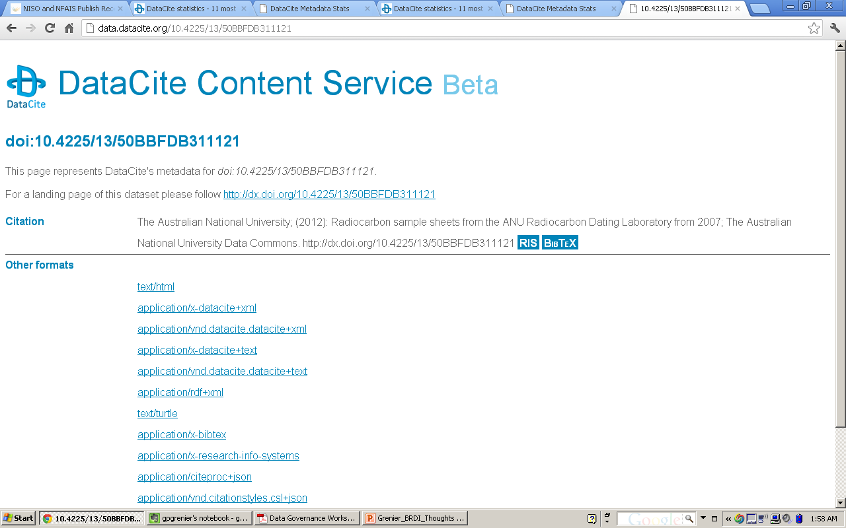
Notes:
Linking to external data sets from journals and from external data sets to journals. Ideally, all liternature that refers to this data set would be listed in the meta-record at the repository level

Slide 12
IEEE considering its role as data repository
IEEE’s Strategic Planning Committee has identified data preservation as a strategic priority
IEEE’s focus in the EE and CS uniquely positions it to play a role in the vertical space

Slide 13
Sustainability questions in addition to technical issues
IEEE believes that the research community would value a public repository that holds data sets and makes them available to other researchers
Complement institutional repositories
Challenges include:
Business Model (Sustainability)
Data governance issue
Interoperability and facilitation of re-use

Slide 14
Two projects to provide focus
IEEE’s immediate next steps
Work with one of our societies to identify a large active data set to pilot
Survey planned
Work with data repositories to create links between data sets and related IEEE journal articles
Purdue and Stanford have reached out

Slide 15
IEEE Data Management Survey of 45 Society Presidents
Does your Society use Big Data? In what sense?
Do any of your publications publish papers on big data?
If yes, to 2, which publications and what aspects of big data?
Do you require data referenced in the results of a paper be publicly available?
If yes to 3, how do you expect the data to be made available?
Do you believe the IEEE should provide an archive for data?
If yes, do you believe a cost per mb is a reasonable model for sustainability and if not, can you suggest a model.
Is there anything else we should have asked about big data and your Society that you are willing to share?
Notes:
Disappointing response, our reaction is to work with an industry group to cast a wider net.
Expand the idea of IEEE survey to larger group through cooperation with STM

Slide 16
Looking forward to a continuing dialog between publishers and the research community
g.grenier@ieee.org

