Slide 1
INTERPLAY BETWEEN QUANTUM MECHANICS AND SOFT MATTER
P. PINCUS
PHYSICS AND MATERIALS DEPARTMENTS
UNIVERSITY OF CALIFORNIA, SANTA BARBARA
CMMRC
WASHINGTON, DC
SEPTEMBER, 2013

Slide 2
OUTLINE & SCOPE
Soft condensed matter physics is generally regarded as mainly classical (ħ=0) because it is typically concerned with objects at the nanoscale or larger.
Some categories where QM plays a role include:
direct interplay between electrons and soft matter properties;
quantum models for classical behavior;
experimental tools to probe soft matter that rely in an essential way upon QM.

Slide 3
ELECTRONS AND SOFT MATTER
BATTERIES, PHOTOVOLTAICS, FLEXIBLE ELECTRONICS where polymers are essential elements
COORDINATION CHEMISTRY EFFECTS WITH TRANSITION METAL IONS AND SOFT MATERIALS….flexible lighting
COMPENSATION OF ELECTRONIC CHARGES BY IONIC CHARGES IN AQUEOUS MEDIA…..screening of Schottky barrier by dissolved salts in doping of conjugated polymers
CONDUCTIVITY OF CONJUGATED POLYMERS…hopping
ELECTRON COUPLING TO BENDING MODES IN d=2..grapheme,
ELECTRON DELOCALIZATION AND POLYMER RIGIDITY

Slide 4
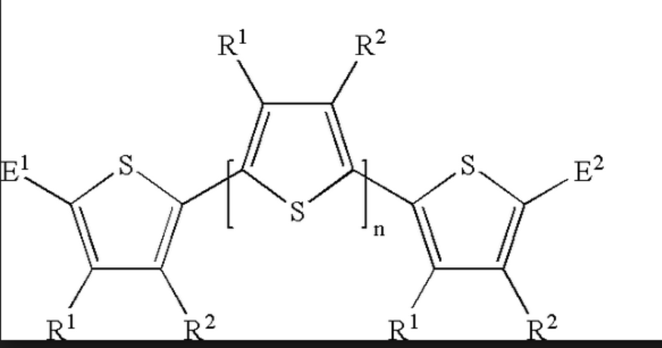
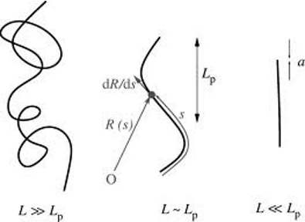
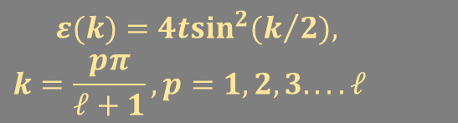
CONFORMONS-ELECTRON DELOCALIZATION AND POLYMER RIGIDITY
ELECTRON DOPED CONJUGATED POLYMER CHAIN
Π ELECTRON DELOCALIZATION STIFFENS GAUSSIAN POLYMER INTO A SEMI-FLEXIBLE CHAIN
POLYTHIOPHENE
TOY MODEL
TIGHT BINDING Π ELECTRON HOPPING MATRIX ELEMENT t……all or nothing
$$\begin{matrix}ε(k)=4t\sin^{2}(k/2), \\ k=\frac{pπ}{ℓ+1},p=1,2,3....ℓ \end{matrix}$$
ℓ is number of monomers per rigid segment
Rigid segment--- conformon….. analogous to polaron
Loss of configurational entropy αT/rigid bond

Slide 5
CONFORMONS AT LOW DOPING-RESULTS
For r electrons (spinless for simplicity) in a conformon:
Optimal conformon length ,
Using transfer matrix method to do stat mech for concentration c of electrons:
  For ,
Isolated one electron conformons
For
There are
conformons each containing
electrons. The chain stiffens and swells considerably.
…………………..

Slide 6
QUANTUM MODELS
Analog calculations using quantum models may be easier because of the finite state counting
HUBBARD MODEL FOR HYDROGEN BOND NETWORKS

Slide 7
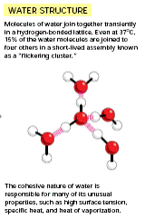
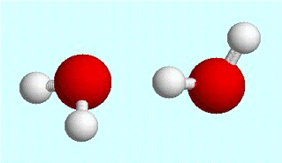
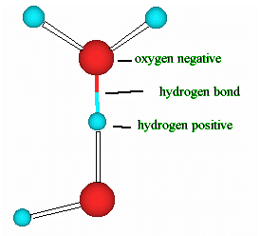
Water Structure
HUBBARD MODEL FOR HYDROGEN BOND NETWORKS

Slide 8
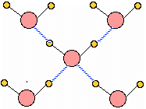
Ice
H Bonds
Crystalline Fields Break Rotational Symmetry

Slide 9







Model- Basins
Crystal field basins may be occupied by (0,1) protons.
Strong Coulomb Repulsion
Spinless Fermions

Slide 10



Single Molecule Energies
U
s-p hybridiztion U>V
2H₂O OH⁻ + H₃O⁺
V

Slide 11
Hydrogen Bonds and the Hubbard Model
Treat basins as Fermion states
t is matrix element to transfer a proton from one basin to another associated with a nearest neighbor O- -
OH⁻
t
H₃O⁺
H-bond energy ~ -t²/V ~ 5k_{B}T
t ~ 10k_{B}T Intermediate Coupling
H Bond is proton resonating between two waters
Hydrophobic Interaction

Slide 12
Quantum Soft Matter Probes
Magnetic resonance techniques
  Dynamic Overhauser effect to study motions
Neutron scattering techniques
Spin Echo Small Angle Neutron Scattering
    SESANS

Slide 13
Spin-Echo Small-Angle Neutron Scattering (SESANS)
Slides courtesy of Xin Li and Roger Pynn (Indiana University)
Elastic scattering technique to investigate structure
Real space correlation function

Slide 14
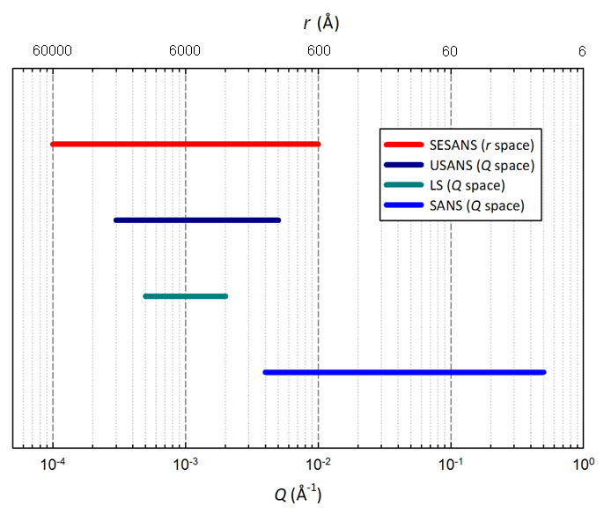
SESANS Length Scale
Notes:
Ultra-small angle: how small?

Slide 15
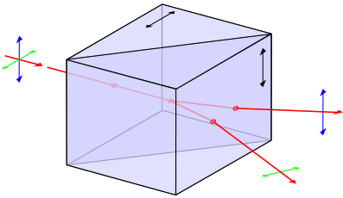
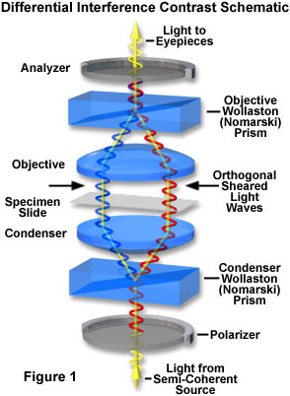
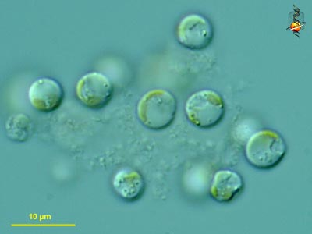
Neutron Alalogue of Differential Interference Contrast Microscopy
Beautiful real-space images at about 1 micron resolution
Wollaston Prism
Eukaryotic Algae
Two polarization states of light “visit” neighboring parts of a sample and interfere to produce contrast that depends on the phase difference between the paths.

Slide 16
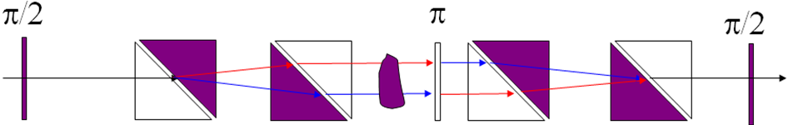
SESANS
L
θ
Triangular regions have oppositely directed magnetic fields to change neutron wavelength
Spin Echo length
SESANS measures a real-space correlation function as a function of z
Notes:
-magnetic fields are birefringent for neutrons because the 2 spin states have different Zeeman energy and hence different kinetic energy i.e. velocity.
Just like Differential interferrence contrast microscopy (DICM), we first polarize the neutron beam then pass it through a device which as a non-adiabatic transition between two regions with magnetic fields at right angles. This is like producing a an eigenstate of the Sx operator, which is a linear superposition of the 2 eigenstates of Sz. This step is equivalent to the 45 degree polarizer for DICM (which produces a iinear combination of the two polarization states of light). The two neutron spin states propagate completely coherently through the SESANS appartus i.e. the apparatus is a way of developing coherence in a way that does not involve having either a coherent source or a pin-hole source far away. We split the two spin states using magnetic Wollaston prisms, in a way analogous to the light case in DICM. The spin echo length is the splitting of the states at the sample position and is essentially the correlation distance probed in the sample. It depends on the magnetic fields (B) in the prisms and the wavelength of the neutrons (lambda), as well as some geometric parameters. Values up to 20 microns have been achieved by a scan from zero to 2 microns is more common.

Slide 17
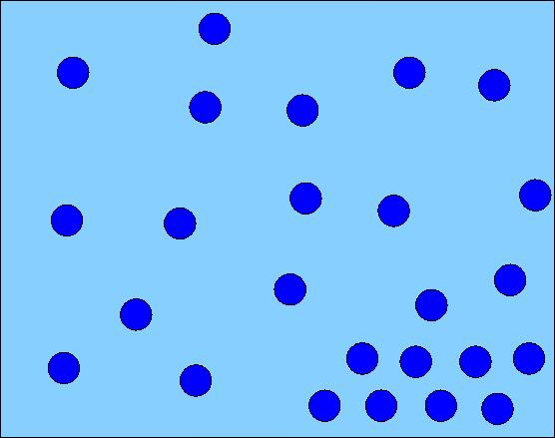
SESANS & SANS Measure Different Transforms of the Debye Correlation Function
Local Particle Density ρ(r)
Debye Correlation Function
SANS
SESANS
Fourier
Abel

Slide 18
Hard Sphere vs. Adhesive Hard Sphere
Unpublished experiments at LANSCE by Xin Li and Roger Pynn
Theoretical Predictions:
T. Kruglov J. Appl. Cryst. 38, 721 2005
Li et al. J. Chem. Phys. 132 174509 2010

Slide 19
We are usually completely wrong in predicting the future in science. However while waiting for unexpected discoveries, I believe that these categories merit some exploration.
Thanks for listening!

