Slide 1
CORF Meeting-2014
Mónica Rodríguez Miranda,
Ingeniería y Administración del Espectro Radioeléctrico
Política Regulatoria y Estudios,
Subsecretaría de Telecomunicaciones
May 2014

Slide 2
CHILE
Chile is a democratic republic, divided into 15 administrative regions; presided over by Ms. Michelle Bachellet. It has a population of more than 15 million people, and a continental longitude of approximately 4.200 km and 8.000 km, if the Chilean Antarctic is considered.
Chile has plenty of natural resources, and is advanced in its multisectorial variety of products and services, such as mining, aquiculture, agriculture, communications, financial sector and retail, among others.

Slide 3
CHILE
Chilean business environment is based on a commitment to economic liberalization and free-market policies. It has focused on building sound macroeconomic bases and strong institutions, as well as promoting competition and international integration.
It is worth mentioning the country’s modern telecommunications system, its internationally competitive banking sector, fine standard of public infrastructure, excellent quality of services and availability of qualified workers.

Slide 4
Framework for Telecommunications

Slide 5
Framework for Telecommunications
Institutional and Legal Framework for Telecommunications in Chile:
The Undersecretariat of Telecommunications (SUBTEL)
  was created in 1977, Decreto N°1762
  as a technical body in charge of regulating and promoting the development of telecommunications
  under the organizational structure of the Ministry of Transport and Telecommunications

Slide 6
Framework for Telecommunications
Functions of Subtel:
Subtel is in charge of
  Developing telecommunications policies;
  Compliance with the laws, regulations, technical standards, as well as international treaties;
  Spectrum management;
  Issuance of technical standards on telecommunications and control compliance;
  Representing the country as the Chilean Telecommunication Administration before the International Telecommunication Union (UIT);
  Granting, modifying, denying, suspending or terminating concessions, permits, and licenses to provide telecommunication services in Chile;

Slide 7
Framework for Telecommunications
Legal framework includes the General Law on Telecommunications, technical rules and plans.
GLT N° 18.168 came into force in 1982
  in order to regulate the installation, operation and exploitation of telecommunications services
  with special emphasis on the promotion of competition
  GLT defines five service categories, which correspond to broadcasting telecommunication services, public telecommunication services, limited (private) telecommunication services, amateur radio services and intermediate telecommunication services
  Compliance with the laws, regulations, technical standards, as well as international treaties;
  Spectrum management;

Slide 8
Framework for Telecommunications
Other institutions in telecommunications regulation
Besides GLT, Chile has a Competition Tribunal
  main purpose is to protect and promote competition in all markets
  it is responsible for determining if an operator is dominant or not and if the market presents conditions pertinent to grant freedom of prices or requires public intervention
National Television Council, established by the Constitution
  its purpose is to guarantee the correct operation of television services
  not under the review or control of any other public entity
  is the competent authority to grant the concessions for television broadcasting services and the permits for limited television services

Slide 9
Spectrum management

Slide 10
Regulating Spectrum
Legal hierarchy on regulating spectrum
Spectrum Plan, Plan General de Uso del Espectro Radioeléctrico, Decreto Nº 127 year 2006 determines the way that the frequencies will be allocated by the Table of frequency allocation. (based on Article 5 of the ITU Radio Regulations, Region 2)
Through Rules (Resolución Exenta), frequency bands are appointed for specific uses, in accordance with requirements of technological trends, spectrum planning criteria based on discussions in different forums (like CITEL), regional and national positions

Slide 11
Regulating Spectrum
Categories of services and allocations
  Services allocated on a Primary basis: can claim protection from harmful interferences from stations of a primary service or from stations of a secondary service
  Services allocated on a Secondary basis: can not claim protection from harmful interferences from stations of a primary service, but they have the right to claim protection from harmful interferences from stations of a secondary service.

Slide 12
Regulating Spectrum
Band | PLAN General: ALLOCATION | Rules: APPOINTED
14,47 – 14,5 GHz | FIJO POR SATÉLITE (Tierra‑espacio) Radioastronomía Móvil por satélite (Tierra-espacio) | Resolución Fijo por satélite
…

Slide 13
Coordination - ALMA Radiotelescope

Slide 14
Coordination
Subtel granted AUI and ESO, licence (Permiso de Servicio Limitado), to install and operate the radiotelescope at Llano de Chajnantor, Atacama.
  Granted in 2004.
  Renewed in 2013
    Resolución Exenta N° 3075, august 2013 to AUI
    Resolución Exenta N° 3076, august 2013 to ESO
  Asociated to characteristics of
    Frequency asignment
    Location
    Type and number of antennas
    Definition of protection zone and coordination zone

Slide 15
…
Coordination
  Reception frequency bands of ALMA antennas
Authorized Frequency Bands [GHz] | Band allocated to radioastronomy service on primary basis [GHz] | Band allocated to radioastronomy service on secondary basis [GHz]
35 - 52 | 42,4 - 43,5
67 - 90 | 76-77,5 / 79 - 90 | 77,5 - 78
84 - 116 | 84 - 94 / 94,1 - 116 | 94 - 94,1
125 - 163 | 130-134 / 136-158,5 | 125-130 / 134-136
163 - 211 | 164 - 167 / 182-185 / 200-211
211 - 275 | 211-231,5 / 241-275
275 - 370 | Not allocated
285 - 500 | Not allocated
602 - 720 | Not allocated
787 - 950 | Not allocated
  The radiotelescope can operate on all the frequency bands authorized, nevertheless it is no possible to guarantee protection on the bands, or parte of them, not allocated to radioastronomy on primary basis.
Subtel – Unidad de Estudios y Planificación
Notes:
Resaltar aspectos positivos.

Slide 16
Coordination
  Protection Zone:
    Centered at lat. 23°01‘40‘‘ South and long. 67°45‘17‘‘ West, 30 km radius.
    Subtel guarantees that will not authorize the instalation of radiocommunicaciones systems which operate in the reception bands of the radiotelescope.

Slide 17
Coordination
  Coordination Zone
    Same center as the protection Zone, inside national territory.
    Any authorization will be submited to a coordination process:
      Subtel will inform ESO and AUI about applications that could afect the operation of the radiotelescope, asking for their technical oppinion.
      In any case ESO and AUI will detect emissions affecting the radiotelescope operation, they will inform Subtel for their coordination.
    “Good Practices” regarding adjusting antenna beams, power, filtering armonic emissions.

Slide 18
Coordination
  Inside the coordination zone, the emissions from equipments authorized to licensees will be limited according to Rec. ITU-R RA 769-2 in the cases:
    For frequencies <31,3 GHz, maximum EIRP is defined for distances from 10Km to 100 Km.
    For frequencies >31,3 GHz, protection criteria established by Rec. ITU-R RA 769-2 (or any ITU Recomentatiod that will replace it) will be settled.

Slide 19
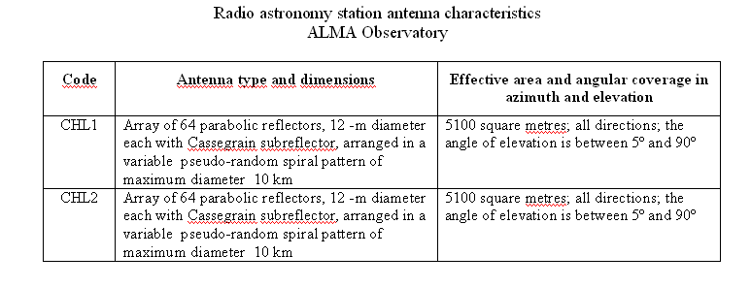
…
Coordination
Inclusion of the frequencies of ALMA Radio Observatory in the ITU Master International Frequency Register
Subtel – Unidad de Estudios y Planificación
Notes:
Resaltar aspectos positivos.

Slide 20
On vehicular radars

Slide 21
…
Coordination
  Reception frequency bands of ALMA antennas
Authorized Frequency Bands [GHz] | Band allocated to radioastronomy service on primary basis [GHz] | Band allocated to radioastronomy service on secondary basis [GHz]
35 - 52 | 42,4 - 43,5
67 - 90 | 76-77,5 / 79 - 90 | 77,5 - 78
84 - 116 | 84 - 94 / 94,1 - 116 | 94 - 94,1
125 - 163 | 130-134 / 136-158,5 | 125-130 / 134-136
163 - 211 | 164 - 167 / 182-185 / 200-211
211 - 275 | 211-231,5 / 241-275
275 - 370 | Not allocated
285 - 500 | Not allocated
602 - 720 | Not allocated
787 - 950 | Not allocated
Subtel – Unidad de Estudios y Planificación
Notes:
Resaltar aspectos positivos.

Slide 22
Regulation on Vehicular Radar
The Legal Framework for Telecommunications includes the vehicular radars in the rule called “NORMA TÉCNICA DE EQUIPOS DE ALCANCE REDUCIDO”
  States the conditions for short-range devices which do not require a license
  In the rule Resolución N° 755, of year 2005 (http://www.leychile.cl/Navegar?idNorma=240404)
  Modified be rule Resolución N° 2094, of year 2013 ( http://www.leychile.cl/Navegar?idNorma=1051775)

Slide 23
Regulation on Vehicular Radar
Resolución N° 755 of year 2005 and its modifications
Article 1°: the following devices which fulfill the conditions settled below will no require license for their use:…
Article 2°: Importers or manufacturers of those devices, should obtain a certified approval from the Undersecretary of Telecommunications.

Slide 24
Regulation on Vehicular Radar
Resolución N° 755 of year 2005 and its modifications
Article 1°:
i) Devices used as radar systems on vehicles which operate in band 77 to 81 GHz with maximum e.i.r.p. 55dBm, as stated in ITU-R Recommendation M.1452-2, in band 76 to 77 GHz with maximum power to the antenna of 10 mW and with maximum gain of 40 dB and, in band 24 to 24.25 GHz with maximum radiated power of 100 mW.

Slide 25
CHILE
Band | PLAN General: ALLOCATION
76 – 77,5 GHz | RADIOASTRONOMÍA
 | RADIOLOCALIZACIÓN
 | Aficionados
 | Aficionados por satélite
 | Investigación espacial (espacio-Tierra)
77,5 – 78 GHz | AFICIONADOS
 | AFICIONADOS POR SATÉLITE
 | Radioastronomía
 | Investigación espacial (espacio-Tierra)
78 – 79 GHz | RADIOLOCALIZACIÓN
 | Aficionados
 | Aficionados por satélite
 | Radioastronomía
 | Investigación espacial (espacio-Tierra)
79 – 81 GHz | RADIOASTRONOMÍA
 | RADIOLOCALIZACIÓN
 | Aficionados
 | Aficionados por satélite
 | Investigación espacial (espacio-Tierra)

Slide 26
Considerations
  The following facts where taken under consideration
    Frequency bands 76-77.5 GHz and 78-81 GHz are already allocated to radiolocation service on primary basis (in the three ITU Regions).
    Frequency band 77-81 GHz has been appointed for the use of automotive short range radar in many countries, meaning they would arrive included as a part of the vehicles to be sold in Chile.
    Seeking to avoid an unregulated development of automotive radar devices, Subtel considered useful to regulate the band in order to inform vehicles manufacturers and importers the conditions for their operation, mainly radiated power (as stated in Recommendation ITU-R M-1452-2).

Slide 27
Considerations
  Sharing might be difficult with radioastronomy, due to the extreme sensitivity of the radioastronomy equipment
  Documents on measurements performed, like NRAO Technical Note N°219 concluded:
    A zone of avoidance of about 30 to 40 km around the mm wave observatory would be needed.
    The study acknowledged that other factors such as terrain shielding, orientation of the vehicular radar transmitter antenna with respect to the observatory were not taken into account
    Smaller zones of avoidance might suffice in areas without direct line of sight to the radio telescope

Slide 28
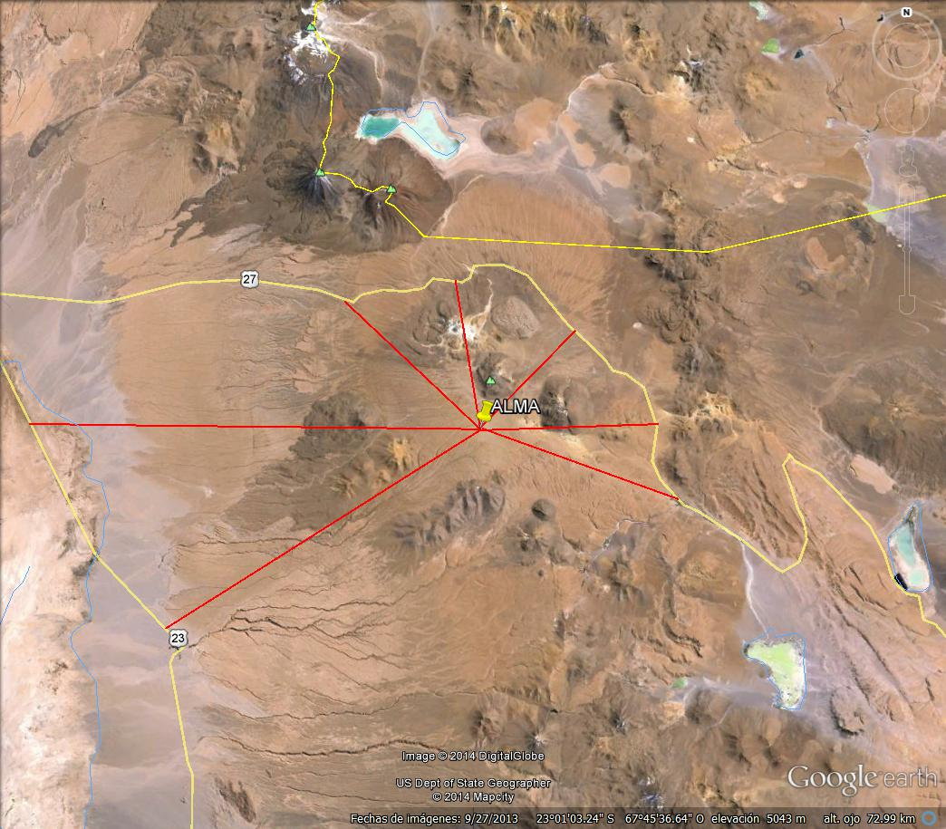
Example of 7 profiles ALMA to nearby roads

Slide 29
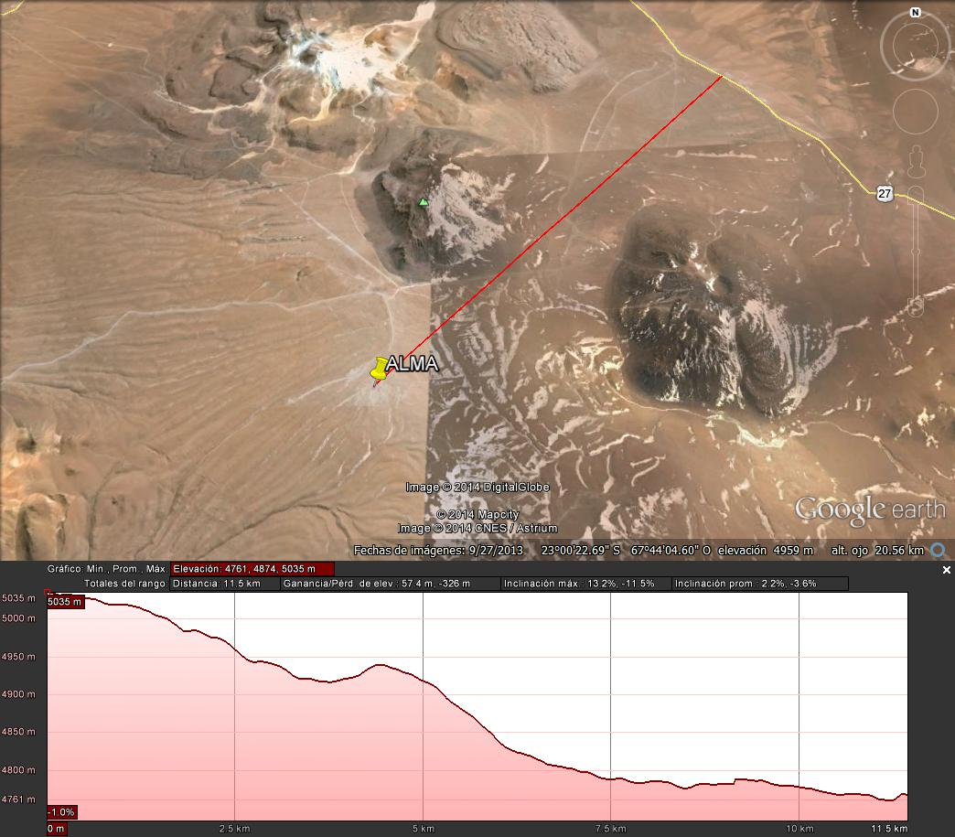
Profile1
Dist.= 11.5 Km

Slide 30
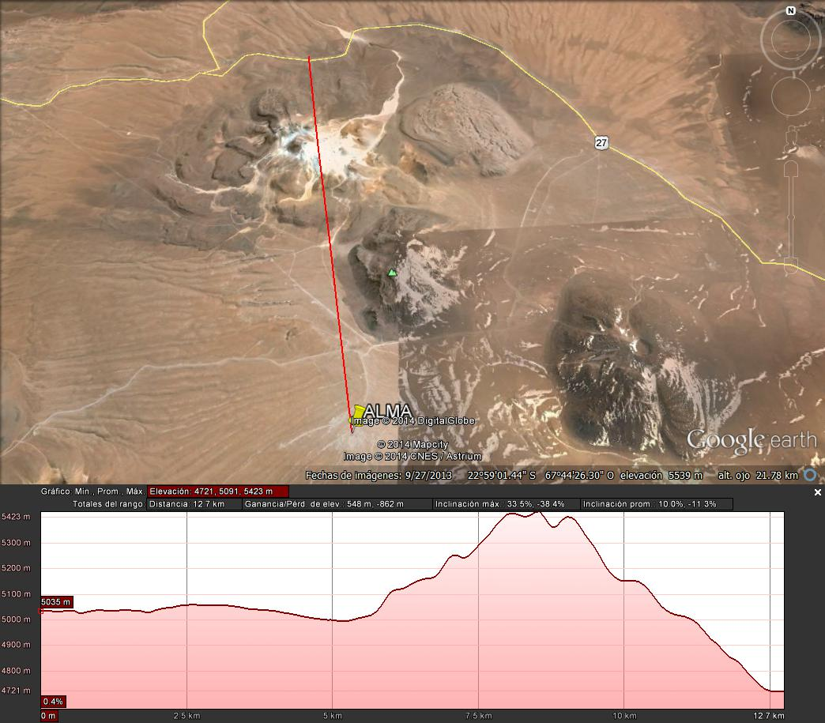
Profile 2
Dist.= 12.7 Km

Slide 31
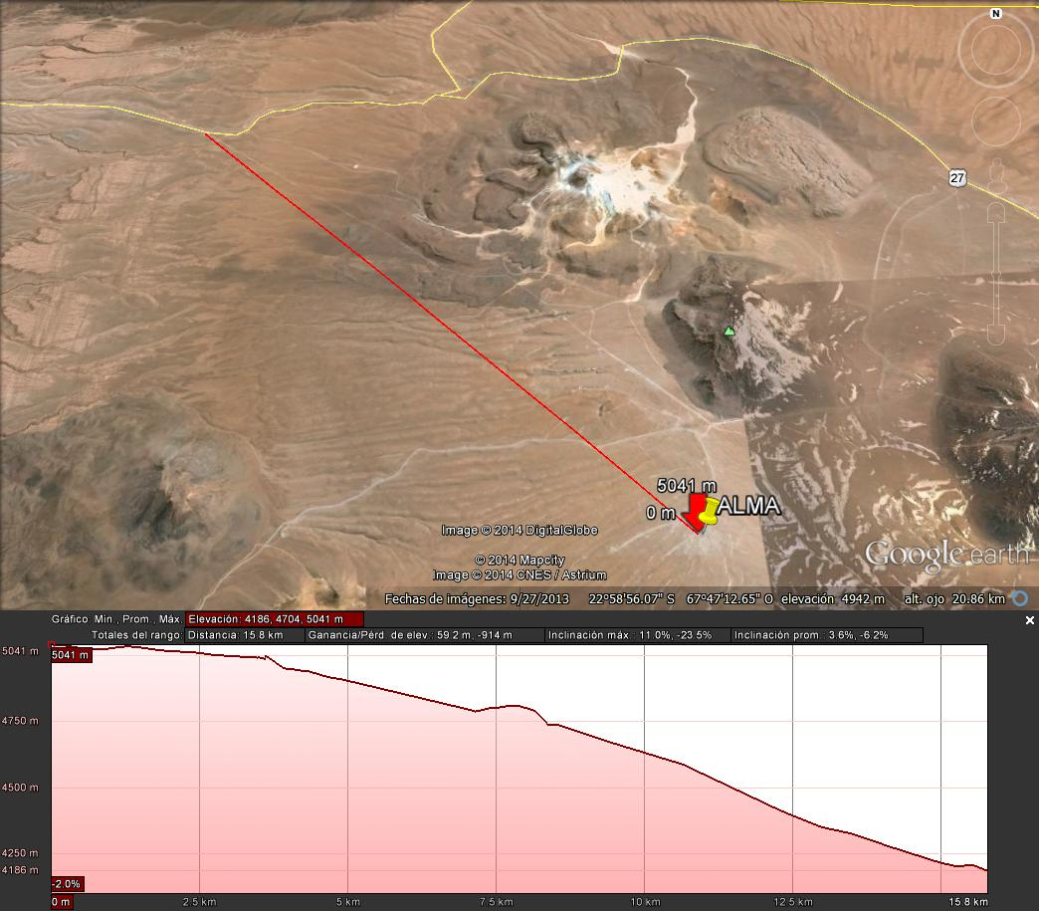
Profile 3
Dist.= 15.8 Km

Slide 32
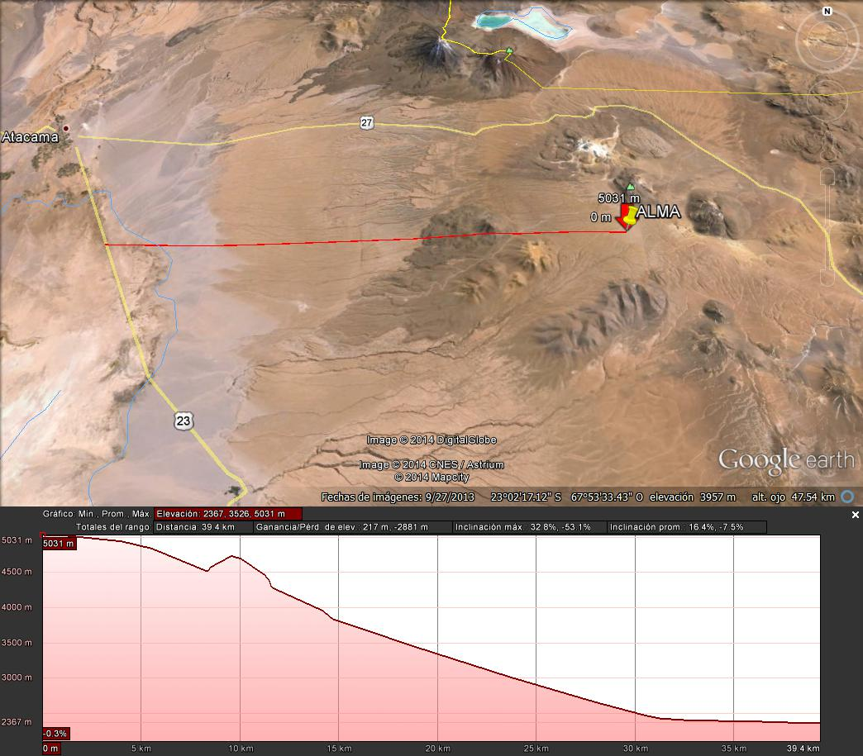
Profile 4
Dist.= 39.4 Km

Slide 33
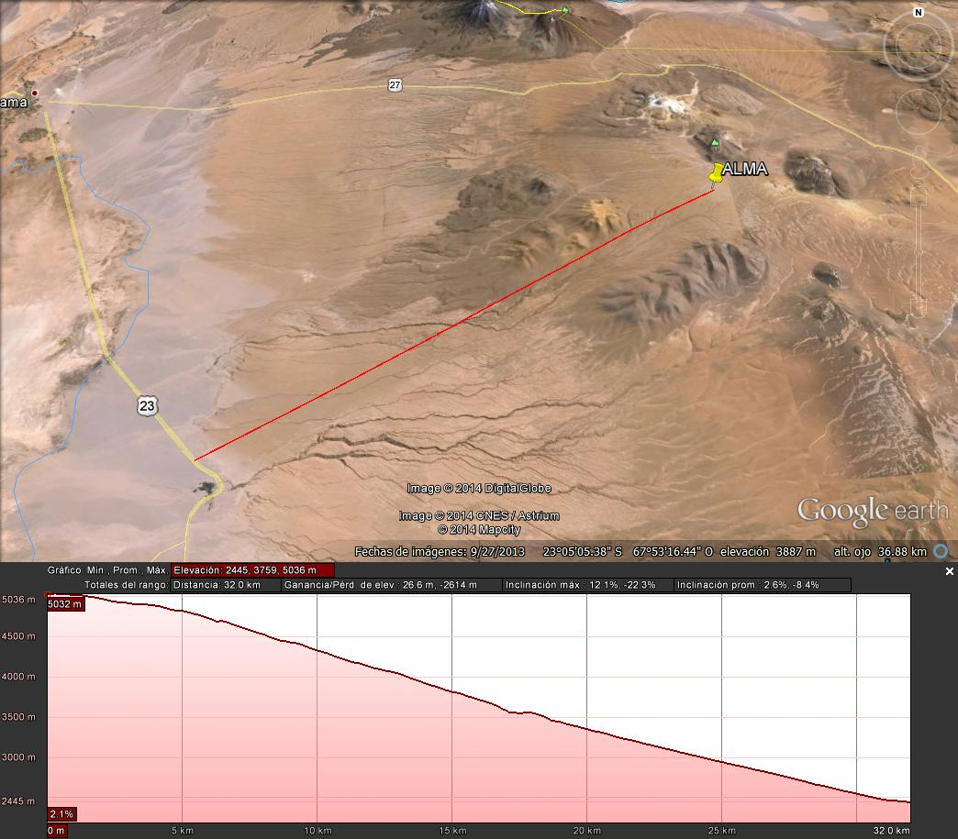
Profile 5
Dist.= 32.0 Km

