Slide 1
FEDERAL SPECTRUM DEVELOPMENTS
June 2013 – May 2014
CORF Meeting
May 2014
Paul J. Feldman, Esq.

Slide 2
I. 1.7 GHz Advanced Wireless Service
BACKGROUND:
-FCC National B’Band Plan (and Presidential Order):
- 300 megahertz between 225 MHz and 3.7 GHz should be made newly available for mobile BBand use within five years.
Add’l 200 megahertz w/in 10 years
-FCC/NTIA work together to identify spectrum

Slide 3
II. 1.7 GHz Advanced Wireless Service (cont’d)
The 1675-1710 MHz band currently allocated to the Meteorological Aids Service and the Meteorological Satellite Service (Space-to-earth).
This band is used for downlinks from certain weather satellites (GOES and POES) and radiosondes (weather balloons) that are administered by NOAA.

Slide 4
II. 1.7 GHz Advanced Wireless Service (cont’d)
A. History
-Feb. 2013: Per 2012 legislation, NTIA “identifies” 1695-1710 MHz portion of 1675-1710 as the 15 MHz to be reallocated to commercial use.
-April 2013: NTIA suggests to FCC a framework for reallocation of band.

Slide 5
II. 1.7 GHz Advanced Wireless Service (cont’d)
B. FCC Order
-March 2014 – FCC releases Order enacting rules for 1695-1710 MHz
(along with 1755-1780 and 2155-2180 MHz)
-allocated to existing Advanced Wireless Service (“AWS”)
-new allocation is “AWS-3”
-used for cellular services
-1695-1710 limited to terrestrial mobile uplinks
-licenses to be assigned by auction in November – expect big $

Slide 6
II. 1.7 GHz Advanced Wireless Service (cont’d)
C. MetSat Allocation Limited to Protection Zones
Allocation for MetSat retained, but geographically limited to
27 “Protection Zones” around specific existing Federal receive sites
-based on interference analysis and protection criteria for each site
-Commercial base stations allowed within each PZ only where coordinated with relevant federal agency
-Commercial operations allowed outside of PZ at < 20 dBm EIRP w/o coordination, but may not cause interference inside of PZ

Slide 7
II. 1.7 GHz Advanced Wireless Service (cont’d)
D. Possible Nationwide Coordination
-Commercial operations outside of PZ at 20-30 dBm EIRP
must submit to nationwide coordination
-FCC and NTIA will issue joint Public Notice on procedures
-likely use of one or more federal on-line portals
for submission of licensee data

Slide 8
II. 57-64 GHz Unlicensed Devices
In August 2013 Order, FCC:
-allowed higher emission limits for 60 GHz devices that operate outdoors with very high gain antennas, and
-specified the emission limit for all 60 GHz devices as an EIRP power level (vs. dBm)

Slide 9
II. 57-64 GHz Unlicensed Devices (cont)
Background
Two primary types of unlicensed equipment in this band:
-short‑range fixed point‑to‑point data backhaul, primarily outdoor; and
in‑building wireless personal area networking (WPAN) devices for consumer audio, video etc.
Under FCC Part 15 unlicensed rules, limit on average power density of any emission in this band was 9 µW/cm² and the peak power density was 18 µW/cm², measured at a distance of 3 meters.
These average and peak power density limits are equivalent to average and peak EIRP limits of 10 W (40 dBm) and 20 W (43 dBm), respectively.

Slide 10
II. 57-64 GHz Unlicensed Devices (cont)
FCC Action
In the Report and Order, the FCC increased the permitted power levels for 60 GHz unlicensed devices that use an antenna exceeding a specific gain and operate outdoors.
For such devices, average EIRP limit increased from 40 dBm to 82 dBm minus 2 dB for every dB that the antenna gain is below 51 dBi, and peak EIRP emission limit from 43 dBm to 85 dBm minus 2 dB for every dB that the antenna gain is below 51 dBi.
Purpose -- promote broadband.
Amended rules also specify the emission limits for all 60 GHz devices in terms of EIRP.
Promote repeatability and uniformity of testing.

Slide 11
II. 57-64 GHz Unlicensed Devices (cont)
Spurious Emissions
-Section 15.255(c)(3) requires that spurious emissions from 40-200 GHz
for 60 GHz equipment be limited to 90 pW/cm² at 3 meters.
-NPRM clarified that measurements must be made in far field and if that distance is greater than 3 meters, then the measurement results must be extrapolated (20 dB/decade) to a distance of 3 meters.
-NRAO: extend spurious emission limits up to 231 GHz, to protect RAS observations at harmonics of 57 GHz -- less attenuation in harmonics.

Slide 12
II. 57-64 GHz Unlicensed Devices (cont)
Spurious Emissions
-FCC rejected NRAO’s suggestion:
-interference unlikely -- 60 GHz devices are urban
(vs. rural sites of RAS receivers)
-reduced amplitude of higher harmonics
-RAS receivers “discriminate against off-axis signals”

Slide 13
III. 75 GHz Level Probing Radars
-January 2014: FCC Order modifying Part 15 rules to allow the broader operation of, and revising the procedures for certification of emission levels for, unlicensed level probing radars (LPRs) operating at 5.925‑7.250 GHz, 24.05‑29.00 GHz, and 75‑85 GHz.
-Prior CORF comments: do not oppose sharing the 75-85 GHz band, subject to the protections proposed by the FCC, along with some additional protections for RAS proposed by CORF.
-The FCC enacted its proposed protections, but did not enact the additional protections.

Slide 14
III. 75 GHz Level Probing Radars (cont)
-Most LPR devices currently operate on an unlicensed basis in frequencies around 6 GHz, 24 GHz, or 26 GHz, primarily in metal or concrete tanks, under general emission limits for unlicensed devices.
-In recent Order, the FCC now allows LPR devices certified under new technical rules in any type of enclosure including plastic, and in open air, in the following frequency bands: 5.925‑7.250 GHz, 24.05‑29.00 GHz, and 75‑85 GHz.
-New rules are designed to promote broader use of LPRs, and to harmonize U.S. technical rules for LPR devices with European standards.

Slide 15
III. 75 GHz Level Probing Radars (cont)
Conditions on Operations
CORF Comments urged FCC to enact its own proposed protections:
(1) LPR antenna integrated with transmitter and professionally installed in a downward position;
(2) LPR limited to fixed locations; and
(3) prohibiting hand‑held applications of LPR and the marketing of LPR devices to residential consumers.
CORF also suggested additional restrictions:
(4) antenna height restrictions and distance separations from certain RAS observatories, and
(5) manufacturers of LPR equipment maintain lists of LPR installations, with the information placed in a publically accessible database.

Slide 16
III. 75 GHz Level Probing Radars (cont)
Conditions on Operations
FCC Order adopted requirements that:
(1) LPR antennas must be dedicated or integrated with the transmitter.
(2) installation only at fixed locations
(3) hand-held or mobile applications, and marketing to residential consumers, prohibited.
The FCC concluded that there was no need to require professional installation.

Slide 17
III. 75 GHz Level Probing Radars (cont)
Conditions on Operations
FCC rejected the following proposals:
-prohibit LPRs within 4 km of RAS facilities that observe in the 75-85 GHz band;
-limit LPR antenna heights to 15 meters above ground level within 40 km of those locations;
-a published database of LPR installations.
LPR trade association did not object, but FCC asserted that unnecessary to protect RAS, and database would raise “confidentiality issues.”
-FCC also rejected the proposal to consider aggregate emission limits at 22-24 GHz to protect EESS -- ETSI standard supposedly takes into account the existence of EESS in these bands.

Slide 18
III. 75 GHz Level Probing Radars (cont)
B. Certification and Emission Limits
-LPR devices have operated for years under the general technical standards for unlicensed intentional radiators in Section 15.209 of the Commission’s rules.
-Manufacturers have had difficulty demonstrating compliance with the rule’s low emission limits for applications in fiberglass or plastic tanks, and for open air use.
Reflections off of the surfaces being measured attenuate inconsistently due to device orientation and the material being measured.
Measuring those reflections tends to give erratic results.
- Under the new procedures, may test LPRs with main beam aimed directly at the test antenna – a “boresight” measurement. Then use a formula to estimate the reduced reflected energy. Newly enacted rule Section 15.256(g).

Slide 19
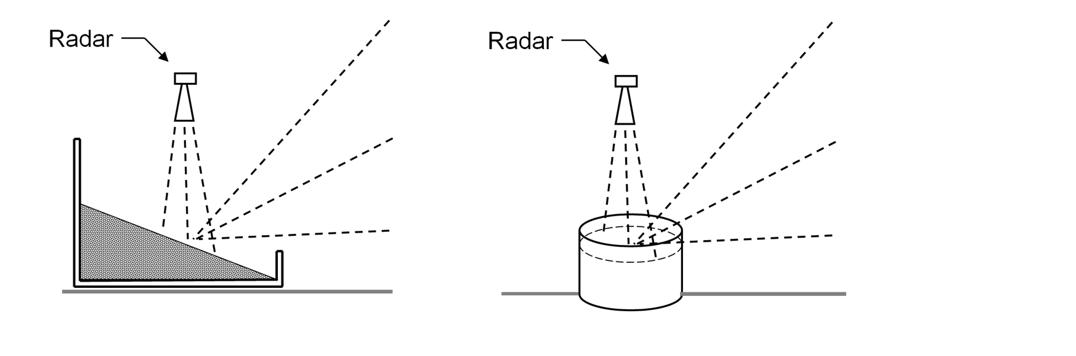
III. 75 GHz Level Probing Radars (cont)
B. Certification and Emission Limits

Slide 20
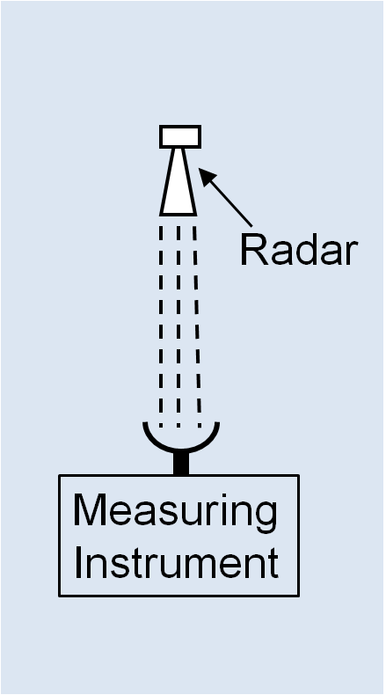
III. 75 GHz Level Probing Radars (cont)
B. Certification and Emission Limits
New “boresight” measurement:
-goal is maximum horizontal emissions of 75 nanowatts
-boresight limits exceed that level by factor of 7, or 540,
or 6,760 depending on band
-allows for losses due to scattering, etc.

Slide 21
IV. Petitions – Above 95 GHz
A. IEEE Petition
In July 2013, IEEE-USA filed Petition for RM (ET 13-259) seeking expedited treatment of petitions/applications for technologies/services above 95 GHz.
-Table of Allocations (uses) goes up to 275 GHz
-FCC service rules only go up to 95 GHz.
-Sale and use of equipment above 95 GHz prohibited except:
-Fed. Govt. agencies
-Experimental use in bands not having only passive allocations
-Amateur use in certain bands (while protecting RAS and EESS)
-Industrial/Scientific/Medical equip at 122-23 and 244-46 GHz

Slide 22
IV. Petitions – Above 95 GHz (con’t)
A. IEEE Petition
Otherwise, users must file waivers or petitions for rulemaking, with long time delay
-inhibit commercial funding/development of new technologies?
-DARPA exploring/funding >100 GHz technologies
IEEE points to Section 7 of the Communications Act:
-encourages new technologies/services
-shifts burden to any party that opposes new t/s
-gives FCC 12 months to determine whether a proposed new t/s is in the public interest
But, the FCC has never used this power!

Slide 23
IV. Petitions – Above 95 GHz (con’t)
A. IEEE Petition
-IEEE Petition asks FCC to use 1 year limit/shift of burden
for consideration of above 95 GHz proposals:
not only to find that proposals are new t/s in public interest, but also
to adopt enabling rules.
-No opposition, but unclear if FCC will grant, and if so, whether that would
speed up or slow down FCC action.
-FCC may issue NPRM.

Slide 24
IV. Petitions – Above 95 GHz (con’t)
B. Battelle Petition 102-109.5 GHz (RM-11713)
-Battelle Memorial Institute (operator of 7 Nat’l Laboratories for DOE/DHS) filed a petition in February of 2014, to enact rules for terrestrial, fixed, licensed operations at 102-109.5 GHz.
short-hop, high capacity broadband links
-Band is allocated to RAS, along with fixed and mobile, all co-primary.
-Also used for SRS (space-based)
-Battelle asserts that RAS uses band only in “Hawaii, Arizona and California”
but “may not actually utilize” the band at all.

Slide 25
IV. Petitions – Above 95 GHz (con’t)
B. Battelle Petition 102-109.5 GHz
-Propose rules similar to existing rules for 70/80/90 GHz terrestrial fixed links
similarity: high atmospheric attenuation,
and narrow, directional “pencil” beams
70/80/90 GHz Process:
-users obtain nation-wide non-exclusive FCC license
-individual links registered with 3rd party database, then automatically sent to NTIA for coordination with federal users and RAS (NSF)
-links in Quiet Zones require individual applications filed with FCC and coordination.
Battelle proposes higher maximum EIRP (+70 dBW vs. +55)

Slide 26
IV. Petitions – Above 95 GHz (con’t)
B. Battelle Petition 102-109.5 GHz
What is RAS usage of this band?
What is experience with 70/80/90?
Industry also interested in mobile/small cell use
Next steps?

Slide 27
V. Iridium – Modification Application for NEXT
-In December 2013, Iridium filed application to modify its license for its
Iridium “NEXT” second generation satellites.
(SAT-MOD-20131227-00148, Call Sign S2110)
application still pending
-Operate on same frequencies (1617.775-1626.5 MHz)
but technical capability to go down to 1616.0,
and pending (Feb. 2013) FCC request to do so.
-NEXT: “increased total and peak network performance”
(voice quality and data transmission speed)

Slide 28
V. Iridium – Modification Application for NEXT
-Launches for 82 vehicles scheduled for 2015-2017:
SpaceX in California
ISC Kosmotras (Rus-Uk.?)
-PFD at ground same as current constellation.
-Engineering statement addresses RAS coordination, to limit noise floor and OOB intermodulation.
-Software and ground operations “applied dynamically to any point on a 2 percent global grid in 30 second steps.” Reconfiguration includes:
-shifting frequency assignment to higher portions of band
-limiting user access
-reduce transmitter power
-mute carriers in a beam

Slide 29
V. Iridium – Modification Application for NEXT
-No discussion in application re minimum required notification time
dynamic RAS scheduling
-Iridium licensing problems in Europe
-FCC application does not appear to propose technical modifications/protections suggested in ECC/CEPT Report 171

Slide 30
VI. Channel 37 – Reallocation of TV Band
-In October 2012, FCC released a Notice of Proposed Rulemaking seeking comments on proposals to reallocate some or all of the UHF TV band between channels 31 and 51 (572-698 MHz).
-This “600 MHz band” would be reallocated from broadcasting to licensed terrestrial mobile wireless services, and then assigned by auction. $$$
-FCC also sought comments on enhancing the availability of the 600 MHz band for unlicensed “TV White Spaces Devices.” (“TVWSD”)
-One topic in this proceeding is the status of Channel 37, which is currently reserved solely for use by RAS and the Wireless Medical Telemetry Service (“WMTS”).

Slide 31
VI. Channel 37 – Reallocation of TV Band
On May 15, 2014, FCC announced Report and Order in this proceeding.
Text not yet released, but:
-All licensed wireless will be allocated between Ch. 51 and Ch. 38. Number of channels to be determined in auction.
-RAS and WMTS will remain on Ch. 37.
-TVWSD may operate on Ch. 37, subject to protections to RAS and WMTS to be enacted in upcoming new rulemaking proceeding.
-Possible guardband (frequency gap) between licensed allocation at Ch. 38 and RAS, but TVWSD and wireless mics may use the guardband. Possible frequency coordination between Ch. 38 licensed and RAS.

Slide 32
VI. Channel 37 – Reallocation of TV Band
Reallocation of TV Band
“Down from 51” Plan
-RAS and WMTS allocations to Channel 37 remain.
-TVWS devices (and possibly wireless mics) may operate on Ch. 37, subject to protections to RAS and WMTS.
-Guardband may be adjacent to Ch. 37 (TVWSD and mics)
-Higher likelihood of displaced TV stations moving to Ch. 36 or 38. If not, may be increased TVWSD or wireless mic usage of 36.

Slide 33
VII. Meet With FCC Commissioners
-We have never met with any of the current Commissioners
-Spectrum reallocation and sharing are among the biggest concerns to this Commission.
-Policy Goals?
-remind them of passive use
-shared use/shared responsibility
-Action Plan:
-Set dates
-finalize slides

Slide 34
QUESTIONS?

Slide 35
THANKS!
Paul Feldman
feldman@fhhlaw.com
703-812-0403

