Slide 1
National Science Foundation Spectrum Management
Tomas Gergely
Glen Langston
National Academy of Sciences
Committee on Radio Frequencies
May 29, 2014

Slide 2
Spectrum Management Challenges 2014 - 2015
Spectrum protections and coordination for the new generation of broadband radio astronomy systems
  EVLA (1-50 GHz), ALMA (30 – 950 GHz), GBT (1-100 GHz), ARECIBO (e.g. 1.15-1.73 GHZ; 3-4 GHz)
  Hydrogen Era of Reionization Array (HERA) systems (MWA, SKA, etc.) & low-frequency systems (i.e., LWA) operate in some of the most crowded spectral regions – Require interference mitigation or excision
Picosatellite systems (Cubesats)
  Increasingly used in research (Ionospheric research, astronomy)
  International issue, but even getting past national regulators is difficult
World Radiocommunication Conference (WRC-15)
  Many issues to follow –in large number of groups

Slide 3
Mm-wave issue: Car radars
Allocation of 77.5-78 GHz to the radiolocation service for vehicular radars on WRC-15 Agenda
    Allocation is a near certainty (most of the world supportive, pressure from car industry)
At the operational power levels envisioned (~ 5 Watts/radar) and millions of vehicles on the road, interference to radio telescopes (ALMA, GBT in US, Bonn in Europe, in Japan ) is certain
NSF working for radio astronomy protection, maybe via a footnote

Slide 4
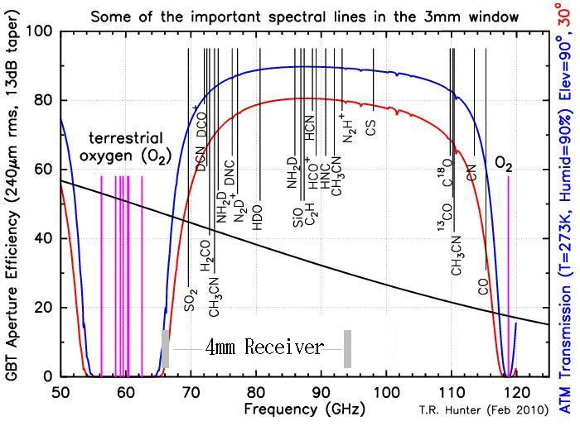
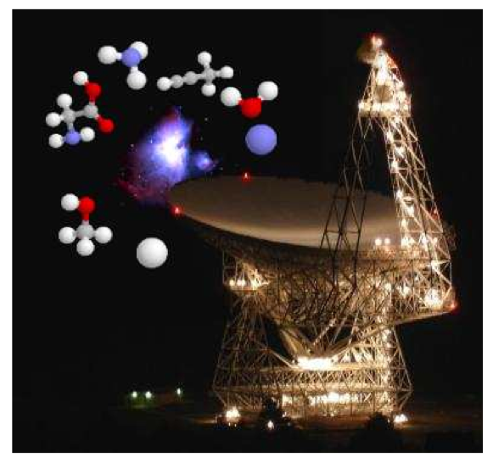
Radar at 76-81 GHz
Dense gas tracers in star-forming regions and nearby galaxies (HCN, HNC, HCO+ all at ~90GHz)
D-species in cold cloud cores (~70-80GHz)
Astro/bio-chemistry (throughout the band)

Slide 5
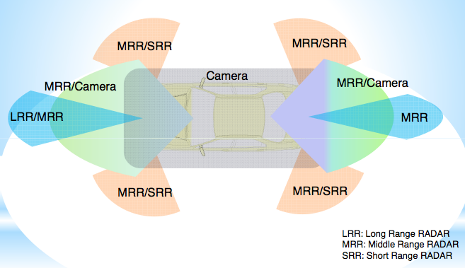
Vehicular Radar in RAS bands

Slide 6
Impact of ITU 77-81 GHz Spectrum Allocation Change
75
76
77
78
79
80
81
GHz
RLS: Radio Location Service
FCC 2012
Primary
RAS: Radio Astronomy Service
?
Primary
Secondary
Amateur and Amateur Satellite Service
Secondary
76 GHz Band Radar
79 GHz Band High-Resolution Radar
6

Slide 7
Mm-wave Mitigation
How to protect radio telescopes?
  Exclusion zones require switching off radars
    Manually or Under (GPS) control?
    Exclusion zone radii ~ 30 km
  Opposed by car industry
  Additional issue: Harmonics?
    2nd and 3rd harmonics fall in RA bands
Expecting an FCC submission to WP7D for Oct 2014 ITU meeting
  New Radio Astronomer submission?

Slide 8
Other WRC issues
Spectrum for Wireless Intra-Avionics Communication – replaces wiring of about 30% of aircraft
  Looking for approximately 250 MHz of spectrum
  So far, radio astronomy bands have been excluded from search
  Some wiring on the exterior of the aircraft unshielded
  Interference to broad band radio astronomy receivers is to be expected
Boeing document studied WAIC systems at 22.5-22.55 and 23.55-23.6 GHz
  Can RAS contribute a study showing a different frequency range GHz is acceptable?
Protection of Radio Astronomy in Space
  Russian Submission suggesting SRS protection.

Slide 9
Principal international activities
Serve on U.S. delegations to the International Telecommunication Union (ITU), specialized agency of the United Nations
  Goal: Protection for Astronomy at World Radiocommunication Conferences (WRC)
Participate in U.S. delegations to the Inter-American Telecommunication Commission (CITEL), an entity of the Organization of American States
Interface with international radio science/scientific spectrum management organizations, such as:
  European Science Foundation’s Committee on Radio Astronomy Frequencies (CRAF)
  Inter-Union Commission on Astronomy Frequencies (IUCAF)
  International Astronomical Union (IAU)
  International Union of Radio Science (URSI), among others

Slide 10
Quantitative Spectrum Sharing
Radio Astronomy Experts need to quantify the contribution of RAS to Sharing
  Goal: RAS should receive fair benefits for sharing RAS bands
  Can CORF Experts define quantitative sharing?:
    Ie: Sharing a 6 MHz band nationwide for 20 hours is equivalent to a 120 MHz band for 1 hour
    Or Cash equivalent…
    Define ownership of bands in the same way as cell phone and TV stations frequency ranges are owned

Slide 11
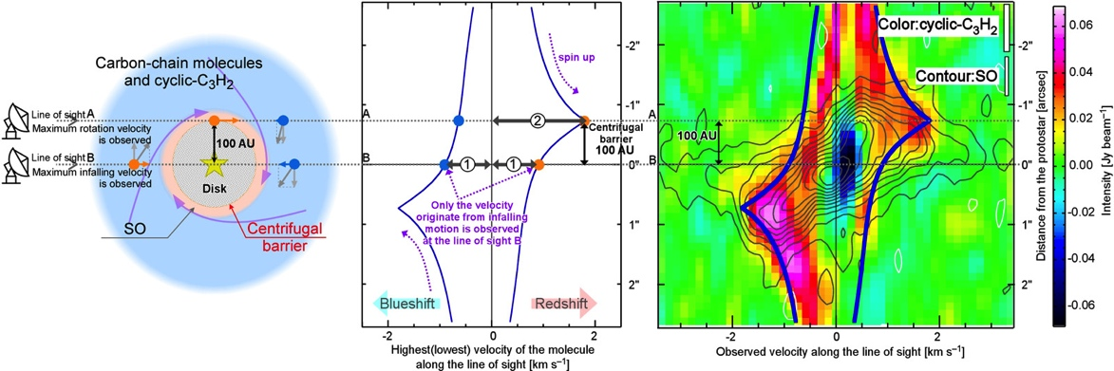
Thanks for your
Consideration
Astro-chemistry Result from ALMA: Sakai et. al 2014, March 6, Nature.
ALMA, JVLA and GBT all have recent Astro-chemistry results from observations
in wide (often un-protected) frequency ranges.

