Slide 1
What’s Going on in Canada?
Ken Tapping
Ken.Tapping@nrc-cnrc.gc.ca

Slide 2
New Instruments: CHIME
New Instruments: SKA Antenna Prototype
The Noise Floor Problem
Mobile and Multiple Unlicensed Devices
The Smart Meter Problem
DRAO Interference/Noise Monitor

Slide 3
CHIME
(Canadian Hydrogen Intensity Mapping Experiment)
Joint project of University of British Columbia, University of Toronto, McGill University and DRAO
Objective is to map fine structural scales in highly red-shifted (z=0.8 to 2.5) hydrogen from the early universe. The instrument is not primarily intended to be an imager, but more a spatial filter and statistical measurement tool. It is also intended to be a pulsar instrument (primary operation 2016-2021).
Primary Operating Band 400-800 MHz, divided into 1024 Channels (Channel width – 390 KHz).
Noise Temperature 50K plus sky temperature.
Antennas are multiple parabolic cylinders with linear feeds, phased to be a transit instrument with multiple beams in declination (10,000 m² collecting area).
Observations will require two years of observation.
To test feasibility and fully evaluate the DRAO observing environment a pathfinder instrument has been built (700 m² collecting area).
An instrument of that size is applicable to many projects. Its use as a full synthesis instrument will need a faster number cruncher.

Slide 4
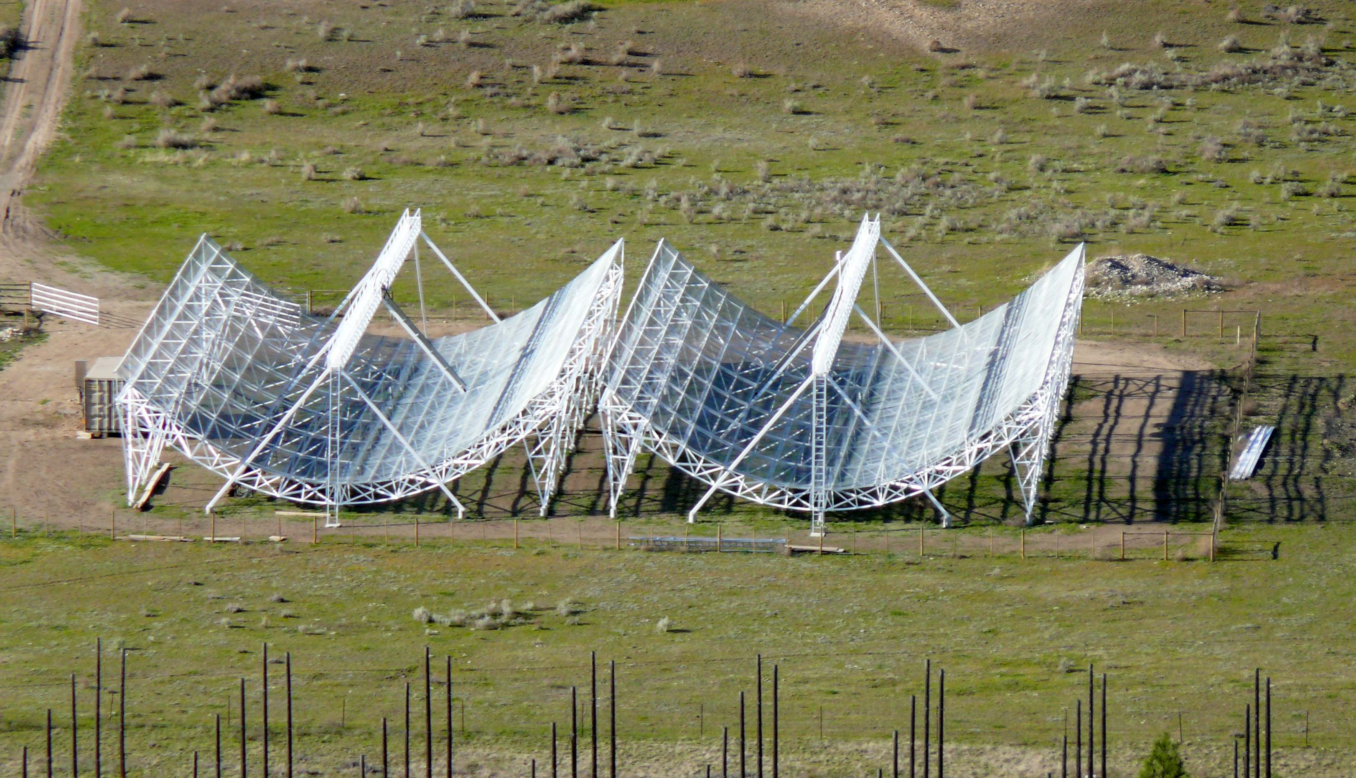
CHIME-Pathfinder

Slide 5
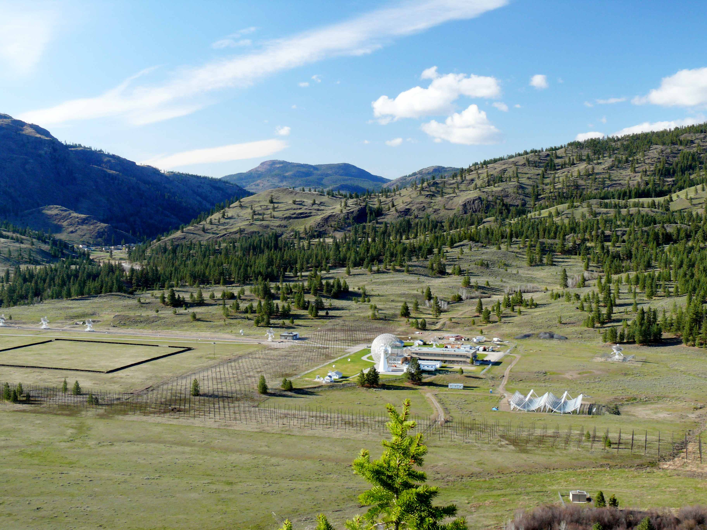
CHIME-Whole Site
Synthesis Radio Telescope
Next Generation Solar Flux Monitor
Remains of 22 MHz Array
Pathfinder
Site for CHIME
Solar Flux Monitors
26m Radio Telescope

Slide 6
Interference Monitor
0.5-40 GHz ELINT Antenna
A system for monitoring base noise levels in bands of interest and for identifying interfering signals of particular interest. SDR technology makes the system very adaptive.
Calibration Noise Source
20dB Directional Coupler
0.5-18 GHz LNA
Ettus B200 SDR Device (10MHz-6GHz)
Can measure integrated power and spectra up to 50-MHz wide anywhere in tuning range.
Can skip around monitoring different frequency bands.
Can demodulate/decode pretty near anything.
Will use for interference identification and also monitoring background noise level in various bands.
Currently the RF amplifier cannot completely use the antenna’s capabilities and the B200 cannot exploit the full band of the RF amplifier or antenna. However, components will be replaced as possible and as required. The antenna was the expensive component.
Linux Computer Running gnu-radio/simple_ra software
Network

Slide 7
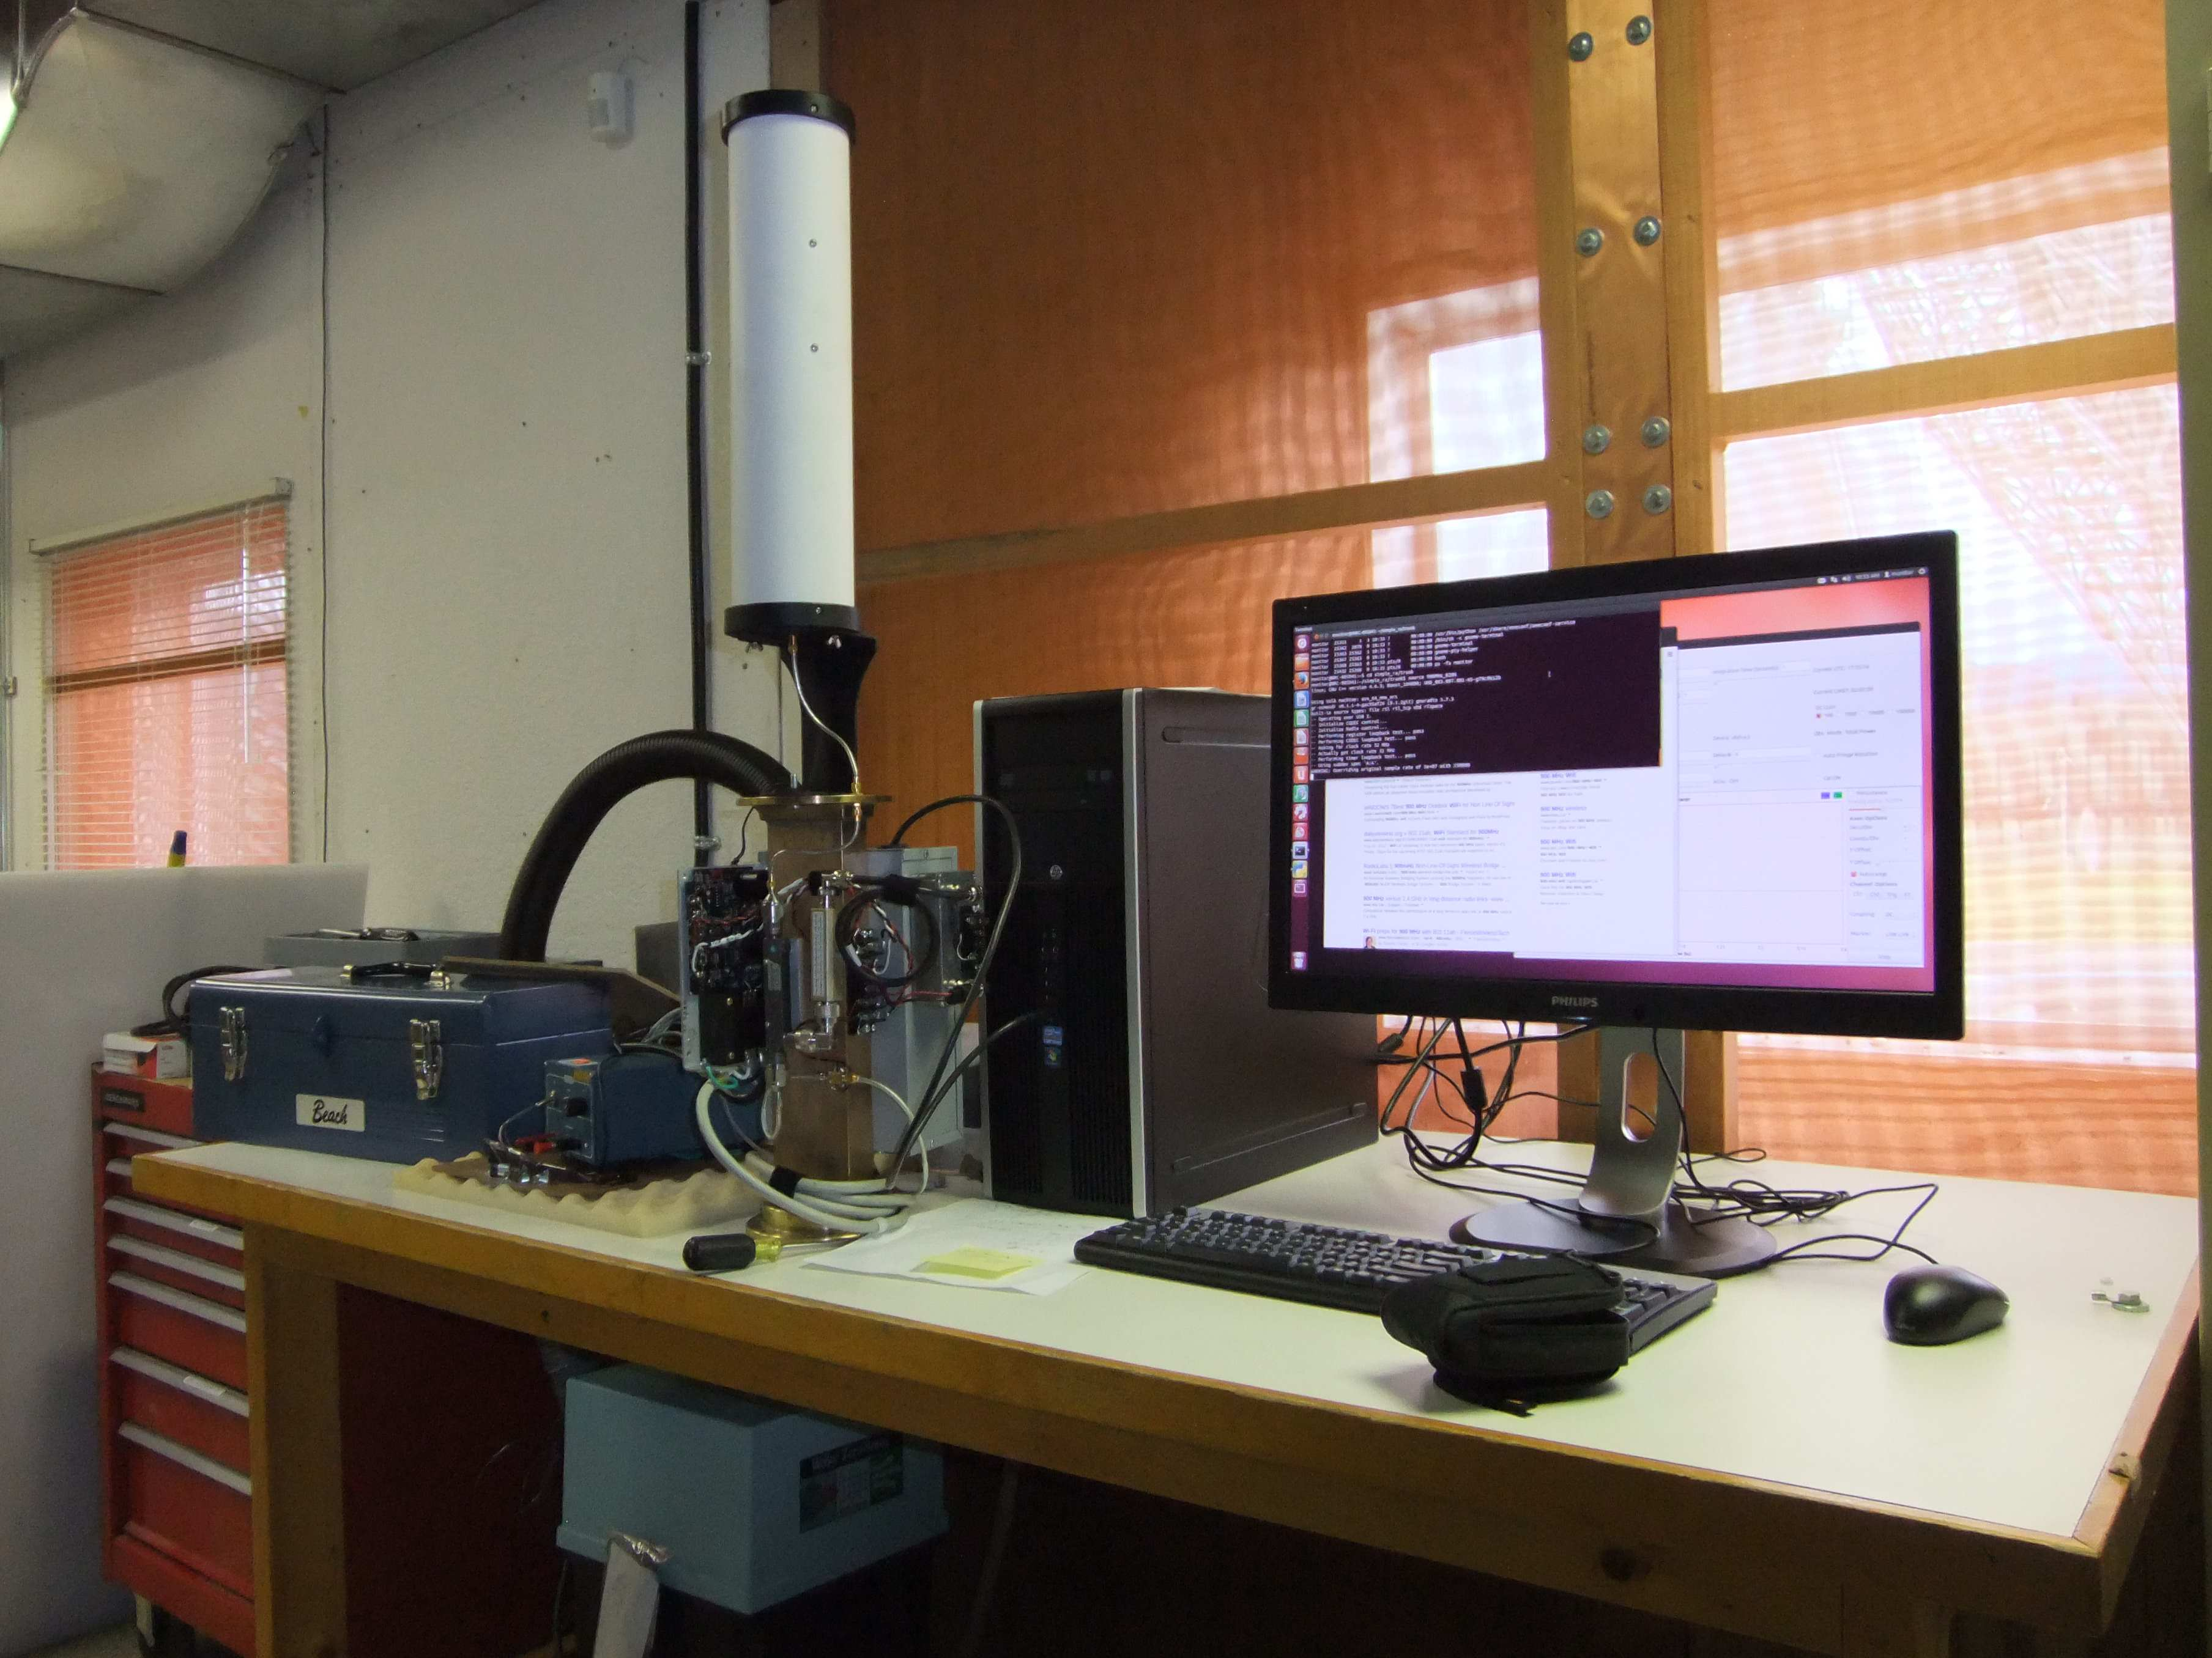
Interference Monitor

Slide 8
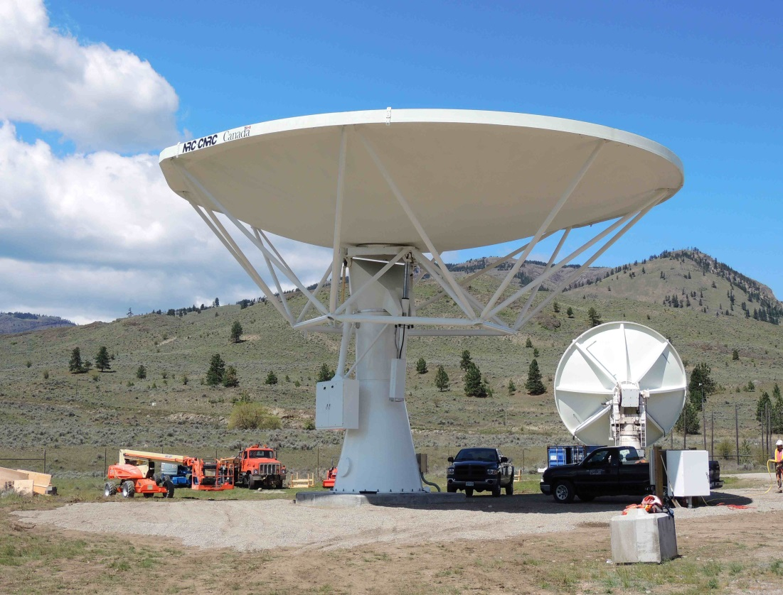
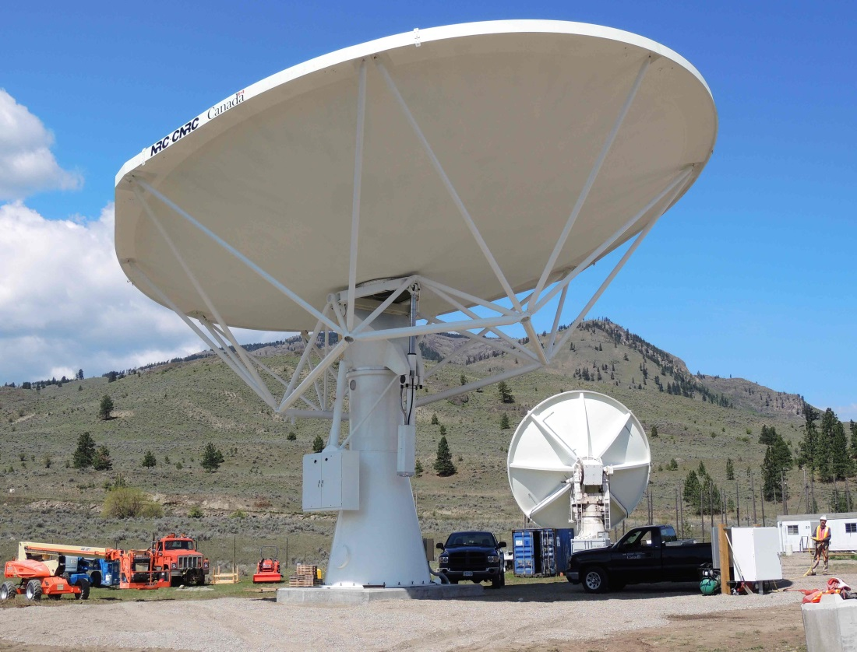
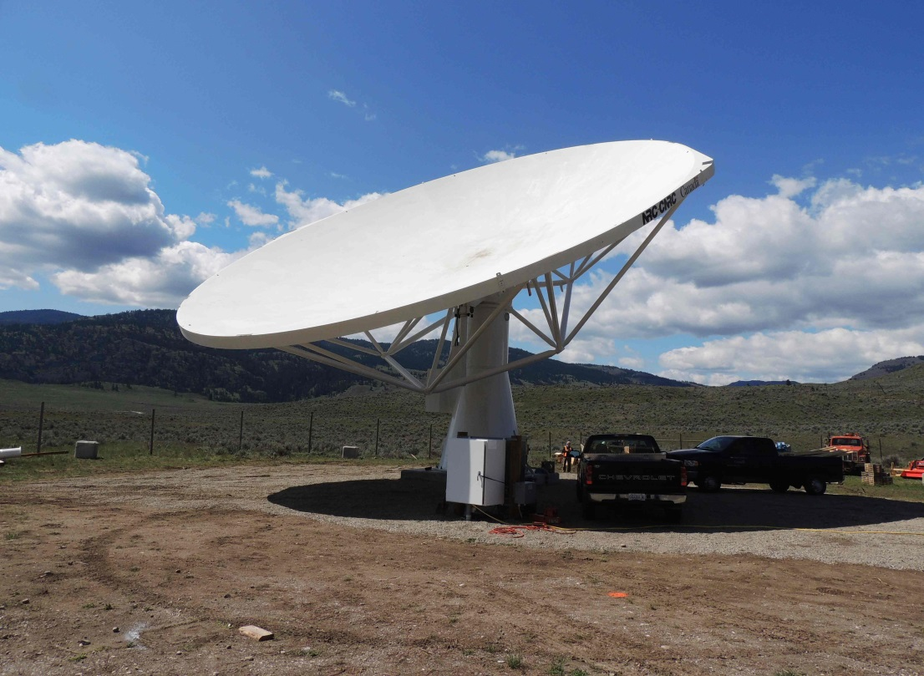
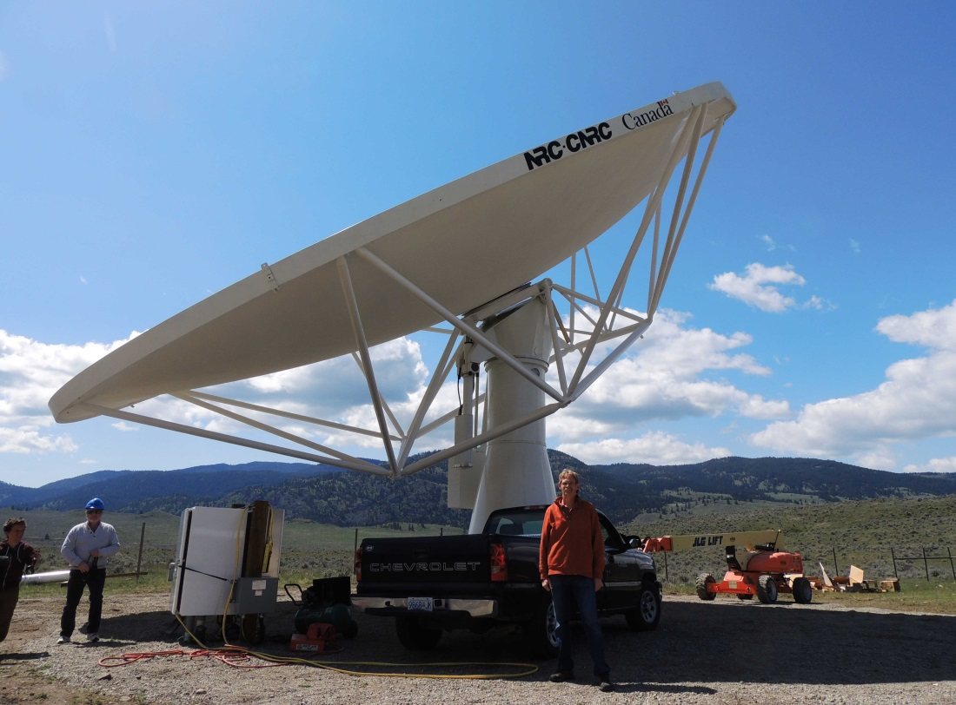
SKA Antenna Prototype

Slide 9
Smart Electricity Meters
The British Columbia electricity utility wants to deploy “smart electricity meters”.
These form a peer-pear network transmitting and relaying data across the network to nodes.
They use the 900 MHz band.
This is close to the CHIME band and could splatter into it. The third harmonic falls in the pass band of our solar radio flux monitors, which produce the F_{10.7} data.
Industry Canada told the utility they must liaise with us as to where the new system may and may not be deployed.
We are doing an interference study to assess the potential threat to DRAO and what sort of deployment would be acceptable (Beyond what range? In what communities?)
Electricity Company

Slide 10
Smart Electricity Meters
N= No Transmitters per km²
P = Mean Power per Transmitter
r
dr
R_{Max}
R_{min}

Slide 11
Smart Electricity Meters
Estimated Interference Levels
Interference sources start 2km away (the community of St Andrews, and end at 100km on a flat Earth.
They individually transmit 1% of the time (randomly distributed).
They are distributed 10 per square kilometre.
Unwanted emission data provided by the manufacturers
Transmitter power +28dBm
Bandwidth = 300kHz
Modulation envelope with sin²(x)/x² roll-off.
Victim | Freq | Threshold | One | Many
CHIME | 800 MHz | -232 dB(W.m⁻².Hz⁻¹) | -214 dB(W.m⁻².Hz⁻¹) | -174 dB(W.m⁻².Hz⁻¹)
CHIME | 900 MHz | -231 dB(W.m⁻².Hz⁻¹) | -158 dB(W.m⁻².Hz⁻¹) | -119 dB(W.m⁻².Hz⁻¹)
F_{10.7} | 2800 MHz | -220 dB(W.m⁻².Hz⁻¹) | -212 dB(W.m⁻².Hz⁻¹) | -200 dB(W.m⁻².Hz⁻¹)
We’re still in the process of making assessments for the other bands used at DRAO. To do this we need more test data, because current information not good enough for extrapolating that far. Need to do 408MHz and 1420MHz.

Slide 12
Other Things
Canada has still to find/coerce/persuade/force a new person to take on the mantle of radio astronomy spectrum manager.
In the “interim” I am still stuck to the Tar Baby for the important stuff, and formally involved with local DRAO issues.
The background noise level produced by multiple sources is a major interest in Canada. Industry Canada has a monitoring system running at DRAO. We are implementing a system of our own as well. It’s not clear how we can address this issue or whether it is solvable at all.
We are working more intensely with the local offices of Industry Canada and also nationally on studies of water and electricity meter networks and similar systems.
Leap seconds…enough said. This issue is now being spearheaded by the national time standard people at NRC.
How do we manage facilities like CHIME, which have to use bands not allocated to radio astronomy? Are local spectrum management agreements workable?

