Slide 1
NASA Domestic Issues & Future Earth Observation Missions
John Zuzek
29-May-2014

Slide 2
NASA Domestic Issues & Future earth observation missions
CORF Spring 2014 Meeting
29-May-2014
John Zuzek, NASA
National Spectrum Program Manager

Slide 3
Outline
NASA Domestic Spectrum Issues
Cubesats, Nanosats, Picosats, Oh My!
Domestic Broadband Initiatives
Active Sensing Issues
Planned/Future NASA Earth Observation Missions
AIRMOSS
GPM
ISS RapidSCAT
OCO-2
SMAP
SWOT
IN-SAR
ACE

Slide 4
Domestic spectrum issues

Slide 5
Cubesats, Nanosats, Picosats – Oh My!
Cubesats, Nanosats, Picosats and other names for very small satellites that are very inexpensive to develop, build and operate
Launched opportunistically as “ride-along” payloads with major space payloads
NASA Launch Services helps facilitate these opportunistic launches
NASA funds many Cubesat programs with Universities
At issue is who owns and operates the transmitters onboard the satellites
If owned and operated by the federal government, must be licensed through NTIA; else, must be licensed through FCC
Must be filed internationally (all satellites) but often ignored by Cubesat operators
Non-government Earth observation instruments must be licensed though NOAA

Slide 6
Domestic Broadband
U.S. Broadband initiatives all seek to enhance the broadband (i.e., high-speed) access to the Internet (smartphones, WiFi, etc.)
All of these actions will require additional spectrum access for wireless broadband service providers in private sector, generally below 6 GHz and particularly below 3.5 GHz (eventually may go up to 10 GHz)
Risk to NASA spectrum use either through taking spectrum from space research and Earth exploration-satellite frequency bands or from moving other users into frequency bands used by NASA
Currently the FCC will auction the 1695-1710 MHz and 1755-1780 MHz bands in the next Advance Wireless Service (AWS-3) auction end of CY 2014
NASA efforts and studies have lead the U.S. to take the S-band satellite frequencies (2025-2110 MHz and 2200-2290 MHz) off the table for now
Google, Cisco, Intel, Microsoft want more spectrum for WiFi and have targeted the 5350-5470 MHz band used by SAR active sensors such as Radarsat (Canada) and Sentinel (ESA)

Slide 7
Active Sensing Issues
Three NASA remote sensing missions are using or will use the 1215-1300 MHz band for active sensing applications
Aquarius (operational), whose primary focus is on measuring ocean salinity, will use a scatterometer
Soil Moisture Active Passive (SMAP), whose primary focus is on measuring soil moisture content, will use a somewhat different scatterometer
IN-SAR (Joint ISRO/NASA mission), whose primary focus is measuring Earth surface and ice sheet deformation using an L-band synthetic aperture radar (SAR)
FAA and AF operate important air surveillance radars in this band and these active sensing instruments could potentially cause harmful interference to these radars
SMAP scatterometer design has been adjusted to help mitigate interference to air surveillance radars
Other international L-band missions causing FAA concern
GPS also operates in the 1215-1260 MHz portion of this frequency band and space-based radars are required to protect operation of GPS receivers
JPL tested various active radar signals into certain high-precision semi-codeless GPS receivers and results were fairly positive
GPS proponents now expressing concern that the aggregation of interference from multiple active sensors may cause harmful interference to GPS receivers

Slide 8
Planned/future NASA earth observation missions

Slide 9
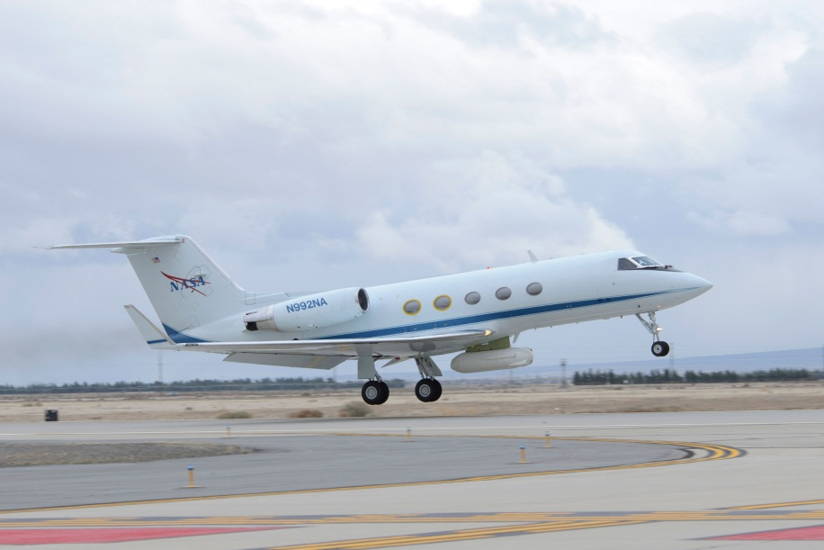
AIRMOSS Airborne Radar
NASA P-band Airborne SAR
Will fly missions periodically over boreal forest areas
Begin Date: June-2012
Altitude: 12.5 km
Polarization: H, V
RF Center Freq: 430 MHz
RF bandwidth: 20 MHz
Pulsewidth: 40 μsec
Pulse repetition freq: 1200 Hz
Xmt Pwr: 2.34 kW Pk
Chirp rate: 0.5 MHz/μsec
Transmit Duty Cycle: 4.8%
Airborne Microwave Observatory of Subcanopy and Subsurface (AIRMOSS) will use an airborne SAR that has the capability to penetrate through substantial vegetation canopies and soil to depths down to approximately 1.2 meters.

Slide 10
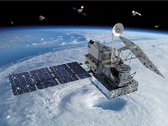
Global Precipitation Measurement (GPM)
NASA/JAXA Earth observation mission follow-on to TRMM
Dual frequency Precipitation Radar instrument
Launch Date: February 27, 2014
Orbit at 407 km and 65° inclination
Polarization: N/A
RF Center Freq: 13.597, 13.603 & 35.547, 35.553 GHz
RF bandwidth: 14 MHz
Pulsewidth: 1.6 μsec
Pulse repetition freq: 4206 (Ku) & 4275 Hz (Ka)
Xmt Pwr: 986 W (Ku) & 147 W Pk (Ka)
Chirp rate: 8.75 MHz/μsec
Transmit Duty Cycle: 0.67%
Radiometer operates at 10.65, 18.7, 23.8, 36.5, 89, 165.5 & 183.31 GHz
GPM concept centers on the deployment of a “Core” satellite carrying an advanced radar / radiometer system to measure precipitation from space and serve as a reference standard.

Slide 11
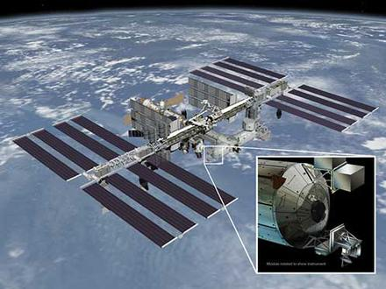
ISS RapidSCAT
NASA Scatterometer onboard the International Space Station
Radar Scatterometer
Launch Date: June 6, 2014
ISS Orbit nominally at 375-435 km and 51.6° inclination
Polarization: N/A
RF Center Freq: 13.402 GHz
RF bandwidth: 430 kHz
Observation swath of 900 km
Pulsewidth: 1.0 msec
Xmt Pwr: 80 W (Peak)
Chirp rate: 250 kHz/msec
Antenna size: 0.75m
Antenna rotation rate: 18 rpm
The ISS-RapidScat instrument is a speedy and cost-effective replacement for NASA's QuikScat Earth satellite, which monitored ocean winds to provide essential measurements used in weather predictions, including hurricane monitoring.

Slide 12
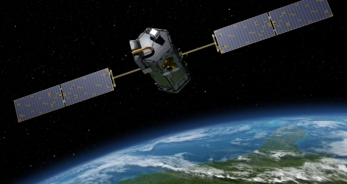
Orbiting Carbon Observatory (OCO-2)
NASA replacement carbon observatory for failed launch
Spectrometers will measure sunlight reflected off the Earth’s surface
Employs crycoolers to keep temparature stability for instruments
Launch Date: July 1, 2014
Sun-synchronous orbit of 705 km with 98.2° inclination
TT&C will be in S-band (2035.3179 MHz uplink and 2210.3 MHz downlink)
Data downlinks in X-band (8115.2534 MHz with 150 MHz bandwidth to Fairbanks, AK and Wallops Island, VA)
Orbiting Carbon Observatory-2 (OCO-2) will be NASA’s first dedicated Earth remote sensing satellite to study atmospheric carbon dioxide from Space. OCO-2 will be collecting space-based global measurements of atmospheric CO₂ with the precision, resolution, and coverage needed to characterize sources and sinks on regional scales.

Slide 13
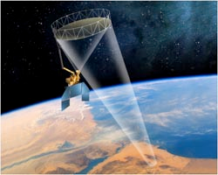
Soil Moisture Active Passive (SMAP)
NASA Soil Moisture Active Passive (SMAP) Mission
L-band scatterometer instrument
Launch Date: November 5, 2014
Polar orbit at 670 km and 98° inclination with 3 day repeat
Polarization: Dual, Linear H & V
RF Center Freq: 1217.25-1297.75 MHz
RF bandwidth: 1.4 MHz
Pulsewidth: 40 μsec
Pulse repetition freq: 3500 Hz
Xmt Pwr: 250 W Pk
Chirp rate: 0.025 MHz/μsec
Transmit Duty Cycle: 14%
Antenna diameter = 6 meters
Radiometer operating at 1413.5 MHz (27 MHz Bandwidth)
SMAP will utilize a frequency hopping scheme to mitigate interference to/from terrestrial radars operating in this band.

Slide 14

Surface Water and Ocean Topography (SWOT)
NASA/CNES Follow-On Mission to JASON-1, 2, 3
KaRIN, a Ka-band radar interferometer instrument
JASON-class dual-frequency (C and Ku-band) altimeter
3-frequency radiometer similar to Advanced Microwave Radiometer (AMR) on OSTM
Projected Launch Date: 2020
Orbit at 970 km and 78° inclination with 1-3 day repeat
Polarization: Dual
KaRIN RF Center Freq: 35.6 GHz
RF bandwidth: 200 MHz
Pulsewidth: 5.1 μsec
Pulse repetition freq: 4400 Hz
Xmt Pwr: 1.5 kW Pk/33.66 W Avg
Chirp rate: 39.22 MHz/μsec
Transmit Duty Cycle: 2.24%
SWOT satellite mission and its wide-swath altimetry technology are a means of completely covering the world's oceans and freshwater bodies with repeated elevation measurements.

Slide 15
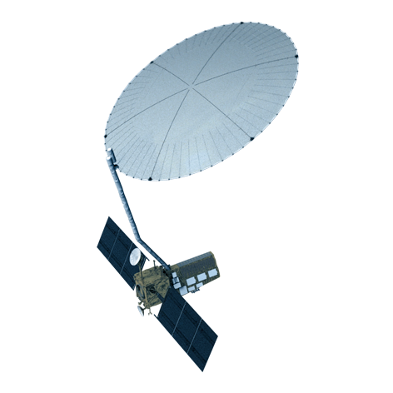
NASA/ISRO SAR (NI-SAR)
NASA/ISRO Joint Mission using interferometric SARs
Status: Pre-Formulation
L-band and C-band SAR instruments
Projected Launch Date: 2021
Polar orbit at 7547 km and 98° inclination with 8 day repeat
Polarization: Dual, Linear H & V
RF Center Freq: 1215-1300 MHz
RF bandwidth: 25 MHz
Pulsewidth: 60 μsec
Pulse repetition freq: 3200 Hz
Xmt Pwr: 3.2 kW Pk/614.4 W Avg
Chirp rate: 0.42 MHz/μsec
Transmit Duty Cycle: 19.2%
Antenna diameter = 15 meters
The mission uses repeat-pass InSAR techniques for surface deformation and ice sheet dynamics measurements, and polarimetric SAR for biomass estimation.

Slide 16
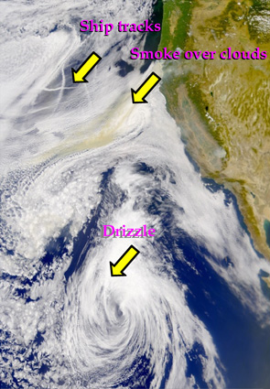
Aerosol - Cloud – Ecosystems (ACE)
NASA Earth observation mission using a Multi-angle Polarimeter Doppler Radar
Dual frequency cloud profiling radar
Projected Launch Date: 2020+
Polar orbit at 650 km and 98.2° inclination
Polarization: TBD
RF Center Freq: 35.6 & 94.1 GHz
RF bandwidth: 2.5 & 7.5 MHz
Pulsewidth: 1.67 μsec
Pulse repetition freq: 7700 & 5600 Hz
Xmt Pwr: TBD kW Pk/TBD W Avg
Chirp rate: 1.54 & 4.5 MHz/μsec
Transmit Duty Cycle: 1.2 & 0.94%
ACE will help to answer emerging fundamental science questions associated with aerosols, clouds, air quality and global ocean ecosystems.

Slide 17
Questions???

