Slide 1

National Science Foundation
Division of Physics
C. Denise Caldwell
Division Director
Presentation to the Plasma Science Committee, July 2014

Slide 2
Plasma Physics Program - Overview
NSF/DOE Partnership in Basic Plasma Science & Engineering (solicitation NSF 13-596)
in existence since 1997, under interagency MOU
combined funding level $2.1 M FY13 (new starts)
NSF ( 7 programs), DOE BPS, & AFOSR
12% of submissions funded
NSF Career Awards
5 yr grants, 8 awarded since 2005, young faculty
Conference/Workshop grants

Slide 3
Scientific Focus
The Plasma Physics Program embraces the diversity and dynamism of the plasma physics field
Some key science questions for the field:
How does anti-matter behave?
Where are the new frontiers for plasmas in biology & medicine?
Where are we headed with plasma systems in nanoscale manufacturing?
Where will fundamental knowledge lead with plasmas for combustion, lighting & displays?
Why do some planets & stars have strong surface magnetic fields and others do not?
What is the origin of coronae and winds in virtually all stars, including the Sun?
How are magnetic fields generated in stars, galaxies, and clusters?
How does the addition of charged dust affect plasma behavior?
Can plasma processes lead to room sized high energy particle accelerators?

Slide 4
Current Plasma Physics Portfolio
HED/LPI … 18 projects
Low Temperature … 21 projects
Turbulence, etc. … 20 projects
Reconnection … 13 projects
TOTAL … 72 projects
Thru end of FY13

Slide 5
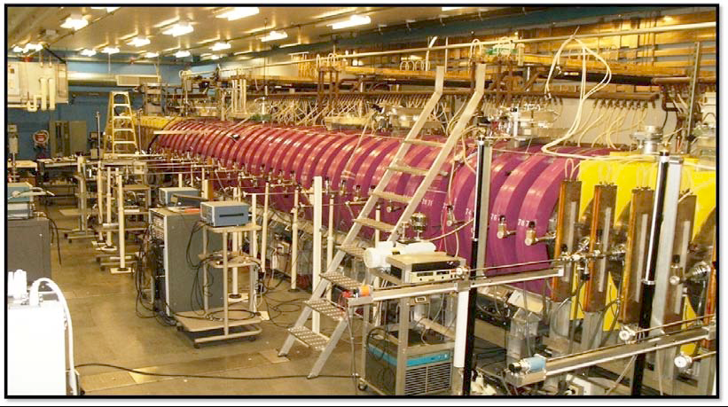

Plasma Program – research areas
Basic Plasma Science Facility at UCLA was renewed thru 2016 … shared funding between DOE Office of Science & several NSF divisions
NSF – PHY 1036140 – Walter Gekelman, PI

Slide 6
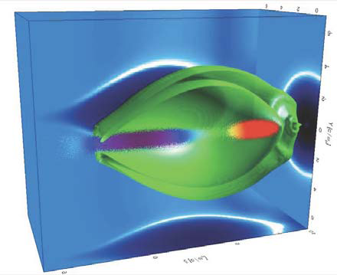
Plasma Program – research areas
Simulations of Plasma Wake Field Accelerator experiments at FACET*
Figure 1. Illustration plot of a two-bunch PWFA in the "Blow-Out" regime. This plot is a combination of (a) the plot of cross-section of the plasma electron density (three blue plots on the walls), (b) three dimensional contour surface of the plasma electron density (green surfaces which stand for the inside and outside surfaces of the plasma electron sheath around the bubble) and (c) the beam particles (plotted as colored dots
NSF – PHY 0936266 -- PI Chan Joshi; this work … University of California Los Angeles, CA, USA, Los Alamos National Laboratory, NM, USA, Stanford Linear Accelerator Center, CA, USA, Instituto Superior Tecnico, Lisboa, Portugal

Slide 7
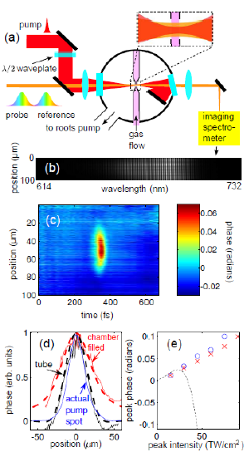
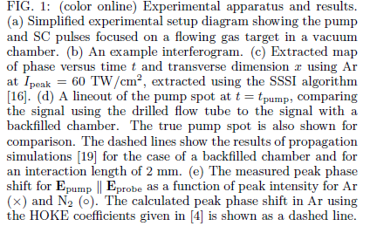
Plasma Program – research areas
Optical nonlinearity in Ar and N2 near the ionization threshold … measured with 10 fs time resolution and micron space resolution … impacts for example propagation of intense laser pulses in gases
NSF – PHY 0904302 -- PI Howard Milchberg; this work … University of Maryland, College Park MD

Slide 8
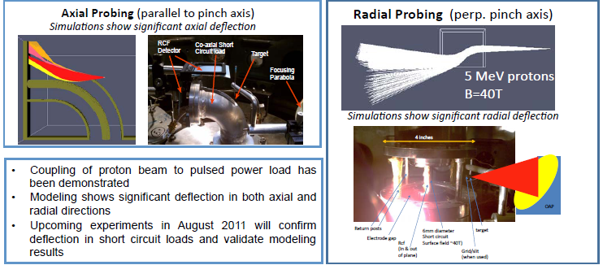
Plasma Program – research areas
“Assessment of Proton Deflectometry for Exploding Wire Experiments”
Proton deflectometry has the potential to recover details of the B-field configuration vital to accurate interpretation and simulation of these systems
NSF – PHY 0903876 -- PI Farhat Beg; Co-PIs Mingsheng Wei & Simon Bott; University of California San Diego, CA, USA

Slide 9
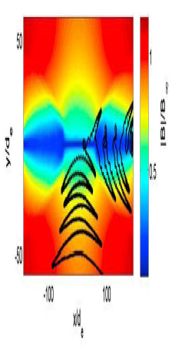
Plasma Program – research areas
Three-Dimensional Onset and Evolution of Spontaneous Reconnection
Figure based on a kinetic simulation shows a typical trajectory of a trapped electron in anti-parallel reconnection overlaid on contours of constant |B|
NSF – PHY – 0844620 – Jan Egedal-Pedersen, PI – MIT

Slide 10
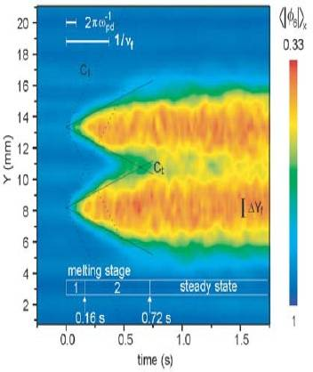
Plasma Program – research areas
Evolution of shear induced melting in dusty plasma
“Melting is a kind of disorder. We measured disorder locally, in each video frame. Then we prepared this graph which shows how disorder spreads. There is a melting front that moves through the crystalline lattice. Previously nobody knew whether it would propagate at the speed of transverse or longitudinal waves or not at any fixed speed at all due to thermal diffusion. We found it had the fixed speed of the transverse wave.”
NSF – PHY – 0903501 – John Goree, PI – this work was published in PRL with co-authors Yan Feng , John Goree & Bin Liu – University of Iowa

Slide 11
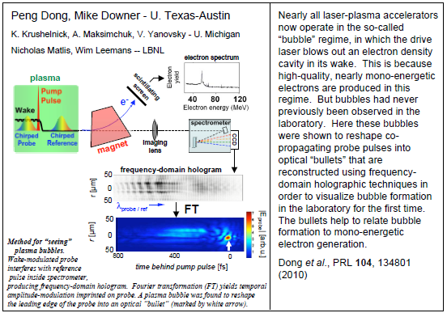
Plasma Program – research areas

Slide 12
MPS Budgets
FY 2014
FY 2015
FY 2012
– 4.5%
FY 2013
+4.0%
-0.3%
$ 1300 M
$ 1296 M
(request)
$ 1309 M
$ 1250 M
(estimate)
2.8%
5.2%
vs. FY13
1.6%
3.6%
2.4%
FY12
Amount (Millions)
FY13
FY14
FY15
AST
CHE
DMR
DMS
PHY

Slide 13

FY 2014 Budget Estimate
Physics Division Estimate for FY 2014 is $266.3 M
Approximately 2% for Operations -
Panels, IPA Appointments, IPA Travel, M&S
Approximately 30% for M&O for Facilities –
ATLAS and CMS, IceCube, LIGO, NSCL
Approximately 8% for Physics Frontiers Centers – Competition Underway
Approximately 3% for Education and Broadening Participation –
REU Sites, LIGO Education Center, QuarkNet
Leaves 57% ($152 M) to Cover Major Areas of Physics –
Experimental and Theoretical
Base Programs Essentially Flat with Respect to FY 2013

Slide 14
FY 2015 NSF Budget Request to Congress

Slide 15
R&RA – Research and Related Activities
(Direct Support for Research and Facilities Operations)
MPS is 22.3% of Total

Slide 16
FY 2015 MPS Budget Request to Congress

Slide 17
Reaching Out Across NSF
Benefit through MRI
e.g. MRI: Development of Magnetized Dusty Plasma Device
PHY-1126067, Auburn, Edward Thomas, PI
MRI: Consortium: Development of A Large Plasma Device for
Studies of Magnetic Reconnection and Related Phenomena
Key Player in CIF21 through CDS&E
Revamped Computational Physics to Focus on New Approaches
to Computation Driven by Science Questions
Stressed Overlap with Disciplinary Programs in Division
Worked Closely with Program in Advanced Cyberinfrastructure
e.g. SI2-SSI: Particle-in-cell and kinetic simulation center
ACI-1339893, UCLA, Warren Mori, PI
Launched New Program in Accelerator Science
University-Based Program with Focus on Education
Seeking New Paradigms
Currently Reviewing 50+ Proposals

Slide 18
Five Perspectives on the Frontiers of Physics
Controlling the Quantum World– Electromagnetic radiation in the non-classical limit,
Entanglement, Cavity QED, QIS, Optomechanics
Complex Systems and Collective Behavior – Living cells, biological systems,
ultracold fermions and bosons, quark-gluon liquid
Neutrinos and Beyond the Higgs – Neutrino mass, new particles, unification
of quantum mechanics and gravity, electron and neutron dipole moments
Origin and Structure of the Universe – Star formation and creation of the elements,
dark matter and dark energy, modeling of black holes, gravitational waves,
magnetic fields
Strongly-Interacting Systems– QCD computations, quark structure of baryons,
high-field laser-matter interactions, supernovae, strong gravity

