Slide 1
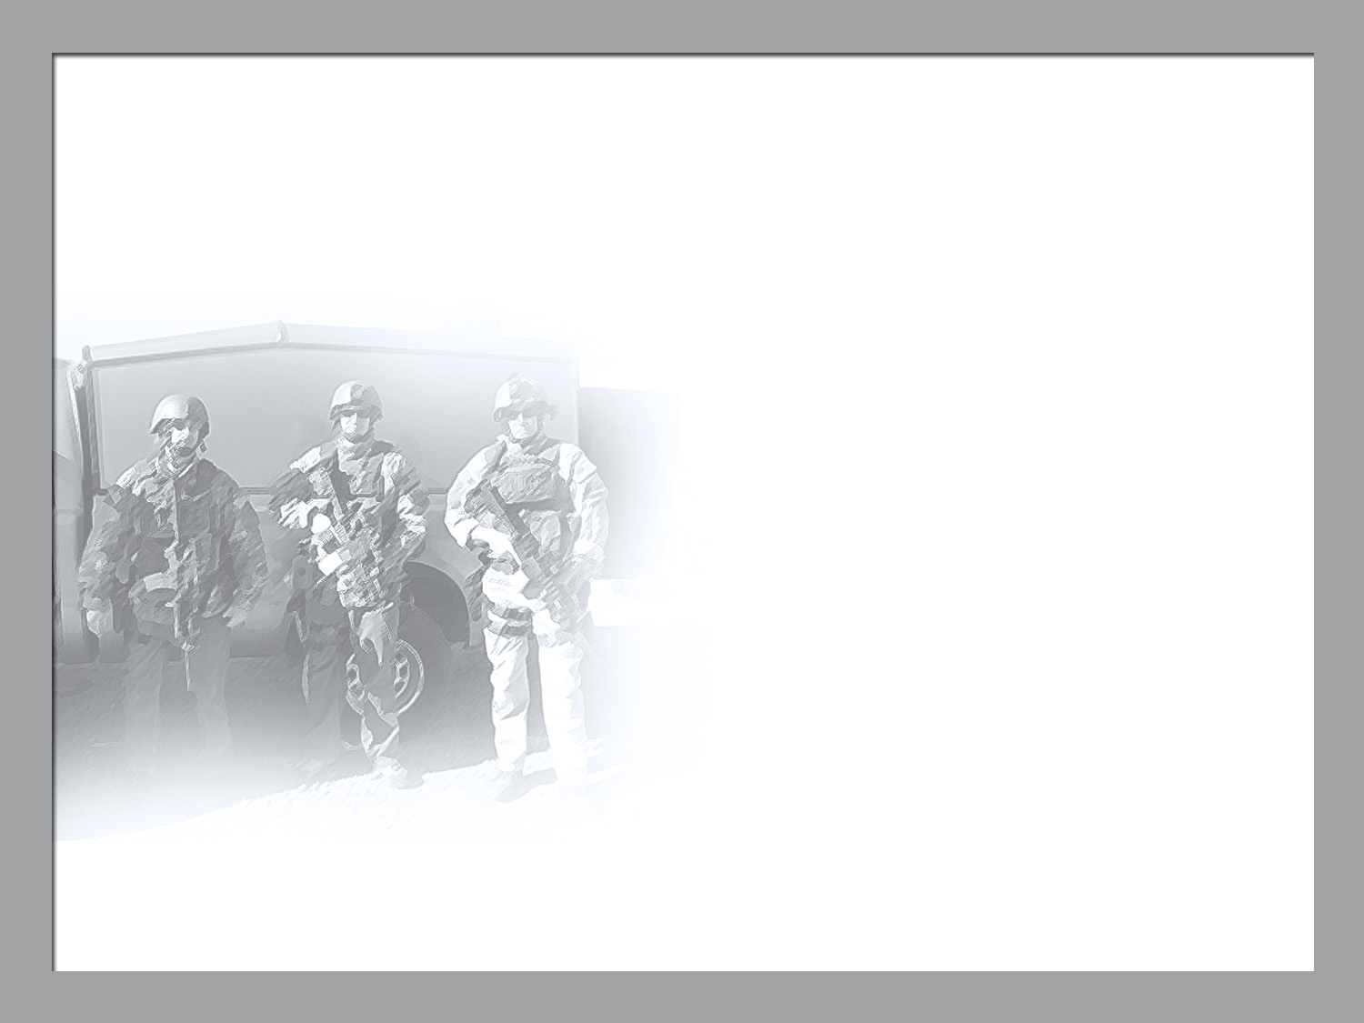

NATIONAL NUCLEAR SECURITY ADMINISTRATION OFFICE OF DEFENSE PROGRAMS
Status of the NNSA High Energy Density Physics Program
Presented to:
National Academy of Sciences
Board on Physics and Astronomy
Spring Meeting
Washington, DC
Presented by:
Kirk Levedahl, PhD
Program Manger in the NNSA Office of Inertial Confinement Fusion
April 24, 2015

Slide 2
NNSA has successfully transformed the ICF program to a program focused on HED science in support of DOE’s mission
Principal source of success gained through FFRDC leadership of a peer community of scientists.
2009 Beginning of Diagnostics Working Group led by Joe Kilkenny, GA
NNSA/SC workshop on “Basic Research Directions for User Science at the National Ignition Facility (NIF).” report Nov 8, 2011
2012 Science of Fusion Ignition Workshop
2014 HED physics workshop – 150 participants [Abe Szoke to young presidential investigator grant winner – Bob Tipton discussing NIF experiments]
2014 Ignition summer study
2015 Advanced Diagnostics Strategy developed by Diagnostics working group and reviewed
Dan Clark and 3-D computing of NIF ignition
NIF operations improvements take leap forward – March 2015.
Agate Experiment (history dates back to when Justin Wark was a post-doc at LLE working with Kilkenny)
Rich Petrasso produces two Lawrence Award winners – March 2015

Slide 3
HED success requires
Mission need and mission fit – HED for long term health of stockpile stewardship.
Facilities and operations
NIF
Z
Omega
Jupiter
Trident
LCLS – MEC end-station
Computing
Targets
Diagnostics
People
Scientific Community

Slide 4
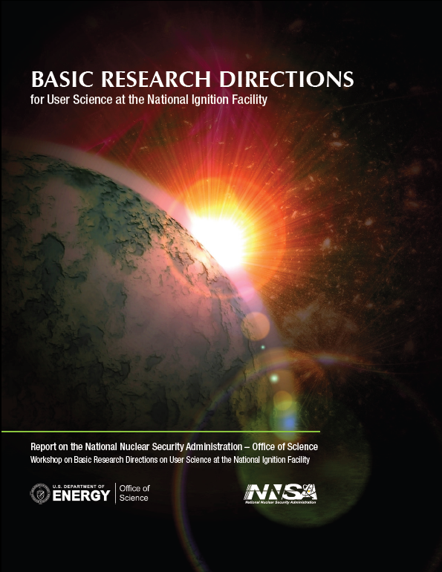
NNSA/Office of Science collaboration in HED science is critical to our program
Redirected JHEDLP to basic plasma and HED science
OFES committee of visitors determined that the JHEDLP was a model for how to run other solicitations.

Slide 5
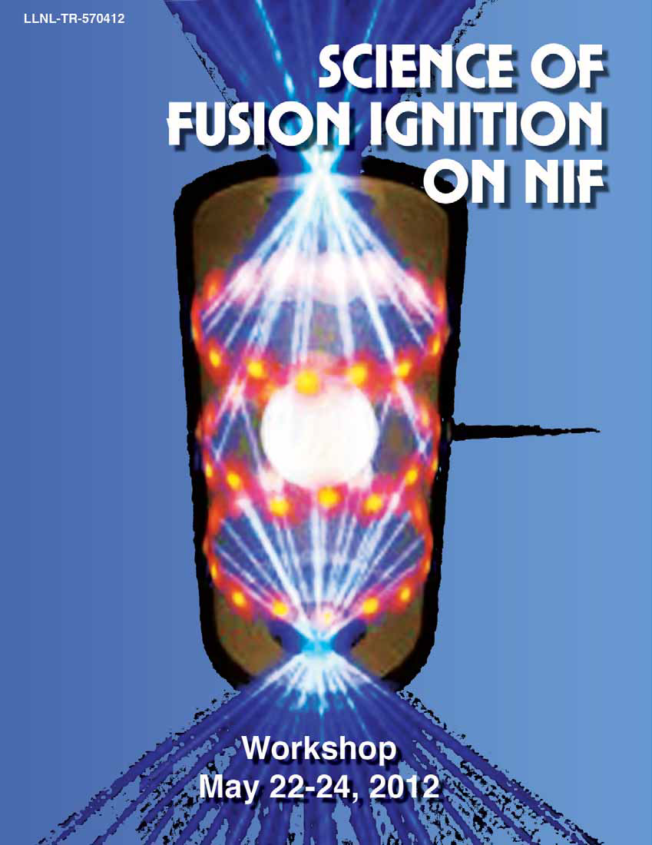
The NIF Indirect Drive Ignition approach has been focused on illumination of underlying physics issues
Primary focus since 2013 has been on understanding and controlling capsule implosion symmetry.
New x-ray sources developed for radiographic measurements demonstrate that implosion symmetry does not meet ignition requirements.
Lower convergence higher adiabat implosions being pursued to establish “known knowns.”
Platforms (diagnostics, targets, operating protocols) to support a campaign of experiments using three shocks being qualified
Two recent experiments with yields >9x10¹⁵ neutrons.
Mix experiments have been executed
E.g. C (n,γ) reaction produces 4.1 Mev gamma that can provide a measure of rho-R of ablator material mixed into dense fuel regions.
CD mix experiments have been conducted
~120 scientists from around the world met to identify key missing understanding & path to resolve

Slide 6
2014 HED workshop suggested a set of key experiments that could be done on NIF
X-ray crystallography of materials properties and phase changes at high pressures including recent Pu experiment. (fascinating history)
Opacities / atomic physics of mid and high Z materials at temperatures and densities (demonstrating the Fe opacity problem on Z illuminates a key astrophysics issue)
NLTE processes in an HED environment
Nuclear physics (light nuclei, fission fragments, ….) Nuclear fission of heavy nuclei from ground and excited states, in dense plasma conditions, and in the presence of ultrahigh fluxes of 14 MeV and 2 MeV neutrons and protons from capsule implosions.
Collisionless and astrophysical shocks. Kinetics in “hydrodynamic” shocks.
Physic of highly magnetized plasmas including implosion and explosion of magnetized targets.
Physics of stagnation, mix and burn
Experiments on mixing, turbulence and kinetic effects
Understanding hohlraums
X-ray lasers and their diagnostic uses

Slide 7
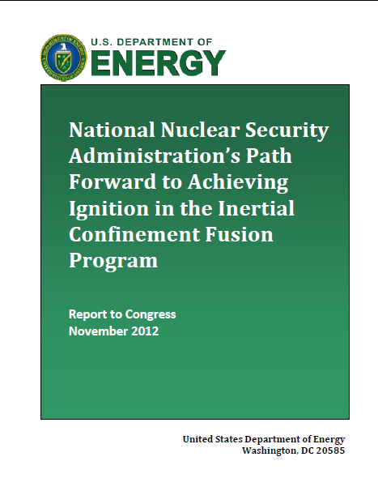
In Summer of FY 2015 we will review progress on the ICF program path forward.
Path Forward report laid out implementation for work in five areas:
Indirect Drive
Polar Drive
Magnetically-Driven ICF
Diagnostics
Targets
Review panels on:
Ignition
HED plans for weapons physics
Science Foundations

Slide 8
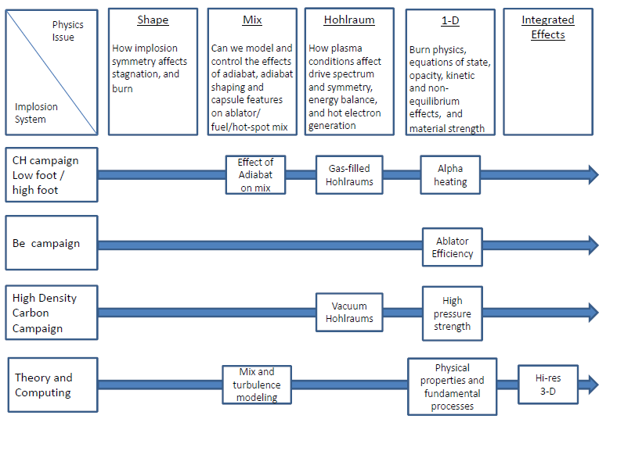
New approach to ignition

Slide 9
Systematic improvements in implosion quality
Y_{α}/Y_{no-α}
total neutron yield
fuel ρR (g/cm²)

Slide 10
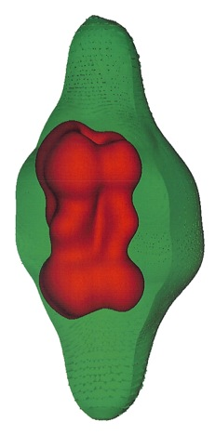
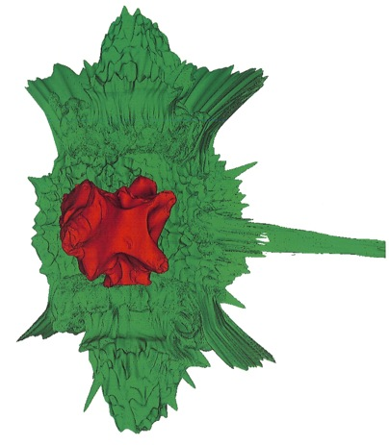
High Resolution 3-D simulations required to assess implosion features
asymmetries only
all perturbation sources
tent perturbation
fuel-abl.
interface
fill tube perturbation
hohlraum axis
T_{ion} = 2 keV
expt.
3.1 keV
4.2 x 10¹⁴
T_{ion} = 3.5 keV
Y₁₃₋₁₅ = 1.0 x 10¹⁵
2.7 keV
5.9 x 10¹⁴

Slide 11
Computing advances
3D implosion calculations for ignition implosions
Molecular dynamics simulations
DFT calculations of materials properties at high pressures
“Affordable” opacity models

Slide 12
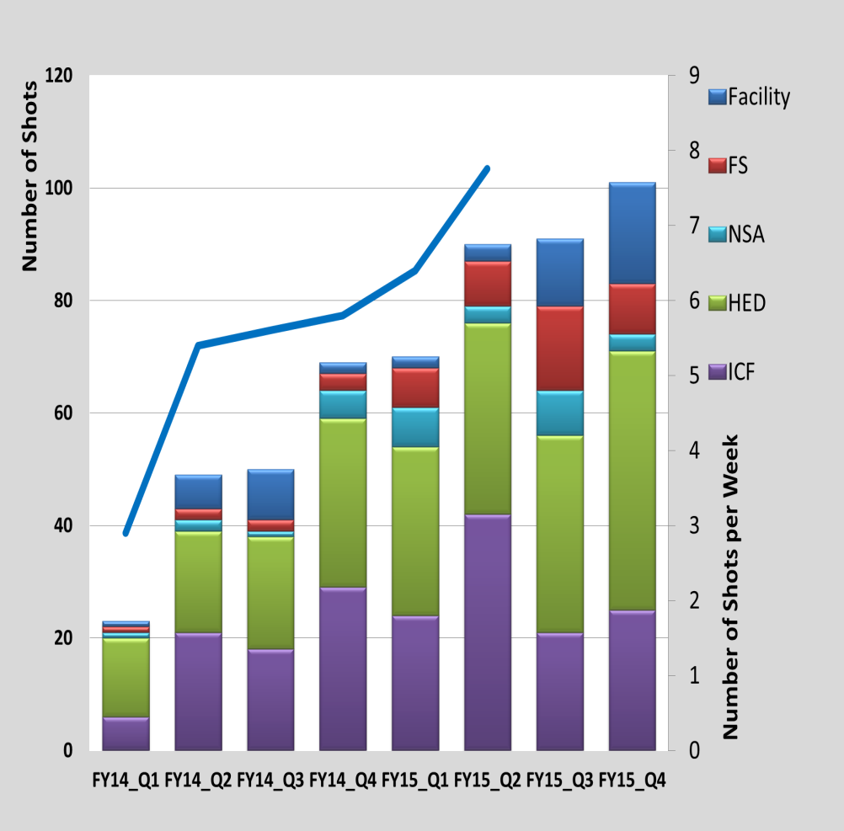
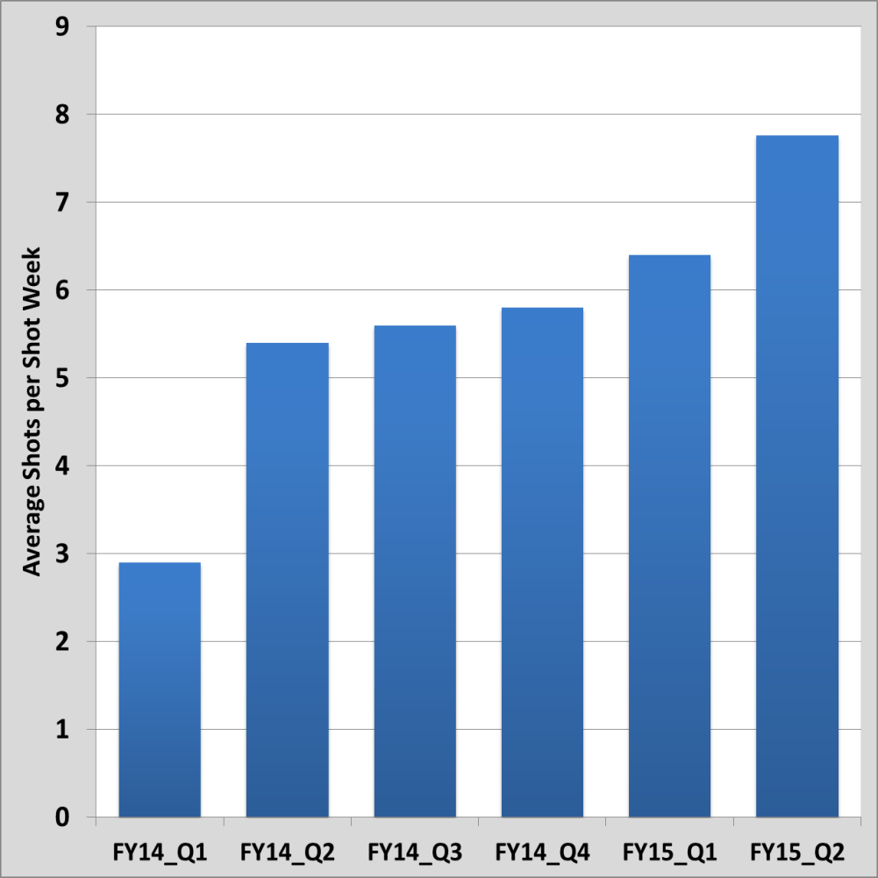
Operations: Steady increase of the shot rate through deliberate improvements
Target Shots (Actual thru Q2FY15)
Weekly shot rate
Start of 5 Day Shot Week
Actual
Planned
~40 % increase in shot rate
Since the January we have regularly added opportunity shots !
Notes:
Updated introduction

Slide 13
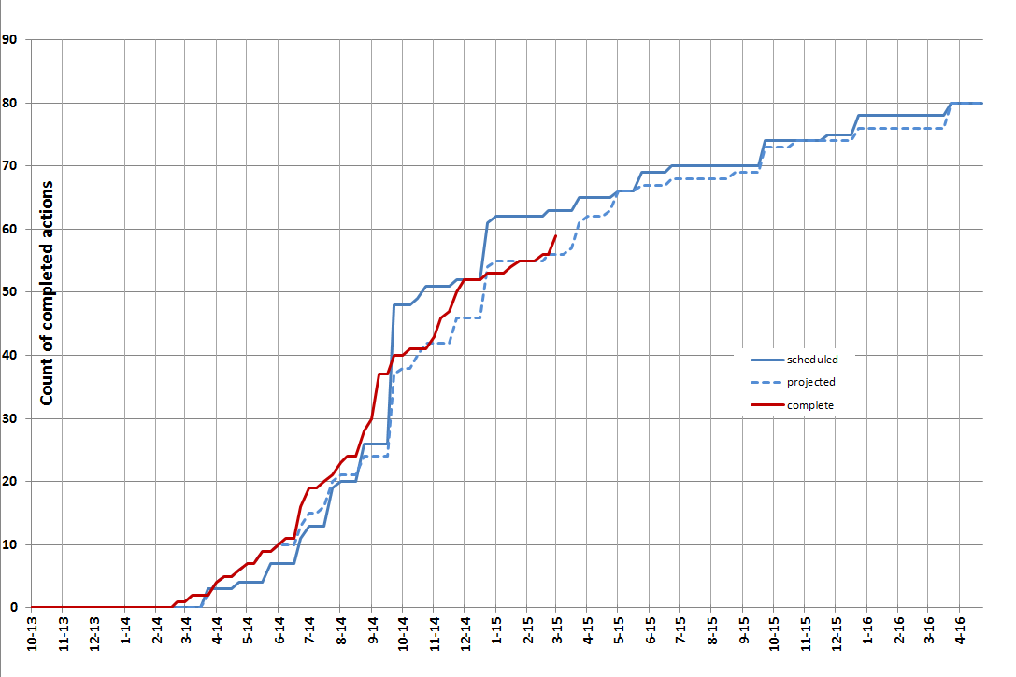
Improvements through execution of identified improvement projects
Good progress on milestones – 59 complete, 4 late

Slide 14
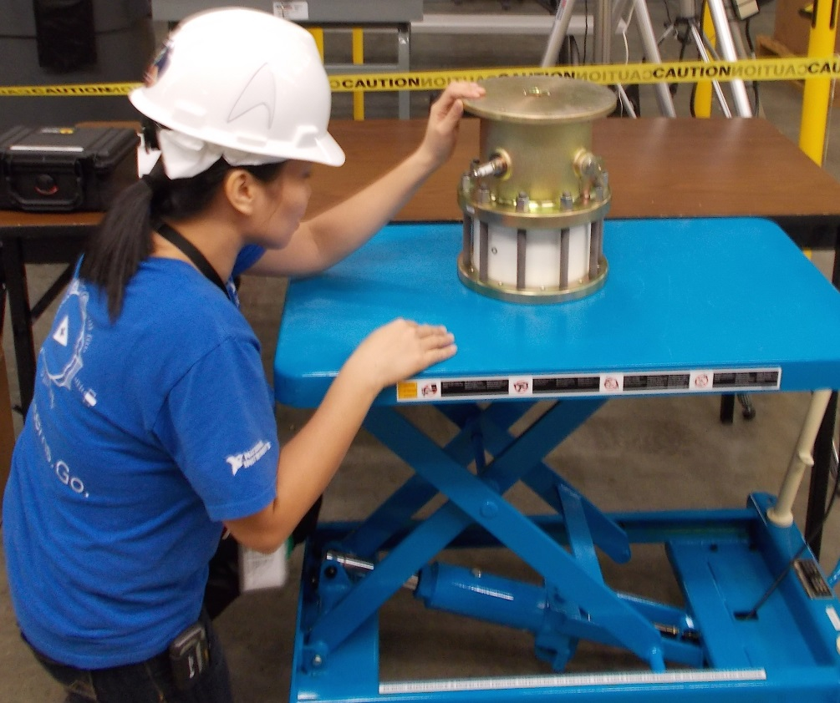
Example: Cross training continues to improve the efficiency of the NIF staff
Recently, facility/utility maintenance techs were trained to refurbish power conditioning system (PCS) switches
Doubled capacity of switch refurbishment
Improves PCS reliability by enabling earlier replacement of “marginal” switches
Offline task that can be done while Target Area is swept for shots
Two techs now trained to do this critical maintenance work: observe, participate, solo
They’ve done 20 switch replacements so far
Also enables increased rate of cross-training PCS operators
An engineering improvement in this area is to redesign the switch to more than double its useful life – testing in progress

Slide 15
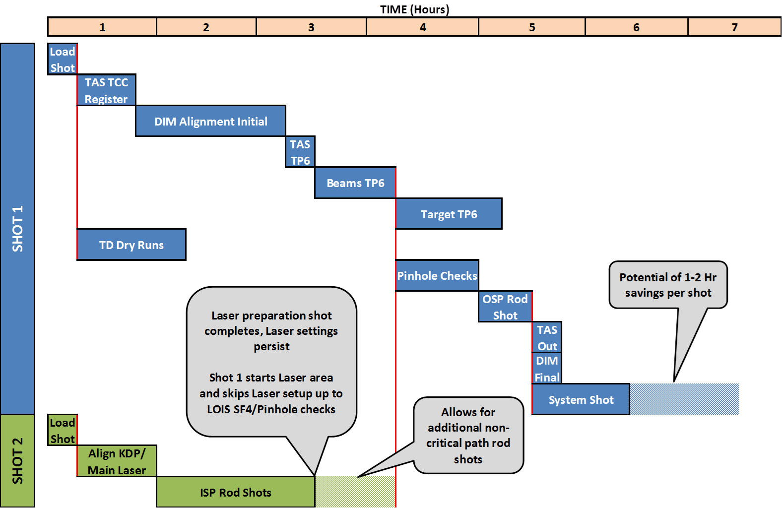
Example: Parallel laser qualification shots and target alignment
Potential of
~1 Hr savings per shot
Shot 1 starts Laser bundles, skips Laser setup up to pinhole checks
Allows for additional non-critical path activities
Optimizations save up to 1 hr per shot cycle. Extensible to future inclusion of loop1 capability for further savings later this year

Slide 16
Example: New Rules allow parallel target alignment actions
New Rules of Engagement allow more opportunities for aligning positioners with a single operator, resulting in
Speed up chamber alignment
Speed up chamber clearing after shot
Reduce inter-operator dependencies
Simplify operations for TAC, BCS and TAO
Reduce operator clicks
All while:
Maintaining safe operations
SXIs
TASPOS
DIMs
TARPOS
Software modifications and new operational rules expected to save up to 0.5 hr per shot cycle and minimize variance shot-to-shot

Slide 17
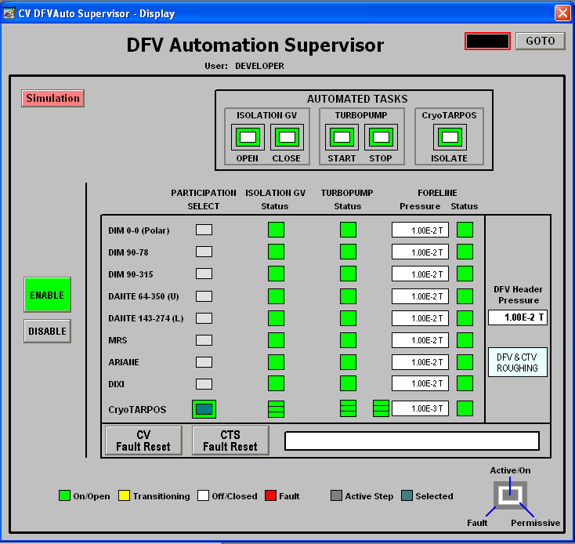
Example: Automated vacuum pumpdown
Saves from 15-34 minutes per pumping activity (start to crossover)
Eliminated many manual operator interactions
Start the task and walk away
Pages operators when faults occur
Improved machine safety
Team worked over the Christmas holiday to deploy and commission concluding 5 MM effort to automate 16 valves and 8 high-vac pumps
Now in routine use

Slide 18
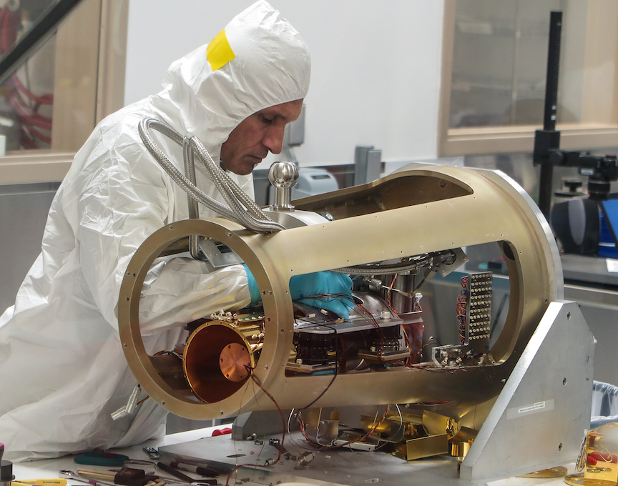
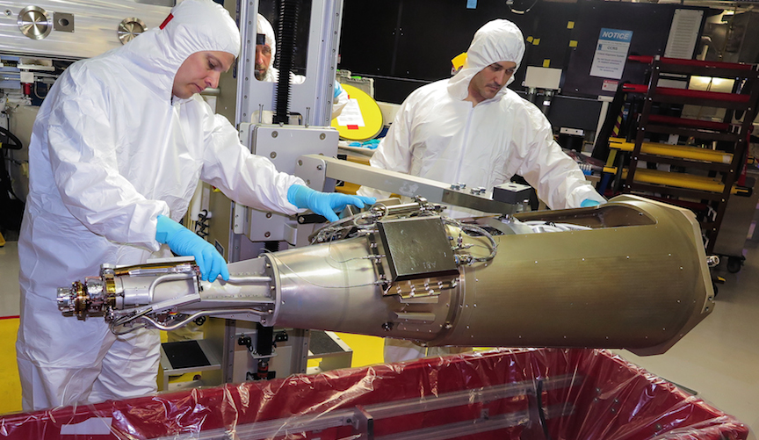
Example: Reengineered cryo system for faster cooldown
Replaced He pot with Pb block in ITIC cold head assembly
Along with changes to cold shield temperature control scheme, allows for cooldown to shot temperature in 3.5 hours for non-layered shots (compared to 7 hours)

Slide 19
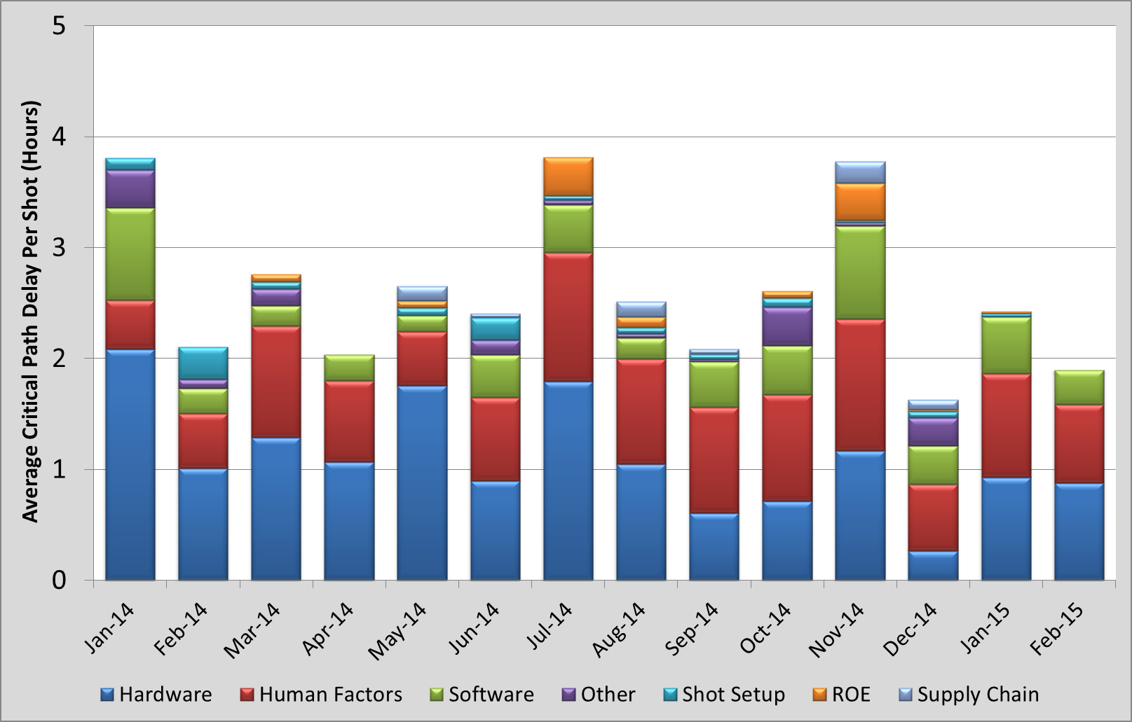
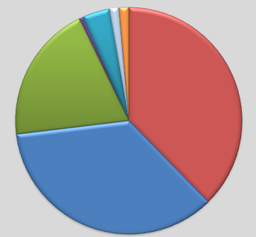
Average Critical Path Delay per Shot is slowly trending down – RAM effort actively deals with HW and SW
Last 3 months:
Software
20%
Human Factors
38%
Hardware
35%

Slide 20
Advanced Diagnostics Strategy Review
R. Paul Drake
Robert D. Fulton
Allan Hauer
J. Pace VanDevender
Jeffrey Quintenz
Alan Wootton

Slide 21
Overall comments
National Diagnostics Working Group provides a superb model for a scientific peer community coming together to share issues, ideas and approaches to innovate diagnostics for our HED facilities.
Excellent presentations demonstrating an effective planning and selection process.
Filter of “transformative diagnostics” applied reasonably with each proposed diagnostics being important and feasible on a reasonable timescale.
There are plans for diagnostics outside of the the “transformative “set which were not presented in detail. These are either are higher risk and worthy of preliminary exploration for development later or else can be reasonably prioritized and accomplished within the resources and discretion of a single site.
Reviewers differences in priorities are affected by personal view of the priority for ignition vs non-ignition experiments and the resulting diagnostic requirements.

Slide 22
Review Outcome
Reviewer | SLOS | OTS | Wolter | Super GCD | MRS-t | NIS/GRI | HiRES | TARDIS
1 | 1 | 6 | 3 | 7 | 4 | 8 | 5 | 2
2 | 1 | 2 | 4 | 7 | 6 | 8 | 5 | 3
3 | 1 | 7 | 4 | 3 | 6 | 2 | 5 | 8
4 | 1 | 3 | 5 | 4 | 2 | 7 | 6 | 8
5 | 1 | 6 | 3 | 4 | 5 | 8 | 7 | 2
6 | 1 | 1 | 2 | 2 | 2 | 3 | 2 | 1
Average Priority | 1 | 4.2 | 3.5 | 4.5 | 4.2 | 6 | 5 | 4
Table 1: Diagnostic Prioritization by the Reviewers (one reviewer only provided scores of 1, 2 or 3)
“Ignition Diagnostics regarded as slightly lower priority
NIS/GRI viewed as “expensive
SLOS (time dilation w/ hCMOS unanimously viewed as highest priority
(SLOS- single line of sight, OTS-optical Thomson Scattering, Wolter- hard x-ray microscope, MRS-t-streaked Magnetic Recoil Spectrometer, NIS/GRI-neutron/gamma imager, HIRES- high resolution x-ray spectrometer, TARDIS-diffraction x-ray spectrometer)

Slide 23
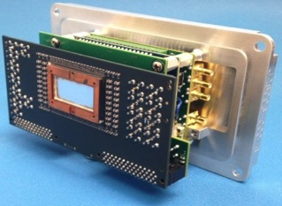
Single Line of Sight multi-frame imaging is enhanced by integrating two cutting-edge technologies
Pulse-dilation technology
Hybrid-CMOS sensors
Manipulate images in time/space (10ps ➔ 1ns)
Multi-frame fast-gated pixels
Hybrid
CMOS
(2015)
0.5 megapixels
2 frames
1.5ns per frame
photo
cathode
anode
mesh
sensor
pulser
10 ps
signal
1ns signal
B-field
photons
electrons
drift space
Future sensor (2016)
1.0 megapixels
8 frames
1ns per frame
x300 pulse dilation

Slide 24
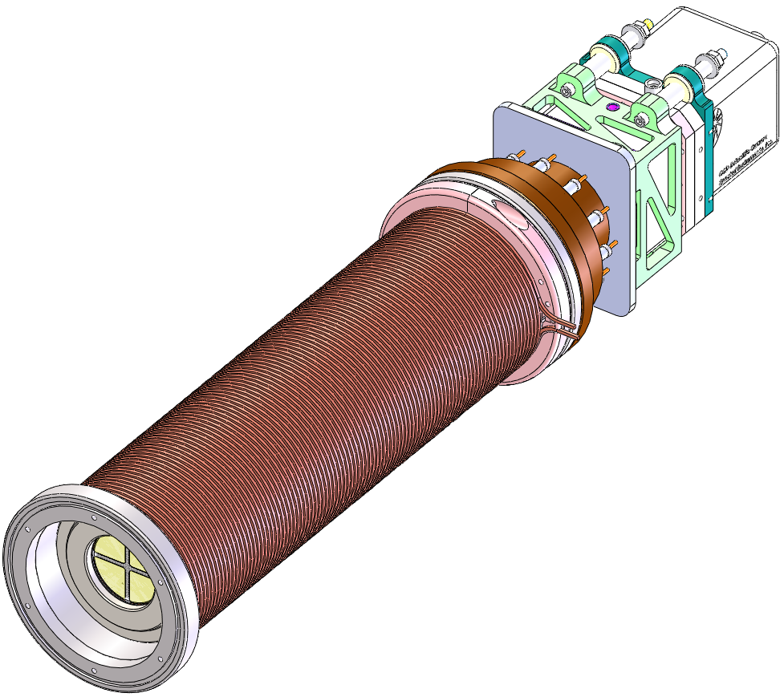
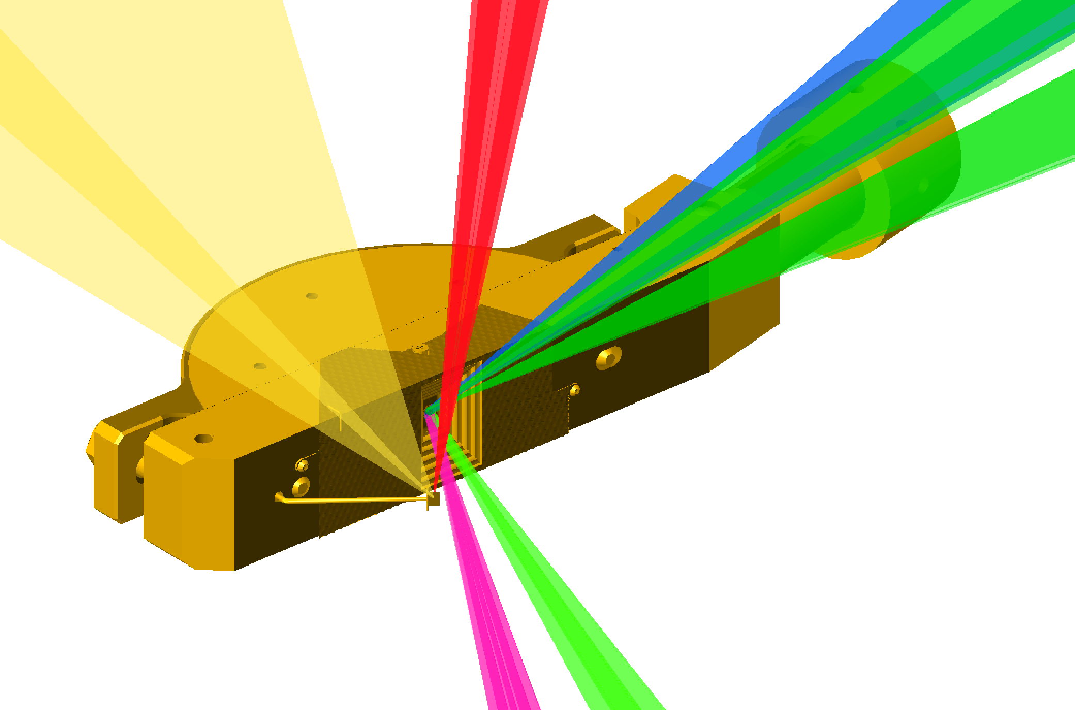
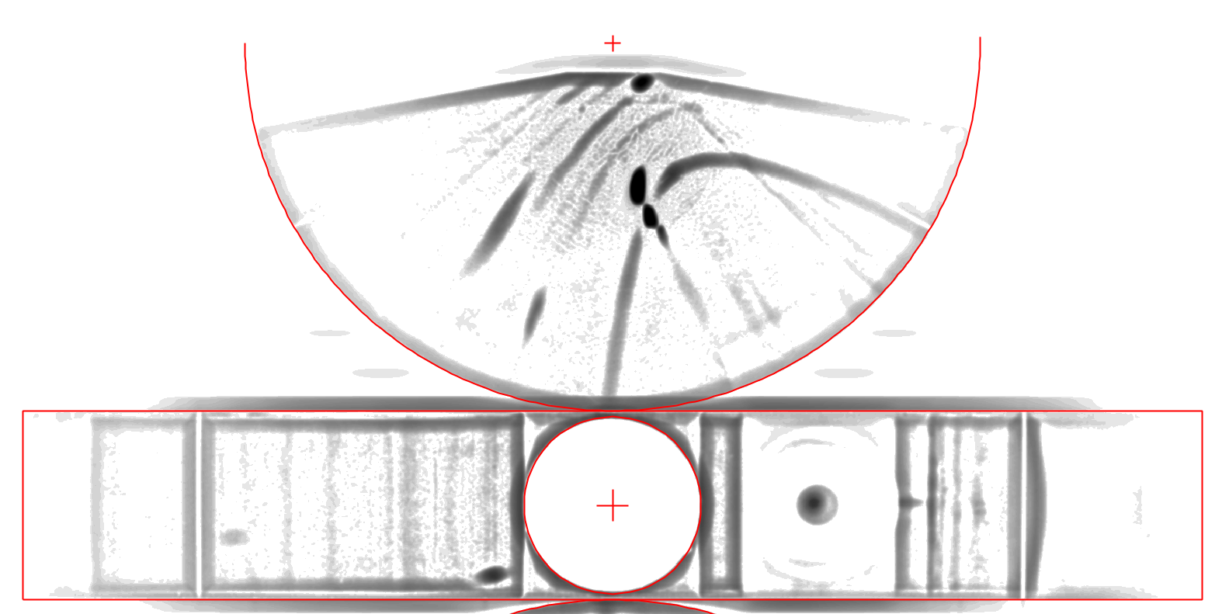
Transformative diagnostics will allow time-dependent phase change measurements in materials at high pressure.
Science Drivers
Phase determination at high pressure
Lattice deformation at high stress
Transformational Diagnostic Approach
Time-gated x-ray diffraction
SLOS
TARDIS
Diagnostic | Facility Implementation | Collaborating Institutions
Fast Phosphors | Z | SNL, NSTec
TARDIS + SLOS | NIF | LLNL, GA, SNL

Slide 25
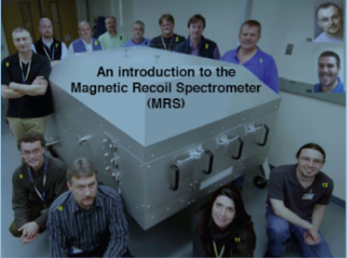
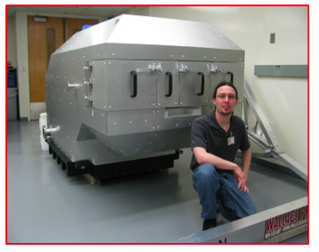
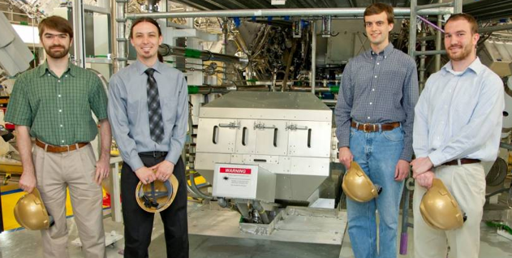
Students and universities
LLE Engineers & MIT built the MRS* for NIF in 2009
MRS* on NIF & four MIT
Stockpile Stewards
25

Slide 26
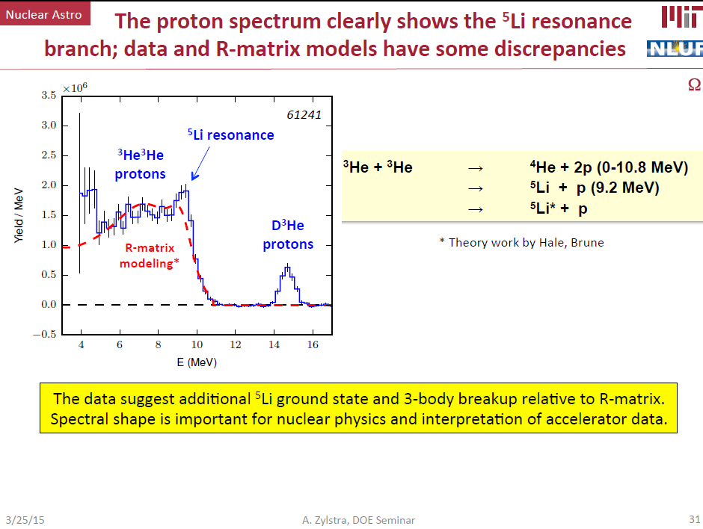

Slide 27
Summary
HEDP is now an established field with a scientific community “up and running”
Exciting scientific program of work for two decades
NNSA labs are central participants and demonstrating appropriate leadership
Approach to ignition is through deliberate effort to improve scientific understanding of challenges and address them.

