Slide 1
The 2016 Budget: Investing in America’s Future
Office of Management and Budget
Office of Science and Technology Policy
Notes:
Good afternoon, and other greetings.

Slide 2
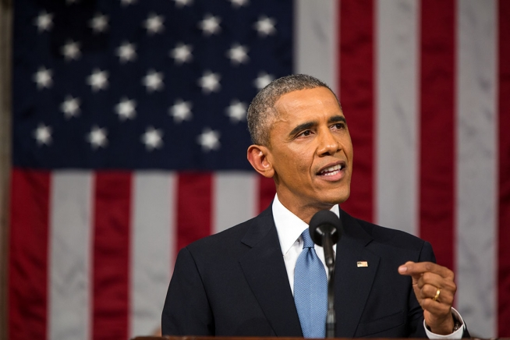
“Twenty-first century businesses will rely on American science and technology, research and development.”
- President Barack Obama
January 20, 2015

Slide 3
What does the Office of Science and Technology Policy do?
Policy for science and technology
Responsibility, in partnership with the Office of Management and Budget (OMB), for advising the President on the Federal Research and Development (R&D) budget and shaping R&D priorities across those Federal agencies that have significant portfolios in science and technology.
Science and technology for policy
Timely, independent, objective advice for the President about S&T dimensions of all policy issues with which he is concerned
As well as
Strengthening S&T policy mechanisms
Providing White House liaison and oversight for the NSF and NASA;
Carrying out a range of functions in support of National Security and Emergency Preparedness Communications
Coordinating & overseeing US cooperation in S&T with other countries

Slide 4
Some of the major topics covered in OSTP’s four divisions:
Science:
Life Sciences
Biotechnology
Physical Sciences and Engineering
Social and Behavioral Sciences
Prizes and Awards
STEM Education
Technology:
Open Government
Internet and Broadband
Telecommunications
Nanoscience and Nanotechnology
Information Technology
Space and Aeronautics
Technology R&D
Manufacturing
Energy and Environment:
Energy
Climate
Oceans
Environmental Quality
Ecosystems
National Security & International Affairs:
National Security R&D
International S&T Engagement
Emergency Preparedness
Nuclear Security – defense, nonproliferation
Chemical and Biological Countermeasures
Nuclear Weapons and Arms Control
Plus, in all divisions: Regulatory issues, S&T horizon-scanning, WH events support (e.g., National Medals, Science Fair), etc.

Slide 5
OSTP-managed entities
President’s Council of Advisors on Science and Technology (PCAST)
Helps link White House to wider ST&I community
Co-Chairs J. Holdren & E. Lander
Vice-Chairs W. Press & M. Savitz
~16 other members from academia, industry, NGOs
National Science and Technology Council (NSTC)
Coordinates S&T activities that cross agency boundaries
Nominally chaired by the President; chaired in practice by the OSTP Director / Science Advisor; administered by OSTP
Deputy secretaries & undersecretaries of cabinet departments with S&T missions, plus heads of NSF, NIH, NASA, NOAA, NIST, EPA, USGS, CDC

Slide 6
What is the Office of Management and Budget?
One of the interesting things about OMB is that it is unexplainable to everyone who lives outside of the Beltway and misunderstood by nearly everyone who lives inside the Beltway.
- Paul O'Neill, Former Treasury Secretary and OMB Deputy Director

Slide 7
What Does the Office of Management and Budget Do?
OMB serves the President in overseeing the implementation of his vision across the Executive Branch.
(1) Budget and policy development and execution.
(2) Management, including oversight of agency performance, Federal procurement, financial management, and information technology.
(3) Regulatory policy, including coordination and review of all significant Federal regulations by executive agencies.
(4) Legislative clearance and coordination, including agency testimony and draft bills.
(5) Executive Orders and Presidential Memoranda.

Slide 8
Budget Timeline
Calendar
Year
NOW
Budget
Year
12 13 14 15 16 17
FY16 OMB/OSTP Priorities Memo
17
16
15
14
FY16 Submission to OMB
FY15 Budget to Congress
Appropriation/CR bill signed
Agency
OMB/Agency
Congress
Execution

Slide 9
The 2016 Budget:
Continues our commitment to world-class science and research
Invests in innovation
Improves Americans’ health
Makes America a magnet for jobs
Invests in homegrown clean energy
Takes action on climate change
Prepares students with STEM skills

Slide 10
Continuing our commitment to world-class science and research
$68.8 billion for non-defense R&D.
$76.9 billion for defense R&D.
$66.9 billion for (basic and applied) research.
$7.7 billion for the National Science Foundation (NSF).
$5.3 billion for the Department of Energy (DOE) Office of Science.
$755 million for the National Institute of Standards and Technology (NIST) laboratories.
$18.5 billion for NASA.
$550 million for U.S. Department of Agriculture competitive grants, including $450 million for competitively-awarded extramural research grants.

Slide 12
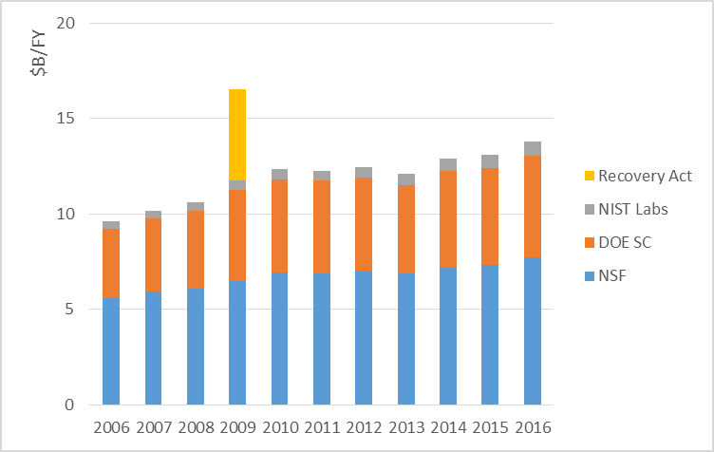
President’s Plan for Science and Innovation

Slide 13
Investing in Innovation for National Security
$12.3 billion for DOD’s Science & Technology (S&T) program of basic research, applied research, and advanced technology development.
$3.0 billion for the Defense Advanced Research Projects Agency (DARPA) to maintain DOD’s critical role in fostering breakthrough approaches for discovering promising technologies.
The Budget invests in defense-related S&T across a diverse portfolio, including advanced manufacturing, energy, cybersecurity, robotics, a safe and secure nuclear arsenal, explosives detection, and biodefense.
The Budget includes $243 million for civilian R&D to support innovative cybersecurity technologies.

Slide 14
Investing in Innovation for Industries of the Future
“So no one knows for certain which industries will generate the jobs of the future. But we do know we want them here in America. We know that.” - President Barack Obama
January 20, 2015
The Budget provides strong support for R&D that is likely to create the foundations for the industries and jobs of the future. Examples include robotics, cyber-physical systems, big data, the Materials Genome Initiative, the National Nanotechnology Initiative, and engineering biology.
$1.5 billion for the National Nanotechnology Initiative.
The Budget expands our capabilities in the space industries of the future: $1.2 billion for the Commercial Crew program, $725 million for Space Technology, and $230 million for Advanced Exploration Systems to increase the capabilities of NASA, other government, and commercial space activities.

Slide 15
Advanced Manufacturing in the 2016 Budget
Making America a magnet for jobs
$2.4 billion in advanced manufacturing R&D in the 2016 Budget.
These investments will expand R&D on innovative manufacturing processes, advanced industrial materials, and robotics.
Over $400 million for the DOE Advanced Manufacturing Office.
Support advanced manufacturing R&D
Establish a national network of manufacturing innovation institutes
The Budget builds on the 9 manufacturing innovation institutes already funded through 2015 with more than $350 million in additional discretionary funds to support 7 new institutes.
The Budget includes a mandatory proposal of $1.9 billion to fund the remaining 29 institutes in the national network for a total of 45.

Slide 16

Improving Americans’ health through innovation in life sciences, biology, and neuroscience
The 2016 Budget provides $215 million to launch a Precision Medicine Initiative with funding from HHS agencies.
The BRAIN Initiative will continue with a Federal commitment of over $300 million from NIH, DARPA, and NSF.
The 2016 Budget provides over $1.2 billion for a government-wide effort to combat antibiotic-resistant bacteria.
$31.3 billion for the National Institutes of Health (NIH) to support high-quality, innovative biomedical research.
The Budget provides $82 million at USGS, EPA, and USDA to address pollinator health, including colony collapse disorder.
Notes:
Hold for later: National Network for Manufacturing Innovation: a $1 billion network of institutes where researchers, companies, and entrepreneurs can come together to invest in new manufacturing technologies with broad application.

Slide 17
Energy R&D Highlights in the 2016 Budget
Investing in homegrown clean energy
Clean Energy Technology
The Budget provides $7.4 billion for clean energy technology programs across the Federal government.
. $2.7 billion for DOE Energy Efficiency and Renewable Energy (EERE) and $325 million for ARPA-E.
$47 million for DOE, EPA, and USGS for research to reduce health and environmental impacts from hydraulic fracturing.
Hydraulic Fracturing
Carbon Capture and Storage
Nearly $500 million in cleaner energy from fossil fuels, focused predominantly on development and deployment of carbon capture and storage technologies.
The Budget proposes a $2 billion carbon capture investment and sequestration tax credit.

Slide 18
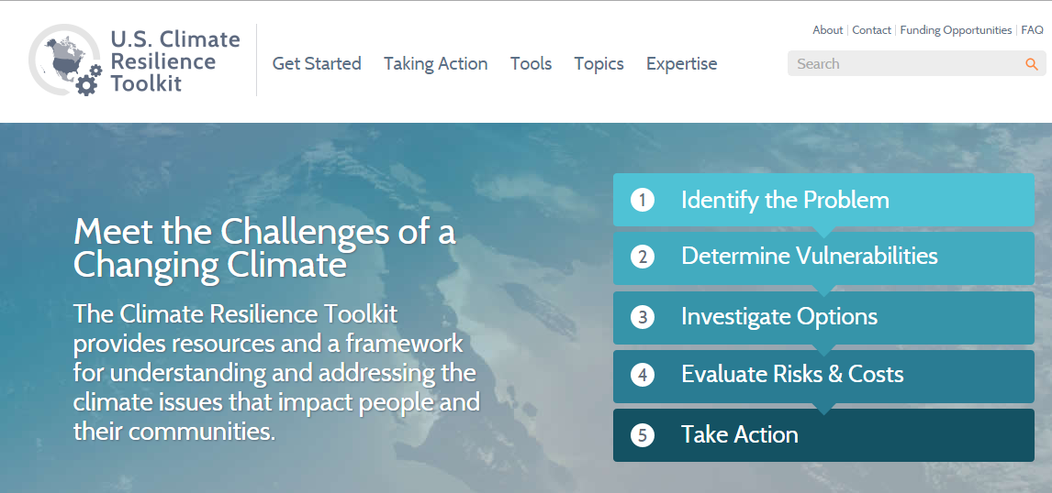
Taking action on climate change in the 2016 Budget
$2.7 billion for the U.S. Global Change Research Program (USGCRP).
USGCRP supports research to improve our ability to understand, assess, predict, and respond to global change.
The 2016 Budget supports an integrated suite of climate change observations, process-based research, modeling, sustained assessment, adaptation science activities, and climate preparedness and resilience strategies.
USGCRP investments support the President’s Climate Action Plan.
The President's Budget provides $20 million to continue expanding and improving the recently-released Climate Resilience Toolkit.

Slide 19
Preparing students with STEM skills
$3 billion for Federal science, technology, engineering, and mathematics (STEM) education programs in the 2016 Budget.
Agencies continue to coordinate implementation of the Federal STEM Education 5-Year Strategic Plan.
$202 million for an expanded Department of Education Math and Science Partnerships program.
NSF has a $135 million effort to improve retention of undergraduate STEM majors and improve undergraduate teaching and learning in STEM subjects.
$338 million in NSF for the Graduate Research Fellowship program.
The Budget establishes a Dept. of Education $125 million competitive program to help communities across America launch Next-Generation High Schools that will be laboratories for cutting-edge STEM teaching and learning.

Slide 20
Thank You

