Slide 1
FY 2016 Budget Request to Congress for DOE’s Office of Science
24 April 2015
Dr. Patricia M. Dehmer
Acting Director, Office of Science
http://science.energy.gov/sc-2/presentations-and-testimony/

Slide 2
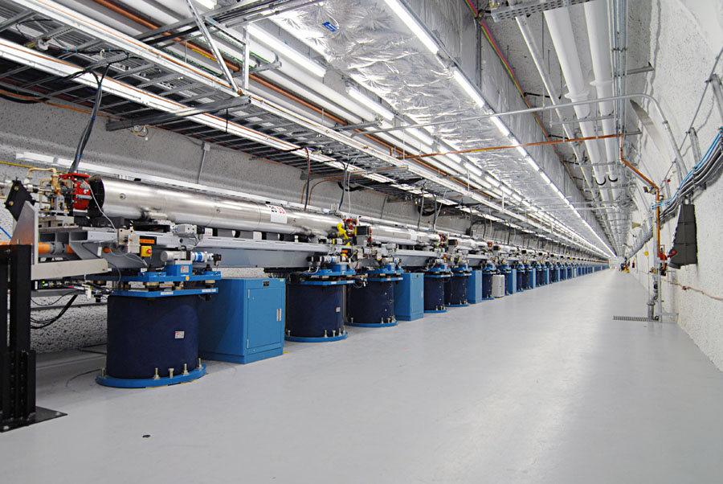
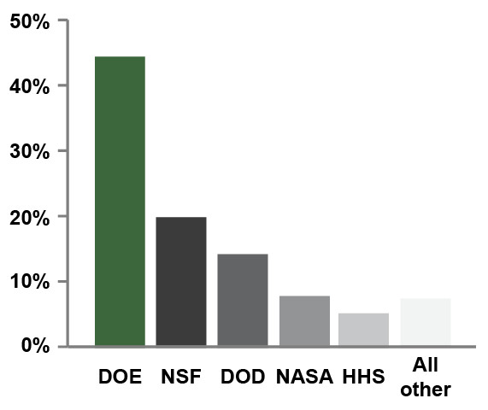
Office of Science
By the numbers
SC delivers scientific discoveries and tools to transform our understanding of nature and advance the energy, economic, and national security of the U.S.
Research
Support for 47% of the U.S. Federal support of basic research in the physical sciences;
~22,000 Ph.D. scientists, grad students, engineers, and support staff at >300 institutions, including all 17 DOE labs;
U.S. and world leadership in high-performance computing and computational sciences;
Major U.S. supporter of physics, chemistry, materials sciences, and biology for discovery and for energy sciences.
Scientific User Facilities
The world’s largest collection of scientific user facilities (aka research infrastructure) operated by a single organization in the world, used by 31,000 researchers each year.
Support for basic research in the physical sciences by agency.
Source: NSF Science and Engineering Indicators 2012
Shown is a portion of SLAC's two-mile-long linear accelerator (or linac), which provides the electron beam for the new Linac Coherent Light Source (LCLS) – the world’s first hard x-ray, free-electron laser. For nearly 50 years, SLAC's linac had produced high-energy electrons for physics experiments. Now researchers use the very intense X-ray pulses (more than a billion times brighter than the most powerful existing sources) much like a high-speed camera to take stop-motion pictures of atoms and molecules in motion, examining fundamental processes on femtosecond timescales.

Slide 3
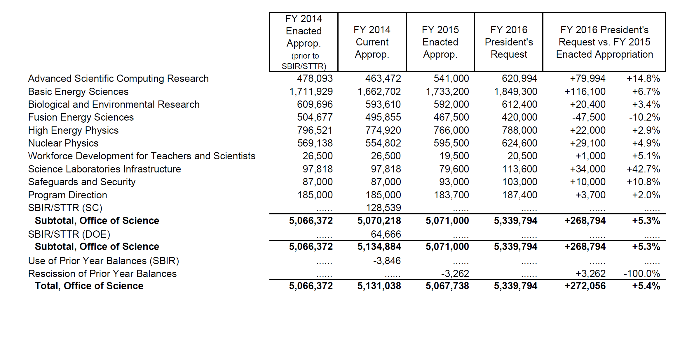
Office of Science FY 2016 Budget Request to Congress (Dollars in thousands)

Slide 4
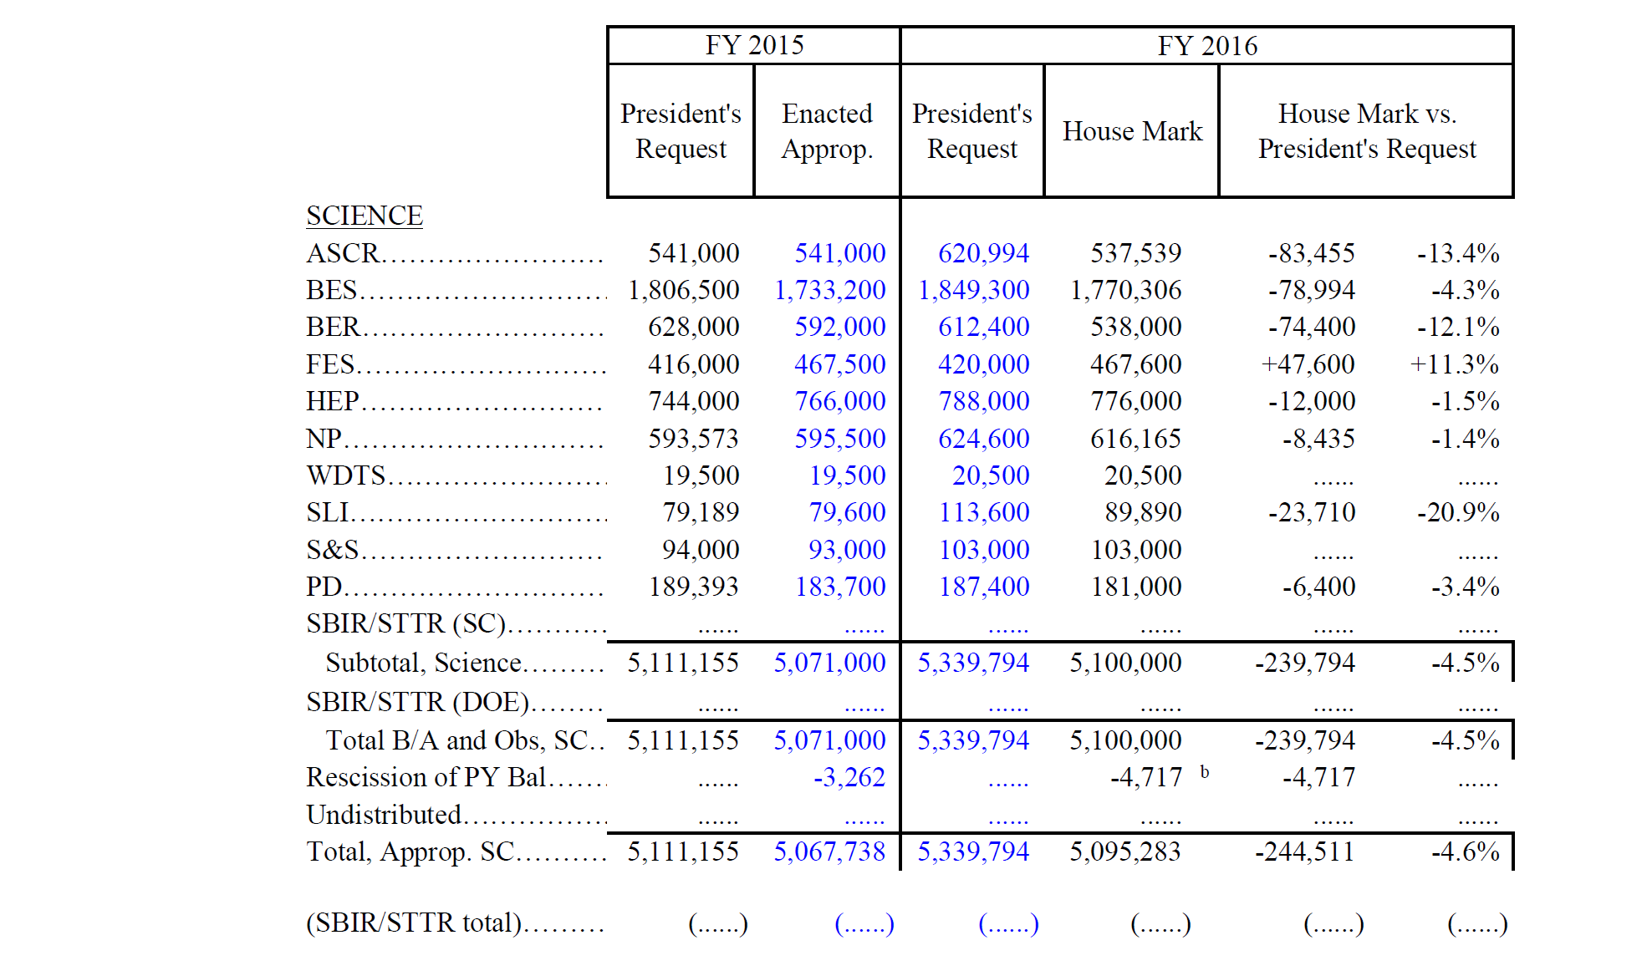
Office of Science FY 2016 Budget Request to Congress (Dollars in thousands)

Slide 5
FY 2016 SC Budget Request by Category Dollars in Thousands
Construction
BES: Linac Coherent Light Source-II continues and is in its peak funding year ($200,300K).
FES: ITER – support for the USIPO, IO, and hardware fabrication continues ($150,000K).
HEP: Long Baseline Neutrino Facility ($20,000K for PED); Muon to Electron Conversion ($40,100K).
NP: FRIB continues and is at the peak of its funding profile ($100,000K); accelerator commissioning and detector construction of the CEBAF 12 GeV upgrade continue ($12,000K).
SLI: Materials Design Lab at ANL ($23,910K); Photon Science Lab Building at SLAC ($25,000K); Integrative Genomics Building at LBNL ($20,000K).
Also in SLI: “Infrastructure Support” increases by $31,100K for top priorities identified as part of the Campus Strategy discussions, for electrical upgrades at ANL and SLAC and for facility improvements at FNAL.
Major Items of Equipment
BES: Advanced Photon Source Upgrade (APS-U) ($20,000K) and NSLS-II Experimental Tools (NEXT) (15,500K).
HEP: LHC Detector Upgrades (ATLAS and CMS) ($9,500K each); Large Synoptic Survey Telescope camera (LSSTcam) ($40,800K); Muon g-2 ($10,200K); LUX-ZEPLIN ($9,000K); SuperCDMS-SNOLab ($2,000K); Dark Energy Spectroscopic Instrument (DESI) ($5,300K).
Research
ASCR: There is a significant increase for the exascale initiative to support for HPC vendors to design and develop exascale node technologies and systems. (Δ = +$86,895K).
Also in ASCR: The Computational Science Graduate Fellowship is restored at $10,000K to fully fund a new cohort!
BES: Increases for EFRCs (Δ = +$10,000K), Computational Materials Sciences (Δ = +$4,000K), and mid-scale instrumentation for ultrafast electron scattering (Δ = +$5,000K).
BER: Increases for Climate and Earth System Modeling with largest increase for Climate Model Development & Validation and Integrated Assessment. (Δ = +$18,730K). Some decreases offset the increases.
FES: Research continues in all areas. Increase for GPP for PPPL in support of NSTX-U operations. HEDLP is reduced, but the Matter in Extreme Conditions end station at LCLS remains fully funded.
HEP: Research funding is nearly flat with FY 2015 and supports scientific results from operating experiments and R&D for future projects.
NP: Research increases by more than 8% to support high-priority work.
Facility Operations
ASCR, BER, BES, HEP: Facilities operate at or near to optimal, >98%.
FES: NSTX resumes operations for 14 weeks; DIII-D operates for 12 weeks until shutdown for installation of upgrades; Alcator C-Mod operates for 5 weeks prior to final shutdown at the end of FY 2016.
NP: RHIC operates 22 weeks, same as in FY 2015 and has funding for capital equipment and spares; ATLAS operates 37 weeks; CEBAF is supported for continued machine development and commissioning of beam to Halls B and C.
Notes:
Research
Continue on the path to exascale computers by
initiating a research program in the area programming models and runtime systems that address the challenges of energy efficient, data intensive applications, which are characterized by asynchronous, fine grain parallelism;
funding HPC vendors to perform research efforts in critical technologies and system interconnects, with the goal of migrating these technologies into their future exascale products;
initiating system engineering efforts with high performance computer vendors that address system level challenges to ensure resulting exascale computer systems will achieve DOE goals.
expanding exascale system studies to model system performance, from hardware architecture to application workflow, with system software management. These studies are necessary to understand the properties determining ultimate operational and performance characteristics, within the projected range of exascale size and capability.
Initiate exploratory SciDAC partnership efforts to establish for future partnership programs for data intensive scientific problems.
Initiate a computer science research program to support development of scientific data management and analysis and visualization techniques, including knowledge representation.
Conduct innovative mathematics research to improve the fidelity and predictability of continuous and/or distributed complex systems that accurately capture the physics and/or subcomponent interactions across vastly different time and length scales.
Facility Operations
Operate NERSC and the LCFs at a level to achieve 90% availability.
Begin deployment of planned 20-30 petaflop upgrade at NERSC (NERSC-8); Relocate NERSC from the Oakland Scientific Facility into the new Computational Research and Theory building, located on the LBNL campus.
Begin preparations for the 75-200 petaflop upgrades at each Leadership Computing Facility, which are planned to be operational in the 2017-2018 timeframe.
Extend ESnet to further support SC facilities and large experiments in the U.S. and Europe.
Initiate a Postdoctoral Computational Scientists for Energy, Environment and National Security (CSEENS) program at ASCR facilities to ensure an adequate supply of computational science and engineering trained to meet the national workforce need.

Slide 6
Research
Notes:
Research
Continue on the path to exascale computers by
initiating a research program in the area programming models and runtime systems that address the challenges of energy efficient, data intensive applications, which are characterized by asynchronous, fine grain parallelism;
funding HPC vendors to perform research efforts in critical technologies and system interconnects, with the goal of migrating these technologies into their future exascale products;
initiating system engineering efforts with high performance computer vendors that address system level challenges to ensure resulting exascale computer systems will achieve DOE goals.
expanding exascale system studies to model system performance, from hardware architecture to application workflow, with system software management. These studies are necessary to understand the properties determining ultimate operational and performance characteristics, within the projected range of exascale size and capability.
Initiate exploratory SciDAC partnership efforts to establish for future partnership programs for data intensive scientific problems.
Initiate a computer science research program to support development of scientific data management and analysis and visualization techniques, including knowledge representation.
Conduct innovative mathematics research to improve the fidelity and predictability of continuous and/or distributed complex systems that accurately capture the physics and/or subcomponent interactions across vastly different time and length scales.
Facility Operations
Operate NERSC and the LCFs at a level to achieve 90% availability.
Begin deployment of planned 20-30 petaflop upgrade at NERSC (NERSC-8); Relocate NERSC from the Oakland Scientific Facility into the new Computational Research and Theory building, located on the LBNL campus.
Begin preparations for the 75-200 petaflop upgrades at each Leadership Computing Facility, which are planned to be operational in the 2017-2018 timeframe.
Extend ESnet to further support SC facilities and large experiments in the U.S. and Europe.
Initiate a Postdoctoral Computational Scientists for Energy, Environment and National Security (CSEENS) program at ASCR facilities to ensure an adequate supply of computational science and engineering trained to meet the national workforce need.

Slide 7
Facility Operations
Notes:
Research
Continue on the path to exascale computers by
initiating a research program in the area programming models and runtime systems that address the challenges of energy efficient, data intensive applications, which are characterized by asynchronous, fine grain parallelism;
funding HPC vendors to perform research efforts in critical technologies and system interconnects, with the goal of migrating these technologies into their future exascale products;
initiating system engineering efforts with high performance computer vendors that address system level challenges to ensure resulting exascale computer systems will achieve DOE goals.
expanding exascale system studies to model system performance, from hardware architecture to application workflow, with system software management. These studies are necessary to understand the properties determining ultimate operational and performance characteristics, within the projected range of exascale size and capability.
Initiate exploratory SciDAC partnership efforts to establish for future partnership programs for data intensive scientific problems.
Initiate a computer science research program to support development of scientific data management and analysis and visualization techniques, including knowledge representation.
Conduct innovative mathematics research to improve the fidelity and predictability of continuous and/or distributed complex systems that accurately capture the physics and/or subcomponent interactions across vastly different time and length scales.
Facility Operations
Operate NERSC and the LCFs at a level to achieve 90% availability.
Begin deployment of planned 20-30 petaflop upgrade at NERSC (NERSC-8); Relocate NERSC from the Oakland Scientific Facility into the new Computational Research and Theory building, located on the LBNL campus.
Begin preparations for the 75-200 petaflop upgrades at each Leadership Computing Facility, which are planned to be operational in the 2017-2018 timeframe.
Extend ESnet to further support SC facilities and large experiments in the U.S. and Europe.
Initiate a Postdoctoral Computational Scientists for Energy, Environment and National Security (CSEENS) program at ASCR facilities to ensure an adequate supply of computational science and engineering trained to meet the national workforce need.

Slide 8
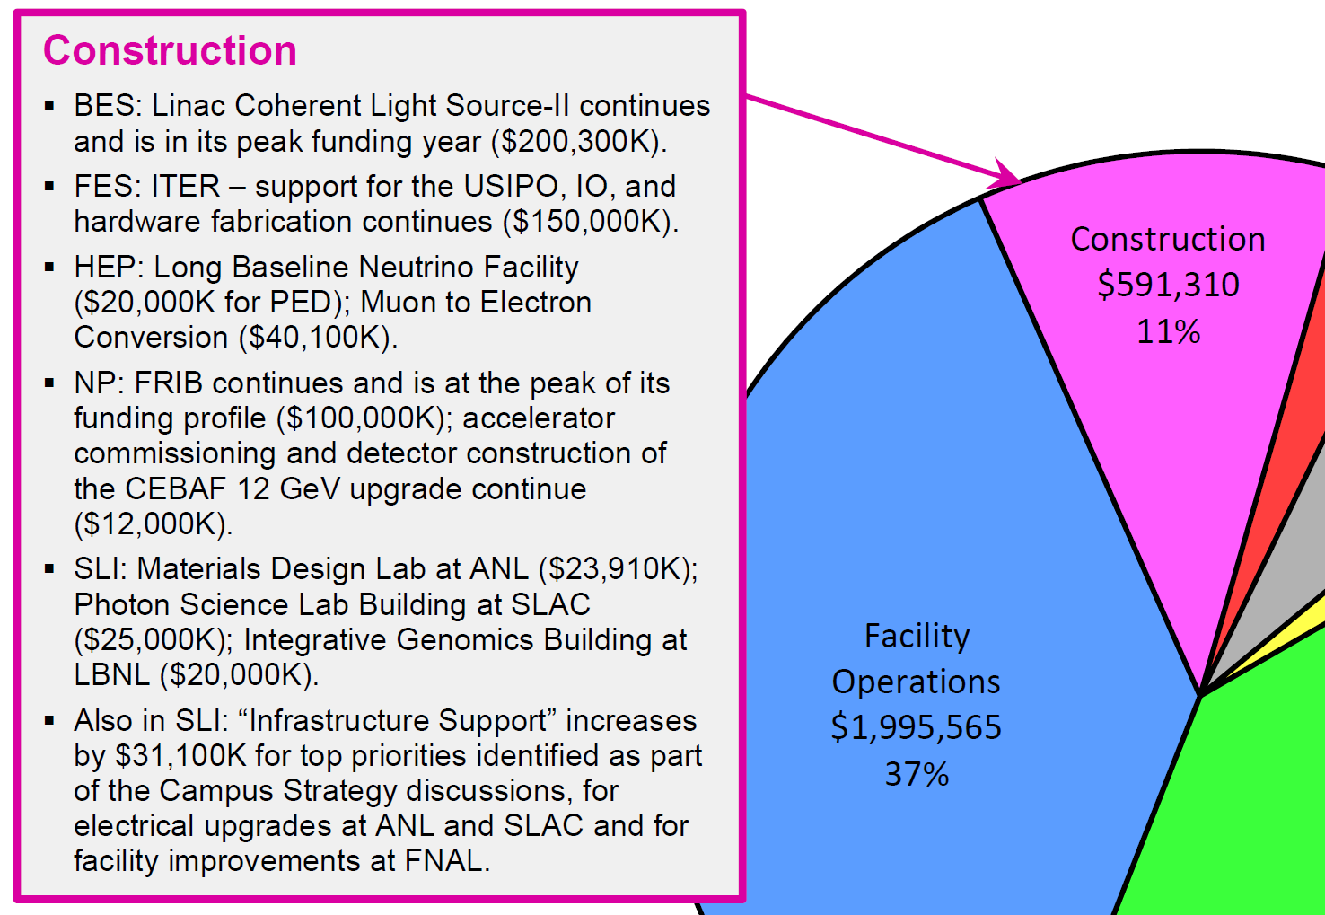
Construction
Notes:
Research
Continue on the path to exascale computers by
initiating a research program in the area programming models and runtime systems that address the challenges of energy efficient, data intensive applications, which are characterized by asynchronous, fine grain parallelism;
funding HPC vendors to perform research efforts in critical technologies and system interconnects, with the goal of migrating these technologies into their future exascale products;
initiating system engineering efforts with high performance computer vendors that address system level challenges to ensure resulting exascale computer systems will achieve DOE goals.
expanding exascale system studies to model system performance, from hardware architecture to application workflow, with system software management. These studies are necessary to understand the properties determining ultimate operational and performance characteristics, within the projected range of exascale size and capability.
Initiate exploratory SciDAC partnership efforts to establish for future partnership programs for data intensive scientific problems.
Initiate a computer science research program to support development of scientific data management and analysis and visualization techniques, including knowledge representation.
Conduct innovative mathematics research to improve the fidelity and predictability of continuous and/or distributed complex systems that accurately capture the physics and/or subcomponent interactions across vastly different time and length scales.
Facility Operations
Operate NERSC and the LCFs at a level to achieve 90% availability.
Begin deployment of planned 20-30 petaflop upgrade at NERSC (NERSC-8); Relocate NERSC from the Oakland Scientific Facility into the new Computational Research and Theory building, located on the LBNL campus.
Begin preparations for the 75-200 petaflop upgrades at each Leadership Computing Facility, which are planned to be operational in the 2017-2018 timeframe.
Extend ESnet to further support SC facilities and large experiments in the U.S. and Europe.
Initiate a Postdoctoral Computational Scientists for Energy, Environment and National Security (CSEENS) program at ASCR facilities to ensure an adequate supply of computational science and engineering trained to meet the national workforce need.

Slide 9
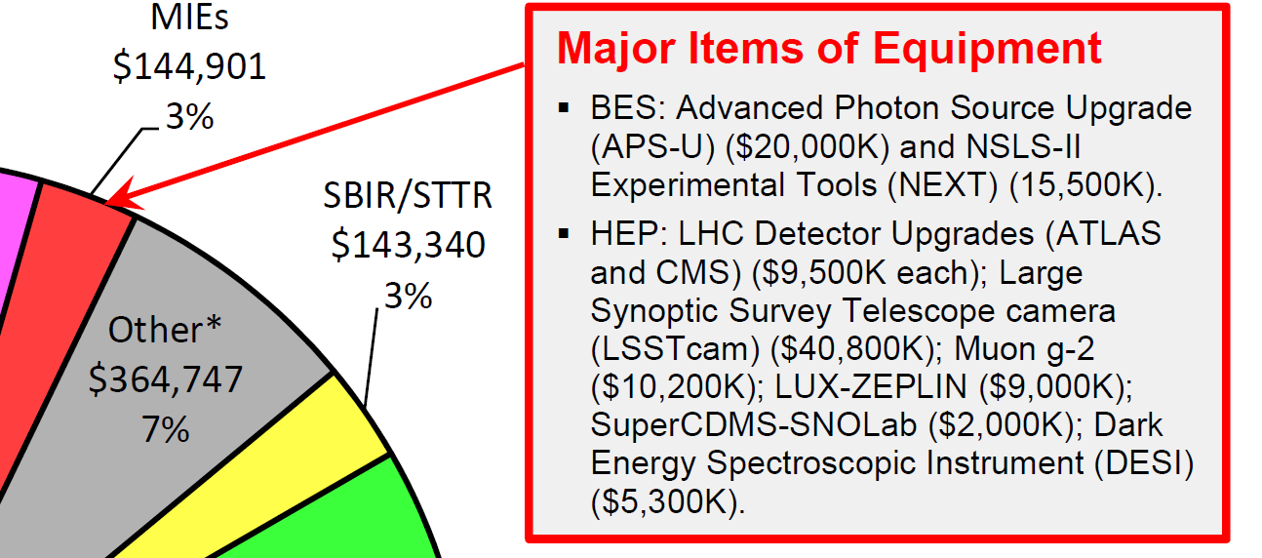
Major Items of Equipment
Notes:
Research
Continue on the path to exascale computers by
initiating a research program in the area programming models and runtime systems that address the challenges of energy efficient, data intensive applications, which are characterized by asynchronous, fine grain parallelism;
funding HPC vendors to perform research efforts in critical technologies and system interconnects, with the goal of migrating these technologies into their future exascale products;
initiating system engineering efforts with high performance computer vendors that address system level challenges to ensure resulting exascale computer systems will achieve DOE goals.
expanding exascale system studies to model system performance, from hardware architecture to application workflow, with system software management. These studies are necessary to understand the properties determining ultimate operational and performance characteristics, within the projected range of exascale size and capability.
Initiate exploratory SciDAC partnership efforts to establish for future partnership programs for data intensive scientific problems.
Initiate a computer science research program to support development of scientific data management and analysis and visualization techniques, including knowledge representation.
Conduct innovative mathematics research to improve the fidelity and predictability of continuous and/or distributed complex systems that accurately capture the physics and/or subcomponent interactions across vastly different time and length scales.
Facility Operations
Operate NERSC and the LCFs at a level to achieve 90% availability.
Begin deployment of planned 20-30 petaflop upgrade at NERSC (NERSC-8); Relocate NERSC from the Oakland Scientific Facility into the new Computational Research and Theory building, located on the LBNL campus.
Begin preparations for the 75-200 petaflop upgrades at each Leadership Computing Facility, which are planned to be operational in the 2017-2018 timeframe.
Extend ESnet to further support SC facilities and large experiments in the U.S. and Europe.
Initiate a Postdoctoral Computational Scientists for Energy, Environment and National Security (CSEENS) program at ASCR facilities to ensure an adequate supply of computational science and engineering trained to meet the national workforce need.

