Slide 1
Basic Energy Sciences Update
Board on Physics and Astronomy
Keck Center of the National Academies
April 24, 2015
Harriet Kung
Associate Director of Science for Basic Energy Sciences
U.S. Department of Energy

Slide 2
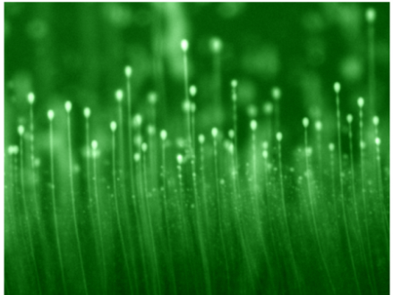
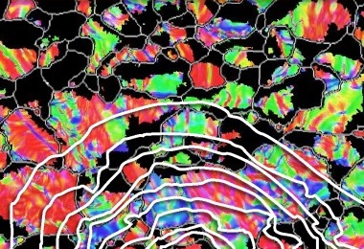
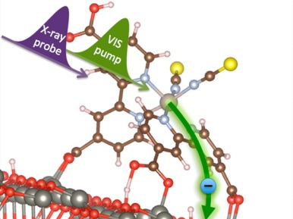
Basic Energy Sciences
The Program:
Materials sciences & engineering—exploring macroscopic and microscopic material behaviors and their connections to various energy technologies
Chemical sciences, geosciences, and energy biosciences—exploring the fundamental aspects of chemical reactivity and energy transduction over wide ranges of scale and complexity and their applications to energy technologies
Supporting:
32 Energy Frontier Research Centers
Fuels from Sunlight & Batteries and Energy Storage Hubs
The largest collection of facilities for electron, x-ray, and neutron scattering in the world
The Scientific Challenges:
Synthesize, atom by atom, new forms of matter with tailored properties, including nano-scale objects with capabilities rivaling those of living things
Direct and control matter and energy flow in materials and chemical assemblies over multiple length and time scales
Explore materials & chemical functionalities and their connections to atomic, molecular, and electronic structures
Explore basic research to achieve transformational discoveries for energy technologies
Understanding, predicting, and ultimately controlling matter and energy flow at the electronic, atomic, and molecular levels
Notes:
The four energy-relevant 2012 highlight images—all on the SC web site—are (left to right):
• Catching Lithium Ions in Action in a Battery Electrode
New microscopy with nanometer-sized resolution may bring revolutionary new understanding to energy storage technologies.
http://science.energy.gov/bes/highlights/2012/bes-2012-10-a/
• Synchrotron plus Mass Spectrometer equals New Insights Into Combustion Chemistry
Unique analysis of the reaction of propene with oxygen atom reveals the influence of electron spin on combustion chemistry.
http://science.energy.gov/bes/highlights/2012/bes-2012-10-b/
• Experimental Confirmation of a New State of Magnetism Previously Predicted by Theory
This observation paves the way for a deeper understanding of high-temperature superconductivity and future applications for quantum computing.
http://science.energy.gov/bes/highlights/2012/bes-2012-12-a/
• Finding Hidden Oil and Gas Reserves
Supercomputers + Software + electromagnetic images yield new way to discriminate underground deposits from surrounding geology.
http://science.energy.gov/bes/highlights/2012/bes-2012-10-e/

Slide 3
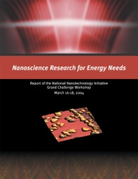
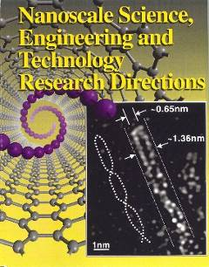
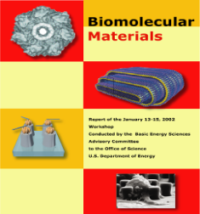
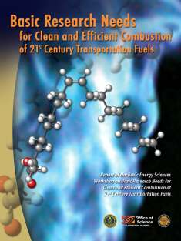
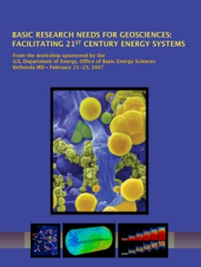
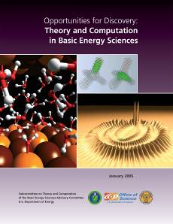
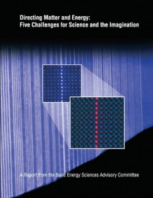



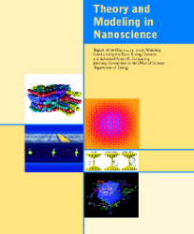


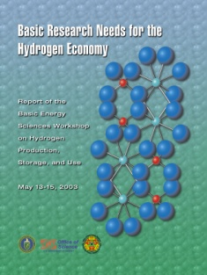


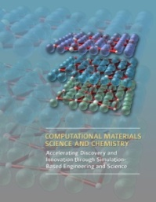

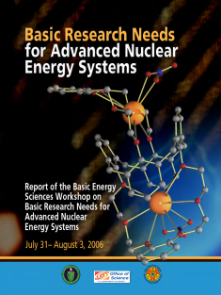

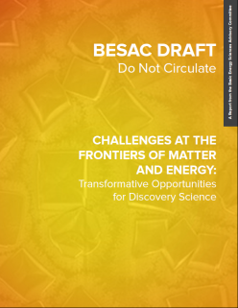
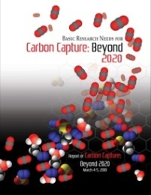

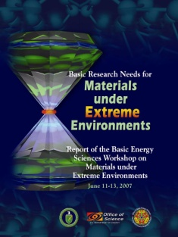
BES Strategic Planning and Program Development
1999
2000
2002
2004
2006
2008
2010
2012
2015
NNI
HFI
EFRCs
Early Career Awards
Batteries Hub
Solar Fuels Hub
CMS
BESAC
BES
3
http://www.besac2014.com/
http://science.energy.gov/bes/news-and-resources/reports/

Slide 4
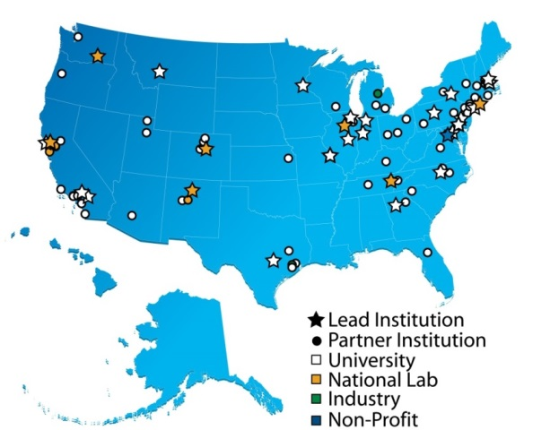
Energy Frontier Research Centers
EFRCs (2009 – 2013)
2014 Recompetitions
100M/Yr
32 awards of $2-4 million per year
Lead institutions by type: 23 universities; 8 DOE National Laboratories; 1 nonprofit organization
Over 100 participating institutions, located in 33 states plus the District of Columbia
525 senior investigators and an additional estimated 900 researchers, including postdoctoral associates, graduate students, undergraduate students, and technical staff
46 EFRCs: $100M/yr from BES; $55M/yr from Recovery Act
PUBLICATIONS, PATENTS, …
Near 6,000 peer-reviewed publications; >215 pubs in Science and Nature.
~280 U.S. and 180 foreign patent applications; ~100 patent/invention disclosures, and ~70 licenses
HIGHLIGHTS:
17 PECASE and 15 DOE Early Career Awards
EFRC students and staff now work in:
> 300 university faculty and staff positions; > 475 industrial positions; > 200 national labs, government, and non-profit positions
~70 companies have benefited from EFRC research
Website: http://science.energy.gov/bes/efrc/
4
Notes:
All new EFRCs undergo a reverse site visit management peer review during the first year of operations. This review is intended primarily for the benefit of the EFRC leadership, to provide them with early stage feedback on the management and operations of their centers that can be used to make corrections or enhancements that will increase the likelihood of scientific success.
The review criteria used during these reviews in FY2015 are as follows:
Vision, Major Goals, Scientific Objectives, and Research Strategies
Has the EFRC clearly articulated its aims and the scientific approaches to be used?
Have they explained the need for an integrated synergistic EFRC approach involving multiple personnel and capabilities?
Leadership
Has the EFRC described processes for priority setting, resource allocation, encouragement of high-risk and relevant research?
Have they established processes to reconfigure research thrusts as needed to respond to new scientific challenges and developments?
Establishment and Operation of the EFRC
Does the EFRC have a plan for developing and operating the EFRC, including recruitment and retention strategies for scientific and technical personnel?
Are processes in place to ensure that efforts that span multiple research groups and multiple institutions are coordinated and integrated?
How will the EFRC measure its progress toward scientific and operational goals?
Synergy
Has the EFRC presented processes for integration, building synergy, and facilitating coordination among subtasks?
Resources and Infrastructure
Does the EFRC have access to the research space, instrumentation, experimental and computational capabilities and facilities needed to achieve the goals?
Staffing and Budget Tables

Slide 5
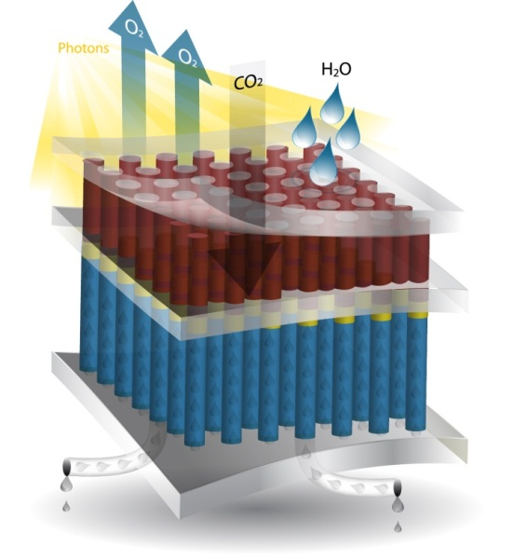
Fuels from Sunlight Hub Joint Center for Artificial Photosynthesis (JCAP)
Overview:
Mission: Develop a solar-fuels generator to produce fuel from the sun 10x more efficiently than crops
Launched in Sept. 2010; 5-yr award ends in Sept. 2015
Led by Caltech with LBNL as primary partner; additional partners are SLAC, Stanford, UC Berkeley, UC San Diego, UC Irvine
2010 - 2015: Development of prototypes capable of efficiently producing hydrogen via photocatalytic water splitting
2015: Renewal to focus on CO₂ reduction discovery science
Goals and Legacies:
Library of fundamental knowledge
Prototype solar-fuels generator
Science and critical expertise for a solar fuels industry
Photoelectrochemical Solar-Fuel Generator
Renewal Planning:
Renewal project would restructure R&D to focus primarily on discovery science related to CO₂ reduction for efficient solar-driven production of carbon-based fuels
Annual funding of up to $15M for a maximum of 5 years reflects reduced project scope
De-emphasis of discovery efforts targeted solely towards hydrogen production
Development of integrated prototypes mainly to test the capability of new materials, concepts, and/or components
Renewal decision is expected by end of April 2015
Research Accomplishments:
Developed novel high throughput capabilities to prepare and screen light absorbers and electrocatalysts
Established benchmarking capabilities to compare large quantities of catalysts and light absorbers
Fabricated and tested integrated artificial photosynthetic prototypes with optimized properties
Developed new multi-physics modeling tools for analysis of solar-fuels prototypes and processes
Discovered method to protect light-absorbing semiconductors (e.g. Si, GaAs) from corrosion in basic aqueous solutions while still maintaining excellent electrical charge conduction

Slide 6
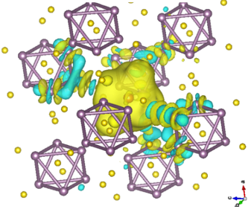
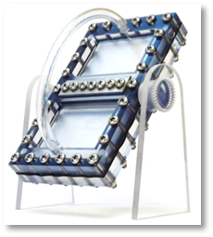
Batteries and Energy Storage Hub Joint Center for Energy Storage Research (JCESR)
Overview:
Mission: Discovery Science to enable next generation batteries—beyond lithium ion—and energy storage for transportation and the grid
Launched in December 2012; Led by George Crabtree (ANL) with national laboratory, university and industrial partners: LBNL, SNL, SLAC, PNNL,UI-UC, NWU, UCh, UI-C, UMich, Dow, AMAT, JCI, CET.
Goals and Legacies:
5x Energy Density, 1/5 Cost, Within 5 years
Library of fundamental knowledge
Research prototype batteries for grid and transportation
New paradigm for battery development
FY 2015 - 2016 Milestones:
For the “electrolyte genome,” calculate data for >10,000 molecular systems.
Complete techno-economic modeling for electrolyte systems identified by the electrolyte genome, that have the potential to meet the “5-5-5” goals
Research Accomplishments:
Rational design of high-performance Li₂S cathodes;
Discovery that incorporation of percolating networks of nanoscale conductors improves charge transfer kinetics in liquid electrodes;
Techno-economic modeling of alternate designs for lithium-air batteries; Fabrication/testing of the first research prototype Mg-ion battery to establish baseline capability.
Bench-top prototype flow battery
6
Notes:
An isosurface of the charge density difference between pristine Mo₆S₈ and the inclusion of a single Mg²⁺ intercalant (and accompanying 2 electrons). Colors: Yellow (cyan) indicates an increase (decrease) in electron density, the Mg atom is shown in orange, S yellow, Mo purple.

Slide 7


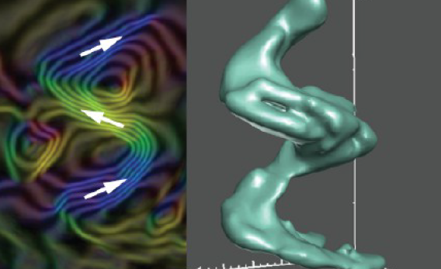

Computational Materials Sciences in support of the Materials Genome Initiative
Deliverable: Open-source community codes and software packages that incorporate multiple length and time scales for discovery and prediction of materials functionality
Deliver research codes and data for design of functional materials to the materials sciences communities in academia, labs, and industry
Use integrated teams combining expertise in materials theory, modeling, computation, synthesis, characterization, and processing/fabrication
Use facilities and tools for materials synthesis, characterization, simulation, and computation, relying especially on the SC scientific user facilities
$8M in support for multiple teams will begin in FY 2015 for planned 4-years award terms.
Tailored Surfaces for Advanced Electronics
Novel Thermal Transport
Next Generation Magnets
Enhanced Light Absorption
Notes:
FY 2015 budget language:
A new activity for computational materials sciences will be initiated that emphasizes integrated theoretical and experimental research, approaches to derive new knowledge from large experimental and theory/modeling data sets, and community software to accelerate discovery and advancement of functional materials for energy-use inspired applications.
A new activity proposed for FY 2015 will support integrated, multidisciplinary teams of theorists and experimentalists that will focus on computational materials science to develop validated community codes for predictive design of functional materials. This activity will also support new approaches that enhance the use of the large data sets derived from advanced materials characterization of materials synthesis, processing, and properties assessments and the parallel data that are generated by large scale computational efforts on theory and modeling of materials phenomena.
Recent major strides in materials synthesis, processing, and characterization, combined with concurrent advances in computational science—enabled by improvements in high performance computing capabilities—have opened an unprecedented opportunity to design new materials with specific properties. The opportunity is to leap beyond simple extensions of current theory and models of materials towards a paradigm shift in which specialized computational codes and software enable the ability to design, discover, and develop new materials, and in turn, create new advanced, innovative technologies. Today, the world leader in the development of dedicated codes and commercial software for materials science and engineering is arguably Europe, with growing efforts in Asia, notably China. Given the importance of materials to virtually all technologies, computational materials sciences is a critical area in which the United States needs to be competitive.
If successful, this paradigm shift would significantly accelerate the design of revolutionary materials to meet the Nation’s energy goals and enhance economic competitiveness. Development of fundamentally new design principles could enable stand-alone research codes and software packages to address multiple length and time scales for prediction of the total functionality of materials over a lifetime of use. Recent scientific workshops and National Research Council studies have identified enticing scientific challenges that would advance these goals. Examples include dynamics and strongly correlated matter, conversion of solar energy to electricity, design of new catalysts for a wide range of industrial uses, and transport in materials for improved electronics. Success will require extensive research and development with the goal of creating experimentally validated, robust community codes that will enable functional materials innovation.
Research and development to create the computational codes will require a fully integrated team approach, combining the skills of experts in materials theory, modeling, computation, synthesis, characterization, and processing/fabrication. The range of the research will include development of new ab initio theory, mining the data from both experimental and theoretical databases, performing advanced in situ/in operando characterization to generate the specific parameters needed for computational models, and well controlled synthesis to confirm the predictions of the codes. Many of the underlying phenomena require understanding the material dynamics at ultrafast time scales and with near atomic resolution—requiring effective use of the unique, world leading tools and instruments at DOE’s user facilities, from ultrafast free electron lasers to aberration corrected electron microscopes to the best tools for atomically controlled synthesis.
To facilitate U.S. leadership in this competitive field, FY 2015 funding is requested to support up to four large teams of scientists and engineers who would perform the basic research and develop and deliver codes and associated experimental/computational data for the design of functional materials. Each team would focus on a different area of functional materials; BES-led coordination among the teams would further leverage activities and accelerate key foundational research. A Funding Opportunity Announcement would solicit proposals from the materials research community, with the best proposals selected by peer review. Awards would be for five years, with the first year funded with FY 2015 funding. An ideal end product would be open source, robust, validated, user friendly software that captures the essential physics and chemistry of relevant systems and can be used to dramatically accelerate the design of new functional materials. Following the effective management approach employed with other large team research activities, BES will actively manage the project through annual peer reviews to assess progress towards planned scientific goals.

Slide 8

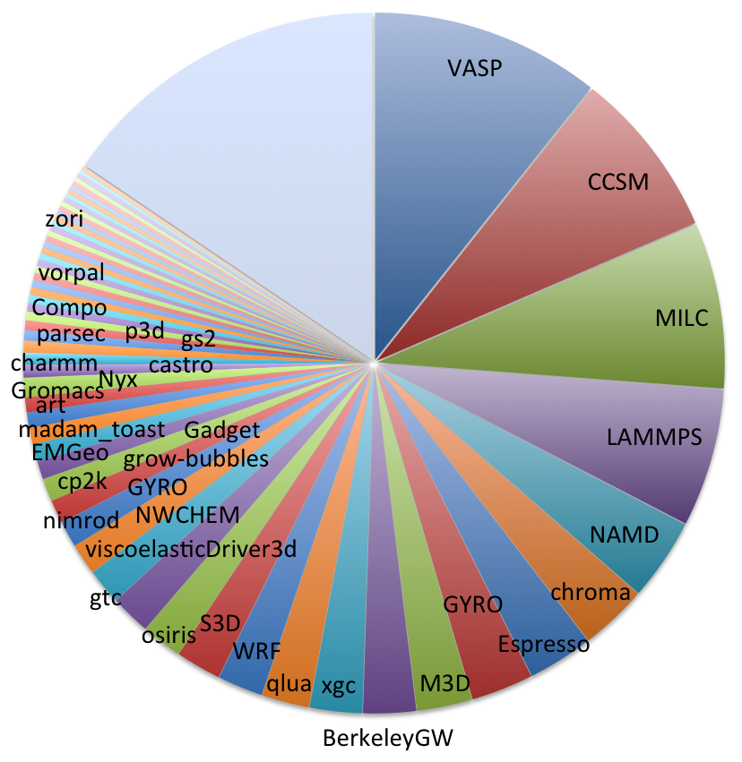


Increase for Computational Materials Sciences
Funding
FY 2015 included $8M for new awards. FOA announced in January 2015 for proposals for 4-year research projects to be funded at $2-4M per year.
FOA closed on 4/17/2015; award announcement expected by June 2015.
Why computational materials sciences? The U.S. trails competitors in computational codes for materials discovery and engineering
At NERSC, the most used code is VASP, an commercial Austrian atomic scale materials modeling code requiring purchase of license.
(Quantum) Espresso, a popular materials modeling code, was developed by Italy.
Top codes for other fields used at NERSC were developed in the U.S. and are all free, community codes.
Atomic Scale Materials Modeling
Climate
QCD Physics
Molecular Dynamics
Biophysics
QCD Physics
Plasma Physics
Atomic Scale Materials
Modeling
Atomic Scale Materials Modeling
2013 Top Application Codes at NERSC
8
Notes:
FY 2016 budget language:
Recent major strides in materials synthesis, processing, and characterization, combined with concurrent advances in computational science—enabled by improvements in high performance computing capabilities—have opened an unprecedented opportunity to design new materials with specific function and properties. The opportunity is to leap beyond simple extensions of current theory and models of materials towards a paradigm shift in which specialized computational codes and software enable the design, discovery, and development of new materials, and in turn, create new advanced, innovative technologies. Given the importance of materials to virtually all technologies, computational materials sciences is a critical area in which the United States needs to be competitive.
If successful, this paradigm shift would significantly accelerate the design of revolutionary materials to meet the Nation’s energy goals and enhance economic competitiveness. Development of fundamentally new design principles could enable stand-alone research codes and software packages to address multiple length and time scales for prediction of the total functionality of materials over a lifetime of use. Scientific workshops and National Research Council studies have identified enticing scientific challenges that would advance these goals. Examples include dynamics and strongly correlated matter, conversion of solar energy to electricity, design of new catalysts for a wide range of industrial uses, and transport in materials for improved electronics. Success will require extensive research and development with the goal of creating experimentally validated, robust community codes that will enable functional materials innovation.
Research and development to create the computational codes requires a fully integrated team approach, combining the skills of experts in materials theory, modeling, computation, synthesis, characterization, and processing/fabrication. The range of the research includes development of new ab initio theory, mining the data from both experimental and theoretical databases, performing advanced in situ/in operando characterization to generate the specific parameters needed for computational models, and well controlled synthesis to confirm the predictions of the codes. Many of the underlying phenomena require understanding the material dynamics at ultrafast time scales and with near atomic resolution—requiring effective use of the unique world leading tools and instruments at DOE’s user facilities, from ultrafast free electron lasers to aberration corrected electron microscopes to the best tools for atomically controlled synthesis. This is also an important topic for U.S. international scientific competitiveness as many of the codes currently used for materials research and engineering were developed outside of the U.S.
To facilitate U.S. leadership in this competitive field, FY 2016 funding will continue support of teams of scientists and engineers who received multi-year awards in FY 2015 to perform the basic research and develop/deliver codes and associated experimental/computational data for the design of functional materials. Additional FY 2016 funding is requested to support research for functional material topics not supported in FY 2015. Each research team will focus on a different area of functional materials. BES management and coordination among the teams would further leverage activities and accelerate key foundational research. An ideal end product for this research is open source, robust, validated, user friendly software that captures the essential physics and chemistry of relevant systems and can be used by the broader research community and by industry to dramatically accelerate the design of new functional materials. Following the effective management approach employed with other large team research activities, BES will actively manage the project through annual peer reviews to assess progress towards planned scientific goals. Early in the award period, each funded research team will be reviewed, with a focus on management and early research activities.
FY 2016 Request: Computational Materials Sciences will advance U. S. leadership in the development of computational codes for materials sciences and engineering. The research activities involve teams of theorists, computational experts, and experimentalists with expertise in synthesis, characterization, and processing/fabrication of materials. The computational materials sciences teams that will start in FY 2015 will perform the first year of research as outlined in their proposals. This research will focus on basic science necessary to develop research-oriented, open-source, experimentally validated software and the associated databases required to predictively design materials with specific functionality. Funding will support additional research teams focused on functional materials topics not supported by the FY 2015 awards. Early in the award period, all teams will be peer reviewed to assess management and early research activities for each award.
Change explanation: In addition to supporting the ongoing research for the FY 2015 awards, the FY 2016 request will broaden the technical breadth of the research to include teams focused on additional types of materials functionality.

Slide 9
BES User Facilities Hosted Over 16,000 Users in FY 2014
More than 300 companies from various sectors of the manufacturing, chemical, and pharmaceutical industries conducted research at BES scientific user facilities. Over 30 companies were Fortune 500 companies.

Slide 10




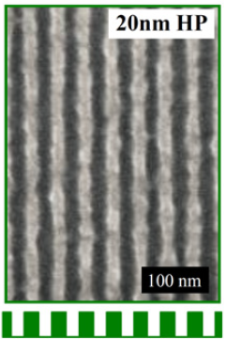
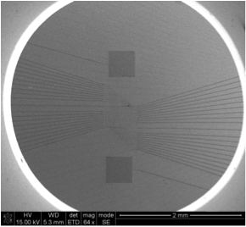
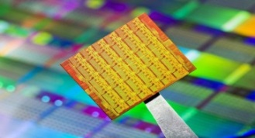
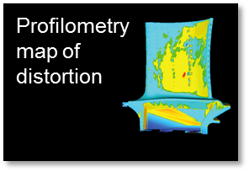
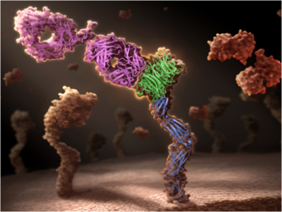
Industrial R&D at BES Scientific User Facilities
Next Generation Integrated Circuits
Improving NanoBioSensing Chips
Advanced Microprocessors
Laser Additive Manufacturing of Turbine Blades
From Protein Structures to Drugs
Novel Extreme Ultraviolet (EUV) photoresist was developed at NSRCs that has both high resolution and high sensitivity. This approach may be the key to achieving the industrial goals for sub14 nm nodes.
NSRC User Vista Therapeutics, Inc. launched the first commercial NanoBioSensorTM System which uses nanowire transistors to instantly detect target biomarkers via their electrical charge.
Unique NSRC hard x-ray Nanoprobe enables nondestructive measure of in-situ stress distributions in silicon-on-insulator (SOI)-based CMOS for sub 75nm microprocessor technology.
Neutron imaging and scattering have been used to understand the link between residual stress distortions and laser additive manufacturing of turbine blades with optimized internal cooling structures.
Developing a unique therapeutic antibody, onartuzumab, for treating multiple cancer types based on the structure information obtained from BES light source facilities
Notes:
Sematech/TMF – Next Generation Integrated Circuits
Users from Intel collaborated with staff from the Molecular Foundry and LBNL’s Advanced Light Source (ALS) to create a new photoresist containing dilute cross-linking that features both high-resolution and sensitivity, and could lead to patterned feature control at the molecular level. By adding dilute cross-linkers to a chemically amplified molecular resist, the researchers harnessed changes to molecular weight and intermolecular bonding to create a system that outperforms current resists which emphasize one contribution over the other.
Vista Therapeutics/CINT - Improving NanoBioSensing Chips
Working with CINT scientists and capabilities, Vista Therapeutics and BasePair Inc have developed nanowire-aptamer biosensors that can detect several proteins from a single drop of blood. Combining nanowires and aptamers increases signal strength and greatly improves the signal to noise ratio.
IBM/CNM – Advanced Microprocessors
Scientists from Argonne’s Center for Nanoscale Materials, Argonne’s Materials Science Division and the IBM Research Alliance recently reported a new method for quantitatively mapping lattice properties of nanoscale heterostructures with hard x-rays. This phase analysis can extract two distinct types of structural deformation at ~15 nm spatial resolution from complex structures without having to section or otherwise modify the sample. Coherent x-ray Bragg diffraction patterns from crystalline materials contain a wealth of information regarding the structure of the scattering object. Subtle, picometer-scale perturbations of the atomic lattice planes can lead to dramatic changes in the observed coherent diffraction at a Bragg peak. This encoded structural information yields unique insight into materials behavior, especially when employing techniques that resolve these structural details in real space such as Bragg Projection Ptychography (BPP) recently developed by Argonne’s Materials Science Division. By applying this technique to image lithographically defined interfaces present in nanoscale semiconductor heterostructures, this work demonstrates that the complex-valued maps resulting from the BPP technique can be analyzed to simultaneously resolve two distinct lattice deformations – lattice strain and lattice rotation. This approach can be applied to nanoscale and mesoscale strains that influence properties in other systems such as complex photovoltaic devices, wide bandgap semiconductors, and electrochemical systems.
Morris Technologies - Laser Additive Manufacturing of Turbine Blades
Employing the neutron imaging and scattering techniques at SNS, scientists from Morris Technologies are able to understand the link between residual stress distortions and laser additive manufacturing of turbine blades. The information is crucial to enable the low-cost manufacturing of turbines with optimized internal cooling structure.
Genentech - From Protein Structures to Drugs
Using the 3D structures obtained from ALS, scientists from Genentech are able to understand the mechanism of action to assesses its effectiveness in clinical trials for the therapeutic antibody, onartuzumab, for treating multiple cancer types. These structural information are crucial for the development of this new cancer fighting drug.

Slide 11
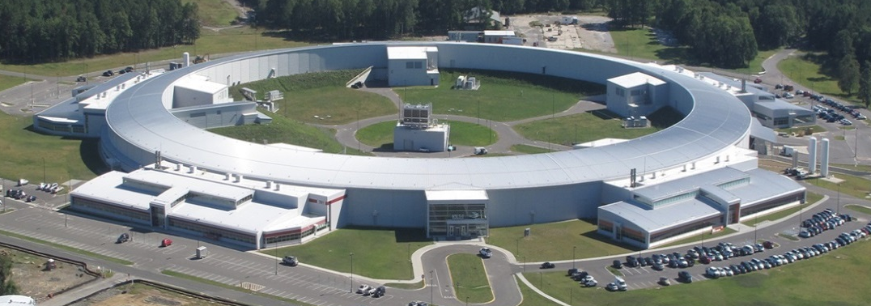
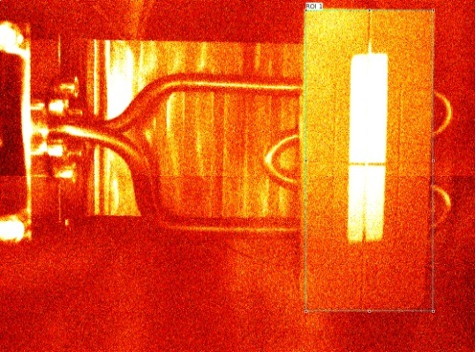
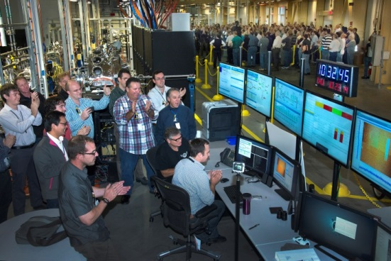
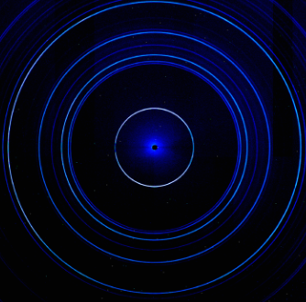
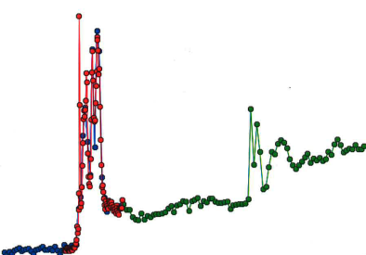
National Synchrotron Light Source-II
Successfully completed ahead of schedule and within budget
The project has delivered:
A highly optimized electron storage ring with exceptional x-ray brightness and beam stability
Six advanced instruments, optics and detectors that capitalize on these capabilities
Design goals:
1 nm spatial resolution
0.1 meV energy resolution
Single atom sensitivity
First light on October 23, 2014
All project scope and Key Performance Parameters completed – Dec 2014
Office of Project Assessment Review Feb. 10-11, 2015, recommending CD-4 approval
NSLS-II First Light at CSX Beamline Oct 23, 2014
Aug 2005 CD-0, Approve Mission Need
Jul 2007 CD-1, Approve Alternative Selection & Cost Range
Jan 2008 CD-2, Approve Performance Baseline
Jan 2009 CD-3, Approve Start of Construction
Dec 2014 Project Early Completion
Feb 2015 S-1 Dedication of NSLS-II
Mar 2015 CD-4, Approve Start of Operations
First Diffraction Data
First Spectroscopy Scan
11

Slide 12

LCLS Facility
Injector
at 2-km point
Existing 1/3 Linac (1 km)
(with modifications)
New e⁻ Transfer Line
X-ray Transport Line (200 m)
Undulator (130 m)
Near Experiment Hall (underground)
X-Ray Transport/Optics/Diagnostics
Far Experiment
Hall (underground)
Notes:
Increased brightness & contrast +20%

Slide 13
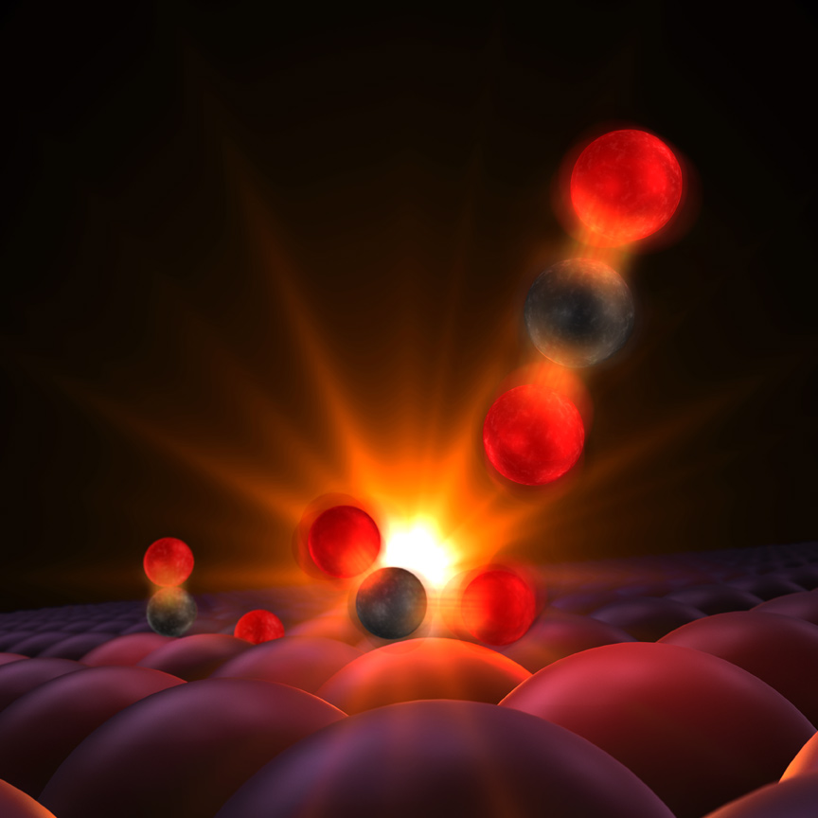

Probing the Transition State Region in Catalysis
Scientific Achievement
The transition state of CO oxidation on a Ru catalyst surface can be directly observed using the LCLS and an optical laser pulse excitation.
Significance and Impact
This work provides the first experimental detection of the transition state in a surface catalytic reaction, to directly validate models derived from the theory of heterogeneous catalysis.
Research Details
Carbon monoxide molecule, left, made of a carbon atom (black) and an oxygen atom (red), reacts with atomic oxygen (to the right of CO). A surface of a ruthenium catalyst holds them in proximity to facilitate their reaction. When excited with optical laser pulses 10¹² times per second, the reactants vibrate and the carbon atom forms a transitional bond with the oxygen (center). The resulting carbon dioxide molecule detaches and moves into the gas phase (upper right). The x-ray laser (LCLS) probes the evolution of the reaction with ultrafast pulses of 10⁻¹⁵ s duration, to show the formation of the transition state molecule and a new chemical bond between carbon and oxygen, in accordance with DFT calculations.
Öström, Öberg, Xin, LaRue, Beye, Dell'Angela, Gladh, Ng, Sellberg, Kaya, Mercurio, Nordlund, Hantschmann, Hieke, Kühn, Schlotter, Dakovski, Turner, Minitti, Mitra, Moeller, Föhlisch, Wolf, Wurth, Persson, Nørskov, Abild- Pedersen, Ogasawara, Pettersson, Nilsson, accepted in Science
From experiments at the SXR instrument at the LCLS and theory and calculations at the SUNCAT.
Notes:
Notes: Include 200 word highlight summary….

Slide 14
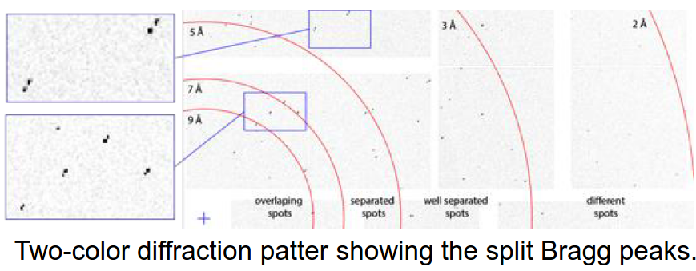


Twin-Bunch Two-Color X-ray FEL
Scientific Achievement
A new scheme for generating two hard-x-ray free-electron laser pulses based on twin- electron bunches with a controllable difference in photon energy
Operation both in SASE and hard X-ray self-seeded mode demonstrated and delivered to users
Significance and Impact
Improves the peak power of 2-color SASE by a factor 20 at hard X-rays
The unprecedented intensity and temporal coherence of this new two-color XFEL enable an entirely new set of scientific applications, ranging from pump-probe to imaging complex biological samples
Research Details
~10 fs pulse duration, over 1mJ 2-pulse energy
Up to 1% X-ray photon energy separation
(Variable pulse delay)
SASE
Seeded
5 sec running average
FEL spectra
Marinelli et al. Nature Comm. 6: 6369 DOI: 10.1038/ncomms7369
A.A. Lutman et al. Phys. Rev. Lett. 113, 254801
Notes:
Previous two color schemes relied on a single bunch and the use of two different K values for the undulator. Under the previous method, because the same electron bunch is used for lasing twice, yielding a total power typically between 5 and 15% of the full saturation power.
With our new setup each color is generated by one electron bunch using the entire undulator length, which improves the peak power (factor 20 at hard x-rays) and allows self-seeding on both colors.
This setup is now routinely delivered to the users. So far we have delivered it to 6 experiments:
1 MAD imaging experiment (S. Wakatsuki)
3 x-ray pump/x-ray probe experiments at hard x-rays (Bostedt,and Boutet/Schlichting in CXI and Barbrel in MEC)
1 x-ray pump/x-ray probe experiment in AMO (Marangos)
1 diagnostic experiment in AMO (Helml)

Slide 15
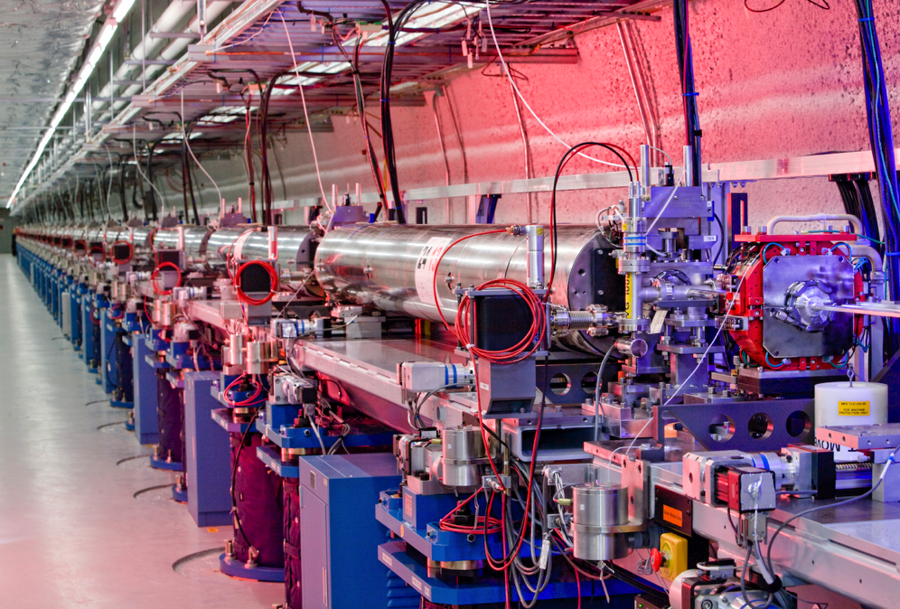

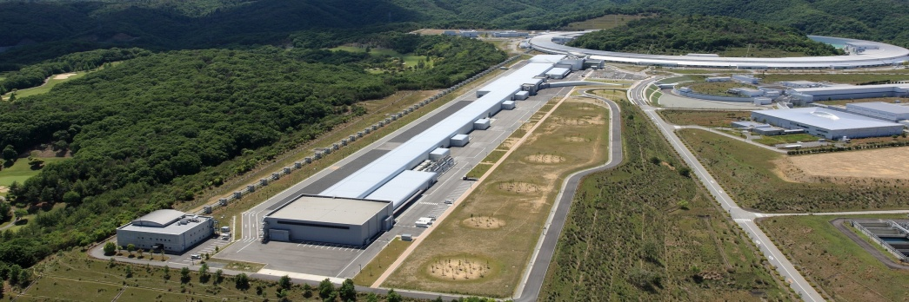
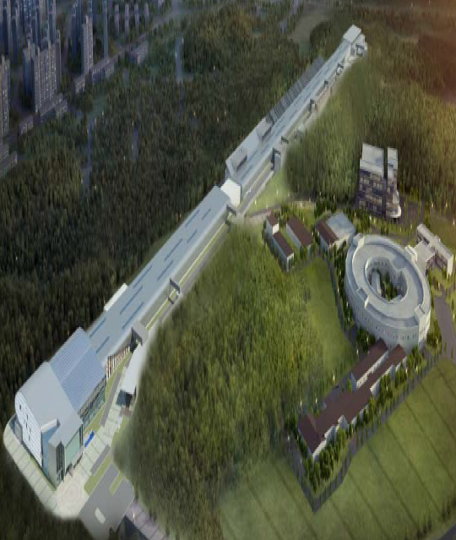

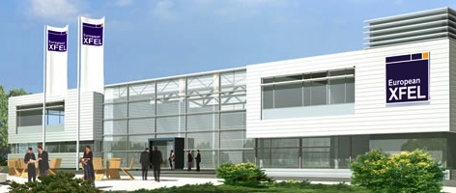

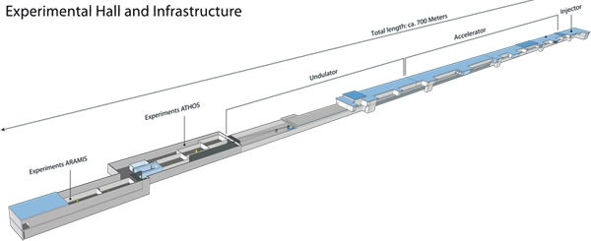

LCLS Faces Strong International Competition
LCLS 2009
14.5 GeV, 120 Hz NC
SACLA 2011
8.5 GeV, 30 Hz NC
XFEL 2016
17.5 GeV, 2700 x 10 Hz SC
PAL XFEL 2016
6 GeV, 100 Hz NC
SWISS FEL 2017 5.8 GeV, 100 Hz NC
Four normal conducting (NC) linacs
One pulsed superconducting (SC) linac

Slide 16

New Injector at
Beginning of linac
LCLS-II
New 4 GeV
Superconducting Linac
Extend existing transfer Line,
Bypassing LCLS Linac
New Hard x-ray Undulator,
fed by either SC or Copper linac
Use Existing X-ray Transport Line
New Soft x-ray undulator fed by
SC linac
Use Existing Near Experiment
Hall and instruments
Use Existing Far Experiment
Hall and Instruments
Notes:
Increased brightness & contrast +20%

Slide 17
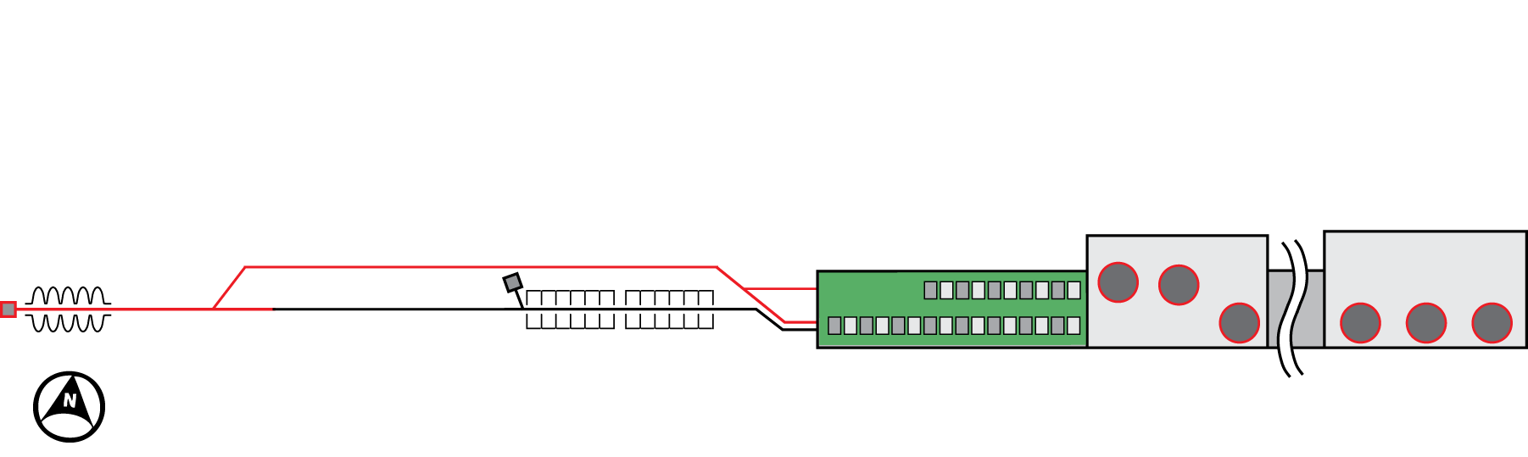
Revised LCLS-II in response to BESAC Subcommittee Report
Accelerator | Superconducting linac: 4 GeV
Undulators in existing LCLS tunnel | New variable gap (north) New variable gap (south), replaces existing fixed-gap undulator
Instruments | Repurpose existing instruments (instrument and detector upgrades needed to fully exploit)
Near
Experimental
Hall
Far
Experimental
Hall
4 GeV SC linac
In sectors 0-10
14 GeV LCLS linac still used
for x-rays up to 25 keV
North side source:
0.2-1.2 keV (~ 1 MHz)
South side source:
1.0 - 25 keV (120 Hz, copper” linac )
1.0 - 5 keV (~1 MHz, )
17
Notes:
Easier tuning and wider radiation wavelength tunability range

Slide 18





SLAC collaborating with other SC national laboratories on LCLS-II
50% of 1.3 GHz cryomodules
All 3.9 GHz Cryomodules
Cryoplant selection/design
Collecting costs for cryoplant
50% of 1.3 GHz cryomodules
Cryoplant concept & cost
Undulators & electron injector
Undulator vacuum chamber, R&D
Support for SC RF cavity prototyping
processing for high-Q
electron gun option

Slide 19
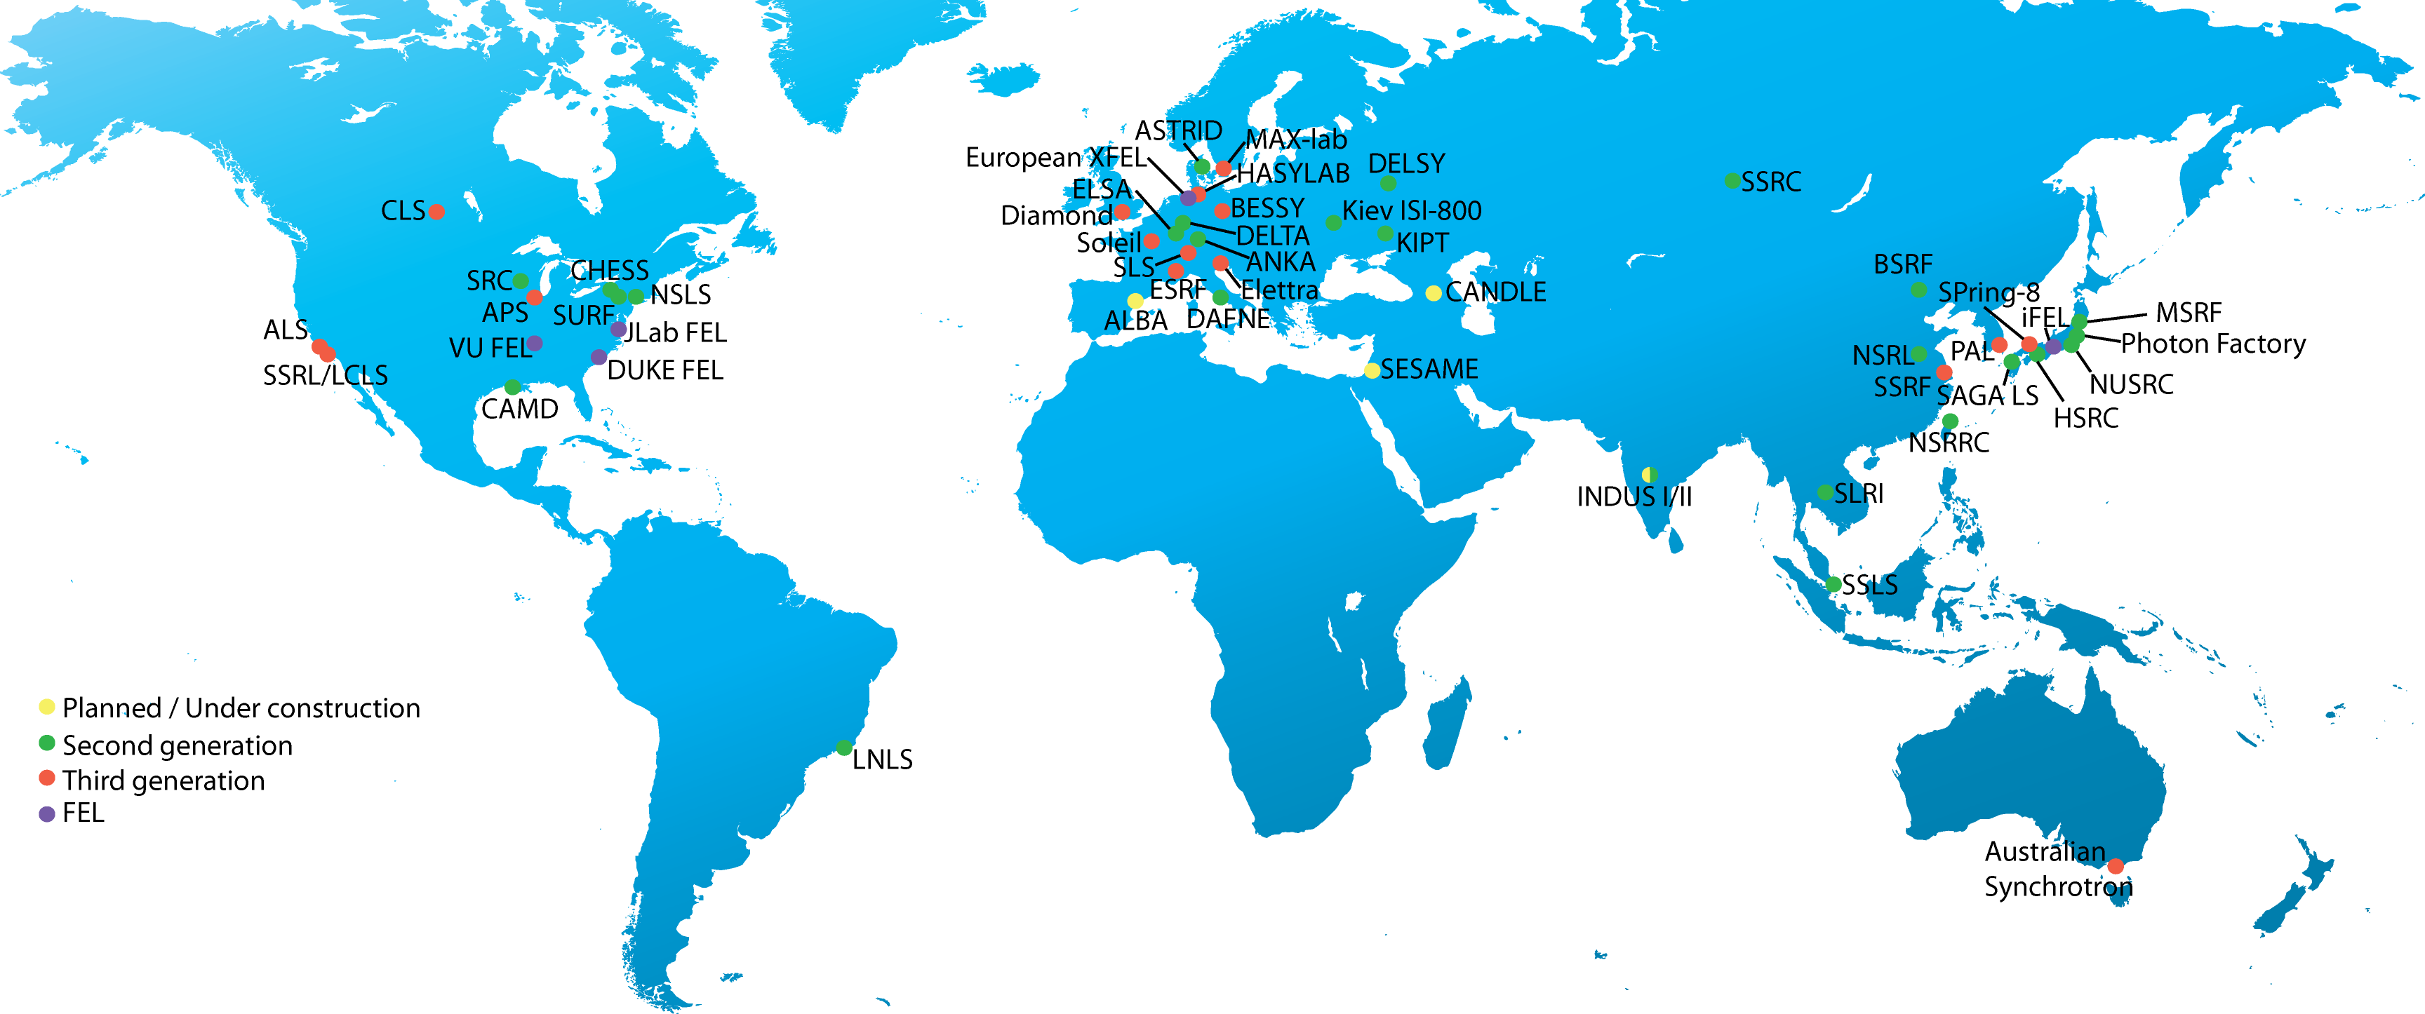
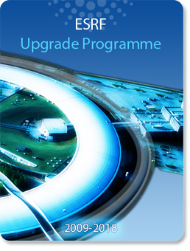
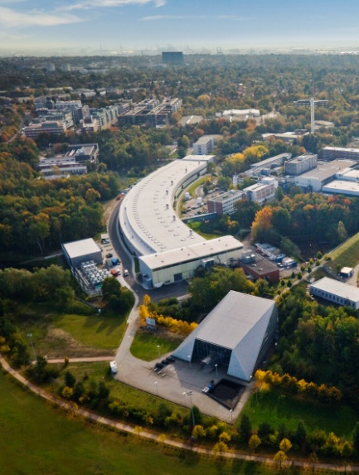
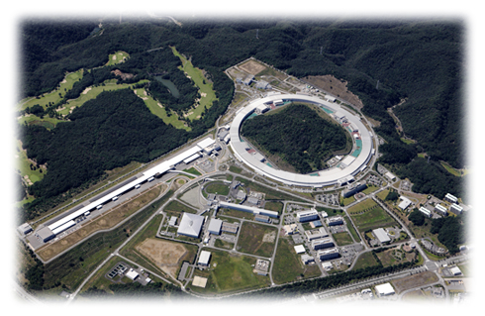

The World of Synchrotrons
-- APS faces fierce international competition --
ESRF, France: Upgrading
PETRA-III, Germany: New
SPring-8, Japan: Upgrading
19

Slide 20
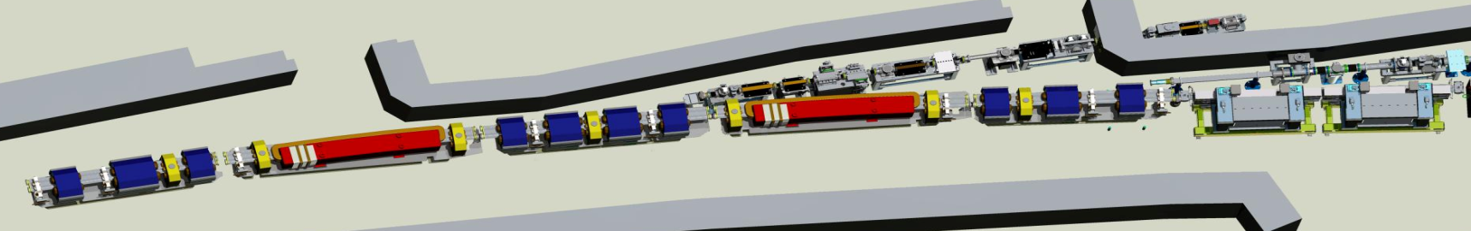
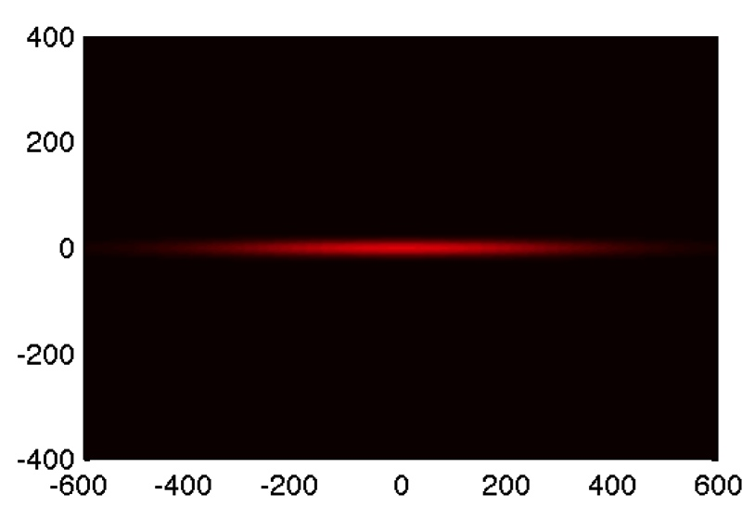
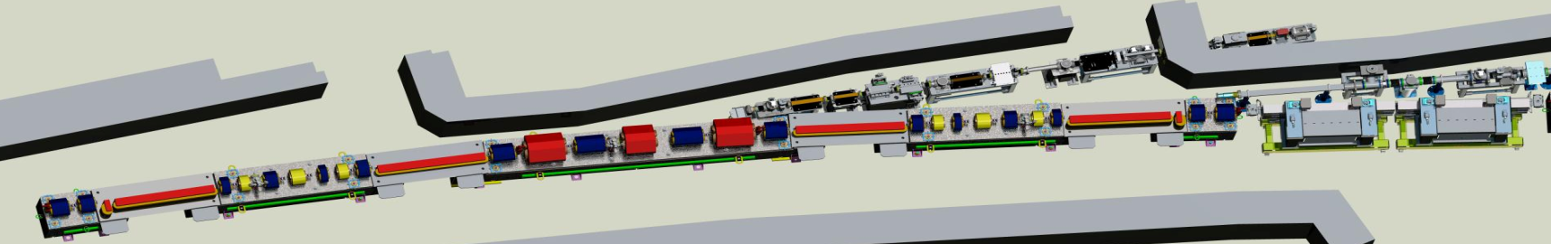
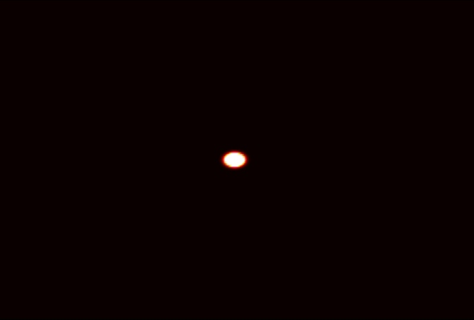
Advanced Photon Source Upgrade (APS-U)
APS today
APS w/MBA Lattice
Photon Beam Size Comparison
The APS-U project will:
Provide scientists with a high energy x-ray source possessing world-leading transverse coherence and extreme brightness. The magnet lattice of the APS storage ring will be upgraded to a multi-bend achromat (MBA) configuration to provide brightness enhancements. This upgrade will ensure APS remains a world leader in hard x-ray science providing a unique scientific capability directly relevant to problems in energy, the environment, new and improved materials, and biological studies.
The most recent Critical Decision is CD-3A (Approve Long Lead Procurements), received on August 30, 2012. BES is currently working with the project to develop revised project management documentation. The project team has completed initial conceptual re-design of the project in response to the July 2013 BESAC report recommendations.
$20.0M is requested in FY 2016 to continue design, limited prototype procurements and fabrication, and testing of equipment.
Notes:
the red objects are the bending magnets
Full sector is 25 meters, including insertion devices. – 40 around the ring
1,200 magnets being replaced.
Circular beam creates flexibility in undulator design

Slide 21
FY 2016 BES Budget Request
Research programs
Energy Frontier Research Centers ($110M; Δ = $10M)
Mid-scale Instrumentation for ultrafast electron scattering ($5M)
Computational Materials Sciences ($12M; Δ = $4M)
Core Research & Energy Innovation Hubs at ~FY 2015 level ($550.5M)
Scientific user facilities
All full operating facilities at near optimal (~99%) operations ($850.9M)
NSLS-II 1st year of full operations ($110M; Δ = $19.6M )
FY 2016 Request:
$1,849.3M
(+$116.2M from FY 2015)
SUF Research 22.2
SBIR/STTR, LTSM & GPP
67.9
Construction
MIE
NSRCs 118.8
235.8
Neutron Sources
255
EFRCs, Hubs, CMS
161.1
Facilities
Ops 850.9
CSGB
Research
241
Light Sources
477.1
MSE
Research
270.4
Construction and instrumentation
NSLS-II instrumentation (NEXT) ($15.5M)
Advanced Photon Source upgrade ($20M)
Linac Coherent Light Source-II ($200.3M; Δ = $52.3M )

Slide 22
FY 2016 BES Budget Request Understanding, predicting, and controlling matter and energy at the electronic, atomic, and molecular levels
Increased funding for additional Energy Frontier Research Centers (EFRCs) (Δ = +$10,000K)
Increased funding for computational materials sciences research to expand technical breadth of code development for design of functional materials (Δ = +$4,000K)
New funding for mid-scale instrumentation for ultrafast electron scattering (Δ = +$5,000K)
Energy Innovation Hubs:
Joint Center for Energy Storage Research (JCESR) will be in its 4th year. (FY 15 = $24,175K; FY 2016 = $24,137K)
Joint Center for Artificial Photosynthesis (JCAP) is under review for renewal starting in September 2015. (FY 2015 = $15,000K; FY 2016 = $15,000K)
National Synchrotron Light Source-II (NSLS-II) begins its 1st full year of operations.
Linac Coherent Light Source-II (LCLS-II) construction continues.
BES user facilities operate at near optimum levels (~99% of optimal).
Two major items of equipment: NSLS-II Experimental Tools (NEXT) and Advanced Photon Source Upgrade (APS-U) are underway.
Notes:
The four highlight images are (left to right):
• A thiophene-based covalent organic framework (COF), a class of polymeric crystalline material similar to metal-organic framework (MOF) materials. These new porous materials can be doped to make them electrically conducting, thereby rendering them suitable for use in a variety of applications, including photovoltaics and electrical energy storage. Image from: Mircea Dinca, MIT. Image is an artistic rendering of the structure.
• A mushroom-pillar like structure formed via dynamic self-assembly of sticky epoxy droplets on electrode surfaces in an alternating (ac) electric field. By controlling the electric field and particle surface properties, other three-dimensional structures such as wavy furs and dense interconnected network architectures can be fabricated in a bio-inspired, out-of-equilibrium assembly process. Image from: Igor Aranson, ANL. Scanning electron microscope image; individual pillars are about 100 micrometers in length.
• Researchers using the high-brightness, highly penetrating x-rays at the Advanced Photon Source combined experimental methods to obtain high-resolution, quantitative measurements of the events involved in material cracking, and linked the measurements to a history of how a crack evolved. An aluminum-magnesium-silicon sample was mechanically tested until a crack formed and grew to failure. A top-down view of the crack-formation site shows crack growth along grain boundaries (black regions) or within grains (colored regions), with white curves representing crack shape over time. Image from: Shiu Fai Li, LLNL
• Ultrafast optical and x-ray pulses at the LCLS were used to study charge-transfer dynamics in films of dye-sensitized nanocrystals. Femtosecond time-resolved x-ray photoelectron spectroscopy identifies a transient charge-transfer state at the interface between a molecular dye and a nanoporous ZnO substrate, providing key insight into a potential bottlenecks in photoinduced free charge-carrier generation at such interfaces. Image from: Oliver Gessner, LBNL (early career)

