Slide 1
Status of the DOE
High Energy Physics Program
NAS Board on Physics and Astronomy
April 24, 2015
Jim Siegrist
Associate Director
for High Energy Physics
Office of Science, U.S. Department of Energy

Slide 2

The High Energy Physics Program Mission
…is to understand how the universe works at its most fundamental level:
Discover the most elementary constituents of matter and energy
Probe the interactions between them
Explore the basic nature of space and time
The Standard Model (SM) describes the elementary particles that make up ordinary matter and the forces that govern them with very high precision.
With the discovery of the Higgs boson, we have all the nominal pieces of the SM in place. But they don’t all fit perfectly…

Slide 3
Known Unknowns in Particle Physics
There is now a lot of “known” Beyond the Standard Model (BSM) physics, most of which is accessible to experiments:
Gravity at Microscopic Scales
  We have no theoretical model that works yet (but lots of ideas).
Earliest Moments of the Universe
  What caused the rapid early inflation of the universe? Is there a way to integrate inflation with the Standard Model?
Neutrino Masses
  Why are they so small? What is the mechanism that generates them?
Matter-Antimatter Asymmetry
  Matter exists and antimatter (almost) doesn’t. We don’t know why.
Dark Matter
  Clearly it exists. We have ruled out a lot of possible candidates but no clear evidence for what it is made of; the simplest explanations may be wrong.
Dark Energy
  Clearly it exists, but we don’t know anything about it’s nature.

Slide 4
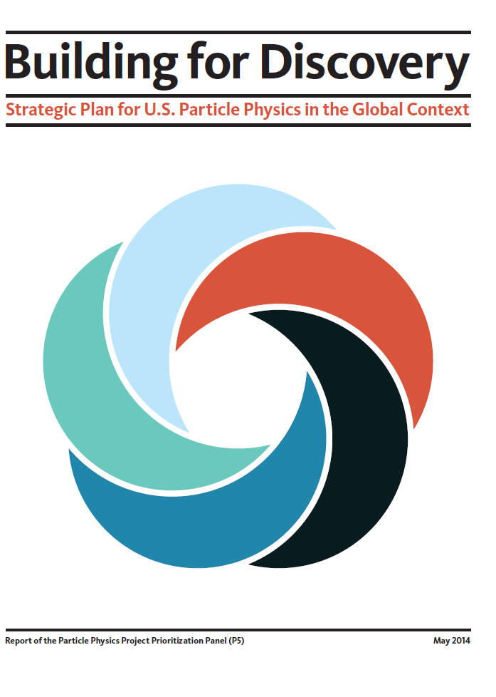
A Long-term Strategy to Enable Discovery
How do we address the science drivers and enable the next discovery in particle physics?
The Particle Physics Project Prioritization Panel (P5) report is the culmination of years of effort by the U.S. particle physics community
  2012 – 2013: American Physical Society’s Division of Particles and Fields organized a year-long community planning exercise (“Snowmass”)
  2013 – 2014: DOE and NSF charged the High Energy Physics Advisory Panel (HEPAP) to convene P5 to develop an updated strategic plan
    Plan to be executed over a ten year timescale in the context of a 20-year global vision for the field
  In May, 2014, HEPAP unanimously approved a P5 report that presents a strategy that enables discovery and maintains the U.S. position as a global leader in particle physics
U.S. particle physics community enthusiastically supports the new plan
  2,331 community members signed a letter of support to DOE and NSF

Slide 5

Particle Physics Is a Global Field
From Chapter 1 of the P5 Report
“The scientific program required to address all of the most compelling questions of the field is beyond the finances and the technical expertise of any one nation or region.”
“The capability to address these questions in a comprehensive manner is within reach of a cooperative global program.”
“The field is at a juncture where the major players each plan to host one of the large projects most needed by the worldwide scientific community.”
Japan
International
Linear Collider
Fermilab
Long-Baseline
Neutrino
Facility
CERN
Large
Hadron
Collider

Slide 6






The Science Drivers of Particle Physics
The U.S. long-term strategy report identified five intertwined science drivers, compelling lines of inquiry that show great promise for discovery:
Use the Higgs boson as a new tool for discovery
Pursue the physics associated with neutrino mass
Identify the new physics of dark matter
Understand cosmic acceleration: dark energy and inflation
Explore the unknown: new particles, interactions, and physical principles

Slide 7

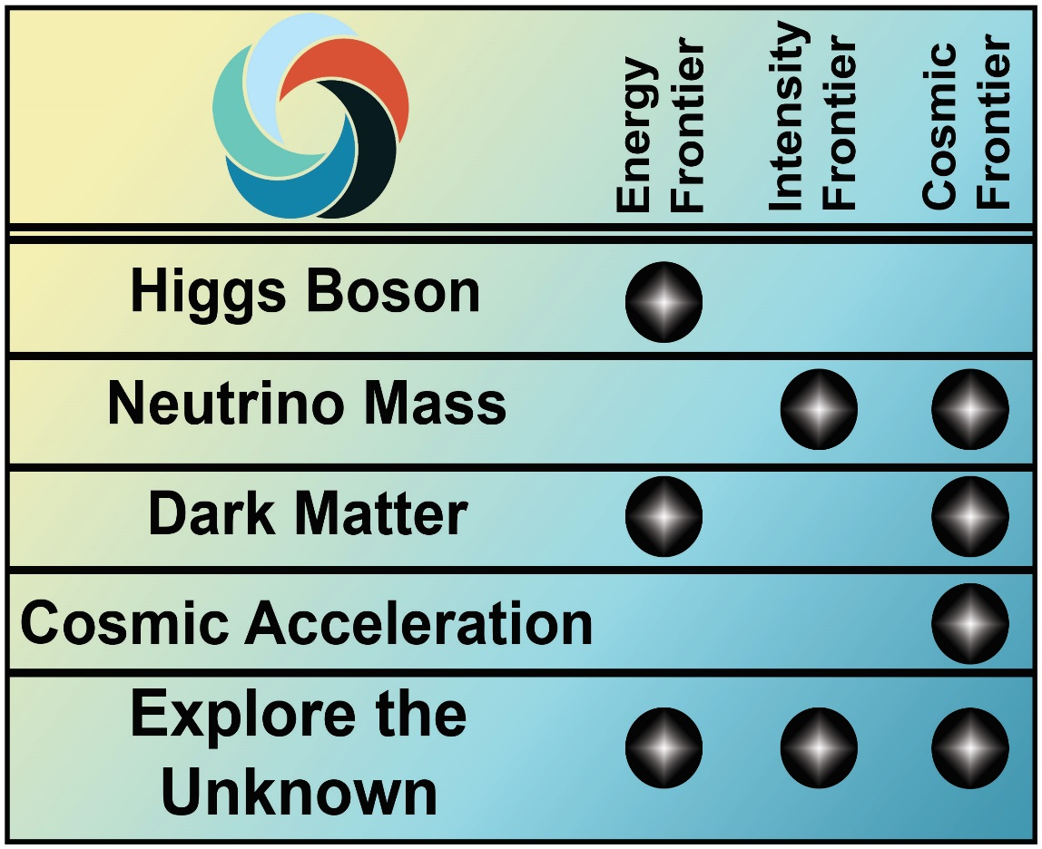

Enabling the Next Discovery
Science drivers identify the scientific motivation while the Research Frontiers provide a useful categorization of experimental techniques

Slide 8
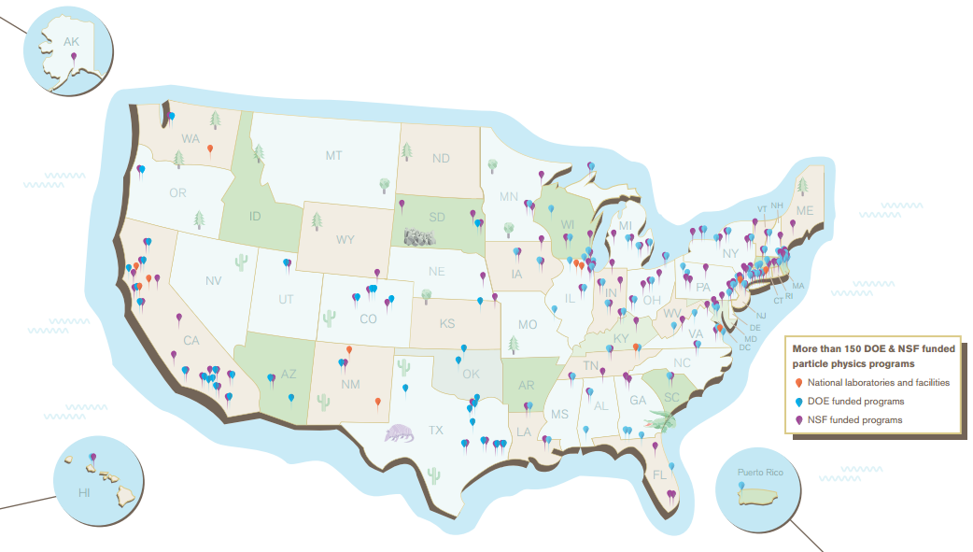
The U.S. HEP Program
U.S. particle physics research involves over 150 universities and laboratories in 43 states (plus Washington DC and Puerto Rico)
Major activities at 5 national laboratories (ANL, BNL, FNAL, LBNL, SLAC) involving ~2,600 FTEs
University research program consists of ~250 active grants to >100 institutions, involving ~1,700 FTEs
A few small, specialized research efforts at other SC and NNSA labs

Slide 9
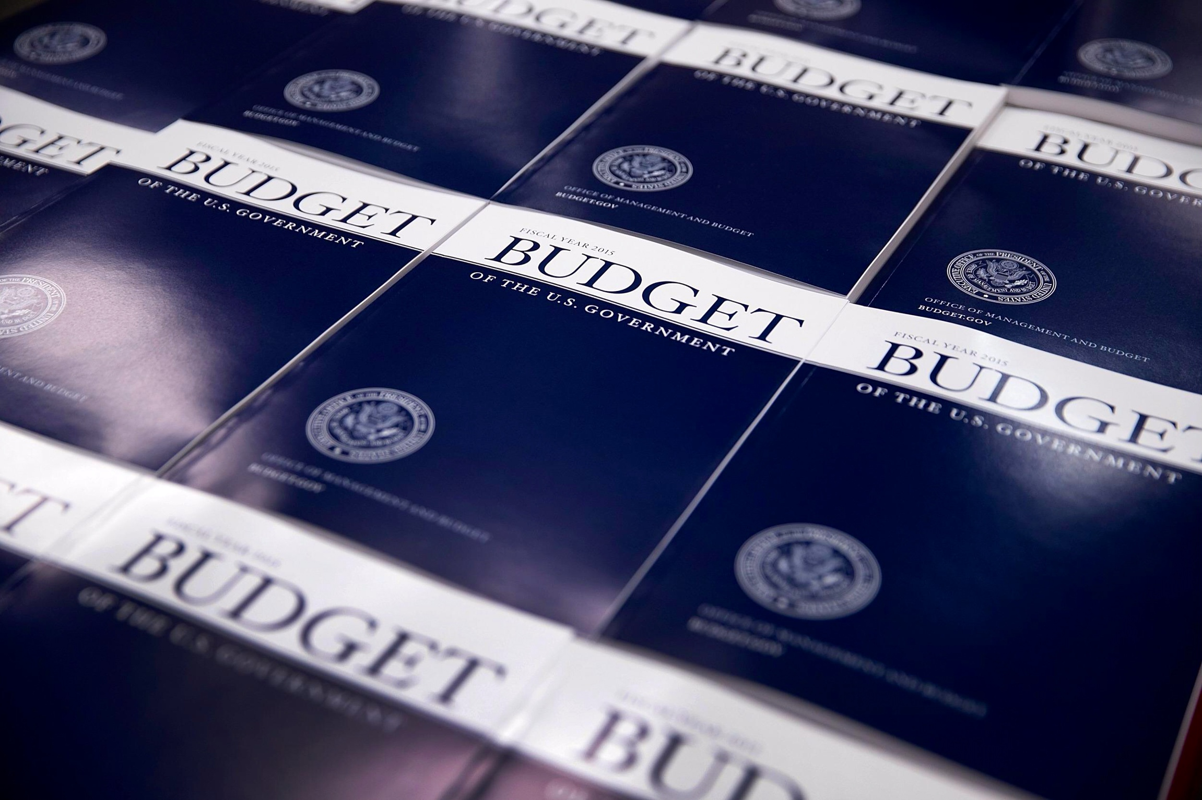
HEP Budget AND ISSUES

Slide 10
Funding Trends by Fiscal Year
(FY 2016 shows President’s Request)
Ramp up ILC and SRF R&D programs
Begin
P5
Plan
Trading Projects for more Research
P5 report recommendation suggests increasing the project budget fraction to 20%–25%
  “Addressing the [science] Drivers in the coming and subsequent decades requires renewed investment in projects.”
P5 report strategy has informed the HEP request in the FY 2016 DOE budget

Slide 11
FY 2016 HEP Funding by Activity
HEP Funding Category ($ in K) | FY 2014 Current | FY 2015 Enacted | FY 2016 Request | Explanation of Changes (FY16 vs. FY15)
Research | 373,932 | 337,383 | 334,703 | Research reductions support project investments
Facilities | 278,683 | 265,125 | 262,658 | Maintain efficient operations of facilities and ongoing experiments
Projects | 71,305 | 105,698 | 113,401
Energy Frontier Projects | 0 | 15,000 | 19,000 | Ramp up in LHC detector upgrades fabrication
Intensity Frontier Projects | 37,400 | 43,970 | 33,700 | Continue g-2 and FNAL acc. upgrade profiles; some LBNF efforts move to construction
Cosmic Frontier Projects | 30,705 | 45,728 | 58,701 | Increase supports LSSTcam, DESI and second generation dark matter experiments
Other Projects | 3,200 | 1,000 | 2,000 | Planned Lattice QCD hardware acquisition
Construction (Line Item) | 51,000 | 37,000 | 56,100 | Planned profile for Mu2e; engineering and design for LBNF
SBIR/STTR | 21,601* | 20,794 | 21,138
Total | 796,521* | 766,000 | 788,000 | Current House mark for FY16: $776,000 K
adf
* SBIR/STTR added to FY 2014 for comparison to FY 2015/2016

Slide 12
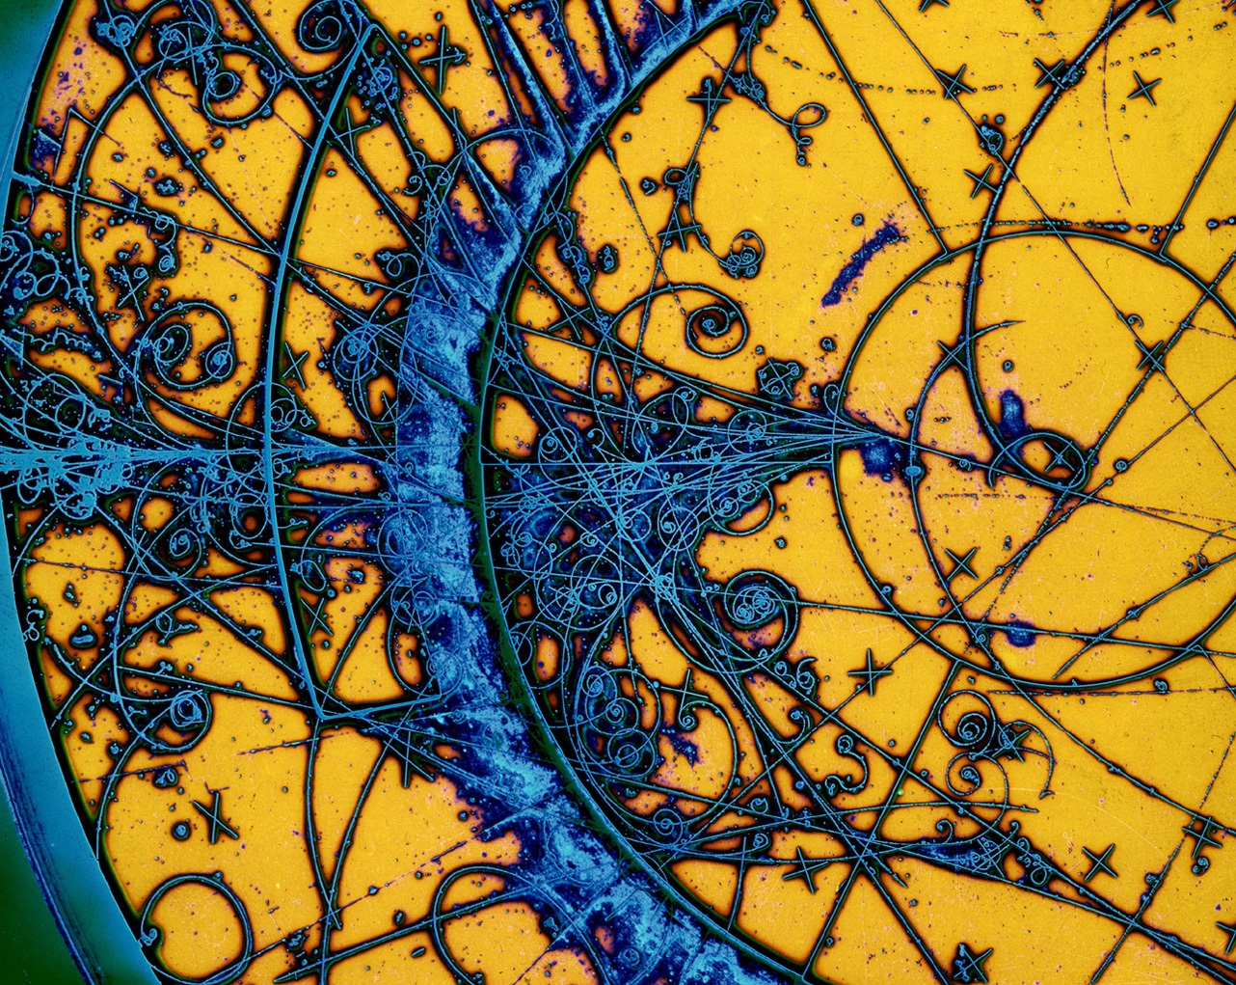
DOE HEP Program Status

Slide 13
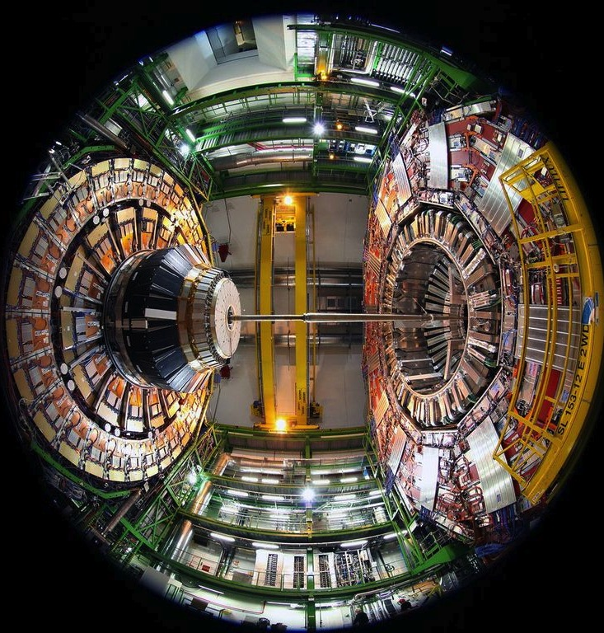
Energy Frontier

Slide 14
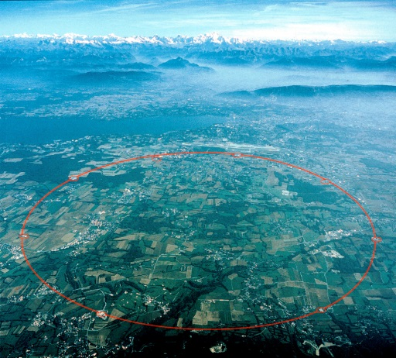
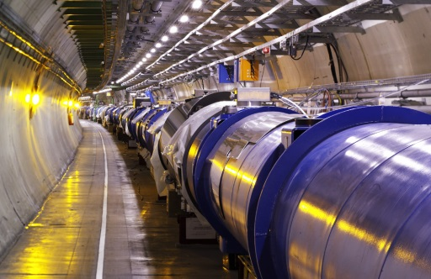
Enabling Discovery at the Energy Frontier
Energy Frontier researchers accelerate particles to the highest energies ever made by humanity and collide them to produce and study the fundamental constituents of matter
  The Large Hadron Collider (LHC) is currently the centerpiece of Energy Frontier research, where scientists seek to observe newly produced particles to provide insight into fundamental forces of nature and the conditions of the early universe
The Energy Frontier pursues these science drivers:
  Use the Higgs boson as a new tool for
  discovery
  Identify the new physics of dark matter
  Explore the unknown: new particles,
  interactions, and physical principles
Higgs boson
Dark matter
Explore the Unknown

Slide 15
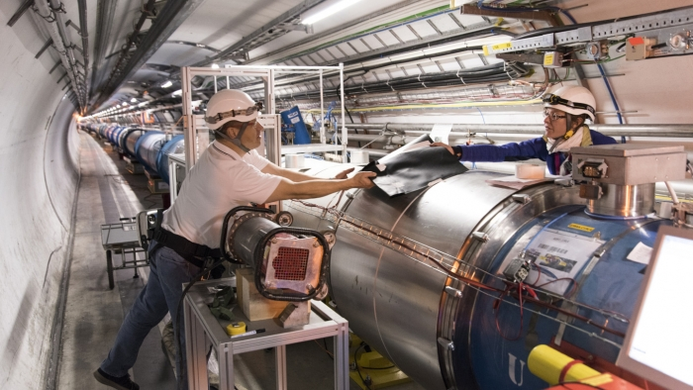
Energy Frontier Highlight:
LHC Prepares for Run 2
LHC restarted on April 5, 2015!
  Circulating beams achieved in opposite directions, passing through the detectors of all 4 LHC experiments
  First collisions of Run II could begin as early as next month
Higher energy collisions at 13 TeV will increase the reach into search for new physics in high-impact topics:
  SUSY, dark matter,
  extra dimensions, …
  Run II aiming for an
  integrated luminosity
  ~100 fb⁻¹
    Higgs boson was
    first observed using
    ~10.5 fb⁻¹

Slide 16
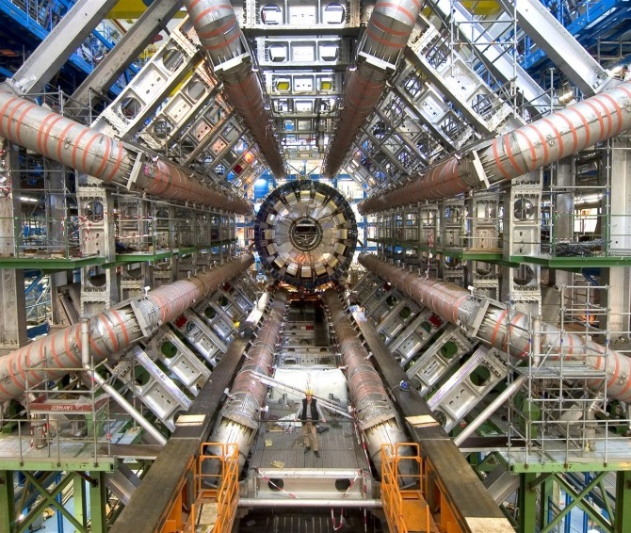
Energy Frontier Status
Current program
400+ LHC Run I papers submitted by each of the ATLAS and CMS Collaborations
The U.S. will continue to play a leadership role in LHC discoveries and is actively executing the initial upgrades (Phase-1) to the LHC detectors
  Phase-1 U.S. CMS/ATLAS upgrades received CD-2/3 approval on November 12, 2014
Planned program
Considering high-luminosity LHC upgrade around 2023 to extend discovery reach
  Increase luminosity by 10 times LHC design value
  to explore new physics at TeV energies
  DOE/HEP actively working with US-CMS/ATLAS to
  begin mounting HL-LHC Detector Upgrade Project
The new bilateral CERN-DOE-NSF Cooperation
Agreement is nearing signature
  DOE has initiated drafting of the 3 Annexes
  (≡ Protocols) to the umbrella agreement
Modest investments in R&D for future
options:
  Lepton colliders
  Very high energy hadron colliders

Slide 17
Energy Frontier Strategy
P5 report identified LHC upgrades as the highest priority near-term large project and specifically recommends:
  Complete “Phase-1” (2018) upgrades of ATLAS and CMS experiments
  Continue collaborations with the “Phase-2” (High-Luminosity LHC, 2023-25) upgrades of the accelerator and the ATLAS and CMS experiments
    HL-LHC upgrades will increase LHC luminosity by a factor of 10 beyond its design value and significantly extend its discovery potential
  U.S. leadership in superconducting magnet technology in general, and with Nb₃Sn in particular, is widely recognized and acknowledged
    U.S. LHC Accelerator Research Program (LARP) aims to leverage this expertise to serve needs of HEP community
      Consists of four U.S. laboratories, BNL, FNAL, LBNL, and SLAC
      Aims to realize the full capability of the LHC and maximize the discovery potential of U.S. investments in the LHC
P5 noted the strong scientific importance of the ILC global project:
  Recommended modest and appropriate levels of ILC accelerator and detector design in areas where the U.S. can contribute critical expertise
  Report emphasized that support for these efforts would ensure a strong position for the U.S. within the ILC global project

Slide 18
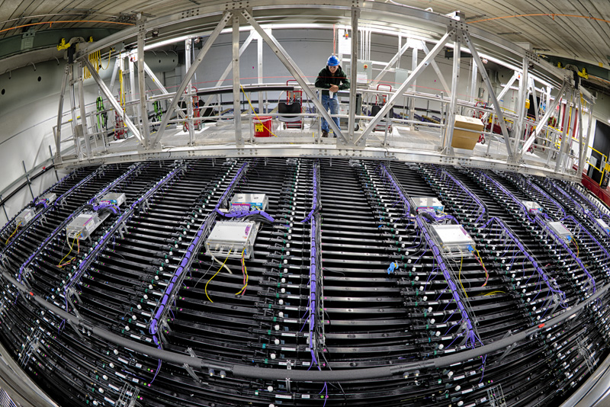
Intensity Frontier

Slide 19
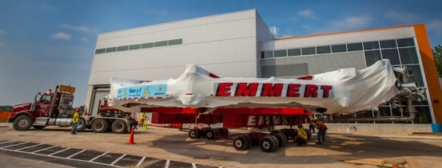
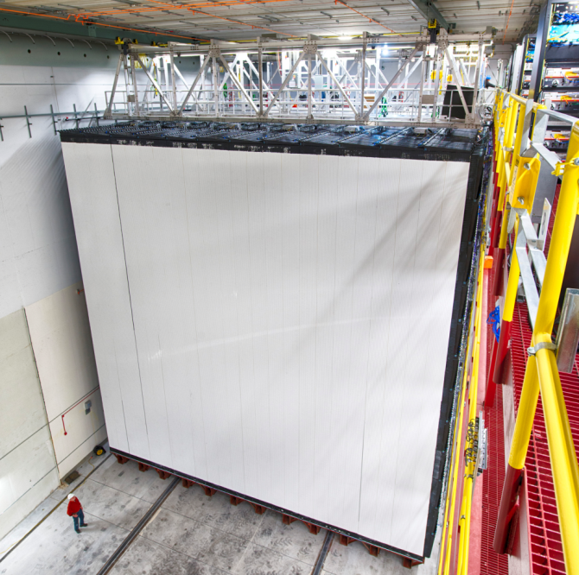
Enabling Discovery at the Intensity Frontier
Intensity Frontier researchers use intense particle beams and highly sensitive detectors to make precise measurements and search for new physics
  Precise measurements of particle properties and studies of the rarest particle interactions predicted by the Standard Model could uncover new physics
  Measuring the mass and other properties of neutrinos may have profound consequences for understanding the evolution and fate of the universe
The Intensity Frontier pursues these science drivers:
  Pursue the physics associated with
  neutrino mass
  Identify the new physics of dark matter
  Explore the unknown: new particles,
  interactions, and physical principles
Neutrino Mass
Dark matter
Explore the Unknown

Slide 20
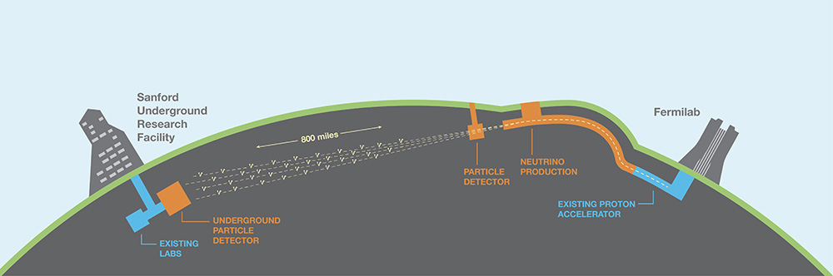
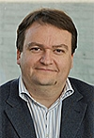

Intensity Frontier Highlight:
International Collaboration Established for DUNE
The long-baseline neutrino experiment has transformed into the Deep Underground Neutrino Experiment (DUNE)
  Major milestone in the implementation of the P5 report strategy
Collaboration includes 700 scientists from 23 countries in Asia, Europe, and North and South America
  André Rubbia (ETH Zurich) and Mark Thomson (University of Cambridge) have been elected spokespersons of the international collaboration
First collaboration meeting was held April 16—18 at FNAL
  DUNE seeks further international partners to participate in this world-class experiment!
DOE is working with the International LBNF/DUNE programs to develop the organizational structure

Slide 21
Intensity Frontier Status
Exploring the unknown through precision measurements
Development of muon-beam based program at Fermilab continues:
  Muon g-2: Cryogenic test of the SC magnet system will be completed before baselining
  Mu2e: Reached CD-2/3 on March 4, 2015
Collaborating with Japan on K meson, c/b quark, and τ lepton precision studies:
  Belle II: reached CD-3 in April 2014
  K0TO
Identify the physics of dark matter
APEX and Heavy Photon Search performing particle beam based searches for DM
  Heavy Photon Search (HPS) expects first physics run this month!
Pursuing the physics associated with neutrino mass
Mass hierarchy & ν properties studied at Fermilab, Japan, China, and underground:
  Daya Bay, MicroBooNE, MINERvA, MINOS+, NOvA, Super-K, T2K
Sterile neutrino search and neutrino CP violation program continues to evolve:
  Fermilab short-baseline neutrino (SBN) program will complement MicroBooNE with ICARUS arrival in 2017, LAr1-ND installation in 2018
  Workshop on Intermediate Neutrino Program (WINP) at BNL provided useful input for taking the next step in the non-FNAL neutrino program
  DUNE established as international long-baseline neutrino experiment

Slide 22
Intensity Frontier Strategy
The P5 report recommended completing the Muon g-2 and Muon-to-electron Conversion (Mu2e) experiments at Fermilab, which provide complimentary ways of exploring the unknown for signs of new particles and interactions
P5 recommended substantial investments in the U.S. neutrino program in order to develop, with international partners, a coherent short- and long-baseline neutrino program hosted at Fermilab
  The swift establishment of the international Deep Underground Neutrino Experiment (DUNE) is a strong indication of the high level of interest from the neutrino community in achieving this global vision
  The Fermilab Proton Improvement Plan II (PIP-II) program of updates to the accelerator complex will provide proton beams with power >1 MW by the time of first operation of DUNE
  A coordinated set of short-baseline neutrino experiments will address the observed anomalies in current neutrino experiments while advancing the R&D necessary for LBNF and DUNE

Slide 23
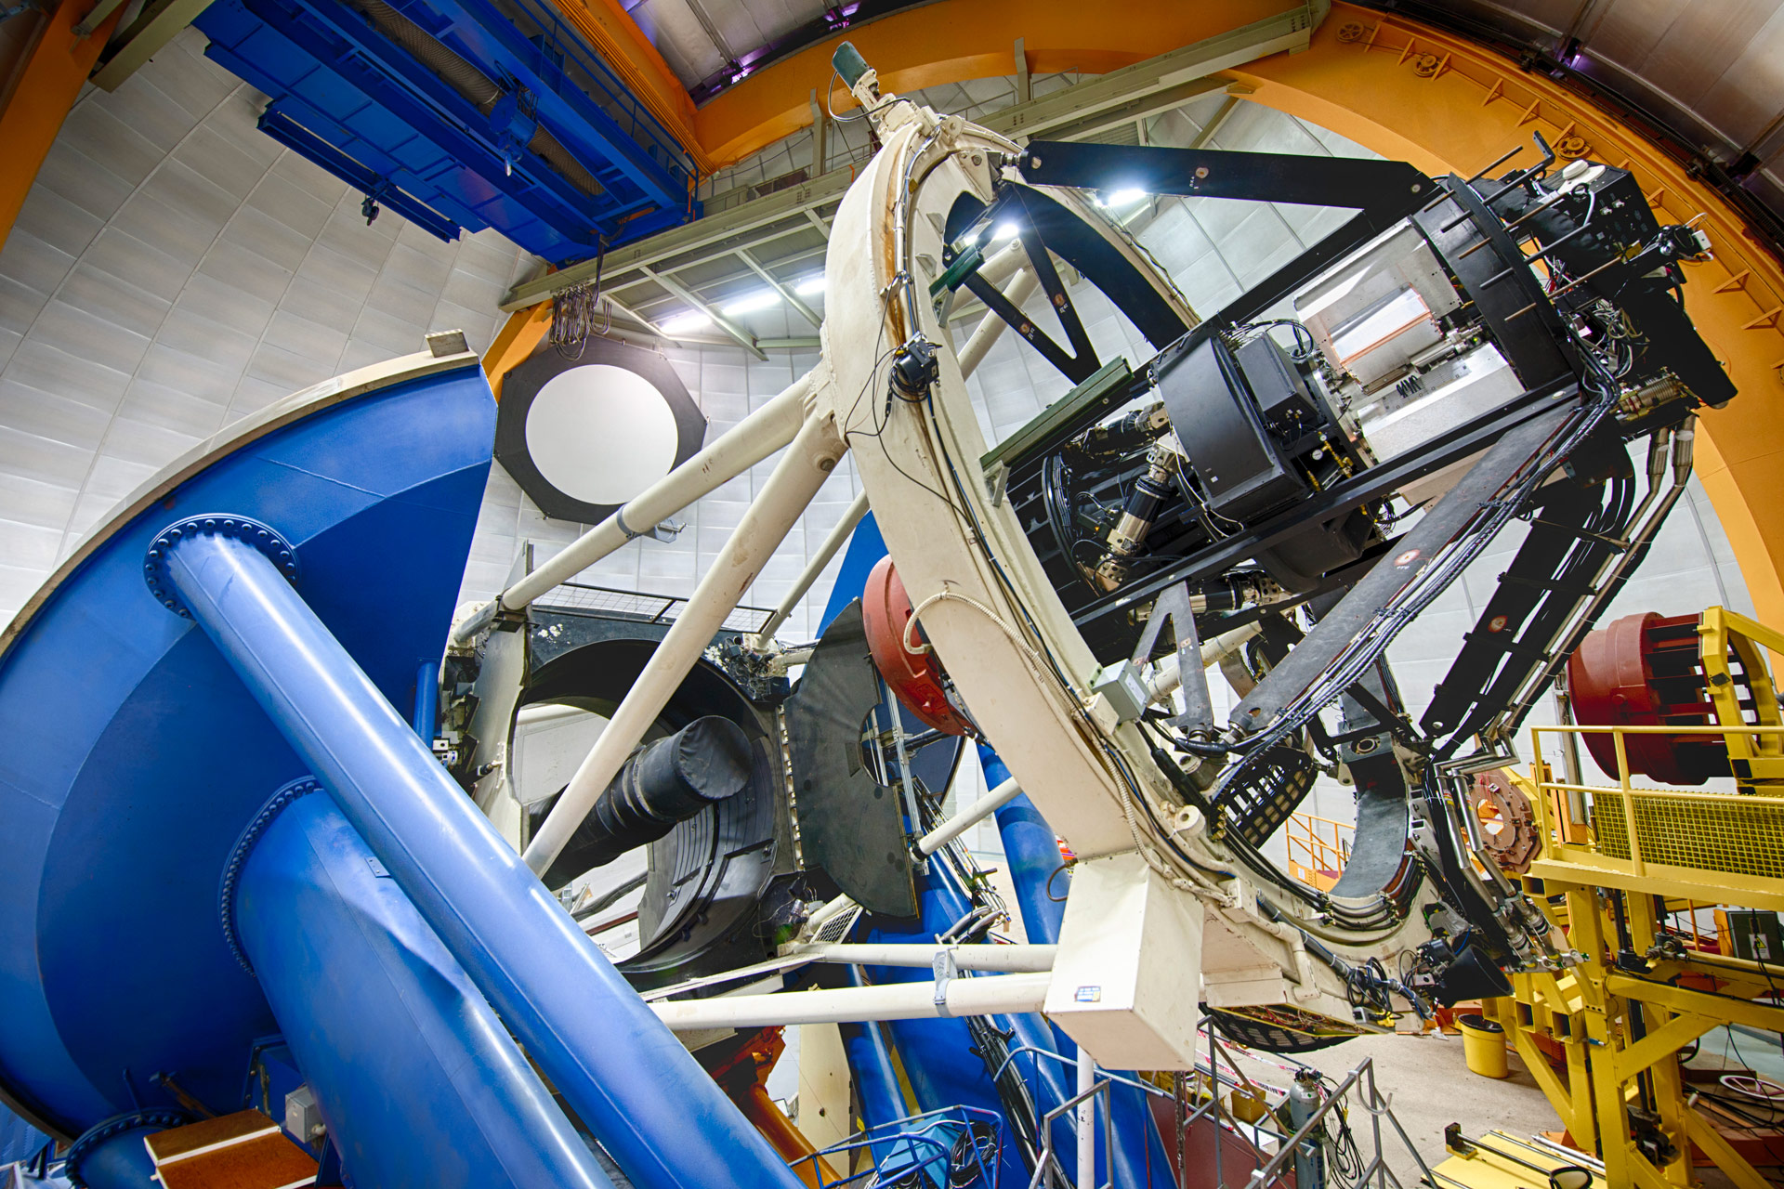
Cosmic Frontier

Slide 24
Enabling Discovery at the Cosmic Frontier
Cosmic Frontier researchers seek to reveal the nature of dark matter and dark energy by using naturally occurring particles to explore new phenomena
  The highest-energy particles ever observed have come from cosmic sources
  Ancient light from distant galaxies allows the distribution of dark matter to be mapped and perhaps the nature of dark energy to be unraveled
  Ultra-sensitive detectors deep underground may glimpse the dark matter passing through Earth
The Cosmic Frontier pursues these science drivers:
  Identify the new physics of dark matter
  Understand cosmic acceleration:
  dark energy and inflation
  Explore the unknown: new particles,
  interactions, and physical principles
  Aspects of “Pursue the physics associated
  with neutrino mass”
Dark matter
Cosmic acceleration
Explore the Unknown

Slide 25
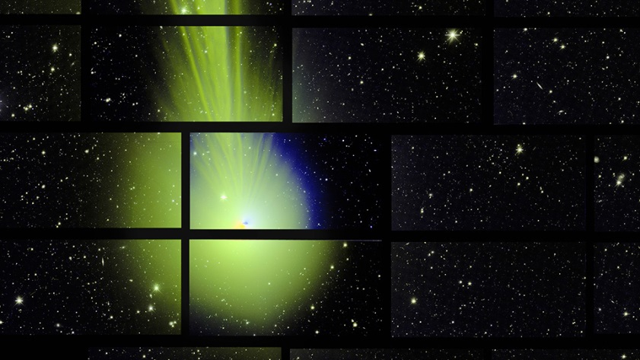
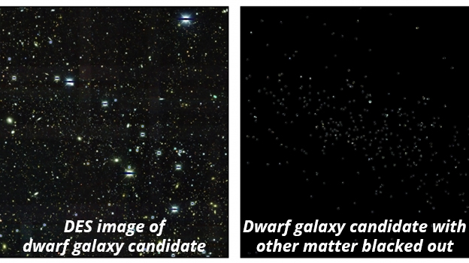
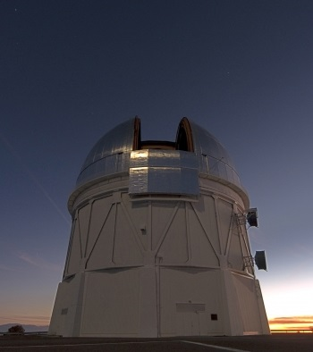
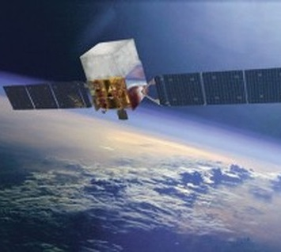
Cosmic Frontier Highlight:
DES Discovers Dwarf Galaxies, FGST Constrains Dark Matter
Images from the Dark Energy Survey’s 570-megapixel camera moves science forward as they continue to make headlines
  Partnership with NSF; DECam mounted on the 4-meter Victor Blanco Telescope in the Chilean Andes
  Captured a popular image of comet Lovejoy on December 27, 2014
DES data has led to the discovery of 9 new dwarf satellite galaxies orbiting the Milky Way
  Dwarf satellite galaxies are dominated by dark matter and present an excellent cosmic laboratory to search for signs of dark matter annihilation
  Fermi Gamma-ray Space Telescope used the newly discovered dwarf galaxies to put a tight limit on dark matter annihilation cross-section
  DES may find as many as 30 dwarf galaxies in the region of the sky it scans
  4 papers out in March 2015 using these data – from DES and FGST collaborations and independent work

Slide 26
Cosmic Frontier Status
Dark Energy
BOSS and DES anticipate releasing new results soon!
Large Synoptic Survey Telescope (LSST) received CD-3a in June 2014, CD-2 in Jan. 2015
  CD-3 review scheduled for August
Dark Energy Spectroscopic Instrument (DESI) received CD-1 in March 2015
  CD-2 review scheduled for July; fabrication start approved in FY 2015
  Finalizing MOA with NSF to transition Mayall telescope operations costs to DOE in FY2016 – FY2019
Dark Matter (direct detection)
Progress continues on DM-G2 experiments: ADMX-G2, LZ, SuperCDMS-SNOLab
  LZ & SuperCDMS-SNOLab MIE projects are approved for fabrication starts in FY 2015
  LZ held CD-1 review in March 2015, SuperCDMS-SNOLab will have CD-1 review in summer 2015
Cosmic-ray, Gamma-ray
Fermi/GLAST, AMS, and HAWC continue operations
  HAWC gamma-ray observatory began taking data in late November 2014
DOE operations efforts will complete in FY 2016 for VERITAS and Auger
Cosmic Microwave Background (CMB)
South Pole Telescope polarization (SPTpol) continues operations
SPT-3G had successful review of DOE roles/responsibilities in September 2014
  Fabrication funding approved for FY 2015 – 16
Community planning continues for a CMB Stage IV experiment

Slide 27
Cosmic Frontier Strategy
P5 recommended proceeding immediately with a broad second-generation (G2) dark matter direct detection program and R&D towards third generation experiments
  Three G2 experiments jointly selected by DOE and NSF in July 2014 (ADMX-G2, LZ, and SuperCDMS-SNOLab); fabrication will begin in 2015
P5 supported advancing the dark energy program from current generation of experiments to the Large Synoptic Survey Telescope (LSST) and the Dark Energy Spectroscopic Instrument (DESI)
  LSST baseline was approved in January 2015
  DESI is approved for fabrication start in 2015
P5 recommended an advanced cosmic microwave background (CMB) experiment sensitive to the early expansion phase of the universe
  Community planning towards a “Phase IV” CMB experiment continues

Slide 28
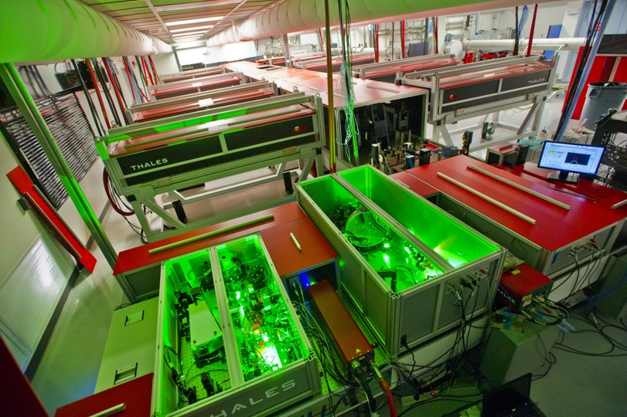
Advanced Technology R&D

Slide 29
Enabling Discovery though Advanced Technology R&D
Advanced Technology R&D supports and advances research at all three experimental Frontiers
  Fosters cutting-edge research in the physics of particle beams, accelerator R&D, and particle detection
Three broad categories:
  Near- to mid-term directed R&D for specific facilities or technologies in support of DOE projects (sometimes captured in project TPC)
  Mid-term, facility-inspired R&D focused on specific concepts or technologies to demonstrate feasibility and engineering readiness
  Long-term, proposal-driven research on the fundamental science underlying particle accelerators and beams to enable breakthroughs in size, cost, beam intensity, beam energy, and control

Slide 30
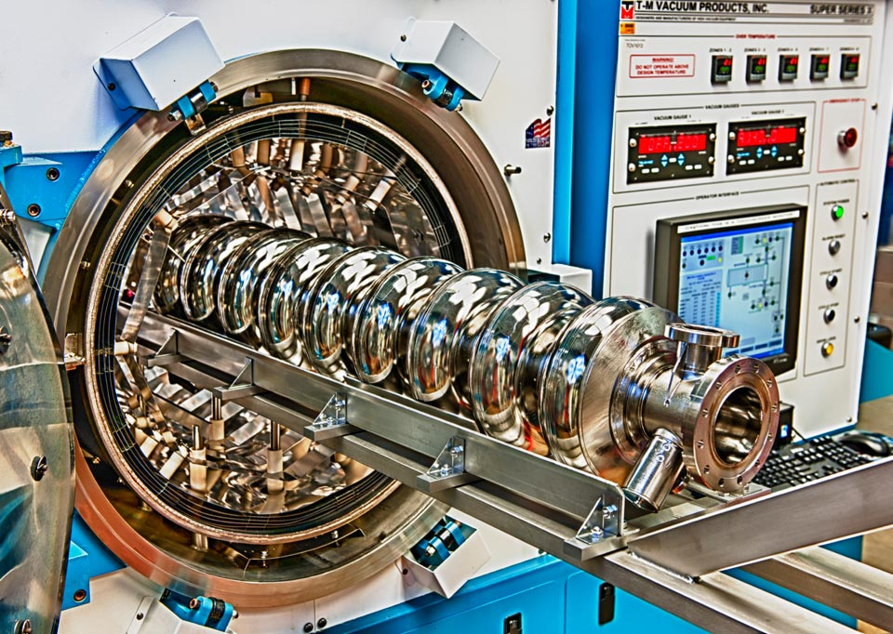
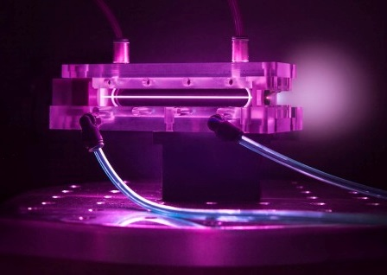
Recent Results from Advanced Technology R&D
Low-Loss Superconducting Radio-Frequency (SRF) Cavities using N₂-doping process developed by Fermilab
  LCLS-II (BES) will be the first beneficiary
Advances in laser-driven and beam-driven plasma wakefield accelerators
  Could produce high-gradient accelerators for future machines
Record current in high-temperature superconductors
  Could enable magnetic field levels that double existing particle collision energies

Slide 31
Advanced Technology R&D Strategy
P5 report recommended moving forward with a focused Advanced Technology R&D strategy:
  Play a leadership role in superconducting magnet technology focused on the dual goals of increasing performance and decreasing costs
  Reassess the Muon Accelerator Program, in consultation with international partners
  Pursue accelerator R&D with a focus on outcomes and capabilities that will dramatically improve cost effectiveness for mid-term and far-term accelerators
  Focus resources toward directed instrumentation R&D in the near-term for high-priority projects
On April 6, 2015, HEPAP approved a report by the Accelerator R&D Subpanel that evaluated the HEP accelerator R&D program and identified the most promising research areas to support the field
  Recommendations will guide HEP Accelerator R&D investments

Slide 32
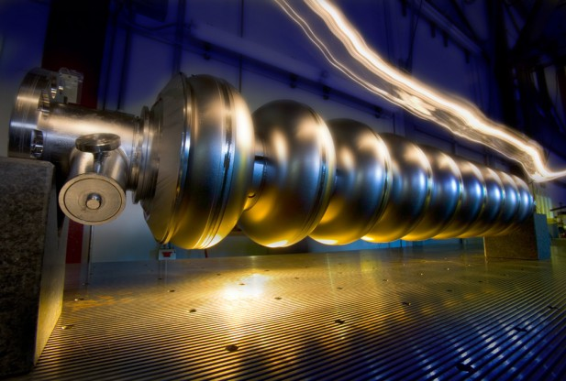
Accelerator Stewardship

Slide 33
The Accelerator R&D Stewardship Program
The mission of the HEP long-term accelerator R&D stewardship program is to support fundamental accelerator science and technology development of relevance to many fields and to disseminate accelerator knowledge and training to the broad community of accelerator users and providers.
Strategies:
  Improve access to national laboratory accelerator facilities and resources for industrial and for other U.S. government agency users and developers of accelerators and related technology
  Work with accelerator user communities and industrial accelerator providers to develop innovative solutions to critical problems, to the mutual benefit of our customers and the DOE discovery science community
  Serve as a catalyst to broaden and strengthen the community of accelerator users and providers
Engages the entire U.S. accelerator R&D ecosystem in a coordinated manner to solve high-impact challenges at a scale well beyond the reach of the DOE Small Business Innovation Research (SBIR) program

Slide 34
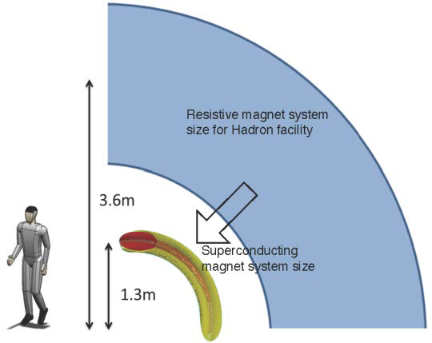
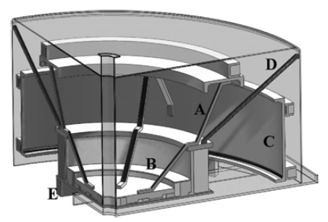
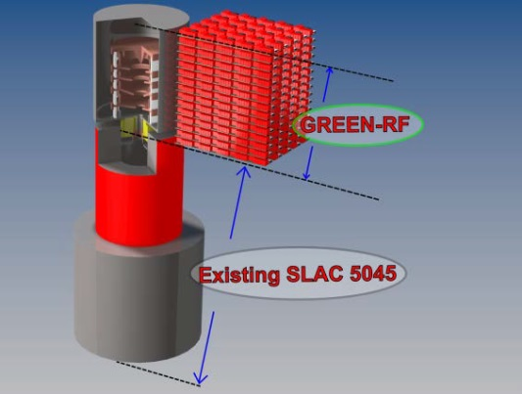
Accelerator R&D Stewardship Program Awards
Two awards coordinated with the National Cancer Institute of the National Institutes of Health, targeting particle-beam-based cancer therapies:
  LBNL, Paul Scherrer Institute, and Varian Particle Therapy, Inc.
    Light-weight SC magnets to reduce the size and weight of particle beam delivery systems by nearly a factor of 10
  MIT and ProNova Solutions, LLC
    Innovative design for an ironless superconducting cyclotron capable of providing particle beams for cancer therapy
Four grants coordinated with BES, NP, DOD and NSF focus on broad, promising new areas for improving general accelerator performance:
  LBNL, LLNL and University of Michigan
    Test technologies that promise to increase the speed of laser-based science by a factor of 1,000
  SLAC and Communications & Power Industries, LLC
    Energy recapture technology that could be applied to LCLS and other klystron-powered linacs
  Cornell University
    Advanced optimization techniques to automate the control of complex accelerators
  Texas A&M
    Beam dynamics in cyclotrons to increase beam power

Slide 35

Future Strategy Planning

Slide 36
The Future of U.S. Particle Physics
Our current program is guided by the P5 report strategy
  Presents a clear vision for HEP with strong community support
  Significant changes in direction are underway and new projects are ramping up based on the P5 recommendations
  Current investments will guide the program towards the long-term goals of addressing the science drivers
At an appropriate point, the strategy for U.S. particle physics will need to be reevaluated and updated
  Discoveries and results from upcoming experiments will impact the strategy for future investments
    Next strategy should be informed by results from the high-energy run of the LHC, second generation dark matter experiments, precision muon experiments, and short- and long-baseline neutrino experiments
  Updated strategy for the future of particle physics should be available in time to guide next round of major investments
    Guidance should be available as the current round of projects are being completed and the field seeks to make new investments

Slide 37
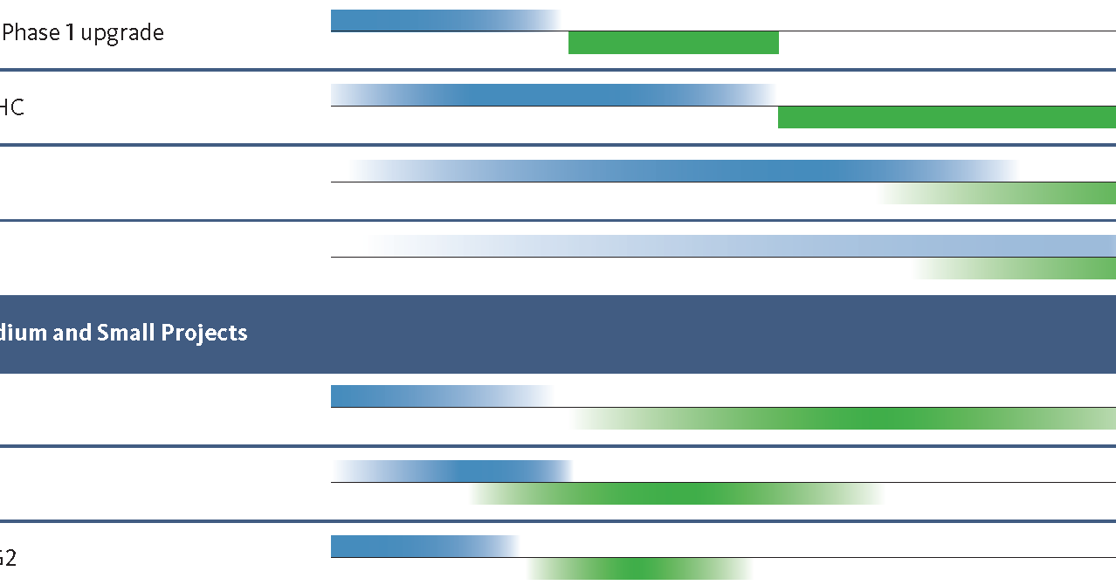
P5 Construction and Physics Timeline
Next major decision point for future HEP projects will occur near 2020
[>$200M]
Legend:
Approximate
Construction
Expected
Physics
[<$200M]

Slide 38
Timeline for Updating the U.S. Strategy
The May 2014 P5 report was successful because it was well informed by the science community, including information from:
  2010 New Worlds, New Horizons in Astronomy and Astrophysics
  2013 European Strategy for Particle Physics Report
  2013 U.S. Particle Physics Community-driven “Snowmass” process
The timeline to create a well-informed strategic plan for 2020 may include:
  2018 update of the European Strategy for Particle Physics
  2018-19 new Decadal Survey from the National Research Council
  2018-19 iteration of the “Snowmass” process
  2019-20 release of an updated P5 strategy report

Slide 39
Conclusion
The P5 report is having a large impact on U.S. particle physics
  Receiving strong support from the community, administration, and legislators
  Rapid progress is being made in aligning the U.S. program with the new strategy:
    Strong interest in establishing major international science facility hosted in the U.S.
    U.S.-CERN agreements on LHC and neutrino programs are making good progress
    LBNF/DUNE moving forward faster than expected
These are exciting times in particle physics!
  LHC turning back on at 13 TeV
  NOvA, T2K taking data and running well
  New results on dark matter
  New Intensity Frontier experiments (Belle II, dark photon searches, precision muon experiments) are “just around the corner”
Achieving the P5 vision will require sustained effort and continued support from the U.S. particle physics community
  Continued strong support and consistent messaging from the community will be needed to sustain progress

Slide 40
Backup

Slide 41
The FY 2016 HEP Budget Request
HEP is implementing the strategy detailed in the May 2014 report of the Particle Physics Project Prioritization Panel (P5), formulated in the context of a global vision for the field
  HEP Addresses the five compelling science drivers with research in three frontiers and related efforts in theory, computing and advanced technology R&D
  Increasing emphasis on international partnerships (such as LHC) to achieve critical physics goals
Energy Frontier: Continue Large Hadron Collider (LHC) program with higher collision energy (13+ TeV)
  The U.S. will continue to play a leadership role in LHC discoveries by remaining actively engaged in LHC data analysis and the initial upgrades to the ATLAS and CMS detectors
Intensity Frontier: Develop a world-class U.S.-hosted Long Baseline Neutrino Facility (LBNF)
  Continue the design process for an internationalized LBNF and development of a short baseline neutrino program that will support the science and R&D required to ensure LBNF success
  Fermilab will continue to send world’s highest intensity neutrino beam to NOvA, 500 miles away to Ash River, MN
Cosmic Frontier: Advance our understanding of dark matter and dark energy
  Immediate development of new capabilities continue in dark matter detection with baselining of 2nd-generation experiments; and in dark energy exploration with baselining of DESI and fabrication of LSST camera.

Slide 42
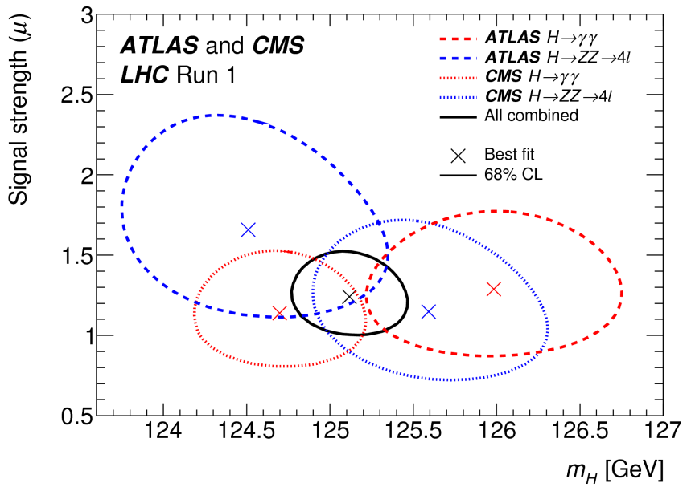
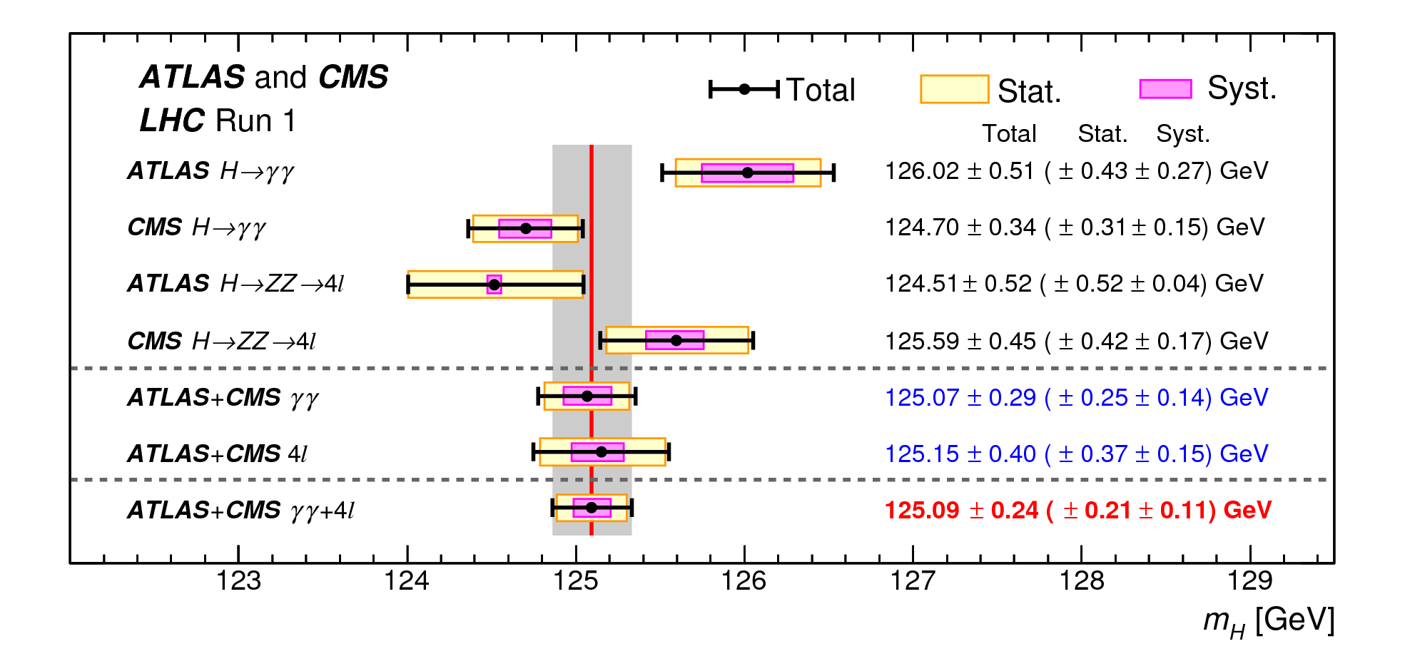
Energy Frontier Highlight:
Combined ATLAS and CMS Higgs Mass Measurement
ATLAS and CMS recently released a combined measurement of the Higgs boson mass
  1st combination of the Higgs mass by the LHC experiments
    Combines H→γγ and H→ZZ→4ℓ channels from both experiments
    Measured masses from the individual channels and the two experiments are found to be consistent among themselves
  m_{H} = 125.09 ± 0.21 (stat.) ± 0.11 (syst.) GeV (0.19% precision!)

Slide 43
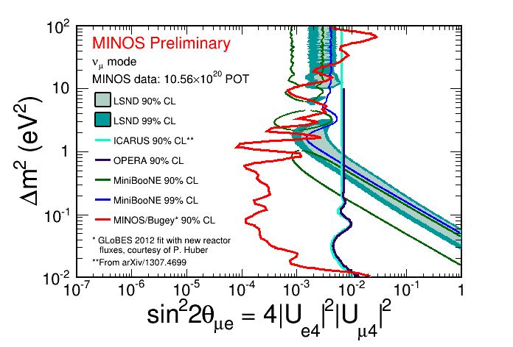
Intensity Frontier Highlight:
MINOS/MINOS+ Further Constrain Sterile Neutrinos
MINOS/MINOS+ continues exploiting MINOS data and will be soon combining results with MINOS+
  The MINOS/MINOS+ experiments are sensitive to several exotic oscillations channels, including sterile neutrinos
  Combining MINOS NC
  and CC disappearance
  data with ν_{e} disappearance
  data from the Bugey Reactor gives combined limits comparable to MiniBooNE, LSND, ICARUS, and OPERA
  New results with 1st year’s full dataset to be presented at APS, April 11th!

Slide 44
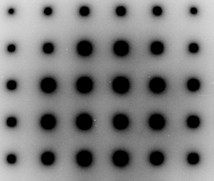
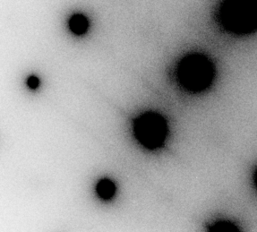
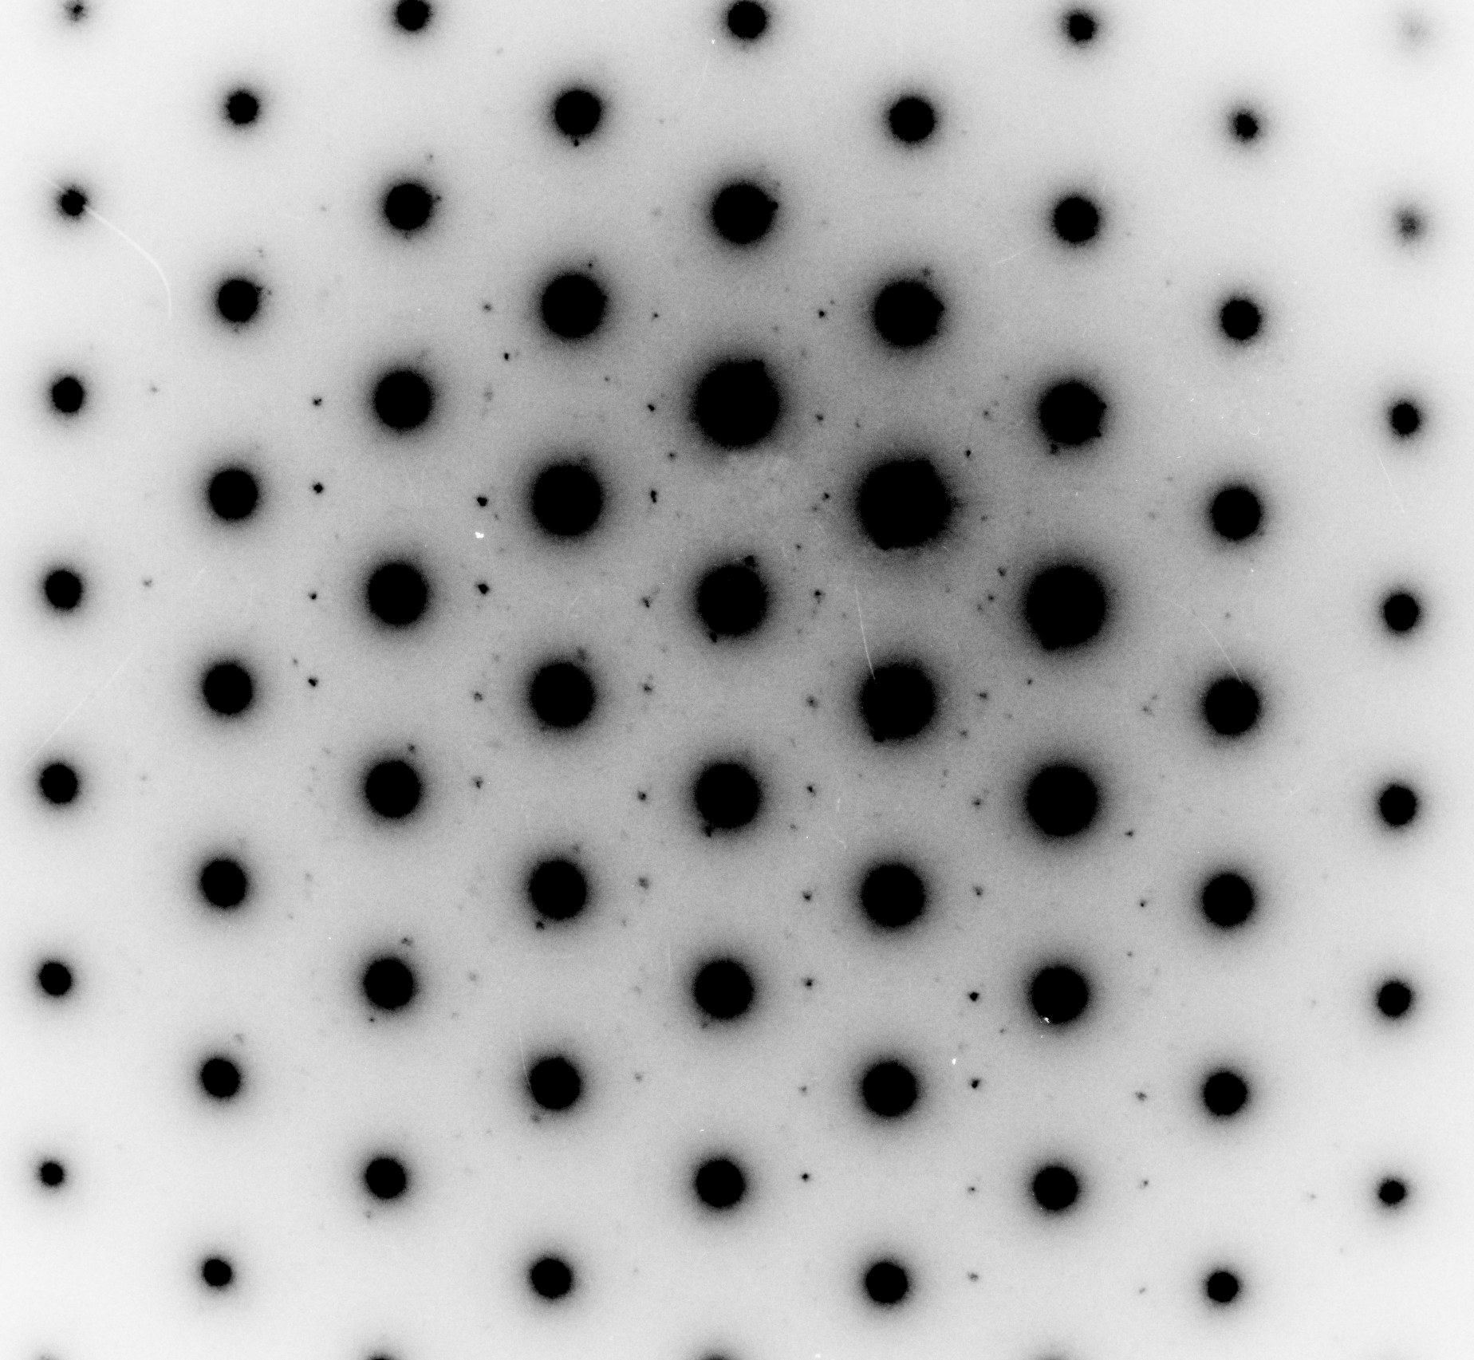
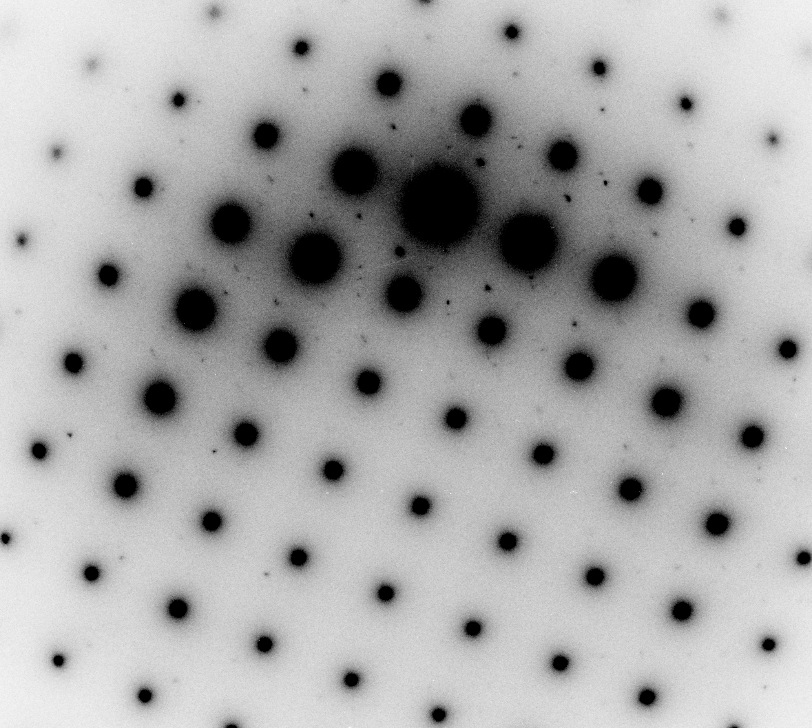
Advanced Technology R&D Highlight:
Advances in SRF Performance
Recent SRF advancements have been driven by fundamental understanding of the underlying physics of the cavity surface
  Microscopic mechanism of “Q-disease”
  Origin of the “high field Q slope”
  Mechanism of the “120 C baking”
  Nitrogen doping to increase Q
  Effect of cooling dynamics on Q
Room T: body-centered cubic Nb phase only
N doping traps H, removes hydride phases
94 K:
Nb hydride phases appear
120 C bake reduces nano-hydride density
Trapped magnetic vortices imaged via Bitter Decoration

Slide 45
FY 2016 HEP Budget Request Overview

Slide 46
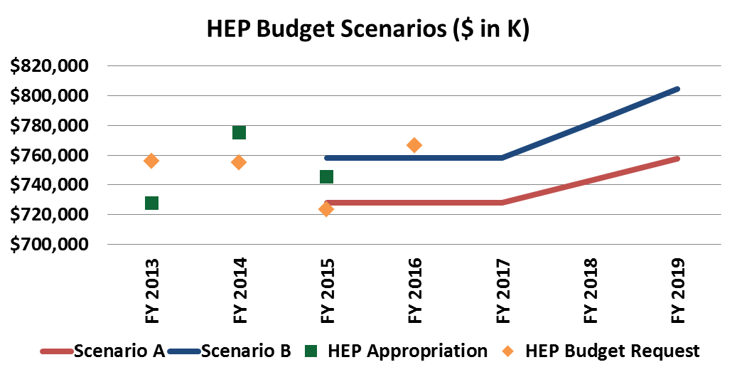
Context: P5 HEP Budget Scenarios
P5 was charged to consider three 10-year budget scenarios for HEP within the context of a 20-year vision for the global field
  Scenario A was the lowest constrained budget scenario
  Scenario B was a slightly higher constrained budget scenario
  Scenario C was “unconstrained,” but not considered unlimited
*Budget Request and Appropriations do not include SBIR/STTR

Slide 47
FY 2016 High Energy Physics Budget
HEP Funding Category ($ in K) | FY 2014 Current | FY 2015 Enacted | FY 2016 Request | Explanation of Changes (FY16 vs. FY15)
Energy Frontier | 152,386 | 147,584 | 154,555 | LHC detector upgrade fabrication; R&D for high-luminosity LHC upgrades
Intensity Frontier | 250,987 | 264,224 | 247,196 | Operations and upgrade of NuMI for NOvA and MicroBooNE; R&D for LBNF and SBN
Cosmic Frontier | 96,927 | 106,870 | 119,325 | Planned ramp-up of LSSTcam; support of DESI and 2nd generation dark matter experiments
Theoretical and Comp. | 64,275 | 59,274 | 60,317 | Planned increase in Lattice QCD project; slight reduction in theory research efforts
Advanced Technology R&D | 150,270 | 120,254 | 115,369 | Reductions reflect shift to P5 priority areas; MAP reduction continues in response to P5
Accelerator Stewardship | 9,075 | 10,000 | 14,000 | Increase supports new research topic areas and expands open test facility efforts
Construction (Line Item) | 51,000 | 37,000 | 56,100 | Planned profile for Mu2e; engineering and design for LBNF
SBIR/STTR | 21,601* | 20,794 | 21,138
Total | 796,521* | 766,000 | 788,000 | Current House mark for FY16: $776,000 K
adf
* SBIR/STTR added to FY 2014 for comparison to FY 2015/2016

Slide 48
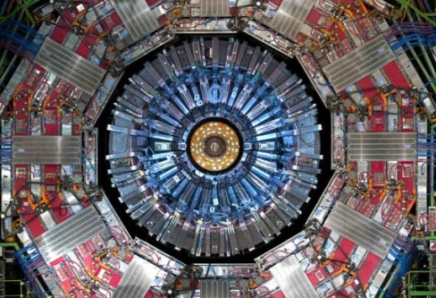
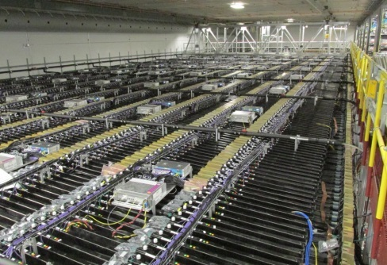
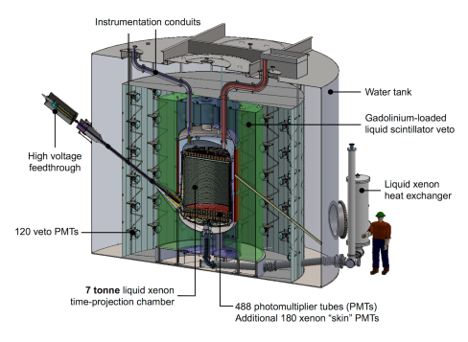
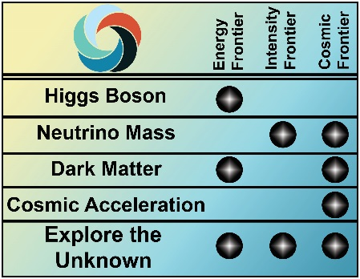

HEP Program: FY 2016 Priorities
HEP is implementing the strategy detailed in the May 2014 report of the Particle Physics Project Prioritization Panel (P5), formulated in the context of a global vision for the field
  HEP Addresses the five compelling science drivers with research in three frontiers and related efforts in theory, computing and advanced technology R&D
  Increasing emphasis on international partnerships (such as LHC) to achieve critical physics goals
Energy Frontier: Continue LHC program with higher collision energy (13+ TeV)
  The U.S. will continue to play a leadership role in LHC discoveries by remaining actively engaged in LHC data analysis and the initial upgrades to the ATLAS and CMS detectors
Intensity Frontier: Develop a world-class U.S.-hosted Long Baseline Neutrino Facility
  Continue the design process for an internationalized LBNF and development of a short baseline neutrino program that will support the science and R&D required to ensure LBNF success
  Fermilab will continue to send world’s highest intensity neutrino beam to NOvA, 500 miles away
Cosmic Frontier: Advance our understanding of dark matter and dark energy
  Immediate development of new capabilities continue in dark matter detection with baselining of 2nd-generation experiments; and in dark energy exploration with baselining of DESI and fabrication of LSST camera.
Energy Frontier
CMS
Intensity Frontier
NOvA
Cosmic Frontier
LZ

Slide 49
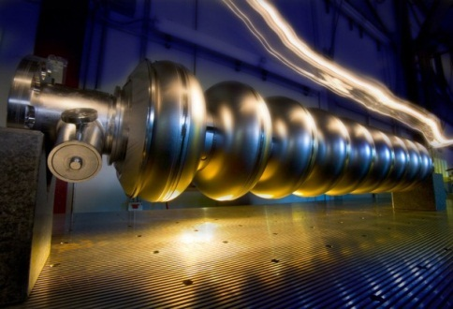
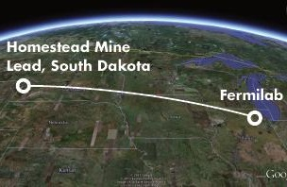
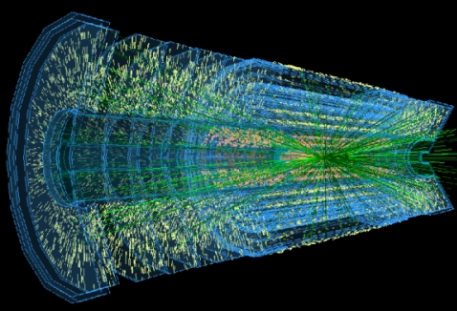
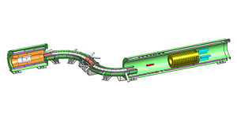
HEP Program: FY 2016 Priorities
Accelerator Stewardship
  This subprogram focuses on the broader applications of accelerator technologies, including major thrusts in technology to enable ion-beam cancer therapy and R&D for high-power ultrafast lasers
  The FY 2016 funding request provides support for a new research thrust in energy and environmental applications of accelerators and expands the open test facilities effort
  The main facility supporting this subprogram, the Brookhaven Accelerator Test Facility (ATF), will undergo relocation and expansion in FY 2016 to accommodate more users
Construction/Major Items of Equipment (MIEs) support reflects P5 priorities:
  The Long Baseline Neutrino Facility (LBNF) continues its design phase as the project baseline cost and technical scope are revised while incorporating international in-kind contributions
  The LHC ATLAS and CMS Detector Upgrade projects continue fabrication
  Muon g-2 continues accelerator modifications and fabrication of the beamline and detectors
  LSSTcam fabrication support increases according to planned profile
  Dark Energy Spectroscopic Instrument (DESI) will be baselined in 2016
  Fabrication proceeds on the dark matter experiment MIEs: SuperCDMS-SNOLab and LZ
  Construction continues for the Muon to Electron Conversion Experiment (Mu2e)
Accelerator
Stewardship
Mu2e
LBNF
LHC Upgrades

Slide 50
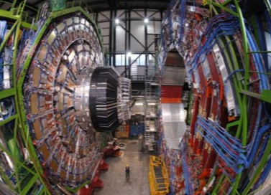
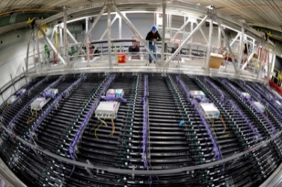
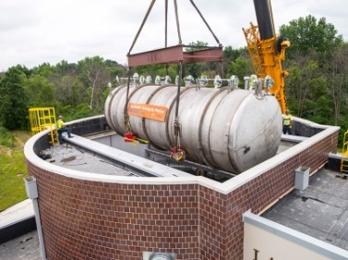

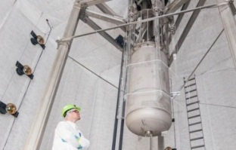
HEP Facilities and Operations
FY 2016 Request: $262,658,000
The Large Hadron Collider (LHC) at CERN will resume operations in Spring 2015 at collision energies nearly double that used for the Nobel prize winning discovery of the Higgs boson
The NOvA experiment is taking data using the world’s most powerful neutrino beam sent along the world’s longest baseline, 500 miles from Fermilab to Ash River, MN
MicroBooNE begins taking data in early 2015 as the first stage of Fermilab’s short-baseline neutrino program that will address key scientific questions while developing the technology for a world-class long-baseline experiment
The Dark Energy Survey (DES) continues surveying the sky using its 570-Megapixel camera to uncover the nature of dark energy by measuring the 14-billion-year history of cosmic expansion
The LUX dark matter experiment, located a mile under the Black Hills of South Dakota, is taking data through 2016 in order to significantly improve the world’s most sensitive search it produced in 2013

Slide 51

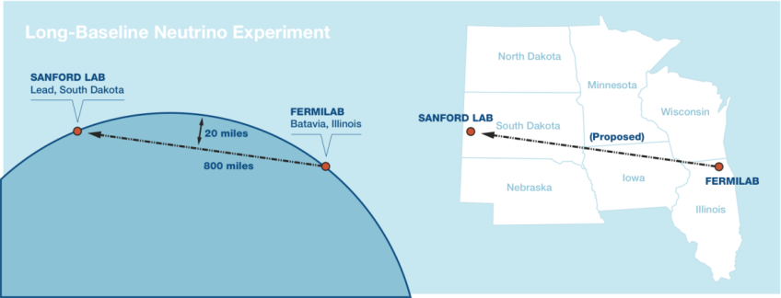
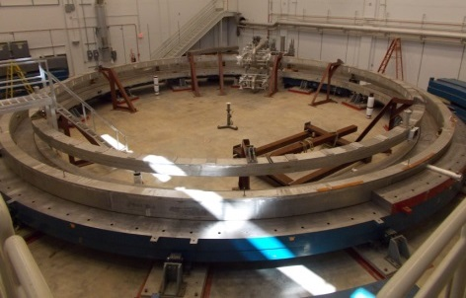



HEP Projects
FY 2016 Request: Projects $113,401,000; Construction $56,100,000
The community-endorsed P5 strategy recommends a prioritized and time-ordered list of experiments to address the most pressing scientific questions
  Investments will produce a continuous flow of major scientific
  results throughout a twenty-year timeframe
Major projects, in time order, include: (funding reflects FY16 request)
  Completion of the Muon g-2 ($10.2M) and Muon to Electron Conversion (Mu2e) ($40.1M) experiments at Fermilab
  Immediate investments in second-generation dark matter experiments ($11M)
  Fabrication of the Dark Energy Spectroscopic Instrument (DESI) ($5.3M) and the LSST Camera ($40.8M)
  High-luminosity upgrades to the Large Hadron Collider (LHC) ($19M)
  A U.S.-hosted Long Baseline Neutrino Facility (LBNF) ($20M) that receives the world’s highest intensity neutrino beam from an improved accelerator complex at Fermilab
LUX
LHC
Muon g-2
DESI
LBNF

Slide 52





High Energy Physics Highlights:
Recent Major Prizes and Awards in HEP
Saul Perlmutter (UC Berkeley/LBNL), along with other members of the Supernova Cosmology Project he leads, shared the 2015 Breakthrough Prize in Fundamental Physics
  For the most unexpected discovery that the expansion of the universe is accelerating, rather than slowing as had been long assumed.
Stanley G. Wojcicki (Stanford University) received the 2015 W.K.H. Panofsky Prize in Experimental Particle Physics
  For his leadership and innovative contributions to experiments probing the flavor structure of quarks and leptons, in particular for his seminal role in the success of the MINOS neutrino oscillation experiment.
Hasan Padamsee (Fermilab) received the 2015 APS Robert R. Wilson Prize for Achievement in the Physics of Particle Accelerators
  For his leadership and pioneering world-renowned research in superconducting radiofrequency physics, materials science, and technology, which contributed to remarkable advances in the capability of particle accelerators.
Chandrashekhar Joshi (UCLA) is recognized with two achievements:
  2014 Inductee of National Academy of Engineering for contributions to the development of laser and beam-driven plasma accelerators.
  2014 Distinguished Engineering Educator Award by the Engineers’ Council
Justin Schwartz (NC State) received the 2014 IEEE Award for Continuing and Significant Contributions to the Field of Applied Superconductivity

Slide 53

High Energy Physics Highlights:
BELLA Sets Record in Laser-driven Plasma Wakefield Acceleration
Research in plasma wakefield acceleration aims to create compact and cost-effective acceleration technology for future particle accelerators
The Berkeley Lab Laser Accelerator (BELLA) set a new world record for laser-driven plasma wakefield acceleration:
  BELLA accelerated electrons to 4.25 GeV using a 9 cm plasma channel created by a 390 terawatt laser pulse
  Today’s technology would require a 200 meter long accelerator to achieve the same energy

Slide 54

U.S. Investments Towards an ILC: LCLS-II
Expertise from HEP is being used to fabricate the advanced SRF cavities needed for constructing the Linear Coherent Light Source II, a Basic Energy Science facility being built at SLAC
  Joint project including FNAL, ANL, JLAB, and LBNL
  Fermilab will advance SRF capabilities and infrastructure through LCLS-II responsibilities, including:
    Low-loss cavity development
    (may lead to cost reductions)
    Design, fabrication and
    testing of 17 cryomodules
    of varying frequencies
    Design and fabrication of
    cryogenic distribution system
    Assistance with linac
    accelerator physics and LLRF
    control

