Slide 1
Open Questions in Organometal Halide Perovskites: Ferroelectricity, Ion migration, and Long carrier lifetime
Andrew M. Rappe The Makineni Theoretical Laboratories Department of Chemistry University of Pennsylvania

Slide 2
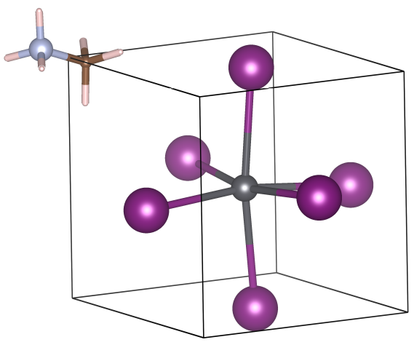
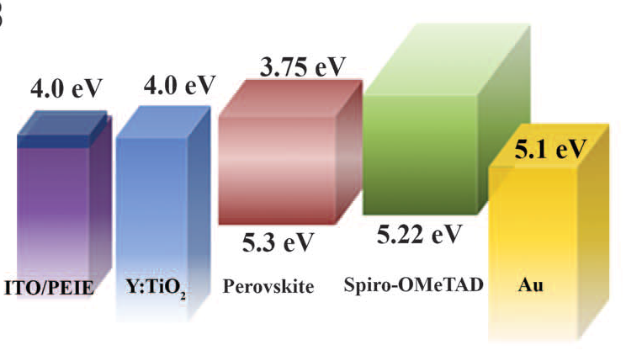
OMHPs as High Efficiency Solar Cell
Unit cell of CH₃NH₃PbI₃ (MAPbI₃)
N
C
Pb
I
~6.3Å
OMHP: Organometal Halide Perovskite
High power conversion efficiency (PCE) reached 20% in 2015! (Best silicon solar cell has PCE around 26%)
Fast improvement PCE increased from 9% to 20% within two years
Cheap to make abundant elements → Pb, I, C, N, H easy to make <$1/m² (Silicon > $10/m²)
Device
e⁻
MAPbI₃
h⁺
Sci. Rep. 2, 591 (2012), Science 345, 542 (2014), Nature 501, 395 (2013)

Slide 3

Many Things are Unknown …
Polar order The A-site organic molecule has permanent dipole moment. Is MAPbI₃ ferroelectric?
Current-Voltage (J-V) hysteresis The origin is not fully clear.
Ferroelectricity? Trap states at interface/surface? Ion migration?
Carrier lifetime MAPbI₃ has exceptionally long carrier life time.
The intrinsic origin remains elusive.
Understanding these properties is essential to further optimize OMHP-based solar cells

Slide 4
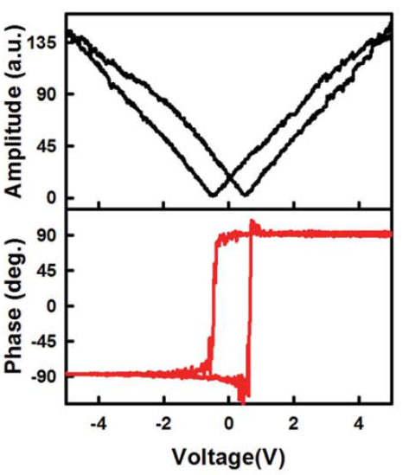
Polar order: Ferroelectricity?
XRD and Raman spectra demonstrate no inversion symmetry J. Phys. Chem. Lett. 5, 3937 (2014), Inorg. Chem. 52, 9019 (2013)
Polarization–Electric field (P-E) loop measurement J. Phys. Chem. Lett. 5, 3937 (2014)
Piezoelectric Force Microscopy (PFM) observed switchable ferroelectric domains J. Phys. Chem. Lett. 5, 3335 (2014), J. Mater. Chem. A 3, 7699 (2015), J. Phys. Chem. Lett. 6, 1729 (2015)
Ferroelectric domains
Piezoresponse Hysteresis
Yes, MAPbI₃ may be ferroelectric
J. Phys. Chem. Lett. 5, 3335 (2014)
J. Mater. Chem. A 3, 7699 (2015)

Slide 5
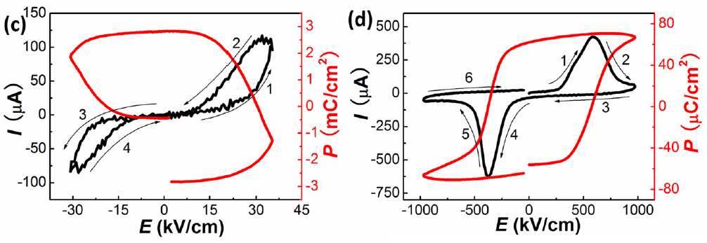
Polar order: Ferroelectricity?
Conflicting experimental observations:
PFM and P-E hysteresis do not support ferroelectric polarization directly Nat. Mater. 14, 193 (2015)
P-E and I-E hysteresis do not show ferroelectricity (large leakage current) J. Phys. Chem. Lett. 6, 1155 (2015)
P-E hysteresis→ observe huge polarization (>1000µC/cm²) →Non-ferroelectric process (e.g., ion migration). is dominant. Appl. Phys. Lett. 106, 173502 (2015)
I/E and P/E hysteresis measurements
MAPbI₃
BiFeO₃
No, MAPbI₃ may not be ferroelectric
Au/MAPbI₃/PEDOT:PSS/ITO
Au/BiFeO₃(260 nm thick)/SrRuO₃
Notes:
Nat. Mater. 14, 193 (2015) is from Prof. Jingsong Huang
The graph shows the comparison between MAPbI3 and a typical ferroelectrics BFO. By showing I/E and P/E hysteresis, MAPbI3 shows very different features compared to BFO, indicating that MAPbI3 is not ferroelectric.

Slide 6
Polar order: Ferroelectricity?
More conflicting experimental observations:
Different scan rates give different results (using PFM) Low scan rate: “No ferroelectricity” Fast scan rate: “Yes ferroelectricity” → poor polarization retention/coercivity. On the time scale around 1 s. J. Phys. Chem. Lett. 6, 1408 (2015)
Crystal size affects polarization retention. Large crystal shows longer retention J. Phys. Chem. Lett. 6, 1729 (2015)
Piezo-phase hysteresis performed at different acquisition times
Ferroelectricity in MAPbI₃ depends on experimental setup→ not robust ferroelectricity, may exhibit voltage-induced local polarization

Slide 7
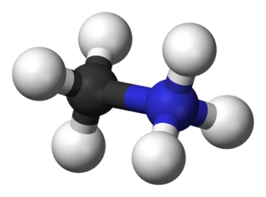
A Site Molecule and Ferroelectricity
A site MA⁺ has permanent dipole moment, which may induce different polar order - Randomly oriented → Paraelecric - Aligned → Ferroelectric - Anti-aligned → Anti-ferroelectric
A site molecules may form specific spatial distribution - Locally ordered nano-domains - Ferroelectric domains and domain walls
A lot of effort devoted to understanding molecular behaviors - Time-dependent permittivity measurement J. Appl. Phys. 87, 6373 (1987) - Neutron powder diffraction Chem. Commun. 51, 4180 (2015) - Quasielastic neutron scattering Nat. Comm. 6, 7124 (2015) - ab initio molecular dynamics Phys. Chem. Chem. Phys. 16, 16137 (2014) - Monte-Carlo simulation APL Mat. 2, 081506 (2014) - …
N
C
+
P
-
2.2D
Study molecular behaviors is important for understanding Ferroelectricity

Slide 8
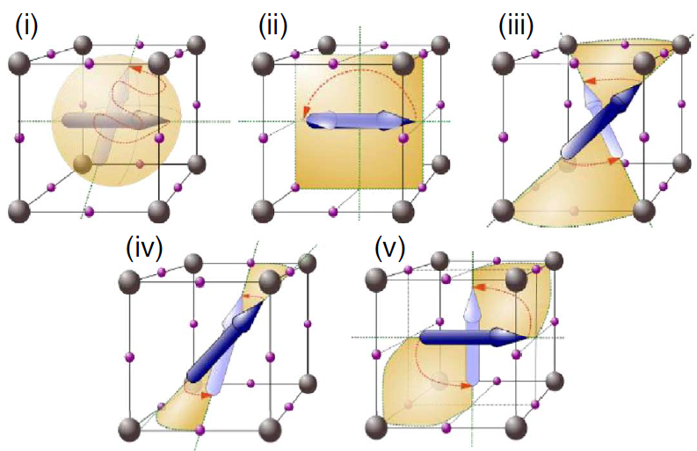
Behavior of A Site Molecule
Quasielastic Neutron Scattering + Monte Carlo
Residence time for MA⁺ orientation is around 14±3 ps. (consistent with previous ab initio MD)
Rotation barrier is on the level of 10 meV. (estimated from Arrhenius activity energy)
Suspect that MA⁺ in ferroelectric domain may have larger rotation barrier (longer residence time)
Complete random
180˚ rotation
(i) and (ii) are unlike to occur in the time scale 1.2~53 ps
Other rotation patterns are possible
Nat. Comm. 6, 7124 (2015)

Slide 9
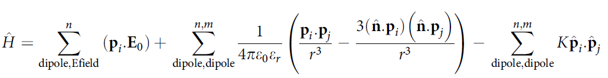
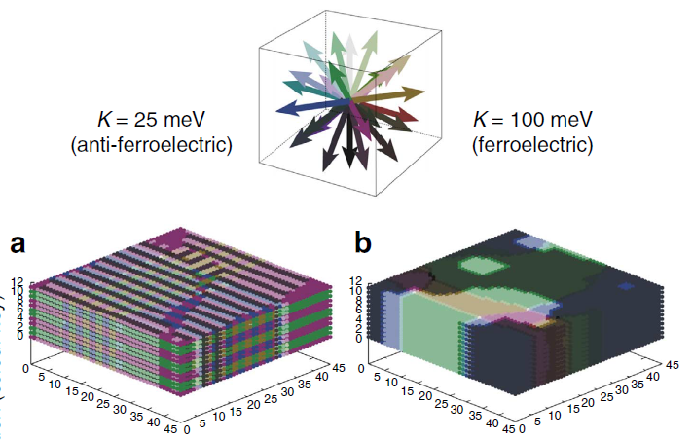
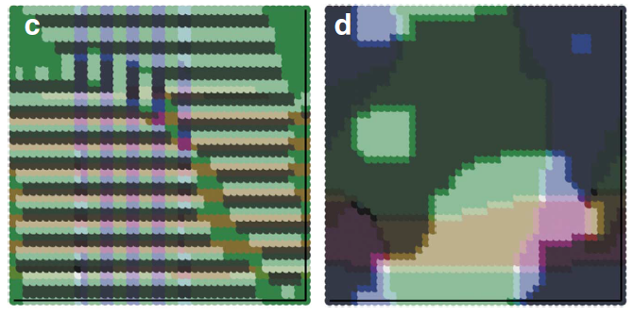
Monte-Carlo Simulation
Dipole-dipole interaction
Value of K estimated from
DFT, favors aligned dipoles
28 nm×28nm×7.5 nm
K = 25 meV
Antiferroelectric domains
Ferroelectric domains
K = 100 meV
Ferroelectric domains can form @ RT
Notes:
The plotted 3D domain graph here is the simulation cooling to 50K. But ferroelectric domain can exist even >350 K from the simulation.

Slide 10
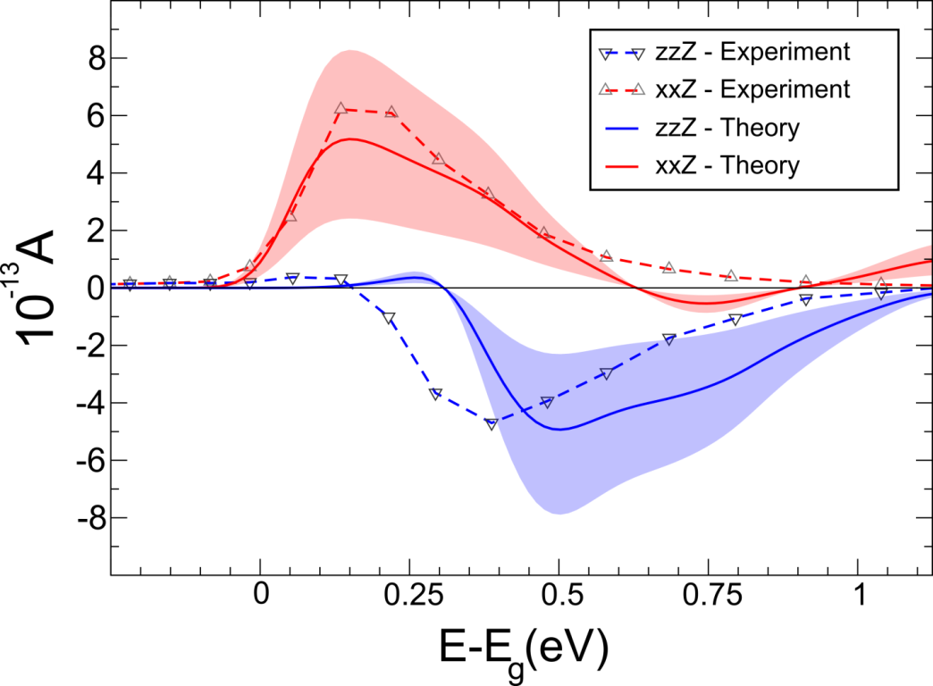
Bulk photovoltaic effect (BPVE)
Intrinsically generated photocurrents and photovoltages from single phase bulk material
Observed in experiments:
Inversion symmetry breaking
Maybe parallel, antiparallel,
or even perpendicular
to material polarization
Strong frequency dependence
Shift current is the main mechanism for BPVE
BaTiO₃
S. M. Young and A.M. Rappe, Phys. Rev. Lett., 109, 116101 (2013)
S. M. Young, F. Zheng, and A. M. Rappe, Phys. Rev. Lett., 109, 236601 (2013)
V. I. Belinicher and B. I. Sturman, Sov. Phys. Usp. 23(3), 199 (1980)

Slide 11

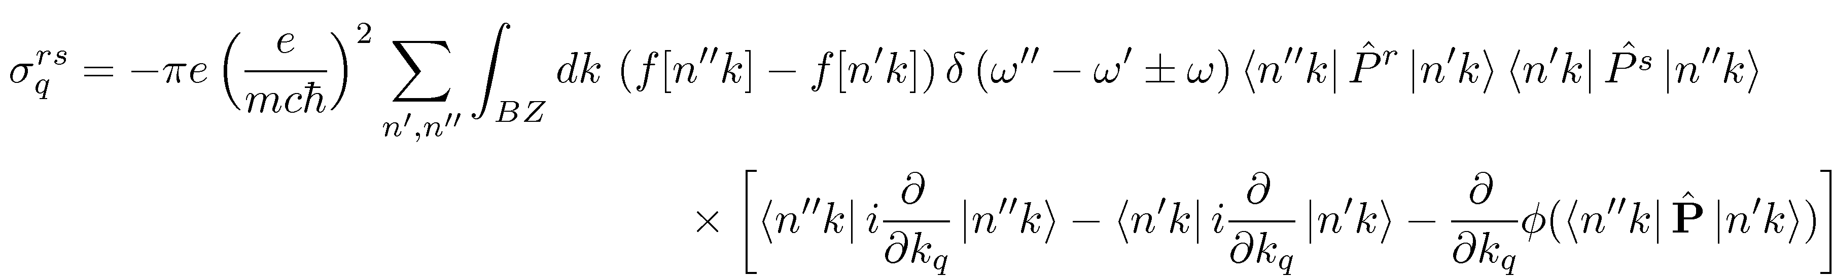
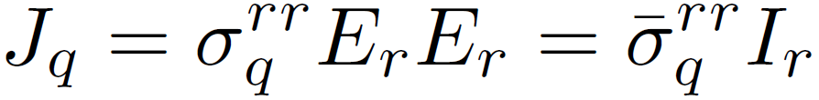
Shift Current
Transition intensity
Shift vector
Quadratic in E field, linear in light intensity!
Need to break inversion symmetry
Rank 3 tensor
Phys. Rev. B. 23, 5590 (1981), Phys. Rev. B. 61, 5337 (2000)

Slide 12
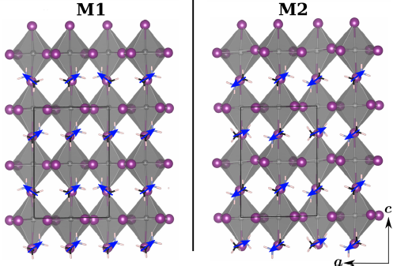
Shift Current in MAPbI₃
Bulk photovoltaic effect emerges when system loses inversion symmetry Shift current effect on two cases: Polar & Non-polar
5 μC/cm² Polarization Along c
Large Pb-I₃ displacement Polar
Near Net Zero Polarization Small Pb-I₃ displacement Non-polar

Slide 13
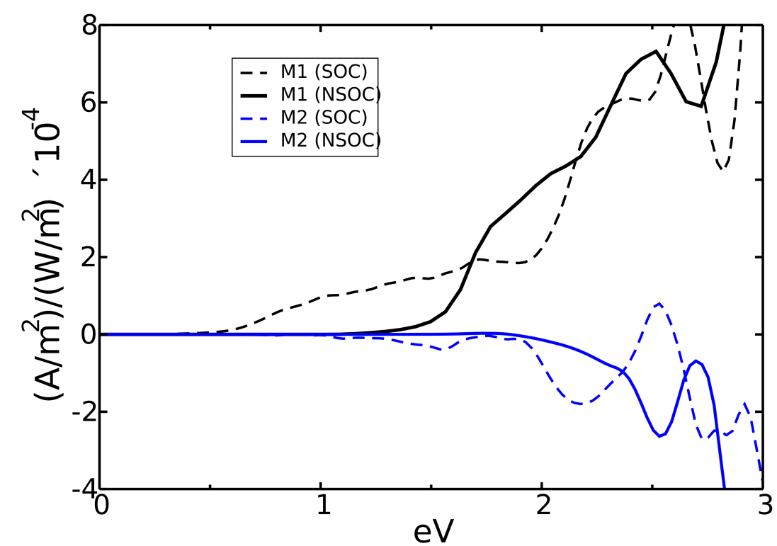
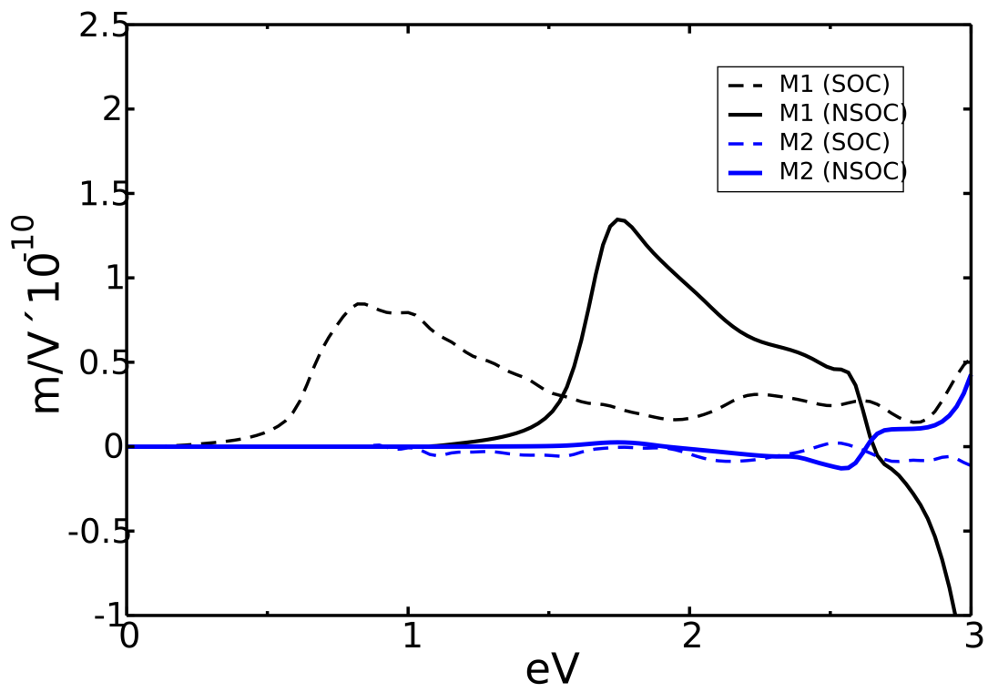
Shift Current in MAPbI₃
Higher response than BiFeO₃ (BFO)
Shift current (thin limit)
Glass coefficient (thick limit)
zzZ
BFO
zzZ
BFO
BFO E_{g}=2.74 eV
Polar (M1) gives larger response than Non-polar (M2)
Higher response than BFO may explain large V_{oc}
J. Phys. Chem. Lett. 6, 31 (2015)
Notes:
By saying that shift current may also explain the I/V hysteresis, the next section about hysteresis can start more naturally.

Slide 14
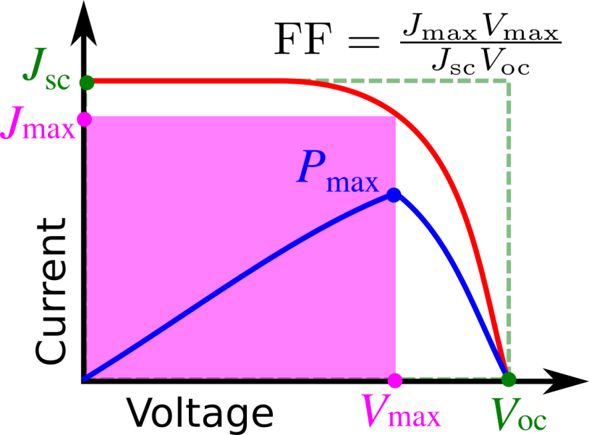
Current-Voltage Hysteresis
J-V curve
Anomalous hysteresis in MAPbI_{x}Cl_{1-x}
Power conversion efficiency:
FB: Forward Bias; SC: Short Circuit
J. Phys. Chem. Lett 5, 1511 (2014)
The rise time to reach stabilized power output is slow
Determination of PEC is ambiguous
J-V curve is sensitive to experimental conditions

Slide 15
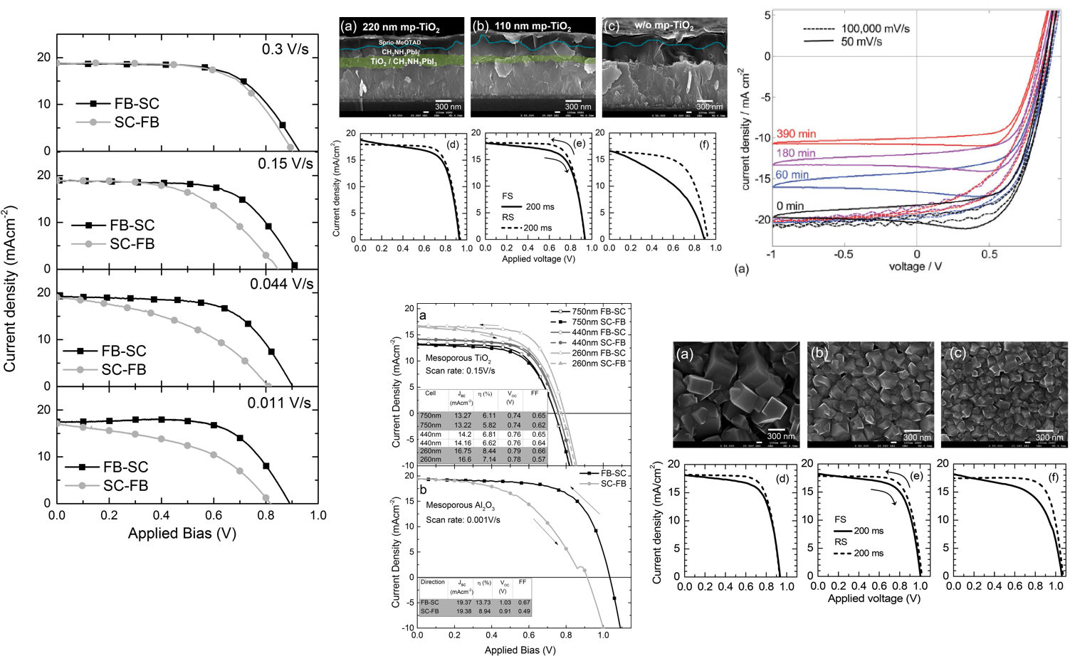
Parameters affecting J-V Hysteresis
Interface
Aging
Scanning rate
Solar cell architecture
Energy Environ. Sci., 8, 995 (2015)
Crystal size
Mesoporous TiO₂
Mesoporous Al₂O₃
J. Phys. Chem. Lett 5, 1511 (2014)
J. Phys. Chem. Lett 5, 2927 (2014)

Slide 16
Possible Origins of J-V Hysteresis
Trap states at interface/surface
Ferroelectricity: remnant polarization
Bulk photovoltaic: large V_{oc}
Ion migration
Light-induced structural transformation
Ferroelectric domains
Trap states at surface
J. Phys. Chem. Lett 5, 3335 (2014)
Light-enhanced piezoelectricity
Ultraviolet photoemission spectra for CH3NH3PbI3 thin films vapor deposited on native oxide terminated silicon from PbI2 (blue) and PbCl2 (red) precursors.
J. Phys. Chem. Lett 6, 1408 (2015)
J. Am. Chem. Soc. 137, 2089 (2015)

Slide 17
Ion Migration in OMHP
Giant switchable photovoltaic effect
Photoinduced giant dielectric constant
Low frequency
Nature Mater. 14, 193 (2015)
Significant ionic conductivity
J. Phys. Chem. Lett 5, 2390 (2014)
σ
ε_{r,∞}
The ionic diffusion is highly relevant for J-V hysteresis, ionic conductivity, low-frequency dielectric response, and material stability.
Low frequency
σ_{ion} > σ_{ele}
σ: conductivity; ε: dielectric constant
Angew. Chem. Int. Ed. 54, 1 (2015)

Slide 18
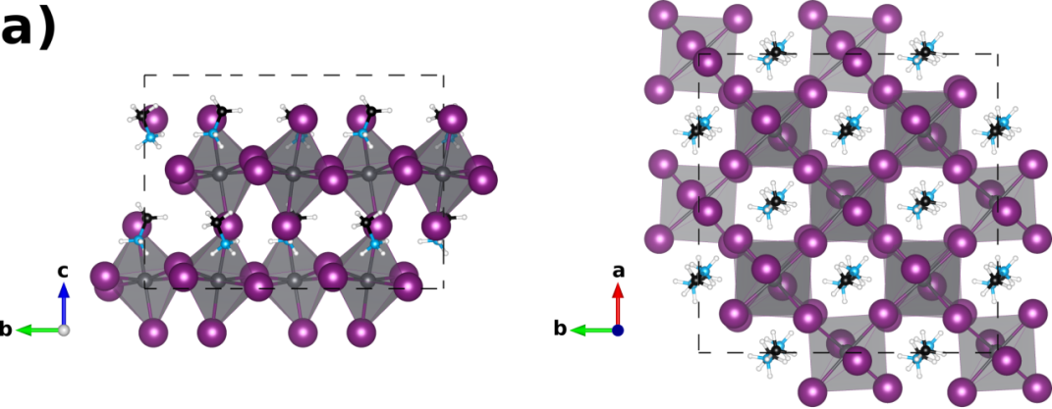
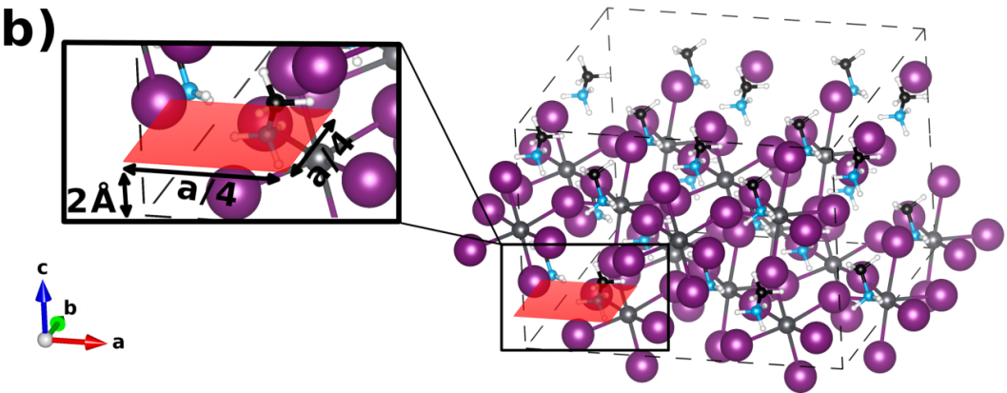
Hydrogen in MAPbI₃: Structural Model
2×2×1 super-cell of MAPbI₃, 16 formula units
PBE-DFT + dispersive corrections in VASP
nudged elastic band (NEB) using VTST
different charge states of hydrogen:
H⁺, H⁰, H⁻
modeled by fixing the number of electrons per cell
sample a slice of lateral adiabatic potential energy surface
D. A. Egger, L. Kronik, A. M. Rappe, Angew. Chem. Int. Ed. 2015, online

Slide 19
Adiabatic PES of Hydrogen in MAPbI₃
All three hydrogenic defects are found to be repelled from the A site
H⁺ is stable in the vicinity of I
H⁰ is in an interstitial Pb-I site
H⁻ is closer to the Pb site
Ionic character MAPbI₃

Slide 20
Ionization enhanced hydrogen migration
H⁻
H⁻
energy
H⁺
Trap states at surface
I Pb I
Bourgoin-Corbett mechanism:¹ interstitial migrates via successive changes of its charge state
Similar mechanism relevant for Si-interstitials in Si^{2,3} → might be relevant for other defect types too
¹ Bourgoin & Corbett, Phys. Lett. 38A, 2 (1971)
² Bar-Yam and Joannopoulos, Phys. Rev. Lett. 52, 1129 (1984);
³ Car et al., Phys. Rev. Lett. 52, 1814 (1984)

Slide 21
Minimum energy path for H⁺ in MAPbI₃
Proton migration between equatorial iodines in MAPbI₃
0.29 eV
Overall proton migration is enhanced by successive displacements of iodide atoms.
The energy barriers for iodide-iodide H⁺ transfer can even be as low as 0.17 eV if proton migration between different I sites is considered

Slide 22
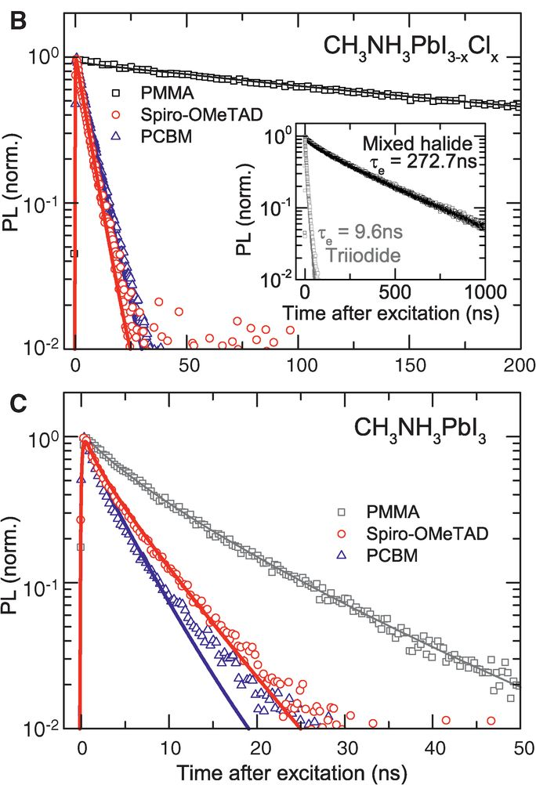
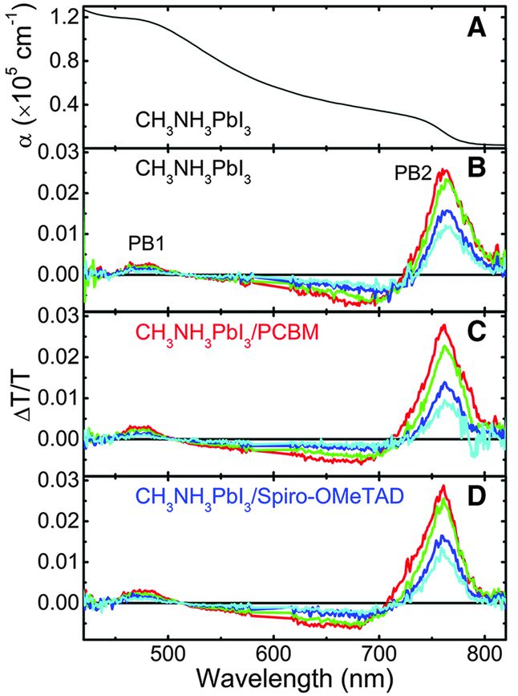
Observation of Long Carrier Lifetimes
Photoluminescence
Transient Absorption
L_{D} =1069 nm
τ = 273 ns
L_{D} =129 nm
τ = 9.6 ns
Legend: 1ps 100 ps 500 ps 1 ns
Science 342, 341 (2013)
Science 342, 344 (2013)

Slide 23
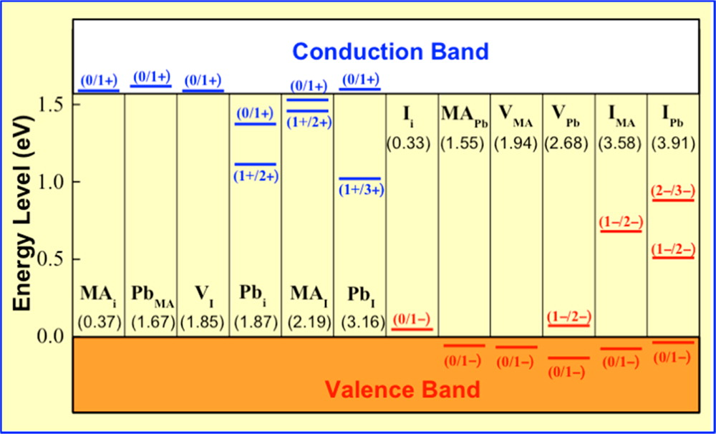
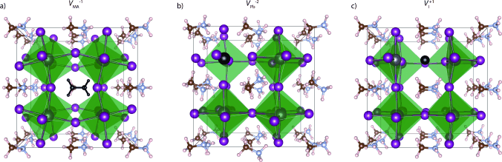
Explanation of Long Carrier Lifetimes (1)
Defects with favorable formation energies have shallow levels → Electronically benign
Adv. Mater. 26, 4653 (2014)
J. Phys. Chem. C, 119 , 5253 (2015)
Angew. Chem. 54, 1791 (2015)

Slide 24
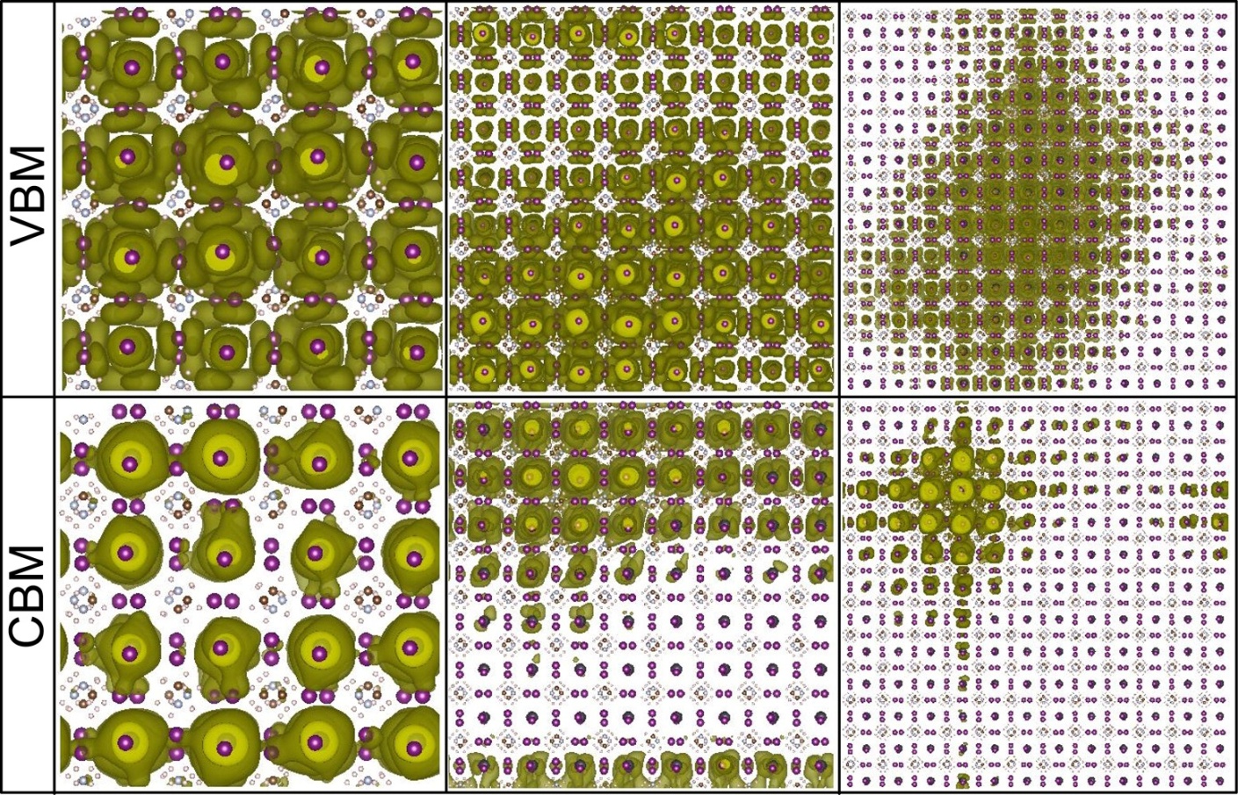
Explanation of Long Carrier Lifetimes (2)
Charge separation induced by long range potential fluctuations associated with molecular orientational disorder.
Large scale DFT calculations suggest that the localization length is 40 – 60 nm.
Nano Lett. 15, 248 (2015)

Slide 25
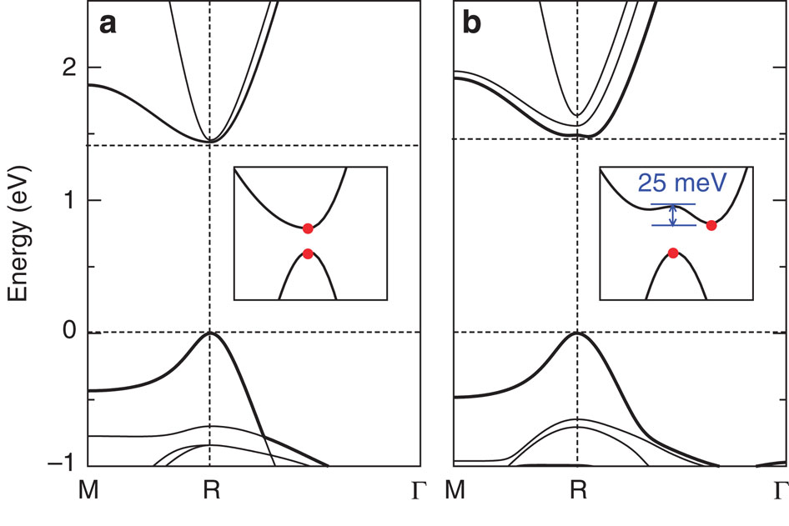
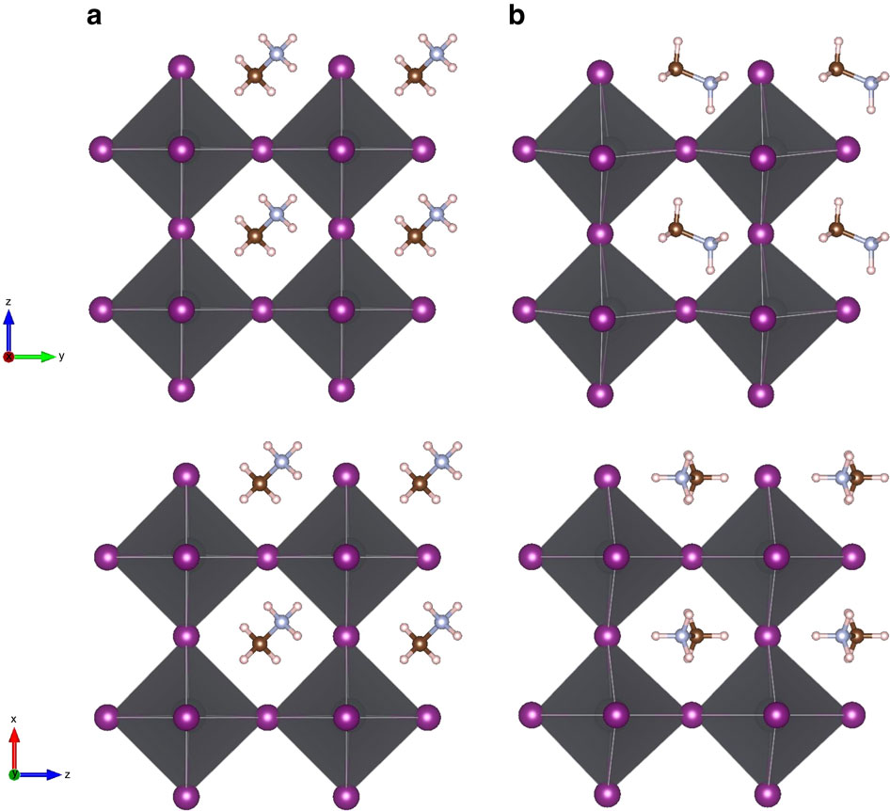
Explanation of Long Carrier Lifetimes (3)
111 molecular orientation
011 molecular orientation
Dynamical band gap: CBM position fluctuates at room temperature
Nat. Comm. 6, 7026 (2015)

Slide 26
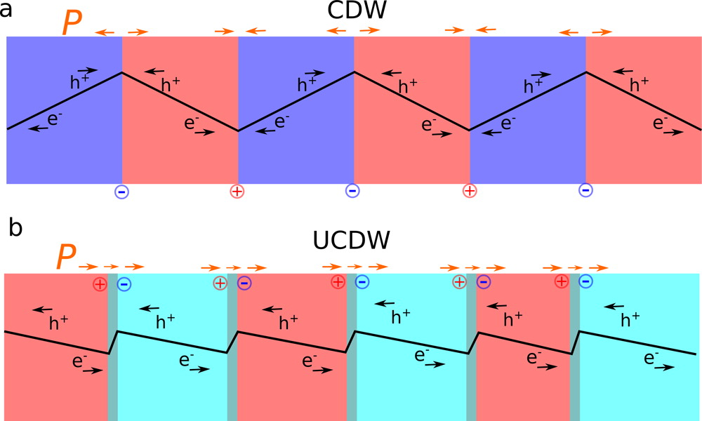
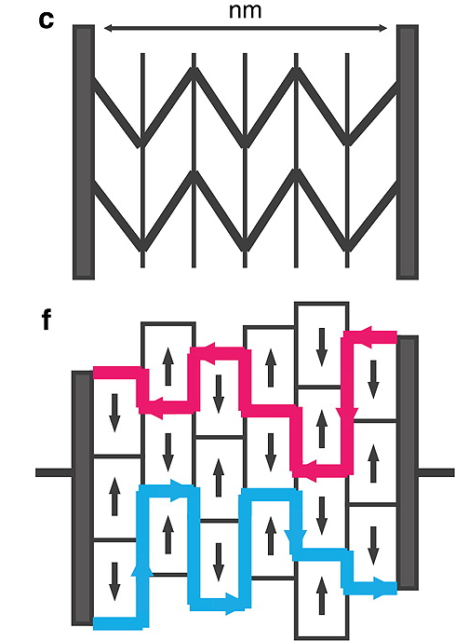
Domain Walls and Carrier Lifetimes
Potential steps from domain walls aid carrier separation
Carriers move along potential maxima in multi-domain samples
J. Phys. Chem. Lett., 6, 693 (2015)
Nano Lett. 14, 2584 (2014)
Domain wall → Polarization gradient → Built-in electric field

Slide 27
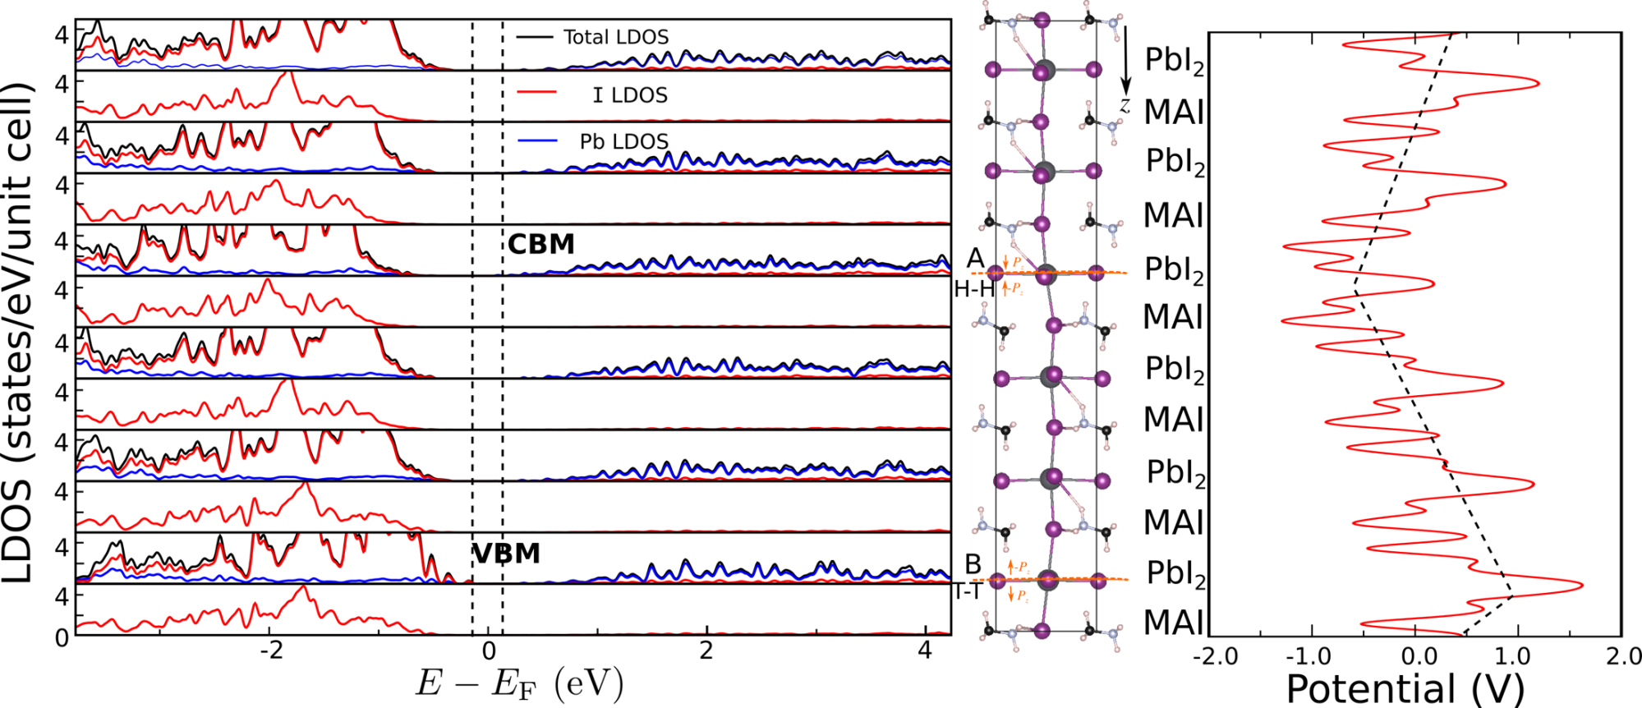
Domain Walls and Carrier Lifetimes
Layer-resolved local density of states
Electronic electrostatic potential
CBM is located at domain wall A: P_{z} components meeting with a head-to-head configuration
VBM is located at domain wall B: P_{z} components meeting with a tail-to-tail configuration
S. Liu et al., J. Phys. Chem. Lett., 6, 693 (2015)

Slide 28
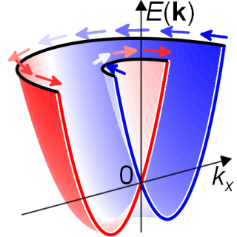
Spin Effects on Carrier Lifetimes
s=+1
S=-1
Favorable and unfavorable spin helicities
C_{S= +1}
C_{S= +1}
Spin-forbidden transition
Spin-allowed transition
V_{S= -1}
V_{S= +1}
Favorable spin helicity
Unfavorable spin helicity
Spin helicity can be controlled by structural distortions

Slide 29
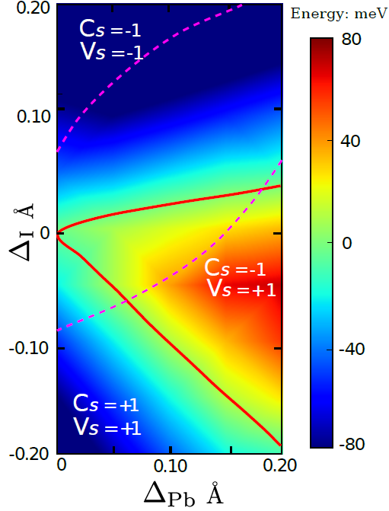
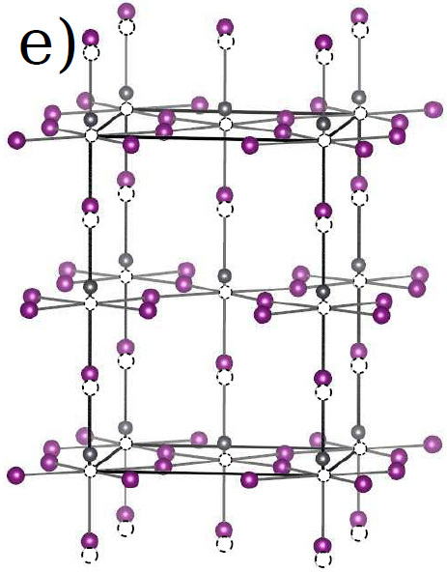
Spin Effects on Carrier Lifetimes
Space group: I4cm, Room temperature
Pb displacements give rise to favorable spin helicity
F. Zheng et al, submitted (2015)

Slide 30
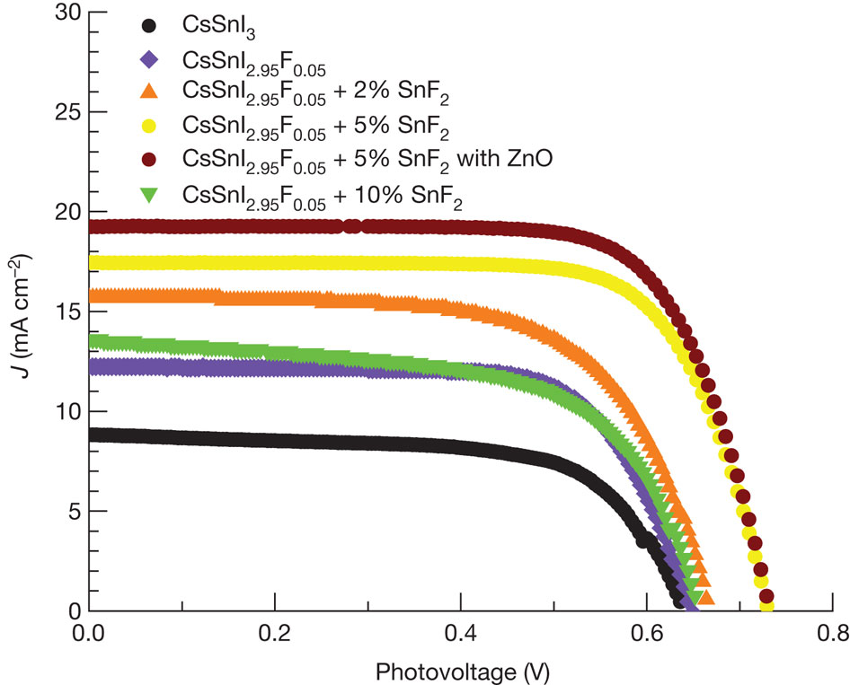
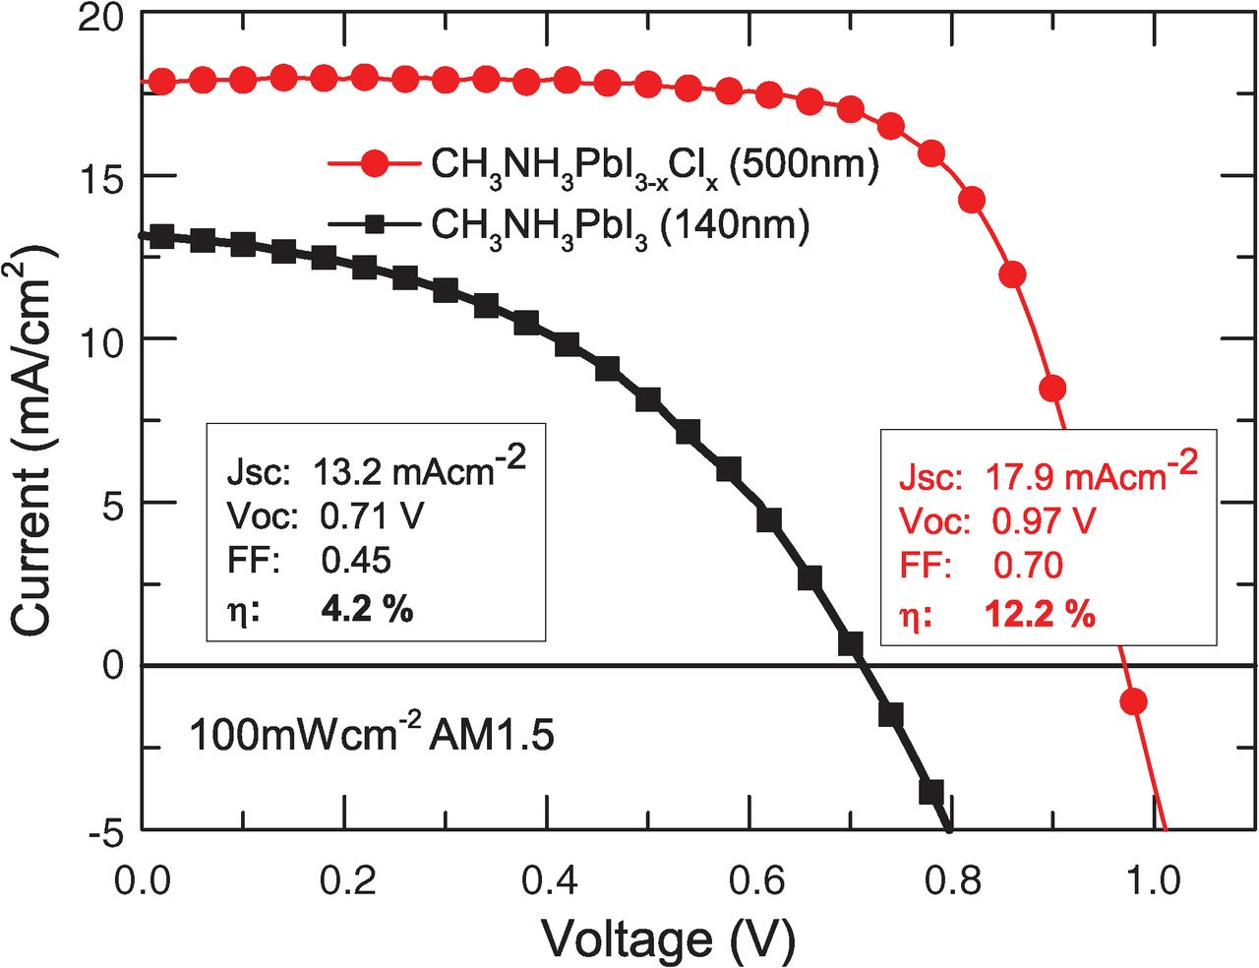
Materials design: Halide Substitution
Halide substitution has significant impact on efficiencies
What are the materials design principles?
Theoretical guidance is needed.
Chung et al., Nature 485,486 (2012)
Stranks et al., Science 342, 341 (2013)

Slide 31
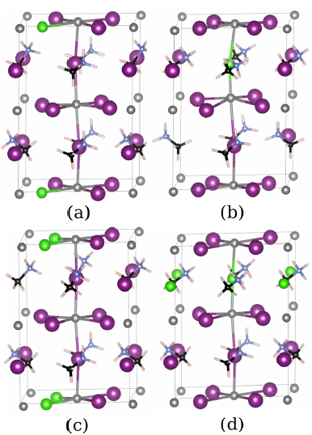
Materials design: Halide Substitution
Atomic structure of CH₃NH3PbI_{3-x}Cl_{x}
Equatorial Substitution
Apical
Substitution
Structure | |P_{z}| (μC/cm²) | Band Gap, SOC (eV)
CH₃NH₃PbI₃ | 5.0 | 0.69
CH₃NH₃PbI_{3-x}Cl_{x} , equatorial | 6.2 | 0.83
CH₃NH₃PbI_{3-x}Cl_{x} , apical | 4.4 | 0.84
J. Phys. Chem. Lett. 6, 31 (2015)

Slide 32
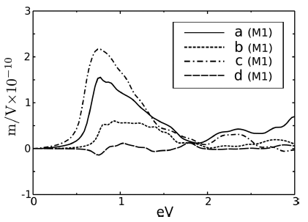
Glass coefficient response of MAPbI_{3-x}Cl_{x} M1 Structures (polar)
M1: net dipole along z
Enhancement due to Cl doping
zzZ
Indicate maximum CH₃NH₃PbI₃ M1 response
Cl substitution increases response in some cases
Equatorial site substitution gives larger response

Slide 33
Summary
Ferroelectricity in OMHPs is in debate: - Experimental setup may strongly affect the ferroelectricity - A site molecular dynamics is important for understanding the ferroelectricity - Bulk photovoltaic effect in polar order has higher magnitude than BiFeO₃, which may explain the large V_{oc}.
Origin of J/V hysteresis is still unknown: - Ion migration may play an important role in J/V hysteresis - Hydrogen migration in MAPbI₃ is studied systematically
Intrinsic reason of long carrier lifetime: - Low defect density; disordered dynamics of molecules; … - Domain and domain wall can help separate carriers - Rashba spin helicity plays a significant role in explaining long carrier lifetime

Slide 34
Acknowledgments
Collaborators:
Shift Current: F.Zheng, H.Takenaka, F.Wang, N.Z.Koocher
Domain walls: S.Liu, F.Zheng, N.Z.Koocher, H.Takenaka, F.Wang
H Diffusion: D. Egger, L. Kronik
Rashba/lifetime: F.Zheng, L.Z.Tan, S. Liu
Funding agencies:
DOE
ONR
NSF
Computational resources:
DOE/NERSC
DOD/HPCMP

