Slide 1

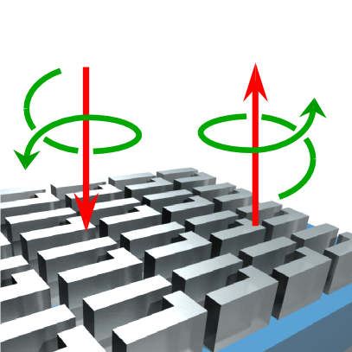
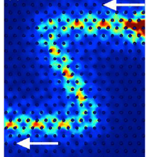
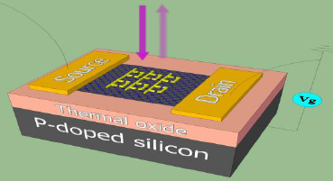
Metamaterials-Inspired Electromagnetics and Photonics
Gennady Shvets, The University of Texas at Austin
Condensed Matter and Materials Research Committee Spring Meeting, National Academies’ Keck Center, Washington, DC, May 1, 2014

Slide 2
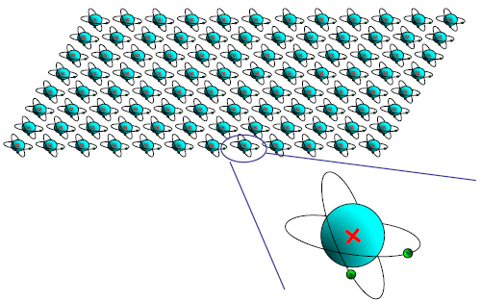
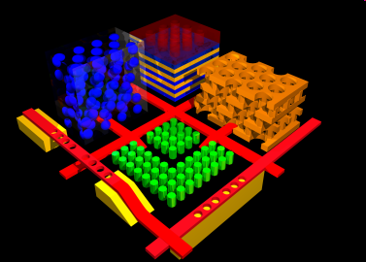
Meta-Materials: Mesoscopic EM Materials
Natural materials: unit cell is an atom << radiation wavelength
Unit cell is small enough→ effective medium description (homogenization, constitutive parameters ε, μ)
Carefully designed resonant unit cells (e.g. split rings etc.)
Remarkable optical/EM properties enabled by finite cell size → spatial dispersion, optical magnetism, bi-anisotropy
MetaMaterials: atom << unit cell < λ
Photonic crystals: unit cell is sized to ½ of the radiation wavelength

Slide 3
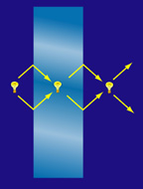
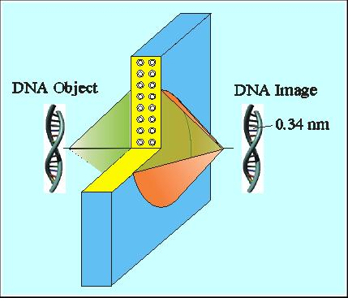
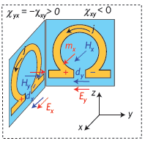
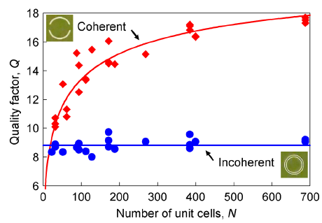
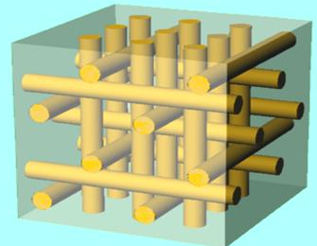
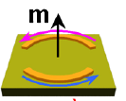
Evolution of Metamaterials Research
Early days: focus on exotic bulk properties → negative refractive index, super-lensing, “cloaking”
Understanding of the EM properties of MMs and their building blocks: high-frequency magnetism, bi-anisotropy, homogenization
Modern Era: Metamaterials-inspired Electromagnetics in two and three dimensions

Slide 4
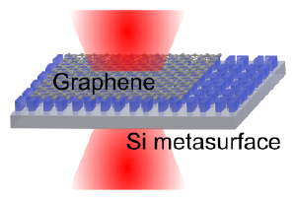
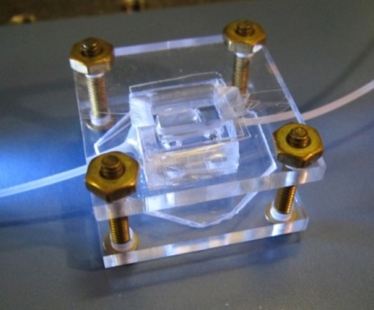
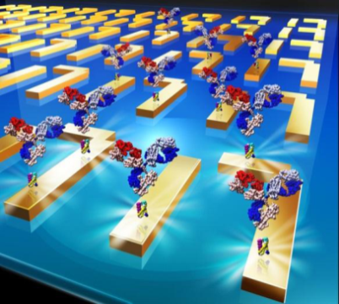
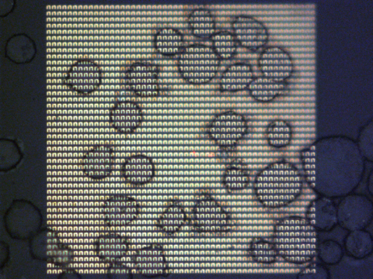
Spectrally Selective Field-Concentrating Optical Resonators Inspired by MMs
High-Precision graphene spectroscopy and ultrafast optoelectronic devices
IR Bio-Spectroscopy: from designing better immunosensors to single-cell fingerprinting
Wu et. al. (Shvets), Nature Comm. (2014, in print)
Wu et. al. (Altug & Shvets), Nature Mat. 11, 69 (2012)
Narrow resonances (high-Q) + Strong field enhancements → Small changes of local environment can strongly affect optical response
Controlling optical response using minute amounts of material, e.g. atomic monolayer of graphene, protein monolayers
Ultra-sensitive fingerprinting/characterization of trace amounts of biological matter (protein monolayers, single cells, etc.)

Slide 5
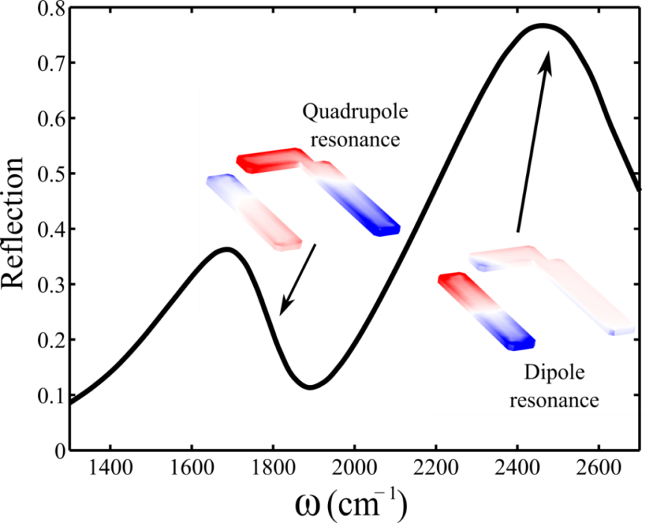
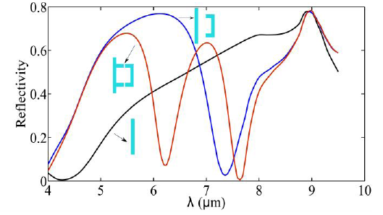
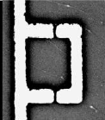
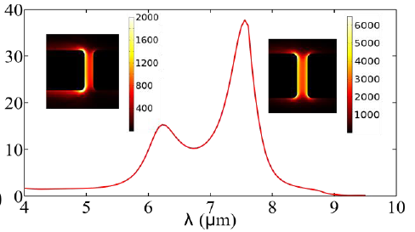
Meta-Surfaces Based on Split Rings
One dark and one bright resonance
Continuum + 2 dark resonances
Easy to turn “Fano”-resonant metasurfaces into active ones:
Strong field enhancement → small amounts of active material (e.g., graphene) is needed
Even small spectral shifts translate into large changes in transmission/reflection
Notes:
We are conducting now extensive theoretical/computational research aimed at understanding resonances of perforated films. Using several types of electromagnetic simulations (direct frequency scans of the field enhancement in response to imposed electric field, eigenvalue electromagnetic and electrostatic formulations, surface impedance method, direct electromagnetic simulations with incident light), we are zeroing in on several types of resonances. Some examples are shown in this slide, but this is still very much work in progress (stimulated by both existing and forthcoming experimental measurements: we have fabricated a number of perforated arrays of different hole diameter, spacing, and film thickness). In this slide I concentrate on the so-called even modes: the in-plane electric field is even with respect to the mid-plane of the film.Two types of resonances have been identified. One is the Localised Surface Polariton (LSP): the fields are tightly concentrated near the hole, and its frequency is independent of the periodicity. The other one is the Surface Phonon Polariton (SPP): the fields are very spread out, and SPP’s frequency is dependent on periodicity. Judging by the wavelength and the magnitude of the field enhancement, it appears that experimentally we’re exciting the SPP. However, we have not yet investigated the resonances which have the in-plane electric field ODD with respect to the mid-plane of the film. Such resonances have a non-vanishing magnetic moment – there is a hope for developing negative-epsilon, negative-mu surfaces!

Slide 6

Outline of the Talk
Plasmonic Meta-Surfaces Functionalized with Graphene
The All-Dielectric Metasurfaces: Beating the Ohmic Loss
Emulating the electron spin in photons using metamaterials: Photonic Topological Insulators
Metamaterials-enhanced IR spectroscopy in life sciences: from proteins to cells
Metamaterials and metamaterials-inspired photonic structures are already contributing to investigating condensed and soft matter materials such as graphene, proteins, cells
They may soon contribute to emulating many-body interactions in condensed matter systems such as topological insulators
The most exciting future work is likely to be done at the meso-scale, e.g., “slightly” sub-wavelength, “somewhat” coherent MMs interacting with wavelength-scale objects (i.e. biological cells)

Slide 7
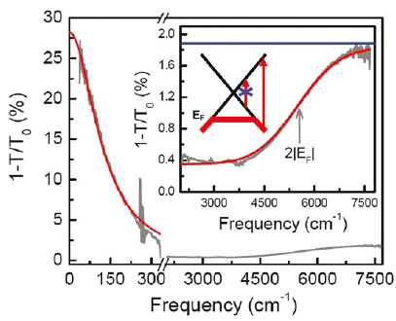
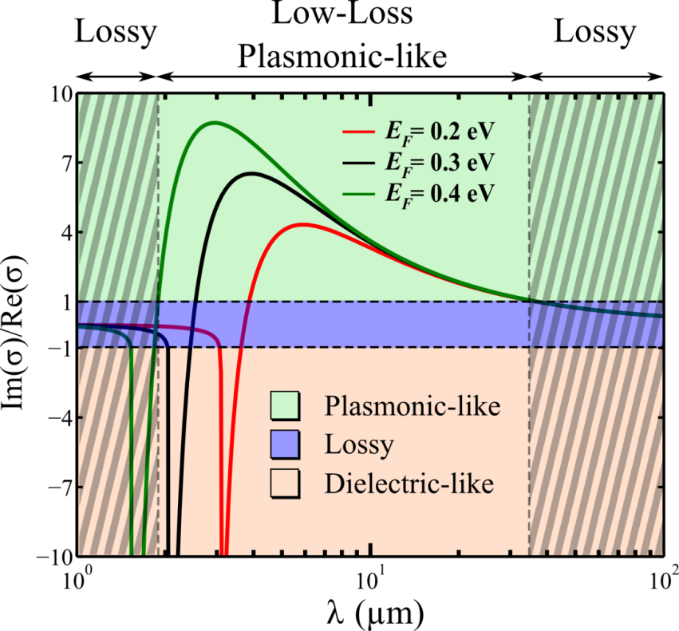
Mid-IR Meta-Surfaces Enhance Graphene’s Response and Can be Controlled by SLG
Induction/Resistance
SLG’s mid-IR response is weak: small Drude conductivity and no interband transitions, but…
Graphene is a low-loss plasmonic material in mid-infrared
Metasurface tuning using “lossless” SLG
MMs enable graphene characterization in mid-IR
. S. H. Mousavi et. al., Nano Letters 13, 1111 (2013).

Slide 8
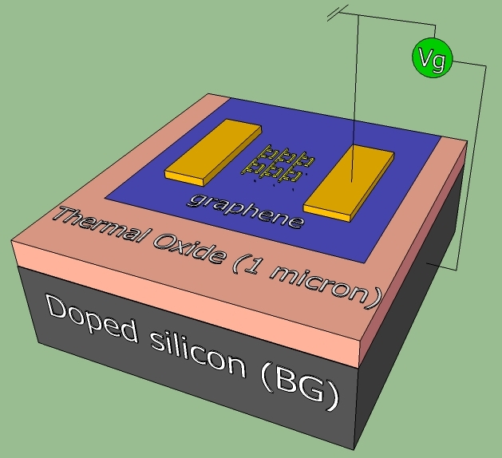
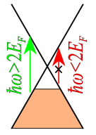
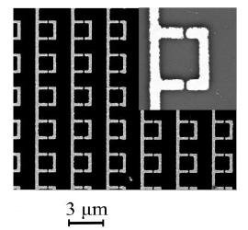

Integration of MMs with Gated SLG
Small (70nm) gap
Dirac Point
Electrons
Holes
Voltage Vg
Back-gating injects carriers into graphene → shifts Fermi energy, changes conductivity
Graphene’s conductivity affects metamaterial’s resonances → graphene spectroscopy
Frequency shift comparable to linewidth → strongly-coupled regime of graphene-MM interaction
Graphene: free + bound carriers
SiO₂
$$\vec{E}$$
Silicon
Antenna arrays: N. K. Emani et. al., Nano Lett. 12, 5202 (2012); Y. Yao et. al., NanoLetters 13, 1257 (2013)

Slide 9
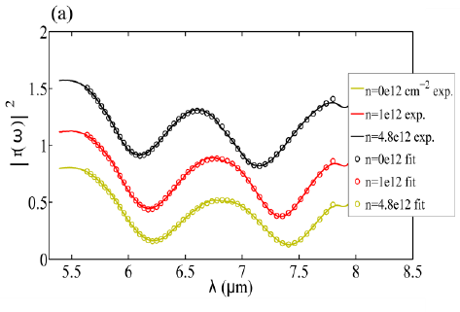
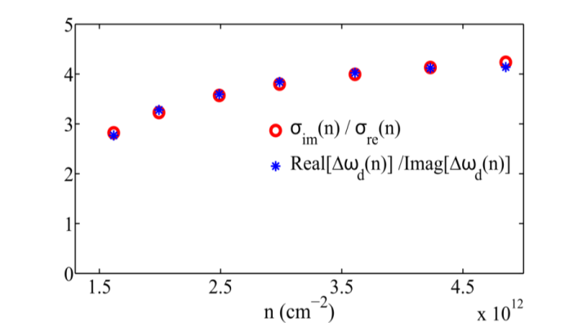
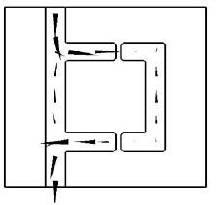
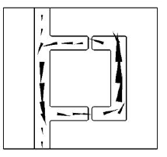

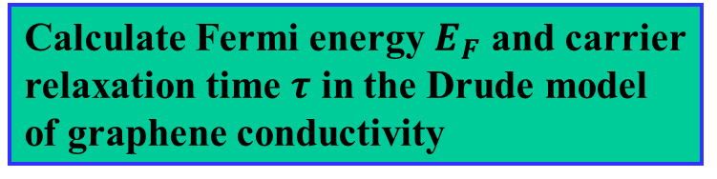
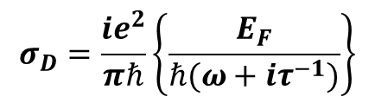
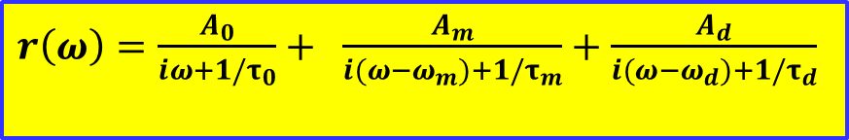
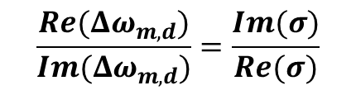


Double-Fano Resonance Fit Used to Extract Graphene’s Optical Properties
Frequency and linewidth changes induced by graphene’s carriers
$$\frac{Re(Δω_{m,d})}{Im(Δω_{m,d})}=\frac{Im(σ)}{Re(σ)}$$
$${\left|r\left(ω\right)\right|}^{2}$$
Calculate Fermi energy $E_{F}$ and carrier relaxation time $τ$ in the Drude model of graphene conductivity
Monopole
SRR Dipole
Best fit: $τ=18fs$
Transport: $τ=14.5fs$
$r\left(ω\right)=\frac{A_{0}}{iω+{1/τ}_{0}}+ \frac{A_{m}}{i(ω−ω_{m})+{1/τ}_{m}}+\frac{A_{d}}{i(ω−ω_{d})+1/τ_{d}}$
$$σ_{D}=\frac{ie^{2}}{πℏ}\left\{\frac{E_{F}}{ℏ(ω+iτ^{−1})}\right\}$$

Slide 10
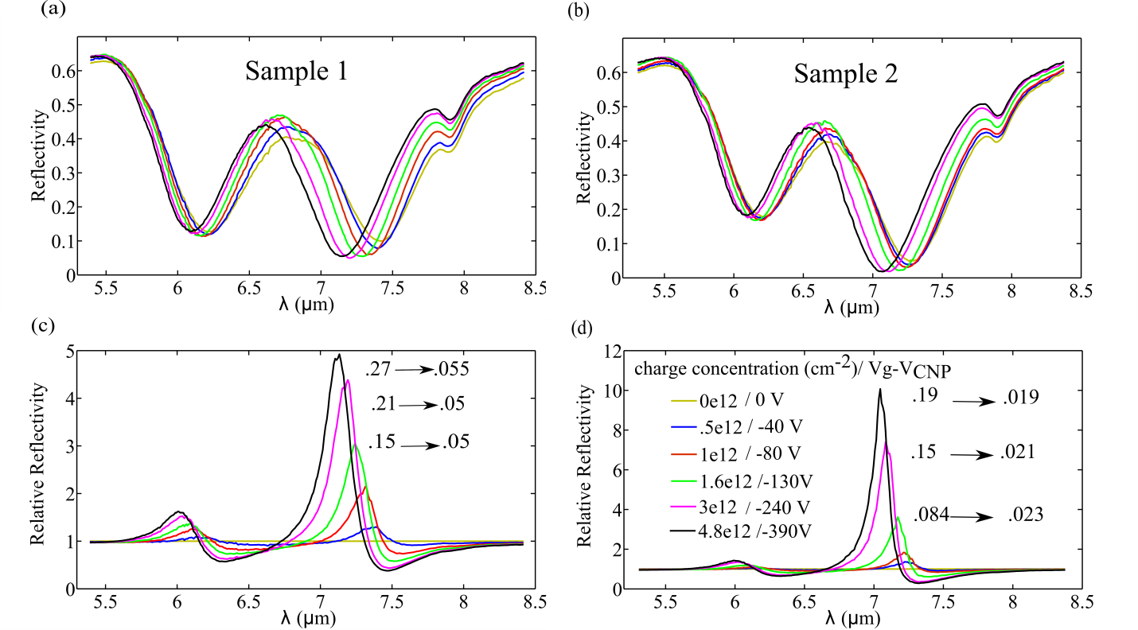
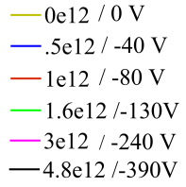


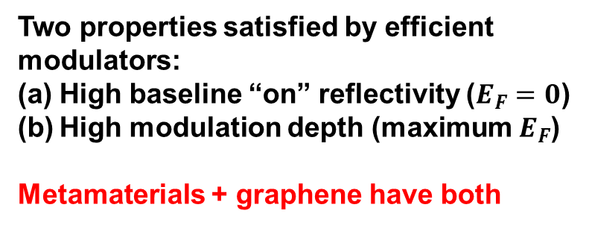


Amplitude Modulator Based on MM/SLG
Modulate reflectivity around Dirac point by back-gating graphene
Two properties satisfied by efficient modulators:
High baseline “on” reflectivity ($E_{F}=0$)
High modulation depth (maximum $E_{F}$)
Metamaterials + graphene have both
$$G=70nm$$
$$G=100nm$$
7dB modulation for $E_{F}=0.28eV$
Modulation Depth: $R(λ;E_{F}=0)/R(λ;E_{F})$
Modulation Depth
Dipole
Monopole
Modulation Depth

Slide 11
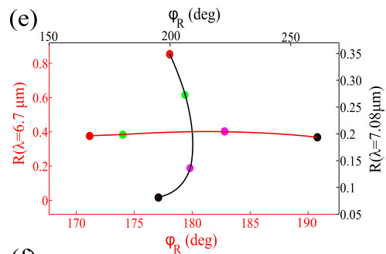
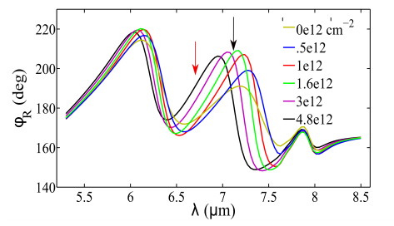
IR Amplitude/Phase Modulator with SLG
amplitude change
phase change
Incident/Reflected IR Light
Either phase or amplitude can be electrically modulated
Independently controlled pixels → electrically controllable IR beam steering or modulation or both
This can be done either in reflection or in transmission
Meta pixel 1
Meta pixel 2
Meta pixel 3
Spacer
Graphene
Substrate

Slide 12
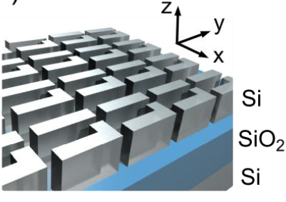
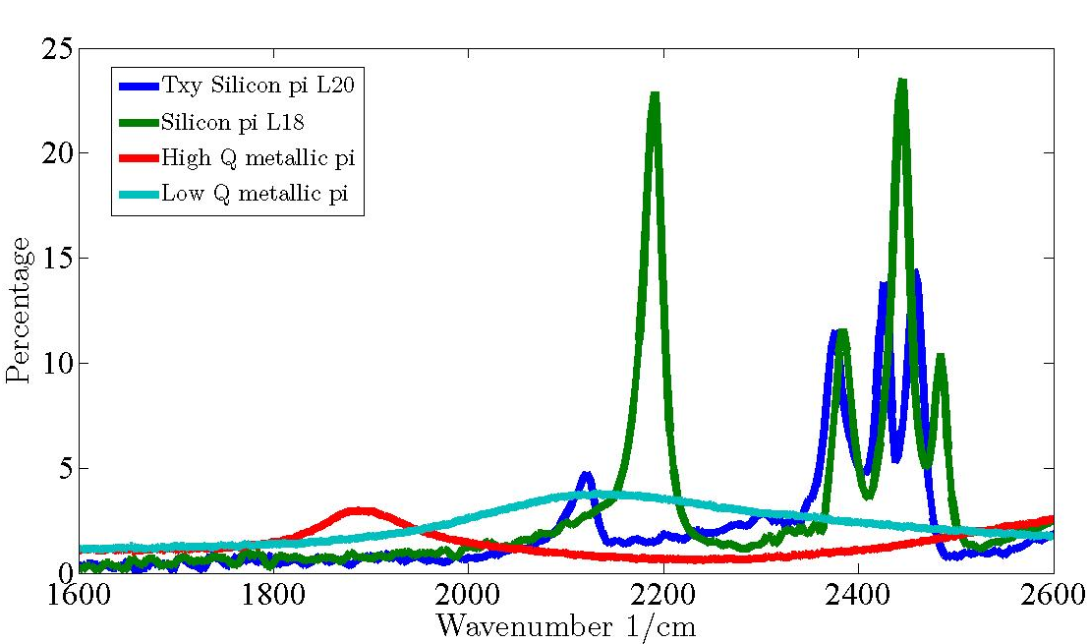
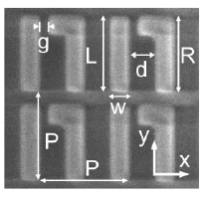
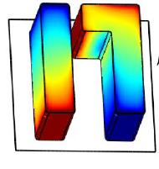
All-Dielectric Fano-Resonant 2D Chiral Metasurfaces: Order of Magnitude Higher Q Than Similar Metallic Metasurfaces
Cross-polarized transmission T_{xy}
Silicon
Metal
C. Wu et. al., “Spectrally Selective Chiral Silicon Metasurfaces Based on Infrared Fano Resonances”, Nature Communications (in press, 2014)

Slide 13
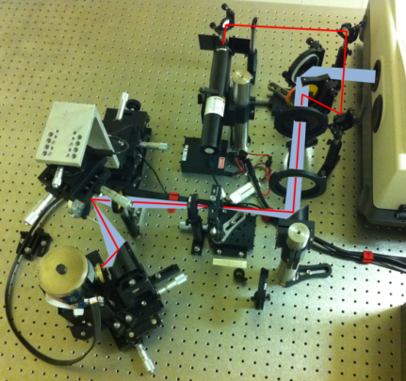
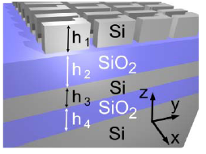
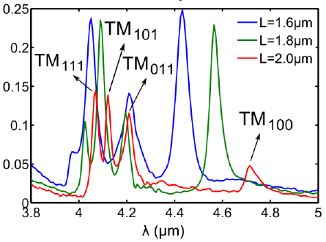
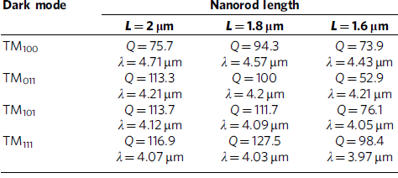


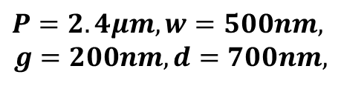

High-Q Fano Resonance in Dielectric MSs
Free-space FTIR spectroscopy using low-NA (=0.14) normally incident IR beam focused to W=200μm
$$P=2.4μm, w=500nm,$$
$$g=200nm, d=700nm,$$
$$h_{1}=h_{3}=1.2μm$$
$$h_{2}=h_{4}=1.6μm$$
$$R=2μm, L=1.6−2μm$$
Experiment, T_{xy}

Slide 14
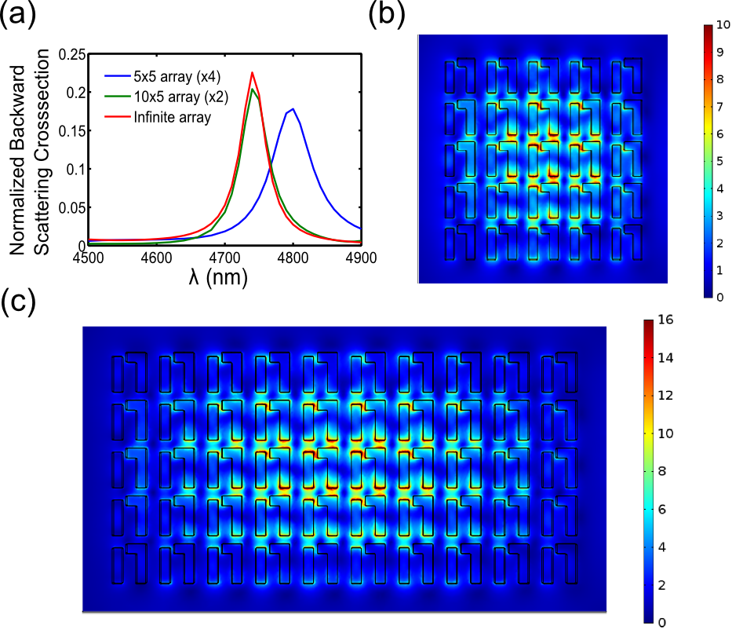

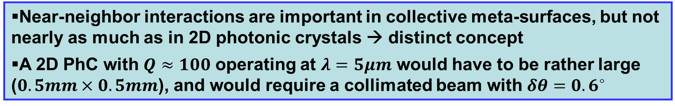

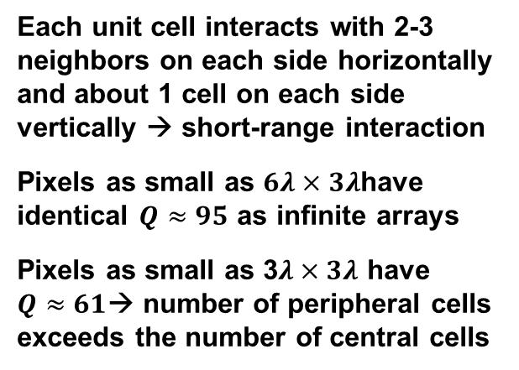

Collective Effects In Metasurfaces
$$σ_{xy}(λ)$$
5x5 array
$$Q≈61$$
Each unit cell interacts with 2-3 neighbors on each side horizontally and about 1 cell on each side vertically → short-range interaction
Pixels as small as $6λ×3λ$have identical $Q≈95$ as infinite arrays
Pixels as small as 3$λ×3λ$ have $Q≈61$→ number of peripheral cells exceeds the number of central cells
$$Q≈95$$
10x5 array
Near-neighbor interactions are important in collective meta-surfaces, but not nearly as much as in 2D photonic crystals → distinct concept
A 2D PhC with $Q≈100$ operating at $λ=5μm$ would have to be rather large ($0.5mm×0.5mm$), and would require a collimated beam with $δθ=0.6^{∘}$

Slide 15
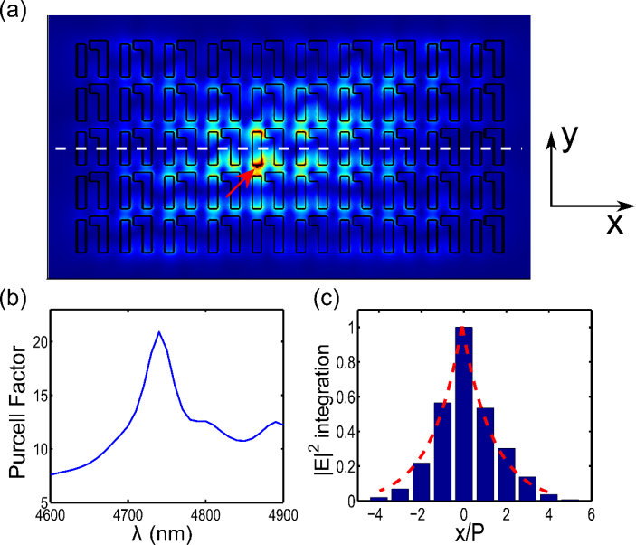

Importance of Close-Neighbor Interactions
Single-cell response: broad poorly expressed resonance
Near-field excitation reveals a narrow-band peak in the photonic density of states
Collective close-neighbor interactions persist over periods → each unit cell must have at least 2 nearest neighbors on each side horizontally
Conceptually different from PhC → “almost-collective” metasurface

Slide 16




LP→ CP: Stokes Parameter Extraction
Rotating analyzer Stokes polarimetry
RCP
LP→CP conversion by 1 micron thick MS with high efficiency (50%) at normal incidence
Experimentally measured quality factor $Q≈95$
Close to 100% Degree of Circular Polarization
$${ S}_{1}=I_{x}−I_{y},S_{2}= I_{45^{∘}}−I_{−45^{∘}}$$
$${S_{0}=I_{x}+I_{y}, |S}_{3}|=|I_{RCP}−I_{LCP}|$$
How does LP→CP conversion work?
How is it different from regular birefringence or 3D chiral structures?
Can one use chiral MS for developing a CP thermal emitter?
¼ wave plate
¼ wave plate
=
polarizer

Slide 17



Super-Chiral Metasurfaces
Objective: $T_{RR}+T_{RL}≪T_{LL}+T_{LR}$→ high Degree of Circular Polarization
$T_{LL}=T_{RR}≈0$ and $T_{RL}=0$, $T_{LR}≈1$
$R_{LR}=T_{RL}=0$ and $R_{RR}≈0$, $R_{LL}≈1$
Only RCP gets transmitted. And when it does, it gets flipped into LCP!
All of LCP gets reflected…as LCP →Super-Chiral Mirror!
The effect does not require (a) dissipation, (b) substrate/air mismatch, (c) non-normal incidence → [¼ $λ$plate + polarizer + ¼$λ$plate] 1$μm$ thick!
It requires finite thickness ($h≈λ/4$→ impossible with noble metals), periodicity, and bi-anisotropy ($M_{z}∝κE_{y}$)

Slide 18




Spectrally Selective CP Thermal Emission
RCP/LCP Reflectivity Matrix
Degree of Chiral Dichroism
Reflectivity asymmetry → emissivity asymmetry
$$\frac{(ε_{R}−ε_{L })_{max}}{{(ε}_{R}−ε_{L})_{baseline }}=45$$
Infrared ID Tags Applications: Unique Spectral/Polarization Signatures!
$σ_{FWHM}≈25nm$: more than 12 CP emission lines separated by 6- $σ_{FWHM}$ inside the $λ=3−5μm$ IR transparency window
The entire scene emits thermal IR, but it is not circularly polarized → unique opportunities for IR Identification Tags
Each line can be RCP, LCP, or un-polarized: $3^{12}=530,000$ unique IR identification tags with unique spectral/polarization signatures

Slide 19



Avoiding Reflections Using Photonic Topological Protection
Property of a scalar wave equation: any obstacle/bend on the scale of one wavelength is going to cause reflections of the microwaves!
This is true for either bulk or surface waves
There is a precedent of suppressed reflections in physics: an electron with spin- ½ and strong spin-orbit coupling propagates without scattering!
A. Khanikaev et. al., Nature Materials 12, 233 (2013)

Slide 20

Emulating Electron Spins and Topological Insulators Using Bi-anisotropic Metamaterials
Bi-anisotropy requires breaking mirror reflection symmetry
A. Khanikaev et. al., Nature Materials 12, 233 (2013)

Slide 21






From Metamaterial to Meta-Crystal
Bi-anisotropy parameters
2-D PhMC: Photonic Crystal comprised of metamaterial inclusions
$${ ψ}^{±}\left(x_{⊥};q\right)=E_{z}(x_{⊥};q)±H_{z}(x_{⊥};q)$$
$$\left(k_{0}^{2}ε_{zz }+∇_{⊥}\frac{1}{μ_{⊥ }}∇_{⊥}\right)ψ^{±}={±\left[∇_{⊥}\left(\frac{−iχ_{xy}}{ε_{⊥ }μ_{⊥ }}\right)×∇_{⊥}ψ^{±}\right]}_{z}$$
Photonic equivalents of spin-up and spin-down electron states
Requires spin-degenerate metamaterials: $ε_{zz }$=$μ_{zz }$, $ε_{⊥ }$=$μ_{⊥ }$
Exact emulation of Kane-Mele Hamiltonian of graphene TIs

Slide 22




Interfaces: Edge States of PTIs
Interfaces between PTIs (e.g. between $χ_{1}>0$ and $χ_{2}<0$ ) support one-way spin-degenerate states!
Gap
Gap
“Spins” don’t scatter into each other as long as the materials are spin-degenerate: $ε_{zz }$=$μ_{zz }$, $ε_{⊥ }$=$μ_{⊥ }$→ restricted topological protection
Spin degree of freedom → relative phase between E_{z} and H_{z}
Orbital degree of freedom → CP at K point of Brillouin zone
RCP
LCP

Slide 23



From Meta-Crystals to Meso-MMs
Topological Interface
Bi-anisotropic Meta-Waveguide (BMW) → simplified version of PTIs emulates spin-orbit coupling
RCP
LCP
Positive Index I:
Negative Index II
LCP
RCP
Spin-polarized photon flow: two spin-up states moving forward, two spin-down states moving backward
Topological protection of edge states against backscatter
Fundamentally different from Tamm states!
topologically protected surface waves
20 units
32 units

Slide 24

Tamm States vs Topologically Protected Edge States: Disorder Sensitivity
Non-trivial interface
“Cavity” placed along the interface → transmission depends on the nature of edge state:
Tamm state → small transmission interrupted by Fabry-Perot resonances
Topologically protected edge state → nearly perfect transmission → guide waves around corners
“Fragile” Tamm surface state:
“Robust” topologically protected edge state:
FP resonances
Topological protection
20 units
32 units

Slide 25










Breaking topological protection
Resonant magnetic impurity inside topological bandgap
chiral edge mode
Off resonance
Gapless rods
Q-factor = 7500
Cavity eigenmode couples $↑↓$ spin states → resonant backscattering is allowed by spin-flipping!
Two-mode theory collapses in the presence of third mode!
Nonlinearities also break topological protection → emulation of many-body effects in CM
Off resonance
On resonance
PTI Interface

Slide 26


What Can Metamaterials Do For You: Applications Time!!
All-dielectric super-chiral metasurfaces with Q>100
C. Wu et.al., Nature Materials 11, 69 (2012) → surface-enhanced IR spectroscopy of protein monolayer; microfluidic integration for cell identification in blood (CTCs)
C. Wu et.al., Nature Comm. (in press) → engineering of thermal/quantum emission → sources of CP radiation across EM spectrum
S. H. Mousavi et. al., NL 13, 1111 (2013) → integration of SLG with metamaterials → agile IR modulators, beam steering.

Slide 27



Acknowledgements
Postdocs/Staff:
Simeon Trendafilov
PhD Students
S. Austin Yi Nihal Arju Hossein Moussavi Nima Dabidian Chih-Hui Wu
Collaborators:
Igal Brener (SNL) Rod Ruoff (UT)

Slide 28
Additional Slides

Slide 29



Novel platform for bio-sensing and molecular fingerprinting: Metasurface Enhanced Infrared Reflection Spectroscopy → MEIRS
substrate
Chihhui Wu et.al., Nature Materials 11, 69 (2012)
Objective: better biosensor by improving the orientation of binding proteins and antibodies → higher binding capacity
Notes:
A standard biosensor (or immunoassay) works by immobilizing antibodies on a solid substrate and detecting its binding with antigens of interest (anything from cells to proteins). Only one region of an antibody binds to an antigen. Therefore, it is important that the antibody presents itself to an antigen in the right orientation. This can be done by using intemediate binding proteins that bind to a specific (Fc) portion of an antibody. However, there is no direct evidence that the binding proteins themselves properly orient themselves. So far antibody orientation has been deduced from immunological activity of immobilized antibodies. This method is indirect!

Slide 30





Meta-Pixels Mosaic Tuned to Fingerprints
Size determines natural frequency
Pixels’ resonance frequencies can be swept across vibrational resonances
Resonant and non-resonant pixels → additional data points for bio-sensing
50 elements
Notes:
We can make mosaics of meta-pixels tuned to different vibrational resonances

Slide 31


How sensitive is MEIRS: Comparison with Fluorescence Measurements
Amide I
$$−dΔR/dω$$
Fluorescently tagged antibodies before washing
Attached antibodies (after washing): fluorescence not observed under microscope
Attached antibodies
$ΔR(ω)$: Difference spectrum (with protein – bare) → peaks at the MM resonance
Single monolayers of fluorescently tagged antibodies are difficult to detect using unspecialized microscopes
Metasurface-enhanced infrared spectroscopy (MEIRS) enables the detection of antibody monolayers → strongest signal when metasurface resonance is matched to vibrational resonance of the protein (e.g., Amide I)
Advantageous to avoid exogenous labels for tagging
Notes:
We are conducting now extensive theoretical/computational research aimed at understanding resonances of perforated films. Using several types of electromagnetic simulations (direct frequency scans of the field enhancement in response to imposed electric field, eigenvalue electromagnetic and electrostatic formulations, surface impedance method, direct electromagnetic simulations with incident light), we are zeroing in on several types of resonances. Some examples are shown in this slide, but this is still very much work in progress (stimulated by both existing and forthcoming experimental measurements: we have fabricated a number of perforated arrays of different hole diameter, spacing, and film thickness). In this slide I concentrate on the so-called even modes: the in-plane electric field is even with respect to the mid-plane of the film.Two types of resonances have been identified. One is the Localised Surface Polariton (LSP): the fields are tightly concentrated near the hole, and its frequency is independent of the periodicity. The other one is the Surface Phonon Polariton (SPP): the fields are very spread out, and SPP’s frequency is dependent on periodicity. Judging by the wavelength and the magnitude of the field enhancement, it appears that experimentally we’re exciting the SPP. However, we have not yet investigated the resonances which have the in-plane electric field ODD with respect to the mid-plane of the film. Such resonances have a non-vanishing magnetic moment – there is a hope for developing negative-epsilon, negative-mu surfaces!

Slide 32




Interaction of Anisotropic and Oriented Proteins with Metasurfaces
z
θ_{z}
θ_{x}
orientation tensor: C=O bond with respect to Cartesian axes
x
for isotropic proteins
Orientation of anisotropic proteins detected by surface-enhanced spectroscopy
Isotropic IgG protein
From Protein Data Base
Anisotropic protein A/G
Notes:
As it turns out, many proteins are not really isotropic. They are more like pasta: very elongated in one direction. This can be described by the so-called
directional tensor T. For an isotropic protein this tensor is a unity matrix. What about real proteins?

Slide 33


MEIRS determines protein layer compositions
mono-layer: dash
Binding of A/G monolayer of thickness h₁=2.7nm to three FRAMM pixels (blue, green, red)
Differential Reflectivity
C. Wu et.al., Nature Materials 11, 69 (2012)
Non-resonant blue pixel is not vibration sensitive→ SPR-like thickness measurement
Resonant green pixel is vibration/orientation sensitive → orientation of A/G on the surface

Slide 34


MEIRS determine protein layer compositions
IgG monolayer of height h₂ = 5.1nm binds to A/G monolayer of height h₁=2.7nm → (h₂ + h₁)/h₁ = 2.9
mono-layer: dash bi-layer: solid
Differential Reflectivity
Non-resonant blue pixel is not vibration sensitive→ SPR-like thickness measurement
Resonant green pixel is vibration/orientation sensitive → orientation of A/G on the surface

Slide 35





Where do we go from here: From Proteins to Cells to Diagnostics
glycogen (1020 cm⁻¹)
phosphate (1080 cm⁻¹)
Spectral signatures of cancer cells
C. Wu et.al., Nature Materials 11, 69 (2012)
Notes:
Advantage of metamaterials: high field localization (tens of nm) which is comparable with the total thickness of binding antibodies and cellular membrane proteins. Also: this sensor has a large dynamic range, i.e. it enables monitoring protein binding, cell attachment, etc.

Slide 36

Metamaterials-Based Fingerprinting of Live Cells: Macrophages vs Malignant
glycogen (1080 cm⁻¹)
phosphate (1030 cm⁻¹)
DNA/RNA (P=O)
C=O ester in P-lipids
Epithelial cancer cells
Normal macrophage cells
Amide II
Amide I
Future: detection and identification of circulating tumor cells (CTCs): the key cause of cancer-related mortality because of metastasis
Notes:
Advantage of metamaterials: high field localization (tens of nm) which is comparable with the total thickness of binding antibodies and cellular membrane proteins. Also: this sensor has a large dynamic range, i.e. it enables monitoring protein binding, cell attachment, etc.

