Slide 1
Proposed revision of ITU-R Recommendation providing
EESS (active) Performance and Interference Criteria
May 13, 2015
Committee On Radio Frequencies
Thomas vonDeak
NASA Spectrum Office
Notes:
This presentation is a reflection of the collective efforts of the NASA Spectrum Office. Information regarding this office and its scope of activities can be found at: https://www.spacecomm.nasa.gov/spacecomm/programs/spectrum_management/about/default.cfm

Slide 2
EESS (active) Protection Criteria
Review of Recommendation ITU-R RS.1166-4 “Performance and interference criteria for active spaceborne sensors”
Application of the Interference and Data availability criteria to compatibility studies
Availability: Measurement area of interest versus global
Considering the instantaneous peak power of the interferer
Sensor susceptibility to interference

Slide 3
Development Schedule
The work on the WRC-15 Agenda item 1.6 studies made us aware of improvements needed for Rec. ITU-R RS.1166-4.
  Actual work on revising RS.1166-4 was delayed until after WRC-15 so as to not call into question the validity of the on-going studies.
To capture the issues discovered, a working document to revise Rec. ITU-R RS.1166-4 has been carried forward in the ITU-R Working Party 7C Chairman Report for the past three meetings.
The work to revise Rec. ITU-R RS.1166-4 is anticipated to occur between WRC-15 and WRC-19.

Slide 4
Rec. ITU-R RS.1166-4
Performance and interference criteria for active spaceborne sensors
Recommends 2
that the interference and data availability criteria given in Table 2 be applied for instruments used for active sensing of the Earth’s land, oceans and atmosphere.
TABLE 2
Sensor type | Interference criteria |  | Data availability criteria (%)
 | Performance degradation | I/N (dB) | Systematic | Random
Synthetic aperture radar | 10% degradation of standard deviation of pixel power | –6 | 99 | 95
Altimeter | 4% degradation in height noise | –3 | 99 | 95
Scatterometer | 8% degradation in measurement of normalized radar backscatter to deduce wind speeds | –5 | 99 | 95
Precipitation radar | 7% increase in minimum rainfall rate | –10 | N/A | 99.8
Cloud profile radar | 10% degradation in minimum cloud reflectivity | –10 | 99 | 95
NOTES:
Systematic data availability criteria isn’t applicable to precipitation radar.
For bands with secondary allocation, the interference criteria are provided only to indicate performance degradation with regard to primary services. (i.e., the data availability criteria cannot be applied.)

Slide 5
Application of the Performance and interference criteria
The random data availability requirement is 95%, assuming that the interference events exceeding the protection criteria are:
  brief (i.e., most outages lasting 2 s or less) and
  randomly dispersed over all observation time and areas.
The data availability requirement is 99% for any geographical areas of interest.
  The impact of interference that is always present at a given geographical location (systematic) is much more serious than that of random interference, because measurements can never be obtained from those geographical areas.
In shared frequency bands, data availability shall exceed
  95% of all locations in the sensor service area in the case where the loss occurs randomly, and
  99% of all locations in the case where the loss occurs systematically at the same locations.
Notes:
The random data availability requirement is typically not used in studies. Since most EESS (active) operate globally including the poles, interference is not typically randomly dispersed over observation time and area.
What has been done in recent studies is to apply the systematic data availability requirement over the entire surface of the Earth as the geographical area of interest.
All the current EESS (active) allocations are shared allocations. Therefore, there is no need for distinction of shared versus non-shared allocations. The data availability requirement is the same in all cases of EESS (active).

Slide 6

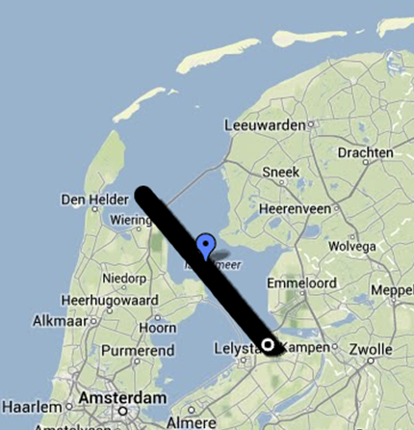
Compatibility Analysis
Static | Dynamic
 | Random Data Criteria | Systematic Data Availability
I/N exceedance | 95% Availability | 99% Availability
Single | Global | Global | Area of interest
Worst case | Average | Average | Worst case
Remote Sensing System
Remote Sensing System
Remote Sensing System
Single source
interferer
Global
interferers
Global
interferers
Analysis not typically done with this criteria. Exception: Precipitation Radar.
Notes:
Single entry used to determine if further detailed studies are needed (i.e., dynamic analysis). If the single entry worst case analysis shows compatibility then there is no need for Dynamic Simulations.
Single entry, static
Worst case (maximum power, minimum distance), main beam to main beam coupling of the offending receiver and the victim receiver is analyzed against the evaluation criteria.
RESULTS: In general, if compatibility is found through this method then compatibility is ensured.
Dynamic analysis
Dynamic analysis is undertaken when single entry static analysis indicates that compatibility is not ensured.
Simulation of victim receiver and offending transmitter deployment using appropriate characteristics to evaluate the offending interference environment against both the amount of degradation to the victim receiver signal and the percentage of time that degradation can be tolerated.
RESULTS: In general, multiple studies produce multiple results due to different simulation assumptions used.

Slide 7
Geographical area of interest
The geographical area of interest:
  As large as the entire sensor repeat cycle over the entire Earth.
  As small as smallest measureable area investigated.
The actual measurement samples used by the investigator need to be known to the analyst in order to properly assess the potential interference impact.

Slide 8
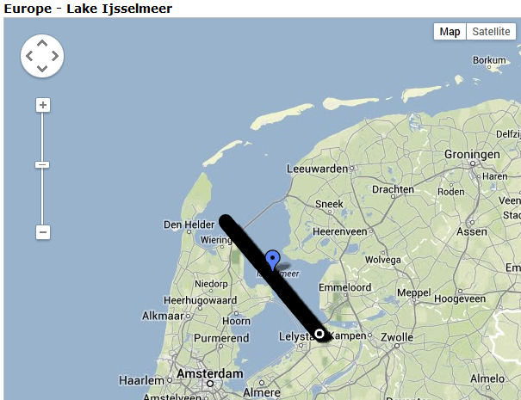
Measurement area of interest
USDA global reservoir and lake monitoring program
Notes:
The United States Department of Agriculture obtains measurements, using the JASON series of sensors, of 83 global reservoirs and lakes. The data obtained and the precise measurement areas for each reservoir and lake is publically available at: http://www.pecad.fas.usda.gov/cropexplorer/global_reservoir/
The Measurement Area of Interest shown in the black line, is a small portion of a single orbital pass by JASON-3. The orbit of JASON-3 is carefully controlled so that every 10 days the JASON-3 orbital pass aligns with the pass of 10 days ago. This enables measurements to be taken over the same Measurement Area of Interest every 10 days.
A single interferer can corrupt the measurements of a measurement area of interest such as that shown in this slide. If the interferer is non-random (i.e., persistent) then the specific area of interest can never be measured.

Slide 9
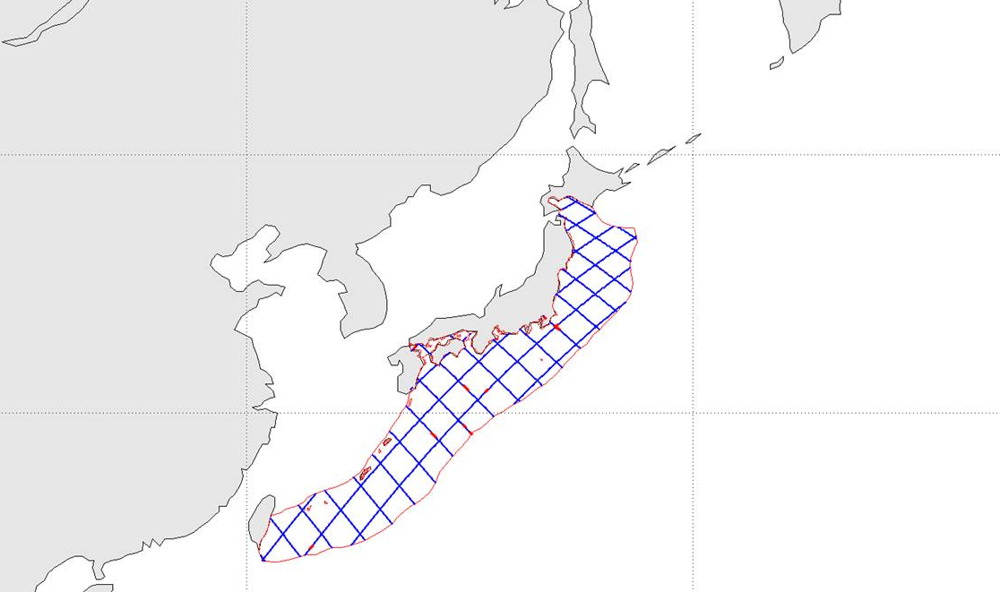
Measurement Area of interest
Assumed measurements for the area of interest
  Blue lines within red outline are every sensor ground track within the area of interest
Proposed Japanese Altimeter
Notes:
This slide shows how we first assumed how a specific area of interest was measured. The identified area of interest was outlined and during a simulation every pass of the sensor over the area was examined for interference. The average interference was calculated and if the average interference fell below the I/N threshold protection level then the sample was declared to be good. A better understanding is needed of the area of interest, what measurements are used, and how the measurements are processed (to obtain the products of the investigator). This understanding is needed by the analyst in order to properly structure the examination of compatibility between the EESS (active) sensor and the interferer.

Slide 10
Compatibility Analysis
Input parameters
Relevant compatibility study characteristics
Sensor characteristics
  System noise, antenna pattern
  Detection type (e.g., peak, average power)
  Sample period
  Background Noise sampling procedure
Offending Transmitter characteristics
  Power (Peak or Median), antenna gain and pointing, deployment characteristics
  Modulation scheme
  Media access method (e.g., TDMA)
Link parameters
  Distance separation, shielding
Evaluation Criteria
Victim receiver acceptable limits of interference (Protection criteria) based on the interpretation of Rec. ITU-R RS.1166-4
  Amount of degradation to victim receiver signal that can be tolerated. (Interference to Noise ratio)
  Percentage of time the degradation can be tolerated.
Notes:
The red text are new topics that need to be assessed for their impact on the results of compatibility studies.

Slide 11
Peak to Average Power Ratio
Median output power of the interference source is typically used in ITU-R compatibility studies.
The EESS (active) altimeter detects and records the peak reflected signal.
The difference between using the peak power of the interferer versus the median power can easily influence the results.

Slide 12
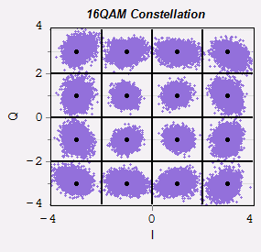
WHY PAPR MATTERS
Altimeters detect this.
Peak Power
7.4 dB
ITU-R studies use
This.
Average Power
Our understanding is that SARs, Precipitation Radars, Scatterometers, and Cloud Profile Radars detect the average power of return signals. Therefore, it is assumed that compatibility studies for those sensors can be conducted using the median power of the interferer.

Slide 13
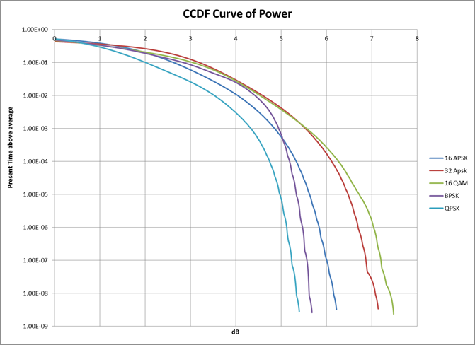
Peak to Average Power Ratio
Five common modulations. Single carrier/passband operation.
Notes:
These measurements were directly measured by observing the amount of time the instantaneous power of a particular modulation remained above the average power. Single carrier per passband were used in these measurements. Some services may use multiple carriers per passband in which case the highest power detected would deviate further from the average than would be the case for a single carrier per passband situation.

Slide 14
Other topics to be investigated
Relevant EESS (active) sensor parameters for interference impact assessment
Sensor parameters
Preliminary list of EESS (active) sensor parameters to be considered in examining a sensor susceptibility to interference
Sensor type | Peak vs Average power detection | Sub sample size (ms) | Number of subsamples in a sample | Pixel size (km²) | Minimum measurement area of interest | Background noise measurement
Altimeter
Scatterometer
Precipitation Radar
Synthetic Aperture Radar (SAR)
Cloud Profile Radar
Notes:
This list has not yet been discussed with our international partners.

Slide 15
FINI

