Slide 1
Opportunities in Basic Science:
Quantum Fluids and Solids
3He
[ key: blue is a challenge; red is a grand challenge]
Brief introduction: solid and liquid 3He
3He as topological quantum matter
Broken symmetry phases
Quantum matter in extreme conditions
Connections to hard quantum matter
Connections to particle physics
Connections to magnetism
Low temperature technology

Slide 2
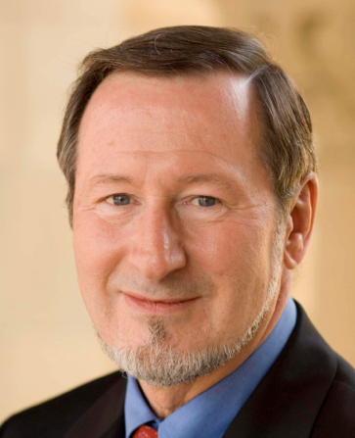
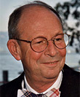
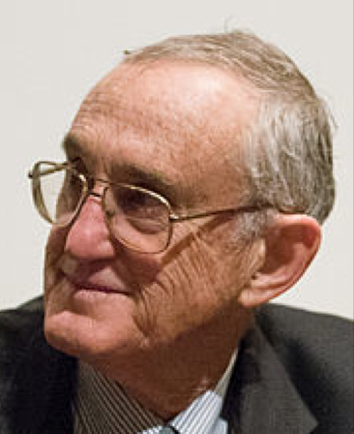
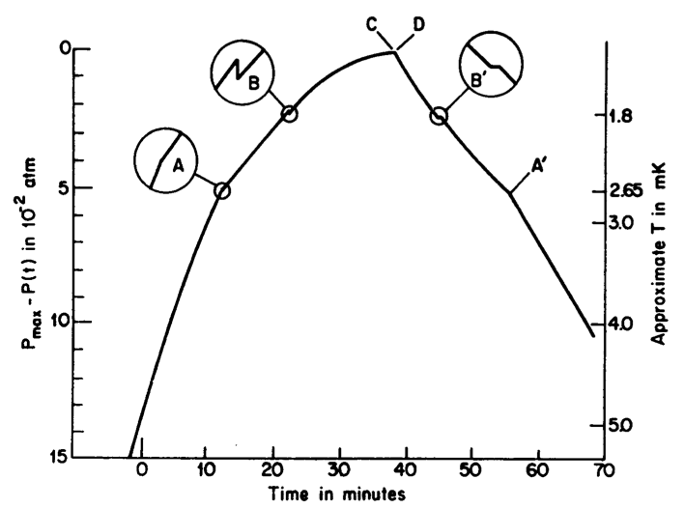
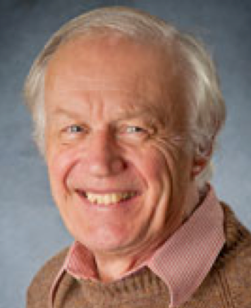
Brief introduction:
solid and liquid 3He
Osheroff
Richardson
Lee
Nobel prize 1996
Leggett
Nobel prize 2003

Slide 3
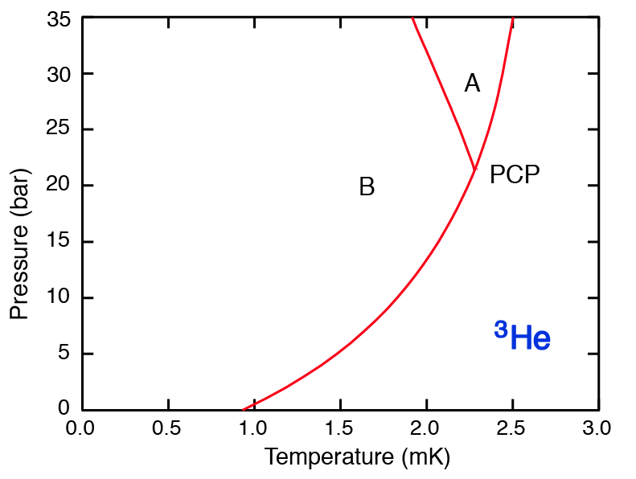
Brief introduction: solid and liquid 3He
Nuclear magnetic order 1974
Halperin, Richardson et al.
Superfluid order in 1972
Osheroff, Richardson, Lee

Slide 4
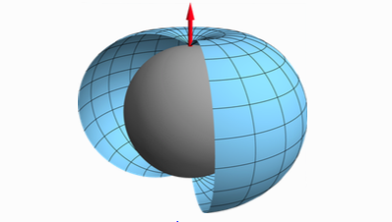
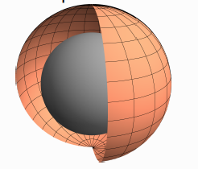
Superfluid 3He as topological quantum matter
Majorana fermionic excitations at 3He-B surfaces (confinement, A-B interface)
Majorana fermionic excitations 3He-A vortex cores
Chiral edge currents in 3He-A
Intrinsic angular momentum of 3He-A
Isotropic B-phase
Axial A-phase

Slide 5
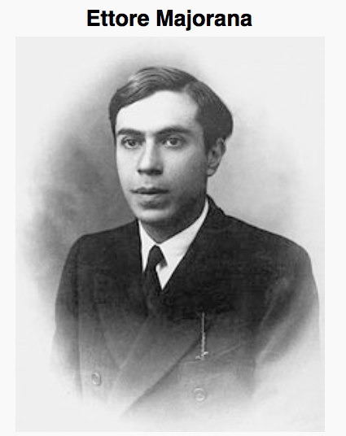
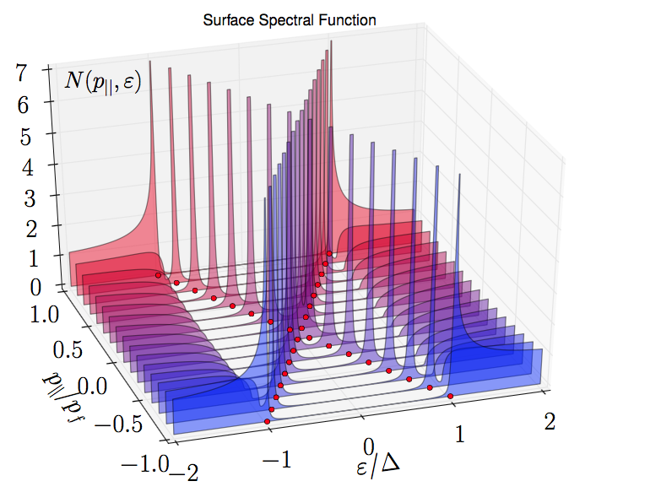
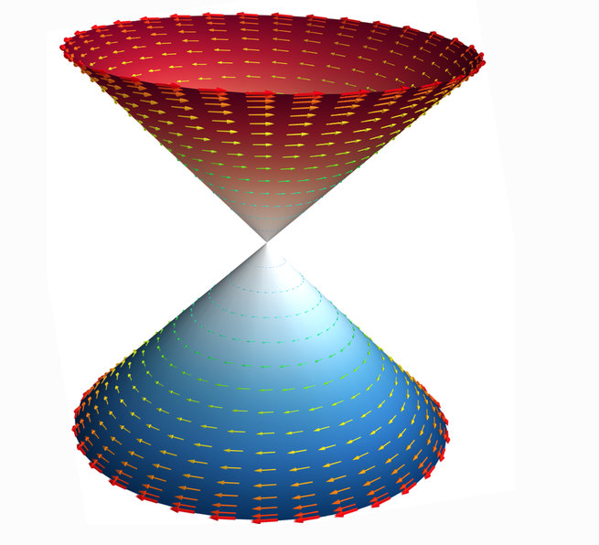
Superfluid 3He as topological quantum matter
Majorana fermionic excitations at 3He-B surfaces
(confinement, A-B interface)
Surface Dispersion 3He-B
Spin helical modes 3He-B

Slide 6
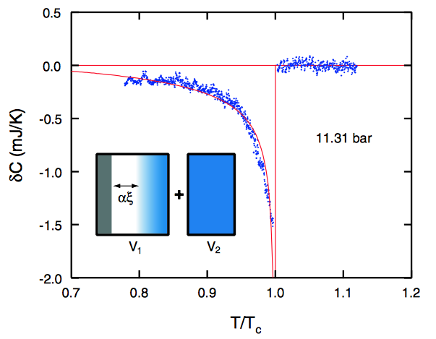
Superfluid 3He as topological quantum matter
Majorana fermionic excitations at 3He-B surfaces:
Heat capacity of surface
Andreev bound states . . . Majoranas.
Choi et al. PRL 96, 125301 (2006).
Here - δC is the heat capacity
of the Andreev bound states
occupying a volume ~ α A ξ(Τ)
A is the surface area of the
sample cell.
Extend to T= 0 and compare with theory.

Slide 7
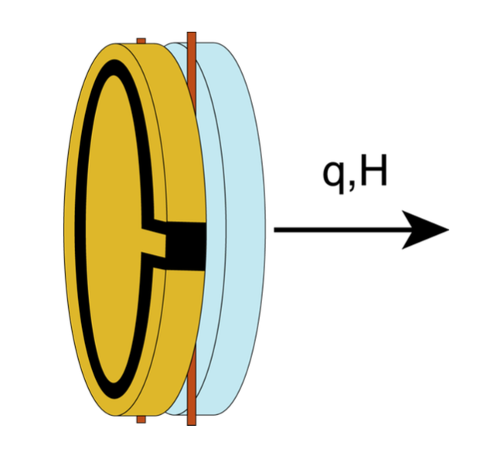
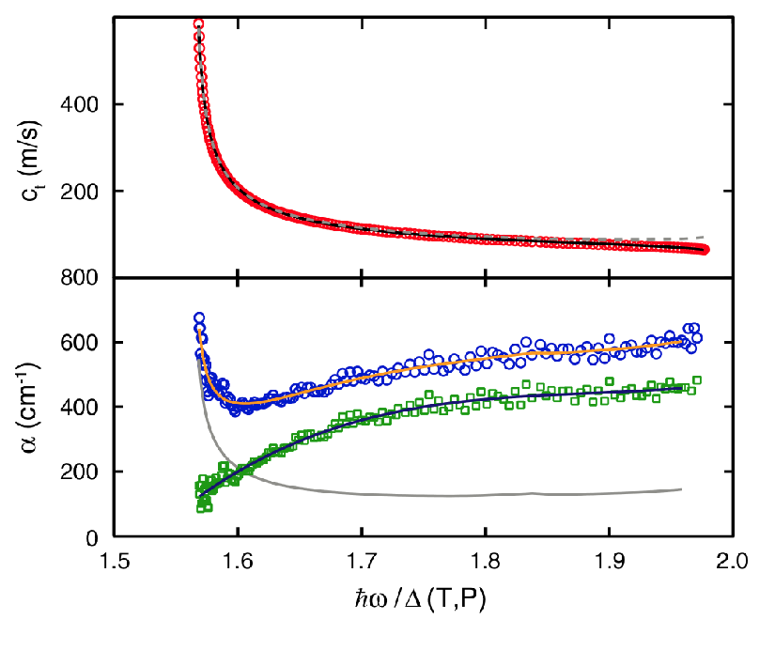
Superfluid 3He as topological quantum matter
Majorana fermionic excitations at 3He-B surfaces:
acoustic cavity
Spectroscopy for
surface Andreev-Majorana bound states
from transverse sound in a thin slab.
Acoustic impedance at the surface:
Y. Aoki et al, PRL 95, 075301 (2005)
Murakawa et al. PRL 103, 155301 (2009)
Attenuation of transverse sound from
surface bound states
Davis et al. PRL 101, 085301 (2008).

Slide 8
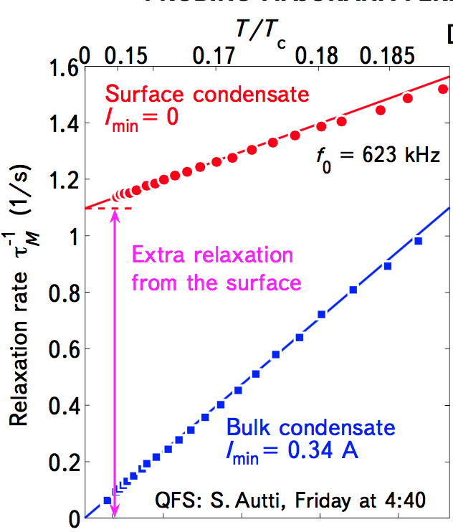
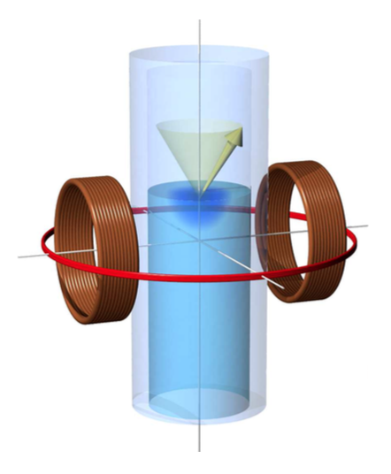
Superfluid 3He as topological quantum matter
Majorana fermionic excitations at 3He-B surfaces:
Majorana states at the AB interface should
relax the homogeneous precession domain
Efitov et al., Grand Challenges Workshop, Buffalo, NY (2015)
(Aalto University)
3He-A
HPD
3He-B

Slide 9
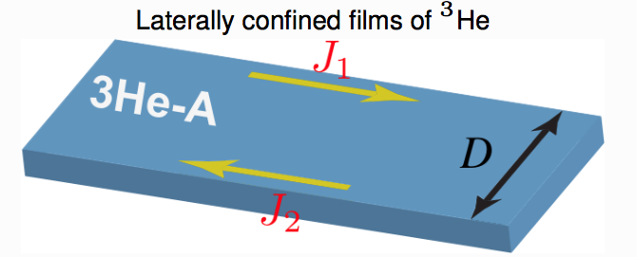
Superfluid 3He as topological quantum matter
Surface states, edge currents, and the angular momentum of chiral p-wave superfluids,
Sauls, Phys. Rev. B 84, 214509 (2011) (Northwestern)
Chiral edge currents in 3He-A
Intrinsic angular momentum of 3He-A: Nh/2

Slide 10
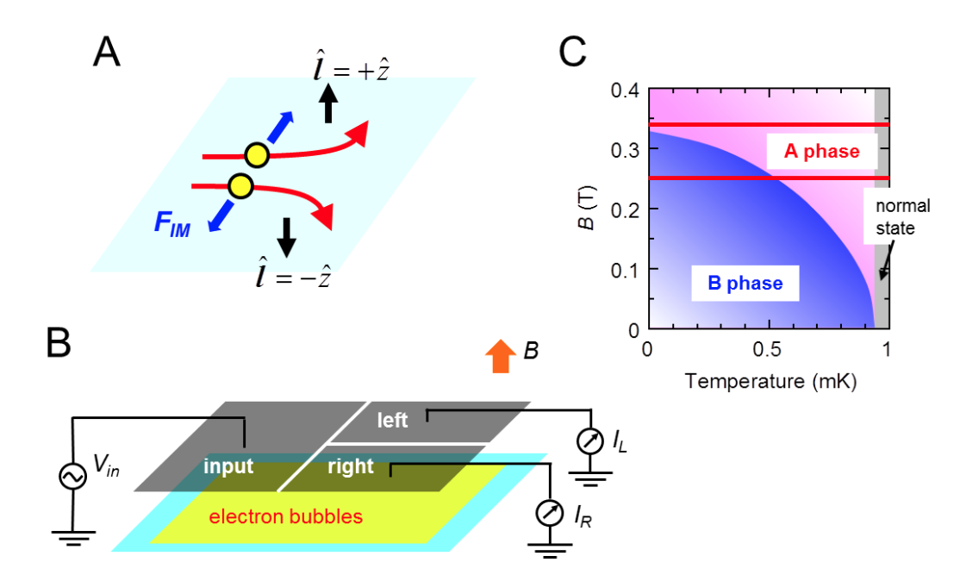
Broken symmetry phases
A-phase is chiral and breaks time reversal symmetry.
The first direct observations by Ikegami, Tsutsumi, and Kono (RIKEN)
Science 341, 59 (2013)

Slide 11
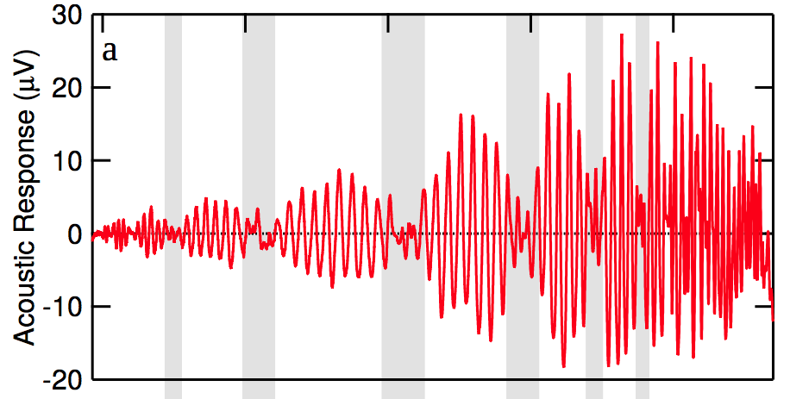

Broken symmetry phases
B-phase is time reversal symmetric with a broken rotational symmetry that preserves relative spin - orbit symmetry (like the predicted color flavor locking symmetry predicted by Wilczek in the quark – gluon plasma).
First direct observations of this characteristic symmetry by Lee et al. Nature 400, 431 (1999) in the acoustic Faraday effect in an acoustic cavity
acoustic cavity

Slide 12
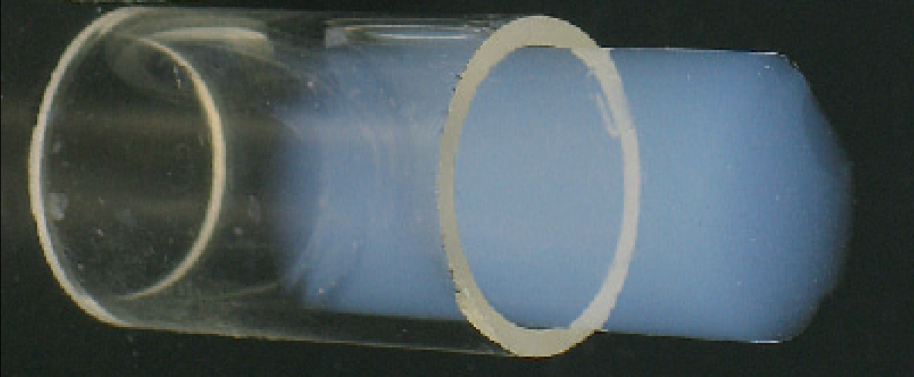
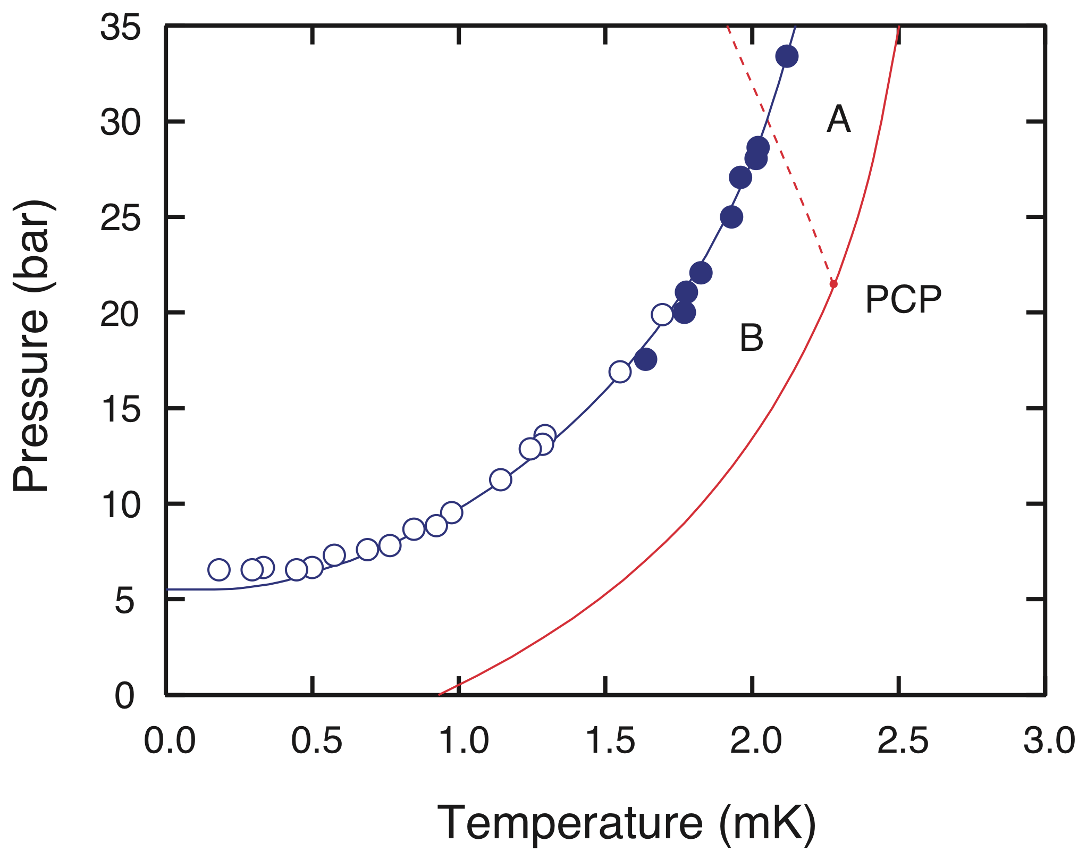
Broken symmetry phases
Isotropic silica aerogel:
Pollanen et al., (Northwestern)
PRL 107, 195301 (2011)
A
B
B
H = 0

Slide 13
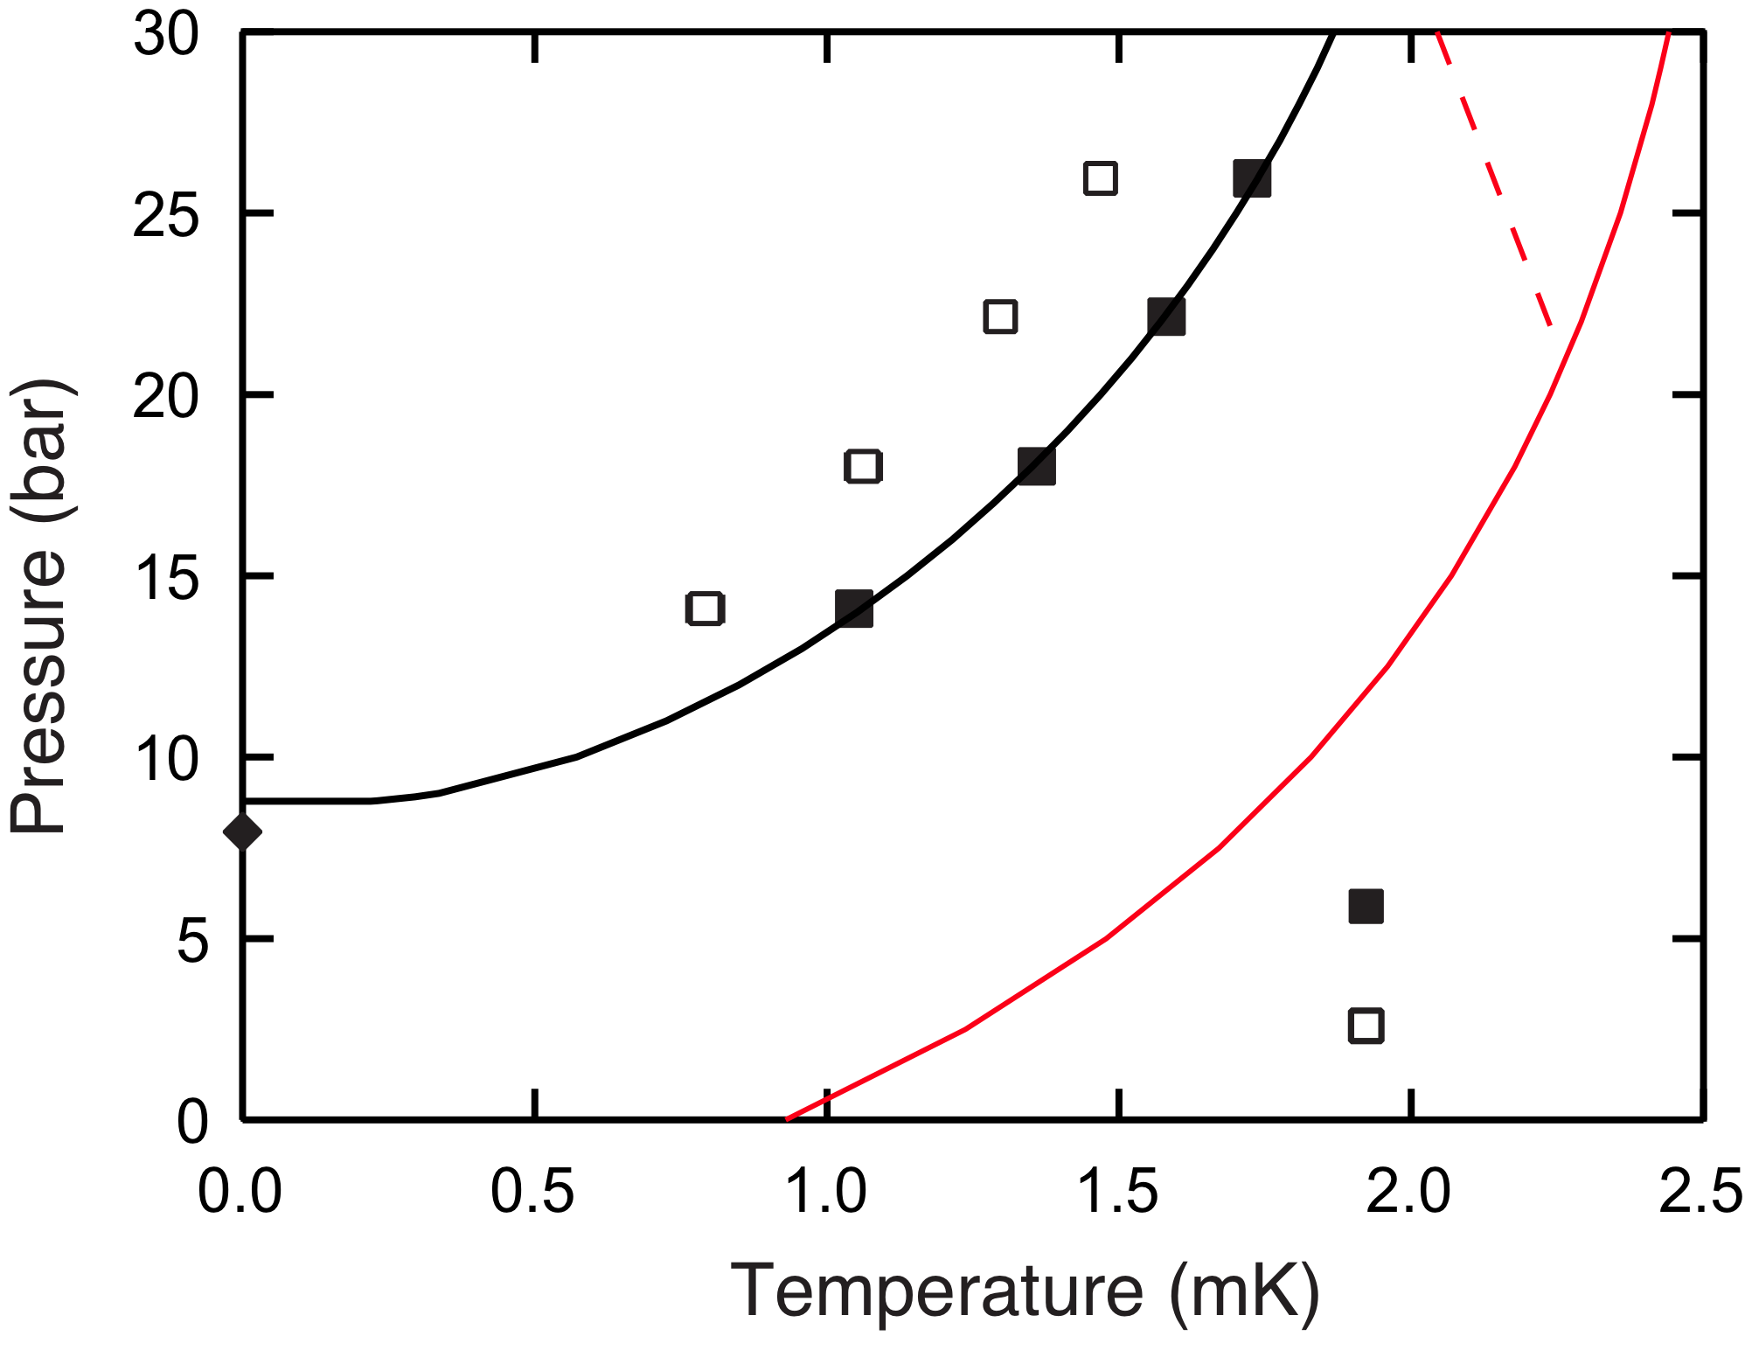
Broken symmetry phases
Anisotropic (stretched) silica aerogel:
Pollanen et al. (Northwestern)
Nature Phys. 8, 317 (2012)
Two chiral equal spin pairing phases (ESP), aligning l || or ⊥ to the strain axis
Theory ? Sauls PRB Phys. Rev. B 88, 214503 (2013).
chiral ESP
A'
A

Slide 14
Broken symmetry phases
Anisotropic (compressed) silica aerogel:
A new type of anisotropic B-phase trumps the A-phase . . . work in progress (Northwestern)

Slide 15
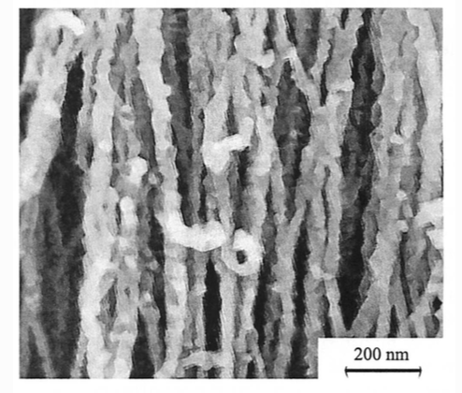
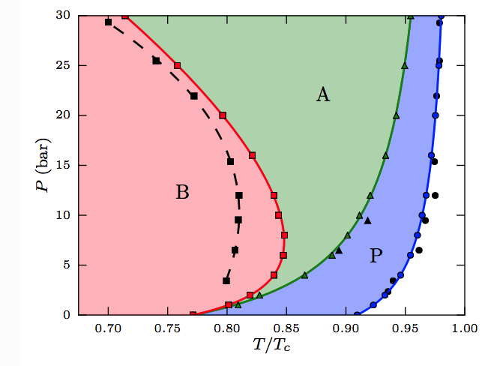
Broken symmetry phases
Anisotropic (nematic) aerogel:
Discovery of the polar phase
Ashkadullin et al. JETPL 100, 662 (2014) (Moscow) PRL to appear
"Nefen" aerogel
Al2O3 strands
Theory (colored curves): Wiman and Sauls, to be published.
The polar phase is an Equal Spin Pairing time reversal symmetric phase (not chiral).

Slide 16
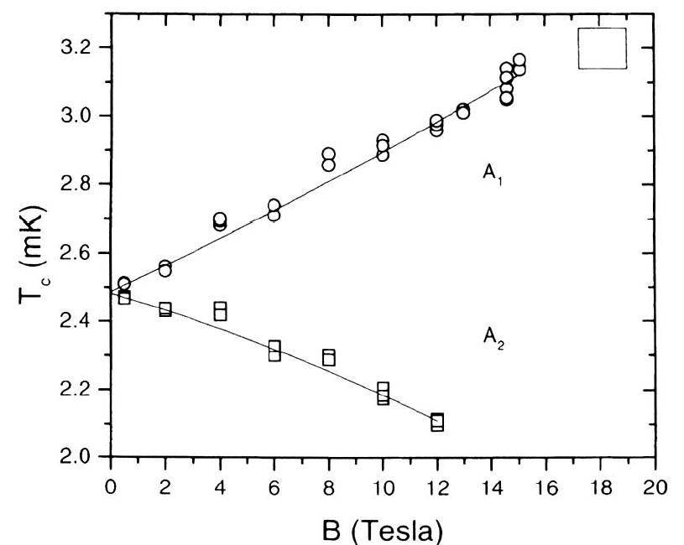
Extreme conditions
Superfluid 3He in High Magnetic Field, Remeijer et al. JLTP 111, 119 (1998).(Leiden)
Superfluid 3He should double its transition temperature in H = 50 T
What is the Critical Field for superfluid 3He? Theory?
Could be 1000 T. We need to measure the quadratic piece.

Slide 17
Extreme conditions
Superfluid 3He at ultra low temperatures:
Too much entropy . . . suggests ordering below 250 µK (Lancaster University)
A
B
B
H = 0

Slide 18


Connections to hard quantum matter
Superfluid 3He-A and chiral superconductors :
Sr2RuO4 and UPt3 are the principal players and candidates for chiral superconductivity
(100 papers/year for 10 years; 11,000 citations)
Questions about Sr2RuO4 and UPt3 :
What is the symmetry of the order parameter?
What are the stable phases?
What is the role of magnetism to supercondcutivity?
Are there edge currents?
What is the intrinsic angular momentum?
UPt3
Stewart, 1984
SrRuO4
Maeno, 1994

Slide 19
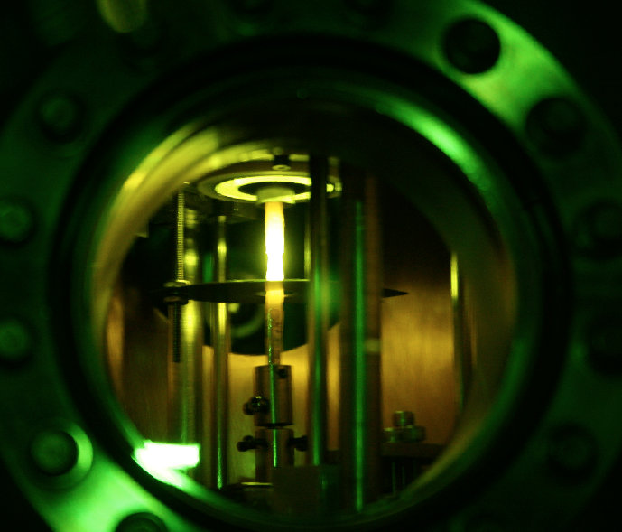
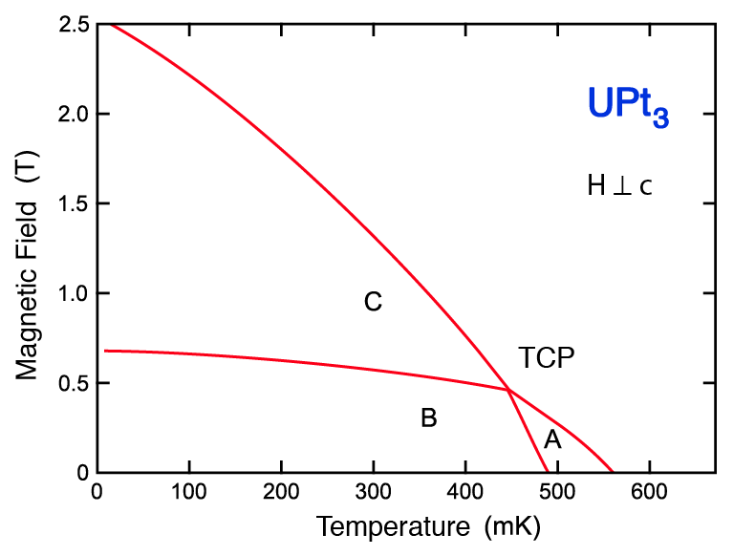
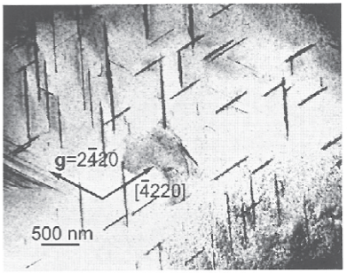
Connections to hard quantum matter
Superfluid 3He and UPt3
Multiple phases: unconventional superconductivity
The anisotropic A phase is stabilized by anisotropic quasiparticle scattering (stacking faults) – just like 3He.
Single crystals:
RRR 1,500
(Northwestern)
TEM stacking faults
A

Slide 20
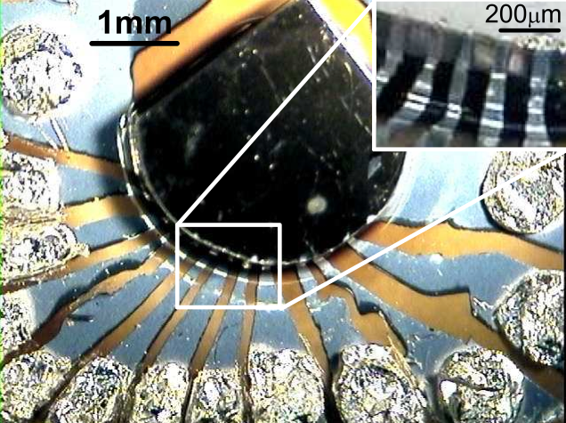
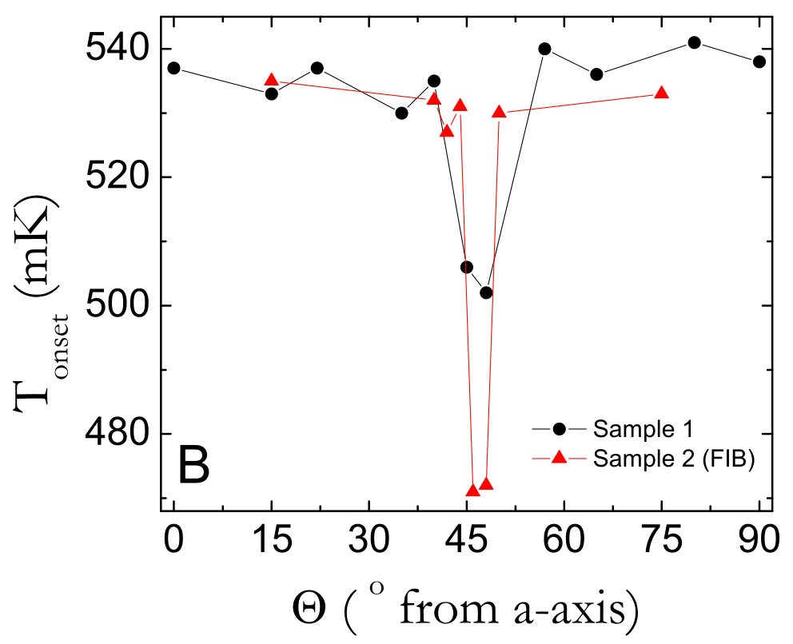
Connections to hard quantum matter
Superfluid 3He and UPt3
Directional tunneling identification of gap nodes in A-phase :
Strand et al. Science 328, 1368 (2010)
consistent only with E_{2u} symmetry
(Univ. Illinois Urbana-Champaign)
Single crystals:
RRR 1,500
(Northwestern)
Bottom line: 3He is indeed a paradigm for unconventional pairing with both time reversal and chiral phases and informs us about hard quantum materials

Slide 21
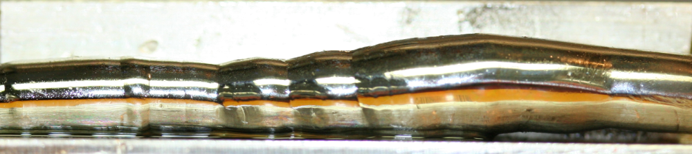
Connections to hard quantum matter
Superfluid 3He and UPt3
Phase sensitive Josephson tunneling: Chern number 2
Strand et al. PRL 103, 197002 (2009).
(Univ. Illinois Urbana-Champaign)
Polar Kerr effect onset proves BTRS in the B-phase
Schemm at al. Science 345, 190 (2014). (Stanford)
Linear temperature dependence of the penetration depth,
quadratically dispersed polar nodes, Gannon et al.
NJP 17, 023041 (2015) (Northwestern)
The chiral 3He A-phase is analogous to UPt3 chiral B-phase.
Single crystals
4 cm, 15 gm
(Northwestern)

Slide 22
Connections to hard quantum matter
Superfluid 3He is topological quantum matter with broad implications
for hard condensed matter applications of topological materials,
notably Dirac - Weyl excitations in topological insulators.
"Discoveries of superfluid phases in 3He, high Tc superconductors,
graphene and topological insulators have brought into focus materials
where quasiparticles are described by the same Dirac equation that governs
behavior of relativistic particles. This class of materials, called Dirac materials,
exhibits unusual universal features: Klein tunneling, chirality
and impurity resonances. These similarities inform the unique role
of symmetries that protect the Dirac spectrum. Dirac materials can be
quantum imaged and ripples in the Dirac sea are generated by defects
inducing fascinating features in local magnetism and Kondo effect.
We can use modern theoretical tools to design Dirac Materials
that host bosonic Dirac excitations impossible in particle physics."
- Sasha Balatsky, Los Alamos/Nordita

Slide 23
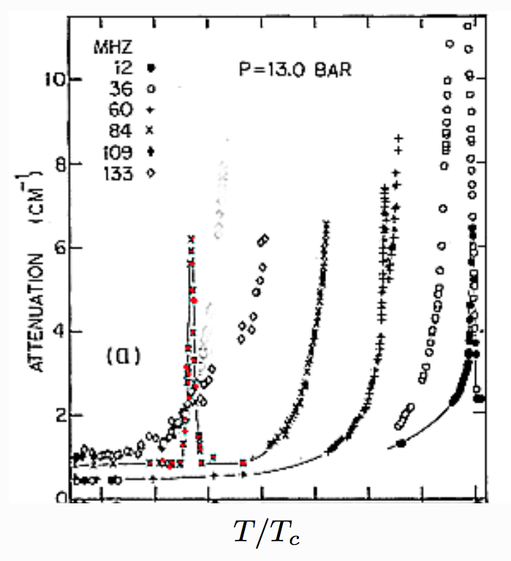
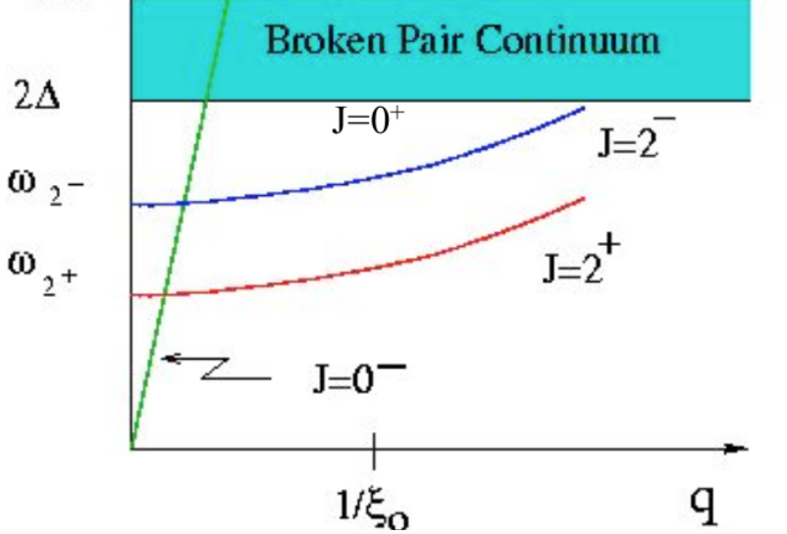
Connections to particle physics
Superfluid 3He bosonic excitations: collective modes of the order parameter in the B-phase are Higgs modes and satisfy the Nambu-Goldstone sum rule. (Northwestern, PRL 45, 266 (1980); Cornell, PRL 45, 262 (1980))

Slide 24
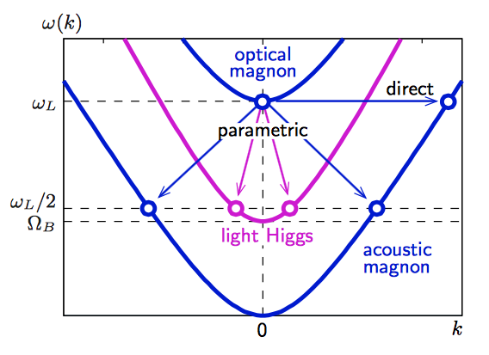
Connections to particle physics
Superfluid 3He bosonic excitations: collective modes of the order parameter in the B-phase are Higgs modes and satisfy the Nambu-Goldstone sum rule. (Northwestern, Cornell)
Recent observations of the little Higgs in superfluid 3He-B have prompted, by analogy, predictionof a new Higgs particle at 325 GeV.
Zavjalov, Volovik, Eltsov et al. arXiv:1411.3983
and to be published in Nat. Comm. (Aalto Univ.)

Slide 25
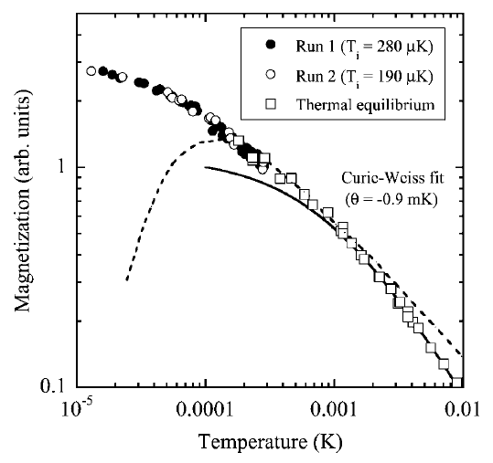
Connections to magnetism
Solid 3He adsorbed on graphite is a two dimensional quantum spin liquid phase with no gap larger than 10 µK. Matsutomi, Ishimoto PRL 92, 035201 (2004).

Slide 26
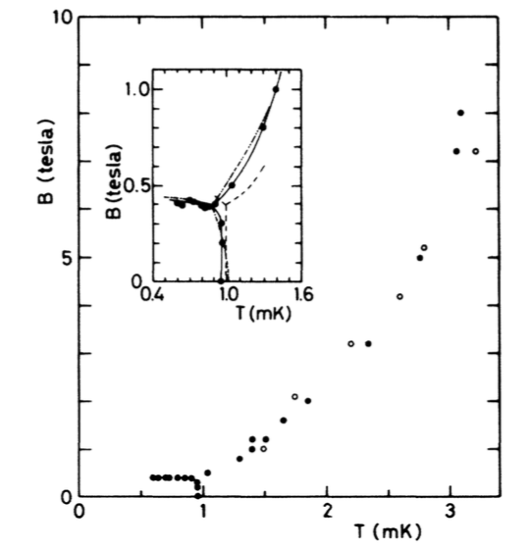
Connections to magnetism
Solid 3He in High Magnetic Field, Sawada et al. PRL 56, 1587 (1986). (Nagoya)
What is the Critical Magnetic Field for solid 3He?
an accessible theoretical problem
Could be 20 T !

Slide 27
Low temperature technology
driven in large part by Quantum Fluids and Solids
push button technology to 10 mK, huge increase in DR sales
hold 1 mK for more than 1 month, proven technology
push button technology to 1 mK
SQUID arrays for measurement and thermometry at < 1 mK
Measurement and thermometry at 100 µK

Slide 28
Summary:
Research on Quantum Fluids and Solids is
an essential component of
research on quantum matter

