Slide 1
IUCAF Activities - 2016
IUCAF
Harvey S Liszt, NRAO
Chair, IUCAF

Slide 2
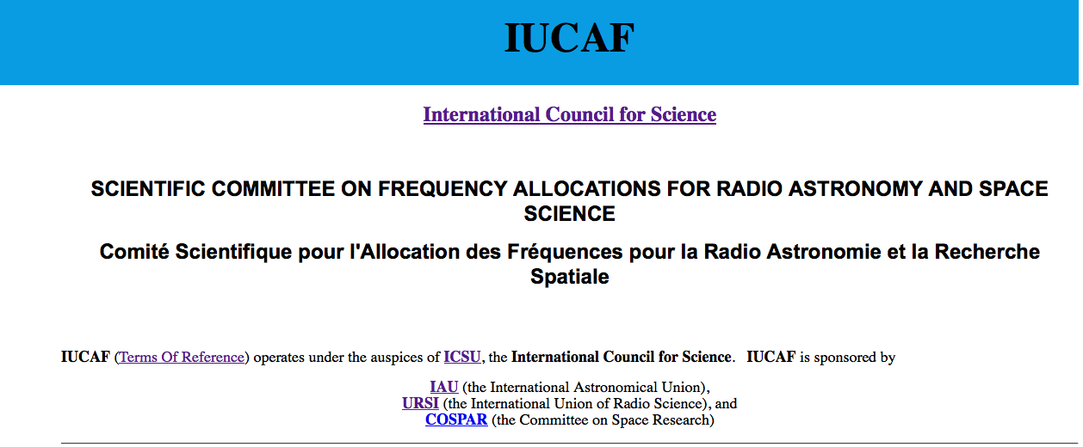
IUCAF.ORG Descends From UNESCO
IUCAF

Slide 3
IUCAF activities / WRC-19
May 23-25, Geneva, TG 5/1 (AI 1.13)
Wim van Driel (CRAF chair) to attend on $ IUCAF
June 7-17, Mainz, SFCG-36 (Space Frequency Coordination Group)
HSL & CRAF frequency manager as IUCAF observers
Initiate discussion to extend ITU-R Rec. RS.2066
Future agreement to avoid illumination of RAS sites by some EESS (active) missions, SAR, etc in bands other than 9.6 GHz
June 13–14 Geneva, Satellite Interference Symposium
History GPS - GLONASS – Iridium – Cloudsat – Next

Slide 4
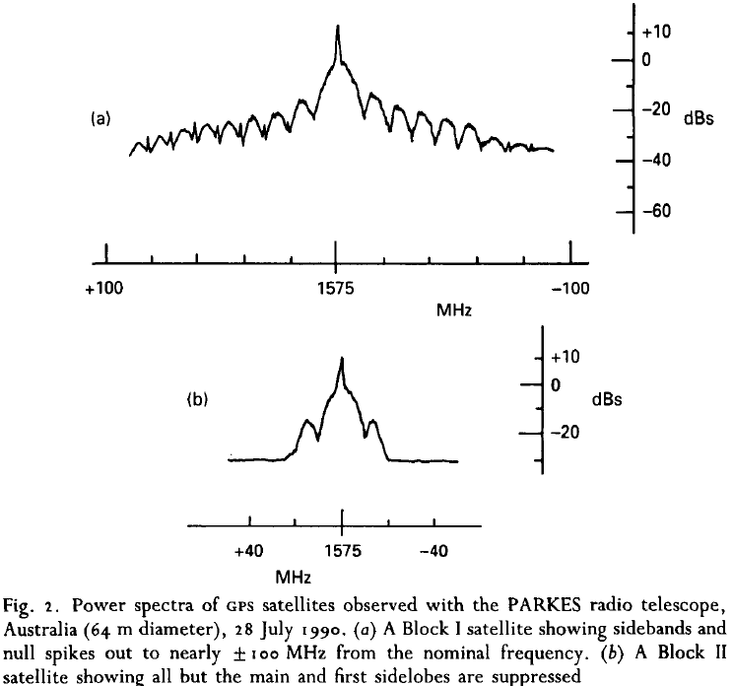
GPS Block I vs Block II (Ponsonby 1991, J. Nav)

Slide 5
IUCAF activities / WRC-19
October 17-20, Socorro, RFI 2016
IUCAF providing $2500 support
October 24-28, Geneva, WP 7D
Fate of IUCAF-originated passive band protection
November 7-18, Geneva, WP 5A,B,C
AI 1.8 GMDSS, 1.10 GADSS, 1.11 Railway, 1.12 ITS, 1.13 IMT, 1.14 HAPS, 1.15 LM/FS 275-450 GHz
November 22-30, Geneva WP 1A,B,C
AI 1.15, 275 – 450 GHz LM & FS

Slide 6
IUCAF activities / WRC-19
AI 1.8 Global Maritime Disaster Safety System
Iridium wishes to enter, compete w/Inmarsat
Their adjacent band interference is an issue, 1.6, 23.6 GHz
We worry that their operations & RFI would be privileged
This system is used ~3 times per day
AI 1.10 GADSS, AI 1.11 Railway comm. systems
AI 1.12 ITS (Intelligent transport systems)
V2V, V2X bands at issue (~6 GHz in US now) – is LM
Short range applications but very ubiquitous

Slide 7
IUCAF activities / WRC-19
AI 1.13 IMT (International Mobile Telecom)
THE big deal, identify new bands 24 - 86 GHz
TG 5/1, Wim to cover this, CRAF to do studies
FCC trying to get way out in front of this
AI 1.14 HAPS (High altitude platform systems)
Google Loon (aerostats)
Uses existing FS allocations but FS links not generally at 35,000 ft
WP 7D not listed as concerned

Slide 8
IUCAF activities / WRC-19
AI 1.15 FS and LM 275-450 GHz
FS is microwave data backhaul, very low error rate
Land mobile seems to be whatever it says it is, but can’t be IMT (normally done by WP 5D).
For instance, LM in WP 5A supplied λ4mm car radar characteristics to WP 5B for AI 1.18 (WRC-15)
LM is heavily into ITS - V2V, V2X

Slide 9
The complicated AI 1.15

Slide 10
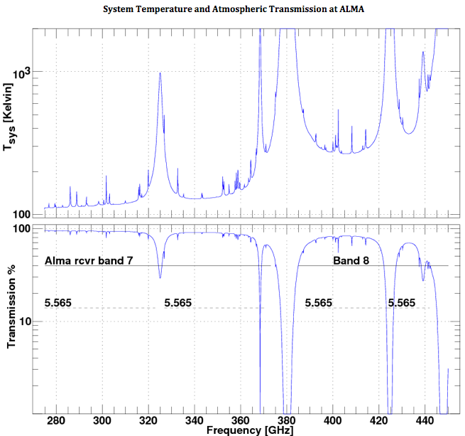
AI 1.15 LM & FS 275 – 450 GHz

Slide 11
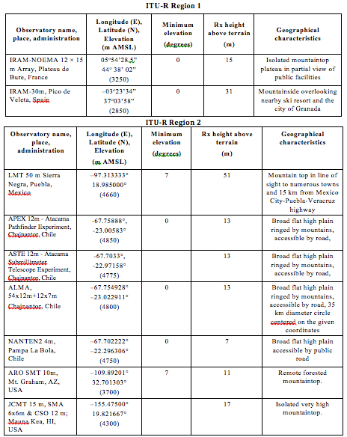
AI 1.15 LM & FS 275 – 450 GHz

Slide 12
AI 1.15 LM & FS 275 – 450 GHz
FS seeking multi-GHz wireless bandwidths
They do not see optical fiber as an option
FS very territorial vis-à-vis other active services
WP 5C has draft showing OOB emissions from 76-81 GHz car radar hurt urban FS 81-86 GHz links
FS and RAS now seem to coexist
Isolation of RAS stations
NTIA Coordination at 81 – 86 GHz

Slide 13
AI 1.15 LM & FS 275 – 450 GHz
Inclusion of two services, WP complicates this
WP 5A, 5C maybe not trusted on their own
WP 1A to accept and channel studies in/out
WP 3x feed to propagation studies to 1A, none>60 GHz
The victim services also have to tell WP 3x their characteristics
Eg RAS operates in low-opacity high-altitude environments
WP 7x feed characteristics to 1A, receive 5A,C output for their own contributions to be fed back
WP 5A, C define LM & FS apps, accept victim info from 1A, study compatibility, return output to 1A

