Slide 1
NOAA SPECTRUM UPDATE
Fred Mistichelli (alfredo.mistichelli@noaa.gov)
19 May 2016
1

Slide 2
OUTLINE
GOES-R Launch & Spectrum Use
NOAA’s L-Band Spectrum
Passive Bands
NOAA View on WRC-19 Agenda Items
2

Slide 3
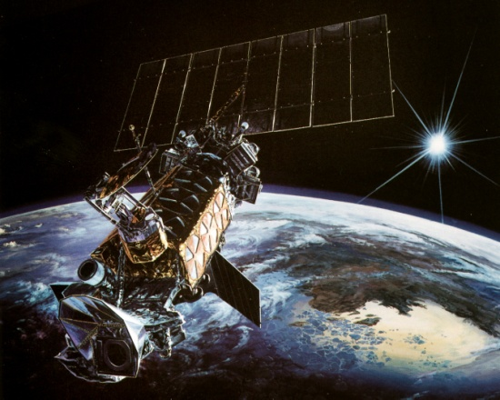
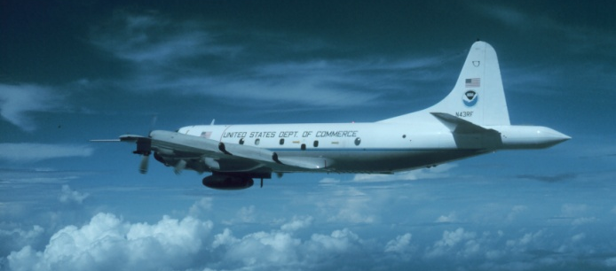
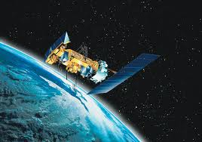
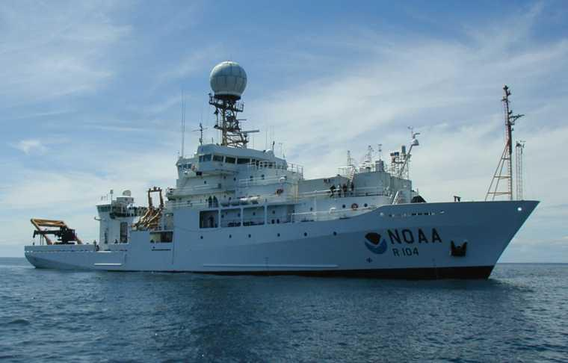
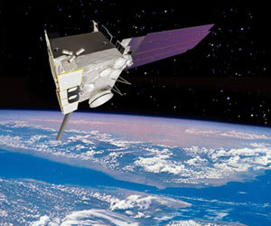
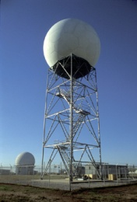
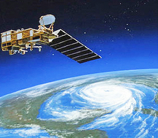
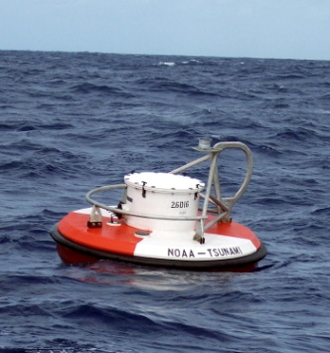
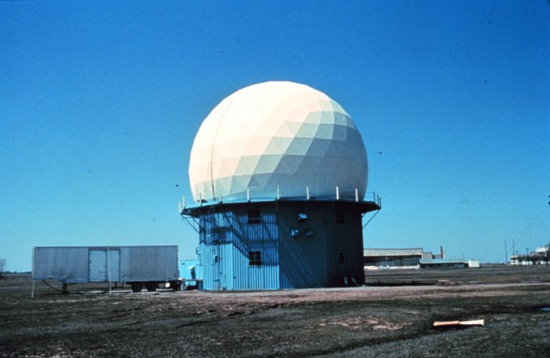

NOAA Spectrum Use

Slide 4
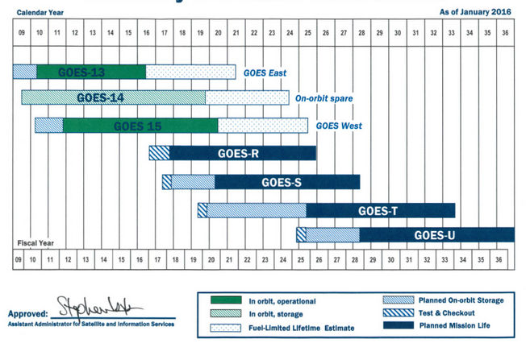
GOES-R Launch Schedule
The first satellite in the Geostationary Operational Environmental Satellite – Series R (GOES-R) is scheduled to launch on OCTOBER 14, 2016 from Cape Kennedy, FL
Three additional GOES-R series satellites (GOES-S, T & U) are planned according to the NOAA/NESDIS Flyout Schedule (Below)

Slide 5
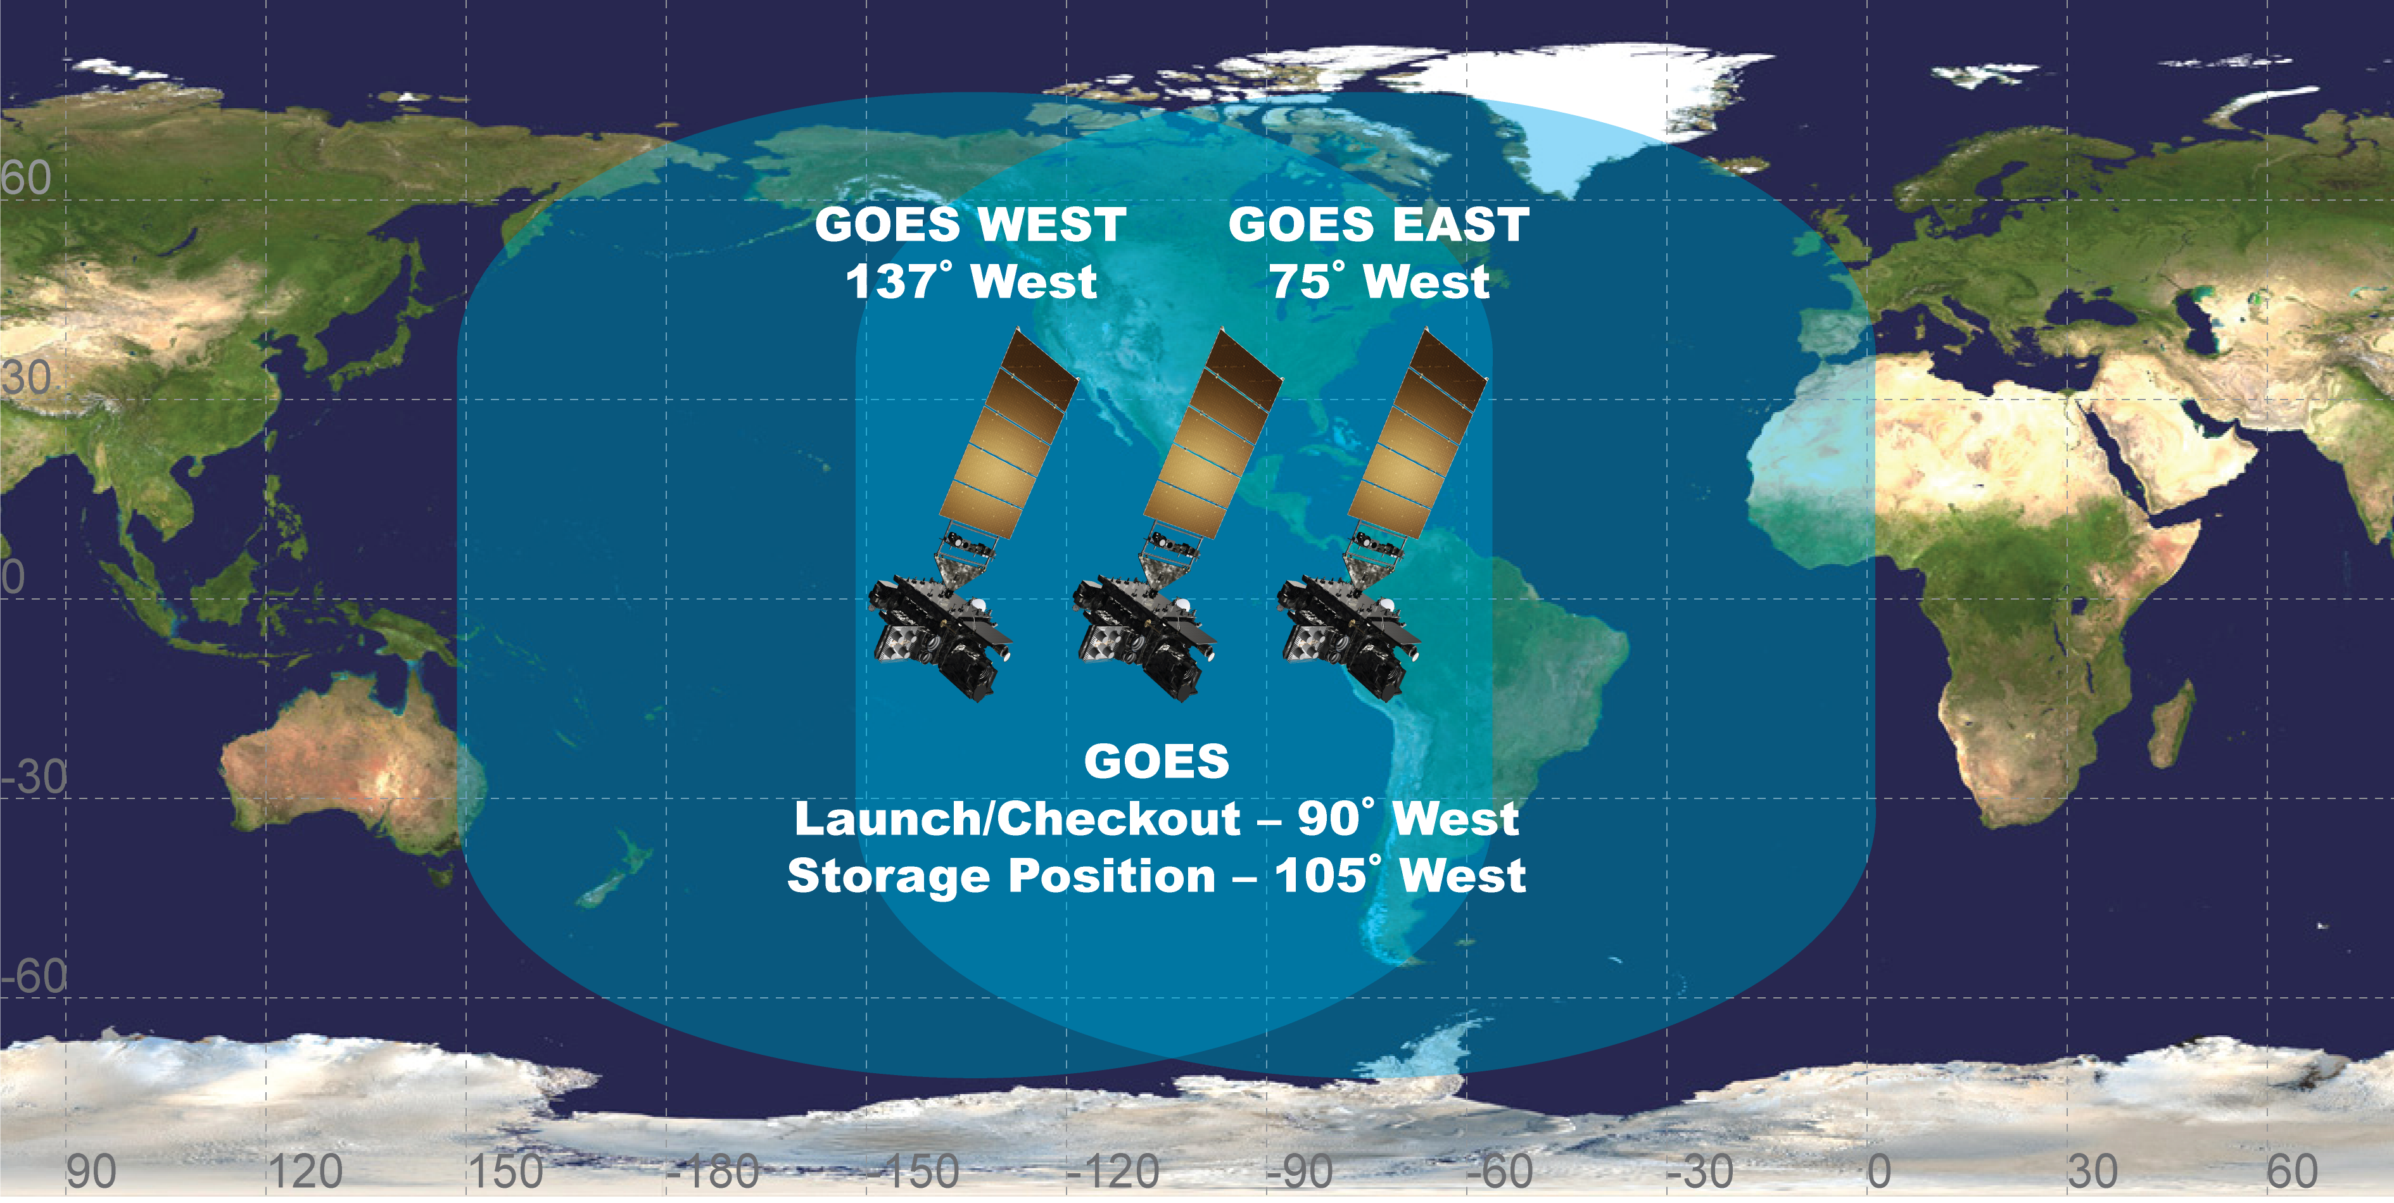
GOES-R Fleet Configuration
89.5°
5

Slide 6
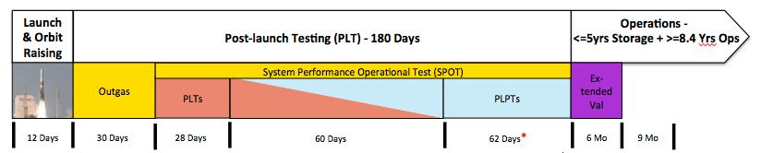
GOES-R Checkout & Extended Operations
GOES-R Launch and Checkout Schedule consists of:
Launch, Orbit Raising & Pre-Test Activity
System Performance Operational Testing (~ 6 months)
Extended Validation of Products in Operations (~ 6 months)
System Performance Operational Testing and Extended Validation would all occur at 89.5° West
Then GOES-R would be moved to either 75° or 137° West for Operations
Subsequent satellites in the series would be moved to an operational slot or into on-orbit storage depending upon NOAA operational needs

Slide 7
Ground Station Support Launch, Orbit Raising and Operations
Ground Station Location | Network or Function
White Sands, New Mexico | NASA Near Earth Network
Wallops, Virginia | NASA Near Earth Network
Singapore | NASA Near Earth Network
Santiago, Chile | Swedish Space Corp - Chile
Dongara, Western Australia | Universal Space Network
South Point, Hawaii | Universal Space Network
Hartebeesthoek, South Africa | Universal Space Network
Wallops Island, Virginia (operations) | NOAA Command & Data Acq. Station
Fairmont, West Virginia (operations) | NOAA Command & Data Acq. Station

Slide 8
GOES-R Downlinks
Center Frequency or Range (MHz) | Name | Function
468.775 - 468.825 | DCS | DCS Command Relay
1544.440 | SAR | Search & Rescue
1679.7 – 1680.4 | DCPR | DCS Platform Data
1686.6 | GRB | Calibrated Science Data
1693.0 | Housekeeping TM | TM
1694.1 | HRIT/EMWIN | Emergency Warning & Reduced Data Transmission
2211.04 | TM & Ranging | TM & Ranging
8220 | Raw Data Downlink | Uncalibrated science data

Slide 9
GOES-R Uplinks
Center Frequency or Range (MHz) | Name | Function
401.7 – 402.4 | DCPR | Terrestrial Sensor Uplinks
406.05 | SAR | Search & Rescue
2027.1 | HRIT/EMWIN | Emergency Warning & Reduced Data Transmission
2032.775 – 2032.825 | DCPC | Platform Command Uplink
2034.2 | Command | Spacecraft Command
2036.0 | Command & Ranging | Command & Ranging
7216.6 | GRB | Calibrated Science Data

Slide 10
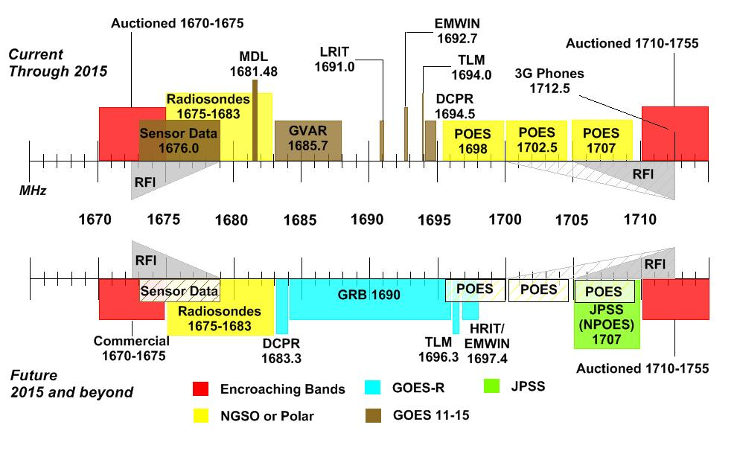
NOAA’s L-Band Spectrum Use
Band Auctioned For Sharing
Today
POES/MetOp
MHZ
Future
GOES-R Rebroadcast
DCPR
TLM HRIT
EMWIN
Commercial
1710 - 1755
15 MHz Shared
1670
1675
1680
1685
1690
1695
1710
Legend
5
Adjacent Bands
GOES-R
Radiosondes
Radiosondes
POES & MetOp
GOES 13-15

Slide 11
1695-1710 MHz Spectrum Auction
Middle Class Tax Relief and Job Creation Act of 2012 (PUBLIC LAW 112–96–FEB. 22, 2012)
1695-1710 MHz auction complete (part of AWS-3)
Major NOAA efforts to enable 1695-1710 MHz sharing:
GOES-R frequencies shifted below 1695 MHz
Development, management and operation of a Spectrum Coordination Portal to address requests for commercial operations within Protection Zones
Development, deployment, and operation of a Spectrum Monitoring System to monitor for potential harmful interference
Replacement of the current Radiosonde Observing Systems (relocate to a lower frequency 402-403 MHz)
Federal ground stations Protection Zones Established

Slide 12




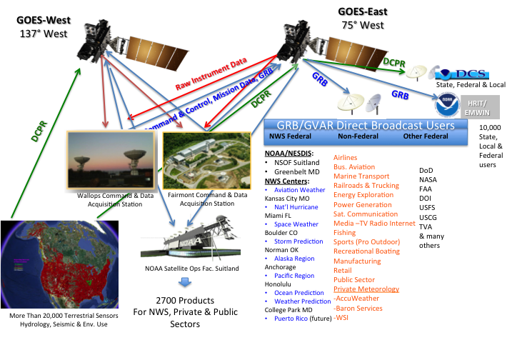
GOES-R Broadcast Architecture
College Park MD
Puerto Rico (future)
-TWC
Notes:
Graphic shows GOES-R with raw data into Wallops and Fairmont being calibrated, then immediately rebroadcast via both satellites to Federal and Non-Federal users.
Seven NWS sites use Direct Broadcast near-real time reception for either primary data reception method, or for data availability or data latency where other methods are inadequate.
Space Weather data which has a stressing latency requirement of 10 seconds from reception to end user warning delivery is in 1675-1695 MHz.
Also more than 30,000 hydrologic and environmental sensors are relayed via 1675-1680 MHz to Federal, State & Local sites for flood warning, hydroelectric dam control, tsunami warning, water reservoir, stream and river monitoring, seismic, tidal gages and environmental use. Over 90% of the source data for flood warnings in the US pass through this spectrum in near-real time.
Thousands of private sector users receive near real time NOAA weather data, intended primarily for Emergency Managers, at 1694.1 MHz. Some communities directly trigger audible warning sirens from the Emergency Managers Weather Information Network.
The three columns of data shown reflect some of the NOAA-Federal, other-Federal and non-Federal industry segments that receive data or (products generated from this data) in the 1675-1695 MHz to support their efforts.
This data is received continuously 24/7/365.

Slide 13
Potential Impact of 1675-1695 MHz Sharing with Mobile Broadband
Interference could degrade severe weather monitoring and prediction from satellites (e.g. hurricane tracking, floods,)
Users of Emergency Managers Weather Information Network (EMWIN), 1692.7 MHz, broadcasts outside protection zones will be subject to interference.
Could prevent reception of data needed to make critical decisions with weather forecasts, warnings, alerts and other safety of life and property information during emergency situations
Other communications means cannot provide required availability and reliability
Users of DCPR broadcasts, 1692.7 MHz (GOES N-P), 1679.7 MHz (GOES-R) outside protection zones will be subject to interference.
Could prevent reception of hydrological data from sensors deployed nationwide which provide data needed for flood prediction and warnings
Could prevent sensor data required for wildfire management

Slide 14
Potential Impact of 1675-1695 MHz Sharing with Mobile Broadband
Possible reduction of quality in the regional and global data sets required for climate monitoring and prediction
Band is part of globally coordinated meteorological operations
Sharing could have a negative impact on global harmonization and interoperability

Slide 15
Potentially Impacted Federal Users
NWS- Aviation Weather Center, National Hurricane Center, Storm Prediction Center, Space Weather Prediction Center, Ocean Prediction Center, Weather Prediction Center, Anchorage, Honolulu, Guam and Puerto Rico Weather Forecast Offices
USGS & NOAA – Flood Forecasts, Real-time Harbor clearance depth for maritime, earthquake & tsunami warnings, drought forecast, ocean buoys, and NOAA ships & research vessels
NASA – spaceflight meteorology
DoD – Weather Operations, all branches; Corps of Engineers
DOI – Wildfire management using sensor data received via DCPR
USCG, FAA, and unknown number of others
Notes:
This is a partial list of known Federal users who have satellite receiving systems.
Some of the ones we have not discussed include NOAA’s National Ocean Service, who operate tidal gages for ship clearance and water depth in all major US ports. Large ships must know if they will clear bridges across harbor entries, or if the water depth is sufficient for them to avoid grounding. NOS has receivers in Chesapeake VA and Seattle WA obtaining DCS data.
NASA receives GVAR data at the Johnson Spaceflight Center to support Manned spaceflight operations.
We are certain that this list is incomplete.
As a spectrum management office, we have a very difficult time identifying each and every organization within our agency that has independently procured receiving equipment for this spectrum or that use products which are derived from data to be received in this band.

Slide 16
Potentially Impacted Non-Federal Users
Emergency Management (EMWIN)
Water Reservoir and Stream, River and Tidal Gage Data (DCPR)
Aviation Operations: Commercial, Business
Over-the-pole Flights
Volcanic Ash warning, especially Alaska
Land, Rail and Maritime Transportation
Electric Power Generation & Energy Production
Agriculture, Fishing
Notes:
As we have discussed in previous slides, non-Federal users directly benefit from Federal products derived from data received in 1675-1695 MHz.
However, other industry segments benefit from both Federal and private sector weather enterprise products.
The U.S. maritime transportation system carries 95 percent of U.S. Foreign Trade. Data from GOES-R, for broad ocean areas. The full resolution GOES-R data is available via Direct Broadcast to Federal and private meteorology users creating weather products, and the harbor clearance depth for once they arrive or depart from a US port is via DCS.
Inaccuracies in GPS positioning, due to degradation from solar events, may be predicted by use of Space Weather data from GOES/GOES-R.
State, Local and Private Emergency Managers use this spectrum for relay of near-real time weather information, which is received throughout the United States.

Slide 17
Passive Bands 15 GHz to 60 GHz
Satellite (Sensor) | Start Frequency, GHz | Stop Frequency, GHz | Satellite (Sensor) | Start Frequency, GHz | Stop Frequency, GHz
JASON-2 (AMR) | 18.6 | 18.8 | SNPP (ATMS) | 52.6 | 53
DMSP-F14,F15 (SSM/I) | 19.15 | 19.55 | DMSP- (SSMIS) | 52.6055 | 52.9945
DMSP- (SSMIS) | 19.172 | 19.528 | NOAA polars (AMSU-A) | 53.361 | 53.531
DMSP- (SSMIS) | 22.0315 | 22.4385 | DMSP- (SSMIS) | 53.406 | 53.786
DMSP-F14,F15 (SSM/I) | 22.035 | 22.435 | SNPP (ATMS) | 53.511 | 53.681
JASON-2 (AMR) | 23.6 | 24 | NOAA polars (AMSU-A) | 53.661 | 53.831
NOAA polars (AMSU-A) | 23.665 | 23.935 | NOAA polars (AMSU-A) | 54.2 | 54.6
SNPP (ATMS) | 23.665 | 23.935 | SNPP (ATMS) | 54.2 | 54.6
NOAA polars (AMSU-A) | 31.31 | 31.49 | DMSP- (SSMIS) | 54.209 | 54.591
SNPP (ATMS) | 31.31 | 31.49 | NOAA polars (AMSU-A) | 54.74 | 55.14
JASON-2 (AMR) | 33.65 | 34.35 | SNPP (ATMS) | 54.74 | 55.14
DMSP- (SSMIS) | 36.21 | 37.79 | DMSP- (SSMIS) | 55.3045 | 55.6955
DMSP-F14,F15 (SSM/I) | 36.25 | 37.75 | NOAA polars (AMSU-A) | 55.335 | 55.665
DMSP- (SSMIS) | 50.11 | 50.49 | SNPP (ATMS) | 55.335 | 55.665
NOAA polars (AMSU-A) | 50.21 | 50.39 | DMSP- (SSMIS) | 57.125 | 57.455
SNPP (ATMS) | 50.21 | 50.39 | NOAA polars (AMSU-A) | 57.125 | 57.455
SNPP (ATMS) | 51.56 | 51.96 | SNPP (ATMS) | 57.125 | 57.455
NOAA polars (AMSU-A) | 52.6 | 53 | DMSP- (SSMIS) | 59.2805 | 59.5195

Slide 18
Passive bands 60 GHz to 200 GHz
Satellite (Sensor) | Start Frequency, GHz | Stop Frequency, GHz | Satellite (Sensor) | Start Frequency, GHz | Stop Frequency, GHz
DMSP-F16,F19 (SSMIS) | 60.737 | 60.843 | SNPP (ATMS) | 179.81 | 180.81
DMSP-F16,F19 (SSMIS) | 63.27865 | 63.28135 | DMSP-F16,F19 (SSMIS) | 180.784 | 183.836
DMSP-F14,F15 (SSM/I) | 84 | 87 | SNPP (ATMS) | 181.01 | 182.01
NOAA-15,18,19 (AMSU-A) | 86 | 92 | SNPP (ATMS) | 182.06 | 182.56
SNPP (ATMS) | 87 | 92 | DMSP-F16,F19 (SSMIS) | 182.784 | 185.836
DMSP-F16,F19 (SSMIS) | 90.2405 | 93.0695 | SNPP (ATMS) | 184.06 | 184.56
DMSP-F16,F19 (SSMIS) | 148.358 | 151.642 | SNPP (ATMS) | 184.61 | 185.61
SNPP (ATMS) | 164 | 167 | DMSP-F16,F19 (SSMIS) | 185.291 | 187.329
SNPP (ATMS) | 175.31 | 177.31 | SNPP (ATMS) | 185.81 | 186.81
DMSP-F16,F19 (SSMIS) | 176.1975 | 177.2225 | SNPP (ATMS) | 186.81 | 188.81
SNPP (ATMS) | 177.81 | 179.81 | SNPP (ATMS) | 189.31 | 191.31
DMSP-F16,F19 (SSMIS) | 179.291 | 181.329 | DMSP-F16,F19 (SSMIS) | 189.3975 | 190.4225

Slide 19
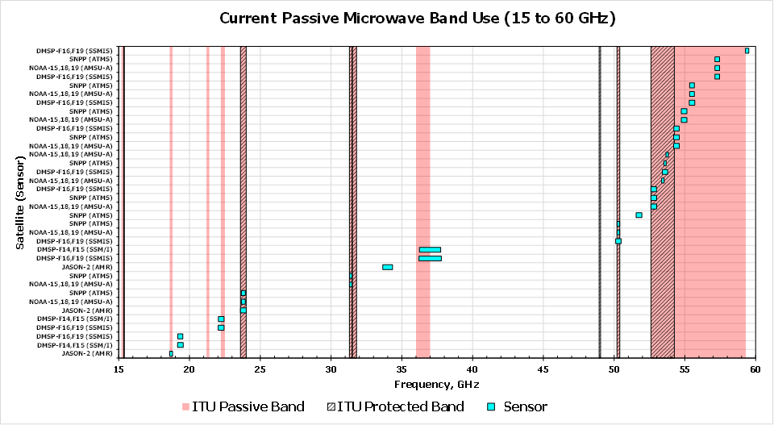
ITU Passive Bands: Per Rec. ITU-R RS.515-5. 1-Water Vapor, Rain Rate; 2-Rain Rates, Sea State, Sea Ice, Water Vapor, Ocean Wind Speed, Soil Emissivity and Humidity; 3-Water Vapor, Liquid Water; 4-Water Vapor, Liquid Water; 5-Water Vapor, Liquid Water, associated channel for Atmospheric Sounding; 6-Sea Ice, Water Vapor, Oil Spills, Clouds, Liquid Water, Surface Temperature, reference window for 50-60 GHz; 7-Rain Rates, Snow, Sea Ice, Clouds; 8-Reference window for atmospheric temperature profiling (Surface Temperature); 9-Atmospheric temperature profiling (O2 Absorption)
ITU Protected Bands: All emissions are prohibited, per ITU Radio Regulations Article 5.340.
+ Exception: In Saudi Arabia, Bahrain, Cameroon, Egypt, the United Arab Emirates, Guinea, Iran (Islamic Republic of), Iraq,
Israel, Kuwait, Lebanon, Oman, Pakistan, Qatar, the Syrian Arab Republic and Somalia, the band 15.35-15.4 GHz is also
allocated to the fixed and mobile services on a secondary basis.
++ Exception: In the band 31.5-31.8 GHz, emissions prohibited only in ITU Region 2 (North America and South America).
* Exception: In the band 48.94-49.04 GHz, emissions prohibited only from airborne stations.

Slide 20
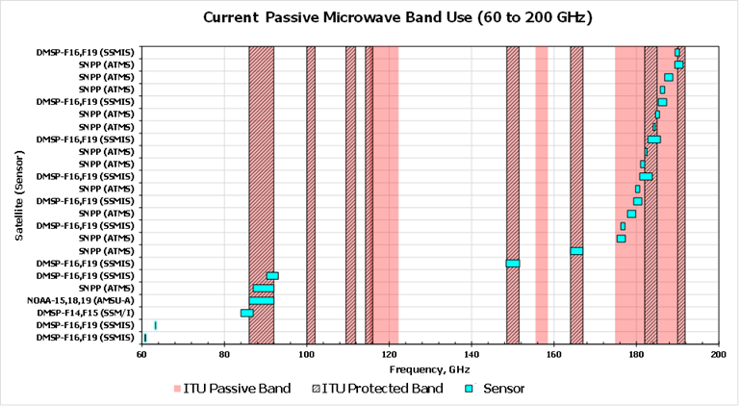
Data source – WMO OSCAR
http://www.wmo-sat.info/oscar/observingmissions

Slide 21
Agenda Item 1.2 - 400 MHz Protection Limits
to consider in-band power limits for earth stations operating in the mobile-satellite service, meteorological-satellite service and Earth exploration-satellite service in the frequency bands 401-403 MHz and 399.9-400.05 MHz, in accordance with Resolution 765 (WRC 15);
Responsible group:
WP-7B
Concerned group (interested group):
WP-4C, WP-5A, WP-7C, WP-3M
Some satellite systems of concern
INSAT-3D, -3DR, -3DS (0.40275 GHz E-s), MTG-I1, -I2, -I3, -I, MTG-S1, -S2 (0.40285 GHz E-s), GOES-13, -14, -15, -R, -S, -T, -U (0.4017-0.4024 GHz E-s) , NOAA-18, -19, SIDAR (0.401-0.401225 GHz), Metor-M-N1, -N2, -N2-1, -N2-2, -N2-3, -N2-4, -N2-5 (0.4019-0.402 GHz E-s and 0.4019-0.4025 GHz E-s), Meteosat-10, -11 (0.402-0.4021 GHz E-s and 0.4021-0.40244 GHz E-s), Himawari (0.402-0.4024 GHz E-s)., SIDAR (0.3999-0.40005 GHz)
Required Action:
Provide technical studies as needed
References:
ITU-R Rec: RS.1165, RS.1263, RS.1884, SA.2045, SA.2044, SA.2046

Slide 22
Agenda Item 1.3 – 460 – 470 MHz Upgrade
to consider possible upgrading of the secondary allocation to the meteorological-satellite service (space-to-Earth) to primary status and a possible primary allocation to the Earth exploration-satellite service (space-to-Earth) in the frequency band 460-470 MHz, in accordance with Resolution 766 (WRC 15)
Responsible group:
WP-7B
Concerned group (interested group):
WP-5A, WP-5D, WP-6A, (WP-3M)
Some systems of concern
Electro-L N2, -N2, -N3 (0.465 GHz s-s), GOES-13, -14, -15, -R, -V (0.4688125, 0.468825, 0.4688375 GHz s-E), NOAA-18, -19 (0.4659875 GHz s-E)
Required Action:
Provide technical studies as needed
References:
ITU-R Rec: M.1085, M.1174, RS.1260
ITU-R Rep: F.2331, M.2110

Slide 23
Agenda Item 1.5 – Earth Stations In Motion (ESIM)
to consider the use of the frequency bands 17.7-19.7 GHz (space-to-Earth) and 27.5-29.5 GHz (Earth-to-space) by earth stations in motion communicating with geostationary space stations in the fixed-satellite service and take appropriate action, in accordance with Resolution 158 (WRC 15)
Responsible group:
WP-4A
Concerned group (interested group):
WP-4B, WP-4C, WP-5A, WP-5C, WP-7B, WP-7C, (WP-3M), (WP-5D)
Some systems of concern
Himawari-8 (s-E),18.2846 GHz, 18.399-18.4 GHz), JASON-2, -3, -CS-A, B (AMR-C) (18.6-18.8 GHz Passive), DMSP-F14,F15 (SSM/I) 19.15-19.55 GHz Passive), DMSP-F16, -F19, -F20 (SSMIS) (19.172-19.528 Passive)
Required Action:
Contribute studies (Res. 750)
References:
ITU-R Rec: F.748, F.595, F.1495, F.1704, RS.1449, SF.1483, SF.1585, SF.1601, SF.1602
ITU-R Rep: S.2357, S.2362, S.2363, S.2223

Slide 24
Agenda Item 1.6 – Non-GSO in Passive Bands
to consider the development of a regulatory framework for non-GSO FSS satellite systems that may operate in the frequency bands 37.5-39.5 GHz (space-to-Earth), 39.5-42.5 GHz (space-to-Earth), 47.2-50.2 GHz (Earth-to-space) and 50.4-51.4 GHz (Earth-to-space), in accordance with Resolution 159 (WRC 15)
Responsible group:
WP-4A
Concerned group (interested group):
WP-5A, WP-5B, WP-5C, WP-5D, WP-6A, WP-7B, WP-7C, WP-7D, (WP-3M), (WP-4B)
Some systems of concern
DMSP-F16,F19 (SSMIS) (36.21-37.79 GHz Passive), DMSP-F14,F15 (SSM/I) (36.25-37.75 GHz Passive), SNPP (ATMS)
Required Action:
Contribute studies
References:
ITU-R Rec: F.1498, F.1500, F.1501, F.1669, F.1819, F.1820. F.2005, RS.1279, S.1325, S.1326, S.1328, S.1529 S.1557,
ITU-R Rep: M.2206, SA.2190, SA.2307

Slide 25
Agenda Item 1.7 – Small SATS TT&C
to study the spectrum needs for telemetry, tracking and command in the space operation service for non-GSO satellites with short duration missions, to assess the suitability of existing allocations to the space operation service and, if necessary, to consider new allocations, in accordance with Resolution 659 (WRC 15)
Bands (MHz): 150.05-174, 400.15-420
Responsible group:
WP-7B
Concerned group (interested group):
WP-4A, WP-4C, WP-5A, WP-5B, WP-5C, WP-6A, WP-7C, WP-7D, (WP-1A), (WP-3M), (WP-4B)
Some systems of concern
JASON-3 (0.40125 GHz E-s), Metop-C, -B (0.401595 GHz E-s), MTG-I1, -I2, -I3, -I, MTG-S1, -S2 (0.4017 GHz E-s), GOES-13, -14, -15, -R, -S, -T, -U (0.4017-0.4024 GHz E-s) , NOAA-18, -19 (0.40165 GHz E-s), SIDAR (0.401-0.401225 GHz), Metor-M-N1, -N2, -N2-1, -N2-2, -N2-3, -N2-4, -N2-5 (0.4019-0.402 GHz E-s and 0.4019-0.4025 GHz E-s)
Required Action:
Contribute studies
References:
ITU-R Rec: F.1567, M.1470, M.1478, M.1084, M.1312, M.1462, S.1716
ITU-R Rep: M.910, M.2010, M.2172, M.2286, M.2359, SA.2162, SA.2271, SA.2312, SA.2348, SM.2258

Slide 26
Agenda Item 1.13 - IMT Above 6 GHz
to consider identification of frequency bands for the future development of International Mobile Telecommunications (IMT), including possible additional allocations to the mobile service on a primary basis, in accordance with Resolution 238 (WRC 15).
Bands (GHz): 24.25-27.5, 31.8-33.4,37-40.5, 42.5-43.5, 45.5-47, 47.2-50.2, 50.4-52.6, 66-76 and 81-86
Responsible group: TG-5/1
Concerned group (interested group):
WP-3J, WP-3K, WP-3M, WP-4A, WP-4B, WP-4C, WP-5A, WP-5B, WP-5C, WP-5D, WP-6A, WP-7B, WP-7C, WP-7D
Some systems of concern
Adjacent to DMSP-F16,F19 (SSMIS) (22.0315 GHz), DMSP-F16,F19 (SSMIS), DMSP-F14,F15 (SSM/I), NOAA-15,18,19 (AMSU-A), SNPP (ATMS) (50.21-50.39 GHz Passive)
Required Action:
Contribute studies
References:
ITU-R Rec: F.1570, F.1608, F.1612, F.1760, M.2003, M.2057, M.2070, M.2071, P.833, P.1238, P.1410, P.1411, P.2001, RS.1259, S.1151, F.1606, F.1607, F.1609, S.1782
ITU-R Rep: F.2107, F.2108, F.2239, M.2040, M.2116, M.2243, M.2360, M.2370, RS.2095, RS.2260, SM.2179, SM.2180, SM.2210, SA.2277, P.2346

Slide 27
Agenda Item 1.14 - HAPS
to consider, on the basis of ITU R studies in accordance with Resolution 160 (WRC 15), appropriate regulatory actions for high-altitude platform stations (HAPS), within existing fixed-service allocations.
Bands (in R-2, 21.4-22 and 24.25-27.5 GHz) 38-39.5
Responsible group:
WP-5C
Concerned group (interested group):
WP-4A, WP-4C, WP-5A, WP-5D, WP-7B, WP-7C, (WP-3M), (WP-7D)
Some systems of concern
Adjacent to DMSP-F16,F19 (SSMIS) (22.0315 GHz, 36.21-37.79 GHz)
Required Action:
Contribute studies
References:
ITU-R Rec: F.1606, F.1607, F.1609, S.1783, BO.1776, BO.1898, BO.1900, P.1238, P.2041, S.1427, SF.1843
ITU-R Rep: M.2206, SA.2190, SA.2277, SA.2307

Slide 28
Agenda Item 1.16 – WLAN/RLAN
to consider issues related to wireless access systems, including radio local area networks (WAS/RLAN), in the frequency bands between 5 150 MHz and 5 925 MHz, and take the appropriate regulatory actions, including additional spectrum allocations to the mobile service, in accordance with Resolution 239 (WRC 15)
Responsible group:
WP-5A
Concerned group (interested group):
WP-4A, WP-4C, WP-5B, WP-5C, WP-7C, (WP-1B), (WP-3J), (WP-3K), (WP-3M), (WP-5D)
Some systems of concern
JASON-2, 3, Meteor-M N2 (5.747124 GHz s-E). Electro-L -N1, -N2, -N3, -N4 (5.747124 GHz E-s), Meteor-M N1, -N2-1, -N2-2, -N2-3, -N2-4, N2-5 (5.747124 GHz E-s)
Required Action:
Conduct studies
References:
ITU-R Rec: F.1613, F.1706, M.1177, M.1179, M.1454, M.1461, M.1582, M.1638, M.1651, M.1652, M.1653, M.1739, M.1828, M.2007, RS.1632, S.1342
ITU-R Rep: M.2034, M.2115, M.2118, M.2232, SM.2255

Slide 29
Agenda Item 9.1.9 – FSS Passive 51/52 GHz
Resolution 162 (WRC 15). Studies relating to spectrum needs and possible allocation of the frequency band 51.4-52.4 GHz to the fixed-satellite service (Earth-to-space)
Responsible group:
WP-4A
Concerned group (interested group):
WP-4B, WP-5A, WP-5C, WP-5D, WP-7C, WP-7D, (WP-3M)
Some systems of concern
AMSU-EUMETSAT-METOP-B Instrument, Instrument DMSP-SSMIS-F19, , SNPP (ATMS) (51.56-51.96 GHz Passive)
Required Action:
Contribute Studies
References:
ITU-R Rec: F.1494, RS.515, RS.1259, RS.1279, RS.1861, RS.2017, RS.2064, S.1339
ITU-R Rep: M.1049, RS.2165, SM.2092

Slide 30
Questions?

