Slide 1
NASA Current & Future Science Missions/Spectrum Issues
John Zuzek
NASA National Spectrum Program Manager
19-May-2016

Slide 2
NASA Current & Future Science missions and Spectrum issues
CORF Spring 2016 Meeting
19-May-2016
John Zuzek, NASA
National Spectrum Program Manager

Slide 3
Current and Future NASA Missions
Planned/Future NASA Earth Observation Missions
GPM
ISS RapidSCAT
OCO-2
SMAP
CYGNSS
SWOT
NISAR
ACE
JWST

Slide 4

Global Precipitation Measurement (GPM)
NASA/JAXA Earth observation mission follow-on to TRMM
Dual frequency Precipitation Radar instrument
Launched: 1:37 PM EST, Feb 27, 2014
Orbit at 407 km and 65° inclination
Polarization: N/A
RF Center Freq: 13.597, 13.603 & 35.547, 35.553 GHz
RF bandwidth: 14 MHz
Pulsewidth: 1.6 μsec
Pulse repetition freq: 4206 (Ku) & 4275 Hz (Ka)
Xmt Pwr: 986 W (Ku) & 147 W Pk (Ka)
Chirp rate: 8.75 MHz/μsec
Transmit Duty Cycle: 0.67%
Radiometer operates at 10.65, 18.7, 23.8, 36.5, 89, 165.5 & 183.31 GHz
GPM concept centers on the deployment of a “Core” satellite carrying an advanced radar / radiometer system to measure precipitation from space and serve as a reference standard.

Slide 5
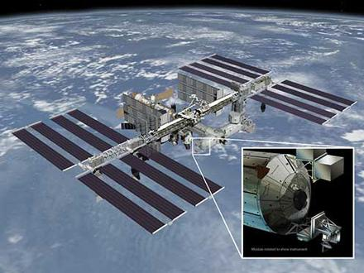
ISS RapidSCAT
NASA Scatterometer onboard the International Space Station
Radar Scatterometer
Launched: September 20, 2014
ISS Orbit nominally at 375-435 km and 51.6° inclination
Polarization: N/A
RF Center Freq: 13.402 GHz
RF bandwidth: 430 kHz
Observation swath of 900 km
Pulsewidth: 1.0 msec
Xmt Pwr: 80 W (Peak)
Chirp rate: 250 kHz/msec
Antenna size: 0.75m
Antenna rotation rate: 18 rpm
The ISS-RapidScat instrument is a speedy and cost-effective replacement for NASA's QuikScat Earth satellite, which monitored ocean winds to provide essential measurements used in weather predictions, including hurricane monitoring.

Slide 6
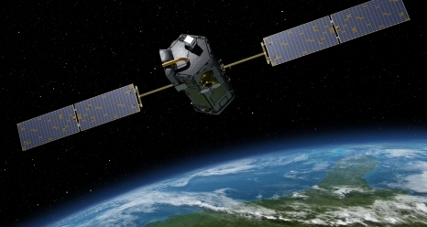
Orbiting Carbon Observatory (OCO-2)
NASA replacement carbon observatory for failed launch
Spectrometers will measure sunlight reflected off the Earth’s surface
Employs crycoolers to keep temparature stability for instruments
Launched: 5:56 AM EDT on July 2, 2014
Sun-synchronous orbit of 705 km with 98.2° inclination
TT&C in S-band (2035.3179 MHz uplink and 2210.3 MHz downlink)
Data downlinks in X-band (8115.2534 MHz with 150 MHz bandwidth to Fairbanks, AK and Wallops Island, VA)
Orbiting Carbon Observatory-2 (OCO-2) is NASA’s first dedicated Earth remote sensing satellite to study atmospheric carbon dioxide from Space. OCO-2 will be collecting space-based global measurements of atmospheric CO₂ with the precision, resolution, and coverage needed to characterize sources and sinks on regional scales.

Slide 7
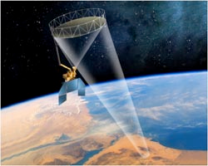
Soil Moisture Active Passive (SMAP)
NASA Soil Moisture Active Passive (SMAP) Mission
L-band scatterometer instrument
Launched: 9:22 AM EST on January 31, 2015
Polar orbit at 670 km and 98° inclination with 3 day repeat
Polarization: Dual, Linear H & V
RF Center Freq: 1217.25-1297.75 MHz
RF bandwidth: 1.4 MHz
Pulsewidth: 40 μsec
Pulse repetition freq: 3500 Hz
Xmt Pwr: 250 W Pk
Chirp rate: 0.025 MHz/μsec
Transmit Duty Cycle: 14%
Antenna diameter = 6 meters
Radiometer operating at 1413.5 MHz (27 MHz Bandwidth)
SMAP will utilize a frequency hopping scheme to mitigate interference to/from terrestrial radars operating in this band.
Note: SMAP active sensor failed early in mission operations.

Slide 8
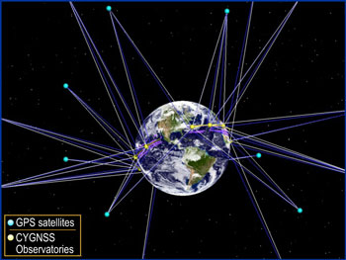
Cyclone Global Navigation Satellite System (CYGNSS)
NASA Cyclone Wind Speed Measuring System
CYGNSS is part of the NASA Earth System Science Pathfinder program
Launch Date: October 2016
8 small satellite observatories
500 km circular orbits
Inclination of ~35°
Telecommand from South Point, HI at 2092.7779 MHz
Downlink at 2272.7 MHz
GPS Receivers for direct and reflected signals
In orbit, CYGNSS’s eight micro-satellite observatories will receive both direct and reflected signals from Global Positioning System (GPS) satellites. The direct signals pinpoint CYGNSS observatory positions, while the reflected signals respond to ocean surface roughness, from which wind speed is retrieved.

Slide 9

Surface Water and Ocean Topography (SWOT)
NASA/CNES Follow-On Mission to JASON-1, 2, 3
KaRIN, a Ka-band radar interferometer instrument
JASON-class dual-frequency (C and Ku-band) altimeter
3-frequency radiometer similar to Advanced Microwave Radiometer (AMR) on OSTM
Projected Launch Date: 2020
Orbit at 970 km and 78° inclination with 1-3 day repeat
Polarization: Dual
KaRIN RF Center Freq: 35.6 GHz
RF bandwidth: 200 MHz
Pulsewidth: 5.1 μsec
Pulse repetition freq: 4400 Hz
Xmt Pwr: 1.5 kW Pk/33.66 W Avg
Chirp rate: 39.22 MHz/μsec
Transmit Duty Cycle: 2.24%
SWOT satellite mission and its wide-swath altimetry technology are a means of completely covering the world's oceans and freshwater bodies with repeated elevation measurements.

Slide 10
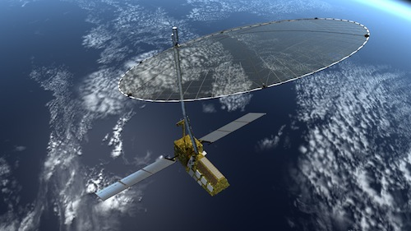
NASA/ISRO SAR (NISAR)
NASA/ISRO Joint Mission using interferometric SARs
Status: Definition Stage
L-band (1215-1300 MHz) and S-band (3100-3300 MHz) SAR instruments
Projected Launch Date: 2021
Polar orbit at 7547 km and 98° inclination with 8 day repeat
Polarization: Dual, Linear H & V
RF Center Freq: 1215-1300 MHz
RF bandwidth: 25 MHz
Pulsewidth: 60 μsec
Pulse repetition freq: 3200 Hz
Xmt Pwr: 3.2 kW Pk/614.4 W Avg
Chirp rate: 0.42 MHz/μsec
Transmit Duty Cycle: 19.2%
Antenna diameter = 15 meters
Downlink 1.5 Gbps in 25.5-27.0 GHz
NISAR would make global integrated measurements of the causes and consequences of land surface changes of highly spatial and temporally complex processes ranging from ecosystem disturbances, to ice sheet collapse and natural hazards including earthquakes, tsunamis, volcanoes, and landslides.

Slide 11
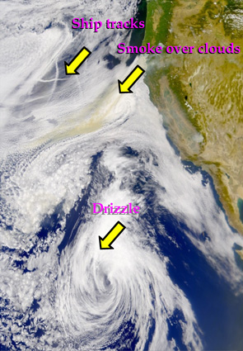
Aerosol - Cloud – Ecosystems (ACE)
NASA Earth observation mission using a Multi-angle Polarimeter Doppler Radar
Dual frequency cloud profiling radar
Projected Launch Date: 2020+
Polar orbit at 650 km and 98.2° inclination
Polarization: TBD
RF Center Freq: 35.6 & 94.1 GHz
RF bandwidth: 2.5 & 7.5 MHz
Pulsewidth: 1.67 μsec
Pulse repetition freq: 7700 & 5600 Hz
Xmt Pwr: TBD kW Pk/TBD W Avg
Chirp rate: 1.54 & 4.5 MHz/μsec
Transmit Duty Cycle: 1.2 & 0.94%
ACE will help to answer emerging fundamental science questions associated with aerosols, clouds, air quality and global ocean ecosystems.

Slide 12
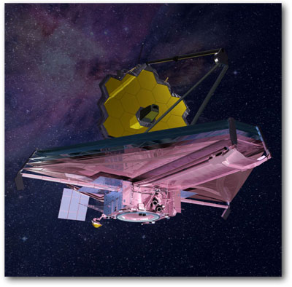
James Webb Space Telescope (JWST)
NASA Follow-On to Hubble Space Telescope
Launch Date: Late 2018
Orbit: L2 libration point
Uplinks: 2090.7521 MHz from NASA Deep Space Network sites
TT&C Downlinks: 2270.5 MHz
Data Downlink: 25.9 GHz to NASA Deep Space Network sites
Downlink emission is 56 MHz wide
JWST will observe space at different wavelengths than Hubble with a much larger mirror in order to view more distant stars and gain knowledge about the early universe.

Slide 13
Domestic Issues
AWS-3 Auction and Transition Planning
Spectrum Legislation
FCC Proceedings
EESS X-band Downlink Issues

Slide 14
Middle Class Tax Relief and Job Creation Act of 2012
Signed Feb 22, 2012 - Updated previous law (Commercial Spectrum Enhancement Act) that provided for reimbursement of funds spent to modify federal system in order reallocate federal spectrum for non-federal use via auction
Provided for funding for pre-auction planning, allowed for state-of-art replacement systems, allowed for pre-auction transfer of funds
Required much more comprehensive data regarding each assignment and the planned transition than did previous auctions
Current use by the federal entity of the eligible frequencies
Geographic location of the federal entity’s facilities or systems
Steps to be taken by the Federal entity to relocate or begin sharing spectrum for specific geographic locations in sufficient detail to indicate when use of such frequencies at such locations will be discontinued by the Federal entity or shared between the Federal entity and non-Federal users
Required NTIA to develop a common format
Final Rules published on Jan 25, 2013
New 47 CFR Part 301 effective Feb 25, 2013
Established a requirement for all unclassified/non-sensitive information to be made public via posting on NTIA website

Slide 15
Annex O of NTIA Manual
Annex O – Relocation or Sharing by Federal Government Stations in support of Reallocation
Dated May 2013; Signed June 2013
Spells out all the requirements in the law along with the basic process for implementing them
Provides the “common format” and guidance for what must be included in a transition plan
1710-1755 MHz: 12 Data Items
New Requirement: > 60 items of information

Slide 16
NASA Transition Plan
Transition of one (1) assignment at LaRC for aeronautical telemetry centered at 1780.5 MHz which therefore overlapped upper edge of 1755-1780 MHz band
Developed in November/December 2013
Submitted to NTIA January 23, 2014
Minor corrections made January 27, 2014
Technical Panel “approved” NASA’s Transition Plan on February 24, 2014
Administrative corrections made February 27, 2014

Slide 17
AWS-3 Auction
Auction Started - 11/13/2014
Auction Ended - 1/29/2015
Rounds: 341
Bidding Days: 45
Qualified Bidders: 70
Winning Bidders: 31 Bidders won 1,611 Licenses
Licenses Held by FCC: 3
Gross Bids: $44,899,451,600
Net Bids: $41,329,673,325

Slide 18
Middle Class Tax Relief and Job Creation Act of 2012
Signed Feb 22, 2012 - Updated previous law (Commercial Spectrum Enhancement Act) that provided for reimbursement of funds spent to modify federal system in order reallocate federal spectrum for non-federal use via auction
Provided for funding for pre-auction planning, allowed for state-of-art replacement systems, allowed for pre-auction transfer of funds
Required much more comprehensive data regarding each assignment and the planned transition than did previous auctions
Current use by the federal entity of the eligible frequencies
Geographic location of the federal entity’s facilities or systems
Steps to be taken by the Federal entity to relocate or begin sharing spectrum for specific geographic locations in sufficient detail to indicate when use of such frequencies at such locations will be discontinued by the Federal entity or shared between the Federal entity and non-Federal users
Required NTIA to develop a common format
Final Rules published on Jan 25, 2013
New 47 CFR Part 301 effective Feb 25, 2013
Established a requirement for all unclassified/non-sensitive information to be made public via posting on NTIA website

Slide 19
Annex O of NTIA Manual
Annex O – Relocation or Sharing by Federal Government Stations in support of Reallocation
Dated May 2013; Signed June 2013
Spells out all the requirements in the law along with the basic process for implementing them
Provides the “common format” and guidance for what must be included in a transition plan
1710-1755 MHz: 12 Data Items
New Requirement: > 60 items of information

Slide 20
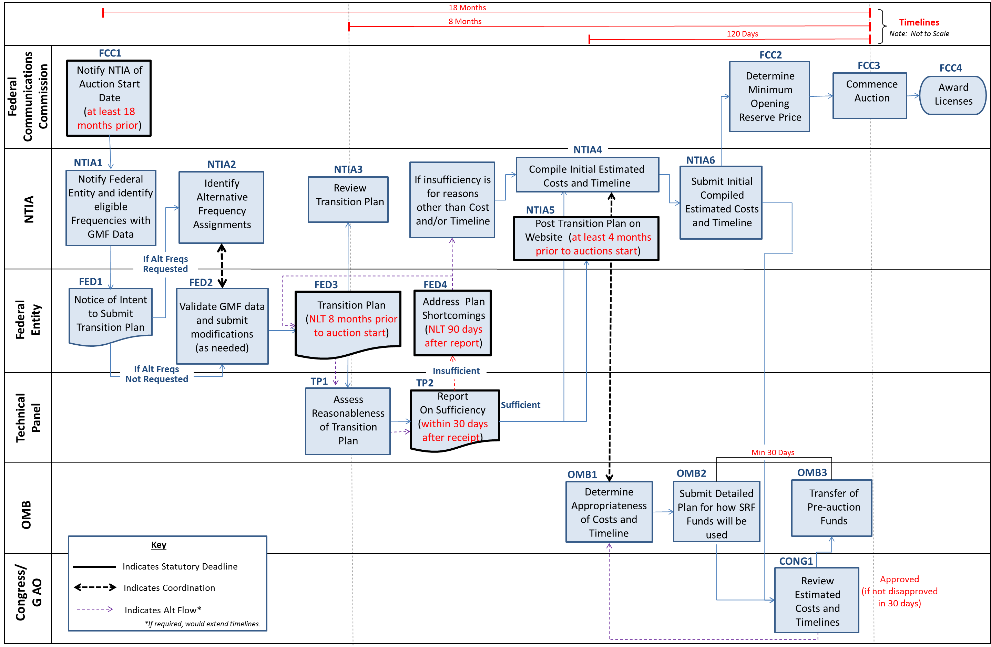
Pre-Auction Transition Planning Process

Slide 21
NASA Transition Plan
Transition of one (1) assignment at LaRC for aeronautical telemetry centered at 1780.5 MHz which therefore overlapped upper edge of 1755-1780 MHz band
Developed in November/December 2013
Submitted to NTIA January 23, 2014
Minor corrections made January 27, 2014
Technical Panel “approved” NASA’s Transition Plan on February 24, 2014
Administrative corrections made February 27, 2014

Slide 22
AWS-3 Auction
Auction Started - 11/13/2014
Auction Ended - 1/29/2015
Rounds: 341
Bidding Days: 45
Qualified Bidders: 70
Winning Bidders: 31 Bidders won 1,611 Licenses
Licenses Held by FCC: 3
Gross Bids: $44,899,451,600
Net Bids: $41,329,673,325

Slide 23
Spectrum Legislation
Numerous pending bills in Congress
More spectrum for mobile broadband
Innovative use of spectrum
Desire to offset deficit through more spectrum auctions
Mobile NOW! Act pending congressional action looking for even more mobile broadband spectrum
Pressure on spectrum used for science will persist and grow

Slide 24
FCC Proceedings
Spectrum Frontiers
Possible interference to EESS passive sensing in 50-60 GHz oxygen absorption band
Commercial Launch R&O
Enabling commercial launch providers to use 2200-2290 MHz government spectrum for launches
5 GHz UNII Changes
Threatens EESS active sensing in 5350-5470 MHz (Radarsat, Sentinel, JASON, etc.)

Slide 25
Commercial Use of X-band
8025-8400 MHz band is allocated for data downlinks for EESS remote sensing satellites
In US, this it primary for federal government and can also be used by commercial operators after case-by-case EMC analysis
New large-scale constellations of small commercial remote sensing satellites want access to band for their operations
Spire Global (~dozens of satellites)
Planet Labs (> 100 satellites)
Terra Bella (Formerly Skybox Imaging, now owned by Google, planning “more than a dozen satellites”
Result is a HUGE operational RFI problem!!!

Slide 26
Questions???

