Slide 1
van der Waals Heterostructures: Fabrication and Materials Issues
J. Hone
Columbia University
Mechanical Engineering
Center for Precision Assembly of Superstratic and Superatomic Solids (PAS³) – Columbia / CCNY MRSEC

Slide 2
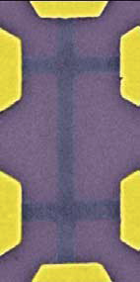
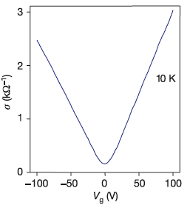
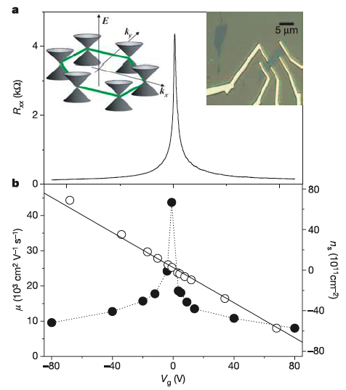
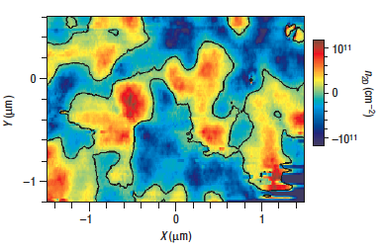
Graphene on SiO₂
Field effect mobility
Novoselov, Geim, Science (2005), Nature (2005); Zhang, Kim, Nat. (2005)
Graphene on SiO₂:
mobility ~20,000 cm²/Vs
surface roughness
scattering from charged impurities
disorder from charged impurities
Martin, et al, Nature Phys. (2008)

Slide 3
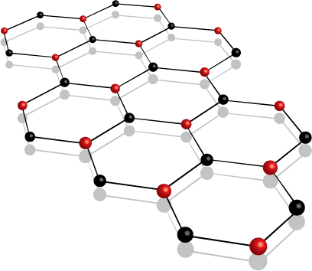
Boron Nitride – graphene’s insulating ‘cousin’
< 2% lattice mismatch to graphene
atomically flat
chemically inert, stable to high temp.
no dangling bonds
good dielectric properties
Boron Nitride
Optical properties of h-BN
 | Band Gap | Dielectric Constant | Optical Phonon Energy
BN | 5.8 eV | ~3.5 | >100 meV
SiO2 | 8.9 eV | 3.9 | 59 meV

Slide 4
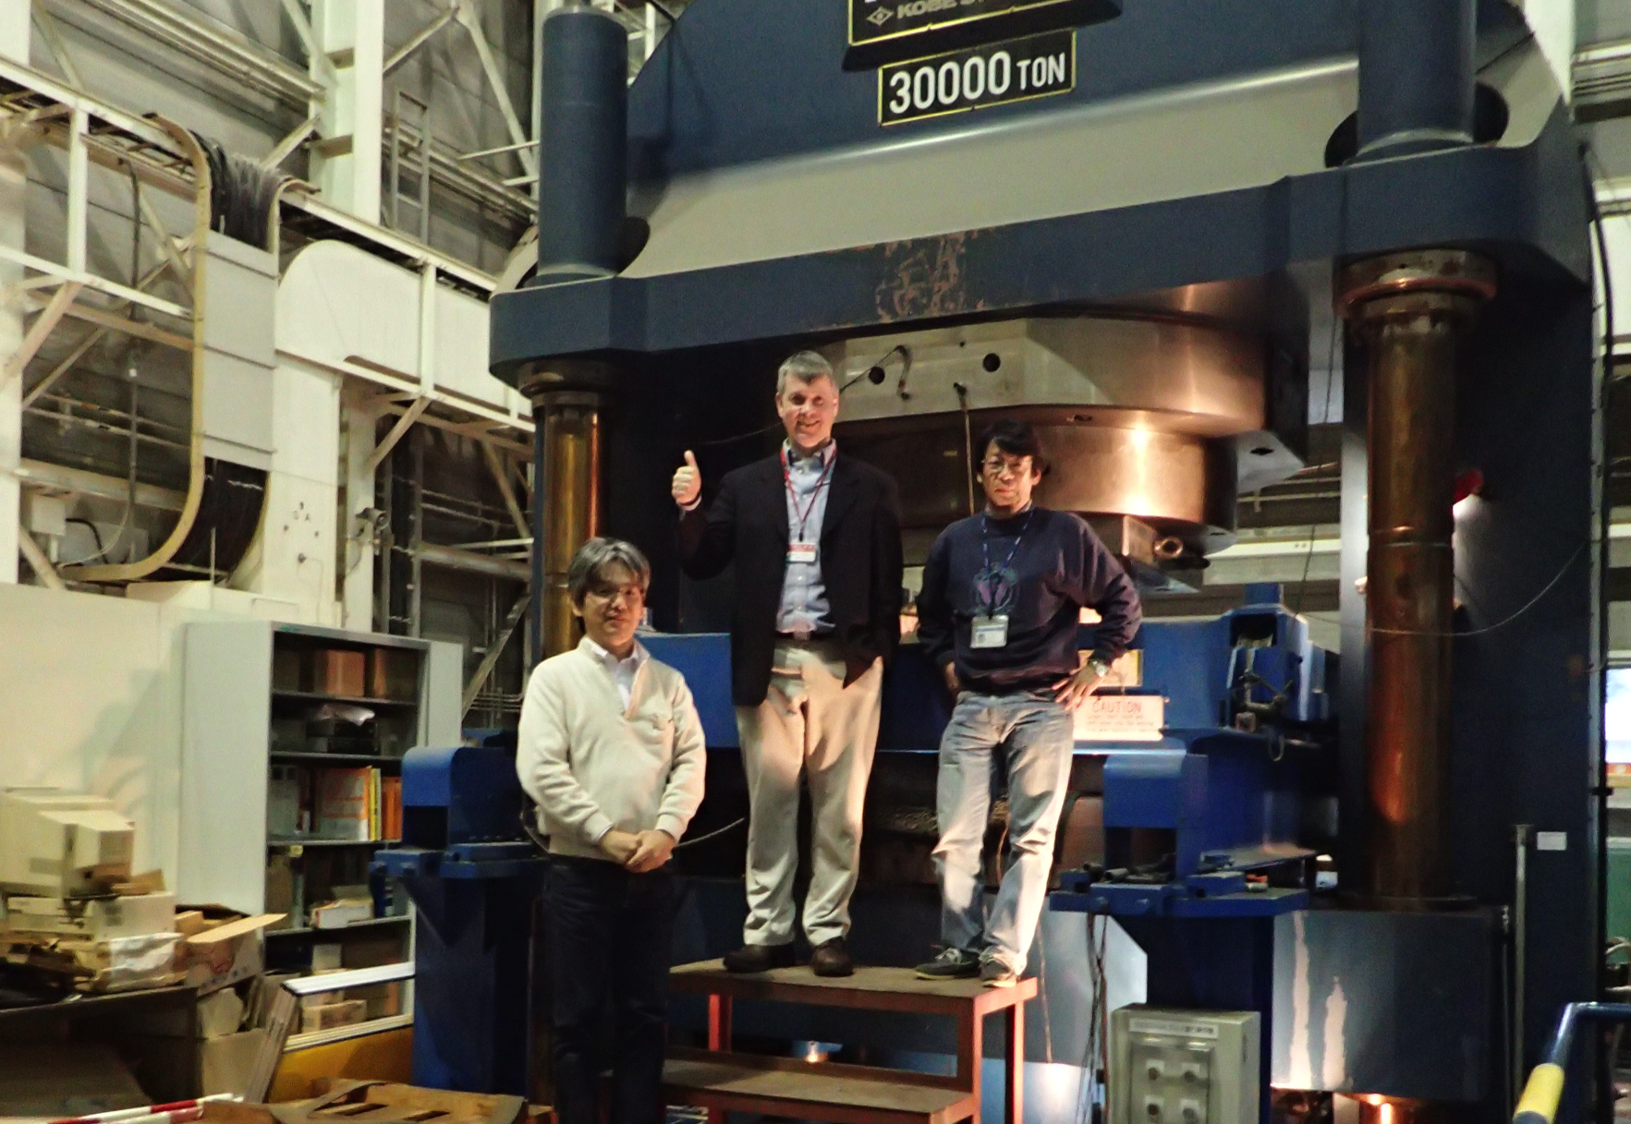
The Source…
Watanabe, K., Taniguchi, T. & Kanda, H. “Direct-bandgap properties and evidence for ultraviolet lasing of hexagonal boron nitride single crystal.” Nature Mater. 3, 404–409 (2004).
Taniguchi, T. & Watanabe, K. “Synthesis of high-purity boron nitride single
crystals under high pressure by using Ba–Bn solvent.” J. Cryst. Growth 303, 525–529 (2007).

Slide 5
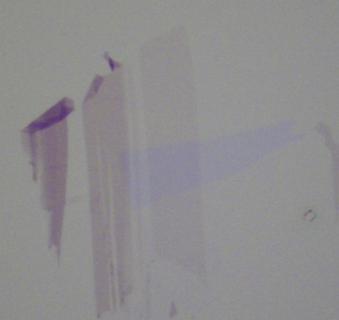
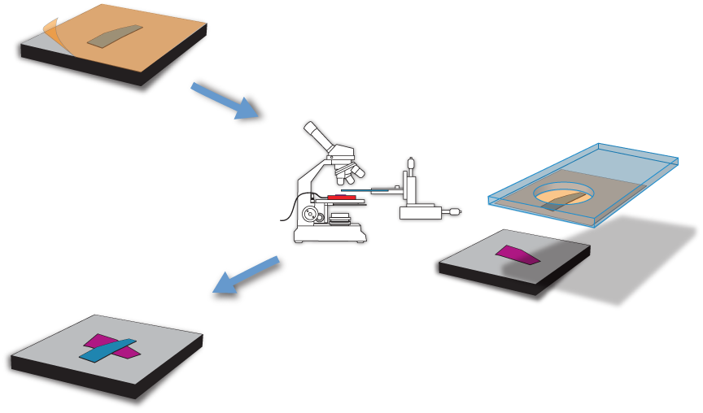
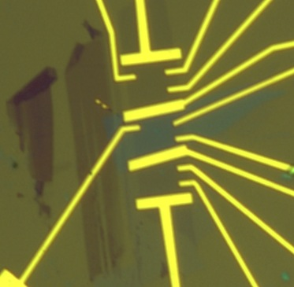

‘Polymer transfer’ of graphene onto BN
C.R. Dean, A.F. Young, I. Meric, C. Lee, L. Wang, S.Sorgenfrei,
K. Watanabe, T. Taniguchi, P. Kim, K.L. Shepard, J. Hone, Nature Nano (2010)

Slide 6
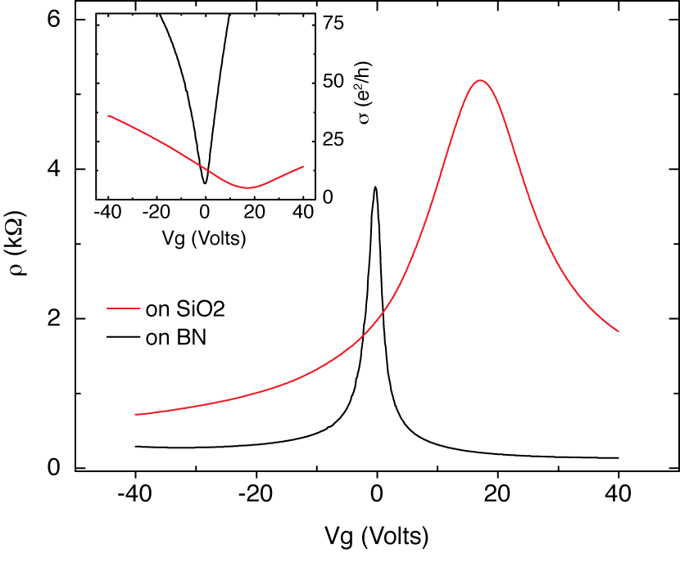
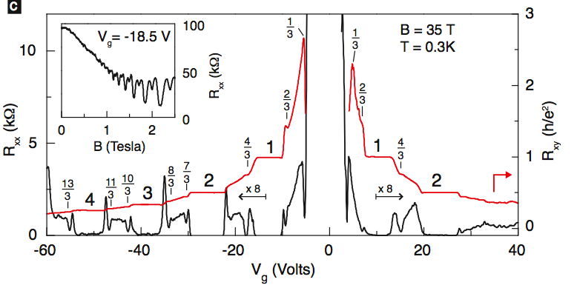
Improved Performance
Enhanced mobility
lower disorder
Many FQHE states

Slide 7
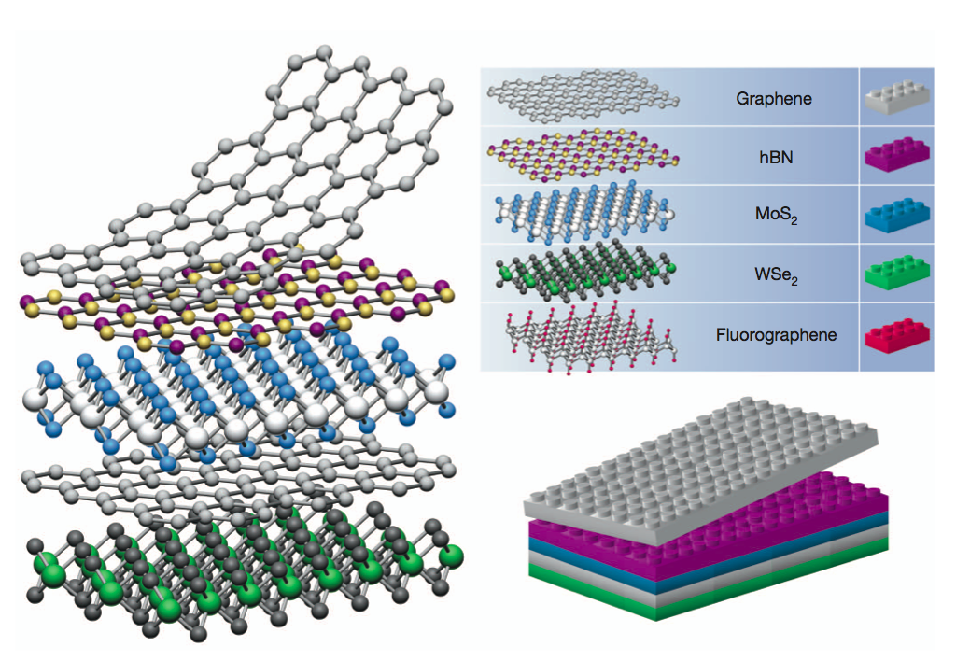
Making Layered Structures
The vision….
Geim, Nature 2013

Slide 8
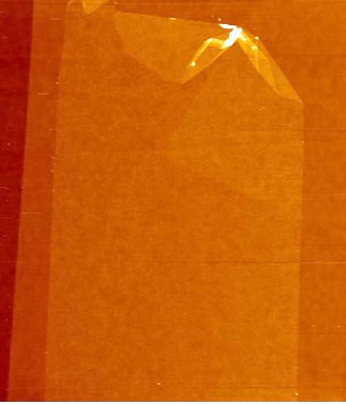
Making Layered Structures
The reality…
BN
Graphene
10 µm
G
BN

Slide 9
Making Layered Structures
The reality…
BN
Graphene
10 µm
BN
G
G
BN
BN

Slide 10
Making Layered Structures
The reality…
BN
Graphene
10 µm
polymer residue
BN
G
G
BN
BN

Slide 11
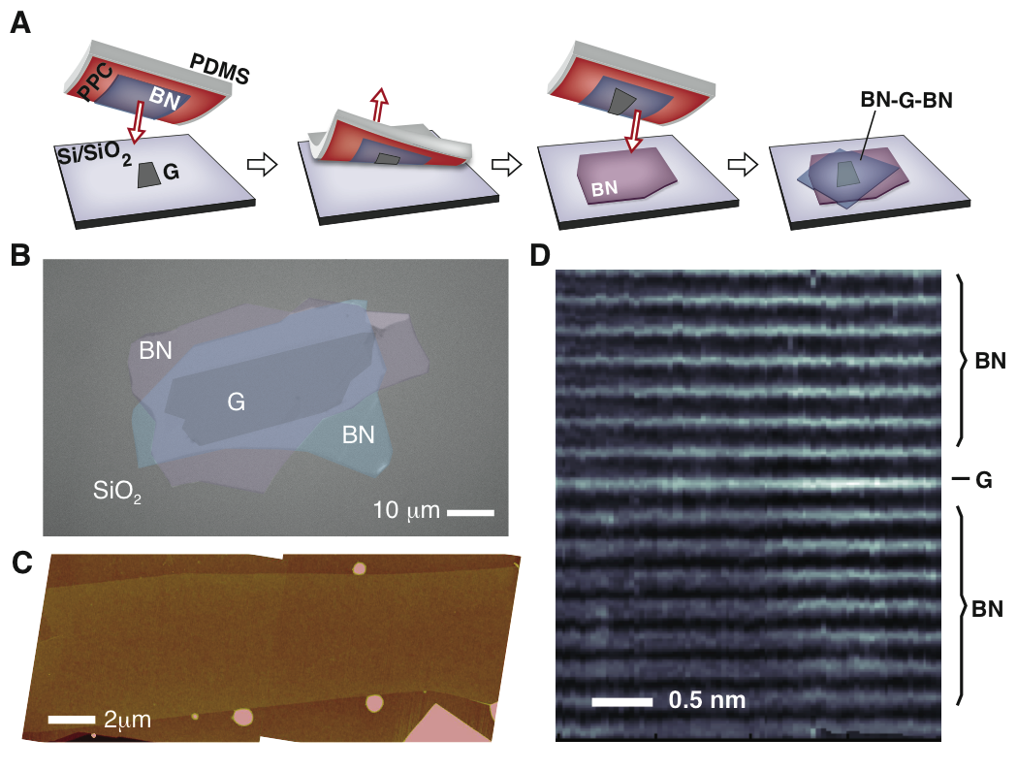

Van der Waals Assembly
L. Wang et al, Science (2013)
Ultraclean technique – graphene never exposed to polymer

Slide 12
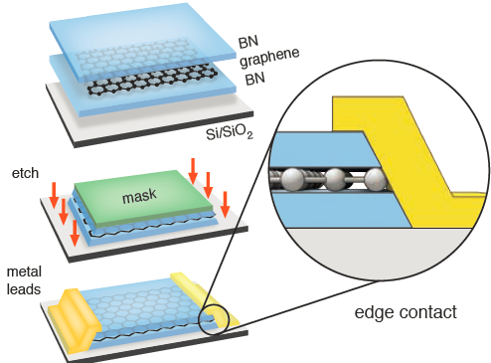
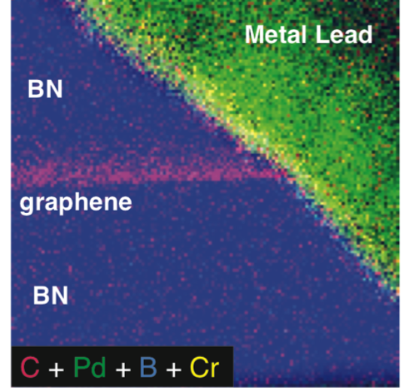
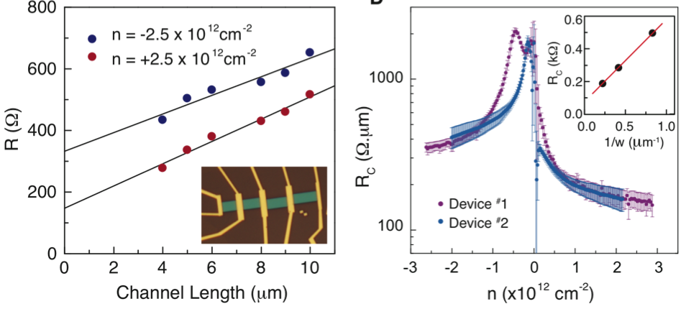
Side Contacts

Slide 13

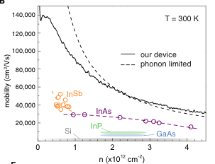
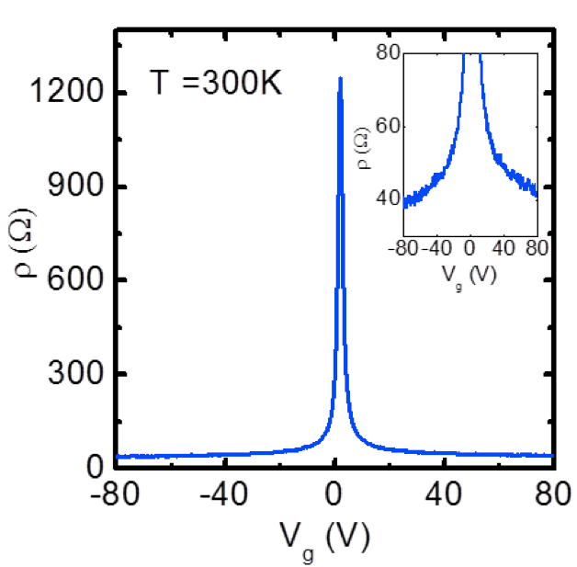
Achieving ideal electrical performance
Sheet resistance below 40 Ω – more conductive than silver or copper!
At limit of acoustic phonon scattering.
Highest R.T. mobility of any material!

Slide 14
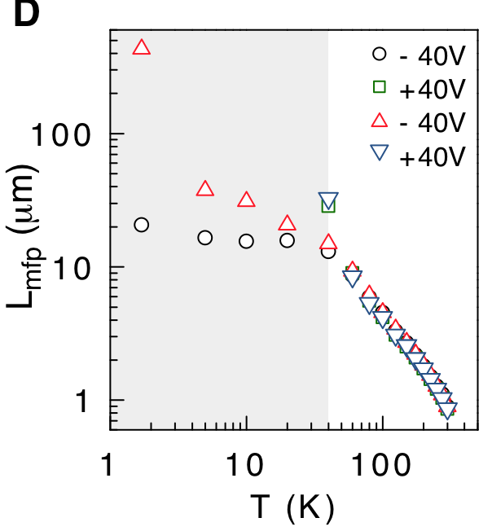
Low-T Ballistic Transport
Transport is ballistic at low T up to at least ~15 µm

Slide 15
Ultra-clean graphene: magneto-transport
’Hofstader Butterfly’
Negative Refraction
Exciton Condensation

Slide 16
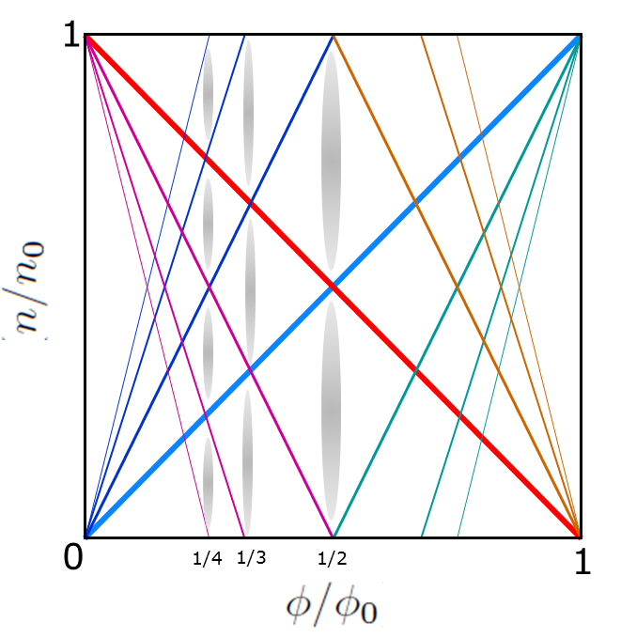
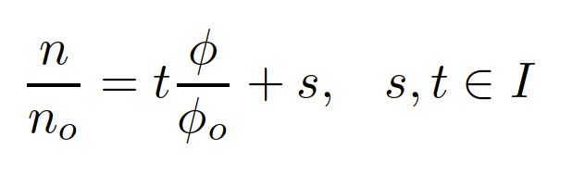
Hofstadter’s Butterfly
Hofstader, PRB 1976:
Basic problem: What are Bloch states in 2D with lattice + magnetic field? (2 length scales)
Energy bands develop fractal structure when magnetic length is of order the periodic unit cell
Wannier (1977): Fractal gaps trace out straight lines in n vs. flux, with two quantum numbers (s,t)
graphene – BN moire’ pattern
a
For well-aligned structure, a ~ 15 nm

Slide 17
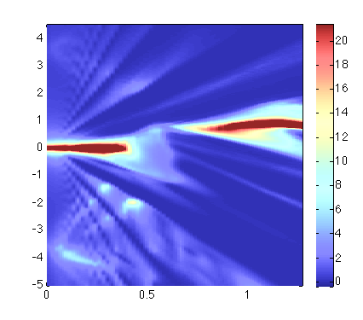
1st generation: polymer transfer
R_{xx}
B (T)
n (cm⁻²)
Also: Ponomarenko, Novoselov, Geim (Nature);
Hunt, Jarillo-Herrero (Science)
C. R. Dean, L. Wang, …, JH, P. Kim, Nature (2013)

Slide 18
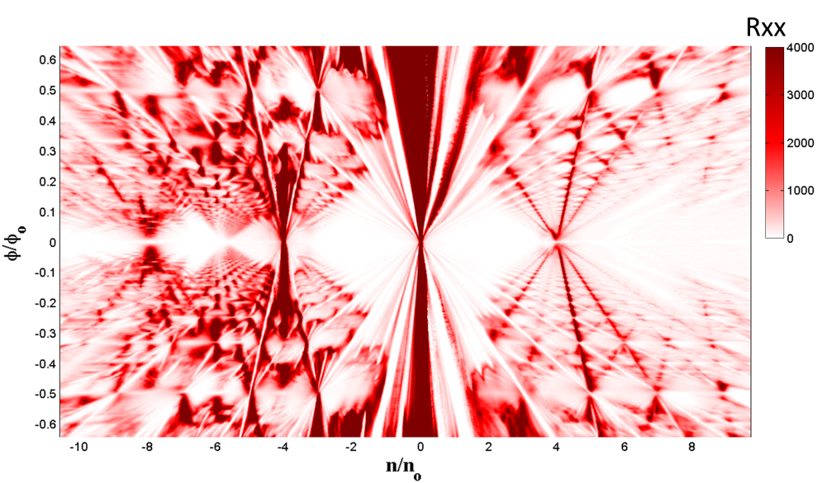
2nd generation – van der Waals assembly
L. Wang, JH, C. Dean, in preparation

Slide 19
States within Hofstader spectrum
New states
Fractal states
fractional quantum Hall states
Fractal states: integer t, s
FQHE: fractional t
New states: fractional s
Wang, L., Gao, Y., Wen, B., Han, Z., Taniguchi, T., Watanabe, K., Koshino, M., Hone, J. & Dean, C. R. Science 350, 1231-1234, (2015).

Slide 20
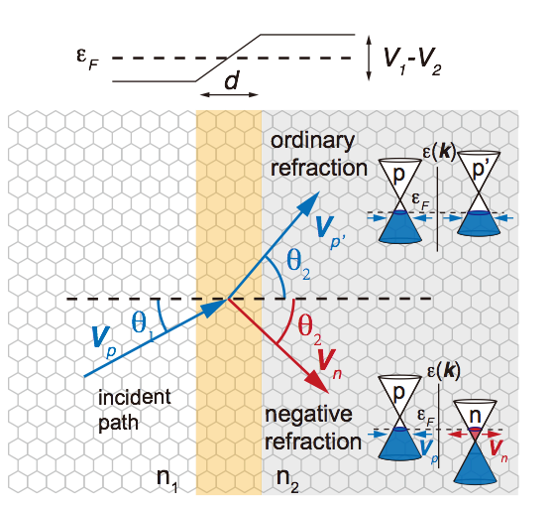
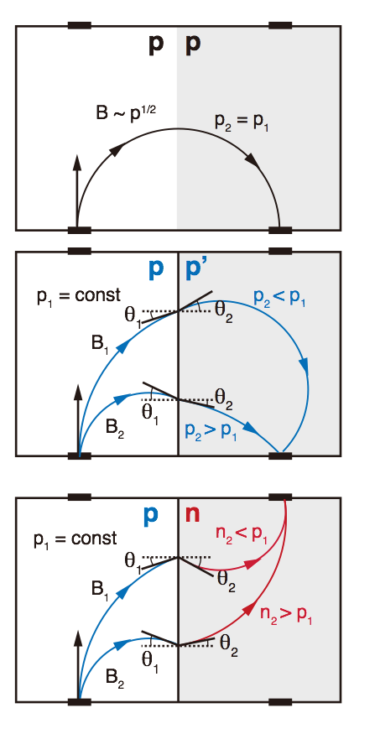
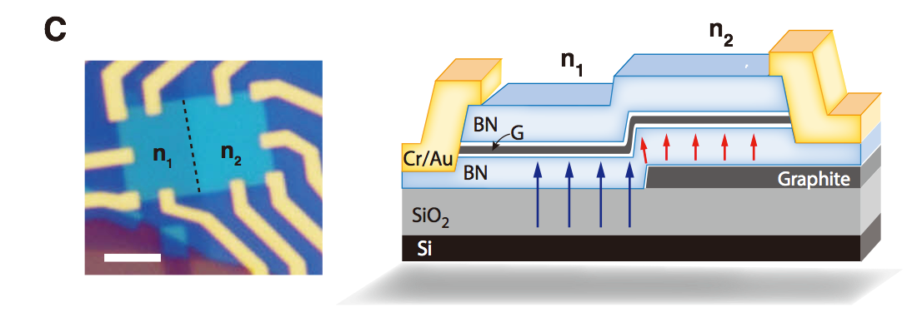
Using Magnetic Focusing to Study Refraction
S. Chen… JH, A. Ghosh, C. Dean, Science (2017)

Slide 21
Negative refraction in p-n junctions
Experiment
Simple geometric model fits shape of focusing peaks
Positive and negative Snell’s law confirmed

Slide 22
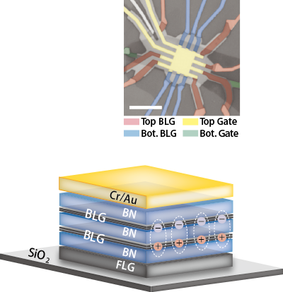
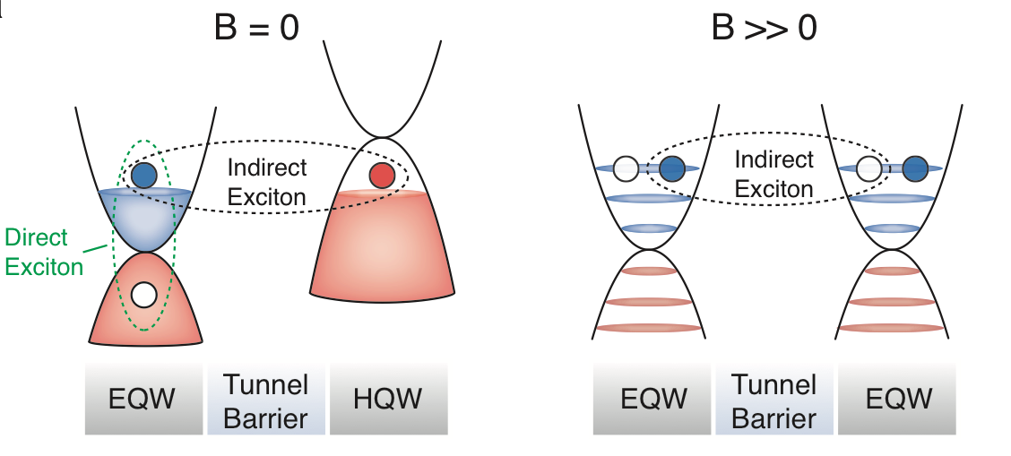
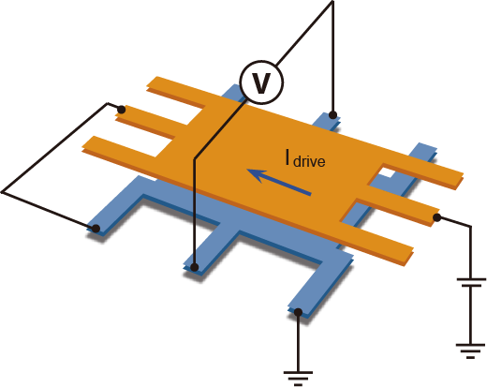
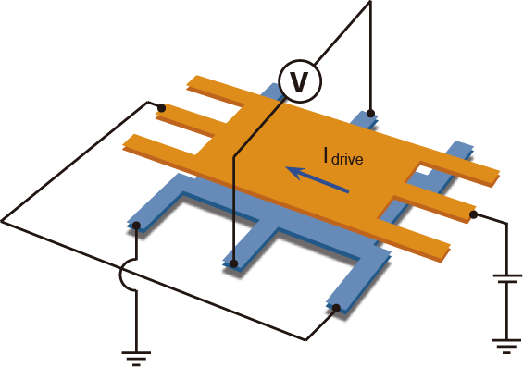
Exciton Condensation in Bilayer Graphene Superlattices
Counterflow
Coulomb Hall drag
B
Parallel Flow
J. Li, JH, C. Dean, under review (Nature). Also P. Kim group

Slide 23
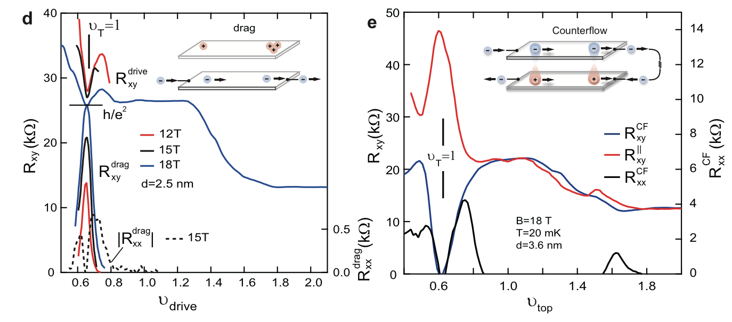
Evidence for Condensate phase at 𝜈_{tot} = 1
At v_{T} = 1, drive and drag layer both show quantized Hall resistance
In counterflow geometry, Hall drag = 0 at v_{T} = 1

Slide 24
New Control of Graphene Devices
Artificial Superlattices
Gate-defined structures
Interlayer Rotation

Slide 25
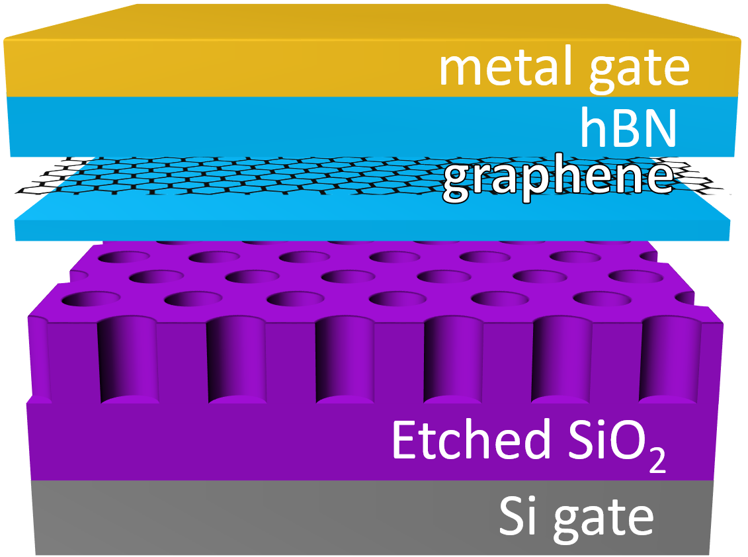
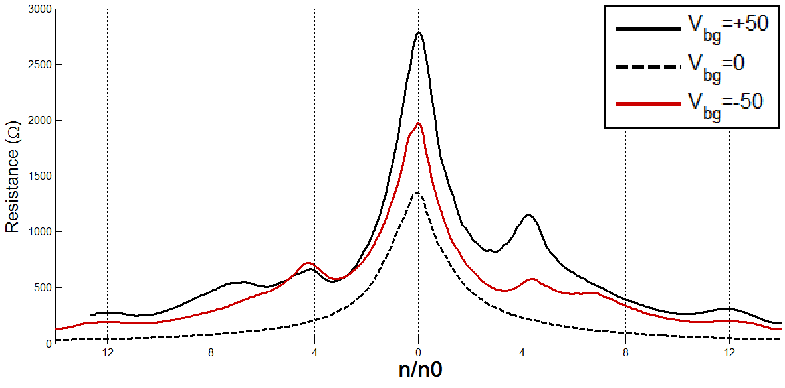
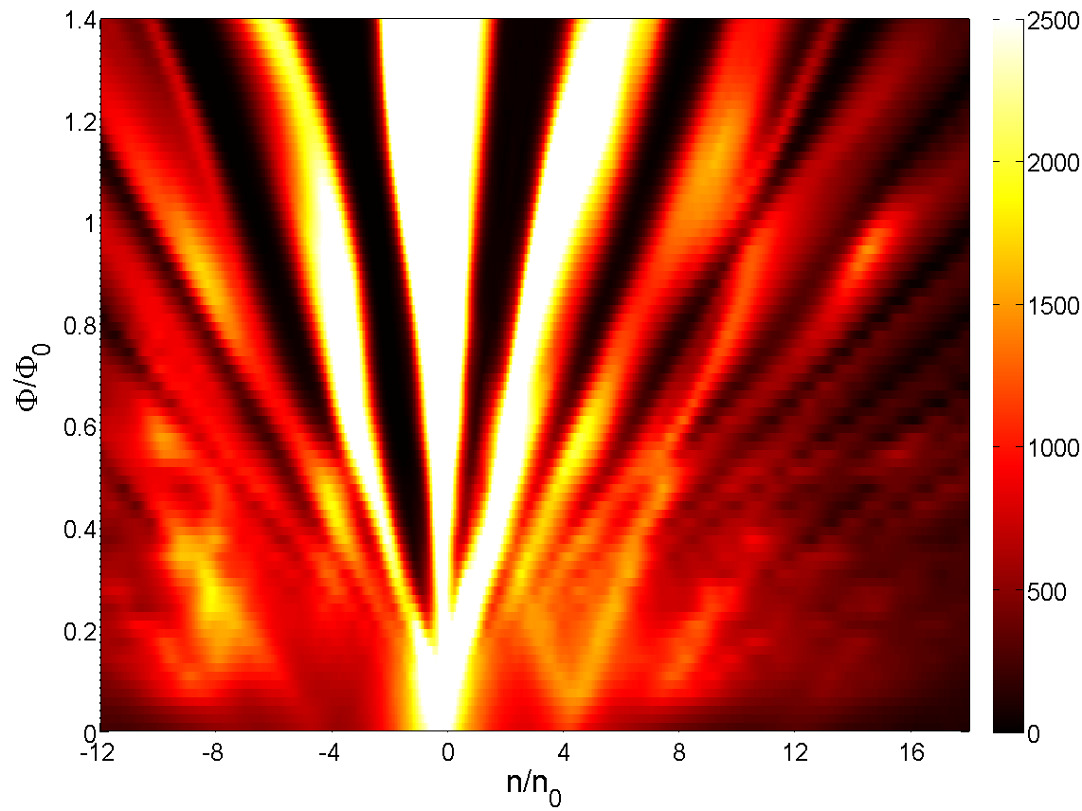
Artificial Superlattices
Triangular lattice of holes in SiO₂, 40nm periodicity

Slide 26
How can we make graphene even better?
Use graphite as top / bottom gates: better electrostatic uniformity
Use top gate to define channel region
Adjust back gate / Magnetic field to maintain insulating (v=0) state
Notes:
This new generation of graphene devices takes advantage of the properties of graphene under a high magnetic field to define electrostatically new structures, in this case Hall bars (a). The main idea of these devices is to avoid edge disorder and electrostatic variations in the device due to fringe field.
In a high enough magnetic field (normally around 4 T) the nu= 0 state of graphene opens an energy gap, which has the particularity of not having edge states. Our double gated devices have a global back gate which sets the fermi energy of the external part of the device in this nu=0 gap while the top gate is used to tune the Fermi energy of the Hall bar (b). Our devices also have current leads that are not covered by the top gate to assure that the external part of the top gate is in an insulating state (d). Using these uncovered leads we can see that the insulating state is present from 4 T for the whole gate range.

Slide 27
Qualitative Improvement in QHE
Etched
Gate defined - metal
Gate defined - graphite
Notes:
Here we have the results for three differnet type of devices: dual gated, where the gates cover the whole device, gate defined –metal where the top gate is smaller than the back gate as described before and gate defined – graphite where the top gate is also smaller but this time made of graphite. We can see that the effects of the gate defined are striking, at moderated magnetic field (15 T) the dual gated device do not show any hint of fractional quantum Hall effect in the N=1 LL while the both gate defined devices do.
Maybe the more remarkable characteristic is that the gate defined- graphite shows a higher quality with moch more fractional states developing at the same magnetic field. Nevertheless, as demonstrated in GaAs samples, the quality of the device is so good that the plateaus of the FQH become very small, this is explained by a small amount of scattering centers which makes localization very hard to achieve.

Slide 28
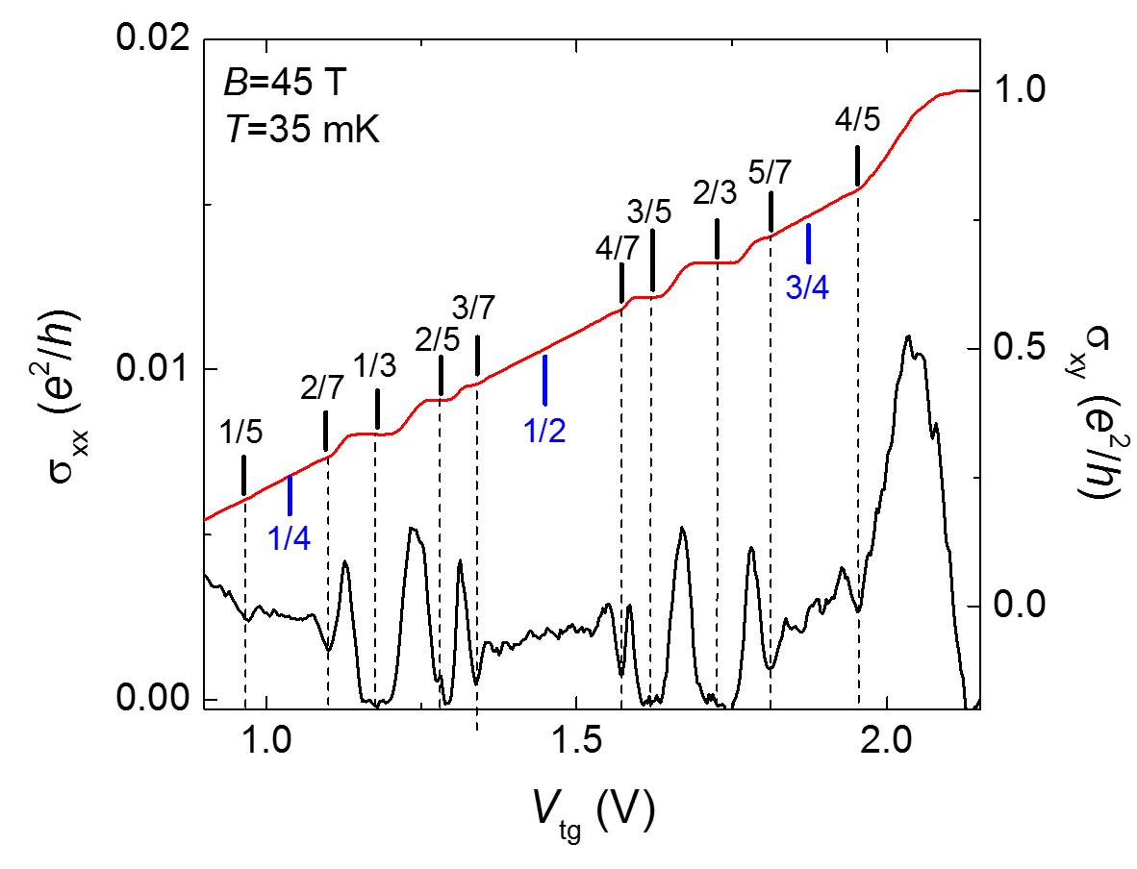
New physics reachable thanks to the gate defined devices
Reentrance state
Notes:
Desides the observation of FHQ effects at lower magnetic fields and the and the new information this brings about how disorder is affecting the quantum Hall effect in graphene these new structures also new physics, not observed before in transport measurements, is not reachable. Amount them the observation of the four-flux states FQHE and the observation of reentrance of the integer quantum Hall effect with a very particular symmetry which could be associated with to the symmetries of the LL.

Slide 29
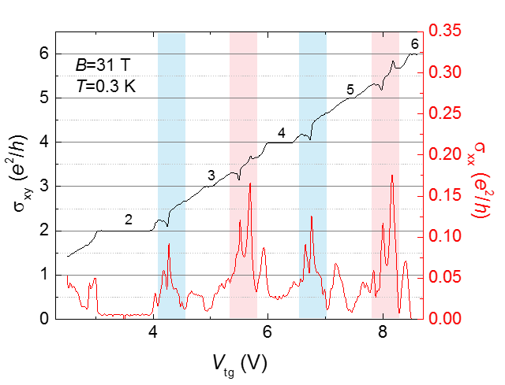
New physics reachable thanks to the gate defined devices
Re-entrant quantum Hall states
Notes:
Desides the observation of FHQ effects at lower magnetic fields and the and the new information this brings about how disorder is affecting the quantum Hall effect in graphene these new structures also new physics, not observed before in transport measurements, is not reachable. Amount them the observation of the four-flux states FQHE and the observation of reentrance of the integer quantum Hall effect with a very particular symmetry which could be associated with to the symmetries of the LL.

Slide 30
Controlling Interlayer Rotation
Angle-dependent contact resistance between graphene and graphite
Chari, Ribero, Dean, Shepard, Nano Lett (2016)
Notes:
In situ manipulation of the electronic band structure of graphene by a Moiré supperlattice is now possible. This is achieved using a set of new devices consisting of (from bottom to top) a graphite gate, h-BN, graphene and a smaller prechasped h-BN piece. The Moiré periodic potential will appear due to the difference in lattice constant of graphene and BN, when these two are close to alignment. In here we manipulate in situ the crystallographic orientation of BN and graphene using an AFM tip in contact mode. The advantage of this technique is not only that it allows to control the angle between two materials but it permit to measure the electrical properties as the angle is changed, creating a technique to really investigate the effects of crystallographic orientations between 2D materials as a function of the angle.

Slide 31
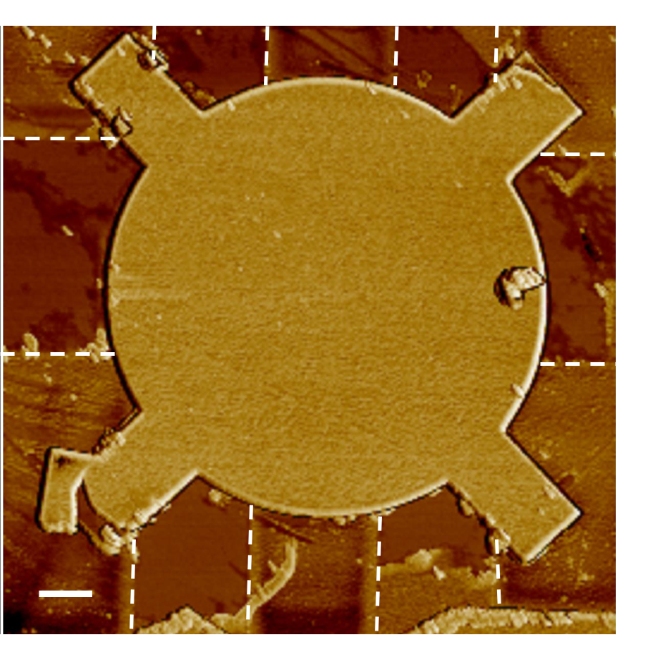
Controlling Interlayer Rotation: Graphene / BN
BN on graphene (band structure manipulation)
AFM tip
BN handle
Contacts
graphene
BN
HSQ/BN
Graphite gate
Shape ‘handle’ structure
Rotate with AFM
Measure transport
Notes:
In situ manipulation of the electronic band structure of graphene by a Moiré supperlattice is now possible. This is achieved using a set of new devices consisting of (from bottom to top) a graphite gate, h-BN, graphene and a smaller prechasped h-BN piece. The Moiré periodic potential will appear due to the difference in lattice constant of graphene and BN, when these two are close to alignment. In here we manipulate in situ the crystallographic orientation of BN and graphene using an AFM tip in contact mode. The advantage of this technique is not only that it allows to control the angle between two materials but it permit to measure the electrical properties as the angle is changed, creating a technique to really investigate the effects of crystallographic orientations between 2D materials as a function of the angle.

Slide 32
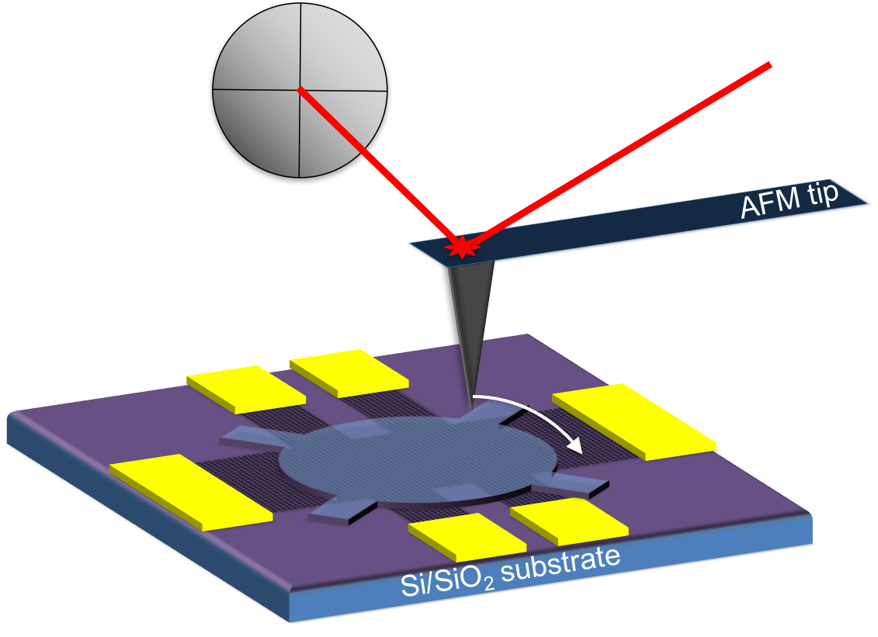
Interlayer friction
BN on graphene (friction)
photodiode
Graphite/BN
Layers ‘lock’ together at commensurate angles
Notes:
Once the devices are build we use friction measurements between the two materials to pre-align them. We found out that in fact the friction response between graphene and BN is neglictible over a wide range of angle except when these two materials are aligned one to the other.

Slide 33
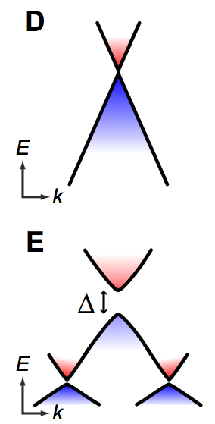
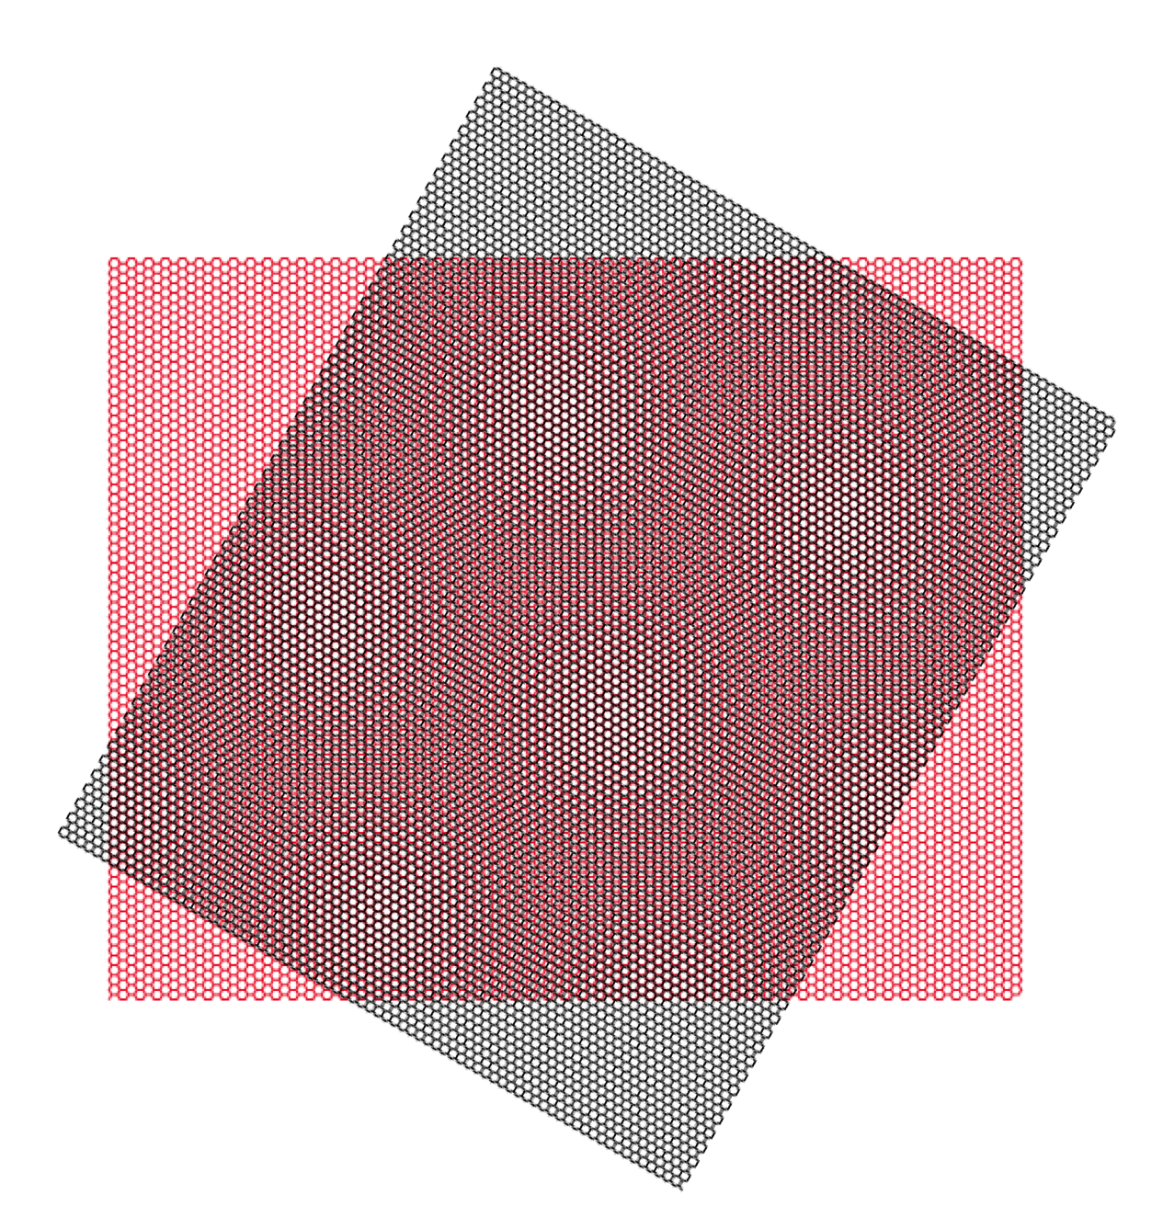
Controlling Moire’ Wavelength
BN on graphene (band structure manipulation)
λ=10 nm
λ
λ=14 nm
Notes:
If we measure the transport response as a function of the angle we find the expected appearance of the satellite peak due to the band structure modification by the Moiré potential. This peak can be mapped out for a wide range of angles which corresponds with a variation of the Moiré length from 14 nm to 10 nm.

Slide 34
Graphene Light Sources
Suspended Graphene Emitters
Ultrafast BN-encapsulated Emitters

Slide 35
2D Semiconductors

Slide 36
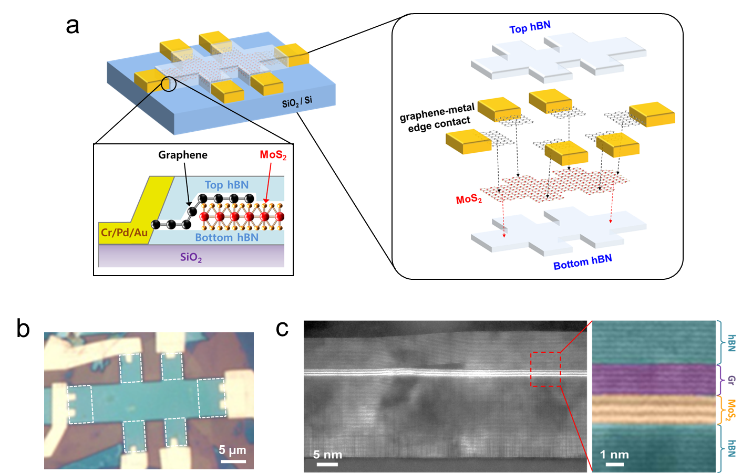
Encapsulated MoS₂ with graphene contacts
X. Cui, G. H. Lee et al.,Nature Nano (2015)

Slide 37
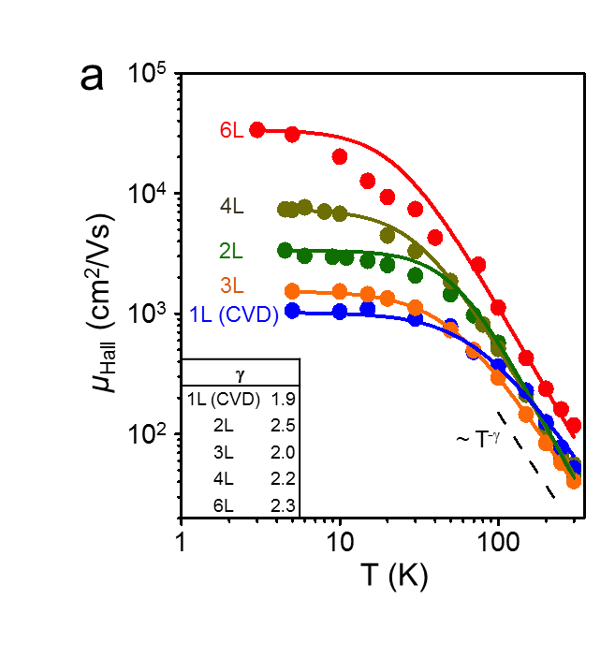
Multi-terminal transport
Hall mobility
Electron-phonon mobility: µ~T⁻² for all samples
contrast to on SiO₂
Independent of gate voltage
50-150 at R.T.

Slide 38
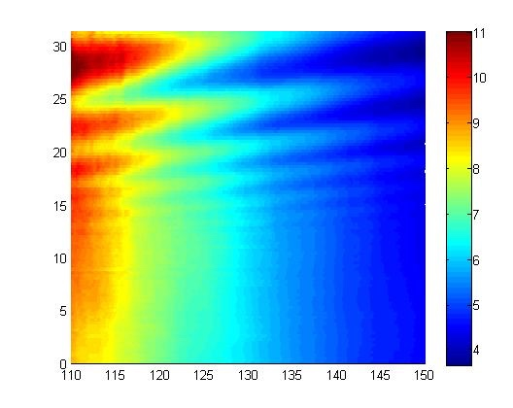
Quantum Oscillations
R_{xx} (kΩ)
B (T)
V_{BG} (V)
Tunable SdH Oscillations in monolayer MoS₂

Slide 39
2D Semiconductors – current challenges
Contacts
Achieiving intrinsic optical properties
Materials Quality

Slide 40
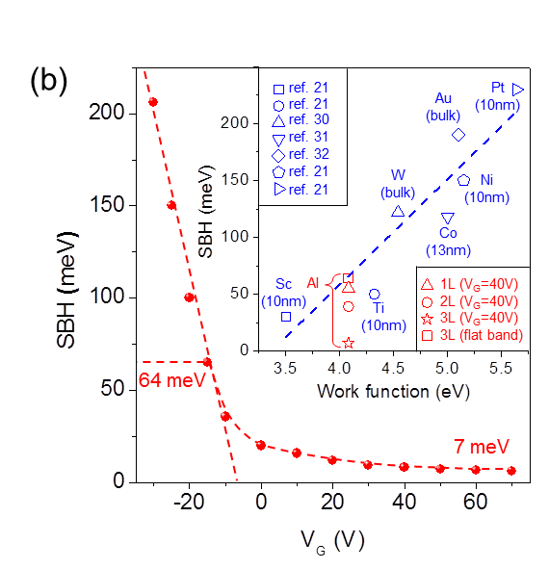
Contacts to TMDCs
A. Allain. Nature Mat. (2015)
Metal contacts: Fermi Level Pinning maintains Schottky barrier even with large change in metal work function
Can make Ohmic contacts with graphene – but only at very high carrier density for monlayers

Slide 41
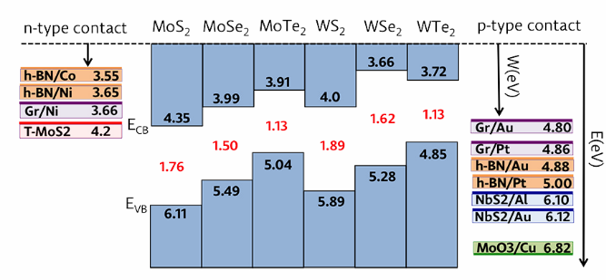
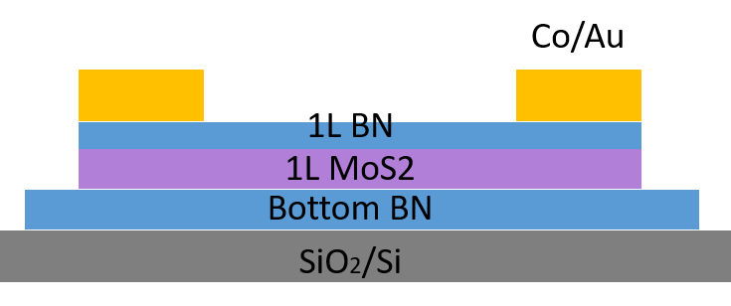
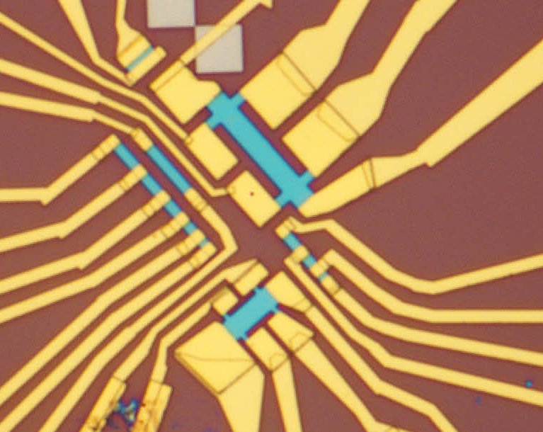
Hybrid Metal / hBN Contacts
Theory: strong hybridization between transition metals and hBN/graphene strongly shifts work function
(M. Farmanbar et al. PRB. (2016))

Slide 42
Approaching the Intrinsic Limit for TMD PL
2DFTS measurements:
Extrinsic
broadening: > 10 meV
Intrinsic
broadening: ~ 2 meV
WSe₂
Can we minimize or eliminate extrinsic effects?
G. Moody, …., A. Knorr, X. Li, Nat. Comm 2015

Slide 43
Approaching the Intrinsic Limit for TMD PL
T = 4 K
O. Ajayi, T. Heinz, S. Strauf, XY Zhu, JH, submitted

Slide 44
Approaching the Intrinsic Limit for TMD PL
Highly consistent spectra
Broad low-E absorption
High-E ’shoulder’

Slide 45
Approaching the Intrinsic Limit for TMD PL
FWHM ~ 2 meV
Voigt Fit (Lorentzian with Gaussian broadening)
Homogeneous width ~ 1.4 meV
Heterogeneous brodening ~ 0.9 meV

Slide 46
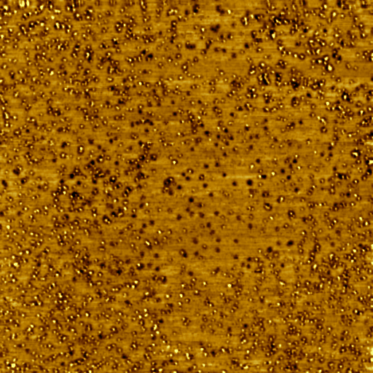
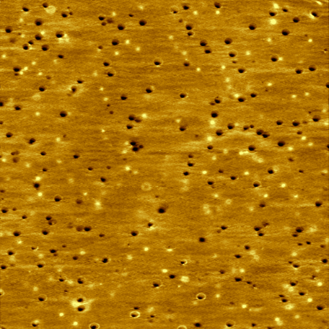
Atomic defects in TMDs
Commercial MoSe₂
Home-grown MoSe₂
          100nm
          100nm
2.6% of Mo are vacancies
1.28 % Interstitial or Antisites per Mo
.33% of Mo are vacancies
.16 % Interstitial or Antisites per Mo
Growth: Hone / Barmak groups STM imaging: Pasupathy group

Slide 47
Atomic defects in TMDs
Most common defects are metal vacancies or interstitials

Slide 48
How can we get better?
Commercial MoSe₂
Home-grown MoSe₂
77 K
PL yield dominated by point defects (Mo and Se vacancies)

Slide 49

Air-sensitive 2D Materials
FeSe
FeTe
FeSe_{x}Te_{1-x}
Air-sensitive materials
CDW
(1T-TaS₂, TaSe₂,
VSe₂, TiSe₂)
SDW
(FeTe)
Novel Phenomena
SC
(FeSe)
2H-TaS₂, TaSe₂, NbSe₂
FeTeS, FeTeSe

Slide 50

Incandescent Visible Light Emission
Stable emission for ~ 10 minutes in air
Stable emission for ~ 10 years in vacuum
Unpublished

Slide 51
2D ‘Stacking’ system in glovebox
Encapsulate in glove box using hBN
Fabricate electrodes etc. afterward

Slide 52

Superconductivity in 2D NbSe₂
Prior work:
Bulk superconducting with T_{c} ~ 5 K
Thin NbSe₂ is not superconducting
High sheet resistance (disordered limit?)
Staley, PRB 2009

Slide 53

Superconductivity in BN-encapsulated bilayer NbSe₂
2-layer NbSe₂
AW Tsen, B Hunt, YD Kim, ZJ Yuan, S Jia, RJ Cava, J Hone, P Kim, CR Dean, AN Pasupathy, Nature Physics (2016)

Slide 54
Scaleup – CVD-grown hBN
S. Kim… YH Lee, J. Kong, Nat. Comm (2015)

Slide 55
Scaleup – passivating SiO₂
Graphene
SAM
BN
SiO₂
Si
C. Zhang, XY Zhu, JH, unpublished

Slide 56
Major Contributors
Pasupathy group
Drew Edelberg
Kim group (Harvard)
S. Strauf group (Stevens Inst.)
Hone group:
Y-D Kim
Lei Wang
Yuanda Gao
Alex Cui
Ghidewon Arefe
Demi Ajayi
Jenny Ardelean
Julia Zhang
T. Taniguchi, K. Watanabe (NIMS, Japan)
Dean group:
Rebeca Ribeiro
Shaowen Chen
Jia Li
En-min Shih
Funding: NSF MRSEC, NSF DMR, SRC / INDEX, DOE BES, ONR, AFOSR BRI

