Slide 1
A reinvigorated US fusion energy program
S. Prager
Princeton University
Reflecting, in part, discussions with T. Carter, R. Fonck, M. Haynes, D. Maurer,
D. Meade,G. Navratil, G. Tynan, D. Whyte

Slide 2
The committee charge is large and expansive
To advance the US to world leadership in fusion research
To develop fusion energy as a priority for the US
Projecting both near- and long-term
This is a crucial and timely opportunity for the US fusion research
(and for the field of plasma physics)

Slide 3
Fusion research at mid-life identity crisis
Several paradoxes
Technical
Timeline
US standing

Slide 4
Technical paradox
Remarkable progress
Tokamak performance, fusion plasma physics, fusion engineering
Constructing ITER - a reactor-scale, burning plasma experiment
But,
More scientific and engineering challenges lie ahead,
Challenges of steady-state, disruptions, high performance are persistent
ITER embodies the strengths and challenges of tokamak confinement (Q = 10, but for 8 minutes),
EU DEMO embodies current knowledge base -> large, pulsed

Slide 5
Timescale paradox
Now there is a societal desire to achieve fusion urgently
But,
The time to fusion power is paced by facility construction times (fusion cannot be proven/developed at small scale, then scaled up)

Slide 6
US leadership paradox
The US workforce is at the world forefront (although narrowing)
But,
The US research program is not
(more later)

Slide 7
A redefined US program can alleviate all 3 paradoxes by
Resolving technical hurdles, emphasizing innovation for improvements
Accelerating the time to fusion landmarks and fusion power
Bringing the US to the world forefront

Slide 8
The interim charge – assess current status of US research– is substantive and important
Substantive: Deserves a frank and accurate assessment of the health and stature of the US program
Important: Defines the landscape from which a new strategic plan will be launched
Not been previously articulated “officially”

Slide 9
US has been a world leader in nearly all areas of fusion research
Built upon major investments in 1980 – 2000
(TFTR, DIII-D, NSTX, CMOD, coupled to strong base program)
One metric is the US share of international research prizes
Nuclear Fusion prize – 8 out of 11 to work led by US scientists
Alfven Prize, EPS – US scientists won 8 out of 17 years, mainly for fusion research
This metric is a lagging indicator of investments built up over decades

Slide 10
US is losing research leadership and vitality for 2 coupled reasons
No current strategic plan for fusion energy
absence of DOE-sanctioned community process,
no consideration of slip in ITER timeline (20 yrs to DT operations)
Lack of major investment in new US research facilities and capabilities
20 year gap in major investments (~$ 1B) in US facilities,
recent closure of CMOD (2016), closure of TFTR (1997) leaves only DIII-D (1986) and NSTX-U (1999/2019)
This contrasts sharply with our international partners

Slide 11
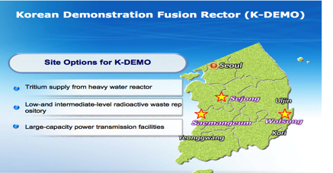
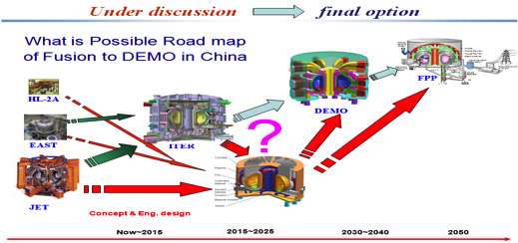
Our ITER partners have roadmaps to DEMO
European roadmap

Slide 12
EU roadmap in a nutshell
And similarly for China, S. Korea, Japan
(the US is distinct in its absence of a fusion roadmap)……

Slide 13
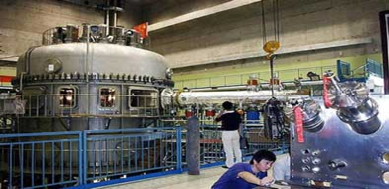

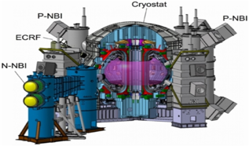
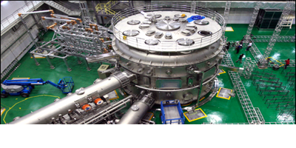
Scientific facilities are increasing across the world
China: superconducting tokamak (2006)
New major facilities
In Asia
Japan: superconducting tokamak (2019)
Korea: superconducting tokamak (2008)

Slide 14
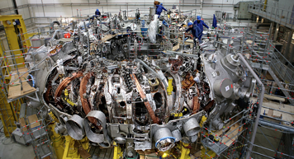
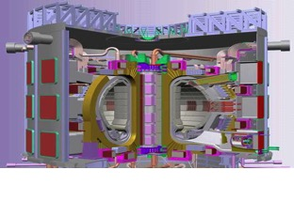
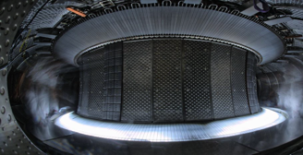
Scientific facilities are increasing across the world
Germany: superconducting stellarator (2016)
In the European Union
France: ITER
France: SC tokamak (2016)
The world has entered the era of superconducting facilities (steady-state)
A leading indicator

Slide 15
Collaboration on facilities abroad
An important, valuable opportunity for the US (and host labs)
But, international collaboration is not a substitute for US leadership.

Slide 16
All fusion research sectors not sufficiently healthy
Universities:
A critical situation. Prospects for faculty positions weak, despite scientific interest. Due to decline in research projects and gov’t long-term commitment. (see UFA report, D. Mauer talk)
National labs:
Similar causes led to few national labs with MFE as priority
Industry:
Little involvement in DOE program (except GA), but new phenomenon of fusion startup companies

Slide 17
But the stage is set for the US to transition to a dynamic, leading fusion program
We have a world-leading workforce
With many innovative and important ideas ready to pursue

Slide 18
A new fusion strategy
Vision:
Employ new scientific advances for an improved fusion power system and an accelerated path to fusion energy,
building upon the existing knowledge base and international activities

Slide 19
A new fusion strategy
Vision:
Employ new scientific advances for an improved fusion power system and an accelerated path to fusion energy,
building upon the existing knowledge base and international activities
Note: the following strategy is described programmatically; the underlying fundamental science is implicit, but not articulated

Slide 20
Three premises for strategy
Pursue ideas to improve the fusion vision and accelerate its pace
New opportunities have emerged within physics and engineering for improvements and solutions to remaining challenges,
Allow for higher risk tolerance
Builds on and leverages the US and world tokamak/ITER program
Accommodates tension between staying with proven performance vs
exploring new ideas
3. Incorporates a US DT program (and facility) as an integrating goal
With a mission that complements ITER, and includes advances
since the ITER design and those that accrue through #1

Slide 21
Features of above strategy
A distinct US approach that complements, and benefits from, the world program; departs from the dominant ITER -> DEMO -> Reactor framework (both too risky and leads to too large a reactor)
Requires a substantially restructured, reinvigorated, US program
Would restore the US to a world leadership position in fusion

Slide 22
Examples of major new research elements suitable to a new strategy

Slide 23
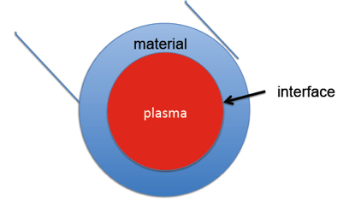
Program mission elements
Create fusion plasma core
high gain, steady-state, disruption-free, compact
Tame the plasma-wall Interface
survivable materials, plasma control
3. Harness fusion power
tritium breeding, structural materials, energy
conversion, environmental attractiveness
Establish an integrated fusion power concept that is
commercially attractive
economic, reliable, high availability

Slide 24
In each area,
There are “big ideas,” many pioneered in the US, not being explored significantly, that can have large impact
Most ideas have “moderate cost” next steps and “substantial cost” integrating/demonstration steps;
the strategy is relatively robust to funding level
Many ideas, no one “silver bullet” for fusion

Slide 25
Create the fusion plasma core
Realize a smaller, steady-state tokamak vision
High temperature/high field SC magnets
Low aspect ratio tokamak
Improved operating regimes
2. Develop new 3D magnetic configurations for intrinsic steady-state
Optimize stellarator for high performance
Aim toward DT facility
3. Establish a program for high risk, high payoff exploratory concepts
With an evaluation structure with metrics

Slide 26
Create the fusion plasma core
Realize a smaller, steady-state tokamak vision
High temperature SC magnets
Low aspect ratio tokamak
Improved operating regimes
2. Develop new 3D magnetic configurations for intrinsic steady-state
Optimize stellarator for high performance
Aim toward DT facility
3. Establish a program for high risk, high payoff exploratory concepts
With an evaluation structure with metrics
A new activity,
potentially transformative

Slide 27
Pushing fusion to smaller size
~
fusion power (pressure)²
~
β²B⁴ where β = p/B²
(κβ_{N}B)⁴ for fixed bootstrap fraction
(β_{N} = β/(I/aB) ,κ = elongation )
~
Increase B by pushing technology
(e.g, high Tc superconductors)
Increase β,κ by
pushing physics
(spherical tokamak)

Slide 28
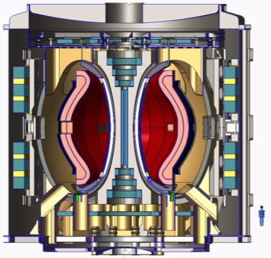
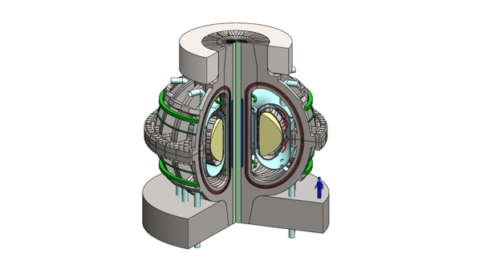
“Compact” fusion pilot plant/FNSF
Generates net electricity,
breeds tritium, high neutron fluence
ST design (PPPL)
ARC design (MIT)
Major radius = 3 m
High T_{c} SC for high field
and/or smaller magnets
Volume within cryostat about 1/3 that of ITER

Slide 29
Advancing the High Magnetic Field Approach
High T_{c} magnet R/D for fusion (3 – 5 years)
Prototype coil tests (incl. for 3D systems)
Develop demountable joints
(Moderate cost)
Enables a compact confinement experiment
e.g., divertor test tokamak, DT experiment
(Substantial cost)

Slide 30
Create the fusion plasma core
Realize a smaller, steady-state tokamak vision
High temperature/high field SC magnets
Low aspect ratio tokamak
Improved operating regimes
2. Develop new 3D magnetic configurations for intrinsic steady-state
Optimize stellarator for high performance
Aim toward DT facility
3. Establish a program for high risk, high payoff exploratory concepts
With an evaluation structure with metrics

Slide 31
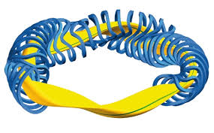
Super-optimizing plasma confinement (stellarators)
3D magnetic field: no symmetry
huge magnetic design space
Merges most advanced physics and computation
W7-X
Can vary: symmetries (helical, toroidal), no symmetry, magnetic shear, curvature, aspect ratio
Optimizes: thermal confinement, energetic particle confinement, MHD stability, turbulent transport…....
Result: Steady-state, disruption-free Challenges:
Well-confined Experimental validation
High fusion energy gain Find optimum

Slide 32
Advancing the stellarator
Begin a national optimization/design study now
Focused on design that complements international effort
(e.g., quasisymmetry, incorporate new ideas such as turbulent transport optimization, magnet simplification, energetic particle
confinement, strong flow…..)
Construct a mid-scale facility to test these ideas
~ moderate cost
• Advance toward a world-leadership-scale experiment
design could be similar or complementary to mid-scale facility,
(substantial cost)
All new and potentially transformative

Slide 33
2. Tame the plasma-wall interface
Develop liquid metal boundaries
Explore and deploy new advanced magnetic divertor topologies
Linear test stands – materials exposed to plasma flux
Explore additive manufacturing for advanced solid walls

Slide 34
2. Tame the plasma-wall interface
Develop liquid metal boundaries
New and potentially transformative
Explore and deploy new advanced magnetic divertor topologies
Existing program, but many additional opportunities
Linear test stands – materials exposed to plasma flux
New program, moving beyond existing facilities
Explore additive manufacturing for advanced solid walls
Largely unexplored for fusion

Slide 35
Liquid metals for the plasma-facing material
Self-regenerating,
No erosion, neutron damage, heat overload (if moving)
Highly absorbing (if lithium): no influx to plasma, improves confinement,
Many science and engineering challenges to establish feasibility

Slide 36


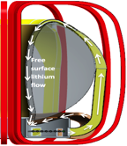
Developing Liquid Metal Boundaries
• Broad R&D program: next 5 – 7 years
Surface science studies
Linear test stands
Liquid flow tests
Studies in existing toroidal facilities
(Moderate cost)
• Integrated fusion facility with LM boundary
Integrated viability of liquid surfaces,
Engineering design/construction begin in ~ 5 years,
Possibly two stages – divertor, full wall
(Substantial cost)

Slide 37
3. Harness fusion power
Materials and blanket research
compact neutron source
innovative blankets (immersion, DCLL)
(moderate cost)
US DT facility: Initiate now a community planning process for possible missions, complementing ITER:
Fusion nuclear science facility (FNSF)
High gain burning plasma science (Q > 10)
Pilot plant (net electricity)
(very substantial cost)

Slide 38
US DT Facility
Next 3-5 years:
Identify mission
(FNSF, high gain burning plasma science, net electricity)
Develop optimal path(s) to a DT experimental program
(e.g., AT, ST, high field, optimized stellarator…...)
In 3-5 years:
Review status and decide mission/timing of DT facility

Slide 39
Increasing opportunities in computation and theory
Computation (at all scales, up to exascale), in concert with theory, underlies all fusion topics
Tremendous opportunities are strongly in line with DOE/national emphasis on large-scale computation

Slide 40
With or Without the US in ITER
Above strategic vision and goals are unchanged ⇒ the strategy is relatively robust
If US not in ITER: affects timing and mission of US DT program, decreases emphasis on ITER prep research
Although if the US pulls out, an earthquake could result with unpredictable consequences

Slide 41
This strategy would be a 4th shift for fusion research
70s/80s: Surge in tokamak research (facilities)
Tokamak performance/understanding exploded
mid-90s: Restructuring: shift to science foundations CIT/BPX TFTR TPX & US out of ITER,
Succeeded in reinvigorating fusion science
mid-2000s: Presidential ITER initiative and coordinated world effort
ITER moves forward as focus of world program
but, US domestic capabilities wane relative to world
2018: Establish an aggressive program, exploiting new innovative ideas, to carry the US to fusion energy:
Re-assert US leadership

Slide 42
Typical fusion plan in other nations (simplified)
Plasma-material
interface
Solid tungsten (tokamaks and test facilities)
High performance,
steady state
Tokamaks, limited stellarator
burning
plasmas
ITER
Fusion nuclear science
Blanket development studies, TBM in ITER, possible IFMIF
Integration
Large-tokamak DEMO

Slide 43
A sample new US program in the international context
Plasma-material
interface
Solid tungsten (tokamaks and test facilities)
Liquid metals (tokamak, test facilities)
High performance,
steady state
Tokamaks, limited stellarator
An HTS reduced size tokamak/ST; a unique-design stellarator
burning
plasmas
ITER
Reduced-cost BPX, FNSF, or Pilot Plant
Fusion nuclear science
Blanket development studies, TBM in ITER, possible IFMIF
Compact neutron source, innovative blanket designs
Integration
Large-tokamak DEMO
More compact DEMO

Slide 44
The above can be described via challenges in fundamental science
A burning plasma is itself a major physics accomplishment – a new complex, physical system
The strategy is driven by major questions in
plasma physics (turbulence, self-organization, breaking of magnetic topology, symmetry effects…..),
material science (under extreme conditions)
The connections to other areas of science is large and specific
(astrophysics, complex systems, accelerator physics.....)

Slide 45
How should fusion R/D be organized within DOE?
The Office of Science (FES) must remain a key sponsor, given the remaining fundamental challenges in plasma physics and material sciences
The Office of Science cannot tackle all the critical challenges in fusion engineering and technology
Thus, a possible approach is to sponsor fusion energy research in both OS and an applied energy office, coordinated from above

Slide 46
Closing comments
A frank assessment of the health of the current program is important, and sets the stage from which to grow a new strategy
A new strategy emphasizing innovations for an improved fusion system concept and accelerated path
Can be embarked upon with moderate new funds,
Forms the basis for aggressive roadmap to fusion power,
Builds constructively upon the current program,
Re-establishes the US as a world leader,
Is scientifically exciting

