Slide 1
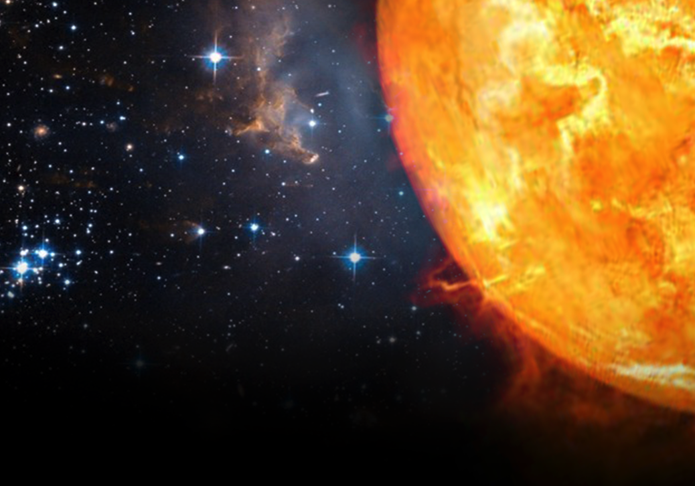
Perspective on Fusion Energy Strategy
By
Tony S. Taylor
With
M. Wade
W. Solomon
Presented at
NAS Committee for a
Strategic Plan for U.S.
Burning Plasma Research
August 29, 2017

Slide 2
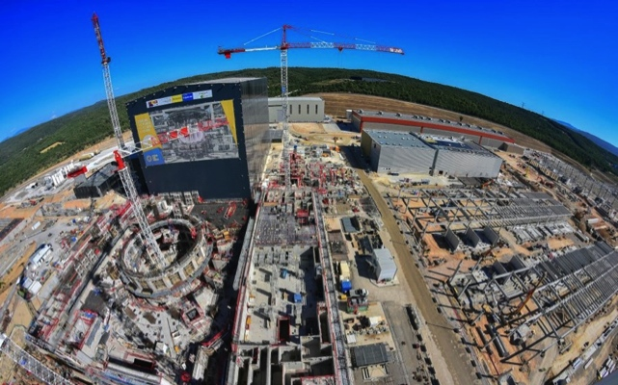
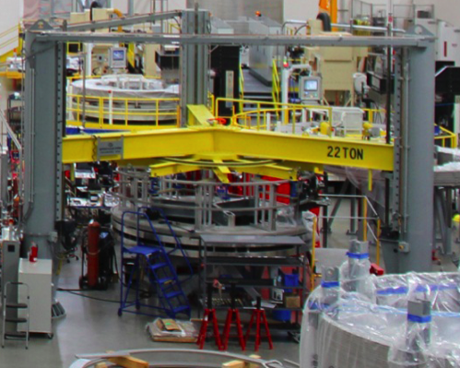
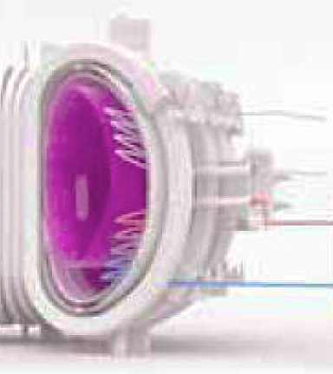
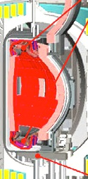
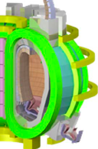
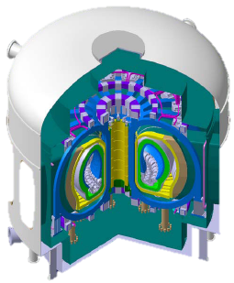
Fusion Energy is at a Crossroads in the U.S.
ITER construction underway
Exciting and vital validation of the fusion energy concept
World program considering major facilities beyond ITER
ITER
Central Solenoid
EU DEMO
K-DEMO
Japan DEMO
CFETR
World program is moving ahead aggressively with fusion energy development. What path with the U.S. take?

Slide 3
Your Charge to Me
We would especially appreciate learning your views on:
The importance of U.S. burning plasma research to the development of fusion energy,
The scientific and technical developments since the 2004 report of the NAS Burning Plasma Assessment Committee
The current status of U.S. research that supports burning plasma science including U.S. scientific support for ITER
Any strategic elements that might strengthen or accelerate U.S. burning plasma research given that economical fusion energy within the next several decades is a U.S. strategic interest.

Slide 4
Importance of Burning Plasmas
Executive Summary:
Burning plasmas are a critical next step towards the realization of fusion energy
Tokamak physics is sufficiently advanced to support burning plasma step, and the tokamak remains the only fusion concept mature enough to proceed to the burning plasma step
Strongly recommend that this committee reaffirm the importance of burning plasmas in fusion energy development, the highly developed status of tokamak plasma science, and the unique opportunity that ITER provides the U.S.

Slide 5
Burning Plasma: First Major Step on Path to Fusion Energy Other Steps: Build on a Burning Plasma to Complete
For DEMO, technical readiness must be established for:
Fusion power source
Materials
Breeding Tritium & Extracting Heat
Successful burning plasma experiment facilitates progress in materials and blanket technology
Fusion Energy
Deployment
Integrated
Demonstration
Materials
Tritium Breeding
Heat Extraction
Foundational Science & Technology
Burning Plasmas
Scientific
Basis
Notes:
Have to say that fusion energy development requires the burning plasma step.
A key question is how important is the burning plasma step without the energy goal?
All panels that have addressed Burning Plasmas have affirmed the importance of burning plasmas - and affirmed BP as the next critical step on the path to fusion energy
FESAC 1996
Snowmass
FESAC 2003
NRC 2004
NAS 2010

Slide 6
A Burning Plasma Will Enable Frontier Fusion Science
Self-sustained fusion plasma is a highly nonlinear system
Self-generated heating & magnetic fields → complex behavior
“Grand Challenge” for theory and numerical modeling
A burning plasma experiment and the supporting scientific program will advance basic plasma science
Plasma turbulence, magnetic field line reconnection, wave-particle interactions, …
Applicable in other regimes (e.g. astrophysical plasmas)
“A burning plasma experiment can offer substantive and important contributions to other fields of science connected to plasma physics, primarily through experimental access to the fundamental and/or extreme conditions offered by such a state.”
– Burning Plasma, NRC Report

Slide 7




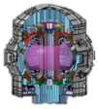


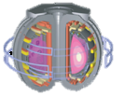





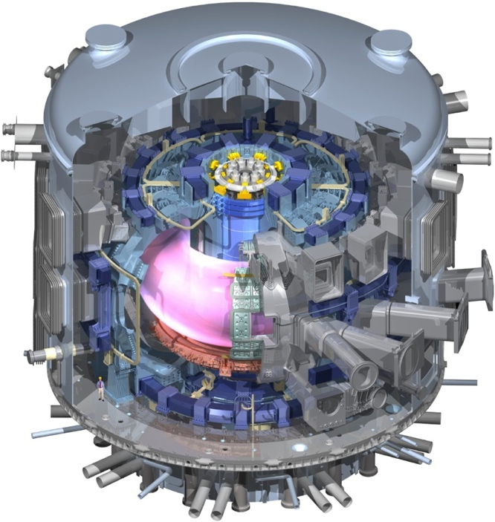
Burning Plasmas are both a Challenge and an Enormous Scientific Opportunity
Challenge: Produce burning plasma conditions and then maintain them
Achieve necessary density/ temperature/confinement (n T τ)
Operate safely at high plasma pressure
Handle concomitant heat/particle flux
Minimize/Eliminate effect of transients
Opportunities enabled:
Alpha-particle impact on stability & turbulence
Turbulent transport and resistive MHD at low ρ* (relative gyroradius) and rotation
Fusion burn stability, control, and propagation
Strong, non-linear coupling of heating, current drive, turbulent transport, MHD stability and boundary plasma
C-Mod
JET
MAST
ASDEX-U
JT-60SA
Physics Basis
DIII-D
NSTX
TCV
SST-1
EAST
KSTAR
Realization
ITER
Exploitation

Slide 8
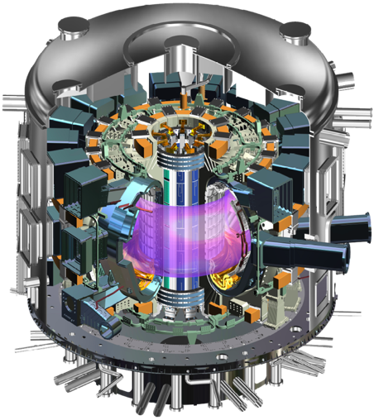
A Burning Plasma Experiment Drives Advances in Fusion Technologies
Large, high field magnets
superconducting if long pulse
Remote maintenance and handling
Tritium processing systems
Hardened diagnostics
High heat flux energy removal systems
Long pulse, high power density heating and current drive systems
Plasma current quench detection/remediation systems
Integrated control systems for the nuclear plant and plasma, including burn control
Desired: test blankets for tritium breeding
…

Slide 9
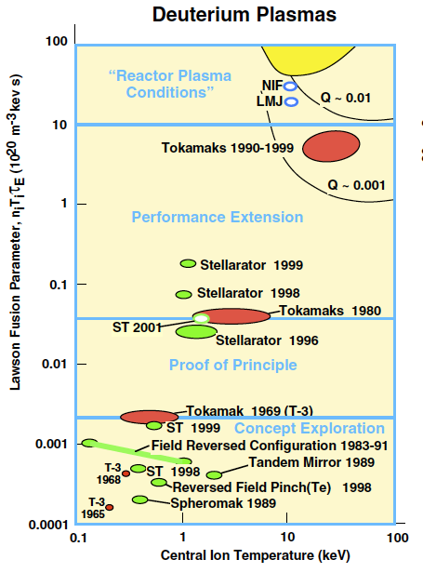
Tokamaks Presently at Highest Level of Readiness of Any Concept to Exploit Burning Plasmas
Achieved tokamak performance is two orders of magnitude above other concepts
Physics basis is well established (ITER Physics Basis in NF 1999, 2007)
Recent advances in later section
Strong Worldwide Research Program
Complementary and versatile facilities
Well diagnosed → solid science
Theory & simulation → prediction
Advanced plasma control
Large, capable work force
ITER
Stellarator ~2020
Tokamak is well positioned for continued scientific advances and innovation
Notes:
Reference for W7-X
Plasma phys. Control. Fusion 58 (2016) 074006

Slide 10
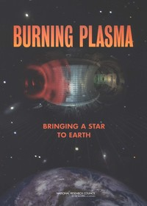
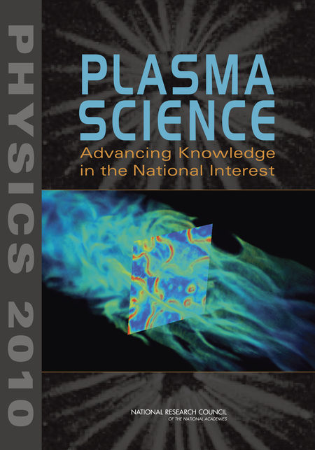
Previous Panels Have Affirmed the Importance of Burning Plasmas and Opportunity to Participate in ITER
NRC Burning Plasma Report 2004
“Participation in a burning plasma experiment is a critical missing element in the U.S. fusion science program”.
“The United States should participate in the International Thermonuclear Experimental Reactor (ITER) project”
“Progress toward the fusion energy goal requires this step”
“There is now high confidence in the readiness to proceed to the burning plasma step.”
“The tokamak is the only fusion configuration ready for implementing such an experiment.”
NAS Decadal Study 2010
“It is clear that the next critical step in the development of fusion power is a burning plasma experiment. ITER is that step.”
Strongly recommend that this NAS committee reaffirm the importance of burning plasmas and the unique opportunity of ITER

Slide 11
Scientific Developments since 2004 NAS Report
Executive Summary:
The understanding of key physics governing underlying performance has advanced dramatically
The U.S. fusion program remains at the forefront of fusion science.
Research since the NAS Burning Plasma Report (2004) has strengthened our confidence in burning plasma (ITER) performance.

Slide 12
Scenarios Match ITER Q=10 Dimensionless Parameters Relevant to Fusion Power & Gain in Present-Day Expts
ITER baseline
Advanced
Issue | ITER Physics Basis (1998, 2007) | Present
Rotation | Co-NBI, high rotation | Zero applied torque solutions found
Electron heating | Ion dominant | Electron dominant heating explored
Operational issues | Basic EC/low voltage startup, rampdown in constant shape | Integrated tests of EC startup and rampdown with shape control
ELM mitigation | First indications of mitigation by RMP | RMP ELM suppression in baseline and advanced scenario, pellet pacing
Heat flux mitigation | Basic radiative divertor demonstration | Radiative divertor in operating scenario
Disruption mitigation | Basic physics understood | MGI and SPI tested
PMI | Mostly in graphite walls | Direct tests of ITER-like wall

Slide 13
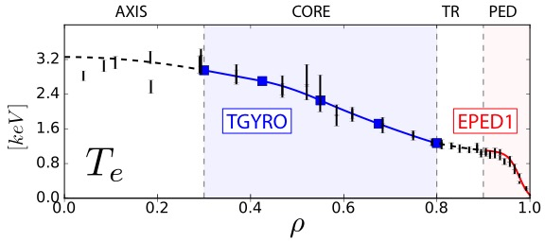
Theory-Experiment Validation Has Increased Confidence in ITER Achieving its Q=10 mission
2004 status:
Manually-intensive “Herculean” simulations. Missing first principle pedestal model, rotation etc
2017 status:
Self-consistent coupling of core & pedestal theoretical models
Enables prediction and optimization of ITER fusion gain: Q~12 possible
Profile Prediction (OMFIT, IPS, TRANSP, TGYRO using TGLF, NEO, EPED)
(TGLF+NEO)
Meneghini Nucl. Fusion 2017,
Snyder Nucl. Fusion Award 2014
Romanelli Plasma Fus. Res 2014
Notes:
Orso says that they only do flux matching using TGLF+NEO between 0.3<rho<0.8 using TGYRO as indicated on the figure. He does this to avoid the drift-ordering break down near the axis and to avoid dealing with sawteeth. instead he has an approach to use a linear profile of inverse gradient scale length from the magnetic axis to rho=0.3.
The JINTRAC system of codes for integrated simulations couples the JETTO transport solver for the core, and EDGE2D for the edge region. It has been used in simulations to evolve a JET discharge from L-mode through the L-H transition to ELMing H-mode and a subsequent back transition to L-mode after the beams are later turned off.

Slide 14
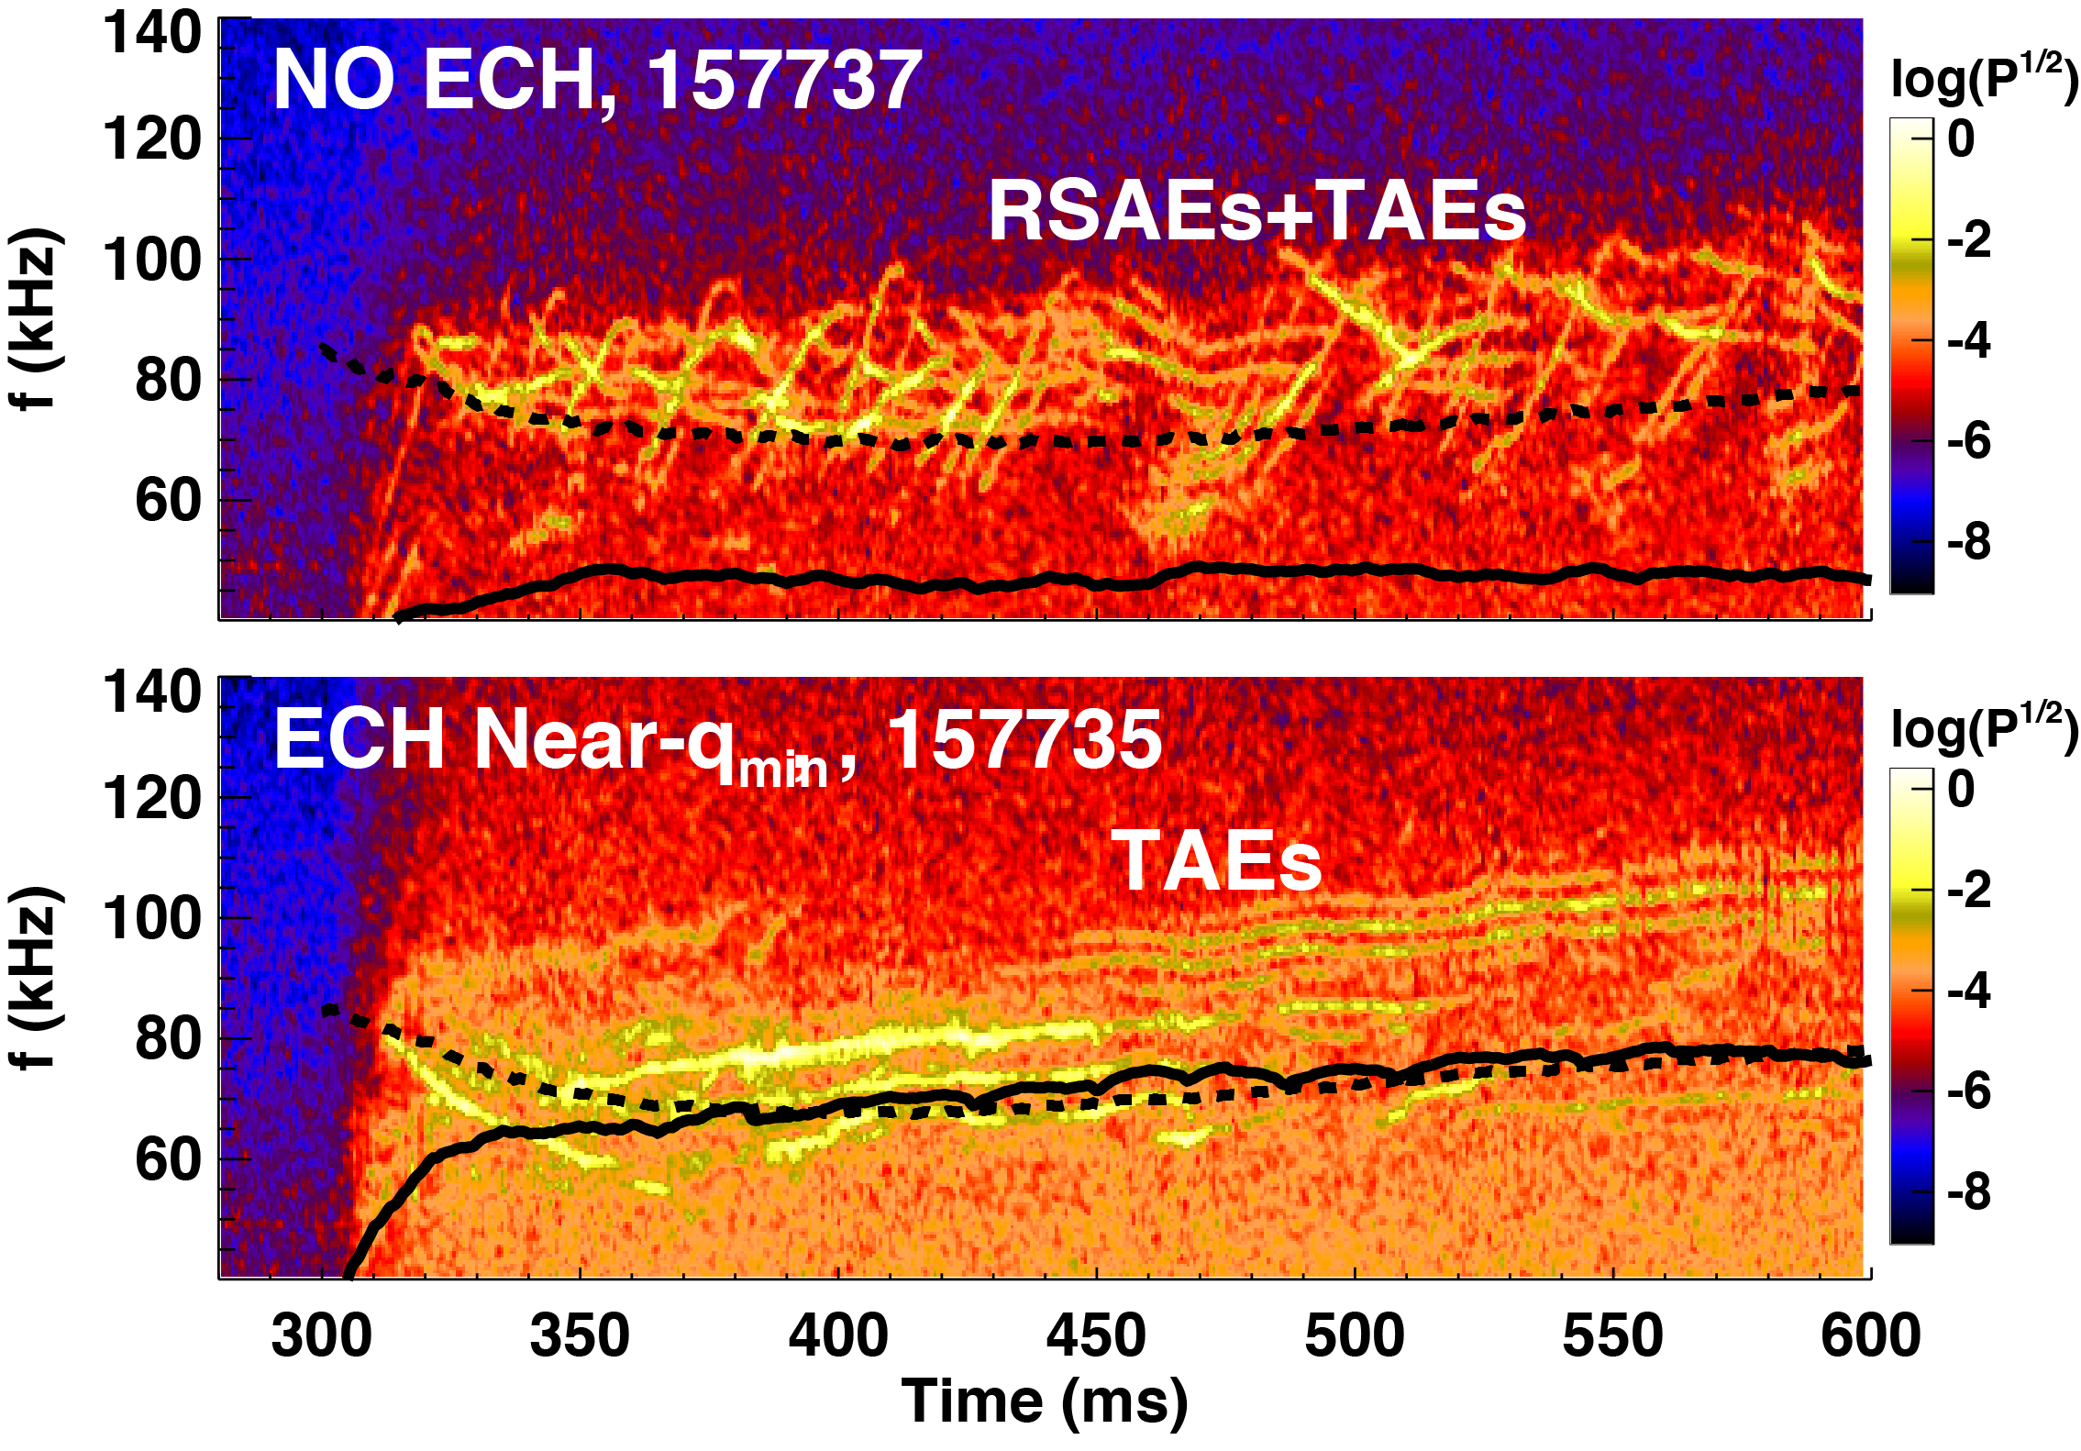
Major Advancement in Core Fluctuation Diagnostics Have Enabled Detailed Validation of Fast Ion Transport Models
ECH modification of RSAEs in DIII-D
2004 status:
Alfven Eigenmodes and associated transport observed and characterized
2017 status:
Fast-ion instability control tools show promise
First principles simulations reproduce measured modes & transport (MEGA)
Reduced predictive models based on critical gradient
f_{TAE}
f_{RSAE-min}
f_{TAE}
f_{RSAE-min}
Van Zeeland Nucl. Fusion 2016
Y. Todo Nucl. Fusion 2016
Sharapov IAEA 2016
Notes:
More recent publications using MEGA to simulate fast ion transport, profile stiffness and flattening include:
Y Todo 2016 New Journal of Physics 18 115005
Y. Todo et al 2016 Nuclear Fusion 56 112008
New diagnostics
FIDA -- fast ion D-alph
ECEI -- electron cyclotron eimission imaging
Interferometry -- very high bandwidth Hz
Variable beam voltate --and input distribution

Slide 15
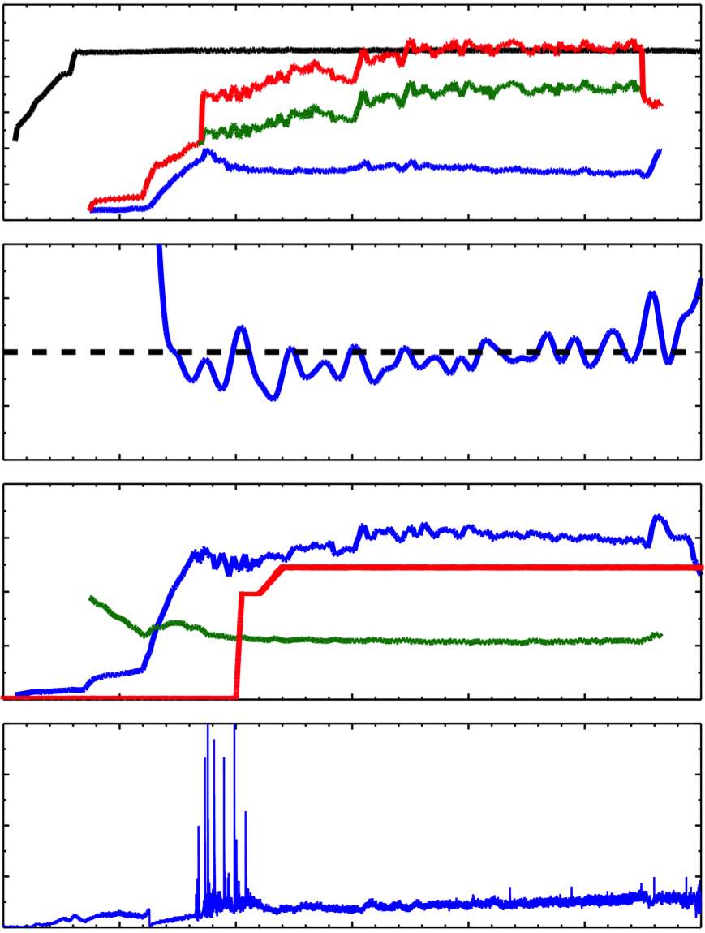
ELM Suppression Achieved in Fully Non-Inductive Hybrid Plasma with Minimal Impact on Performance
2004 status:
Proof-of-principle demonstrations of RMP ELM suppression, pellet pacing, and QH-mode
2017 status:
Extension of all technique towards ITER conditions
Long-pulse ELM suppression
I-mode developed, QH-mode operation expanded
Role of plasma response and field penetration
161403
1.2
I_{P} (MA)
0.8
ECCD
0.4
NBCD
0.0
bootstrap
0.2
V_{surf}
(V)
0.0
-0.2
DIII-D Hybrid scenario
4
β_{N}
3
2
I_{RMP} (kA)
1
q_{min}
0
4
D_{α}
3
2
Petty Nucl. Fusion 2017
Oh IAEA 2016
Sun IAEA 2016
1
0
0
1
2
3
4
5
6
Time (s)

Slide 16
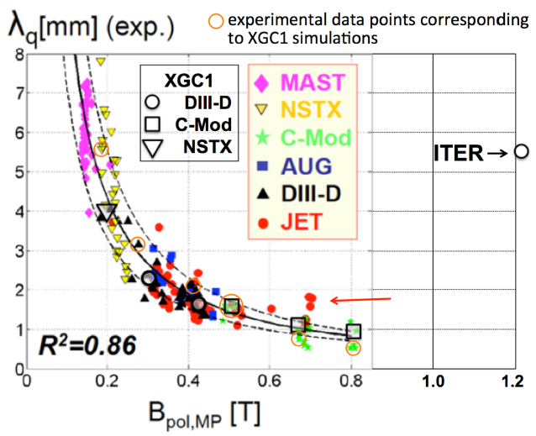
Major New Understanding in SOL Heat Flux Channel Width Developed Through Joint Experiments
2004 status:
Conflicting experimental data on heat flux width; large experimental uncertainties
2017 status:
ITPA empirical scaling developed setting potential challenge for 15 MA ITER discharges (λ_{q} ~ 1mm)
High performance computing enabling gyrokinetic simulations of heat flux width
New role of electron turbulence found in simulations which may significantly broaden heat flux
Goldston Nucl Fusion, 2012
Eich, Nucl. Fusion, 2013
Chang, Nucl. Fusion, 2017,

Slide 17
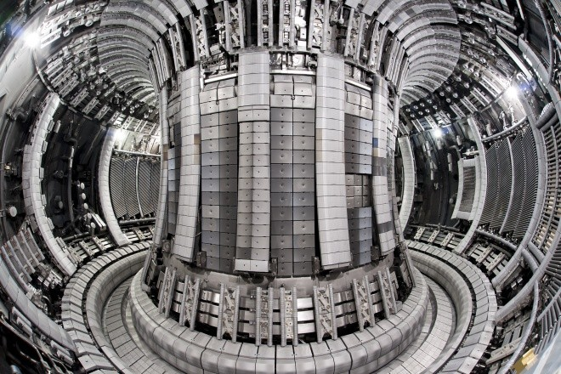
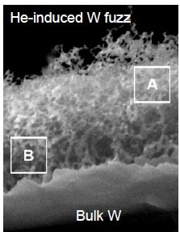
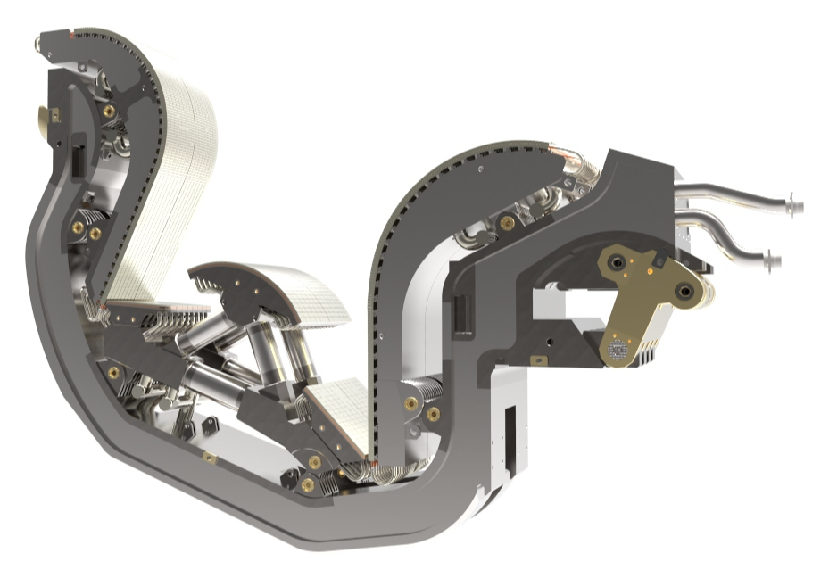
Major Advances Have Been Made to Understand Tungsten Behavior Under Extreme Conditions
2004 status:
Most devices favor low-Z wall for plasma performance
2017 status:
ITER to start operation with full-W divertor
JET ITER-like-wall (ILW) used to characterize tritium retention, fuel removal, cracking, melting, dust, plasma performance
Low T retention (0.3%)
Similar core confinement, pedestal Te reduced
Surface modifications (He-fuzz)
ITER Divertor
Litaudon Nucl. Fusion 2017
Baldwin Nucl. Fusion 2008

Slide 18
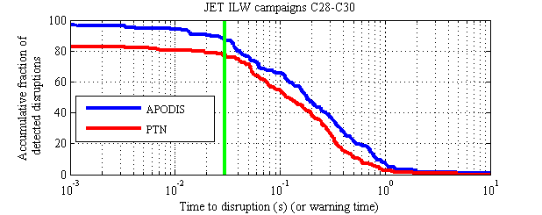
Powerful Tools Have Been Developed to Predict and Avoid Disruptions
Advanced disruption warning systems predict oncoming disruptions
NSTX: > 96% disruptions caught, < 3% false alarm
JET: > 98% disruptions caught, < 1% false alarm
A. Murari, ITPA MHD (2013)
S. Gerhardt Nucl. Fusion 2013
Extensive suite of disruption avoidance techniques
NTM control by ECCD, MHD instability control, MHD spectroscopy

Slide 19
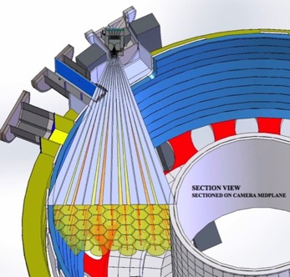
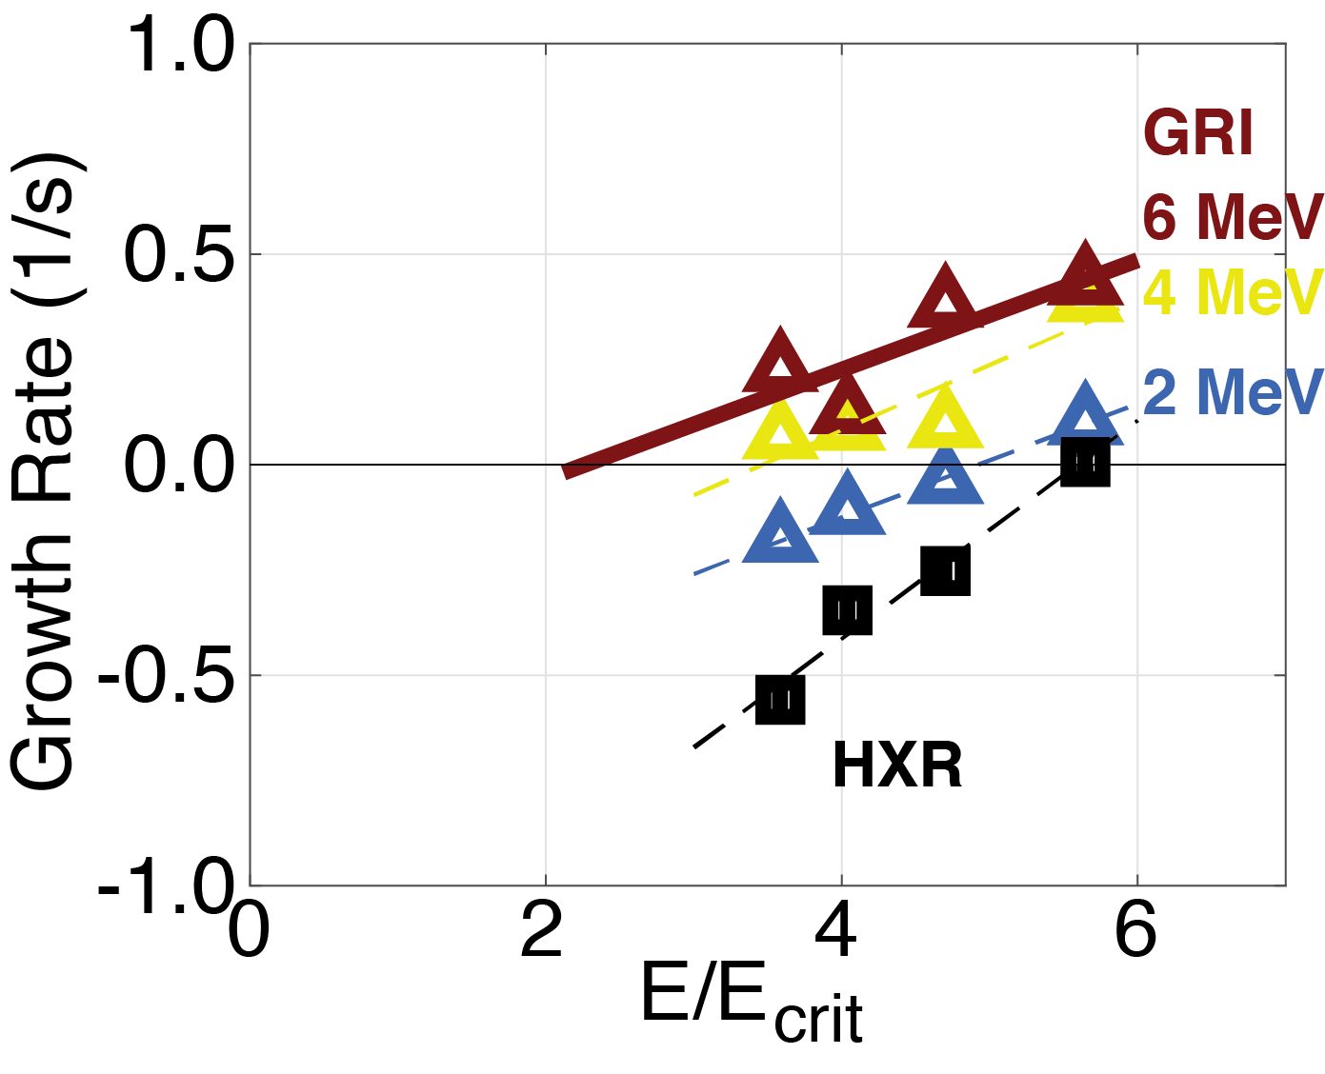
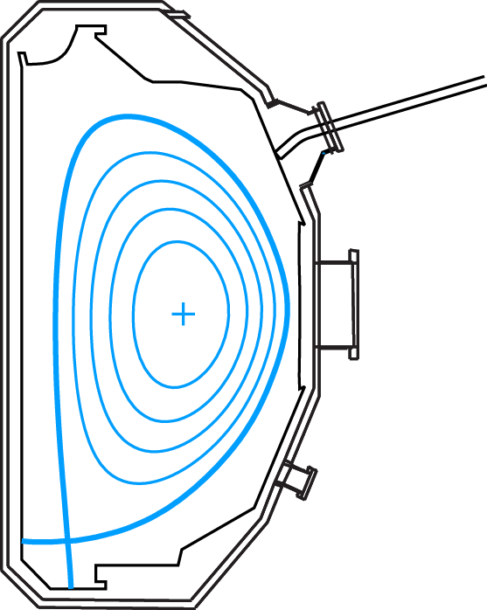
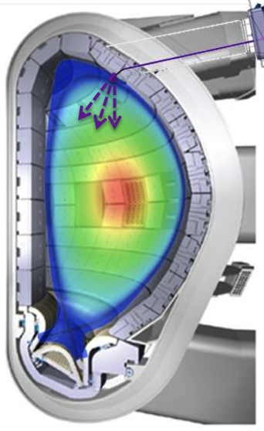
Strong Progress in Explaining Fast Dissipation of ‘Runaway’ Electrons at Plasma Termination
2004 status:
Critical electric field quantified, additional terms starting to be explored
2017 status:
Simulations capture underlying dissipation mechanisms
Dominant RE seed processes discovered (hot tail)
RE control developed
Strong U.S. focus
Experiment
SciDAC SCREAM
BPO task group
ORNL/DIII-D pellets
γ ray camera
Anomalously high dissipation
Increased dissipation
New impurities model
Shattered
pellet
Paz-Soldan PRL 2017
Hesslow PRL 2017
DIII-D
ITER
Notes:
ANOMAOUS DISSIPATION – NOTE EXP AND THEORY ARE DIFFERENT REGIMES AND EFFECTS
Increases in critical electric field. Progress in theory and experiment in explaining anomalously fast dissipation of REs.
(Bold claim was these additional dissipation effects had not been included before - this is not as new as it was sold).
Note different regimes – no argon vs argon. Theory case is singly stripped.
Relevant to mitigation scenario – use impurities to dissipate runaways.
Closing in on agreement with theory.
Note that first experiment obserfation presented by Hollman 2013 (2012 IAEA)
SCREAM SciDAC Simulation Center for Runaway Electron Avoidance and Mitigtion.
BPO: Disruption Task Group Val Izzo, Bov Granetz

Slide 20
Progress Since the 2004 Burning Plasma Report Has Strengthened Our Confidence in BP Performance
Topic (example) | 2004 | 2017
ITER Operational Scenarios | Isolated examples of performance, high rotation, ion heating | Integrated solutions Extended toward ITER conditions (low rotation, e-heating) JET ILW
Pedestal | Peeling-ballooning theory developed | Predictive model of pedestal performance validated against experiments
Energetic particles | AEs observed, basic mode properties and associated transport characterized | Advanced fluctuation and fast ion distribution measurements First gyro-kinetic simulations reproduce measurements Reduced predictive models based on critical gradient
Disruption mitigation and avoidance | Massive gas injection for fast shutdown, limited capabilities on disruption avoidance & mitigation characterization | SPI technique Understanding of radiation asymmetries Real-time stability calculations & disruption predictors

Slide 21
Progress Since the 2004 Burning Plasma Report Has Strengthened Our Confidence in BP Performance
Topic (example) | 2004 | 2017
Runaway electrons | Critical electric field quantified + other terms being explored | Simulations capture underlying dissipation mechanisms RE control developed
ELM control | Proof-of-principle demonstrations of RMP ELM suppression, pellet pacing, and QH-mode | Extension towards ITER conditions Understanding of stability limits
Error Fields | Simple vacuum field understanding | Predictive models with plasma response and field penetration
Transport | Gyrokinetic codes and reduced transport models being developed | Multi-field, multi-scale simulations compared with data Improved fidelity reduced models
Integrated modeling | Manually intensive “Herculean” simulations. Missing first principle pedestal model, rotation etc | General frameworks developed for streamlined integrated workflows High fidelity models using high performance computing

Slide 22
Progress Since the 2004 Burning Plasma Report Has Strengthened Our Confidence in BP Performance
Topic (example) | 2004 | 2017
Plasma control | Feedback control of 0D plasma parameters | Profile control Offline control developed by simulation
Divertor power handling | Demonstration of heat flux reduction in low-Z tokamaks | Extended to metal walls Feedback control of divertor heat flux
SOL heat flux width | Conflicting experimental data on heat flux width | ITPA empirical scaling developed New role of electron turbulence predicted in gyrokinetic simulations
Divertor geometry | Standard configurations with limited poloidal flux expansion | Advanced divertor configurations with increased poloidal/toroidal flux expansion
PMI | Individual research on local surface, global migration, SOL transport | Integrated studies between core/edge/wall Mixed wall and ITER-like wall material studies

Slide 23
Status of World-Wide Research That Supports Burning Plasma Science
Executive Summary:
The world program is focused on preparing for burning plasmas in ITER
ITER has been highly effective as a forcing function for driving progress in fusion science and technology.
World tokamak program is well positioned to address any emerging issues with regard to ITER operations and successful attainment of Q=10
U.S. facilities are highly capable research platforms for innovation and understanding

Slide 24
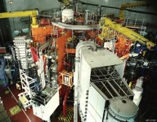
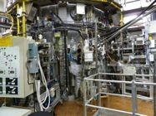
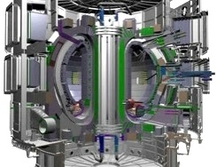
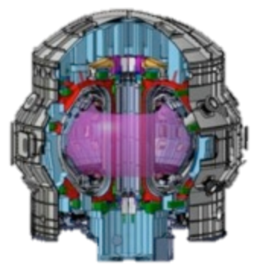
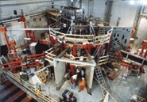
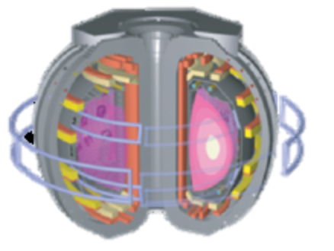
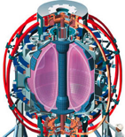

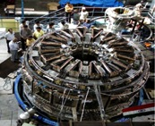
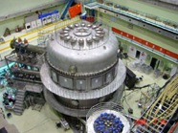
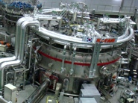
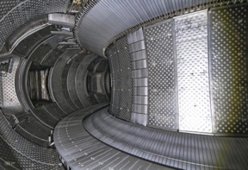
The World Program Is Focused on Preparing for Burning Plasmas in ITER
MAST-U
ASDEX-U
JET
JT-60SA
ITER
DIII-D
NSTX-U
WEST
TCV
SST-1
EAST
KSTAR
U.S. is a major contributor, and benefits greatly from participation

Slide 25
The World Program Is Focused on Preparing for Burning Plasmas in ITER
MAST-U
ASDEX-U
JET
JT-60SA
ITER
International partners provide
Stronger scientific basis
Broad team, range of facilities, tools, and experience
Industrial fabrication capabilities
Shared costs
DIII-D
NSTX-U
WEST
TCV
SST-1
EAST
KSTAR
U.S. is a major contributor, and benefits greatly from participation

Slide 26
The World Fusion Community is Organized to Carry Out Burning Plasma Research
International Tokamak Physics Activity (ITPA) makes key contributions to coordinating worldwide burning plasma research through joint experiments on multiple devices
~ 850 scientists from all 7 ITER parties (US, China, EU, India, Japan, Korea, Russia) plus Australia
7 Topical Groups focus research in key areas
Diagnostics, Divertor-Scrape-Off-Layer, Energetic Particles, Magnetohydrodynamic Instabilities, Pedestal & Edge Physics, Transport and Confinement, Integrated Operating Scenaros
Semi-annual meetings convene 30-40 members and other experts
State of the art burning plasma research discussed
Multi-machine joint research proposals generated
Recommendations for ITER generated
Over 100 refereed journal publications produced directly from ITPA topics in last 5 years
The US plays a substantial role in ITPA experiments and documentation activities
Over 200 US scientists

Slide 27
ITPA Success Story: ELM Suppression by Magnetic Perturbations Verified on US and EU Tokamaks
ELM Suppression using internal coils on DIII-D initially formed the basis for adding 3D coils to the ITER design
ITPA Joint Experiment organized to reproduce ELM suppression on other tokamaks
DIII-D and ASDEX-Upgrade joint experiment led to the first observation¹⁻³ of ELM suppression in AUG, confirming basis for ITER
R. Nazikian, W. Suttrop et al. Proc. 26th IAEA Fusion Energy Conf., Kyoto, Japan (2016), to be submitted to Nuc. Fusion
W. Suttrop, R. Nazikian et al., submitted to Phys. Rev. Lett. (Nov 2016)
W. Suttrop, R. Nazikian et al., Proc 44th European Phs. Soc. Conf., Belfast, N. Ireland (July 2017), to be submitted to Plas. Phys. Control. Fusion

Slide 28
ITER Project is Coordinating Additional Research Activities Involving World Community
ITER Research Plan
Developed in collaboration with community experts worldwide, this document outlines the anticipated content and schedule for research activities on ITER
ITER Integrated Modeling Expert Group
Help guide the ITER integrated modeling program and to act as an interface between member physics modeling programs and the ITER organization.
ITER Scientist Fellow
Prepare for the scientific exploitation phase of the device by strengthening the involvement of the fusion community directly with ITER. Interact closely with the ITER Science & Operations Department in the definition of a research program
ITER Operations Network
Provide advice and feedback to the ITER project in the Operations area…”
Notes:
ITPA has resulted in the achievement of a broad physics basis essential for the ITER design and useful for all fusion programs and progress toward fusion energy generally
contribute to the preparation of the documentation which will constitute the definition of the ITER operations framework

Slide 29
Complementarity/Uniqueness of World Tokamak Facilities Continue to Advance Fusion Toward Burning Plasmas
Tokamak | Key Contributions to Burning Plasma Science
DIII-D | Scenarios, transients, control, EPs
NSTX-U | Low R/a physics, EPs, transients
JET | Tritium, size scaling, ITER-like wall
AUG | Transport, divertor, tungsten wall
TCV | Shaping effects on core and divertor
MAST-U | Low R/a physics, advanced divertor
WEST | Long-pulse tungsten divertor
EAST | Long-pulse scenarios, core/edge compatibility, metal walls
KSTAR | Long-pulse physics, 3D fields, H&CD technology
JT-60SA* | H&CD technologies, advanced scenario demonstration
ITER* | Integrated burning plasma demonstration
Complementarity enables multi-platform development and evaluation of key physics
Uniqueness promotes evaluation of new ideas that emerge from synergistic collaborations across facilities
Well positioned to advance burning plasma science in preparation for and in concert with ITER
*under construction

Slide 30
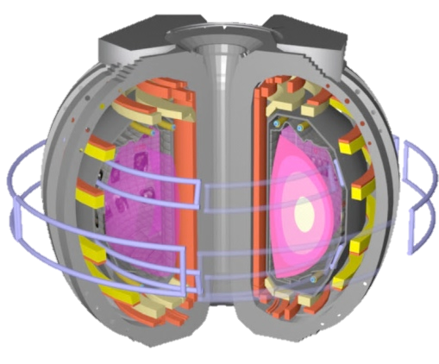
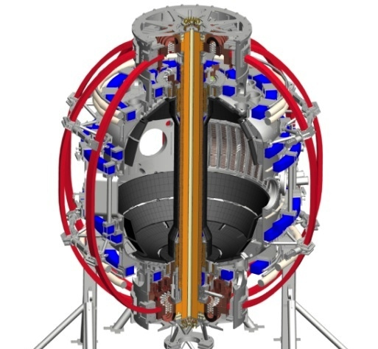
U.S. Facilities: Excellent, Cost-Effecve Research Tools to Provide World-Leading Fusion Science
DIII-D
NSTX-U
DIII-D and NSTX-U provide world-leading and complementary capabilities to resolve scientific Issues for fusion energy
Mature facilities with established infrastructure and experienced staff
Highly flexible, 2D shaping, controlled 3D magnetic perturbations,
Well diagnosed: in-depth scientific investigations and model validation
Divertor structures top and bottom, easily modified
National and international research teams
Low vs high torque and ρ_{e}
Complementary current drive (ECCD, Helicon vs HHFW, helicity injection)
Complementary boundary approach (cryopump vs lithium, solid vs liquid)
Train the next generation of scientists and engineers
Notes:
U.S. Facilities : Excellent Research Tools to provide frontier (cutting-edge) (world-leading) fusion science
Mature facilities with established infrastructure, experienced operations staff -> safe reliable operattion
World leading and complementary capabilities
Comprehensive set of diagnostics enables in-depth scientific investigations and model validation
Powerful set of control tools
H & CD, flexible shaping , density control with cryopumps, flexible 3d coil set
Divertor structures top & bottom, easily modified.
International Team

Slide 31
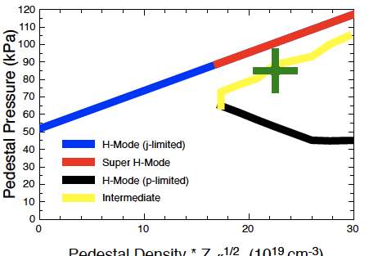
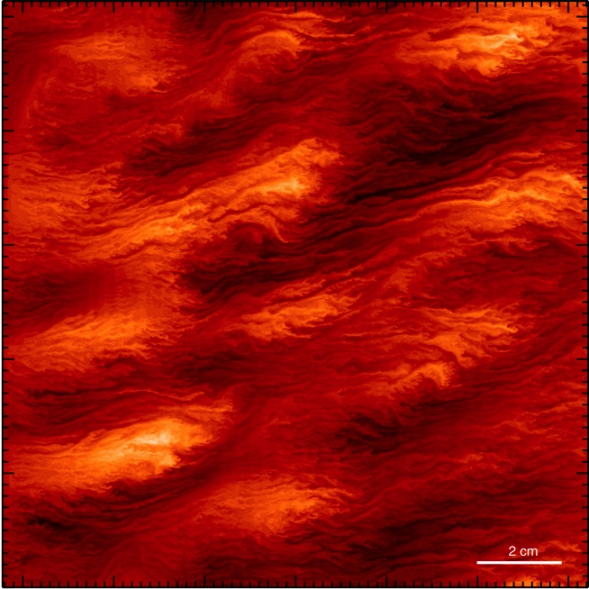
US Theory and SciDAC Burning-Plasma Research: Rapid World-Leading Advances in Predictive Capability
Develop and support world-class numerical tools
GYRO, GS2, GTC, GEM: electromag. turbulence
M3D-C1, NIMROD; nonlinear extended MHD
BOUT, ELITE, XGC1, COGENT, UEDGE: bound. & PMI
TGLF, NEO, EPED: core/pedestal prediction
OMFIT, TRANSP, ISP: integrated simulation
AORSA, NuBEAM, CQL3D: RF sources
Address important burning plasma issues
Performance prediction with coupled core & pedestal → higher confidence, optimization
Pedestal transport and L-H transiton
Plasma response to 3D fields →ELM suppression
Simulation of RE dynamics and disruption mitigation scenarios
Critical gradient and resonance broadening EP transport models
Strong U.S. partnership between theory & experiment
Model validation
Interpret, direct, and predict experiment →discovery and innovation in fusion research
EPED Super H-Mode Prediction
Theory → experiment
Multi-Scale Turbulence (GYRO)
GYRO δT_{e}/T_{e0}
electron scale
ion scale

Slide 32
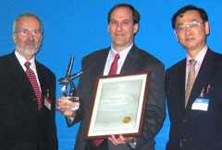
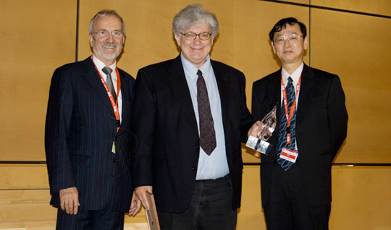
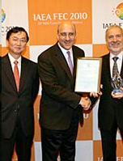
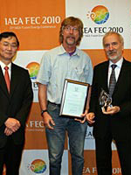
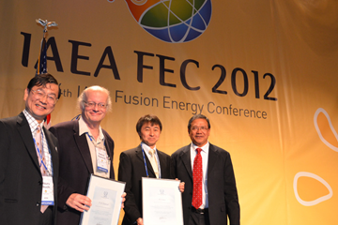
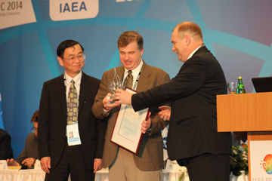
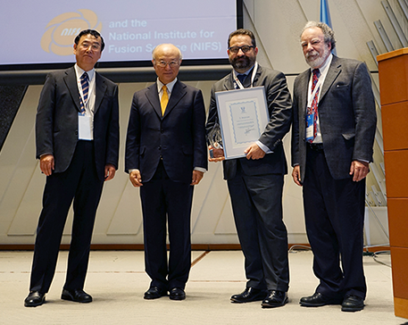
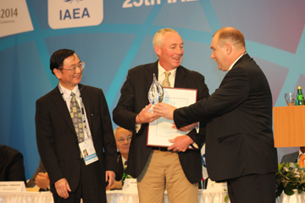
U.S. Leadership In Burning Plasma Research Evidenced By Nuclear Fusion Prize Recipients (won 8 of 11)
Luce, Scenarios, 2006
Evans, ELM Suppression, 2008
Sabbagh, Stability, 2009
Rice, Intrinsic Rotation, 2010
Diamond, Rotation Theory, 2012
Snyder, Pedestal, 2014
Whyte, Scenarios, 2013
Goldston, SOL physics, 2015

Slide 33
Strategic Elements to Strengthen or
Accelerate U.S. Burning Plasma Research
Executive Summary:
Realizing fusion energy within the next several decades will require increased funding and reduced costs.
ITER provides the most timely and capable option for the U.S to exploit burning plasmas.
The U.S. should develop a strategic plan with exciting stage milestones targeting a U.S. cost-attractive DEMO in the next several decades
Fusion energy development requires an increasing effort in fusion materials and fusion nuclear science
Strategic elements in mostly considering the United states is a partner in ITER

Slide 34
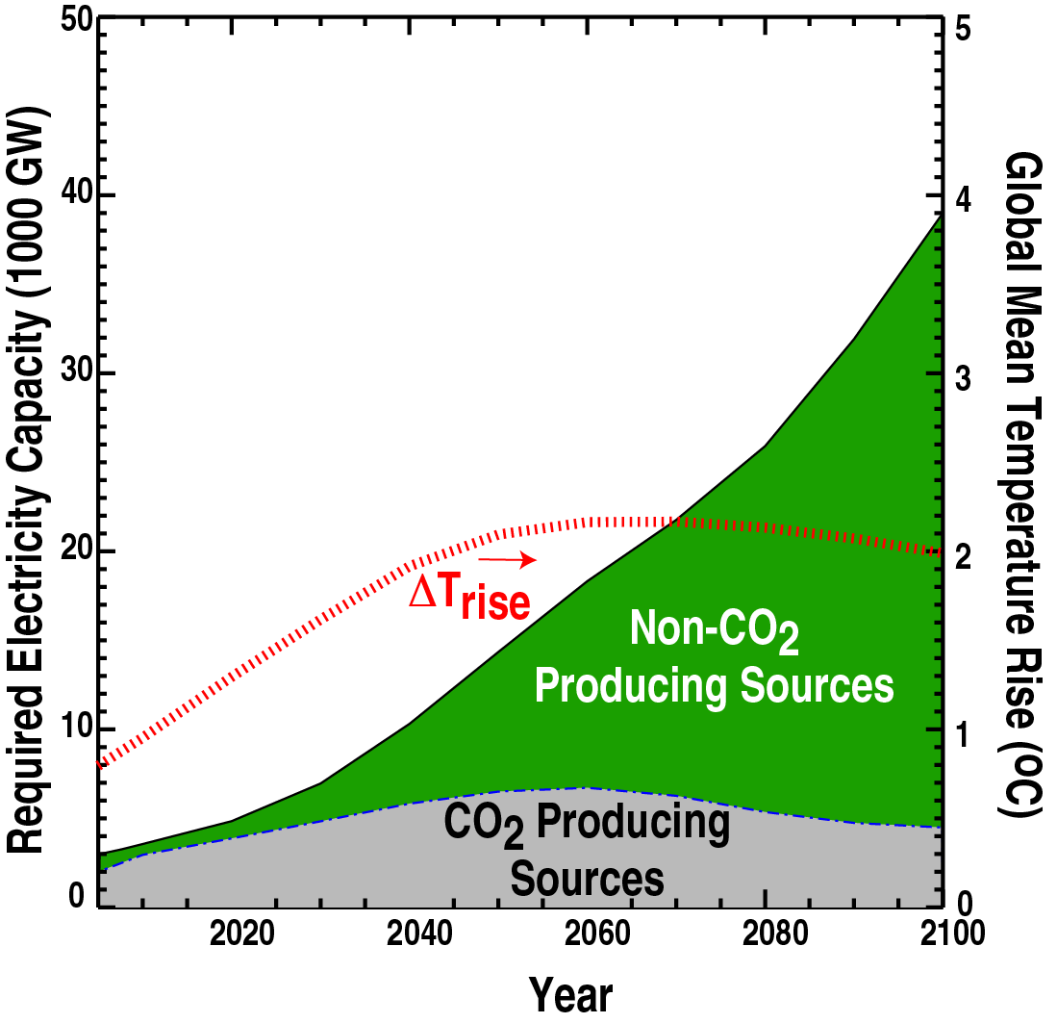
Electricity Demand in Next 100 Years Presents Major Challenges and Also Tremendous Opportunity
*Message AMPERE2-450-FullTech-OPT Scenario
Projected need for ~ 35,000 GW from non-CO2 producing sources
35,000 1 GW-e plants !!!
Consequently, annual investment in energy projected to explode
$0.8T by 2050
$2.5T by 2100
→ Timely positioning is key
Integrated emissions limited to maintain CO₂ levels below 450 ppm , full technology
Strategic Interest for the U.S. and the World

Slide 35

Substantive Progress Towards Fusion Energy Requires a) Increased Funding and/or b) Reduced Costs
International partners are needed to develop fusion energy
Koepke, 2014

Slide 36
What is Required to Increase Funding
Provide an exciting vision for the future to motivate increased public and political support, funding and attract the brightest and best researchers
Work to unify the community, get the community working together
Requires community leadership and engagement, perhaps a process similar to that of 1998 - 2004
Establish a partnership between the Feds (OFES, OS) and the community
Resolve to maintain a strong U.S. commitment to the path forward
Engage the entire U.S. fusion community in burning plasma research: planning, preparing, and execution.
Community must own the path forward as their path forward
Required to maintain community unity and commitment
Recommendation: FES and the U.S fusion community should begin a process to develop a roadmap and strategic plan

Slide 37
Accelerating the Path to Burning Plasmas and Fusion Energy Development
Ages-old quip: “Fusion is 50 years away and always will be.”
How to reconcile?
NAS charge: “given that economical fusion energy within the next several decades is a U.S. strategic interest”

Slide 38
Accelerating the Path to Burning Plasmas and Fusion Energy Development
The Challenge
Very challenging problem → Robust funding required
Multiple challenges must be resolved→ Strategic plan required
Staging of elements essential → Community consensus needed
Ages-old quip: “Fusion is 50 years away and always will be.”
How to reconcile?
NAS charge: “given that economical fusion energy within the next several decades is a U.S. strategic interest”

Slide 39
Accelerating the Path to Burning Plasmas and Fusion Energy Development
The Challenge
Very challenging problem → Robust funding required
Multiple challenges must be resolved→ Strategic plan required
Staging of elements essential → Community consensus needed
Ages-old quip: “Fusion is 50 years away and always will be.”
How to reconcile?
NAS charge: “given that economical fusion energy within the next several decades is a U.S. strategic interest”
The Solution
Compelling vision for energy mission → Increase available funding
Vetted strategic plan → Inform prioritization of available funding
Broad community consensus → Unified purpose and messaging
Bold leadership → Implement & execute difficult priority choices
--- All done in partnership with Office of Science and FES ---

Slide 40
Accelerating the Path to Burning Plasmas and Fusion Energy Development
The Challenge
Very challenging problem → Robust funding required
Multiple challenges must be resolved→ Strategic plan required
Staging of elements essential → Community consensus needed
Ages-old quip: “Fusion is 50 years away and always will be.”
How to reconcile?
NAS charge: “given that economical fusion energy within the next several decades is a U.S. strategic interest”
The Solution
Compelling program vision → Increase available funding
Well informed strategic plan → Inform prioritization of available funding
Broad community consensus → Unified purpose and messaging
--- All done in partnership with Office of Science and FES ---
My recommendation:
Fully participate in ITER as the U.S. Burning Plasma Experiment
Develop a strategic plan with exciting staged milestones targeting a U.S. cost-attractive DEMO in the next several decades

Slide 41
U.S. Should Fully Participate in ITER as the Most Direct and Fastest Path to a Burning Plasma
Observations
All fusion programs worldwide have chosen ITER as the most expedient means to burning plasmas on their path to fusion energy development
Broad consensus on goals, responsibilities, and ownership
Broad worldwide participation in burning plasma research
The framework for pursuing a project of this magnitude is now in place with established design and construction teams, infrastructure, nuclear license…
Established mechanisms for timely resolution of emerging issues
ITER construction is progressing rapidly under new management
Clear communication, responsibility, and accountability structure
Planning and preparation for operations and exploitation are beginning
Recommendation: Fully fund U.S. contributions to ITER
Guarantee on-time, on-spec delivery of U.S. in-kind contributions
Enable ITER IO to address emerging issues in timely, efficient manner
Expand breadth of U.S. community efforts in burning plasma research
These efforts/activities take time and money

Slide 42
Strategic Plan Assertions and Principles
Assertions
Burning plasma R&D is the next major step for fusion development
ITER represents the most timely, capable option for a U.S. burning plasma experiment
Materials and nuclear science challenge is formidable and early resolution of key challenges is critical for timely delivery of fusion energy
Tokamak is the most expedient path to fusion energy
Principles
Enable development of attractive fusion energy as soon as possible
Timeliness over attractiveness of end product (power plant)
Build on existing strengths
Maintain high level of scientific excellence
Value innovation
Leverage capabilities of international partners

Slide 43


Realization of Attractive DEMO Will Require Closing the Feasibility Gap in Three Areas Required for Fusion Energy*
* Priorities, Gaps, Opportunities … 2004
Fusion Power Source (Neutrons)
A successful burning plasma experiment will leave significant gaps in fusion materials and blankets
Materials for Fusion Environment
DEMO
Approximate Technical Readiness Level
Harnessing Fusion Power

Slide 44
Developing Key Elements of a Strategic Plan
Support a significant community effort to provide a more in-depth evaluation of opportunities for a more cost attractive DEMO or power plant. (systems studies)
Define domestic R&D needed to validate opportunities
Support a community/FES process (follow-on to present community workshops) to develop a long term fusion strategy/roadmap targeting a U.S. cost-attractive DEMO in the next several decades.
Include exciting staged milestones
Strategy should include
Robust support for engaging in burning plasma physics
Plans for solid foundational physics; engaging universities, industry, and national labs
A strong theory and computation program
Plans for new U.S. fusion facilities
Plan (how/when) to transition from existing facilities to new facilities
A growing effort in fusion material development and testing
A growing effort in developing fusion blanket research
Challenge: broad effort is needed, requiring significant funding
Difficult priority choices are required

Slide 45
The U.S. Strategic Plan Must Include a Robust Tokamak Effort
To support and prepare for burning plasma research (ITER) → exploitation
To prepare for a cost effective DEMO
To train fusion scientists and engineers for the future
Key elements of a tokamak program should include
Plasma exhaust (divertor, materials)
Disruption prediction and avoidance
Steady-state
Predictive capability
Optimize performance (nTτ/RB)
Proposals for cost effective Demos include significantly improved confinement (~ 1.6 - 1.8) and stability.
Enabling Technologies
Magnet Development program -> demonstrate large, high field magnet with high temperature superconductors
Current drive?
Facility: new tokamak facility or upgrade of existing facility
Notes:
H89P for ARIES II is 2.65 ~1.6 H98y
ARC (B.N Sorbom, Aug 2015) H89p =2.8 is ~ H98y = 1.8
If ITER assumed H98Y of 1.8, then R*B could be 1.8 smaller - 3.5 m
1.6 3.9m

Slide 46
A Growing Effort in Fusion Materials and Fusion Nuclear Science is Required to Advance Fusion Energy
Materials
Develop new materials (BES: materials by design); plasma facing, structural
Test materials in a plasma environment
Linear devices, such as MPEX
Fusion facility environment (tokamak, …) effect of material response on plasma performance is critically important
Test material in high energy neutron environment
Gap in the world program
Potential opportunity for cost effective volume neutron source (Gas dynamic Trap), or integrated nuclear science test facility (FNSF)
Fusion Blankets
Propose next step is a multi-effect, non-nuclear blanket test facility
Develop a long term strategy and plan for U.S. fusion blanket development, in the context of the international program.
We will require a growing workforce of scientists and engineers with expertise in materials and fusion nuclear science

Slide 47

Summary
Burning plasmas are the next step in fusion energy development
ITER represents a unique opportunity for the U.S. to pursue burning plasmas
Feasibility gaps in materials and blanket technology offer rich scientific opportunities
Recommended Actions:
Reaffirm previous panel reports stressing the importance of burning plasmas
Capitalize on the substantial human, technical and fiscal investment made in ITER
Develop a strategic plan with exciting staged milestones leading to a cost-attractive DEMO

