Slide 1














Response to the NAS Committee for a Strategic Plan for U.S. Burning Plasma Research
Phil Ferguson
Director, US Virtual Laboratory for Technology (VLT)
Division Director, Fusion & Materials for Nuclear Systems, ORNL
Presented to:
National Academies Committee for a Strategic Plan for U.S. Burning Plasma Research
August 29, 2017
Notes:
Need UCSB

Slide 2
What is the US Virtual Laboratory for Technology (VLT)?
Formed in 1998 to provide a single entity with central leadership for the US fusion technology program
  Provide advocacy for the technology program
  Provide representation among the fusion program leaders
  Build consensus within the program
  Program management, guidance, and direction remains with FES
Largely dormant from 2013-2016 (Milora retirement)
New director named in May 2016
Currently 18 institutions
  8 universities, 1 private company, 9 national labs
  ~8% of US non-ITER budget

Slide 3
Topics to be addressed by the VLT
The importance of U.S. burning plasma research to the development of fusion energy
The scientific and technical developments since the 2004 report of the NAS Burning Plasma Assessment Committee
Current status of U.S. research that supports burning plasma science and advances fusion energy technologies
Strategic elements that might strengthen or accelerate U.S. burning plasma research
All of these with a technology emphasis…

Slide 4
“Experimental investigation of a burning plasma remains a grand challenge for plasma physics and a necessary step in the development of fusion energy”
National Research Council. 2004. Burning Plasma: Bringing a Star to Earth. Washington, DC: The National Academies Press
As true now as it was in 2004
  Strong consensus on this point, including among the technology programs
“The creation of such plasmas is a necessary but not sufficient condition for the development of a practical energy-producing magnetic fusion power plant”
  Also from the 2004 report, and also still true
  Important questions for fusion nuclear science from burning plasmas that must be answered
Near unanimous opinion that burning plasma science is among the most important, or the most important, topic in fusion energy research.

Slide 5
The 2004 report anticipated participation in ITER driving technology advancements in several areas
From the 2004 report, fusion technology advances from burning plasma experiments were expected to include:
  Breeding blanket development
  Tritium processing
  Magnet technology
  High-heat-flux component development
  Remote handling technology
ITER has driven progress in each of these areas, as well as:
  Radiation transport
  Disruption mitigation
Additional areas of progress (from the base program) includes:
  Fusion materials
  Plasma-materials interactions (PMI)

Slide 6
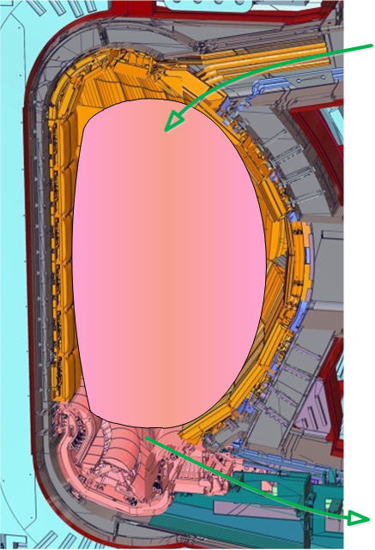
A project approach like ITER drives a holistic approach to the fusion fuel cycle
Characteristics of magnetic fusion
Technology needs
Magnetic plasma resists injection of replacement fuel
Fueling
He “ash” and impurity build-up quenches fusion reaction
Tritium Processing
DT
Plasma
Tritium is radioactive and expensive
Drives all Fuel Cycle technology, including need for tritium self-sufficiency
Only a fraction (~1%) of the fuel burns per pass
Vacuum must be maintained around plasma
Vacuum requires tritium handling

Slide 7
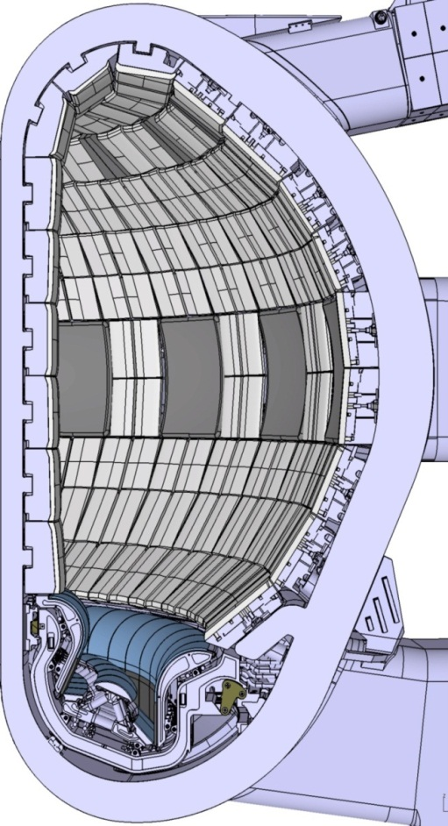
ITER Fueling Needs are Significant:
Cryogenic Pellet Injection is the Solution
ITER plasma volume is 840 m³ and scrape-off layer is ~30 cm thick. This compares to 20 m³ and ~ 5 cm for DIII-D.
ITER is designed to operate at high density (> 1x 10²⁰ m⁻³) in order to optimize Q.
NBI fueling to be negligible (< 2 x 10²⁰ atoms/s or < 3 torr-L/s).
Inboard pellet injection planned for deep fueling and high efficiency. Reliability must be very high.
ITER will require significant fueling capability to operate at high density for long durations
  Gas fuelling will be limited by poor neutral penetration
Pellet
Injection
Gas
Injection
ITER Cross Section

Slide 8
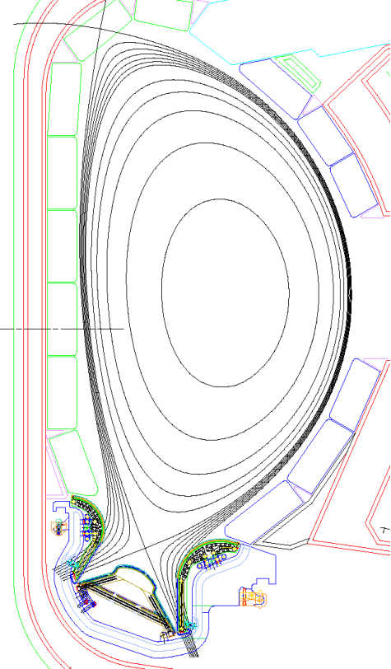
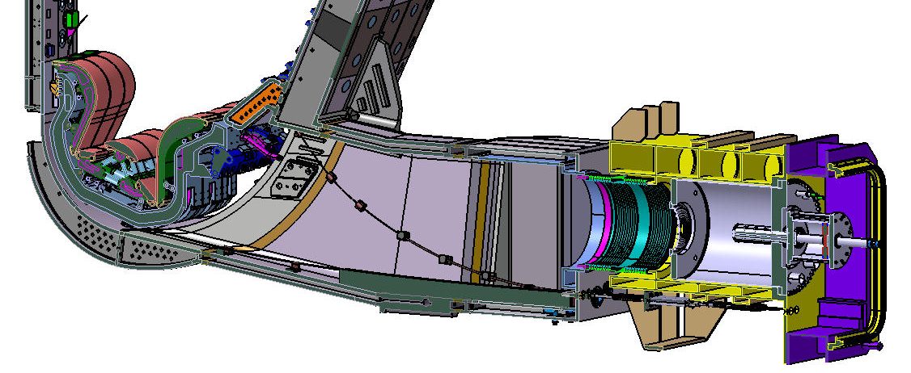
ITER needs have driven advances in vacuum technology
DT fuel is fused in the plasma and turned into Helium ash.
Helium dilutes the plasma reducing the fusion efficiency if not removed
The divertor configuration allows the magnetically trapped plasma particles to be neutralised and hence pumped by the vacuum system
To maintain a low helium concentration in the plasma continuous high speed pumping (>50m³/s) is required in the divertor region.
Vacuum pumping techniques developed for this application pump all neutralized gases, so the fuel (>99%) and the waste helium (<1%).
Pumping is performed:-
  in first stage by specially developed cryo-sorption pumps with integral large valves to allow cyclic regeneration.
  in second stage by cryo-condensation pumps (CVCs) with capability to separate the fuel and helium and return the unused fuel to the fuel cycle.
D⁺+T⁺
He⁺⁺(3.5MeV)
n(14MeV)
Roughing system containing CVCs
He, D₂,T₂, impurities
cryo-sorbtion pumps
Divertor

Slide 9
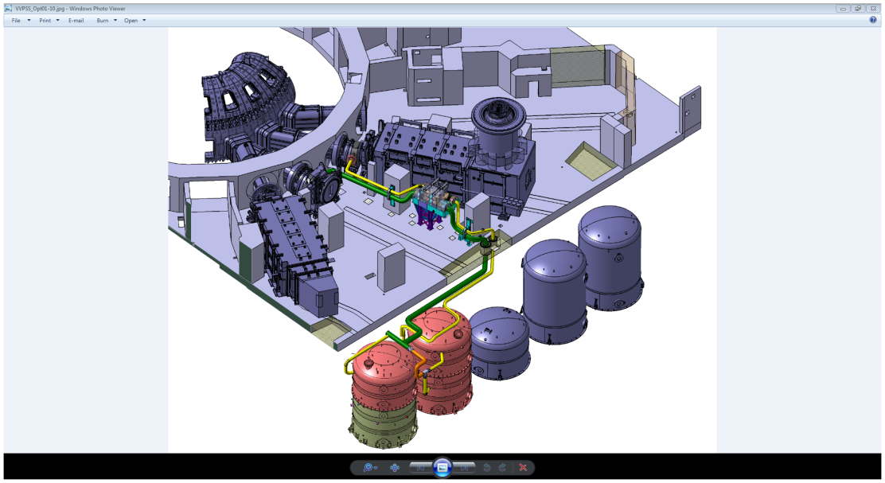
ITER Vacuum Vessel Pressure Suppression System addresses design basis accident scenarios
Prevent the pressure in VV to exceed 1.5 bar(abs) for all design basis accidents following an Ingress of Coolant Event
Keep the VV below atmospheric pressure (dynamic confinement) for all high probability in-VV accidental events: Loss of Coolant Accidents combined or not with air ingress accidents
Key features and technological challenges:
Fast sub-atmospheric steam condensation with variable fraction of non-condensable gases over wide range of flow rates
In-line management of the hazard posed by presence of flammable Hydrogen-air mixtures in large varieties of concentrations
VV
Pressure relief lines
4 vapor suppression tanks

Slide 10
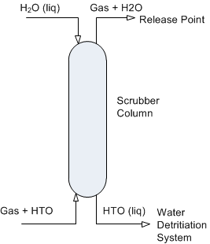
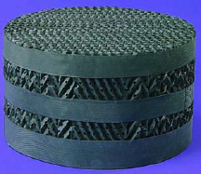
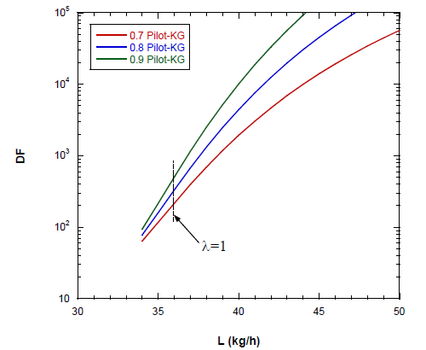
Example: Scrubber column technology developed for ITER-scale gas detritiation
Construction: Uses industrial column packing to promote liquid-gas contact
Performance: Detritiation factor sufficient for safe facility performance and can be increased by raising liquid water flow (λ=1 at equimolar liquid and vapor water flow)
Concept: Clean water trickles down on rising tritiated gas stream and “scrubs” tritium out though isotopic exchange

Slide 11
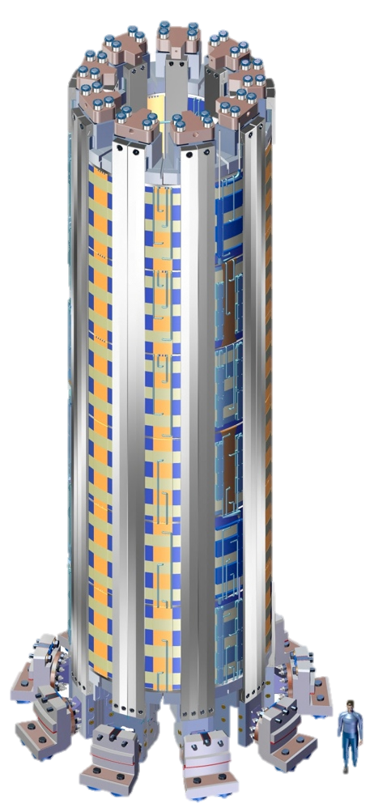
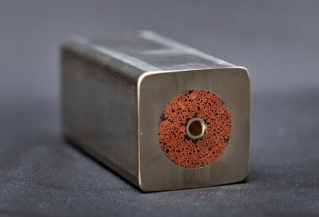
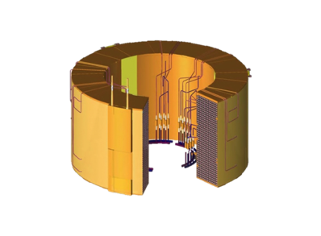
General Atomics Works with International Partners to Manufacture the ITER Central Solenoid
Nb₃Sn CICC Conductor supplied by JAEA in
900 m lengths
7 modules wound, cured, insulated, and tested at GA
6 of these assembled at ITER (1 spare)
Delivered to
GA
Delivered to
Cadarache
Completed module weighs 250,000 pounds has 560 turns (4 miles of conductor)
Design and manufacturing assisted via discussions with Koreans, Japanese, Italians, Chinese
ITER Central Solenoid

Slide 12
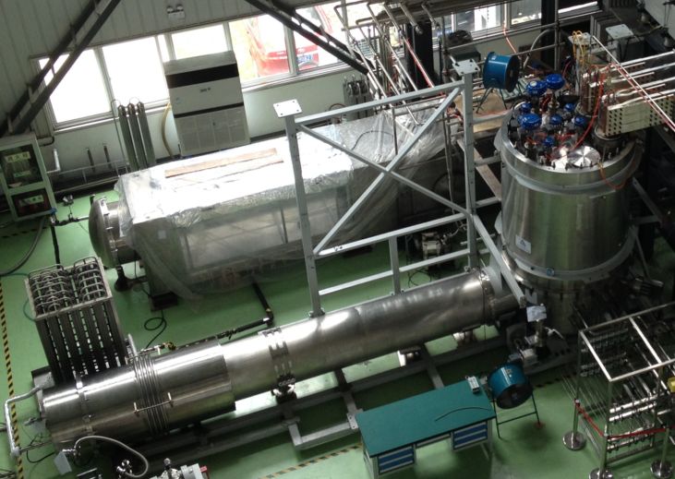
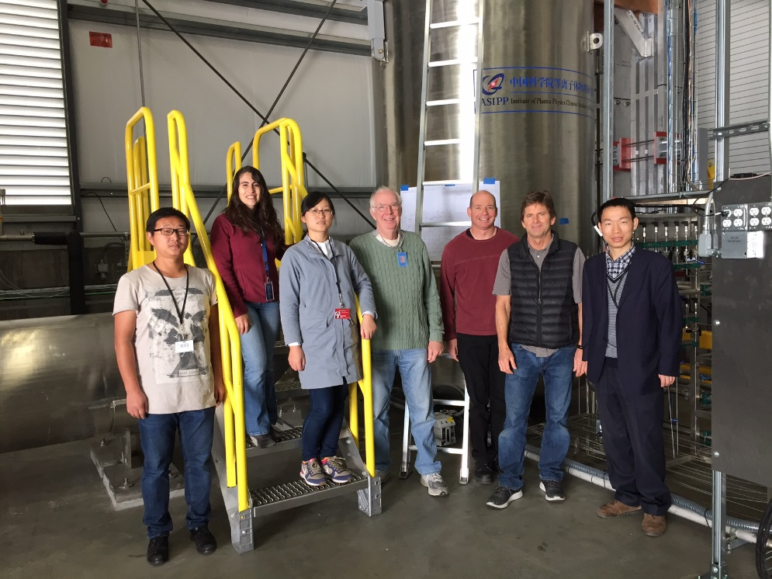
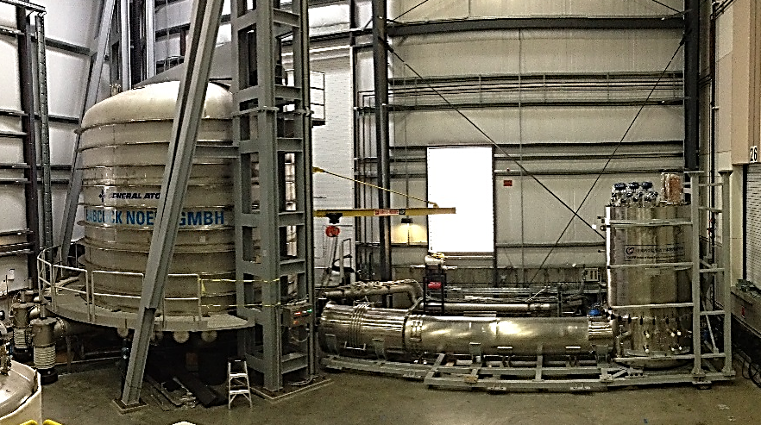
Collaboration between GA and ASIPP for ITER CS Final Test System Feeder
CS Feeder system designed and built at ASIPP based on ITER feeders
Testing of feeders performed at ASIPP with GA assistance
Installation performed at GA as collaboration
Operational testing with balance of CS Final Test System performed by joint GA/ASIPP team
Feeder under test at ASIPP
Test chamber and feeder installed at GA

Slide 13
Design of high heat flux components have matured significantly as a result of ITER
Design reviews and schedule drive engineered systems that meet fusion energy challenges
  Cooling for high heat flux
  Remote handling for replacement
  No leading edges
Result is a design that meets specifications and can be constructed
  ~2 m X 3 m structure
  ~8 tons per cassette
  Provides neutron shielding for vacuum vessel
  Joining of dissimilar metals has been thought through
  Alignment and adjustment has been considered

Slide 14
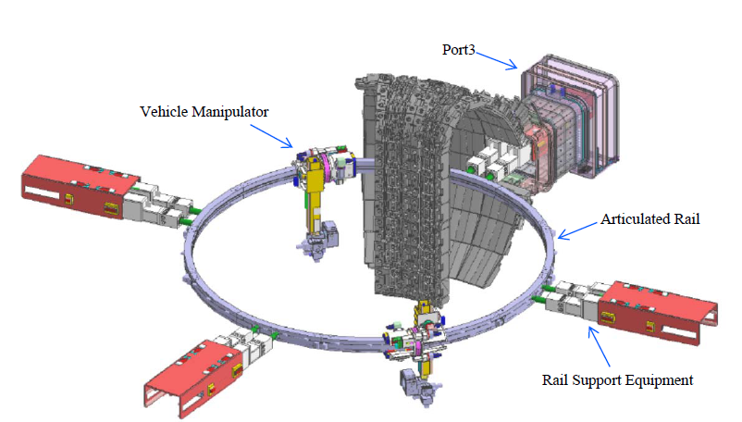
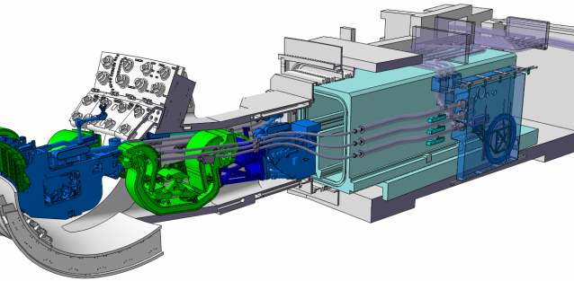
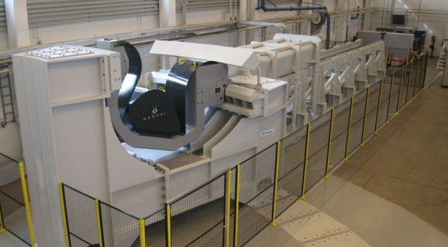
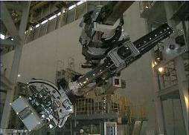
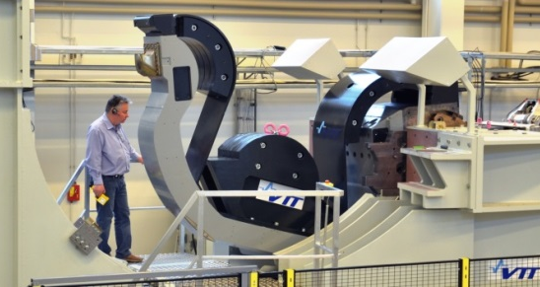
Remote Handling Technology Development for ITER
In-vessel component handling devices
One of the main challenges specific to Remote Handling in ITER is the precise (millimetric) handling of very large in-vessel components (weighing several tons) within radiation fields of up to 500 Grays/hour. To develop and demonstrate the technologies necessary to undertake this task, in the context of ITER, full scale prototype devices have been built and tested in relation to both blanket and divertor remote handling.
Blanket Remote Handling (Japan)
Divertor Remote Handling (EU, Finland)
toroidial mover
Overview of the ITER divertor remote handling process.
Overview of the ITER Blanket RH System.
radial mover
transfer cask
Divertor cassette handling trials in the ITER Divertor Test Platform created by the European Domestic Agency in Tampere, Finland.
Blanket module handling trials using the prototype In-Vessel Transporter (IVT) hosted by the Japanese Domestic Agency in Naka, Japan.
(ITER Blanket module weight is approx. 4 tons).
(ITER divertor cassette weight is approx. 10 tons).

Slide 15
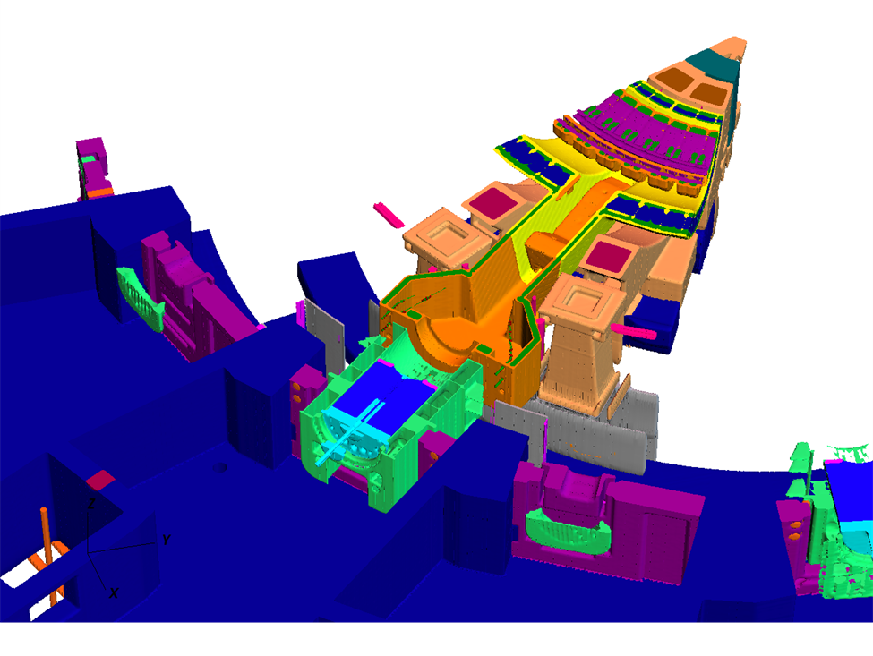
ITER-driven advances in radiation transport methods development makes solutions possible
New software provides major algorithmic and shared memory implementation improvements to the MCNP code. Improvements were absolutely necessary to simulate transport on ITER-released models with useful speed and fidelity.
Significant enhancements of hybrid MC-deterministic methods (ADVANTG) specifically to visualize and generate MC variance reduction parameters for ITER transport models.
Shutdown dose rate analysis toolset (MSX/NAGSS) created with bottleneck removal and parallelism in mind. Toolset was built around the ORIGEN activation solver for the largest ITER models and formally validated for ITER fusion neutronics applications.
CAD-to-MC model conversion and integration process. Includes ITER-preferred model conversion technology coupled with automated tools developed for integration of different radiation transport models.
Massive models (hundreds of thousands of unique geometry cells) of the ITER tokamak integrated into full building models with detailed representations of important equipment.

Slide 16
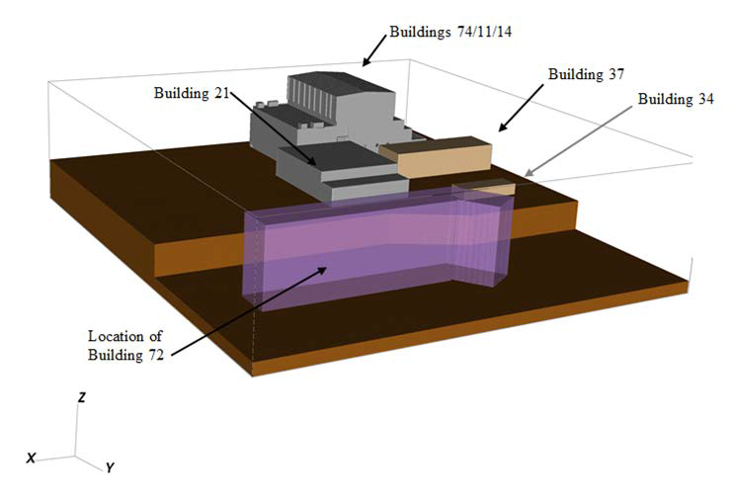
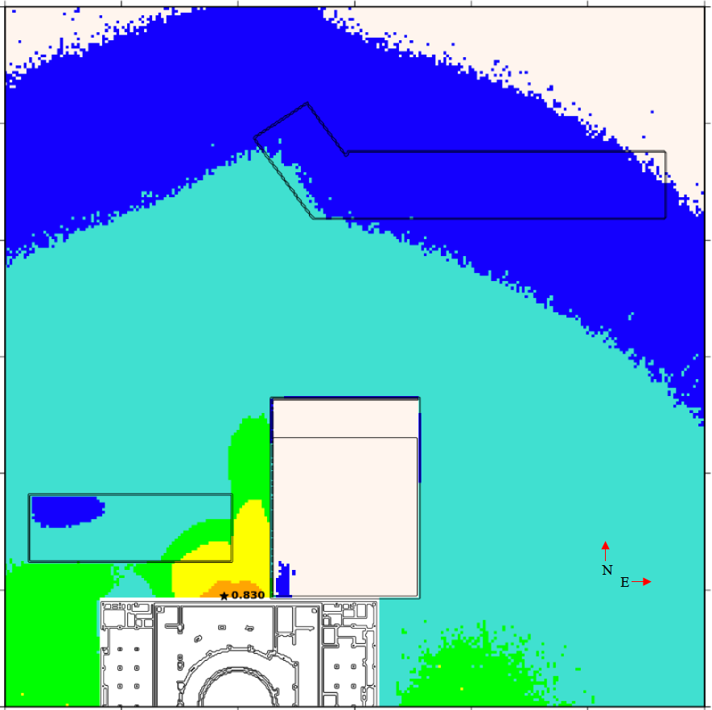
World-leading hybrid methods allow radiation challenges to be addressed
Models developed to represent the entire nuclear platform of the the ITER facility with high fidelity dose rate solutions to determine whether personnel safety criteria are met hundreds of meters away.

Slide 17
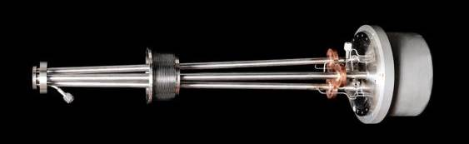
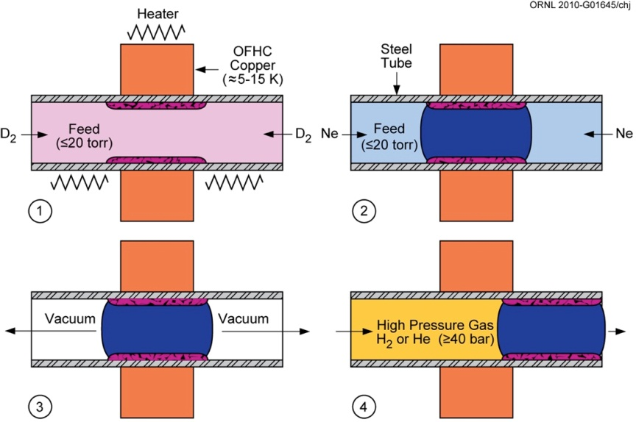
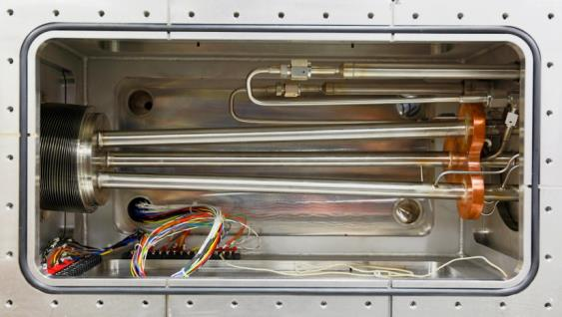
Shattered pellet disruption mitigation systems have become reliable and robust through development and engineering support
Ice forming process in pipe gun injector
Barrel inner diameter increased to 24.4 mm (from 16 mm diameter) in order to study scaling of D2 and neon pellet formation/ acceleration.

Slide 18
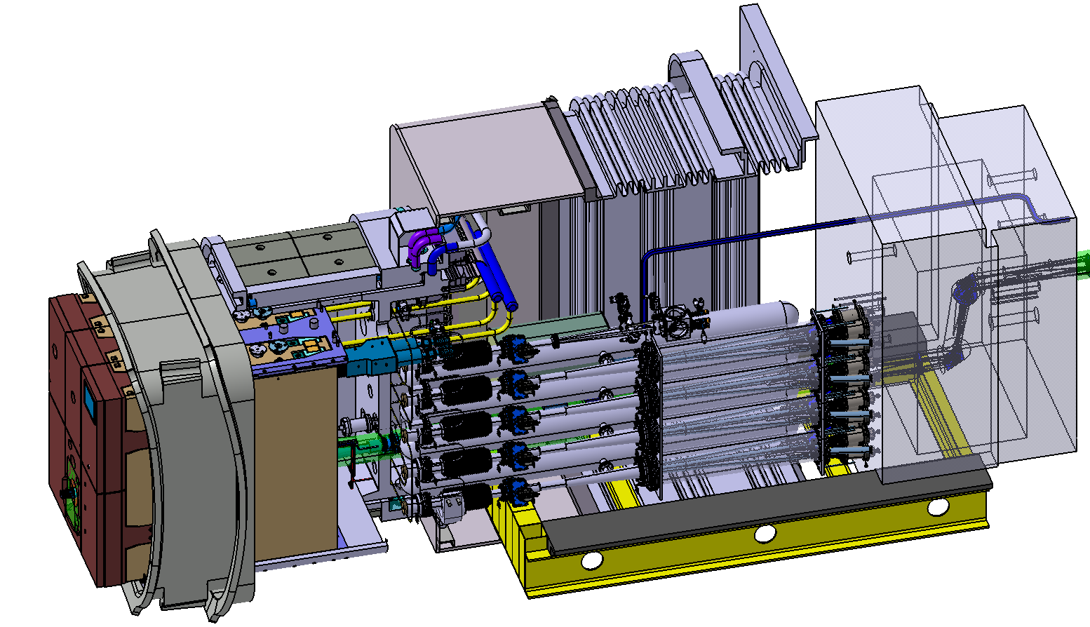
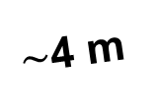
Integrating any pellet system into a nuclear device is a complex engineering challenge, and ITER has risen to that challenge
Equatorial port plug:
Implementation of 4 injectors
Each with 4 barrels
$\sim$4 m

Slide 19
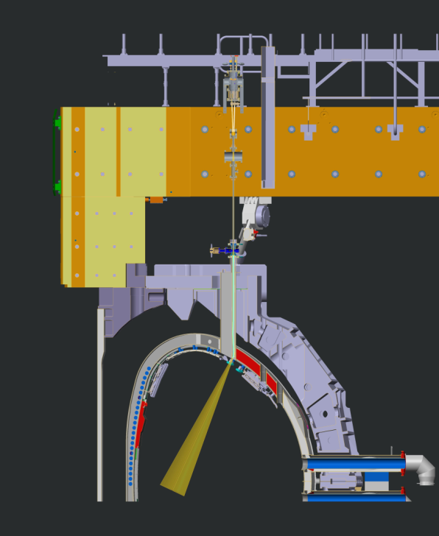
Shattered Pellet Injector DMS experiments on JET under ITER/JET/US collaboration expands our existing knowledge on scalability towards fusion energy
Framework agreement has been signed by IO-CT, USIPO, ORNL, US DoE, EUROfusion and CCFE
Testing SPI at JET is of high priority for the following reasons:
  More energetic and larger target plasmas and larger RE beam cross-section than in DIII-D
  JET could not demonstrate RE mitigation with MGI into a full-blown beam
  Impact of Be/W ITER-like wall on disruption behaviour
  Gain experience in operating SPI in a much more stringent environment (RAMI)
Installation of a 3-barrel SPI, prototypical for that planned for ITER, on a top port at JET
SPI shatter tube fits inside vertical injection line with bend just before entering the plasma.

Slide 20
Fusion materials studies have made great advances since 2004
RAFM steels: high dose (>80 dpa) irradiation effects positively addressed; qualification for use in early DEMO blanket in progress
  Most of recent and planned high dose neutron irradiation studies are in US in international collaborations.
Advanced steels: CNA emerged as the new generation, computationally designed alloys; ODS steels achieved progress in alloy design, understanding properties, fusion environment effects
  US leadership in computational alloy design and development of advanced steels
SiC/SiC: achieved rapid progress as an industrial material and nuclear structural material; on track toward the first code-qualified low-activation structural material
  US leadership in all aspects of SiC/SiC technology for nuclear; from materials development to code qualification
Tungsten: transitioning from poorly understood to material with basic properties and fusion environment effects being understood
  Future directions of tungsten-based PFM development becoming clear
  Case for tungsten sets a model of multi-angle evaluation of candidate/emerging PFMs
Emerging materials: high entropy alloys, bulk metallic glasses, MAX phases, ultra-high temperature ceramics, high entropy ceramics, etc. – initial studies presented promises
  Bridge design window gaps for conventional materials
  Enable novel component designs and reactor concepts
Advanced manufacturing: rapid progress over last decade (outside fusion program)
  Opens routes to develop novel materials that were inaccessible with conventional manufacturing techniques; beyond rapid prototyping and complex net-shaping

Slide 21
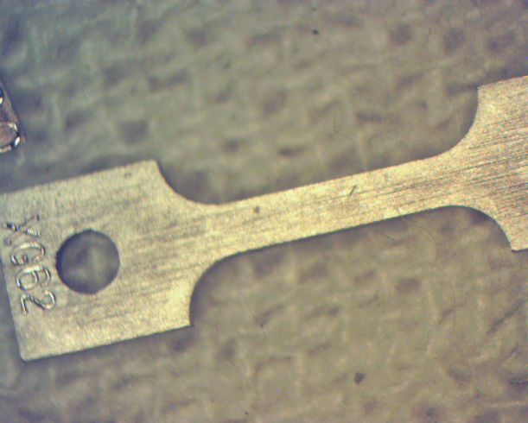
High dose irradiation effects addressed for reduced-activation ferritic/martensitic steels
T. Hirose et al., ICFRM-17
 | JP-28 | JP29
Start | April, 2005 | Jan., 2005
Finish | July, 2013 | July, 2013
Temperature (ºC) | 300/400/500 | 300/400/500
Max dose (dpa) | 87 | 87
# of reactor cycles | 46 | 46
Fission neutron irradiation effects were addressed in US/Japan HFIR JP-28/29 experiment to maximum dose of 87 dpa (more than 8 years of irradiation)
Hardening and ductility degradation appeared significant and unsaturated at 300°C
Helium effects on mechanical properties appeared insignificant as studied by Ni isotope tailoring
300 ºC irradiated (JP29 #13)

Slide 22
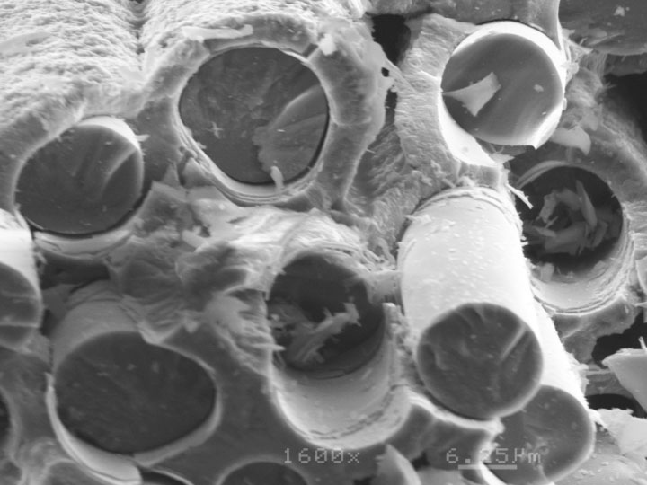
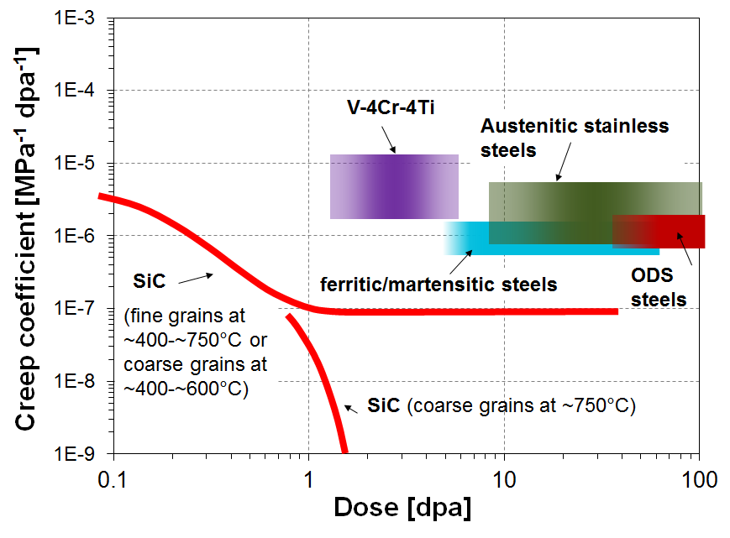
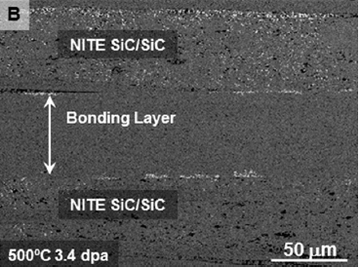
Silicon carbide composite developed from low TRL into industrialized nuclear structural material
Nuclear grade SiC/SiC developed in fusion program in early 2000’s
Proved to be highly radiation-stable in broad temperature/dose ranges
Radiation-tolerant joining technologies were successfully developed in fusion program
Rapid technology development driven by interest from aircraft engine and fission energy R&D communities
T. Koyanagi et al., J.Nucl.Mater., 2016
Y. Katoh et al., J.Nucl.Mater., 2014
Radiation-tolerant joining for SiC/SiC
Exceptional irradiation creep resistance for SiC

Slide 23
Progress has been made on understanding radiation hardening of ferritic/martensitic steels
Next-generation
(TMT, ODS) steels
Current steels
Dramatic reduction in radiation hardening occurs when average spacing between defect cluster nuclei (dislocation loops, etc.) is much greater than average spacing between defect sinks
N_{loop}^{-1/3} >> S_{tot}^{-1/2}
or equivalently,
S_{tot} >> S_{rad defects}
S.J. Zinkle and L.L. Snead, Ann Rev. Mat. Res., 44 (2014) 241
S.J. Zinkle et al., Nucl. Fusion 57 (2017) 092005
Notes:
Needs further confirmation; generally would not be expected to be valid for FCC or high Z BCC metals due to in-cascade formation of large sessile defect clusters
Note: SiC vacancy effective sink strength is >1e17/m2

Slide 24
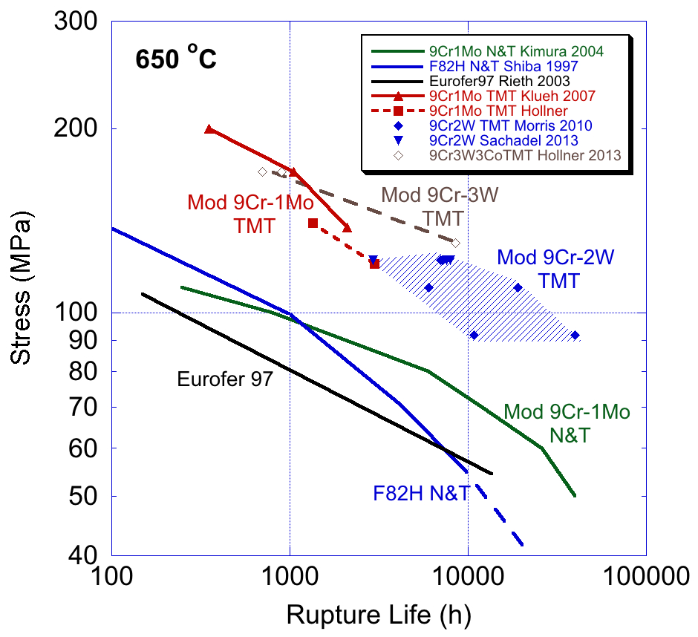
Thermomechanical treatment improves creep rupture behavior over conventional 9Cr steels
50-100% improvement in creep rupture strength for newly designed reduced activation steels
Predicted improvement in radiation resistance as well
S.J. Zinkle et al., Nucl. Fusion 57 (2017) 092005

Slide 25
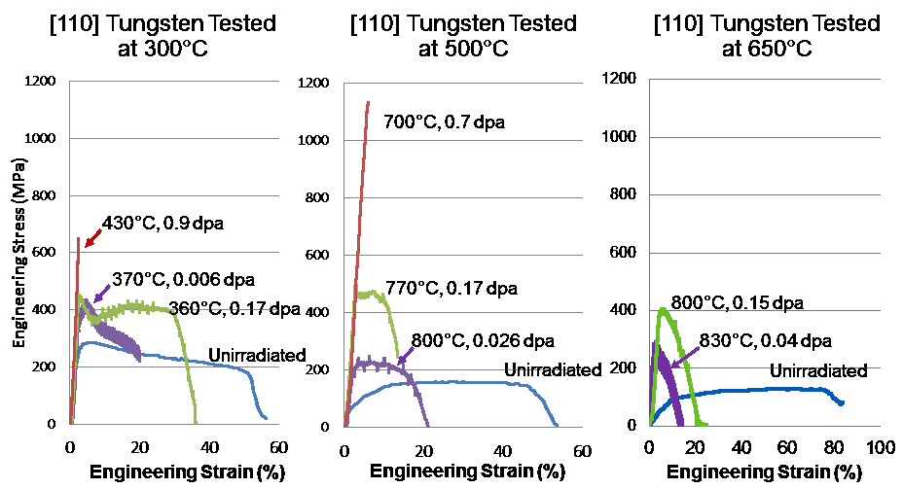
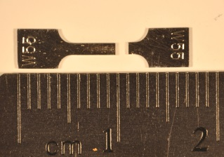
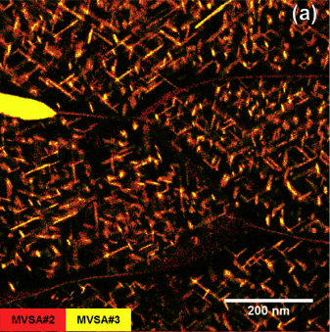
Behavior of tungsten in an irradiation and plasma environment is being understood
L.M. Garrison et al., J.Nucl.Mater. 2016
Hardening and severe embrittlement in irradiated tungsten
C.M. Parish et al., Scr.Mater., 2017
Complex radiation effects in tungsten are finally getting clarified in a systematic manner
Provides information on thermo-mechanical performance envelopes for PFCs
Important implications to design space for tungsten-based composite materials
“Case for tungsten” useful in exploring and assessing emerging materials
Re (red) and Os (yellow) in irradiated W revealing detailed precipitation features

Slide 26
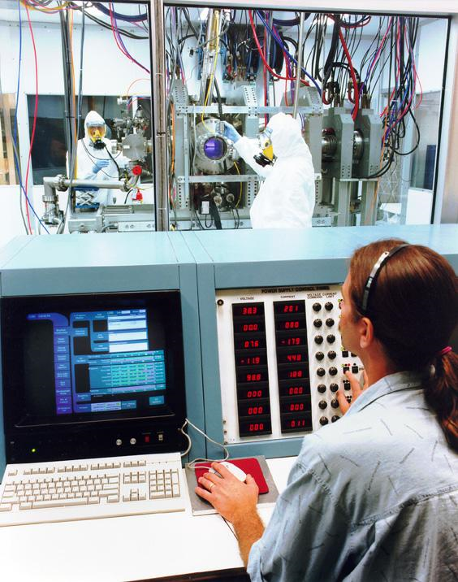
Linear devices have developed to the point of providing ITER relevant fluxes/fluences for PMI studies
PISCES
10⁴ seconds of ITER Divertor Flux
643 K
8 mm thick
samples
No saturation in D retention in W with high-fluence deuterium plasma exposure
5% He⁺ flux during deuterium plasma exposure drastically reduces D retention in W at 643 K
1 mm thick
samples
R. P. Doerner et al. NME 2016
http//dx.doi.org/10.1016/j.nme.2016.04.008.

Slide 27
Fusion Nuclear Science has been identified for more than a decade as an important program element
2005 FESAC “Scientific Challenges, Opportunities and Priorities for the US Fusion Energy Sciences Program”
  Identifies key thrusts including fusion materials, systems engineering, fueling, etc.
2007 FESAC “Priorities, Gaps and Opportunities: Towards a Long-Range Strategic Plan for Magnetic Fusion Energy”
  Identifies predictive modeling, transients, magnet technology, etc.
2009 Research needs for Magnetic Fusion Energy Sciences
  Major thrust of “Harnessing Fusion Power” includes fuel cycle, power extraction, materials science, etc.
2014 FESAC Strategic Planning and Program Priorities Report
  Identified fusion nuclear science among four high priority areas
2015 FES Community workshops focused on three areas with wide community support
  Transients, whole device modeling, & plasma-materials interface

Slide 28
So where are we now?
Fusion nuclear science and technology exists as a stable part of the US program
  ~8% of the FES budget has gone into the FNS&T program for the last 3 years
    An energy program will require additional investment
  Program is highly leveraged where possible (NE, BES, University investment, Lab investment, etc.)
  There are fusion specific challenges that are not funded external to the program (fusion specific, e.g., tritium retention in PFCs, etc.)
Fusion nuclear science covers many topics
  The US can’t and shouldn’t do everything; there is not enough time or budget
  International collaboration will play a vital role in FNS&T
Three areas of prime opportunity are fusion materials, fusion fuel cycle, and power handling
  Other opportunities, like liquid metals and HTS, will be discussed briefly

Slide 29
Fusion materials leadership is strong
The US is a leader among the international fusion materials program
  US-Japan collaboration is more than three decades strong, and continues to make key contributions (current PHENIX collaboration)
  US is executing a structural materials irradiation and PIE for the EUROfusion program (Europe is outsourcing work and recognizing US expertise)
  Consistent request for review participation by US program members
However, resources are limited
  With existing budget, prime focus is structural materials and existing materials
  Not much effort on blanket materials or materials development
  Even PMI science is not a large program in the US
Opportunities for leadership include:
  PMI, fusion relevant neutron source, and modeling & simulation

Slide 30
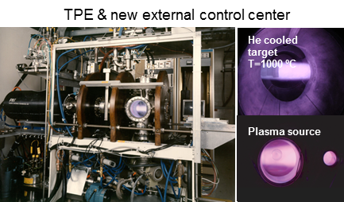
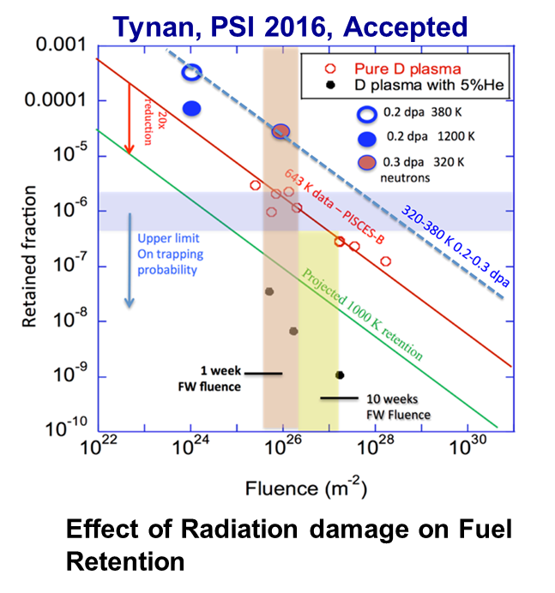
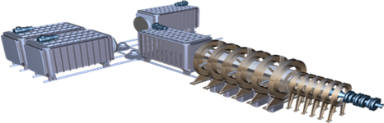
Three PMI facilities would position the US uniquely to address challenges
TPE addresses tritium retention in damaged samples
PISCES is a high fluence facility with beryllium capabilities to address ITER challenges
MPEX will be a DEMO-level fluence device with tilted target & neutron irradiated capabilities

Slide 31
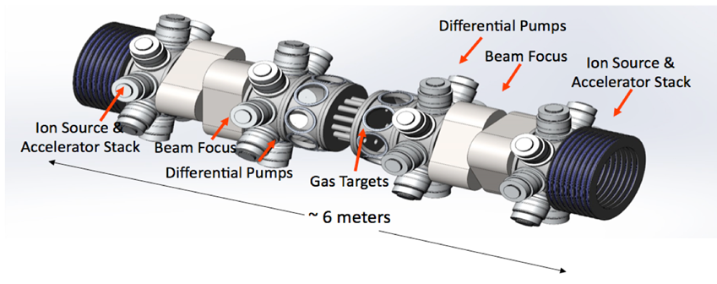
A fusion relevant neutron source is an international need, and a US opportunity
High displacement rate irradiations have been carried out in HFIR for decades
A neutron source with the correct energy spectrum, producing gas synergistically with displacements, is needed for material qualification
IFMIF has been discussed for decades
DONES is the latest version, with reduced scope (30-40 dpa vs 150 dpa) but still costing hundreds of millions of dollars
It is time to consider nearer term, lower cost options with reduced performance compared to DONES
  Phoenix Nuclear Labs has a proposal for a DT neutron generator
  A Gas Dynamic Trap proposal has been mentioned
  Spallation sources can provide low displacement data
    Transmutations become an issue as total displacements rise
Phoenix Nuclear Labs neutron generator concept

Slide 32
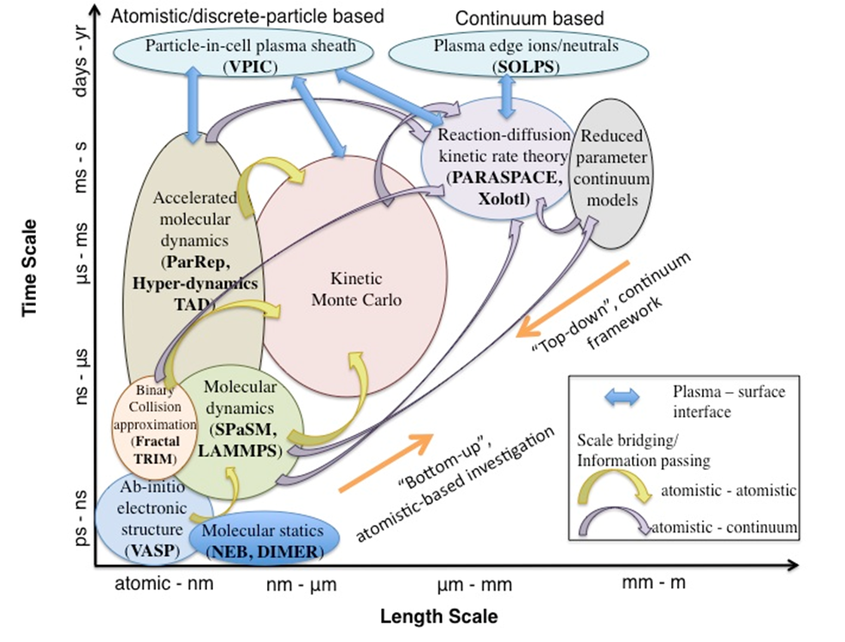
Modeling is a critical part of addressing the materials challenge
Experiments help us understand the physics, so we can accurately model a wide range of scenarios
The PSI SciDAC is making progress on modeling materials challenges from first principles to macroscopic effects, over large length and time scales
Leverages ASCR/HPC and NE investments
BD Wirth, K.D. Hammond, S.I. Krashenninikov, and D. Maroudas, Journal of Nuclear Materials 463 (2015) 30-38.

Slide 33
Closing the fuel cycle is a critical part of fusion energy
Analysis shows there is likely enough tritium for ITER and possibly one DEMO (startup=5-15 kg)
  Control of production and consumption is largely outside of fusion community control
    Korvai, et al, Nuclear Fusion (in press); Federici, SOFE 2017 presentation
  Without a closed fuel cycle, we need tritium production from fission power plants
    Why have additional complexity of fusion power plants if fission plants are required?
We must close the fuel cycle for any fusion energy system
    Must actually do better than that to start additional plants in the future
CFETR
Scenario A:
- Romania does not extract their T
- All HWRs finish their lives ~30y and some HWRs are refurbished +25y
Scenario B:
- Romania extracts their T
- Several refurbishments
Scenario C:
- All known refurbishments go ahead and then some more!
- Romania builds two new CANDUs in the mid-2020s (and refurbishes them)

Slide 34
Tritium inventory & release are significant issues for fusion energy
Fission power reactors (typical annual tritium discharges of 100-800 Ci/GW_{e}; ~10% of production) are drawing increasing scrutiny for tritium release
1 GW_{e} fusion plant will produce ~10⁹ Ci/yr; historic assumed allowed releases are ~0.3 to 1x10⁵Ci/yr (<0.01% of production)
  Public concern about tritium release from fission plants suggests actual release may be limited to ~100 Ci/yr (10⁻⁷ of production)
  Can fusion achieve 10⁶ times better tritium control than operating fission plants?
Tritium inventory and release pathways in fusion plants are poorly understood
  Nanoscale cavity formation may lead to significant trapping of hydrogen isotopes in the blanket structure (tritium inventory issue)
  Tritium trapping efficacy of precipitates, nanoscale solute clusters and radiation defect clusters (blanket & piping) is poorly understood from a fundamental perspective

Slide 35
Leadership opportunities in fuel cycle research exist
US has leadership in tritium science and handling due to the activities at defense/nuclear labs (LANL, SRNL, & INL)
Efficient tritium handling, including extraction in flowing liquids and safety, is a challenge where the US can lead
Tritium breeding blankets are among the lowest TRLs in fusion energy
  US (UCLA) strength in liquid metal modeling and experiments
  Several international collaborations in blankets
US leadership in pellet fueling
  Current discussions/plans for installations on W7-X and MAST-U

Slide 36
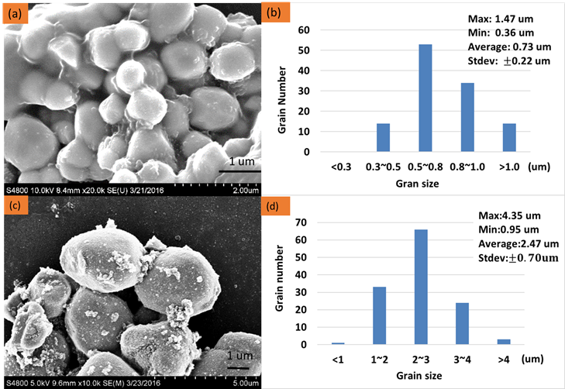
Demonstration of Direct LiT Electrolysis using an Immersion Cell
Scientific Achievement
Direct LiT electrolysis has the opportunity to simplify tritium recovery from a liquid lithium cooling blanket
Improvement of the conductivity and structural integrity of the solid lithium ion conducting materials is critical to creating a viable direct LiT electrolysis process.
Significance and Impact
A direct LiT electrolysis process can eliminate the need to use molten salts for LiT recovery and can eliminate the need for centrifugal separators used in the Maroni process for LiT recovery
Research Details
A sol-gel method was developed for LLZO synthesis that enabled a reduction in grain size to between 0.5 and 0.8 microns as opposed to 2-3 microns for the solid state reaction pathway
The ionic conductivity of the electrolyte is a function of a number of variables, including grain size. The reduction in the LLZO grain size should enable increased conductivity.
Grain size reduction for Lithium Lanthanum Zirconate (LLZO) achieved by using a sol-gel method of synthesis as compared to a solid-state reaction method

Slide 37
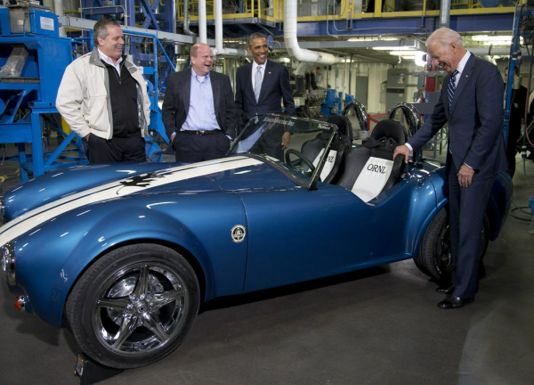
Dealing with power exhaust from a fusion energy device is a recognized challenge
The US is not currently world leading in this area from a fusion nuclear science point of view
We should leverage our strengths to address this challenge
  New materials may provide a solution to the power exhaust challenge, and the US is a world leader in materials
  Additive manufacturing may change the game, and the US is among the world leaders in additive manufacturing

Slide 38
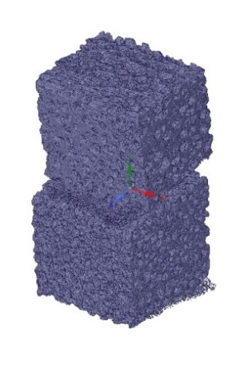
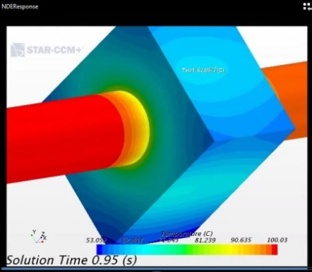
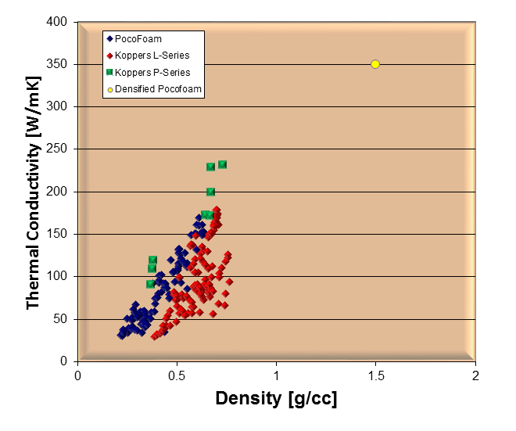
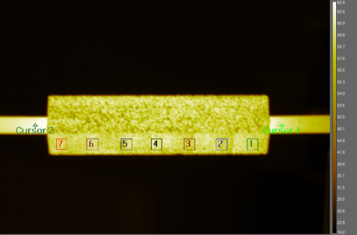
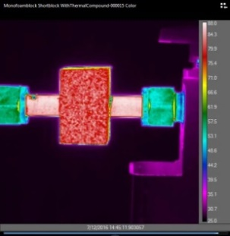
Addressing Power Handling Challenges Can Involve New Materials
Achievement
  Demonstrated that a nearly isotropic high-conductivity, low-Z plasma facing material is possible by combining pyrolytic graphitic ligaments with an isotropic-engineered microstructure
Significance and Impact
  For the first time, the thermal efficiency of low-Z armor is comparable to the copper heatsink
  Max Planck IPP interested in fielding the monoblock in the W7-X stellarator for potential use in divertor scraper element
Research Details
  Densified graphitic foam and mock-ups produced
  Thermal properties measured, k=265 W/mK to date, expect 350 W/mK
  Robust braze joint obtained on CuCrZr tubes
  Hot water IR thermography showed that using no braze joint actually delivers best thermal performance
  Thermal modeling and tomography of microstructure is in progress
Allcomp densified foam
>350 W/mK, ~1.5 g/cc

Slide 39
Advanced manufacturing has been demonstrated on nuclear components
HFIR annular control plates used 1960s technology based on the original design
  Costly, low yield to meet specifications
A joint project between the nuclear fuel materials group, HFIR staff, and the Manufacturing Demonstration Facility at ORNL was initiated in 2014
Multiple techniques were tested
  The cost was less than we initially thought, and was more successful than we could have imagined

Slide 40
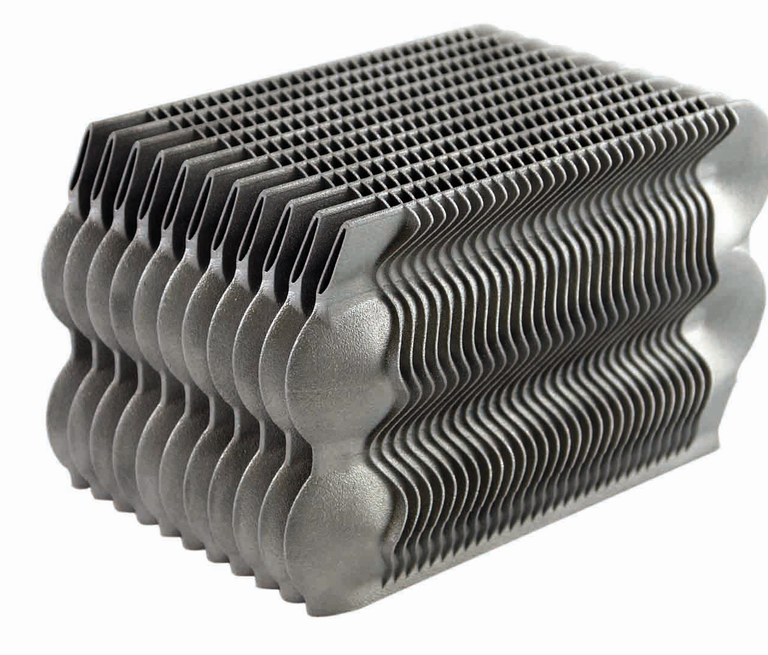


Advanced manufacturing coupled with HPC can lead to innovative solutions for power handling
Additive manufactured parts for HHF testing can be produced and tested
Positron emission particle tracking (PEPT) is used to experimentally validate computational tools
  Remove large conservatism from average heat transfer coefficients
After validating computational tools, HPC can be used to scan a vast array of geometries for additive manufacture
  Optimize the heat transfer capabilities without human bias
Test the new components

Slide 41
Liquid metals are a potential PFC solution for power reactors
Liquid metals (LMs) provide a self-healing and renewable plasma-facing material
LMs eliminate long-time constants associated with plasma-induced wall evolution
LMs separate neutron damage effects from plasma-material interactions
LMs add additional methods for power-exhaust
  Lithium vapor divertor and fast-flow concepts can both greatly exceed current technological limits
Energy Transport Mode
Li CPS (first wall, divertor)
Evaporative and Radiative Cooling
Li Vapor Box,
ARLLD (divertor)
Heat Conduction
to Substrate
FLiLi (first wall)
Sn CPS
(first wall,divertor)
Heat Convection
by Liquid Metal
LiMiTs
(first wall, divertor)
Fast Flow, ACLMD
(first wall, divertor)
See also: M.A. Jaworski, et al., “Breaking through to Reactor Solutions with a Focused, Liquid Metal Program” white paper submitted to the USMFRSD workshop

Slide 42
High temperature superconductors may provide an opportunity for fusion energy development
High-field, high-temperature superconductors (HTS) may enable a new generation of compact fusion experiments and power plants, dramatically speeding up the development path and improving the overall attractiveness of fusion energy
The advantages of HTS are that they can operate at very high magnetic field, high cryogenic temperature, high current densities, and larger mechanical stresses and strains
HTS can significantly enhance the performance and feasibility of almost any type of magnetic confinement device, including:
  Tokamaks
  3D shaped devices such as stellarators and other helical configurations
  STs
  FRCs
  gas dynamic traps
  magnetic mirrors
  levitating dipoles

Slide 43
Summary
Burning plasma research is recognized as a key element in the development of fusion energy
  There are technology implications beyond the physics questions that must be answered
Tremendous advances have been made in fusion nuclear science & technology since the 2004 report
  Advances beyond those predicted in 2004 have been achieved
  Many of these advances have been driven by ITER and the need for design solutions
Fusion nuclear science is an identified need, and an opportunity for world leadership for the US program
A growing fusion nuclear science program is needed to prepare the US for the next step toward fusion energy
Fusion materials is already an area of leadership, but offers opportunities
  PMI, blanket materials, fusion relevant neutron source
Fuel cycle is also a strength and offers opportunities
  Tritium handling, safety, breeding, and fueling
Power handling is a challenge where we are not world leading, but can be by applying our strengths
  New materials, advanced manufacturing, and HPC

Slide 44
Backup

Slide 45

Waste-Free Tritium Recovery: Palladium Membrane Reactor developed for recovery of tritium from water and hydrocarbons
Performance: Almost complete recovery of hydrogen isotopes
Concept: Palladium membrane separates hydrogen isotopes from methane-steam reforming reaction
Construction: Seven palladium/silver tubes (1/4”) prior to catalyst loading

Slide 46


Twin-screw Extruder and Dual Pellet Gun fulfill ITER needs for ELM Pacing and Fueling
A twin-screw extruder is designed to produce the solid 5 mm fueling and 3 mm ELM triggering pellets.
A dual nozzle fills either the fueling and ELM pellet barrels.
A propellant valve fires the pellets once chambered in the respective barrels.
Pellet length is adjustable by changing the extrusion nozzle opening size.
Twin-screw Extruder
Dual Pellet Gun

Slide 47




Vacuum technology - Cryosorption Pump Development
4 K pumping circuit made of charcoal coated panels by forced flow cooling with Super Critical cryogenic Helium.
Pumping by coconut charcoal:
Efficiently Helium at T< 5 K
Efficiently all hydrogen isotopes at T < 10 K
Main inlet valve for flow control and separation of the pump from the torus for regeneration.
The worlds largest all metal high vacuum valve.

Slide 48


Vacuum technology – The Cryogenic Viscous flow Compressor (CVC)
Pump inlet (hydrogen Isotopes and helium)
Novel second stage pump which pumps the regenerated hydrogen isotopes fuel and helium from the first stage cryo-sorbtion pumps.
Hydrogen isotopes are pumped by cryo-condensation and helium is pumped by the flow of hydrogen isotopes and mechanical pumps - separating the fuel and the helium created in the fusion process.
Pump outlet (helium)
80K
4.5K

Slide 49



Why is disruption mitigation required in ITER?
Runaway Electrons damage plasma facing components
JET inner limiter
I_{RE} ≈ 0.9 MA
G.F. Matthews, Phys.Scr. 2016

Slide 50

ITER Has and Will Continue to Enable Advances in Fusion Technologies
  Large, high field superconducting magnets
Remote maintenance and handling
  Test blankets for tritium breeding
  Tritium processing systems
  Hardened diagnostics
  High heat flux systems/components
  Long pulse, high power density heating
  and current drive systems
  Plasma current quench detection/remediation systems
  Integrated control systems for the nuclear plant and plasma, including burn control
Support ITER as an essential Element of the U. S. Fusion Energy Science Program

