Slide 1
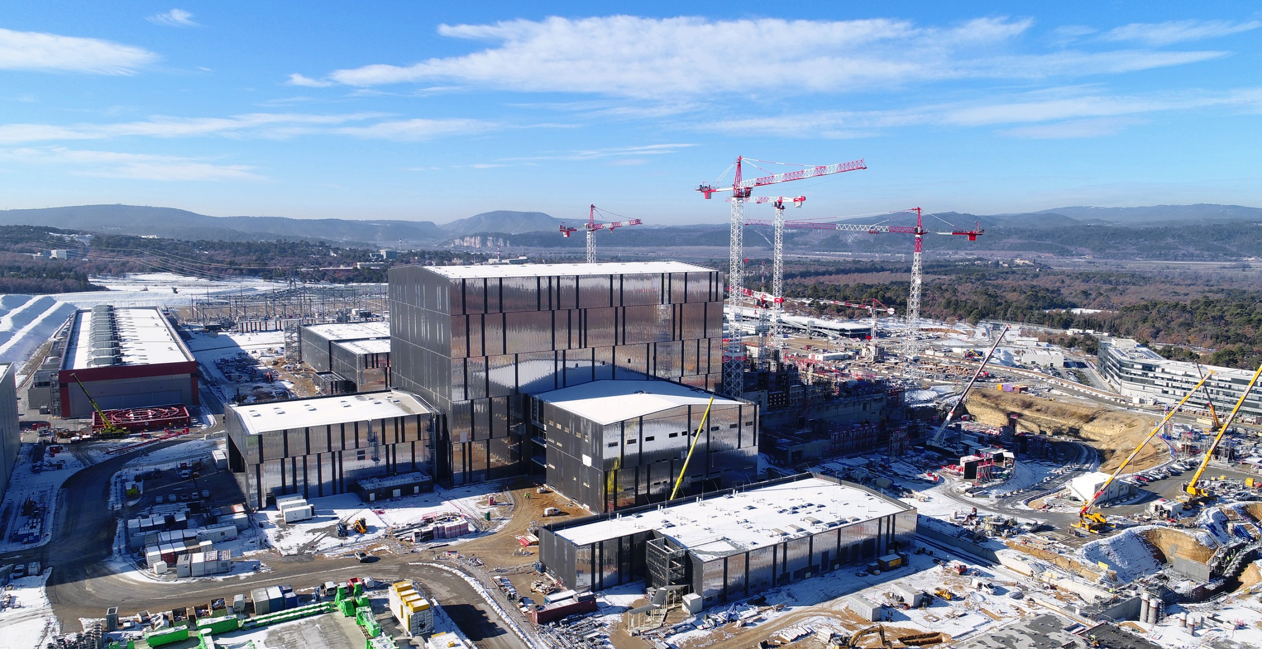
ITER
The way to a new, clean, safe and nearly-unlimited energy
Bernard BIGOT, Director-General, ITER Organization

Slide 2
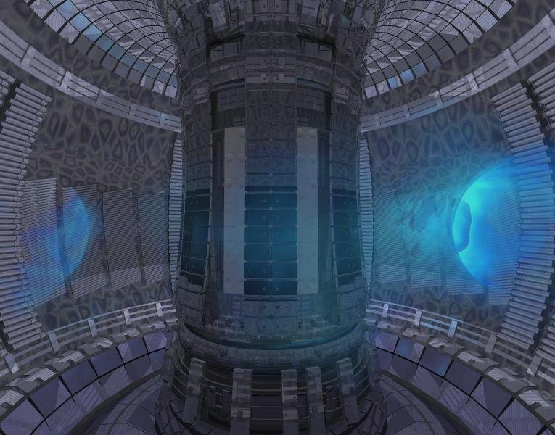
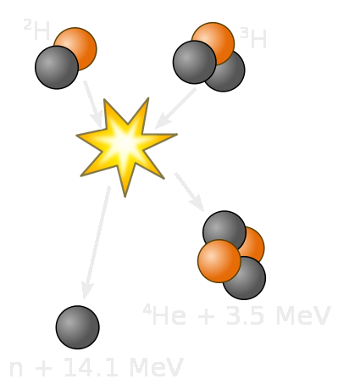
Fusion on Earth
1 gram of fusion fuels = 8 tons of oil
A plasma of Deuterium + Tritium (hydrogen isotopes) is heated to more than 150 million °C.
The hot plasma is shaped and confined by strong magnetic fields.
Helium nuclei sustain burning plasma.
Neutrons transfer their energy to the Blanket .
In a fusion power plant, conventional steam generator, turbine and alternator will transform the heat into electricity.
0.7 MeV
τ
Notes:
Keep hot plasma KD: “will” transform
Hot to High energy,
alpha particles

Slide 3
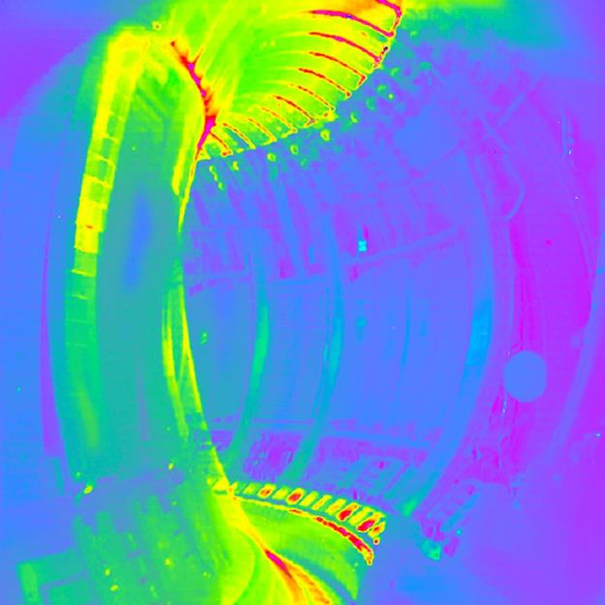
Fusion’s advantages
A new energy source of massive, predictable and potentially continuous or variable power complementary of the renewable energies
Safe, environmentally responsible
Almost limitless supply of fuel for hundreds of millions of years, widely distributed around the globe
No CO2 or other greenhouse gases
No long-lasting high-activity radioactive waste
A plasma in the European tokamak JET

Slide 4
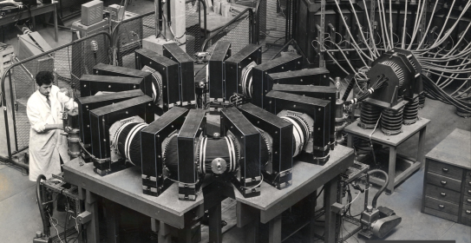
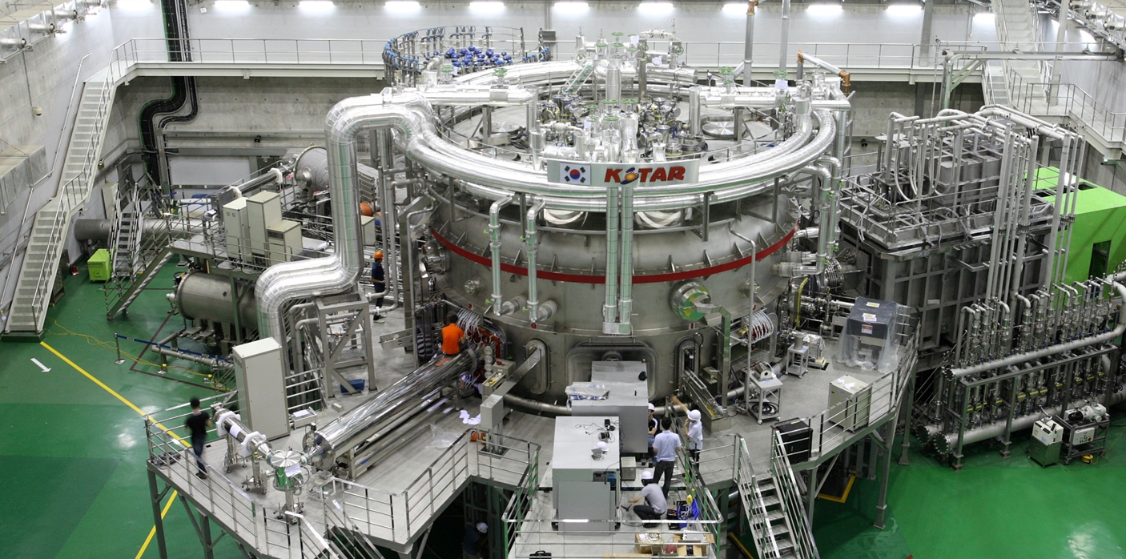
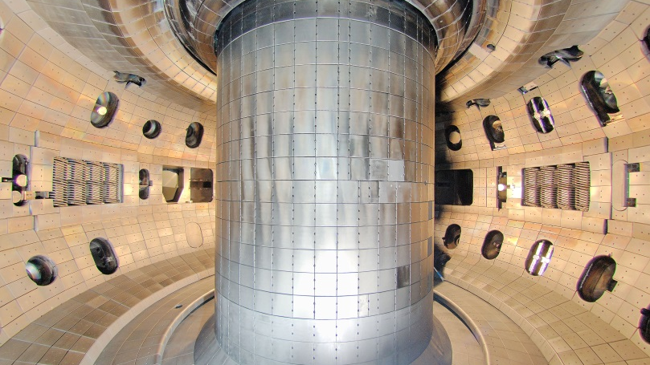
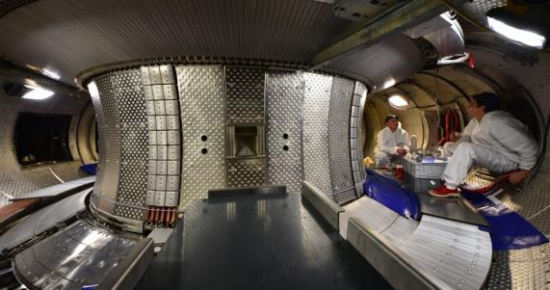
60 years of constant progress
TA-2000,
France, 1957
KSTAR, Korea
2008
DIII-D, US
- 1978
General Atomics - DOE.
WEST, CEA-Euratom, 1988, now testbed for ITER

Slide 5
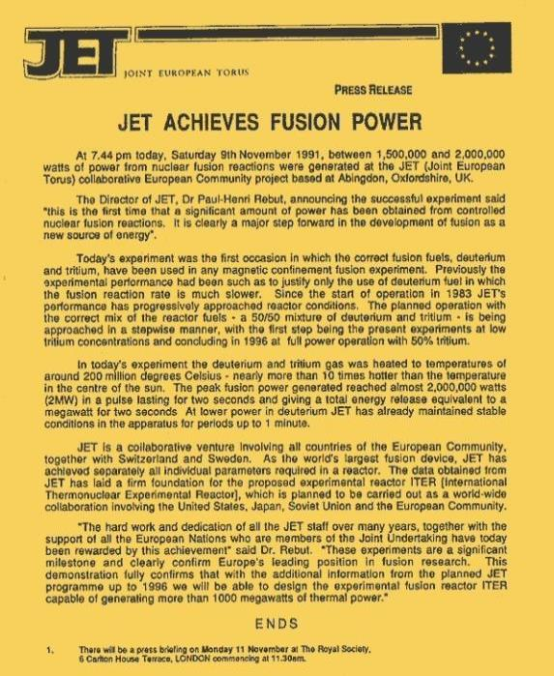
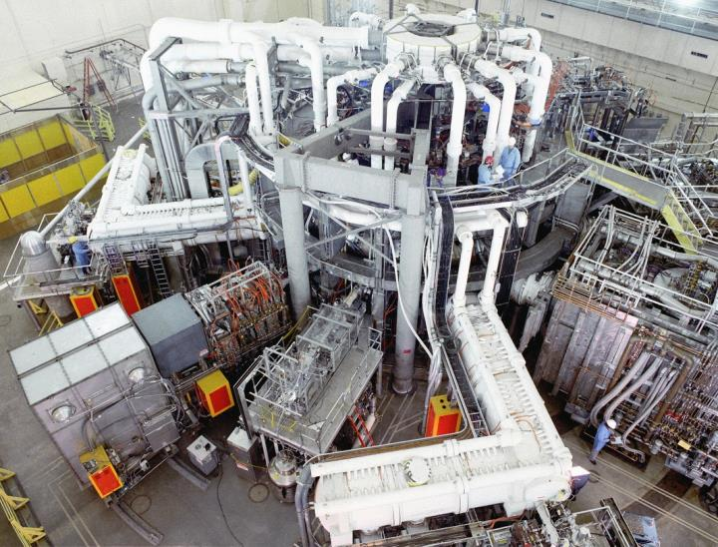
DT Fusion demonstrated!
Among the large tokamaks that went into operation in early 1980s, two were designed to perform Deuterium-Tritium operations: the European JET and the American TFTR. Both achieved DT fusion : JET in 1991 (2 MW of fusion power) and 1997 (16 MW); TFTR in 1993 (6.2 MW) and 1994 (10 MW). However, both machines had required more energy to « light the fire » than the fire had given in return (ratio of Q ~ .65). ITER aims for a ratio of Q > 10.

Slide 6
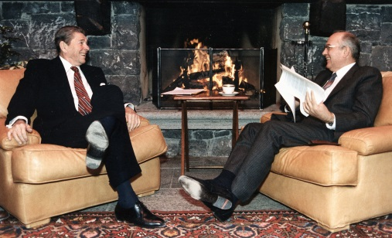
A decisive political push
November 1985
At the Geneva Summit Presiden Reagan and Secretary General Gorbatchev give a decisive political push to an international collaboration on fusion “for the benefit of all mankind”…

Slide 7
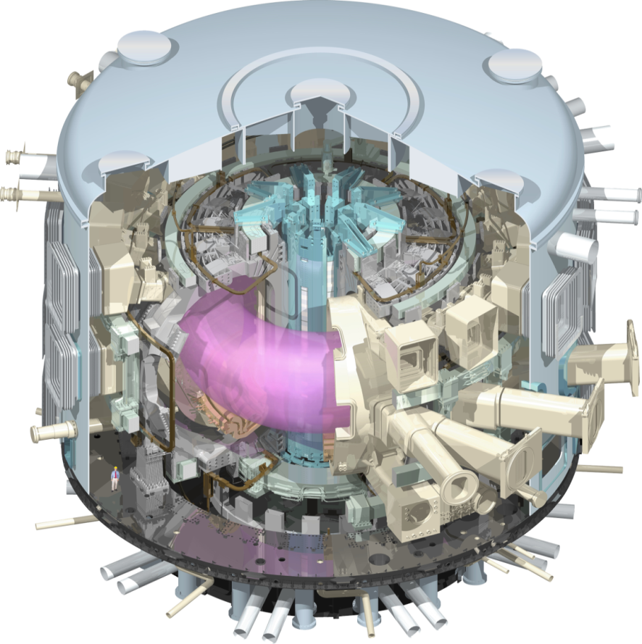
ITER mission
To demonstrate the scientific and technological feasibility of fusion power for peaceful purposes
ITER is the only magnetic fusion device under construction aimed to produce a burning plasma.
Input (heating power): 50 MW
Output (fusion power): 500 MW

Slide 8
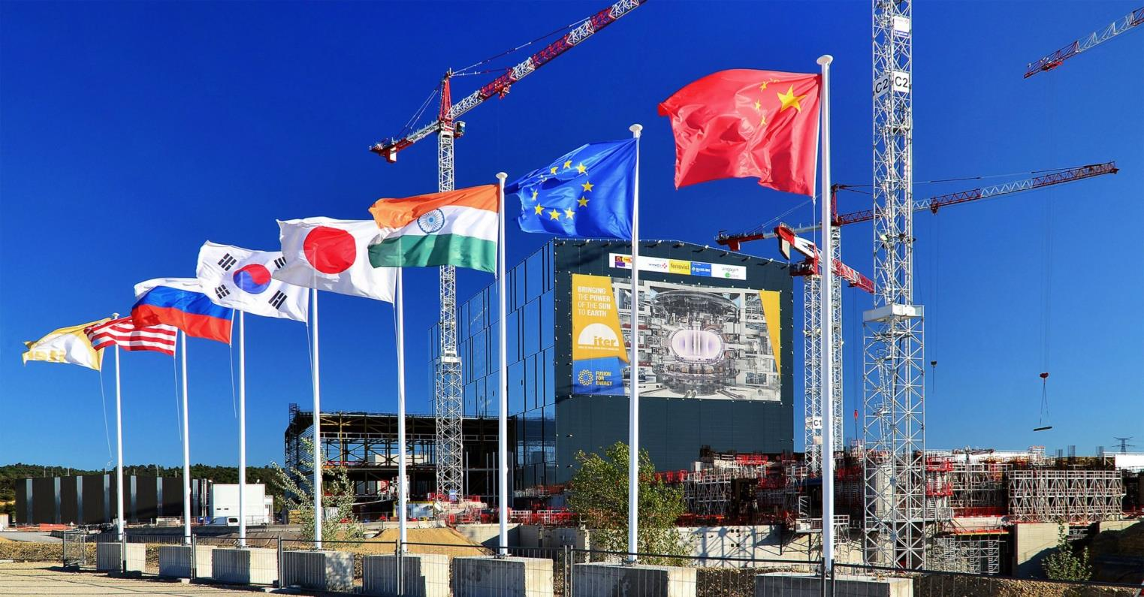
ITER
A multinational scientific collaboration without equivalent in history
A large-scale experiment to demonstrate the feasibility
of fusion energy

Slide 9

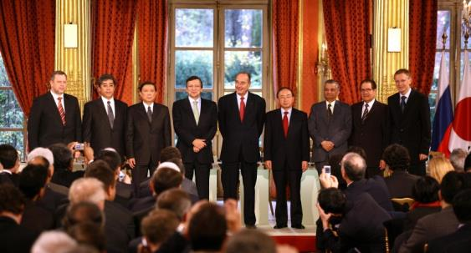
Global challenge,
global response
28 June 2005: The ITER Members unanimously agreed to build ITER on the site proposed by Europe
21 November 2006: The ITER Agreement was signed at the Élysée Palace, in Paris.
The seven ITER Members represent more than 50% of the world’s population and about 85% of the global GDP
China EU India Japan Korea Russia USA
Notes:
KD: “represent” KD: Remove “on” from dates

Slide 10
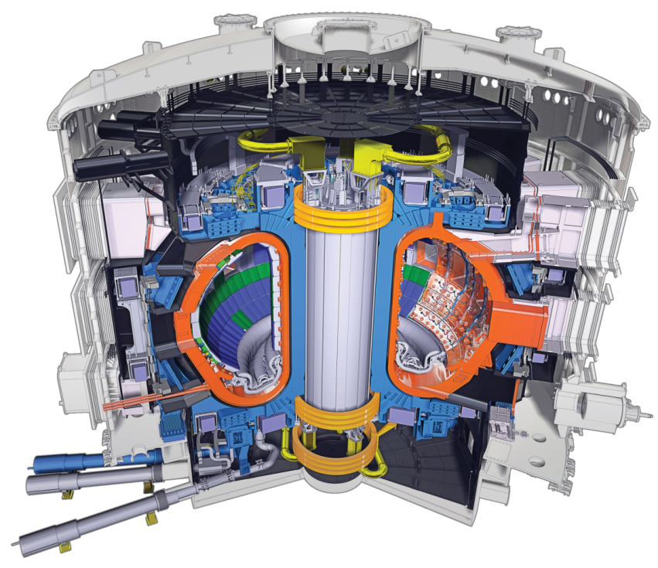
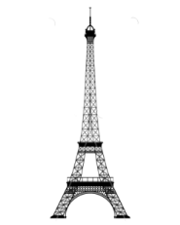

The ITER Tokamak
Vacuum Vessel: ~ 8 000 t.
TF Coils: ~ 18 x 360 t.
Central solenoid: ~ 1 000 t.
Etc.
Total ~ 23 000 t.
R=6.2 m, a=2.0 m, I_{p}=15 MA, B_{T}=5.3 T, 23,000 tonnes
3,5 times the weight of the Eiffel Tower!

Slide 11
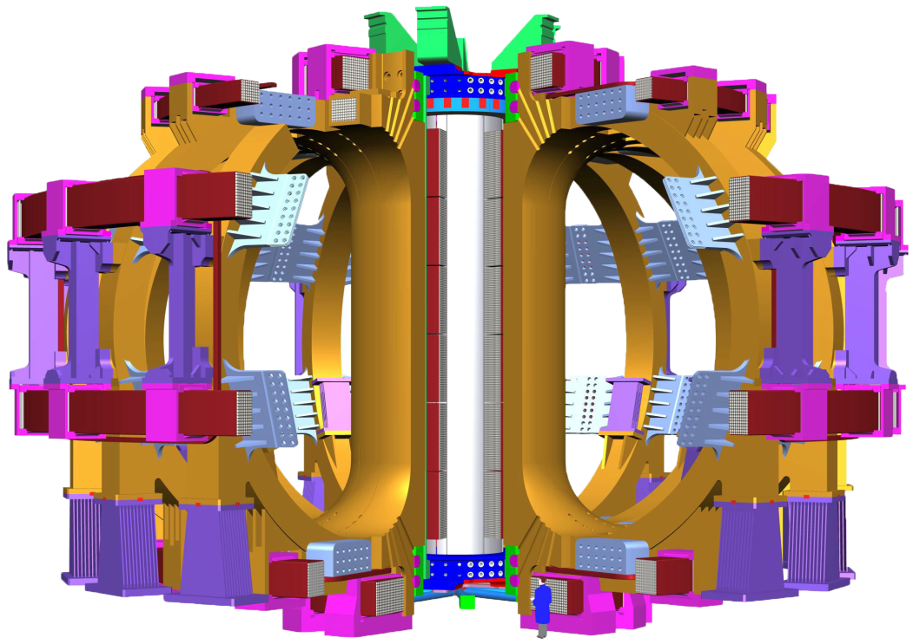
A large magnetic cage
An intense magnetic field, generated by powerful superconducting magnets shape and confine the hot plasma, and keep it away from the vacuum vessel wall.
1 central solenoid, 13 m high, 1,000 tons, powerful enough to lift an aircraft-carrier out of the water
18 Toroidal Field Coils, 17-metre high, 360 tons each.
6 Poloidal Field Coils, 8 to 24 m. in diametre, 200 to 400 tons.

Slide 12

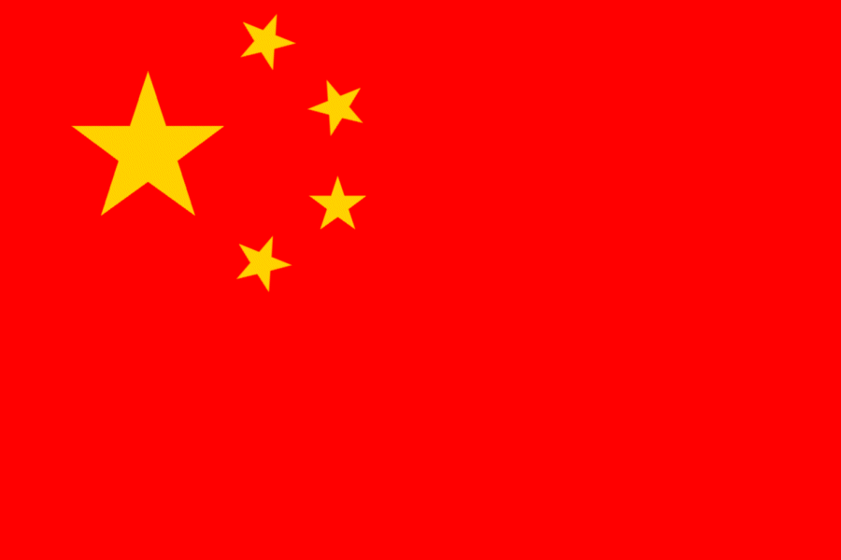

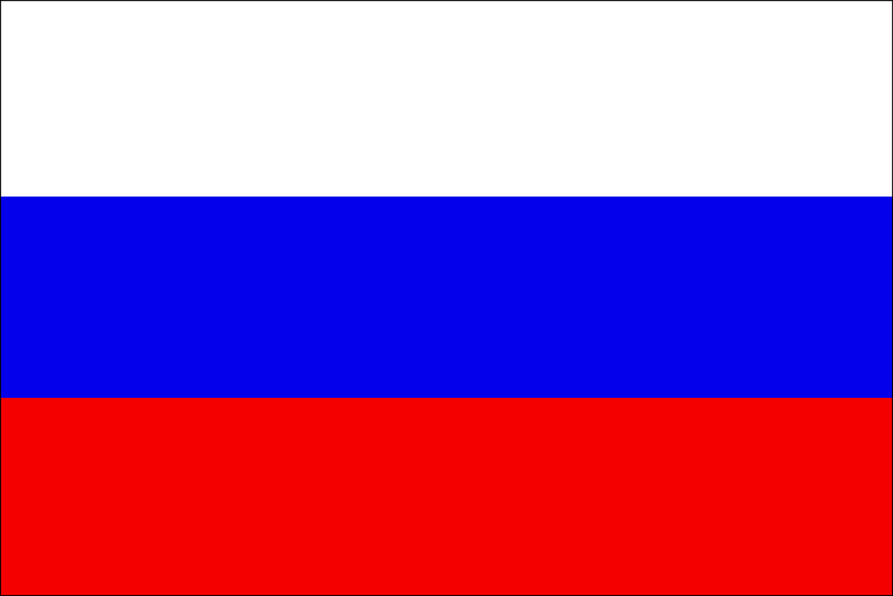
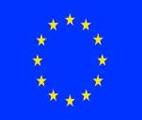



An integrated project:
Central Team & Seven Domestic Agencies
IO
The 7 ITER Members make cash and in-kind contributions (90%) to the ITER Project. They have established Domestic Agencies to handle the contracts to industry.
The ITER Organization Central Team manages the ITER Project in close collaboration with the 7 Domestic Agencies.
The ITER Members share all intellectual Property generated by the Project.
CN
US
ITER Project
RF
EU
KO
IN
JA

Slide 13
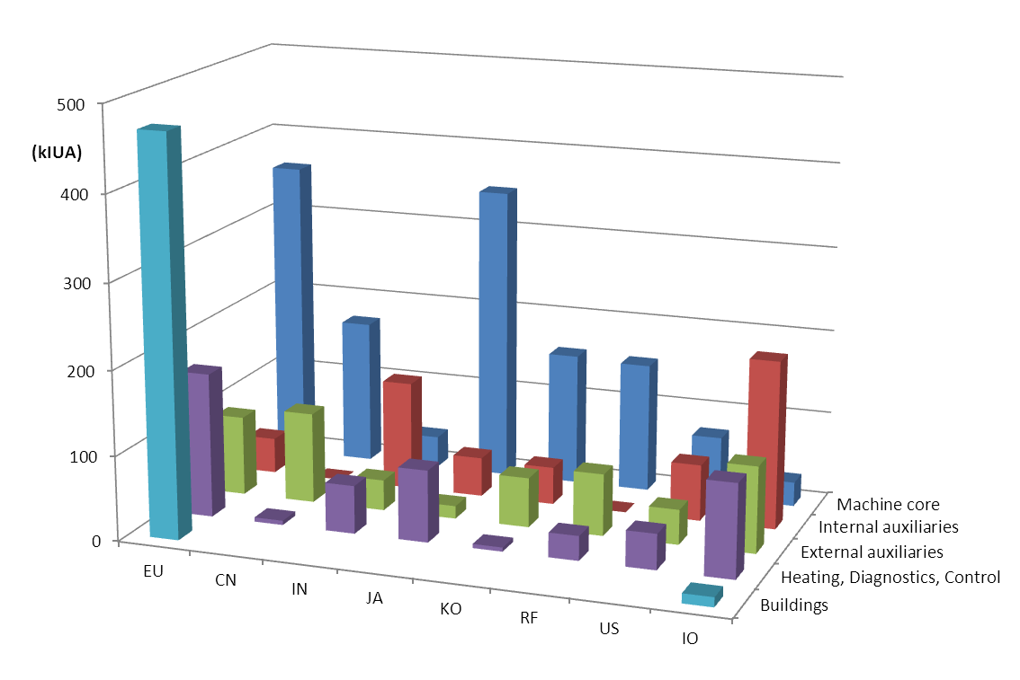
A unique formula
ITER is being built through the in-kind contributions
of the seven Members of the ITER Organization.
China, India, Japan, Korea, Russia and the United States each have responsibility for ~ 9% of procurement packages.
Europe’s share, as Host Member, is ~ 45% (construction and manufacturing).

Slide 14
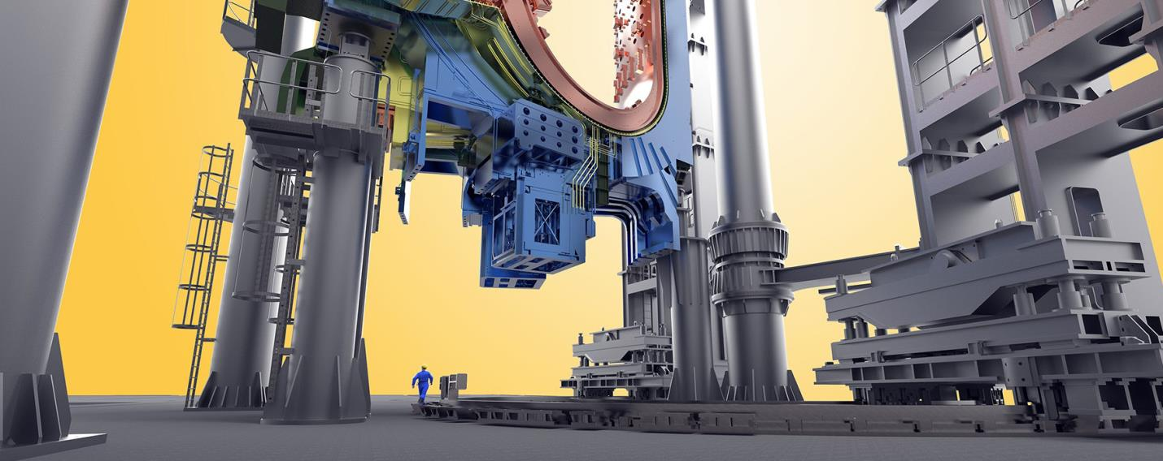
Naval construction-size components…
Inside the Assembly Hall, giant tools (procured by Korea) will handle loads up to 1,500 tons

Slide 15
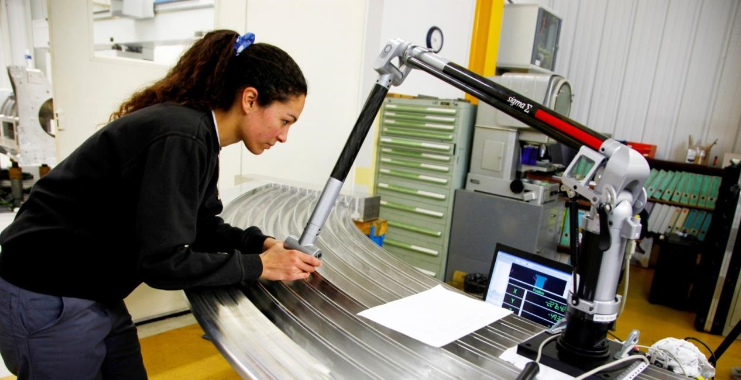
…watch-like precision
Laser measurements of grooves in TF Coil radial plates. Tolerances are in the 1/10th millimetre range.

Slide 16
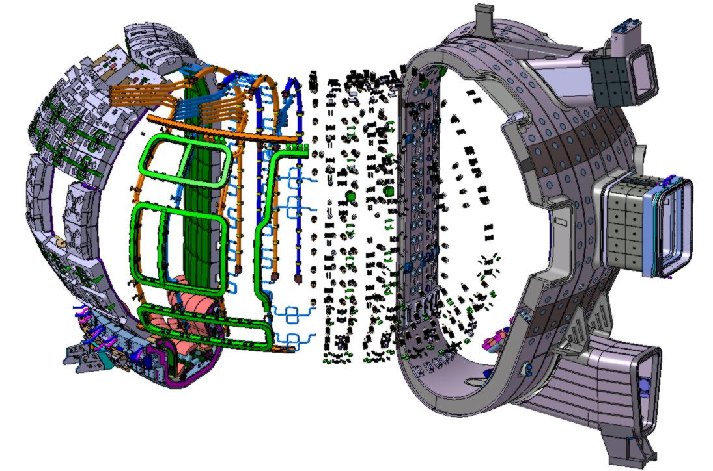
The integration challenge
BLANKET MODULES
MANIFOLD
DIVERTOR
INTERNAL COILS
INTERFACES

Slide 17
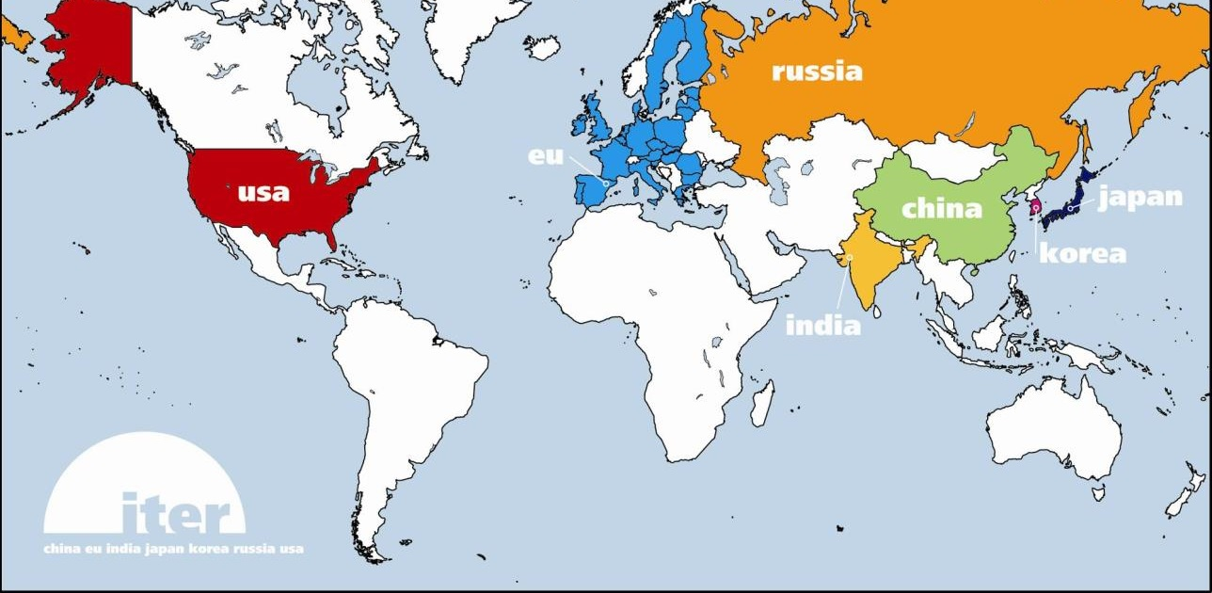
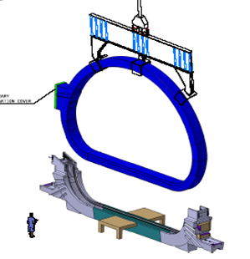
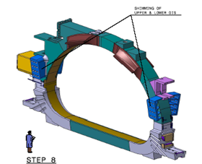
Managing collaboration
(The TF Coils example)
TF Coil
TF coil cases
Conductor
Japan
Japan
China
Russia
Europe
South Korea
United States
Japan
Europe

Slide 18
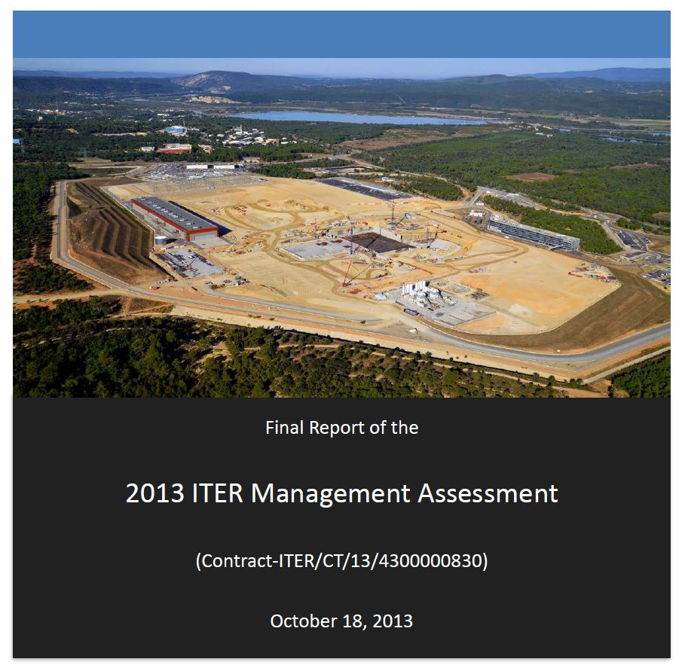
2015: managing the need for change
Action Plan 2015
Set clear priorities and timeline for reform
Reorganized, integrated ITER Central Team with Domestic Agencies
Clear decision processes and accountability
Executive Project Board, Reserve Fund, Project Teams
Finalized and stabilized ITER critical component design
Comprehensive integrated bottom-up review of all activities, processes and systems
Developed an optimized resource-loaded schedule for timely, cost-effective construction and operation through D-T plasma. Updated the 2010 Baseline.
Developed and promoted a strong, organization-wide nuclear project culture

Slide 19
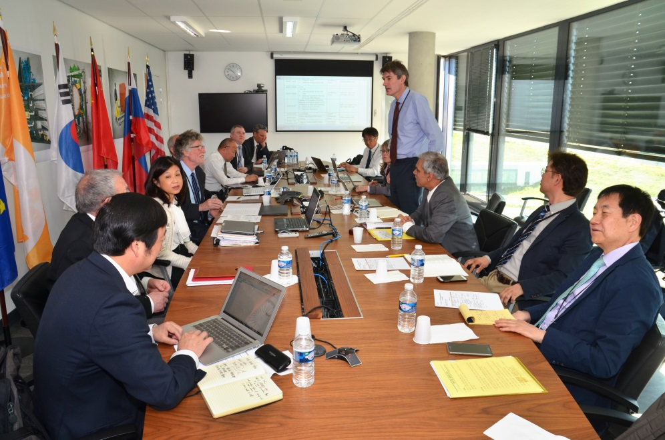
April 2016: intensive, in-depth review by independent expert group declares:
“…substantial improvement in project performance…”
“…high degree of motivation…
“…considerable progress during the past 12 months…”
“…sequence and duration of future activities have been fully and logically mapped in the resource-loaded schedule…”
“…resource estimate is generally complete […] and provides a credible estimate of cost and human resources…”

Slide 20
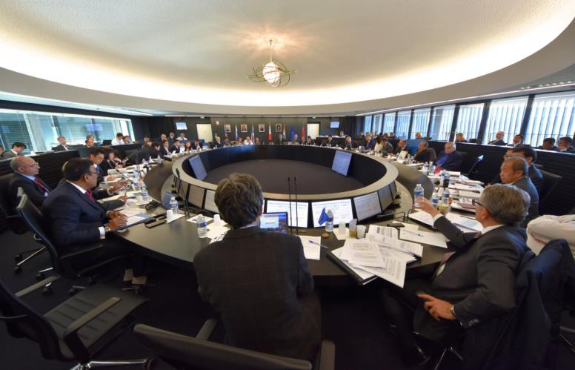
18th & 19th ITER Council endorse updated Schedule
First Plasma in December 2025; first scientific experiments in 2028; first nuclear plasma (DT) in 2035
The updated Schedule is challenging but technically achievable.
It represents the best technically achievable path forward to First Plasma.
Members now have all the elements needed to go through their domestic processes of obtaining approval for the Resource-Loaded Integrated Schedule
ITER Council convenes twice a year in June and November at ITER Headquarters

Slide 21
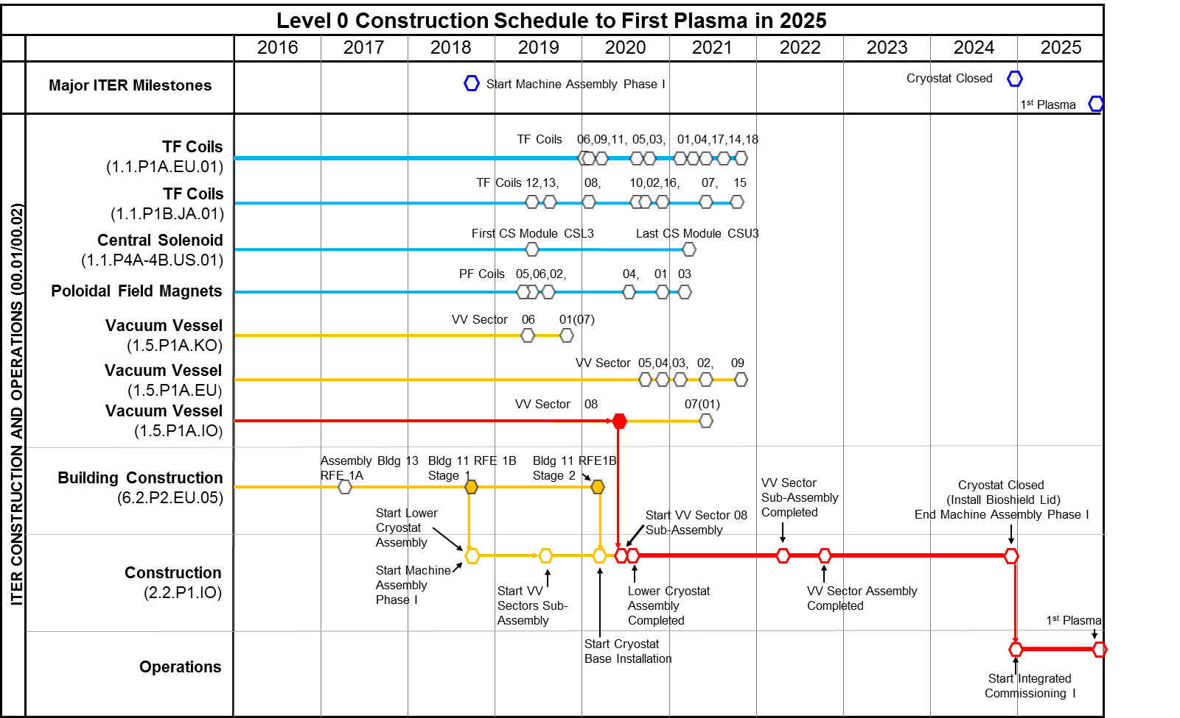
Major assembly milestones

Slide 22
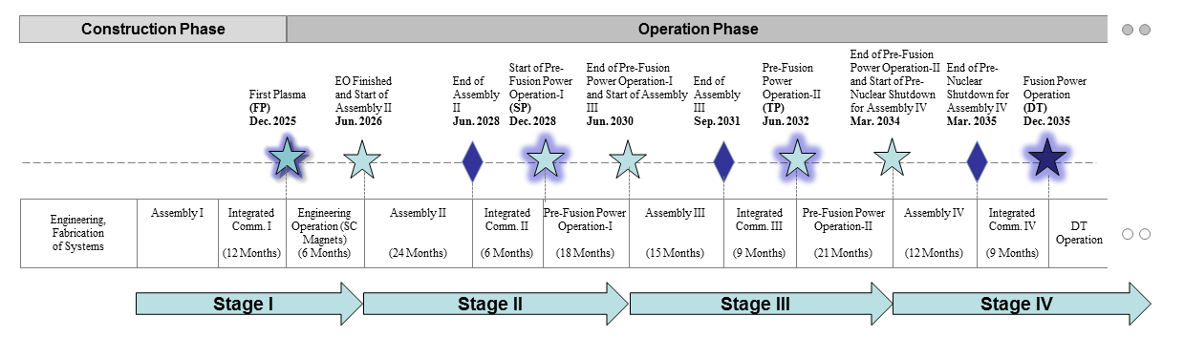
A staged approach to DT plasma
Extensive interactions among IO and DAs to finalize revised baseline schedule proposal
Schedule and resource estimates through First Plasma (2025) consistent with Members’ budget constraints
Proposed use of 4-stage approach through Deuterium-Tritium (2035) consistent with Members’ financial and technical constraints

Slide 23
Who works for ITER?
Distribution by Member
Oct. 2017
The international staff of the ITER Organization (Central Team) comprises ~ 800 persons (35 countries).
An equivalent number of contractors and experts are directly working for ITER in Saint-Paul-lez-Durance.
More than 2,000 specialists work for ITER throughout the world.

Slide 24
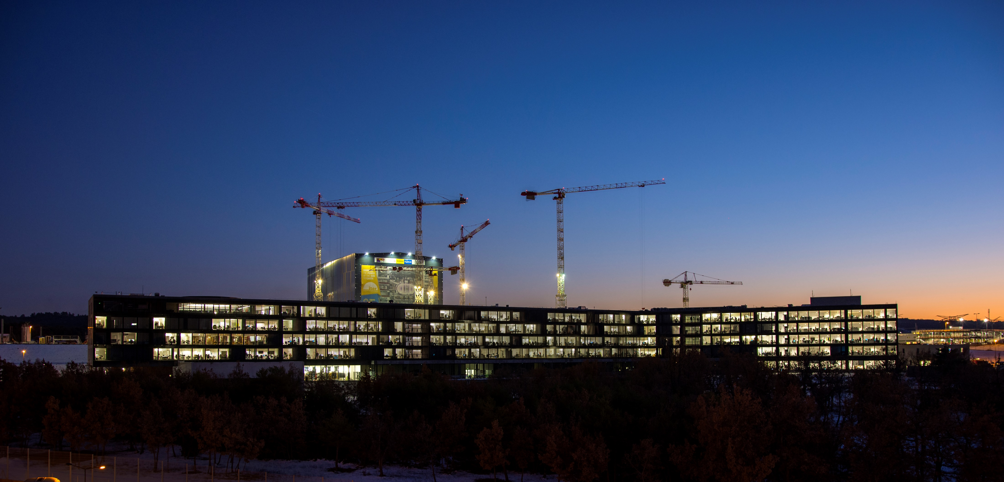













Halfway to First Plasma
According to the stringent metrics that measure project performance, 50 percent of the "total construction work scope through First Plasma" is now complete. More than 750 publications, from a total of 41 countries, hailed the accomplishment.
Etc.

Slide 25
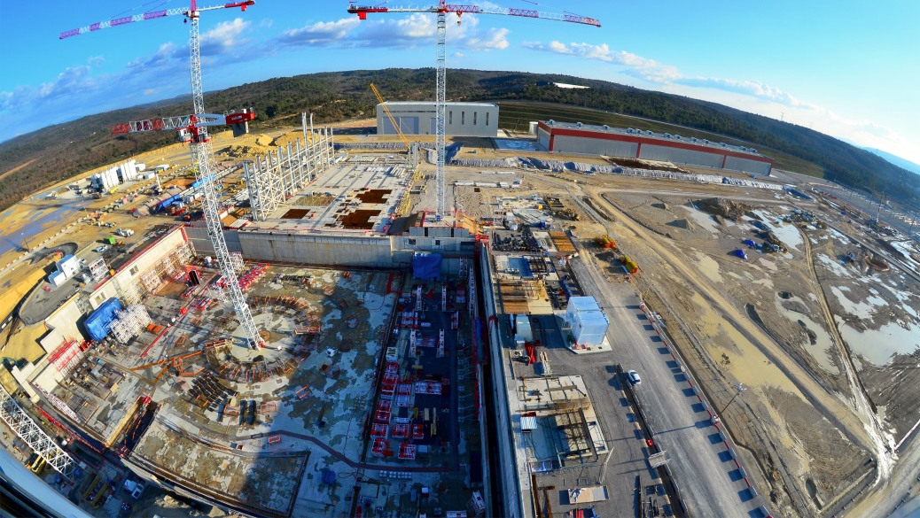
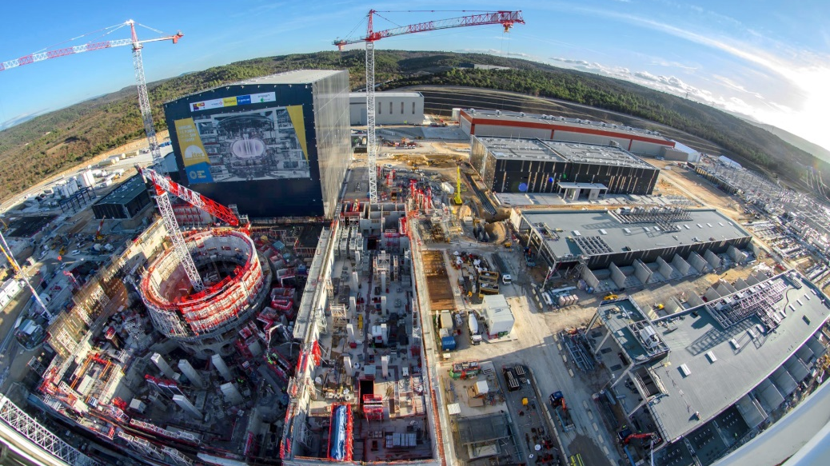
Worksite progress
February 2015 – January 2018

Slide 26
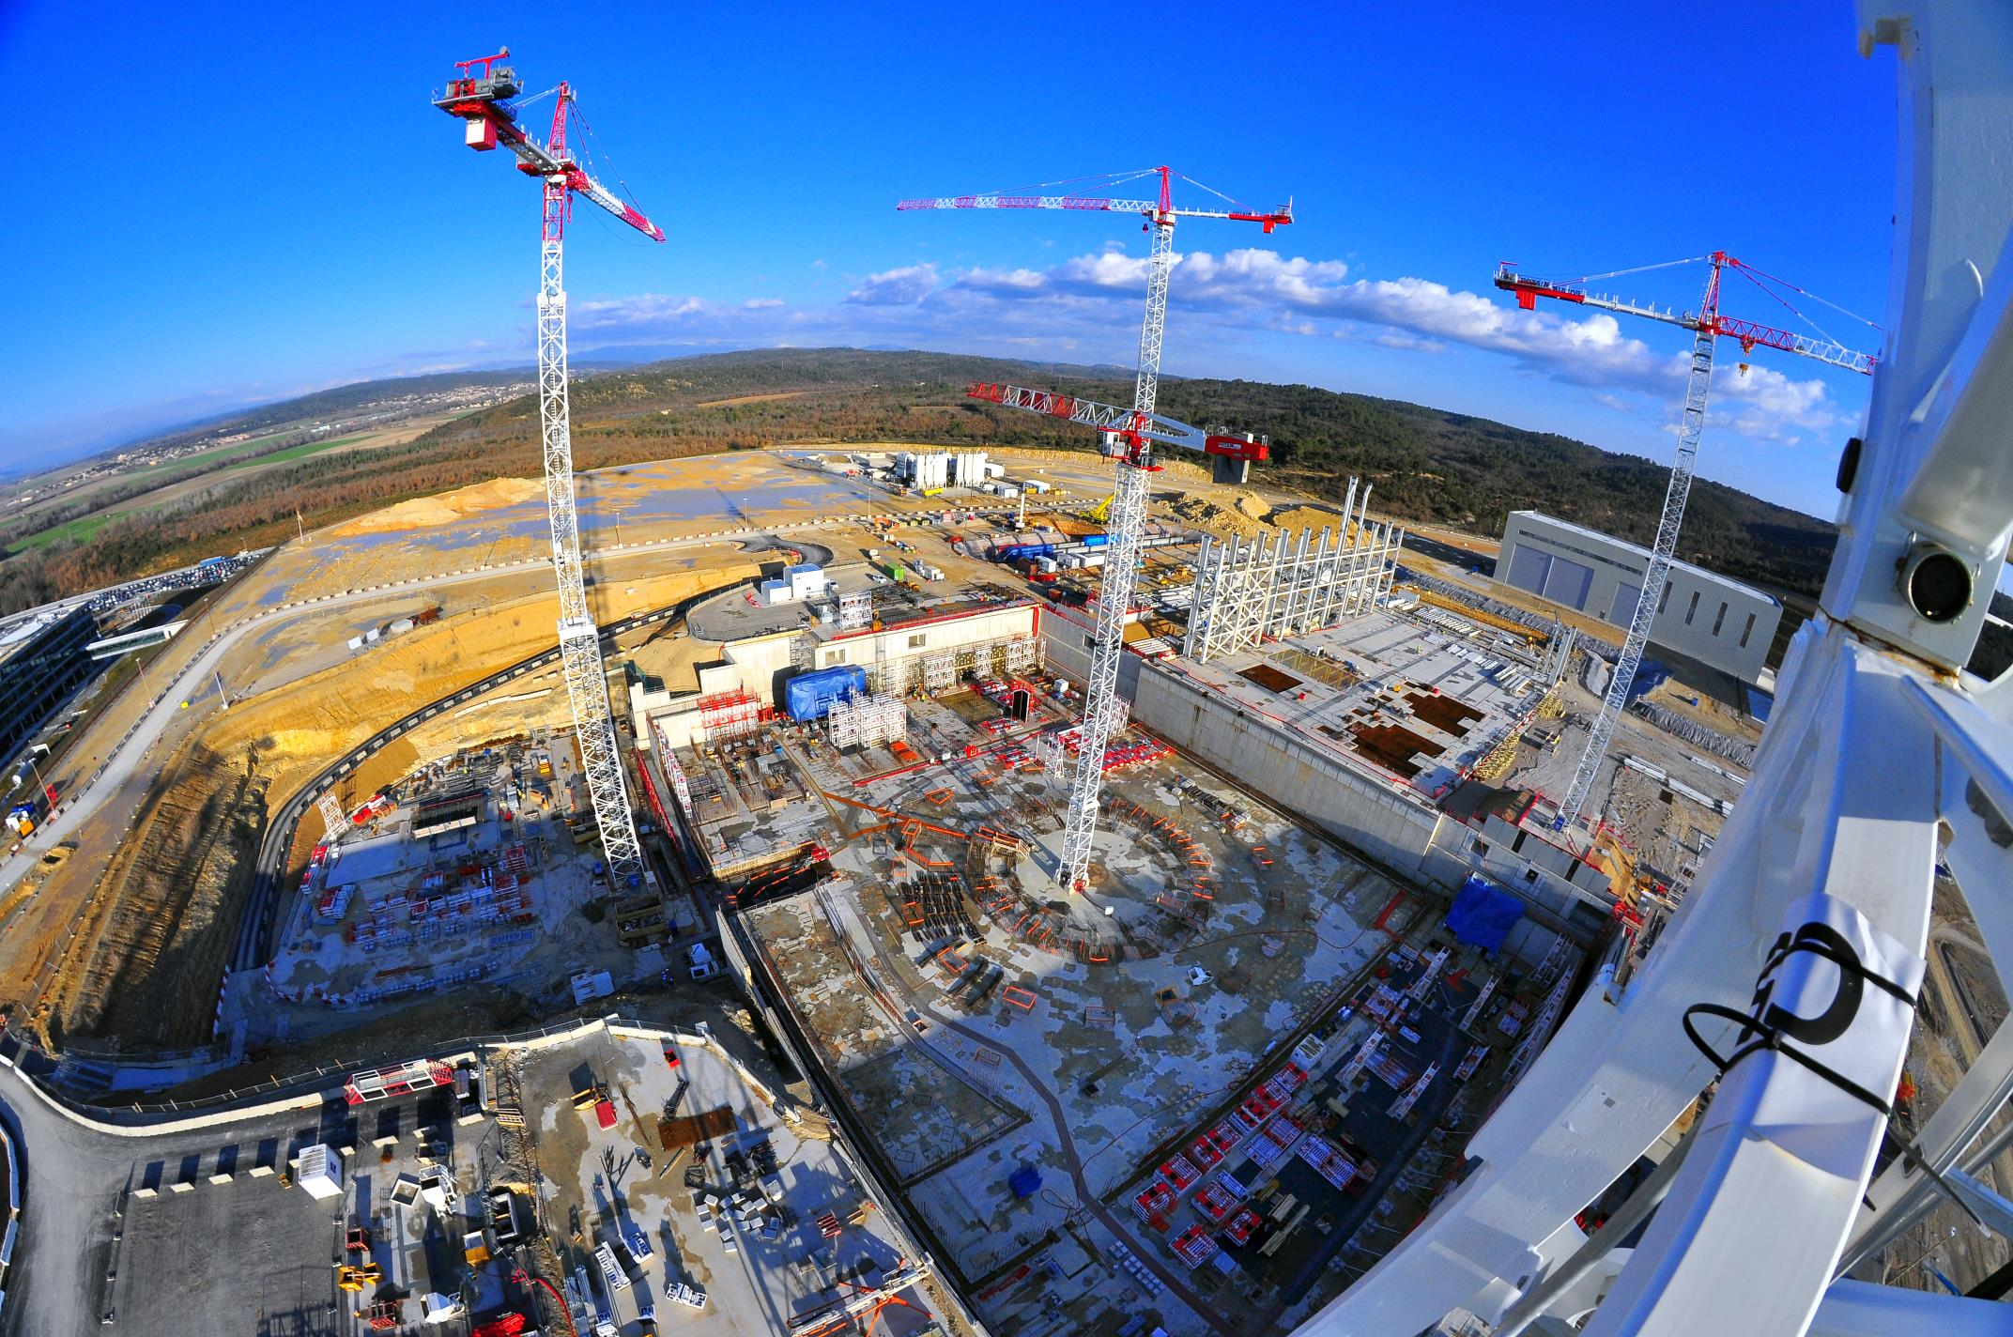
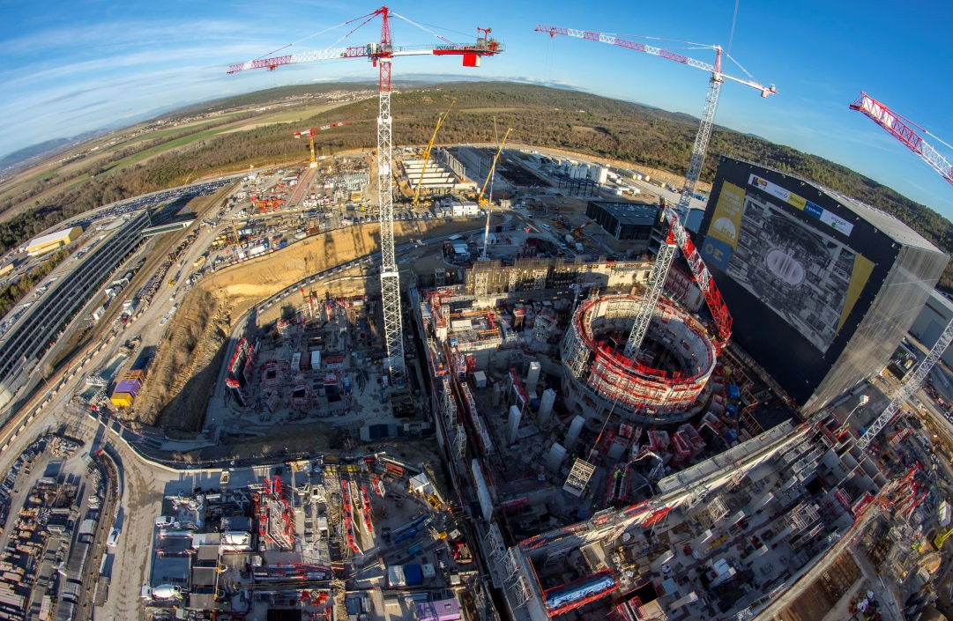
Worksite progress
February 2015 – January 2018

Slide 27
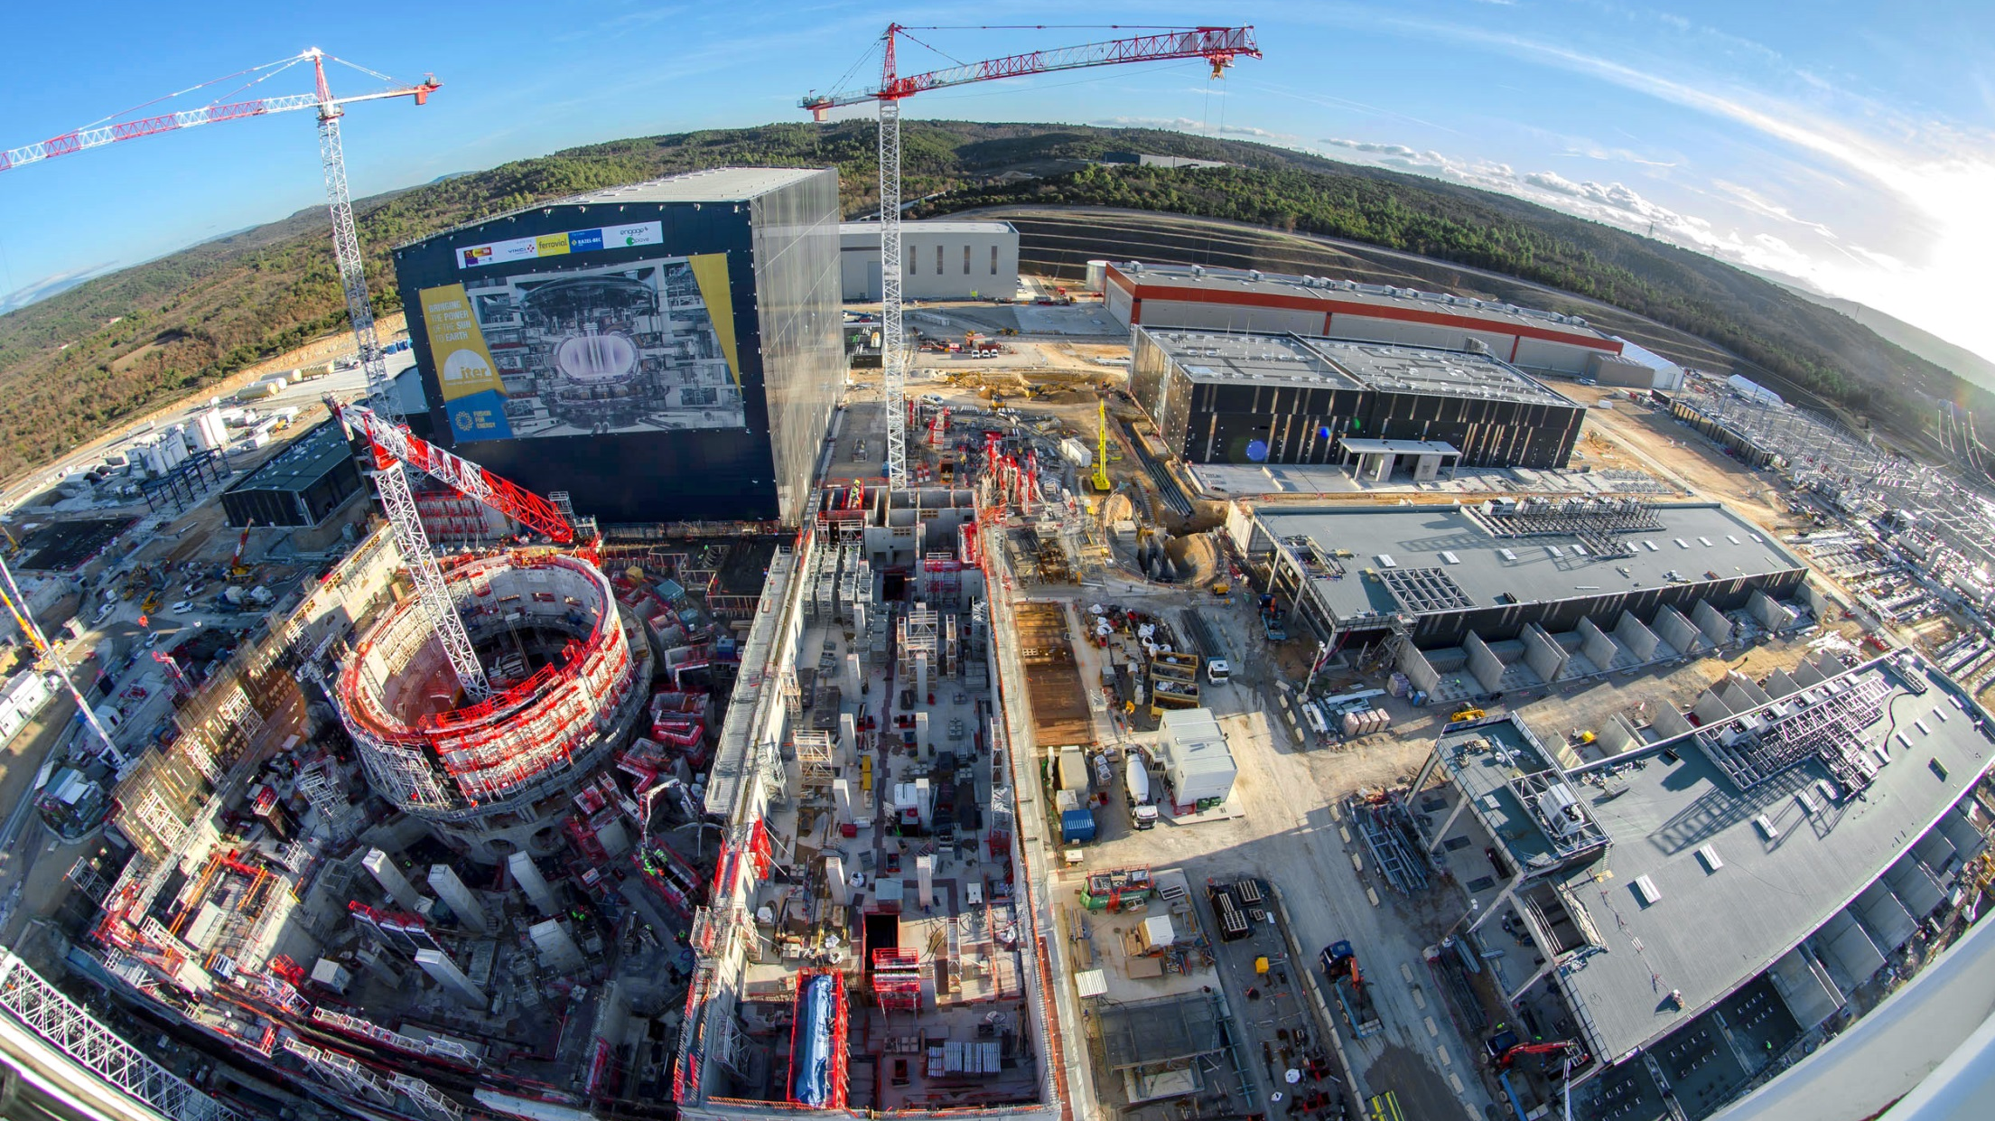
Worksite progress
Cryostat Workshop
PF Coil Winding Facility
Radiofrequency Heating
Assembly Hall
Cryoplant
Service Bdg.
Cooling System
400 kV Switchyard
~ Machine axis
Bioshield
Magnet Power Conversions Bdgs.
Tokamak Bdg.
Diagnostics Bdg.
18 January 2018
Tritium Bdg.

Slide 28
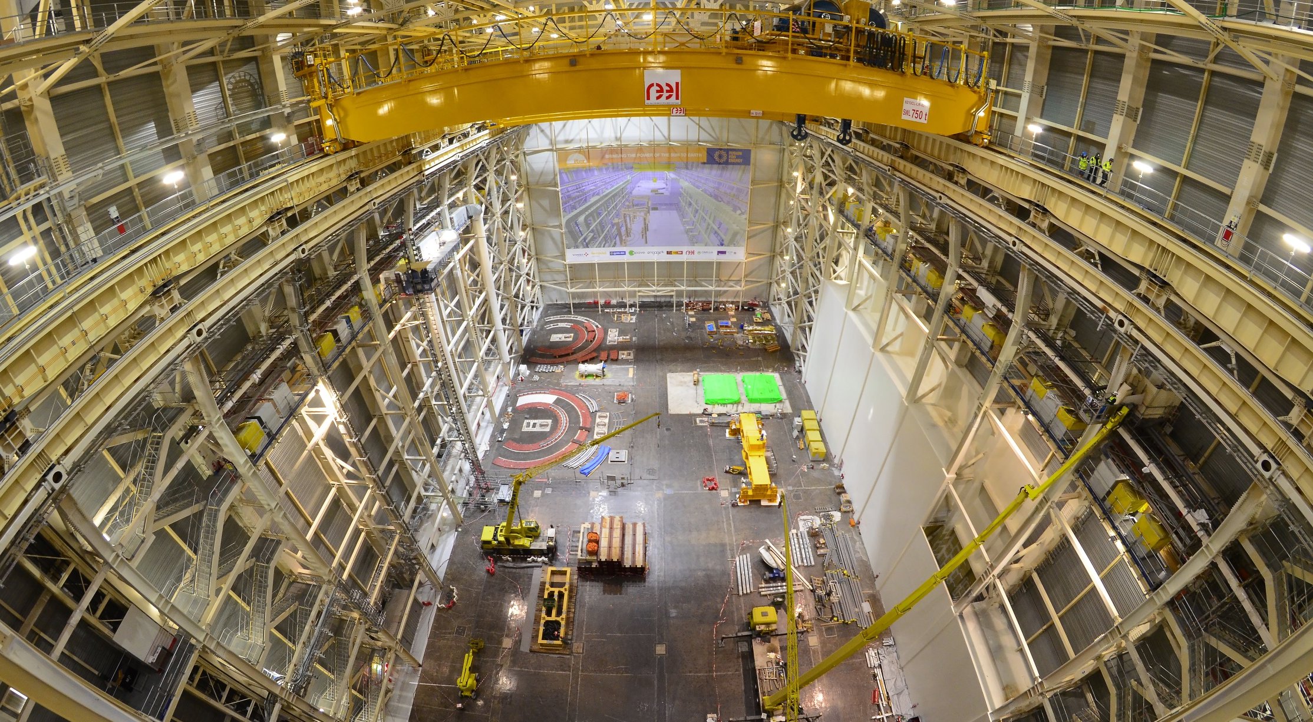
Assembly Hall
Before being integrated in the machine, the components will be prepared and pre-assembled in this 6,000 m2, 60-metre high building. The Assembly Hall is equipped with a double overhead travelling crane with a total lifting capacity of 1,500 tons.

Slide 29
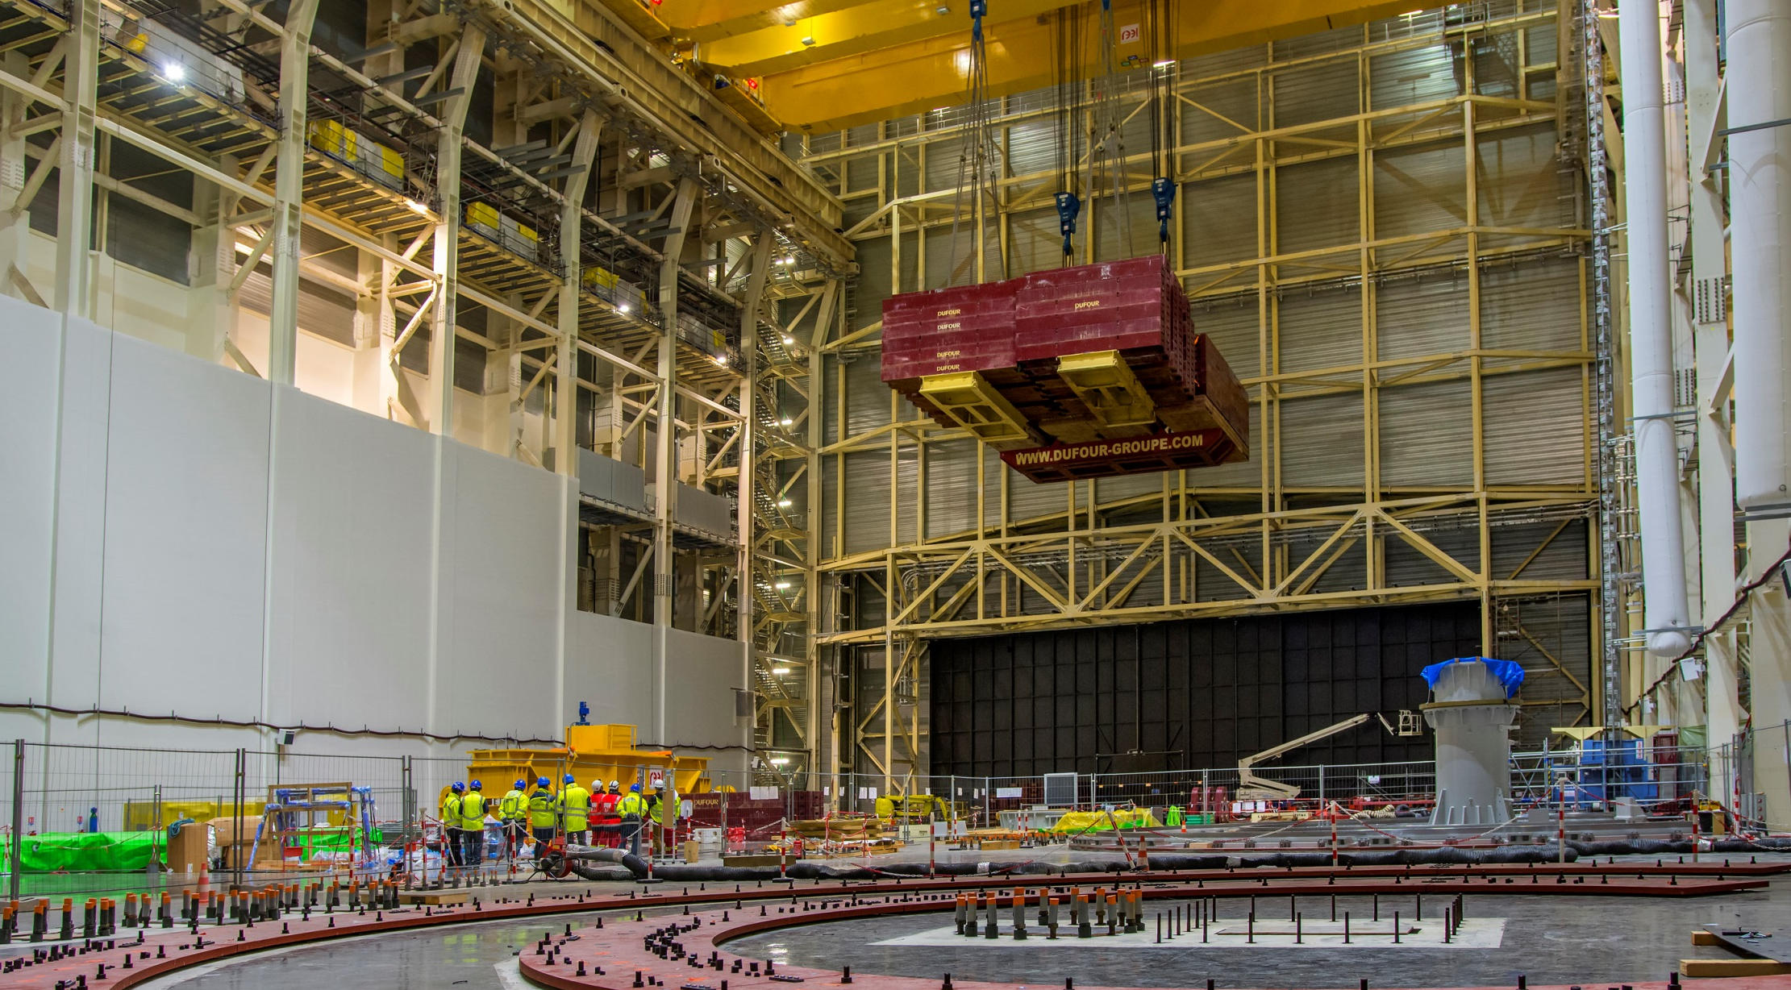
Assembly Hall
Load tests, both static and dynamic (1,875 – 1,650 tonnes), are now finalized in the Assembly Hall. Note the « foot » of the SSAT-1 already in place.

Slide 30
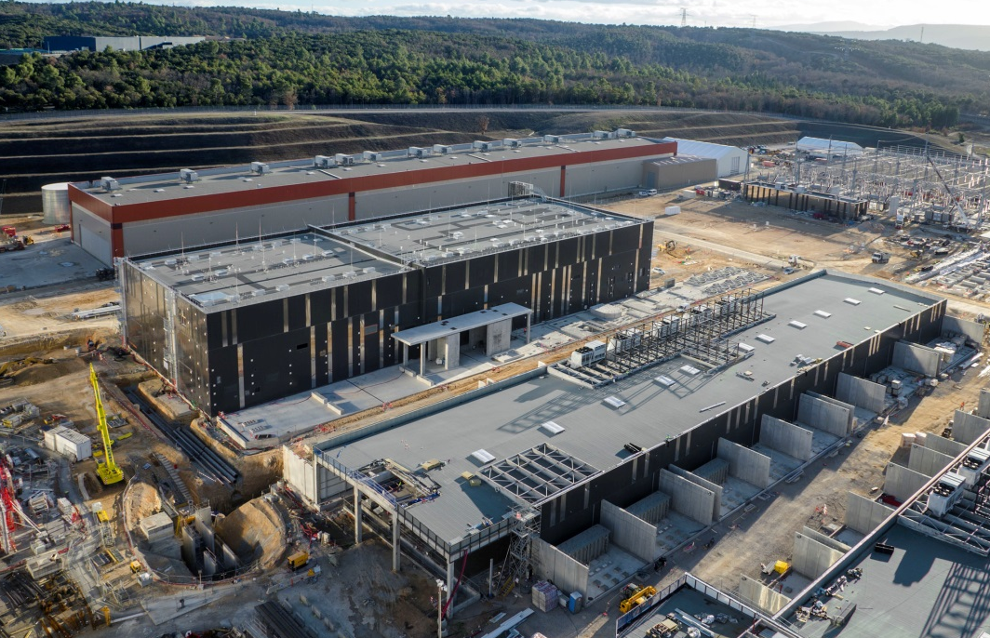
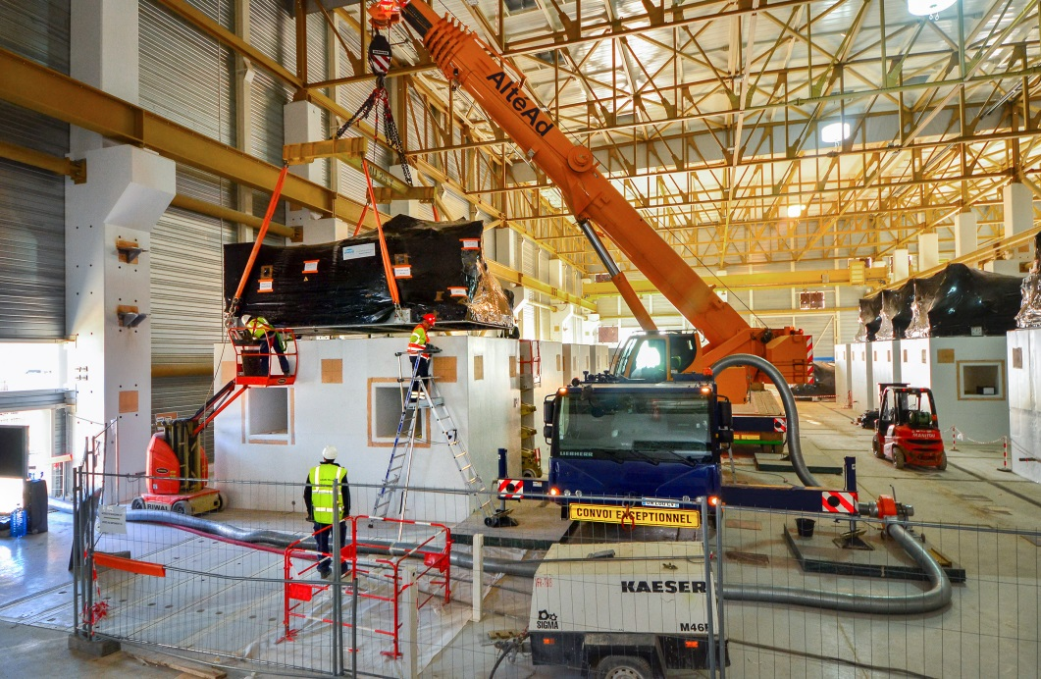
Cryoplant
The ITER Cryoplant will be the largest single platform cryofacility in the world. It will distribute liquid helium to various machine components (superconducting magnets, thermal shield, cryopumps, etc.). The last of 18 skids supporting the helium compressors was installed atop their massive four-metre-high concrete pads in November 2017.

Slide 31
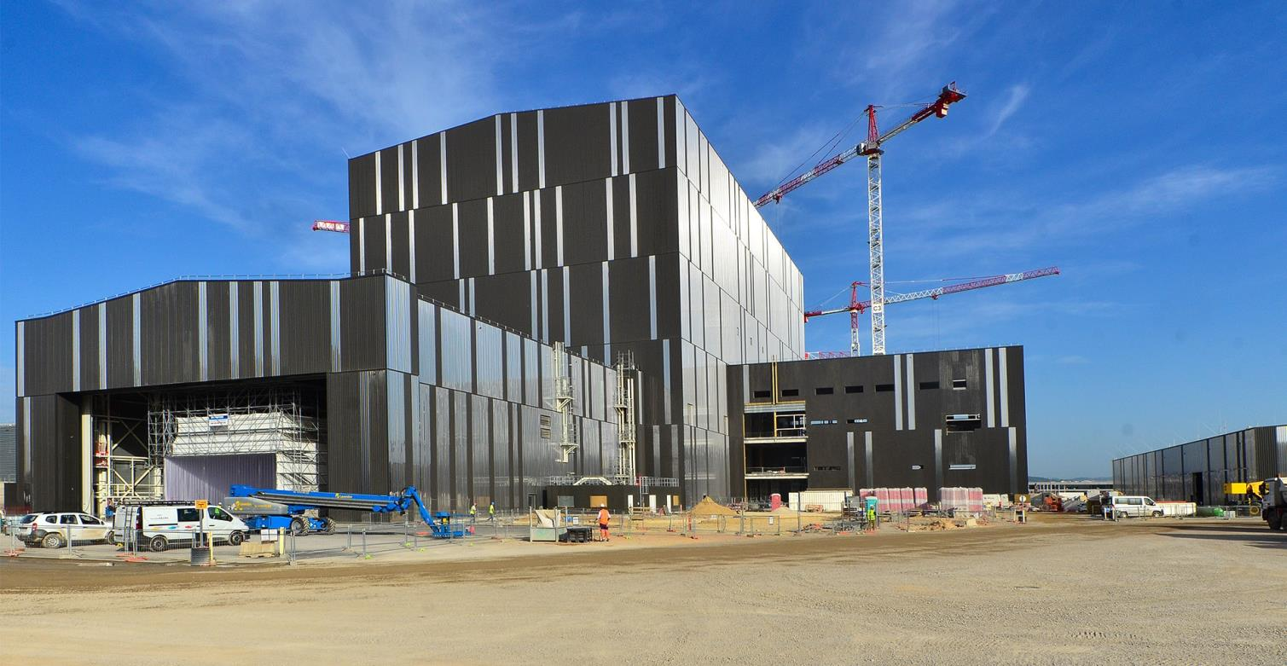
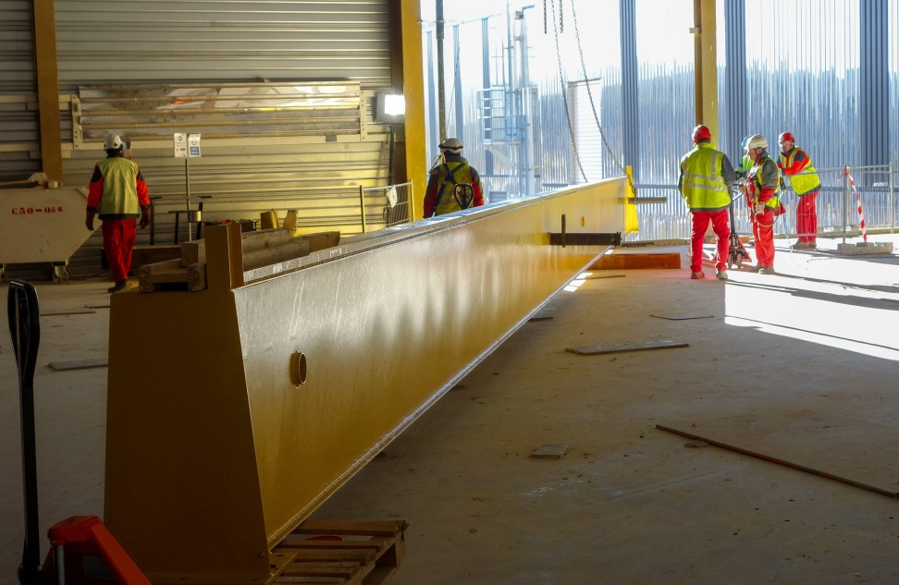
Radiofrequency heating
Adjacent to the Assembly Hall, the building that will house the plasma heating systems (microwave and radio frequency) is ready to be equipped.
This girder is part of the gantry crane that will be used to install radio frequency and microwave heating components. It was installed in December 2017.

Slide 32
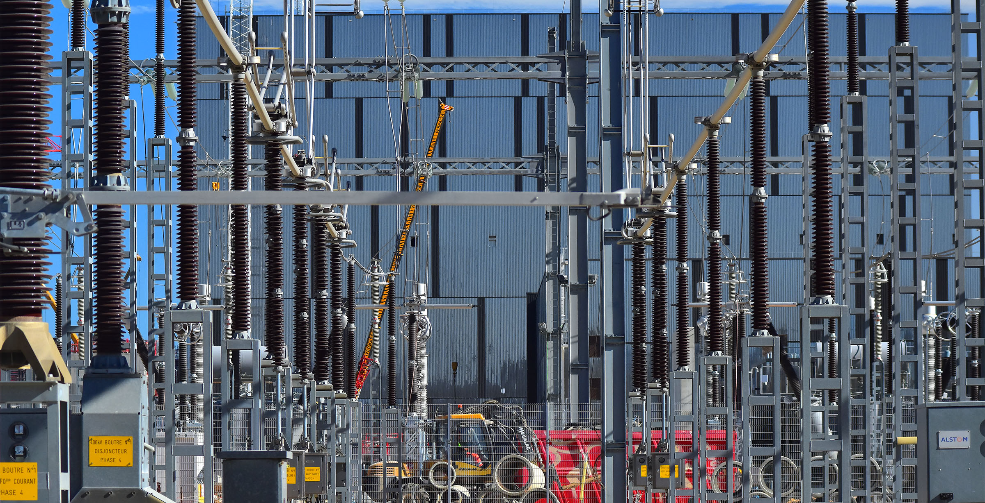
Electrical network
The connection of the 400 kV switchyard to the French grid was successfully demonstrated on 30 March 2017.

Slide 33
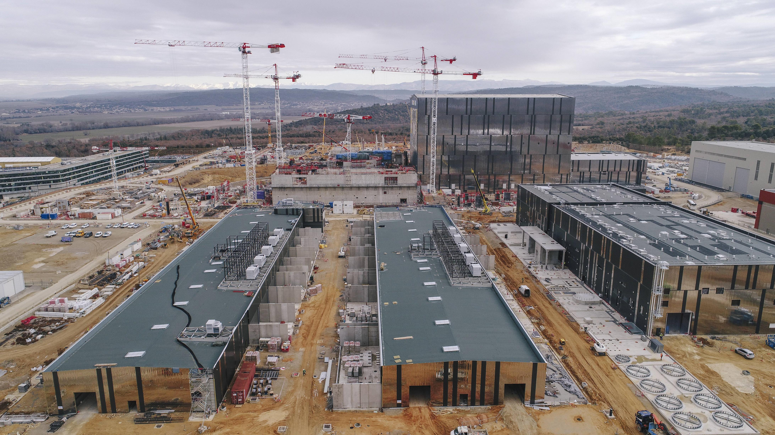
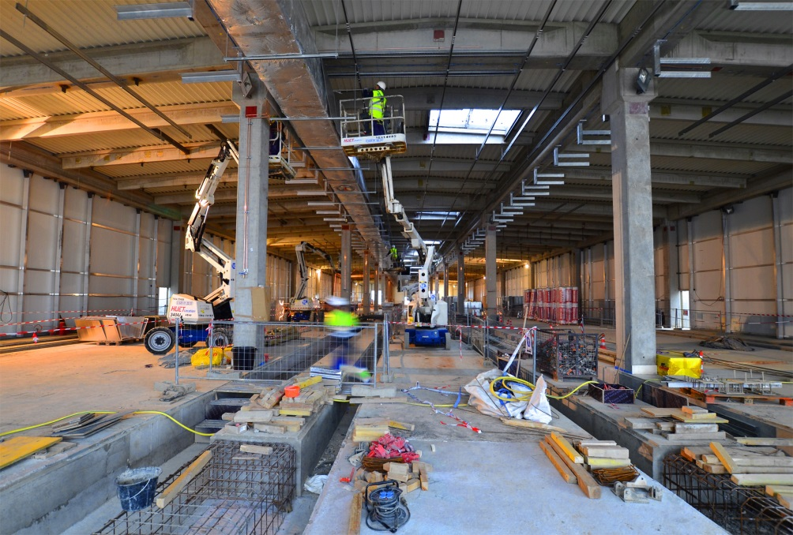
Electrical conversion
Two large Magnet Power Conversion buildings will host the transformers and converters ( AC ► DC) feeding power to the ITER magnets.
The twin buildings are now ready for equipment. Electrical components from China, Korea and Russia will be progressively installed inside of the building as well as in the exterior bays.

Slide 34
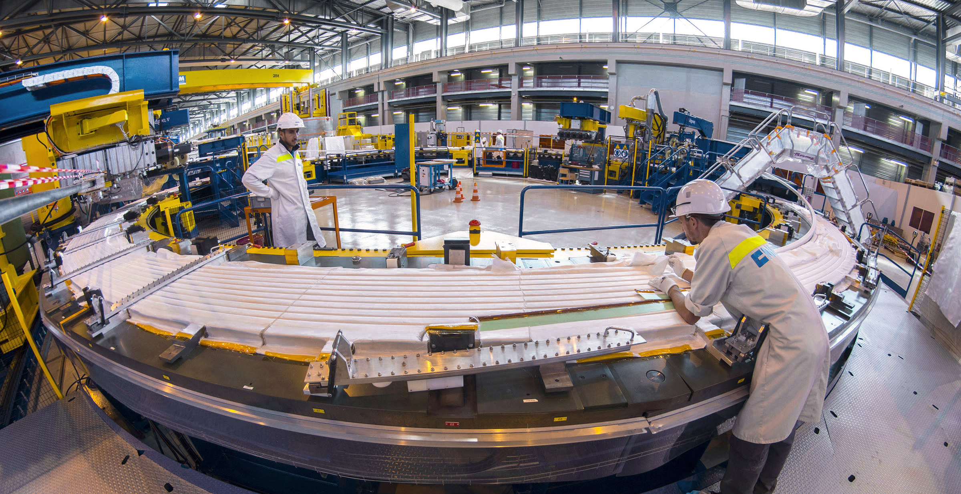
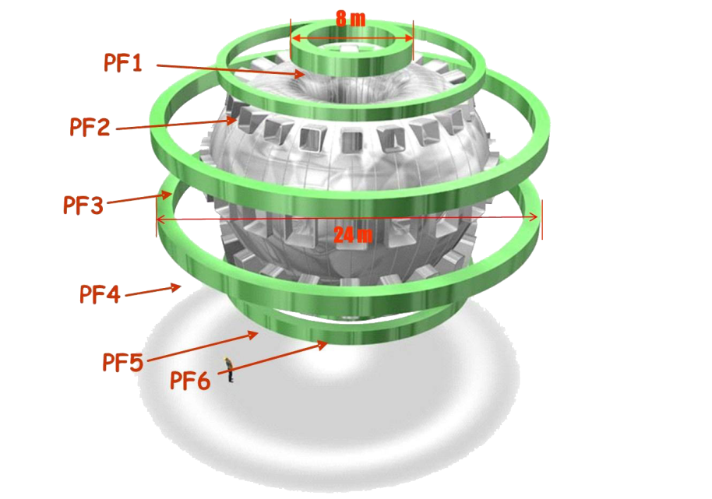
PF Coil winding facility
Too large to be transported by road, four of ITER’s six ring-shaped magnets (the poloidal field coils, 8 to 24 m in diametre) will be assembled by Europe in this 12,000 m² facility.

Slide 35
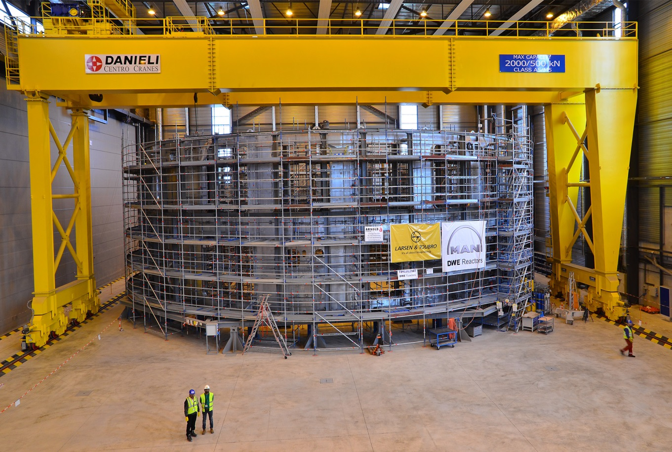

Cryostat workshop
Manufactured in India, the 30 m x 30 m cryostat (the insulating vacuum vessel that encloses the machine) is being assembled and welded on site.

Slide 36


Cooling water systems
ITER power will be partly evacuated by cooling towers (procured by India).

Slide 37

Into the industrial phase
with highly challenging specifications
Manufacturing of ITER components is taking place at the cutting edge of technology:
Geometrical tolerances measured in millimetres for steel pieces up to 17 m tall weighing several hundred tons
Superconducting power lines cooled to minus 270 degrees Celsius
Plasma facing components to withstand heat flux as large as 20 MW per m²
Cryoplant cooling capacity up to 110 kW at 4.5 K; maximum cumulated liquefaction rate of 12,300 l/hr
Etc.

Slide 38




Who manufactures what? The ITER Members share all intellectual property
Cryostat
Feeders (31)
Thermal shield
Toroidal Field coils (18)
Vacuum vessel
Poloidal field coils (6)
Blanket modules
Correction coils (18)
Central solenoid (6)
Divertor

Slide 39


Manufacturing progress
China
Work is underway in China (under contract with Europe) to manufacture 9 double pancakes for poloidal field coil # 6.
China has successfully completed the first component of the feeder package: the cryostat feedthrough for poloidal field coil #4,
Magnet Systems, Power Systems, Blanket, Fuel Cycle, Diagnostics

Slide 40


Manufacturing progress
Europe
European contractors have finalized 2 of 10 toroidal field coil winding packs.
The pre-production cryopump was delivred in August 2017 More than 15 companies in Europe were involved in its manufacturing,
Buildings, Magnet Systems, Heating & Current Drive Systems, Vacuum Vessel, Divertor, Blanket, Power Systems, Fuel Cycle, Tritium Plant, Cryoplant, Diagnostics, Radioactive Materials

Slide 41


Manufacturing progress Japan
In a major production milestone the first TF winding pack has been completed at Mitsubishi Futami plant.
Similar operations are ongoing at Keihin Product Operations of Toshiba Corp.
In September 2017, the Japanese Domestic Agency and suppliers celebrated the completion of conductor fabrication; in all, 43 km (745 tonnes) of conductor were produced.
Magnet Systems, Heating & Current Drive Systems, Remote Handling, Divertor, Tritium Plant, Diagnostics

Slide 42


Manufacturing progress
India
Thousands of in-wall shielding pieces have been manufactured, passed factory acceptance, and are being prepared for shipment.
Welding operations for Tier 1 of the Cryostat base are now complete. preliminary set-up for Tier 2 of the Lower Cylinder has just been completed
Cryostat, Cryogenic Systems, Heating and Current Drive Systems, Cooling Water System, Vacuum Vessel, Diagnostics

Slide 43


Manufacturing progress
Korea
On 18 December the fitting test for the first Toroidal Field Coil Structure was completed at Hyundai Heavy Industry in Ulsan. Tolerance requirements of 0.5mm +- 0.25mm were successfully met!

Slide 44


Manufacturing progress
Russia
Fabrication and qualification tests of PF1 winding pack stack sample were successfully completed.
Electrical equipment prototypes were tested and qualified at the Efremov Institute in Saint Petersburg.
Power Systems, Magnet Systems, Blanket, Divertor, Vacuum Vessel, Diagnostics, Heating & Current Drive Systems

Slide 45


Manufacturing progress
USA
General Atomics is fabricating the 1000-ton Central Solenoid (CS). In April 2016, winding of the first CS module was completed.
Module tooling stations are in place and being commissioned, including the heat treatment furnace shown here.
Cooling Water System, Magnet Systems, Diagnostics, Heating & Current Drive Systems, Fuel Cycle, Tritium Plant, Power Systems

Slide 46


Manufacturing progress
USA
The turn insulation station wraps each bar of conductor
with Kapton® fiberglass tape.
The top plate of the central solenoid assembly platform during fabrication at Robatel.
Cooling Water System, Magnet Systems, Diagnostics, Heating & Current Drive Systems, Fuel Cycle, Tritium Plant, Power Systems

Slide 47


Manufacturing progress
USA
Forging of a tie-plate first article. The tie-plates are part of a substantial structural cage surrounding the central solenoid magnet.
After forging, the tie-plates are machined to required specifications.
Cooling Water System, Magnet Systems, Diagnostics, Heating & Current Drive Systems, Fuel Cycle, Tritium Plant, Power Systems

Slide 48


Manufacturing progress
USA
The cryoviscous compressor full-scale prototype was successfully tested at the ORNL Spallation Neutron Source cryo facility.
A roots pump prototype has been successfully tested at ORNL.
Cooling Water System, Magnet Systems, Diagnostics, Heating & Current Drive Systems, Fuel Cycle, Tritium Plant, Power Systems

Slide 49


Manufacturing progress
USA
A blower for cooling transmission lines will be tested on the high-powered ORNL resonant test line.
A radio-frequency discharge system for diagnostic mirror cleaning is in development and testing. [Inset: Electron cyclotron emission prototype developed at General Atomics and tested on DIII-D.]
Cooling Water System, Magnet Systems, Diagnostics, Heating & Current Drive Systems, Fuel Cycle, Tritium Plant, Power Systems

Slide 50

Manufacturing
progress
USA
The US has delivered an array of components for the steady state electrical network and completed deliveries in 2017.
Cooling Water System, Magnet Systems, Diagnostics, Heating & Current Drive Systems, Fuel Cycle, Tritium Plant, Power Systems

Slide 51


Door-to-door delivery
62 Highly Exceptional loads (HEL) delivered as of Jan. 2018
214 expected before 2025 - 18 expected after 2025
Unloaded at Marseille industrial harbour, components are ferried through the inland sea Etang de Berre on a specially designed barge and delivered to ITER by way of the 104-km long “ITER Itinerary”. The journey to the ITER site takes 3 to 4 nights.

Slide 52




The ITER Itinerary
The 104-km long ITER Itinerary between Berre-l’Etang and the ITER site is part of France’s contribution to the ITER project.

Slide 53






Economic benefits
$ 8 billion is currently engaged in construction and manufacturing contracts for ITER worldwide
ITER

Slide 54


Economic benefits (US)
Engaging US industry, universities and national laboratories
Note: This data does not reflect contracts awarded to US industry by the EU (>$55M).
> $ 20M
$ 1M – 20 M
< $ 1M
As of September 2017, over $957M has been awarded to US industry and universities and obligated to DOE national laboratories in 44 states plus the District of Columbia. To complete its contributions to ITER, the project anticipates an estimated $800M in future contracts to US industry.

Slide 55
Key contracts and awards
US ITER contracts have been awarded in 43 states + D.C.
General Atomics, San Diego, CA; Central solenoid modules
AREVA Federal Services, LLC, Charlotte, NC; Tokamak cooling water system design and drain tank fabrication
Luvata Waterbury, Inc., Waterbury, CT; Toroidal field conductor strand
Transproject, Houston, TX; Shipping
Oxford Superconducting Technology, Carteret, NJ; Toroidal field conductor strand
High Performance Magnetics, Tallahassee, FL; Toroidal field conductor integration/jacketing
Massachusetts Institute of Technology (MIT), Cambridge, MA; Magnet systems and electron cyclotron transmission lines support
Hyundai Corporation, Houston, TX; Steady state electrical network HV transformers
New England Wire Technologies, Lisbon, NH; Toroidal field cabling services
ABB, Raleigh, NC; Steady state electrical network
Siemens Industry, Inc., Wendall, NC; Steady state electrical network control & protection
Peterson, Inc., Ogden, UT; Central solenoid structures
CPI Microwave Power Products, Palo Alto, CA; Gyrotron for electron cyclotron transmission lines R&D
Eaton Corporation, Cleveland, OH; Steady state electrical network switchgear
Major Tool & Machine, Inc., Indianapolis, IN; Central solenoid structure tie plate prototype
Pfeiffer Vacuum, Nashua, NH; Roughing pump
Inficon, Inc., E. Syracuse, NY; Vacuum leak detectors
G&G Steel, Russellville, AL; Central solenoid structure tie plate prototype
Mega Industries, LLC, Gorham, ME; Ion cyclotron heating support
Dielectric Communications, Raymond, ME; Ion cyclotron heating support

Slide 56


Measures of progress and uncertainties
Meeting milestones and more
Full paced construction and manufacturing
All (30) milestones now achieved through 4th Quarter 2017
Approval of Overall Project Schedule by ITER Council
Approval of Overall Project Cost ad referendum
Promotion of ITER-wide project culture
Success requires full commitment by each person
ITER Member support for the project
OPC approved or on the way to be approved by six ITER Members
USA: approved US OPC on Jan. 2017;
Briefing of Congressional Committee: strong expressions of support
Briefing of new DOE Secretary Rick Perry in April and Oct. 2017
Insufficient budget in 2016-2017; 2018 and 2019 ?
UK: positive expectation for continuing UK participation in ITER
Article 50 negotiations beginning; positive remarks by UK government
UK delegation visited ITER recently to view project and meet with staff

Slide 57
Challenges ahead for ITER
until construction completion
ITER Organization, Domestic Agencies and suppliers working as “One-ITER Team” with a strong project culture
Strict respect by suppliers for quality and safety requirements
Strict respect by all stakeholders for the schedule requirements, in particular for the required delivery dates for materials and equipment on the ITER site
Reliable and fully integrated assembly/construction sequences on ITER site
Contracting with high performing and experienced companies for the assembly activities in the Tokamak Complex
Setting in place a well-suited organization in charge of commissioning
Setting in place a well-suited organization to conceive and execute the progressive take-over of the machine, ultimately for its operation and maintenance
Timely, reliable availability of the planned and committed resources from the seven ITER Members

Slide 58

ITER is moving forward!
Thank you for your attention
http://www.iter.org

