Slide 1
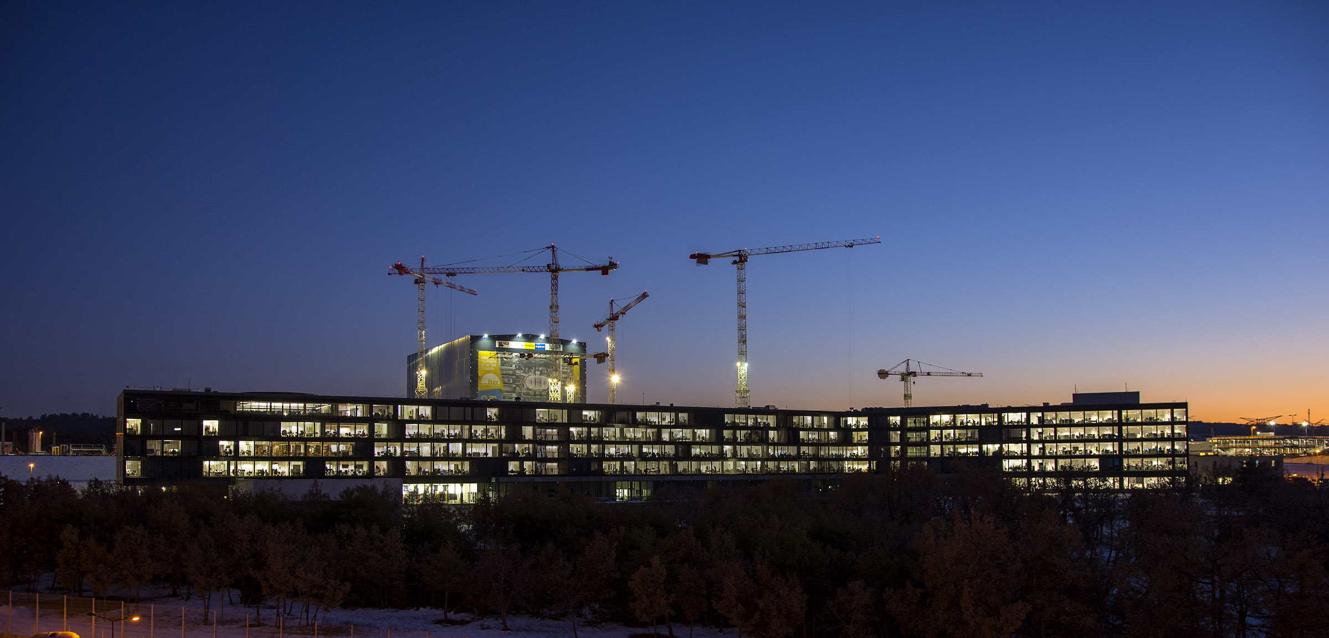
ITER Engineering Science and Breakthroughs
Gyung-Su Lee
Chief Operating Officer / DDG

Slide 2
Outline
Background : Change and Reform
Staged Approach : First Plasma to DT Operation
Building and Plant Construction
Critical Components and Systems Manufacturing
Advancement of Technology R&D Area
Technology & Engineering Breakthroughs and Spinoffs
Summary

Slide 3
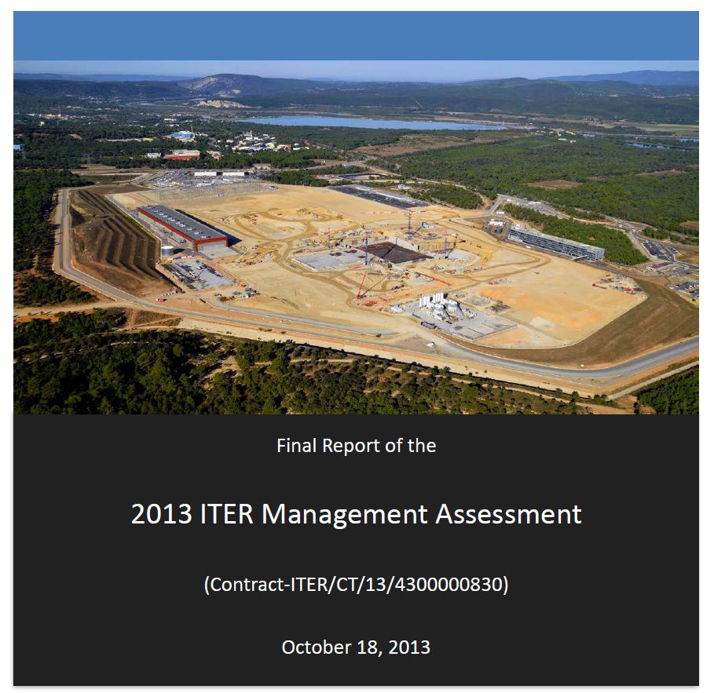
Background : Change and Reform
Action Plan 2015: Set clear priorities & timeline for reform
Reorganized and Integrated ITER Central Team (IO-CT) with Domestic Agencies
Clear decision processes and accountability
Executive Project Board, Reserve Fund, Project Teams
Finalized and stabilized ITER critical component design
Comprehensive integrated bottom-up review of all activities, processes and systems
Developed an optimized resource-loaded schedule for timely, cost-effective construction and operation through D-T plasma. Updated the 2010 Baseline (Baseline2016).
Developed and promoted a strong, organization-wide nuclear project culture

Slide 4
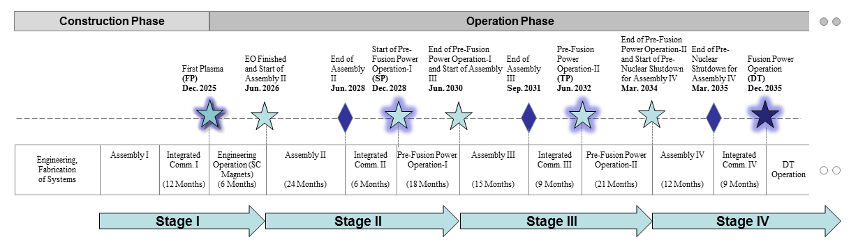
Staged Approach : FP to DT Operation
Extensive works among IO and DAs to finalize revised baseline: Baseline2016 Schedule and Cost (OPS & OPC)
Schedule and resource estimates through First Plasma (2025) consistent with Members’ budget constraints
Adopted 4-stage approach through Deuterium-Tritium Operation (2035) consistent with Members’ financial and technical constraints

Slide 5
Assembly Milestone Schedule to First Plasma
Level 0 Construction Schedule to First Plasma in 2025
2016
2017
2018
2019
2020
2021
2022
2023
2024
2025
Major ITER Milestones
Start Machine Assembly Phase I
Cryostat Closed
1st Plasma
TF Coils (1.1.P1A.EU.01)
TF Coils 06,09,11, 05,03, 01,04,17,14,18
TF Coils (1.1.P1B.JA.01)
TF Coils 12,13, 08, 10,02,16, 07, 15
Central Solenoid (1.1.P4A-4B.US.01)
First CS Module CSL3 Last CS Module CSU3
Poloidal Field Magnets
PF Coils 05,06,02, 04, 01 03
Vacuum Vessel (1.5.P1A.KO)
VV Sector 06 01(07)
Vacuum Vessel (1.5.P1A.EU)
VV Sector 05,04,03, 02, 09
Vacuum Vessel (1.5.P1A.IO)
VV Sector 08 07(01)
ITER CONSTRUCTION AND OPERATIONS (00.01/00.02)
Assembly Bldg 13 RFE 1A
Bldg 11 RFE 1B Stage 1
Bldg 11 RFE1B Stage 2
VV Sector
Sub-Assembly Completed
Cryostat Closed
(Install Bioshield Lid)
End Machine Assembly Phase I
Building Construction (6.2.P2.EU.05)
Start Lower Cryostat Assembly
Start VV Sector 08 Sub-Assembly
Construction
(2.2.P1.IO)
Start Machine Assembly Phase I
58
Start VV Sectors Sub-Assembly
Lower Cryostat Assembly Completed
VV Sector Assembly Completed
1st Plasma
Start Cryostat Base Installation
Operations
Start Integrated Commissioning I

Slide 6
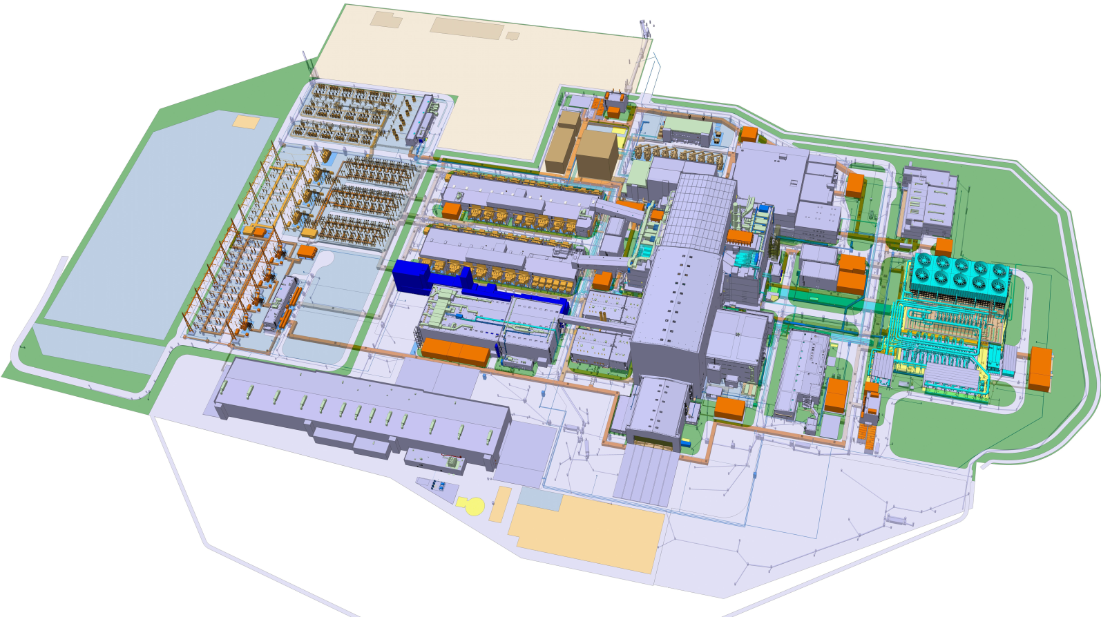
Building & Plant Construction
11 TOKAMAK BUILDING
13 ASSEMBLY BUILDING
14 TRITIUM BUILDING
15 RF HEATING BUILDING
17 CLEANING FACILITY BUILDING
19 SEISMIC ISOLATION BASEMAT
21 HOT CELL BUILDING
23 RAD WASTE BUILDING
24 PERSONNEL ACCESS CONTROL BUILDING
32 MAGNET POWER CONVERSION BUILDING 1
33 MAGNET POWER CONVERSION BUILDING 2
34 NB POWER SUPPLY BUILDING
36 MAIN ALTERNATING CURRENT DISTRIBUTION BLDG
37 NB HIGH VOLTAGE POWER SUPPLY BUILDING
38 REACTIVE POWER CONTROL BUILDING
44 45 EMERGENCY POWER SUPPLY BUILDING
46 47 MEDIUM VOLTAGE DISTRIBUTION BUILDING
49 RTE CONTROL BUILDING
51 CRYOPLANT COMPRESSOR BUILDING
52 CRYOPLANT COLDBOX BUILDING
55 PF COIL FABRICATION BUILDING
56 CRYOSTAT ASSEMBLY BUILDING
57 58 SIC GENERATOR BUILDING
59 60 IP GENERATOR BUILDING
61SITE SERVICES BUILDING
62 HOT WATER BOILERS BUILDING
67 COLD BASIN & COOLING TOWERS
68 COOLING WATER PUMP STATION
71 CONTROL BUILDING
74 DIAGNOSTICS BUILDING
75 FD & SWITCHING NETWORK RESISTOR BLDG

Slide 7
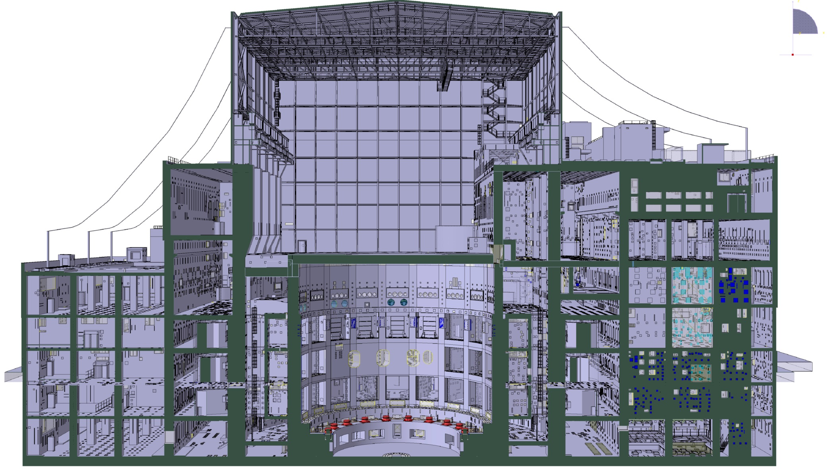
Tokamak Complex Design & Construction
1
Integrated Building Design
2
Construction Design
3
Tritium Building B14
Execution Design & Construction
Tokamak Building B11
Roof
4
As-Built Design
L5
Diagnostic Building B74
L4
L3
* Design Interface fully FROZEN and no more PCRs affecting Tokamak Building.
L2
L1
B1
B2

Slide 8
Status of Tokamak Complex Design & Construction
Categorization
Level
Building / MRR Acceptance Reports approval dates
2
Construction Design
Level L3
Bldg. 11, 14, 74: August 2017 (last version)
Level L4
Bldg. 11, 14 : August 2016 (1st issue)
Level L5
Bldg. 11, 14: May 2017 (1st issue)
Roof
Bldg. 11, 14: October 2017 (1st issue)
Bldg. 74: August 2016 (1st issue)
3
Execution
Design &
Construction
Level B2 Slab
Bldg. 11, 14, 74: September 2017 (Approved by IO)
Level B2 Walls / B2M
Level B1
Level L1
Level L2
4
As Built Design
Level B2
Bldg. 11, 74: January 2018

Slide 9
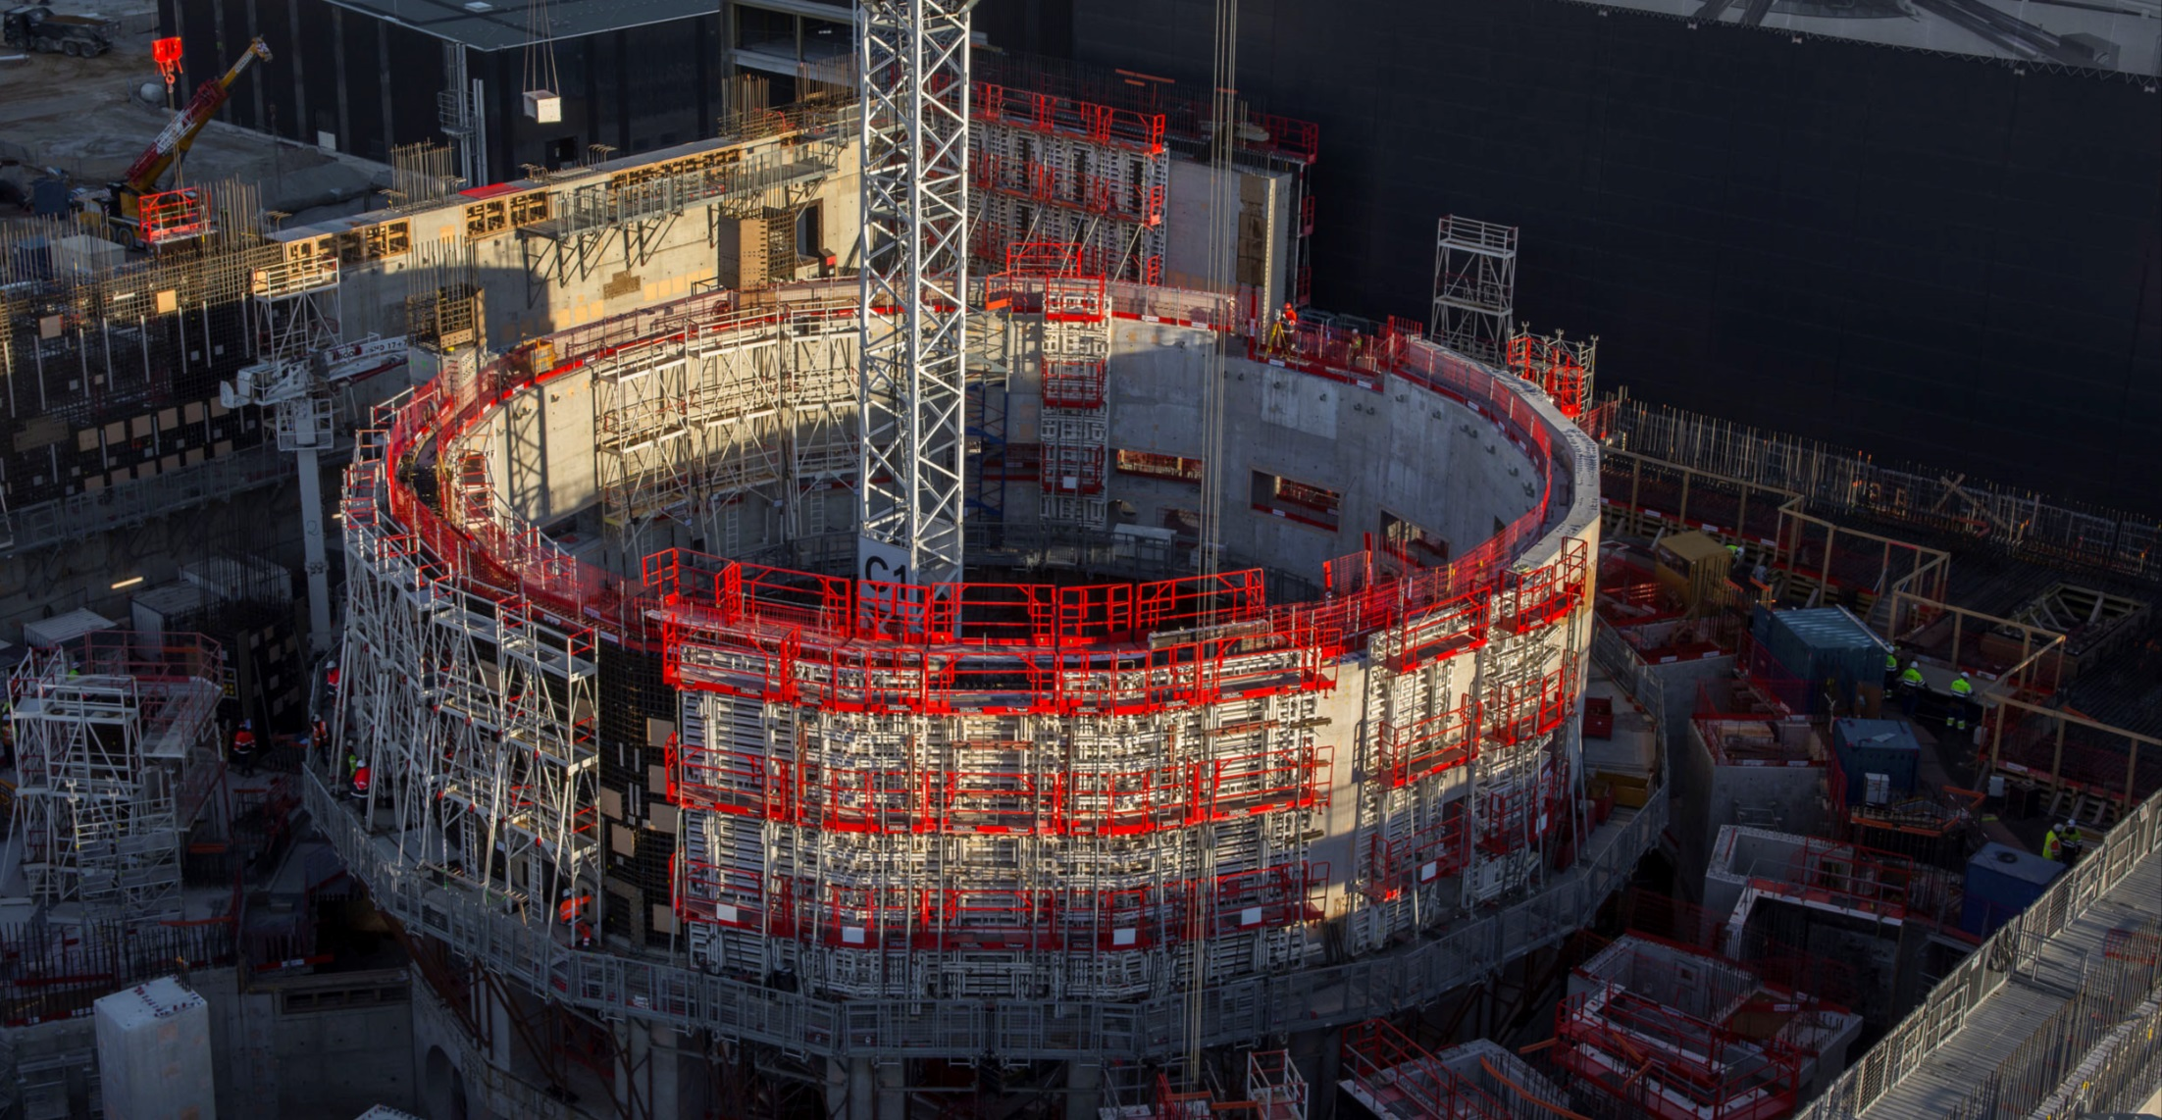
Tokamak Complex

Slide 10
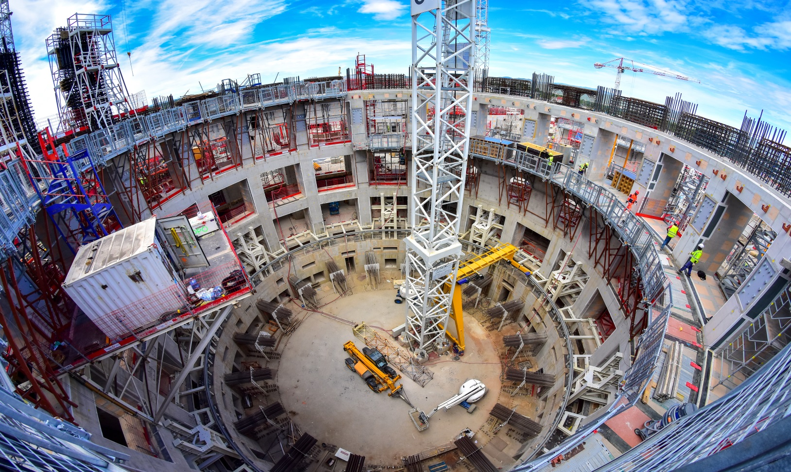
Bioshield Concrete Works Completed

Slide 11
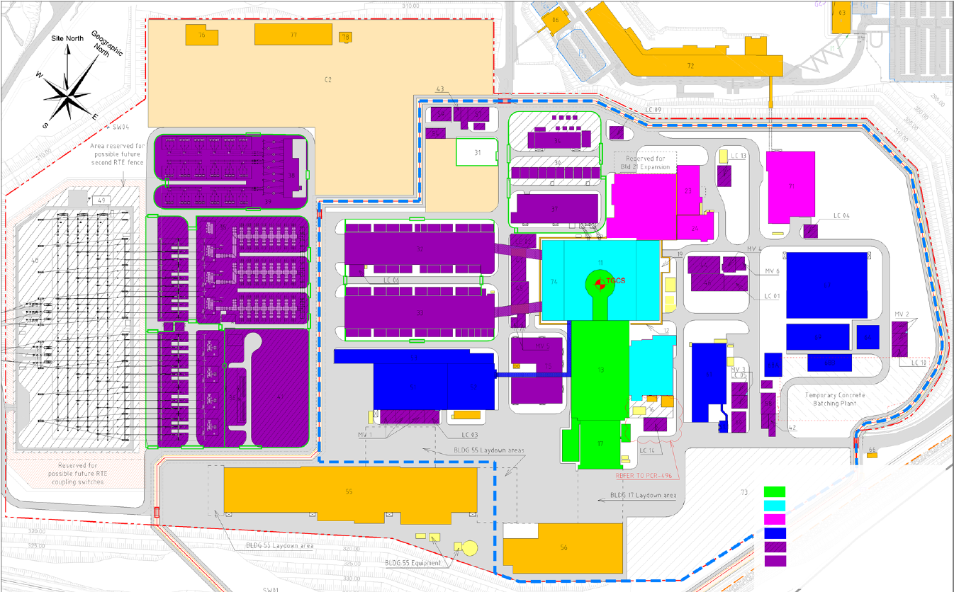
Construction-by-Area Approach (Worksites)
21
14
15
Worksite 1 (TKM Assembly)
Worksite 2
Worksite 3
Worksite 4
Worksite 5 (SSEN)
Worksite 5 (PPEN)
Worksite 1: Tokamak Main Machine, Worksite 2: Tokamak Complex Plant + RF Bldg.(B15)
Worksite 3: Hot Cell + Rad Waste + Control Buildings, Worksite 4: Cryogenic Plant + Cooling Station
Worksite 5: Electrical & Power Supply Buildings,

Slide 12
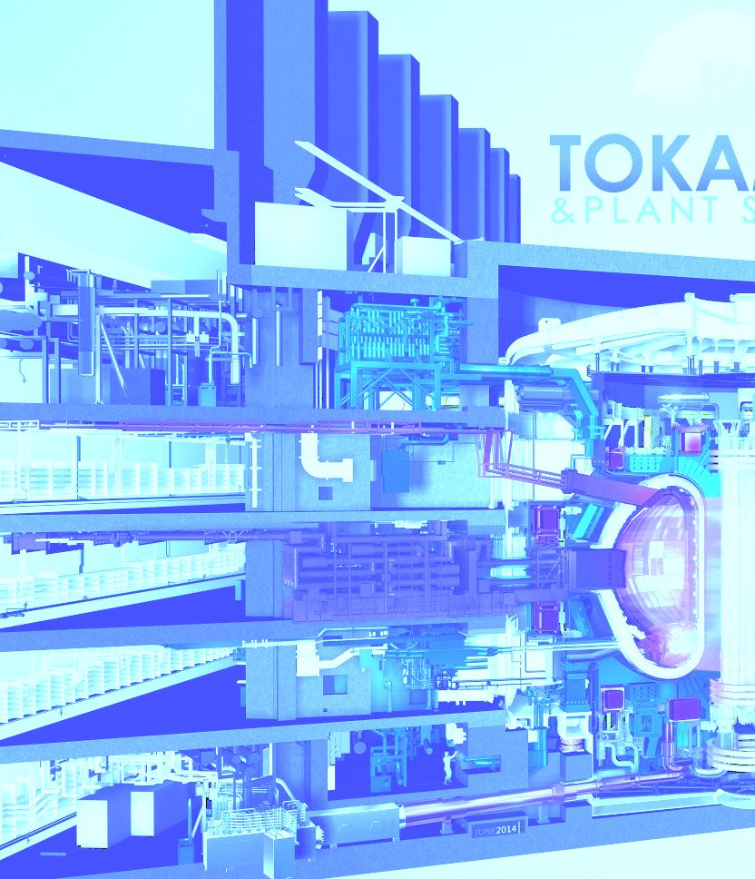
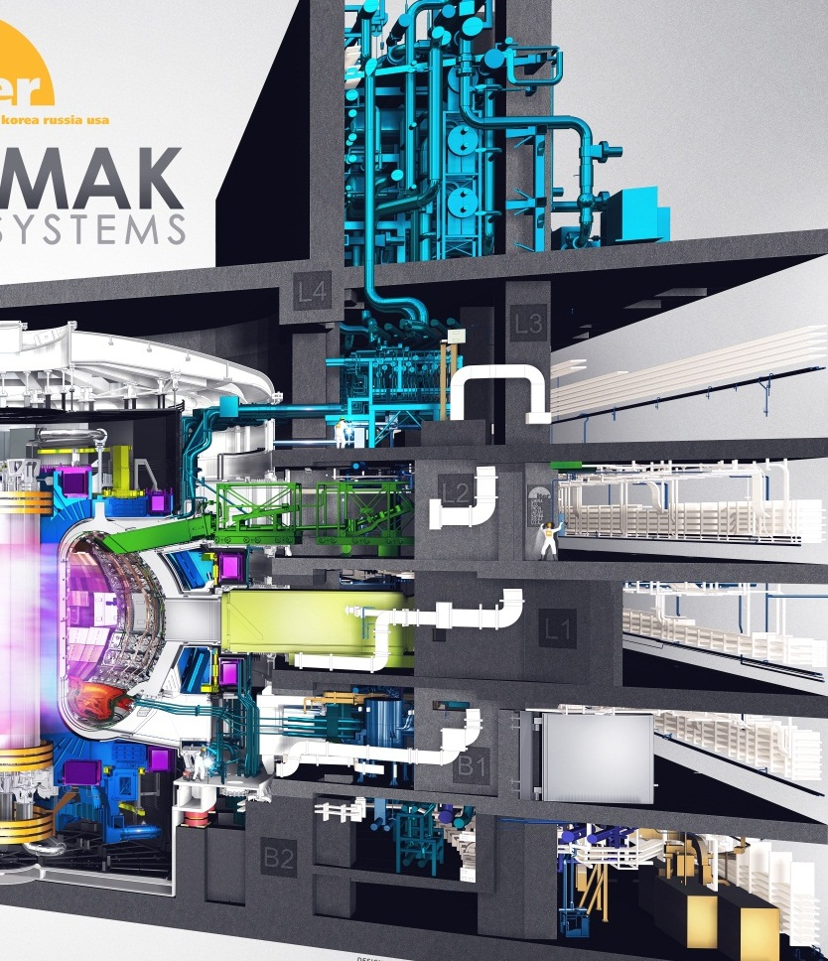
CTTA (Worksite 1) & CTTC (Worksite 2)
L5
L4
IO CTTC Contracts and EU-DA Building Services (TB04)
Contract
Co-activity
Area
Port & Cryostat
L3
❺
In-cryostat
❹
L2
L2 Port Cell
⑤
④
③
②
①
❸
L1
L1 Port Cell
In-vessel
❷
B1
B1 Port Cell
B2 Tokamak Interface
❶
B2
Gallery
Port Cell
Cryostat
(Tokamak Pit)
Port Cell
Gallery
Bio-shield
Bio-shield

Slide 13
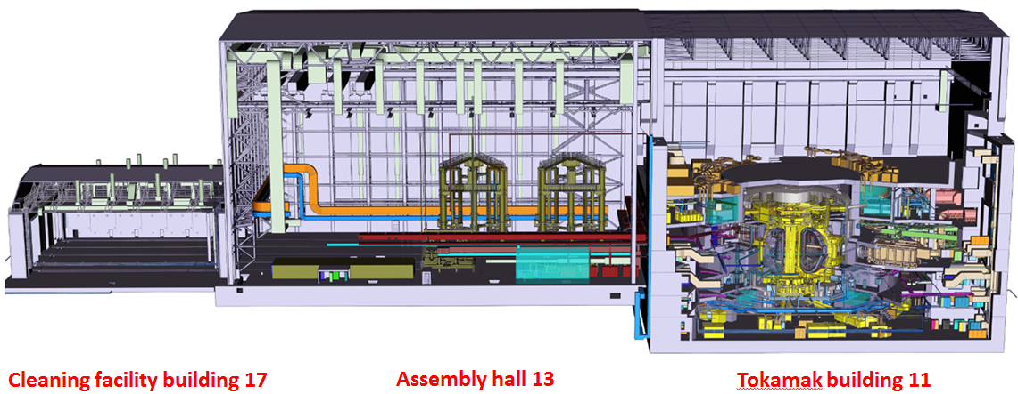
Tokamak Assembly Flow (B17 - B13 - B11)
Introduction of the Tokamak components in Building 17;
Preparation and sub-assembly of the sectors in Building 13;
Transport of the sector sub-assemblies via 2x750t crane to the Tokamak Pit;
Final assembly of the components/sub-assemblies in the Tokamak Pit.

Slide 14
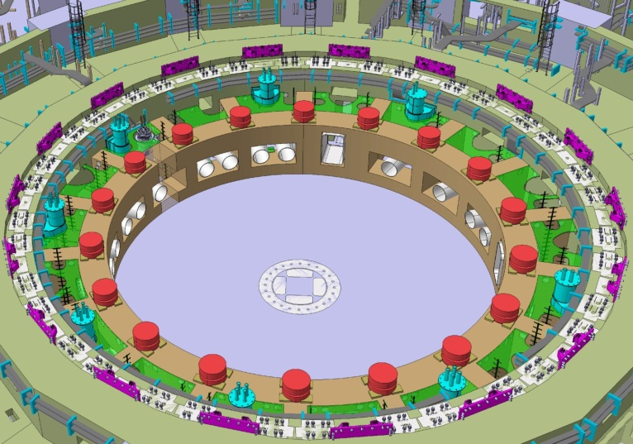
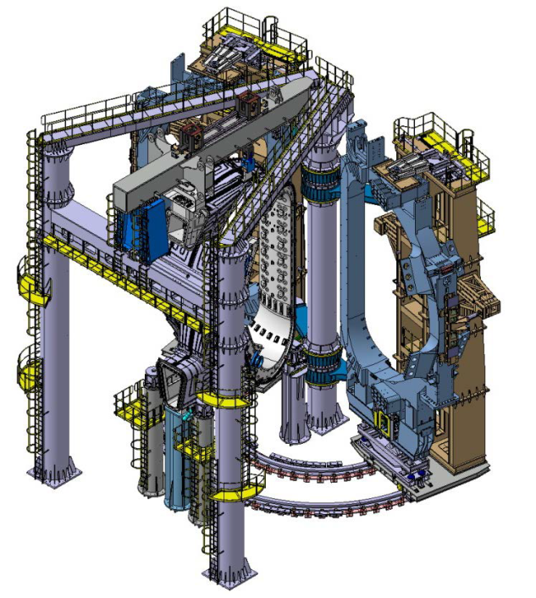
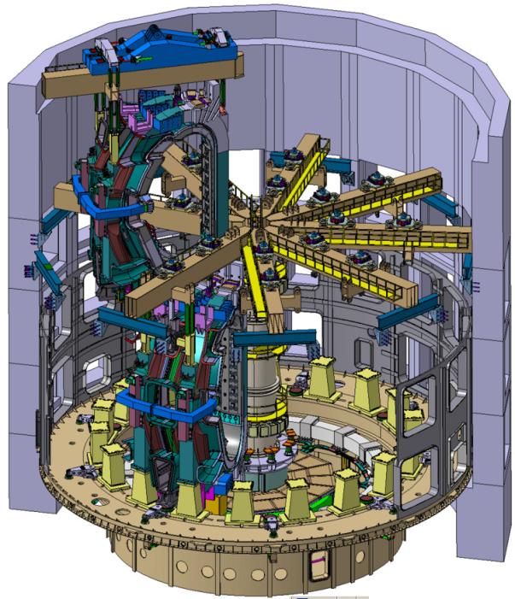
Learning Curve with Sectors 6 & 7
Sub-assembly
Sector-by-Sector Assembly (KSTAR, EAST, JT-60SA) with Learning Curve by Sectors 6 & 7
Tokamak Lower In-pit Installation Activities
Tokamak Assembly Hall Activities
Tokamak In-Pit Installation Activities

Slide 15
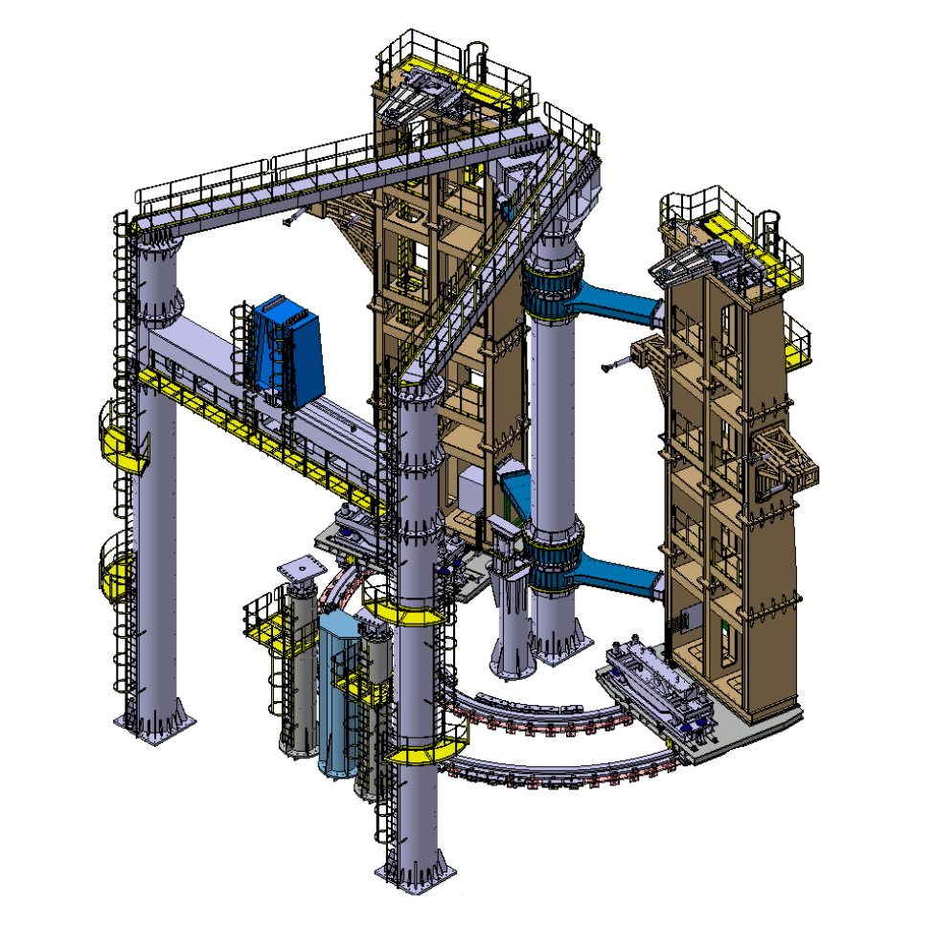
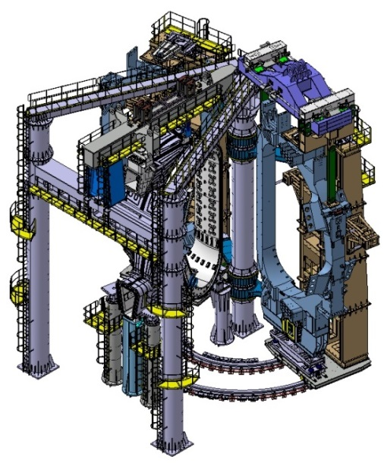
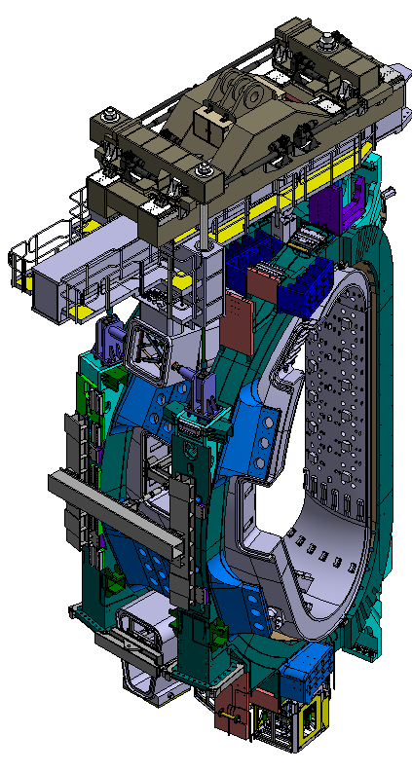
Tokamak Assembly Tools Design
Sector Sub-Assembly Tool (SSAT)
Sector Lifting Tool

Slide 16
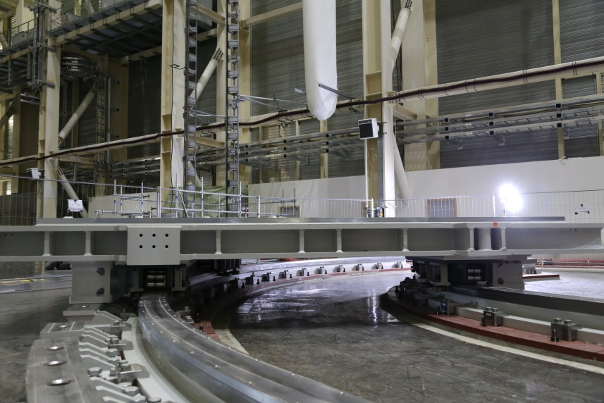
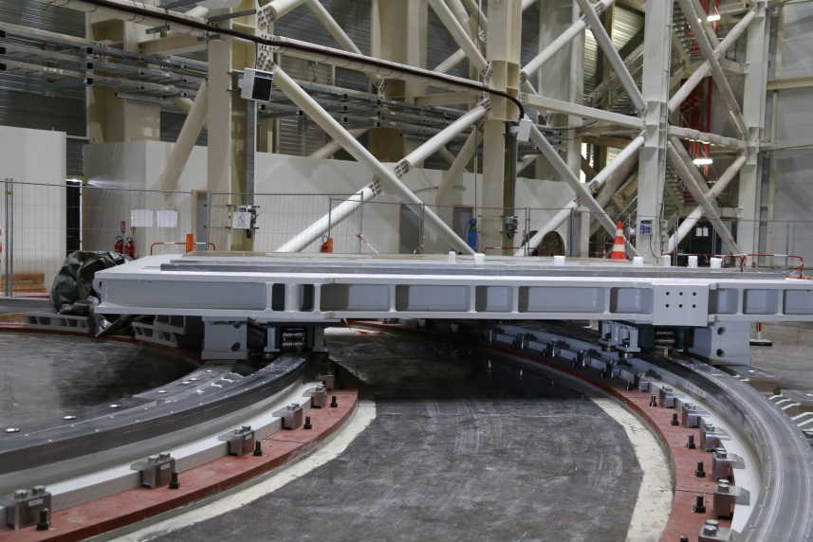
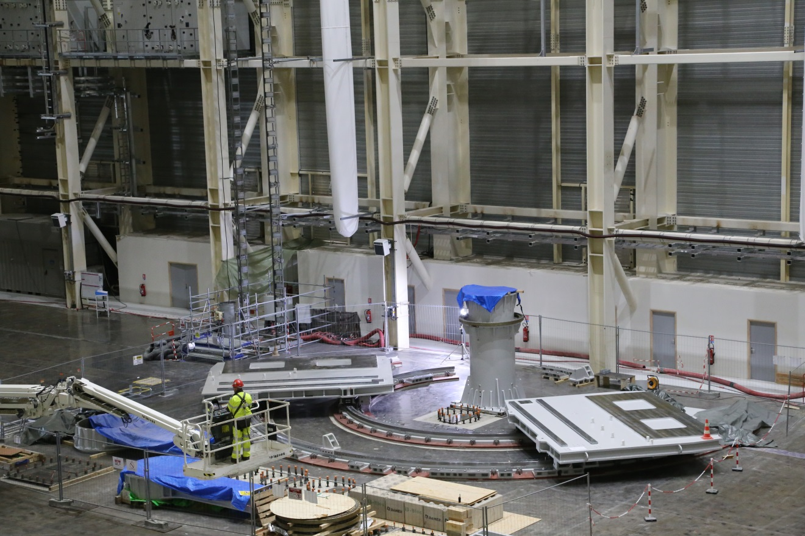
Sector Sub-Assembly Tool (SSAT #1)
B13 Assembly Building

Slide 17
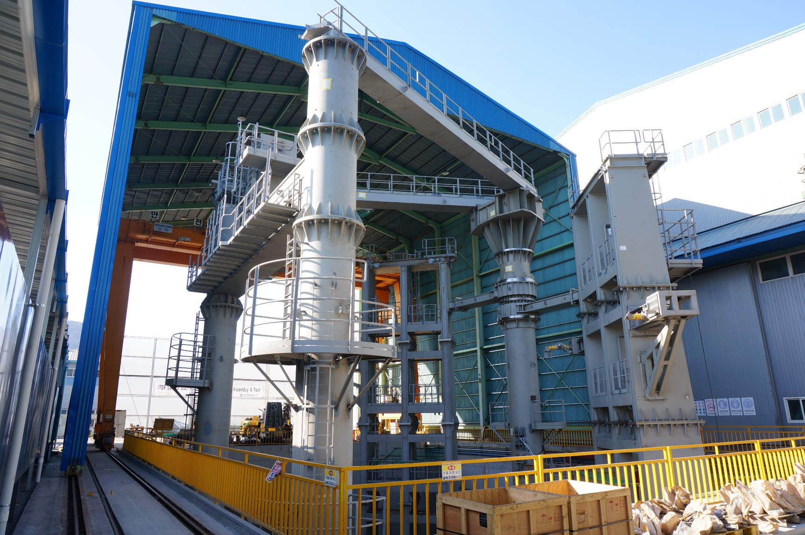
Sector Sub-Assembly Tool (SSAT #2)
RH/LH Horizontal Beam
(IB) Support Block
(OB) Support Block

Slide 18
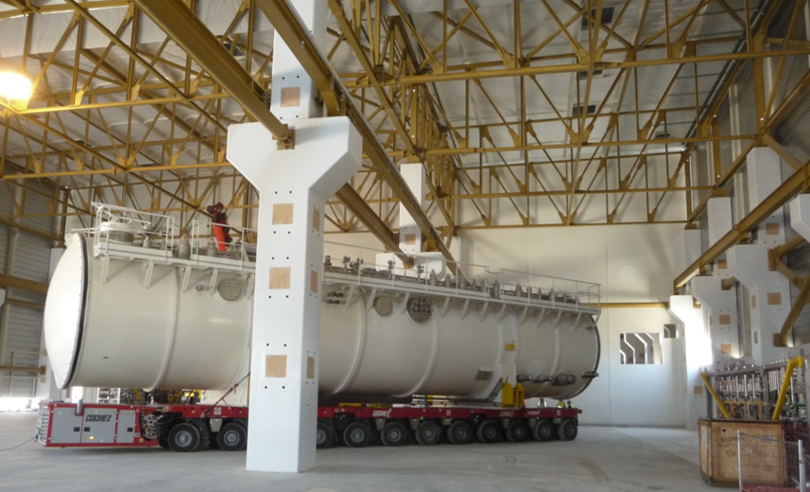
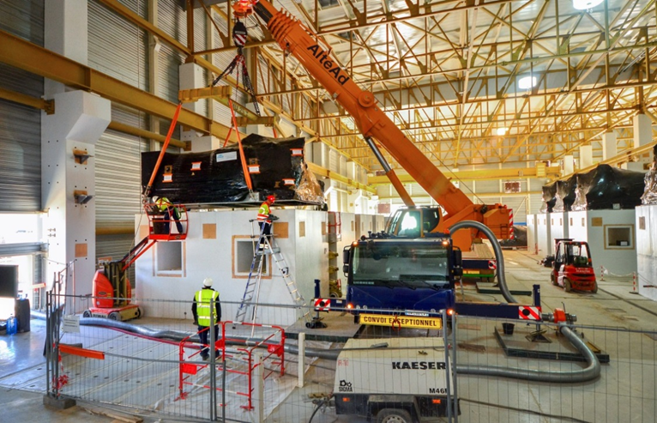
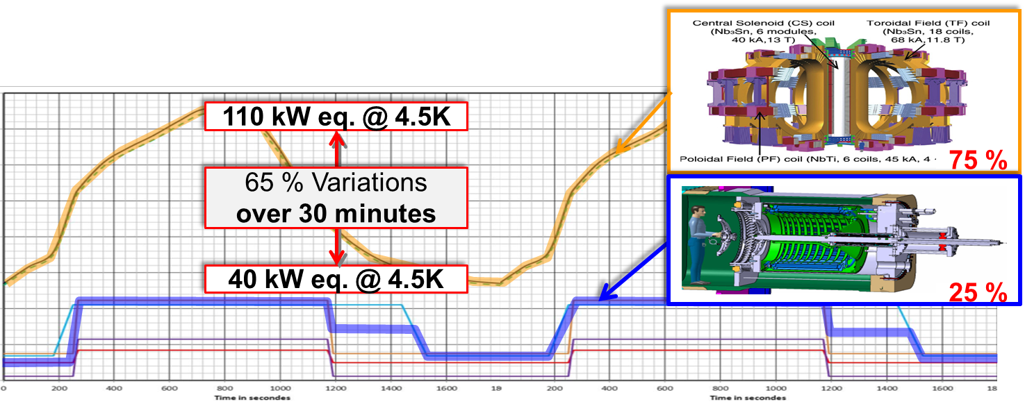
One-of-Kind Plant : Cryogenic System
ITER variable heat loads
(overall heat loads)

Slide 19
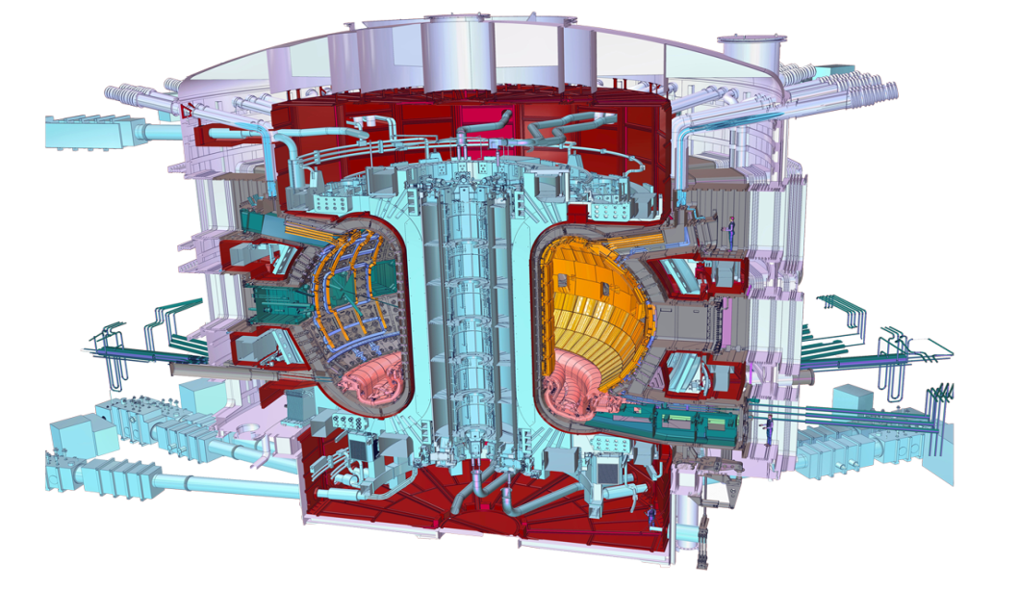



In-kind Procurement Manufacturing
Cryostat
Feeders (31)
Thermal shield
Toroidal Field coils (18)
Vacuum vessel
Poloidal field coils (6)
Blanket modules
Correction coils (18)
Central solenoid (6)
Divertor

Slide 20
Vessel Systems in Mass Production
Cryostat, Thermal Shields,
and Vacuum Vessel Sectors & Ports

Slide 21
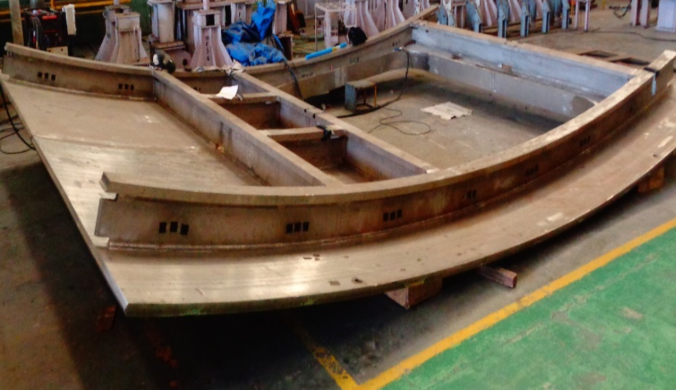
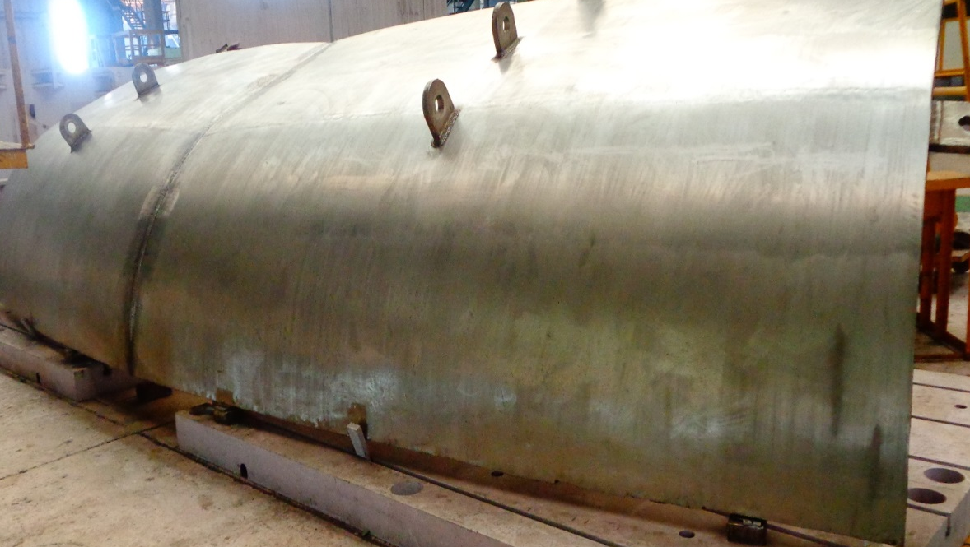
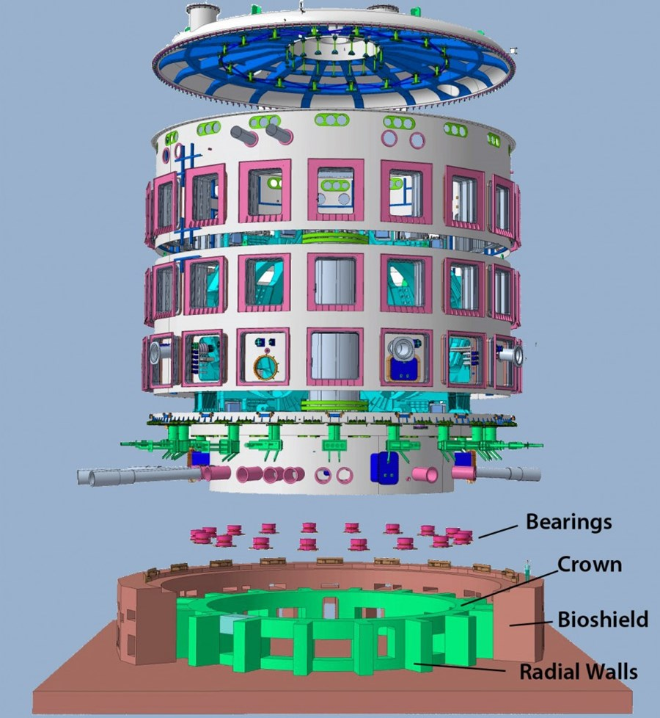
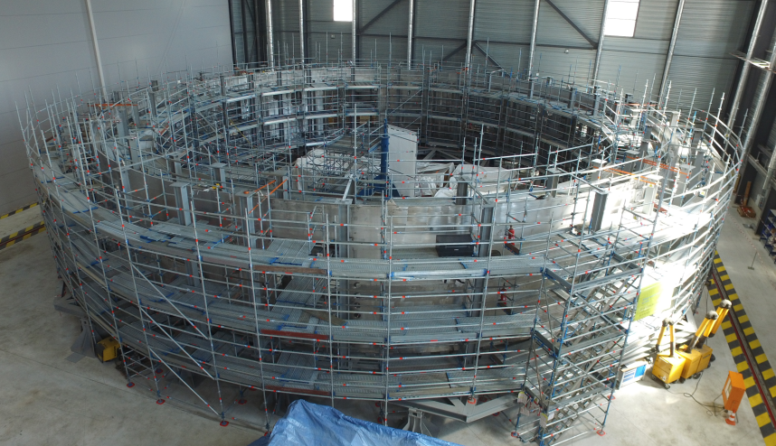
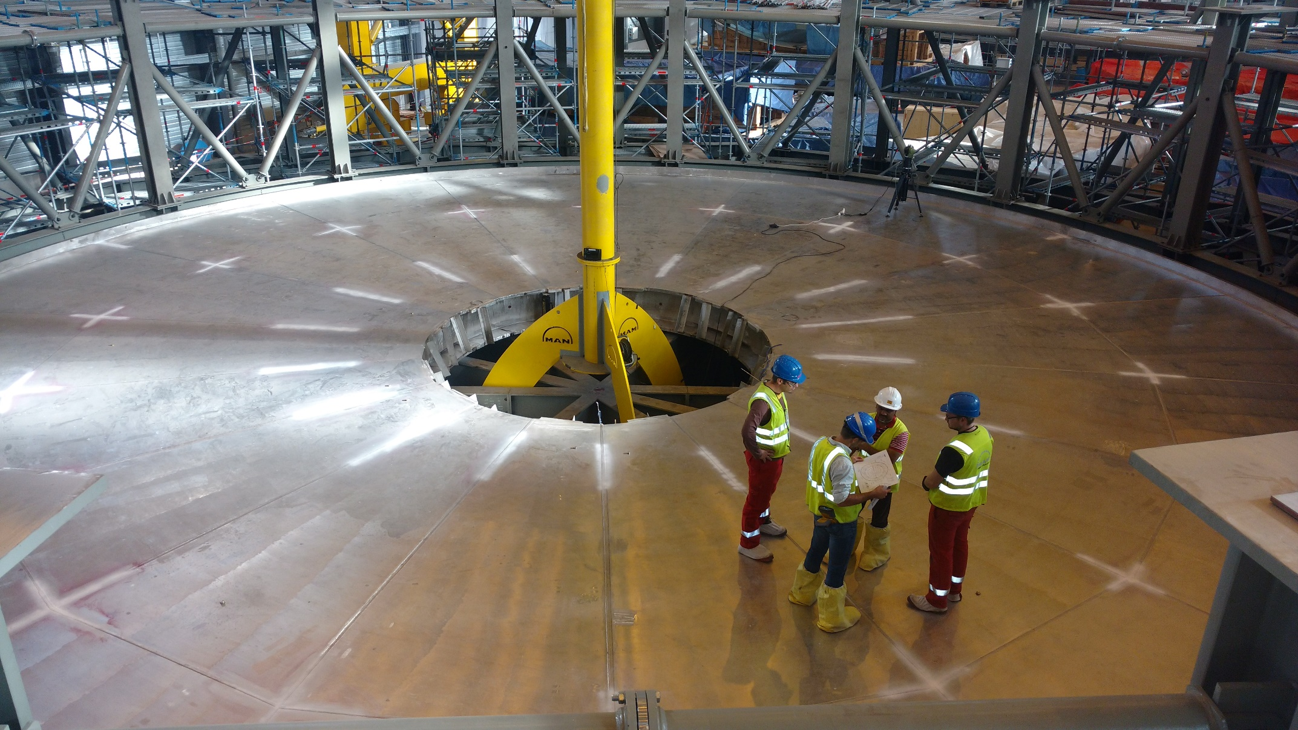
Cryostat in Mass Production
Upper Cylinder
Lid
Lower Cylinder
Base Section

Slide 22
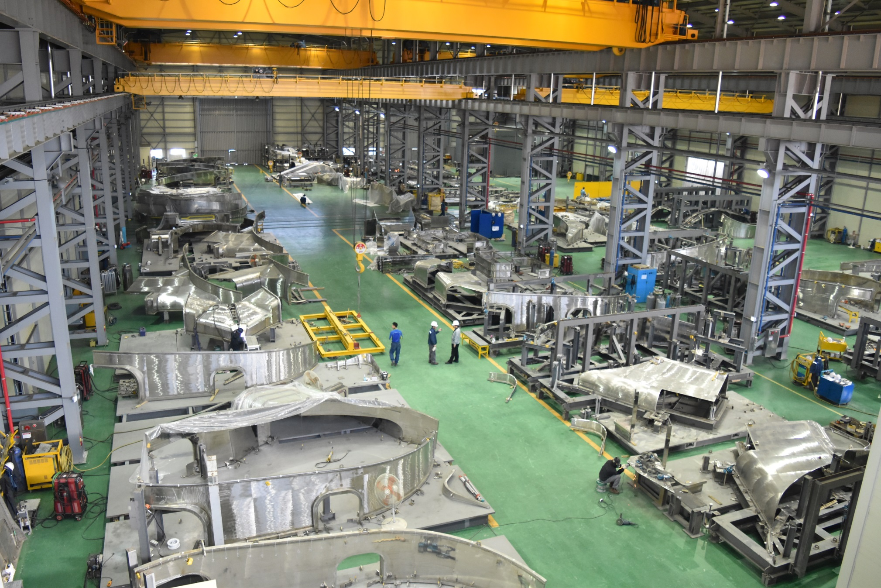
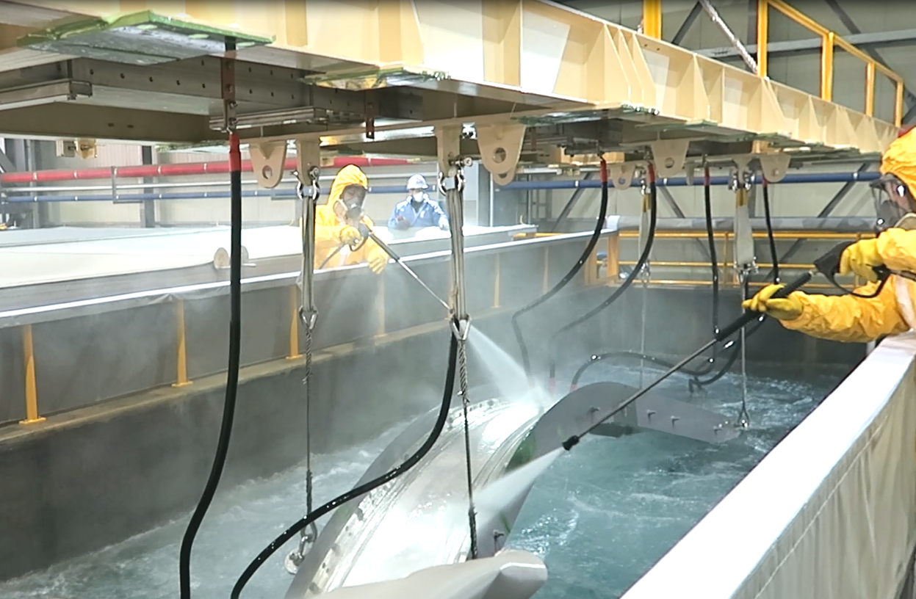
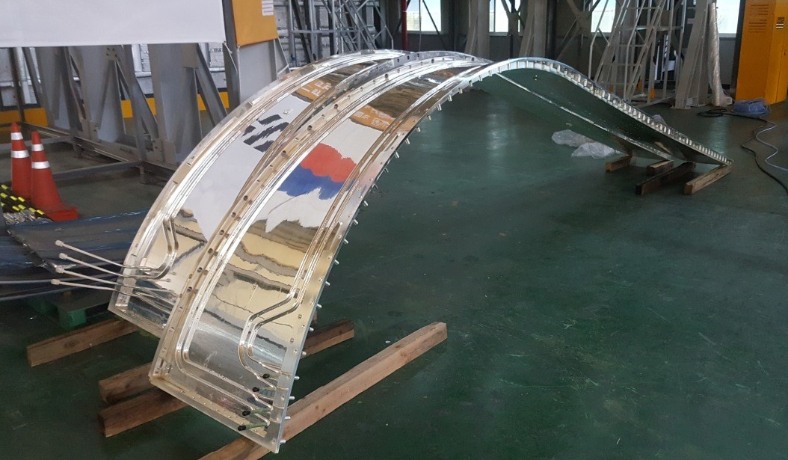
Thermal Shield in Mass Production

Slide 23
Vacuum Vessel in Full Production
Nuclear licensing as an ESPN (First In-Kind of Fusion Nuclear Pressure Vessel)
The ITER VV is defined as an ESPN (Equipement Sous Pression Nucléaire) component that requires that all documents related to design, manufacturing, installation, and operation shall be reviewed and approved by an Agreed Notified Body (ANB) on behalf of the French Nuclear Authority (Autorité de Sûreté Nucléaire : ASN). → (Originally designed as a non-nuclear engineering (French nuclear regulation applied after site selection))
1st application of the RCC-MR 2007 Edition (Code & Standard)
As main C&S, we are applying the RCC-MR 2007 Edition that is the first application on the ITER VV construction that cause a few of major updating of C&S itself during design and manufacturing.
Many clients (Complex interfaces)
The VV supports many in vessel systems such as Blankets, Diverters, Diagnostics, In-vessel Coils, Port Plugs, Components of Heating and Current Drivers, Fuelling, Cooling Pipes, and Assembly, etc. Many of functional and physical interfaces cause long discussion because of mainly different design maturity of each system.
→ Main technical challenges have been resolved during manufacturing process
→ All 9 VV sectors are under manufacturing and the first sector (S#6) has been achieved ~77 % of progress

Slide 24
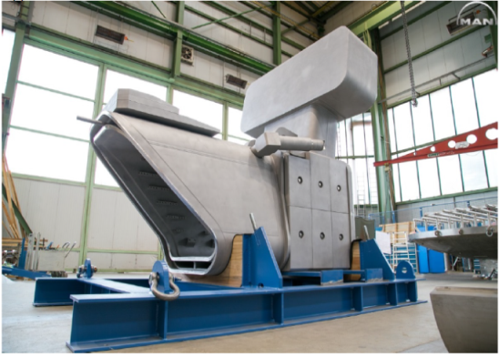
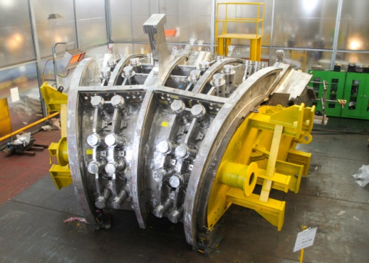
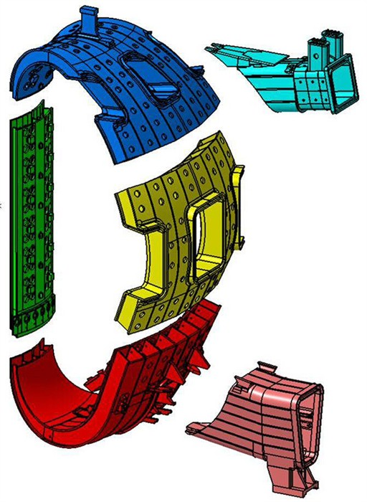
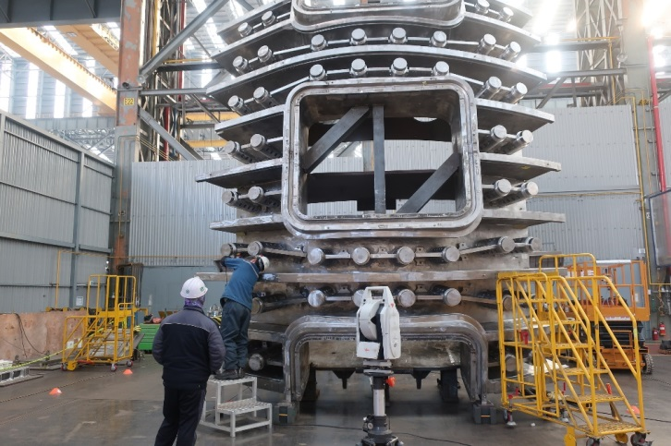
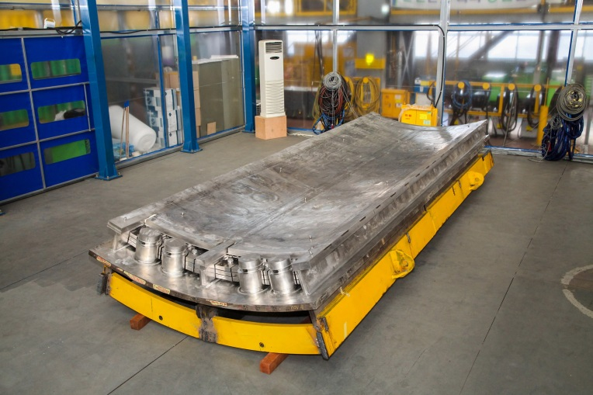
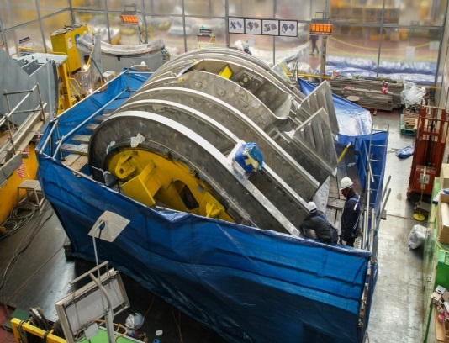
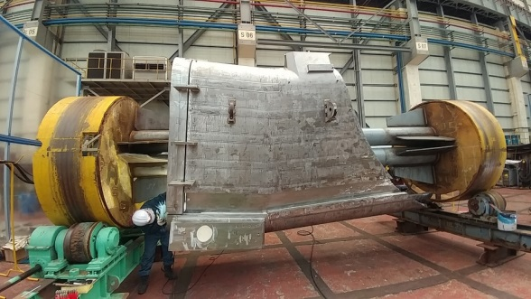
Status of VV Production in KO
Upper Port
PS2
Delivered
from MDT (RF)
to HHI (KO)
PS3
PS1
PS4
PS : Poloidal Segment
Lower Port
VV#6-PS1 : Completion of manufacturing (IC-23) with meeting all required tolerance
Manufactured
by HHI (KO)

Slide 25

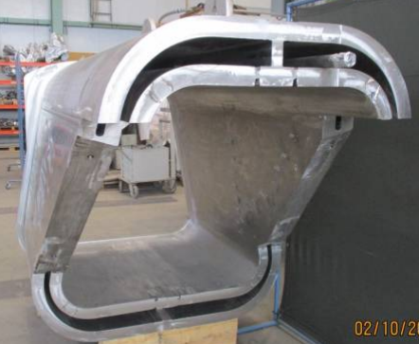
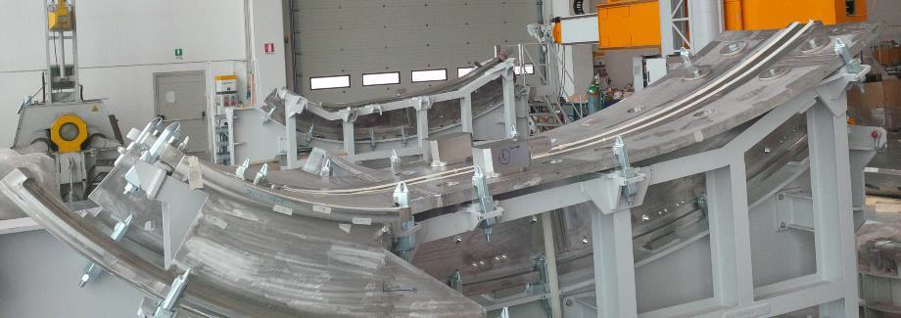
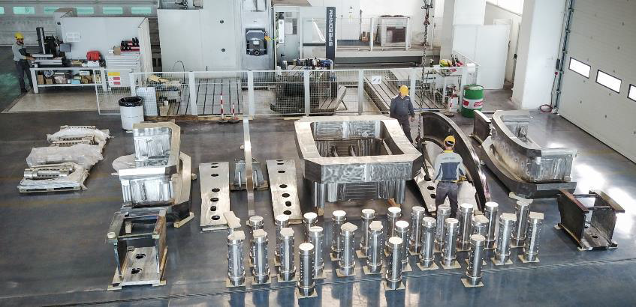
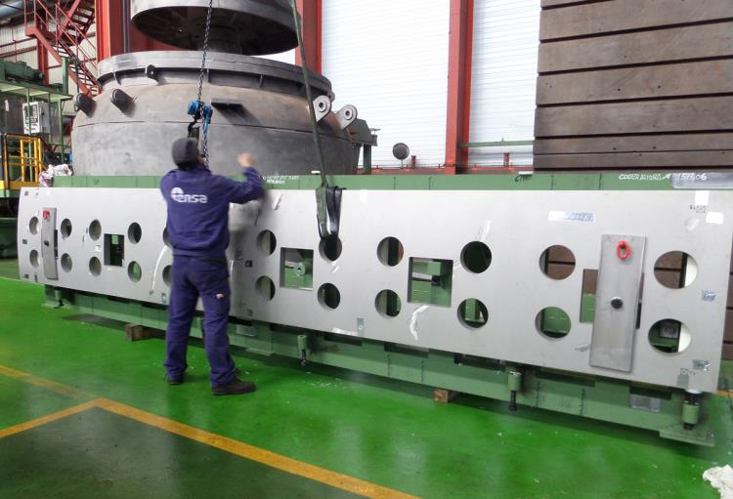
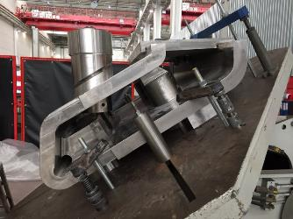
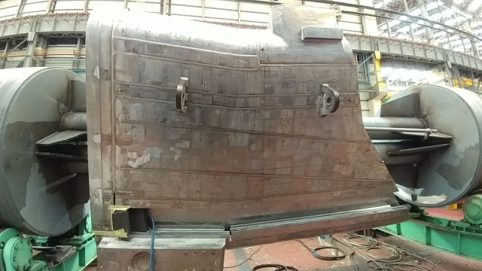
Status of VV Production in EU
PS2
Upper Port
PS3
PS1
PS4
Lower Port

Slide 26
Superconducting Magnets in Full Production
TF Winding Pack, TF Structure, PF Coils, CS Coils, and CC-Coils

Slide 27
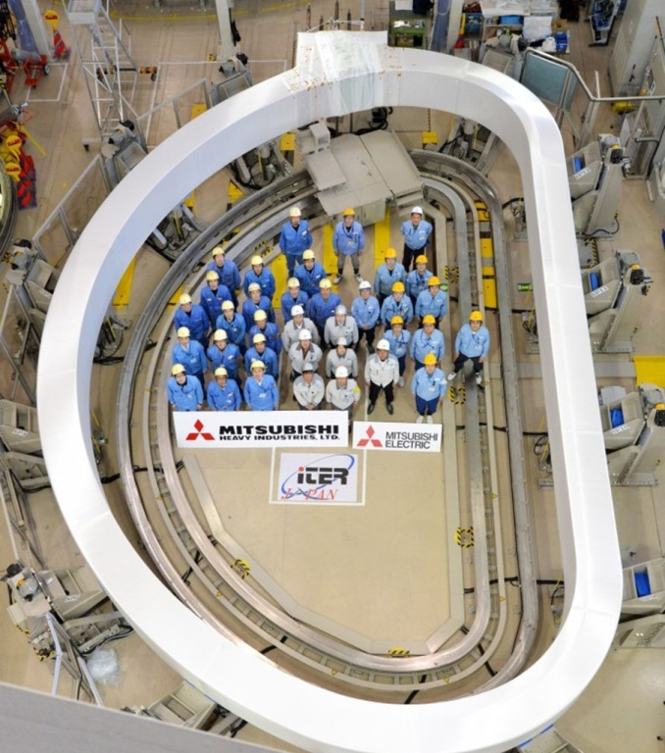
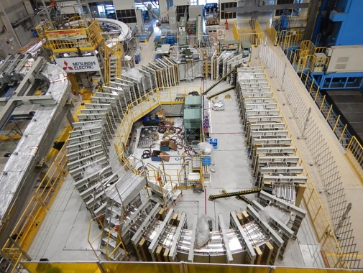
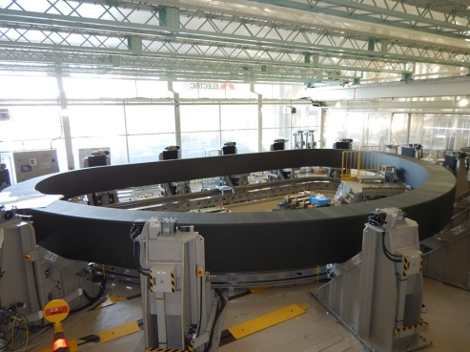
Status of TF WP Production in JA

Slide 28
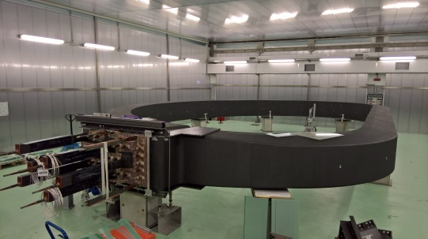



Status of TF WP Production in EU
TF06
TF09
TF WP Instrumentation Test
TF11 (arrived for insertion)

Slide 29



Status of TFCS Production
1) Root Gap : 0.5±0.25mm
2) Misalignment of Welding Root : Within±0.3mm
3) Matching the Splice Plate Side : Within ± 1.3mm

Slide 30





Status of TF Insertion Process

Slide 31


Status of PF5 Production
Two PF5 Real Double Pancakes (DPs) (DP7 and DP8) windings have been completed
PF5: 2nd DP(DP8) Winding Completed

Slide 32


Status of PF6 Production
Five PF6 Real DPs(DP5, DP6, DP7, DP8 and DP9) windings have been completed
PF6: 2nd DP(DP8) VPI Completed
PF6: 3rd DP(DP7) VPI Under Preparation

Slide 33


Status of PF1 Production
Five PF1 Real DP windings have been completed and the 5th DP is underway
PF1: 5th DP Winding Underway
PF1: 3rd DP VPI Completed

Slide 34


Status of CS Coil Production
CS Module-1

Slide 35
In-Vessel Components, Systems in Engineering and Production
W-Divertor, Be First Wall, Shield Blocks, and In-Vessel Coils

Slide 36


Status of Blanket System
Main Functions of ITER Blanket System:
Exhaust the majority of the plasma power
Contribute in providing neutron shielding to superconducting coils
Provide limiting surfaces that define the plasma boundary during startup and shutdown

Slide 37






Status of Blanket FW Manufacturing
Plasma
Exaggerated shaping
RH access

Slide 38

Status of W-Divertor
Divertor Main Functions :
Minimize the helium and impurities content in the plasma
Exhaust part of the plasma thermal power

Slide 39





Status of W-Divertor Manufacturing

Slide 40

Status of In-Vessel Coil System
The in-vessel coils comprise: 3 x 9 picture-framed, ELM coils (aimed at controlling Edge Localized Modes) and 2 ring, VS coils (aimed at controlling Vertical Stability).
Upper VS Coil
Feeders
Feedthroughs
ELM coils (3 per sector)
Lower VS Coil
* PDR finalized successfully.

Slide 41







Status of In-Vessel Coil Conductor
Round conductor with MgO ceramic insulation
Coils attachment through brackets
Unit lengths: up to 70 m
Weight: 12.4 kg/m
[Dimensions in mm]
[ASIPP]

Slide 42


Status of In-Vessel Coil Engineering
2 Insulating Breaks
2 Pipes
(Cooling Supply)
2 Jumper Clamps
(Power Supply)
2 Bellows
Support Structure
IVC In-situ Joint
Joints (to feeders)
IVC FT & IB

Slide 43
Advancement of Technology R&D
Heating & Current Drive Systems, Diagnostics, Remote Handling Systems, and Tritium Systems

Slide 44

Areas of Technology R&D
R&D must be complete in time to enable integration into design and implementation for ITER needs in “Staged Approach”
By internal measures, >85% of design activity is complete : This implies major technology R&D is complete; however, some issues remain and have to be addressed.
Tritium System
RH Tools
FP Diagnostics, ECH
Major Diagnostics
HNB & ICH

Slide 45


Slide 46


H&CD in the ITER Research Plan
4-Stage Approach:
1st Plasma: H
PFPO-1: H and ⁴He
PFPO-2: H and ⁴He
FPO: D and DT
*
ECRH | ICRF | NBI
170 GHz (+100-110 GHz tbc) | 40-55 MHz | 870 keV H⁰, 1 MeV D⁰
20 MW (+20 MW upgrade) | 20 MW (+20 MW) | 33 MW (+16.5 MW)
 | High fusion gain, ST control, wall cleaning, modulation < 1 kHz | Bulk current drive, rotation, limited modulation
24 gyrotrons (24x0.8 MW) | 2 antennas (2x10 MW) | 2 injectors (2x16.5 MW)

Slide 47
Status of ECH PS and RF Sources
Power Supplies: First Factory Acceptance Test has been completed in Nov. 2017; corresponding installation planned for March 2019 (B15);
Gyrotron: Four tubes already in manufacturing or under factory acceptance
RF-DA: first tube’s Factory Acceptance Test started in Oct. 2017; second under manufacturing
JA-DA: first two tube’s manufactured and first Factory Acceptance Test planned in April 2018;
EU-DA: CW prototype being tested in Lausanne for long pulse operation

Slide 48


Status of HNB and DNB Systems
* Front End Components
HV Bushing
Coils
FEC*
Internal components
Passive Magnetic Shield
Heating Neutral Beam Injectors
Diagnostic Neutral Beam Injector

Slide 49










Neutral Beam Test Facility : SPIDER BS
Cooling plant of NBTF
Beam Dump installed
Scaffolding installed
SPIDER Beam Source : installation phase
Plant systems commissioning with CODAS
AGPS delivered and installed and tests are underway
IC-30: Start of integrated commissioning – end March 2018 (@ RFX)

Slide 50








Neutral Beam Test Facility : MITICA
1 MV HV Deck
1 MV HV PS system
Beam Source: in procurement
MITICA vessel supports inside bio shield waiting for vessel installation
MITICA 1MV Bushing: demonstrated 1MV holding
MITICA Vessel in manufacturing

Slide 51








Status of ICH System
RF SOURCES (Building 15)
TRANSMISSION LINES + MATCHING SYSTEM (Building 11-13-15-21)
HV POWER SUPPLIES (Building 15)
ANTENNAS (Building 11)
Antennas: EU DA, “Build to print”, IO for the design
TL & MS: US DA, at functional specs
RF Sources : IN DA, at functional specs
HVPS: IN DA, at functional specs (44%), + IO (56%)

Slide 52
Status of Diagnostic System
50 different diagnostics identified for different measurement roles
Just over 100 sub-projects (in PBS55) in all
PBS55 - Diagnostics
A- Magnetics systems
B- Neutrons systems
C- Optical systems
D- Bolometry systems
E- Spectroscopy systems
F- Microwave systems
G- Operational systems
PBS55-Engineering of:
Q- Equatorial Ports
U- Upper Ports
L- Lower ports
NW- Windows
NE- Electrical Services
PBS57- IVVS
PBS58- PPTF

Slide 53
Challenges of Diagnostic System
Nuclear environment means we need to mitigate transmutation, radiation damage and thermo-electric effects
Target: zero maintenance (in practice very difficult)
Quality requirements are high, in particular for assembly to the nuclear pressure vessel and vacuum vessel feedthroughs
Many interfaces (machine-diagnostics, diagnostics-diagnostics)
Engineering (remote handling capability, neutron shielding, weight)
How are we meeting these?
Staged design, fabrication and installation approach
Joint experiments through dedicated International Tokamak Physics Activity Diagnostic Working Group
Dedicated R&D and development in the ITER IO-DA Teams
Modular design and standardization

Slide 54

Ports for Diagnostic System
Notes:
54

Slide 55

ITER Fuel Cycle : Tritium System

Slide 56



Status of Fuel Cycle
Fuel cycle has unprecedented throughput requirements
Design and safety analysis has advanced
Some equipment is already installed, most systems are in preliminary/final design
High confidence that systems will work, primary questions relate to number of shots per day that can be supported
Vacuum pumping
First torus cryopump manufacturing, testing and delivery completed
High-throughput, tritium compatible roughing pump successfully tested
Gaseous detritiation system
Verification testing for new, high capacity scrubber column technology completed
Recently completed resolution of all major design issues
Receipt of Torus Cryopump
Tokamak Complex Detritiation System

Slide 57







First Torus/Cryostat Cryo-pump Fabrication
Cryo-pump Flange
Cryo-pump inlet valve alignment
Cryo-pump casing preparation for e-beam welding
Assembly of charcoal coated
panels
Completed Cryo-pump
August 2017
Thermal Shield Assembly

Slide 58


Advanced Robotics and Remote Handling
Due to the massive size of the ITER Tokamak components, as well as the intense neutron flux that will occur during operations, the ITER machine has required the development of cutting-edge robotics and remote handling tools, which will be used in both the assembly and operational phases.
Dual nozzle prototype at ORNL.

Slide 59




Remote Handling Technology Development
Blanket Remote Handling (Japan)
Divertor Remote Handling (EU)
Overview of the ITER Blanket RH System
toroidial mover
Overview of the ITER divertor remote handling process
radial mover
transfer cask
* Strong Collaboration (VR, AR, HMI…) with RACE & Industries
Divertor cassette handling trials in the ITER Divertor Test Platform created by the European Domestic Agency in Tampere, Finland.
Blanket module handling trials using the prototype In-Vessel Transporter (IVT) hosted by the Japanese Domestic Agency in Naka, Japan.

Slide 60
Technology & Engineering Breakthroughs and Spinoffs

Slide 61

Multinational Success
The single largest superconductor procurement in industrial history is completed : An eight-year campaign to produce the superconductors for ITER’s powerful magnet systems
Six ITER Members—China, Europe, Japan, Korea, Russia and the United States—have been responsible for the production of 200 kilometres (2,800 metric tons) of cable-in-conduit conductors, worth an estimated EUR 610 million.

Slide 62

ITER Technologies are being developed, demonstrated, are documented, and will be available for the Members’ Fusion Programs
Considerable technical breakthroughs and spin-offs from the ITER Organization and Domestic Agencies activities can be observed (such as the increase in industrial capacity for the production of superconducting material). The ITER Organization and Domestic Agencies are in the process of identifying all the intellectual property related to these activities.

Slide 63
Summary
ITER focuses on the study of burning plasmas, both medium-pulse (400 s) and long-pulse (>1000 s): enabling scientific research on the next step of fusion science and addressing the risks related to the self-heated plasma state.
Schedule Optimization of Tokamak Assembly and Tokamak Complex Installation with “under-pinned Critical Deliveries” showed that First Plasma in 2025
% Complete for FP installed Capital Item Components by end of December : 51.5% complete including IO assembly and installation
Technologies for ITER have been developed and are in production (for First Plasma) and nearing production (for Post-First Plasma), consistent with the needs of the “Staged Approach”
“Staged Approach” constitutes a prudent approach to investment protection and risk management : building on the successful demonstration of the previous stages till DT Operation

