Slide 1
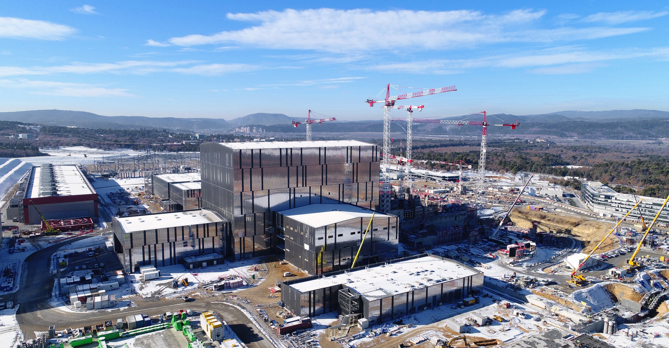
The Science of ITER

Slide 2
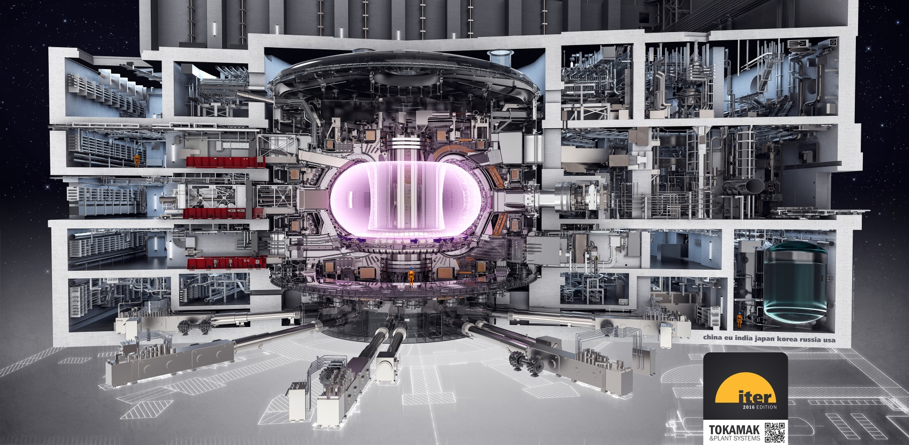
Inside the Tokamak Building

Slide 3
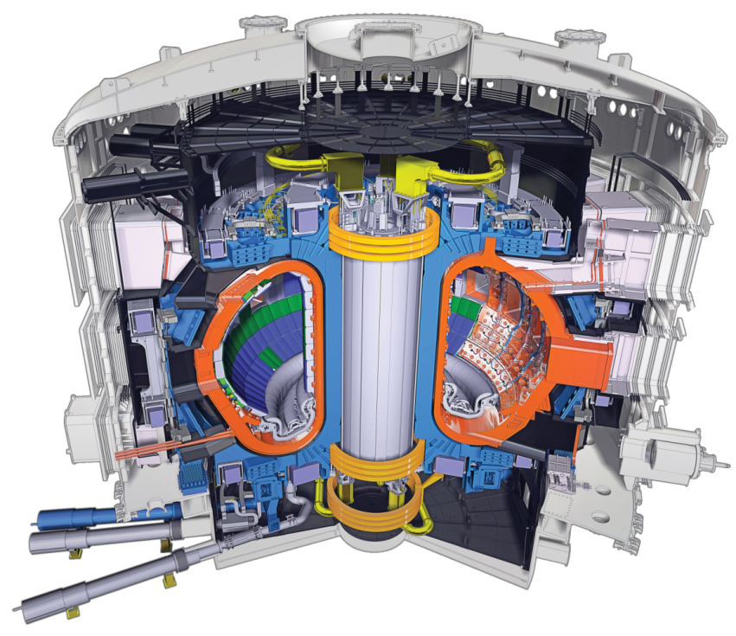
The ITER Tokamak
Vacuum Vessel: ~ 8 000 t.
TF Coils: ~ 18 x 360 t.
Central solenoid: ~ 1 000 t.
Total ~ 23 000 t.
R = 6.2 m, a = 2.0 m
B = 5.3 T, I = 15 MA

Slide 4
What Is the Mission of ITER?
Quoting from the Project Specification (‘the top level ITER Technical Document’):
…demonstrate the scientific and technological feasibility of fusion energy for peaceful purposes
But how?

Slide 5
Physics, Engineering, and Operational Objectives Were Specified
Achieve fusion power of 500 MW with P_{fus}/P_{in} (≡ Q) ≥ 10 for 300-500 s (i.e., stationary conditions)
Aim at demonstrating steady-state operation with Q ≥ 5
Capable of advanced operational modes and a wide operating parameter space
Achieve the minimum cost device that meets all the stated requirements

Slide 6
Why These Conditions?
Fusion power of ~500 MW is the minimum for a power plant
Q ~ 10 is the minimum for a power plant; also dominant self-heating
Stationary conditions imply duration is not limited by physics, but hardware investment
Direct comparison of inductive and steady-state scenarios in burning plasmas answers a key design question for the next step
Wide parameter range requirement avoids a ‘point solution’
Minimum cost because … why pay more?
In the following, I would like to explore the science of these—the ITER design basis and in turn what science questions will be answered

Slide 7
Physics, Engineering, and Operational Objectives Were Specified
Achieve fusion power of 500 MW with P_{fus}/P_{in} (≡ Q) ≥ 10 for 300-500 s (i.e., stationary conditions)
Aim at demonstrating steady-state operation with Q ≥ 5
Capable of advanced operational modes and a wide operating parameter space
Achieve the minimum cost device that meets all the stated requirements

Slide 8
500 MW Fusion Power
Fusion power for DT reactions is given by (in the range where <σv> ∝ T²):
P_{fus} (MW) ≈ 7.6 10⁻¹² p² V
Therefore, smaller devices need higher pressures to reach the 500 MW goal
Pressure can be limited by MHD stability or confinement
<σv>∝ T²

Slide 9
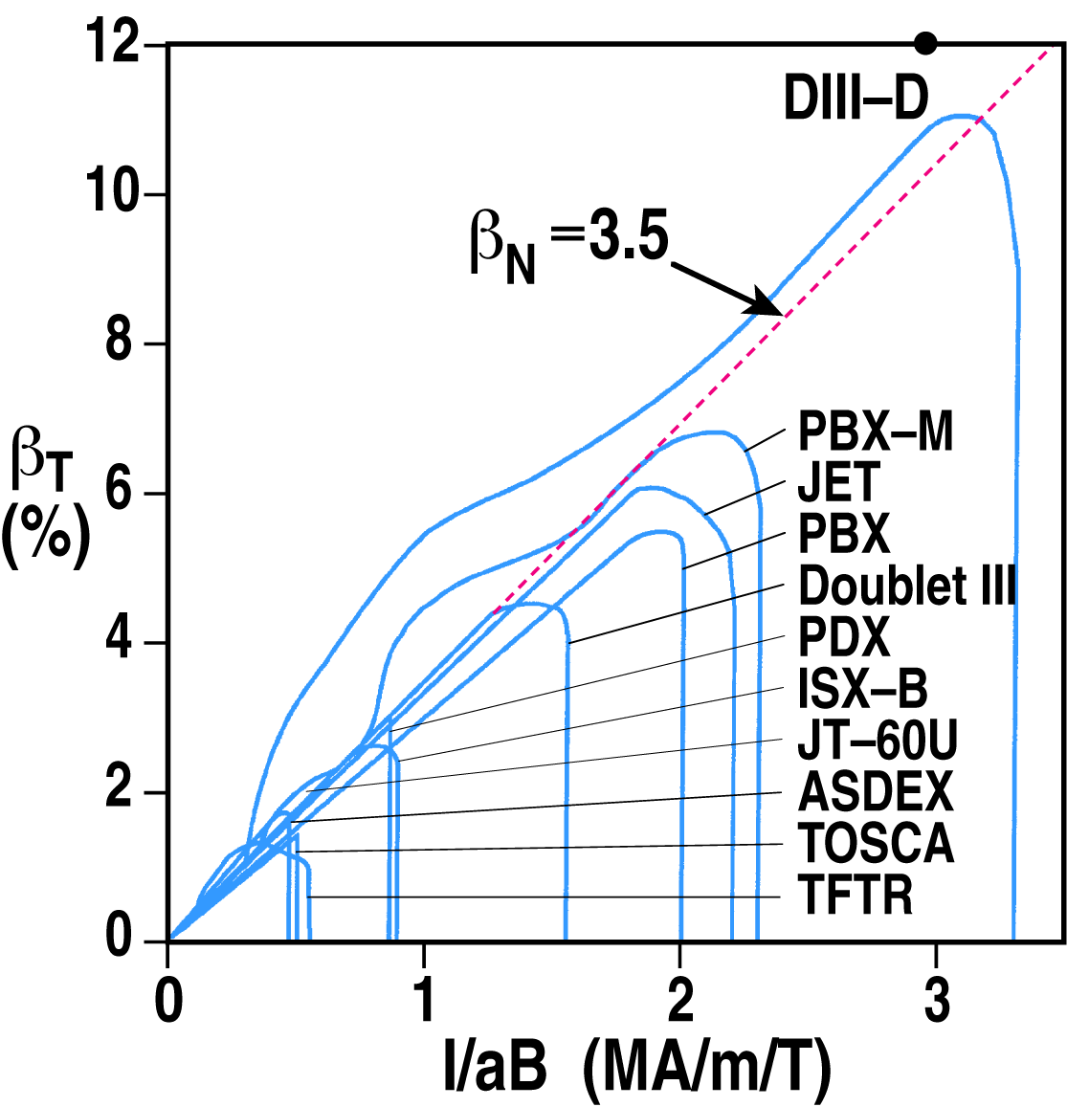
MHD Stability Pressure Limits
MHD equilibrium is given by:
∇p = j x B = (∇ x B) x B/μ₀
There is a dimensionless parameter 2μ₀p/B², which is the ratio of thermal to magnetic energy (β) and is << 1
In a tokamak, the following parameters are also small: r/R and B_{P}/B_{T} ∝ I/aB_{T}
With 3 small parameters, ratios yield two O(1) parameters: ι = 1/q = RB_{P}/rB_{T} and β/(I/aB_{T}), which describe limits on current and pressure in ideal MHD, predicted by theory and validated by experiment

Slide 10
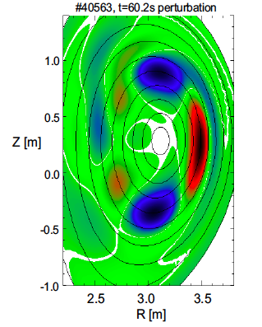
Pressure Limits and Fusion Power
Adding the stability scaling gives:
P_{fus} (MW) ≈ 2.9 10⁻² (f I B)² Rκ
f is the fraction of the maximum pressure limit
For a given operating scenario, I ∝ B and f is constant, so fusion power rapidly increases with B => choose highest practical B
Tokamak scenarios can trade f and I to give the same fusion power
ITER baseline has max(I) and f ≈ 0.5 to lower risk of instability, including tearing modes
Other scenarios can have same f x I at lower I => want to explore a wide operating space
G Huijsmans, JET
JET

Slide 11
Physics, Engineering, and Operational Objectives Were Specified
Achieve fusion power of 500 MW with P_{fus}/P_{in} (≡ Q) ≥ 10 for 300-500 s (i.e., stationary conditions)
Aim at demonstrating steady-state operation with Q ≥ 5
Capable of advanced operational modes and a wide operating parameter space
Achieve the minimum cost device that meets all the stated requirements

Slide 12
Gain (Q) Is Determined by Confinement
For DT fusion, 20% of the fusion power goes to α particles and can heat the plasma
At the 500 MW operating point, 100 MW of self-heating power is available and Q ≥ 10 implies the auxiliary heating power is ≤ 50 MW
Reaching 500 MW fusion power implies two conditions:
The available power can heat the plasma to the required pressure
The self-heating is effective

Slide 13
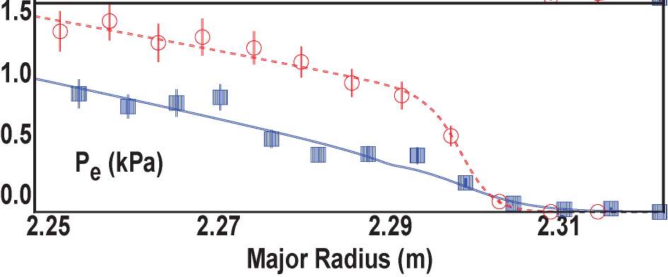
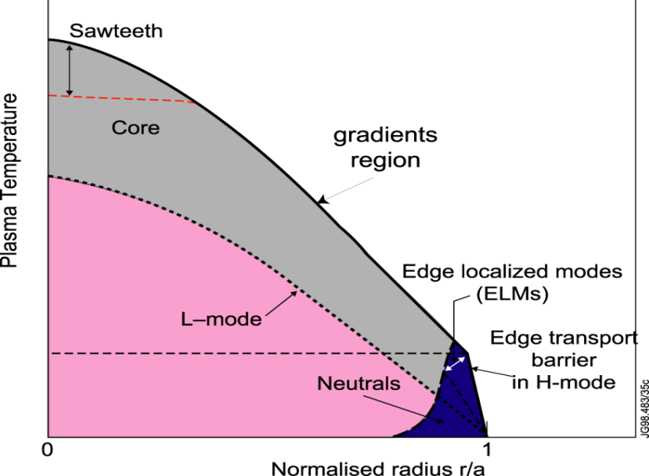
Gain (Q) Is Determined by Confinement
As tokamaks are heated, stored energy increases more slowly than linear with power
Stored energy/Input power = Confinement time
Transport is characterized by the ratio of flux to gradient
At a certain power, the plasma transitions spontaneously to very low transport of particles and heat at the edge (H-mode)
P_{LH} (MW) = 0.098 m_{H}⁻¹ B^{0.80} n^{0.72} S^{0.94}
In ITER, the plasma should be ~5 keV very near the plasma boundary => good fusion reactivity in the entire volume
Sufficient power must be applied to sustain this edge condition
Early DIII-D work
H mode
L mode
Plasma Pressure

Slide 14
How Is Tokamak Confinement Predicted?
Three main methods are used to predict energy confinement:
Engineering parameter scaling
Dimensionless physics parameter scaling
Direct numerical solution of the fundamental equations
Each of these methods has strengths and weaknesses
To predict gain, it is necessary to get self-consistently the pressure (related to stored energy and the self-heating) and the additional power needed to reach that pressure

Slide 15
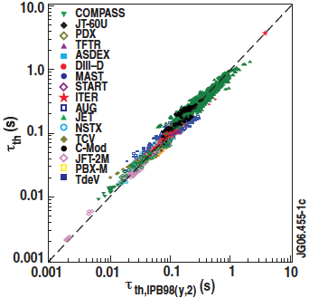
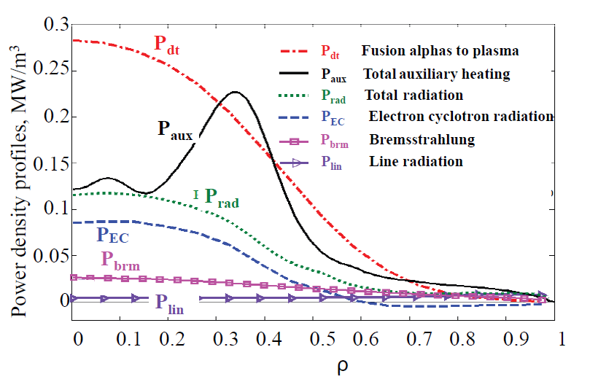
Engineering Parameter Scaling
ITER
Database of confinement time from many tokamaks fit by linear regression to a power law dependence on engineering parameters
Strengths:
3 orders of magnitude in fit extrapolated to target less than 1 order outside the data
Easily used for large design surveys
τ_{E} ∝ I R² P^{-2/3}
Weaknesses:
Improper linear regression
Burning plasmas enter a regime of significant intrinsic radiation (esp. cyclotron radiation)

Slide 16
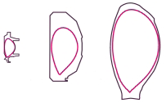
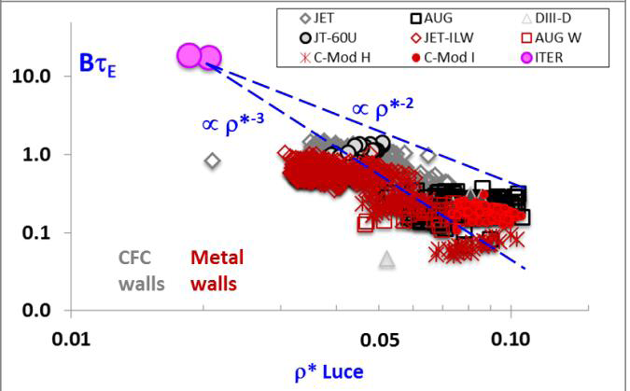
Dimensionless Parameter Scaling
Use similarity arguments to reduce the number of scaling parameters to two
Can keep shape, β, and q fixed
Two other dimensionless parameters: number of gyroradii across the plasma, number of transits before a collision
C-Mod
JET
DIII-D
Strengths:
Variables from basic physics
Validated by identity experiments
Weaknesses:
Uncertainties large => cannot be used alone for prediction, but can be used to check scalings

Slide 17
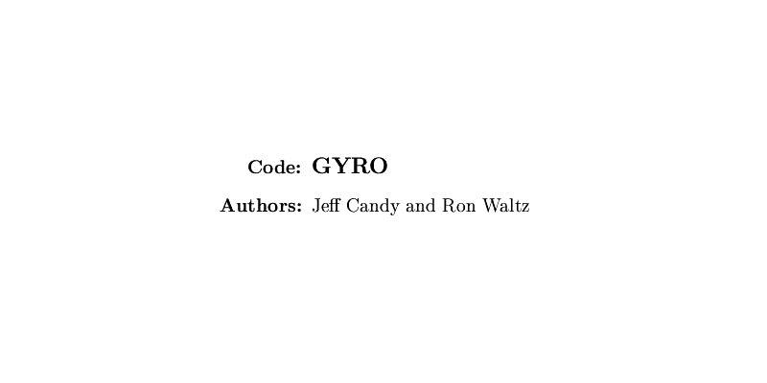
Direct Numerical Solutions
The fundamental equations governing the plasma turbulence are believed to be known
Modern computers can now solve these for realistic parameters
Strengths:
First-principles physics
Weaknesses:
Not practical for design optimization, but can check design points
Solutions sensitive to boundary conditions that do not have the same first-principles basis

Slide 18
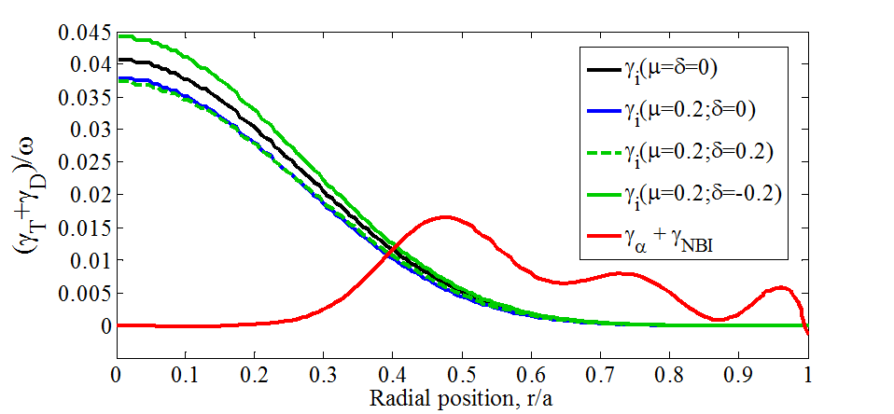
Self-Heating of Plasmas is a New Regime
The charged fusion product of DT reactions is a 3.4 MeV α particle
First time plasmas are heated by an isotropic particle distribution in velocity space
Most calculations all α particle is thermalized except prompt losses
These α particles are faster than the phase velocity of Alfvén waves in the background plasma
The wave-particle interaction can lead to instability
Waves excited are eigenmodes of the background plasma
Think of Cherenkov emission in an active medium where gain is possible
Fuel mixture:
Depletion:
Drive from alpha-particles + beams
Damping from thermal plasma

Slide 19
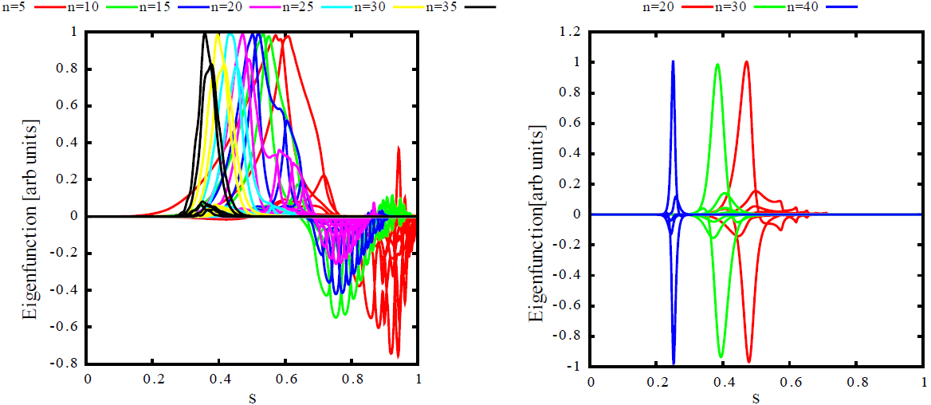
Plasma Response is Also in a New Regime
From dimensionless parameter arguments, the toroidal wavelength of the most unstable modes is proportional to the number of gyroradii across the plasma radius
NSTX: n≈1, DIII-D: n≈3-5; ITER: n≈15-25
The background particles in ITER will see a wave field more typical of turbulence than discrete wave fields
Calculations indicate little loss of heating efficiency due to α particle transport
But we have to actually test it!

Slide 20
Physics, Engineering, and Operational Objectives Were Specified
Achieve fusion power of 500 MW with P_{fus}/P_{in} (≡ Q) ≥ 10 for 300-500 s (i.e., stationary conditions)
Aim at demonstrating steady-state operation with Q ≥ 5
Capable of advanced operational modes and a wide operating parameter space
Achieve the minimum cost device that meets all the stated requirements

Slide 21
Reaching Stationary Conditions
Four significant issues must be dealt with to reach stationary conditions:
Supplying the magnetic energy associated with the operating current
Handling of the stationary heat and particle exhaust (focus on heat here)
Eliminating the transient heat loads associated with standard H-mode operation
Stable stationary operating scenarios must be realized
Each of these has fundamental implications for the design of a burning plasma device

Slide 22
Supplying the Magnetic Energy
A fundamental design consideration for any tokamak is the inner ‘radial build’—the space required for the toroidal field coils, solenoid, and (for burning plasmas) blankets and shielding
There is no demonstrated method to remove completely the need for a solenoid for the current rise, even if it is not needed for sustaining the plasma
To achieve stationary conditions, the plasma duration should be at least 2 current relaxation times for any scenario
The magnetic stored energy required to reach maximum current is far larger than than dissipated by resistivity in current flattop for 2 current relaxation times
ITER solution: >270 Wb of flux, more than 200 Wb is needed to get to 15 MA
Lower current pulses can then be run substantially longer (up to 3000 s)

Slide 23
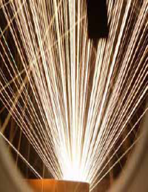
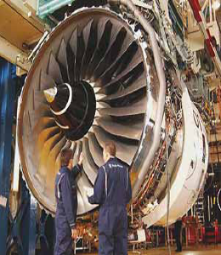
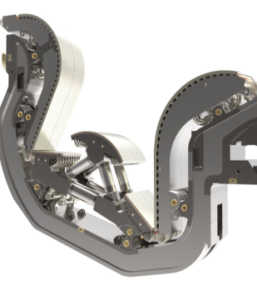
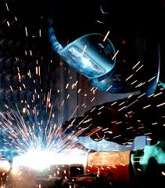
Handling Heat and Particle Flux
ITER transients
The challenge is not small!
Re-entry
vehicle
Ariane 5/
Vulcain 2
~1 <10 85 2000
HWR
Power load [MW/m²]
Arc welding
Rolls Royce Trent 900
ITER steady-state

Slide 24
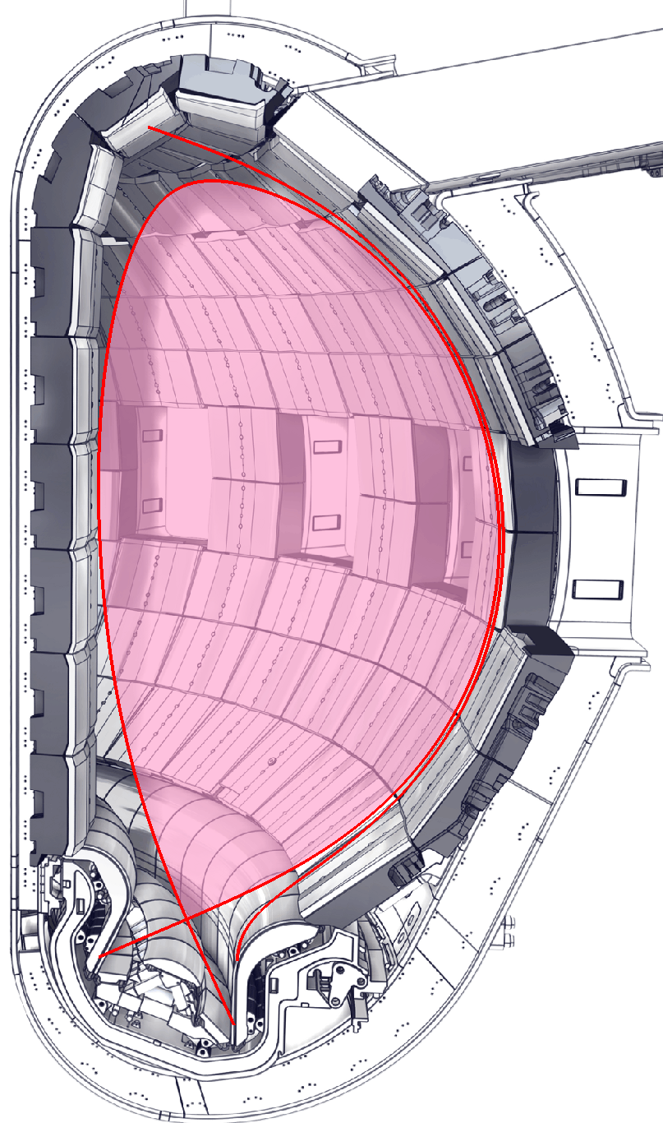

The First Challenge: How Big is the Problem?
The thickness of the layer in which heat is exhausted is small (few mm)
ITER design assumption was ~3-4 mm based on stability considerations
Recent empirical scaling would extrapolate to 1 mm!
Scaling is consistent with an analytic model based on particle drifts
State-of-the-art numerical solutions indicate turbulence in ITER should broaden the exhaust layer to ~5 mm
Existing machines cannot reproduce these conditions
P_{SOL} ~120 MW
Power flow

Slide 25
The Second Challenge: How to Handle the Problem?
To reduce the heat flux, deliberate introduction of impurities, such as noble gases, is envisioned
Preferably, radiation is in the main chamber to spread the energy over a larger surface
Potential problem with dilution from impurities entering the core plasma
Potential problem staying in H mode if too much power radiates from the core plasma
Many experiments have demonstrated radiation in the divertor in order to ‘detach’ the field lines from the divertor targets
The radiating zones and the area over which the energy is deposited may be too small
P_{SOL}
λ_{q}
SOL
Dissipation zone
β

Slide 26
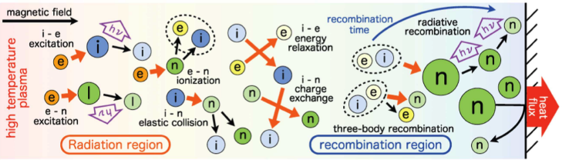
The Third Challenge: How to Compute the Problem?
P_{SOL}
Present calculations contain many of these effects, but are not yet comprehensive
Present-day tokamaks cannot reproduce the ITER divertor conditions
λ_{q}
SOL
β

Slide 27
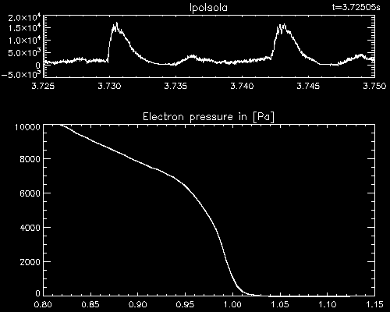
Transients in Standard H-Mode: ELMs
The high confinement at the plasma edge in H mode is actually too high
Pressure increases until an instability limit is reached
In present-day tokamaks, this has beneficial effects
Particle content of the plasma can be controlled by pumping
Impurity content of the core is reduced
ASDEX-Upgrade
E. Wolfrum

Slide 28
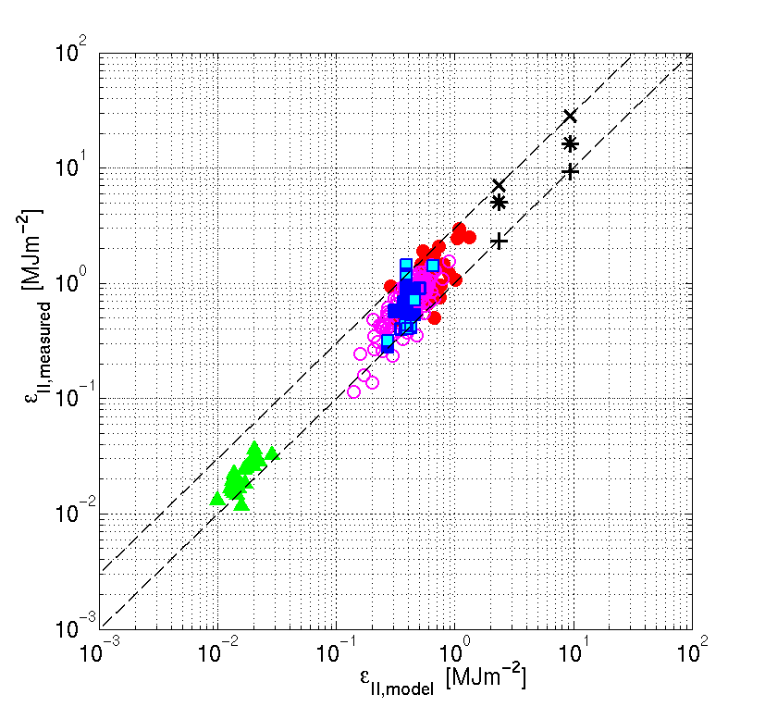
Single ELMs Might Cause Melting
T. Eich, Nucl. Mater. Energy (2017)
Scaling of the energy loss in large ELMs projects energy near the surface melt limit of the ITER divertor
~ surface melt limit
T. Eich et al., [39]
*
ITER-Regr.
JET-C
JET-ILW
MAST
ITER 7.5, 15 MA
AUG-C
AUG-W
AUG-W-inner

Slide 29
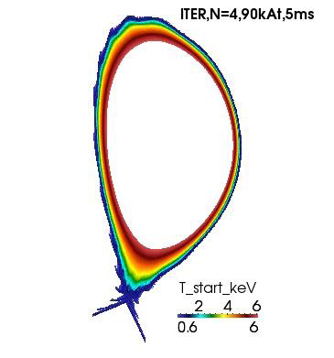
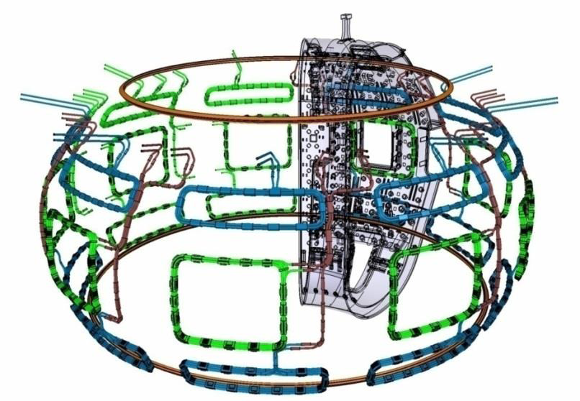
Mitigation of ELMs
The primary method for ELM mitigation in ITER is application of Resonant Magnetic Perturbations
This has been successfully applied in several tokamaks
ITER can apply up to n=4
In addition, a pellet system to trigger ELMs at a pace much faster than natural will be available

Slide 30
What About Disruptions?
A very important reason to operate stationary discharges in ITER is to end the concern about disruptions
A truly stationary plasma will not disrupt because of plasma physics
Disruption occurrence should become a component or power supply reliability issue and not a physics issue
The key question is whether truly stationary operating scenarios exist
Note: take care that stationary ≠ steady-state

Slide 31
Do Candidate Stationary Scenarios Exist?
DIII-D
ITER baseline scenario operated stably at zero input torque in DIII-D
Advanced inductive scenario operated at low torque JT-60U to 28 s

Slide 32
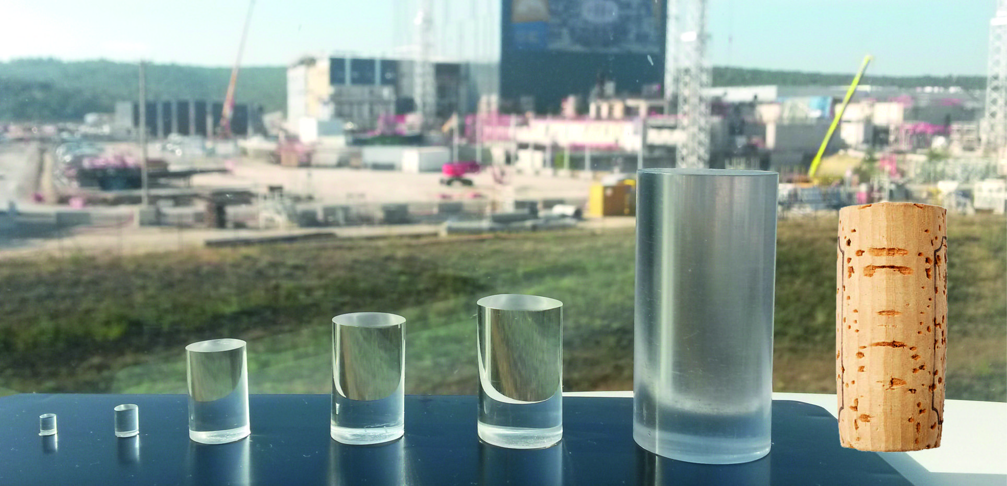
Disruption Mitigation Is Still Mandatory
ITER must be ready to mitigate disruptions at any operating point
Learning to run a stationary discharge will not happen in a day
Components and power supplies will fail
Mitigation pellets are substantially larger than ordinary fuelling pellets (leftmost)
28 mm
20 mm
17 mm
13 mm

Slide 33
Physics, Engineering, and Operational Objectives Were Specified
Achieve fusion power of 500 MW with P_{fus}/P_{in} (≡ Q) ≥ 10 for 300-500 s (i.e., stationary conditions)
Aim at demonstrating steady-state operation with Q ≥ 5
Capable of advanced operational modes and a wide operating parameter space
Achieve the minimum cost device that meets all the stated requirements

Slide 34
True Steady-State Scenario Will Be Difficult
With the day-1 heating and current drive systems, fully non-inductive operation predictions range from Q=2-5
Even with upgrades, true steady-state scenario is difficult because of divertor heat loads at reduced density
However, ITER can definitively compare scenarios with different q profiles proposed for steady-state operation
Two key aspects of the comparison:
Dependence of energy confinement on q
Dependence of stability of Alfvén modes excited by fusion α particles as a function of q

Slide 35
Physics, Engineering, and Operational Objectives Were Specified
Achieve fusion power of 500 MW with P_{fus}/P_{in} (≡ Q) ≥ 10 for 300-500 s (i.e., stationary conditions)
Aim at demonstrating steady-state operation with Q ≥ 5
Capable of advanced operational modes and a wide operating parameter space
Achieve the minimum cost device that meets all the stated requirements

Slide 36
What Questions Will ITER Answer?
While we are are confident in the design basis for ITER, it is still an experiment
This means operation of ITER as envisioned in the design basis will validate (or invalidate) its design basis
In the time between now and ITER plasma operation (and especially DT operation), simulation capability will continue to advance
This means operation of ITER will validate (or invalidate) the physics and assumptions in a variety of simulations

Slide 37
Fusion Questions ITER Will Answer
By design, ITER will answer several key questions for fusion energy, such as:
Does self-heating work?
How large does a plasma need to be to achieve dominant self-heating?
Are advanced scenarios actually ‘advanced’?
Is steady-state operation feasible in a burning plasma?
Is there a self-consistent solution coupling a burning core plasma to a working heat and particle exhaust solution?
Can helium ash be exhausted?
Are plasmas disruption-free in stationary conditions?

Slide 38
Physics Questions ITER Will Answer
ITER will address several interesting plasma physics questions, such as:
Does gyro-kinetic theory really describe plasma transport?
What limits the inverse cascade of turbulent energy at low wavelength?
Is there ‘intrinsic’ rotation?
Do heat and particle transport depend strongly on gyroradius or collision frequency?
What is the mechanism of the L-H transition?
What is the mechanism for runaway generation in a disruption?
Are high temperature plasmas more or less prone to tearing modes?
Do current drive efficiencies increase with temperature?
What is the origin of isotope scaling?

Slide 39
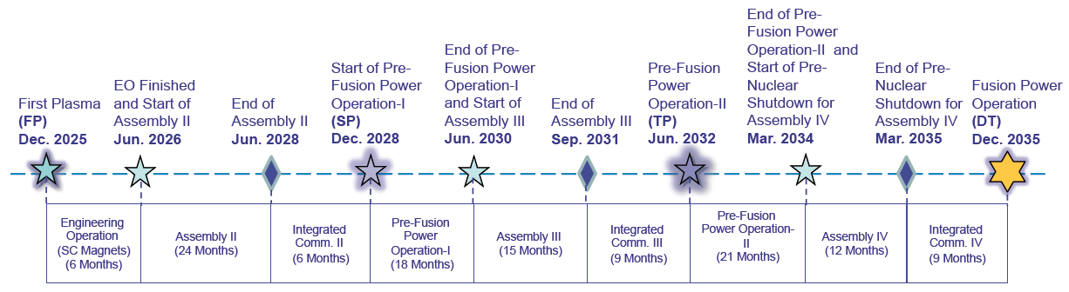
When Will ITER Answer These Questions?
ITER will can address some questions in the early operational phases, but system commissioning for DT is the highest priority task

Slide 40
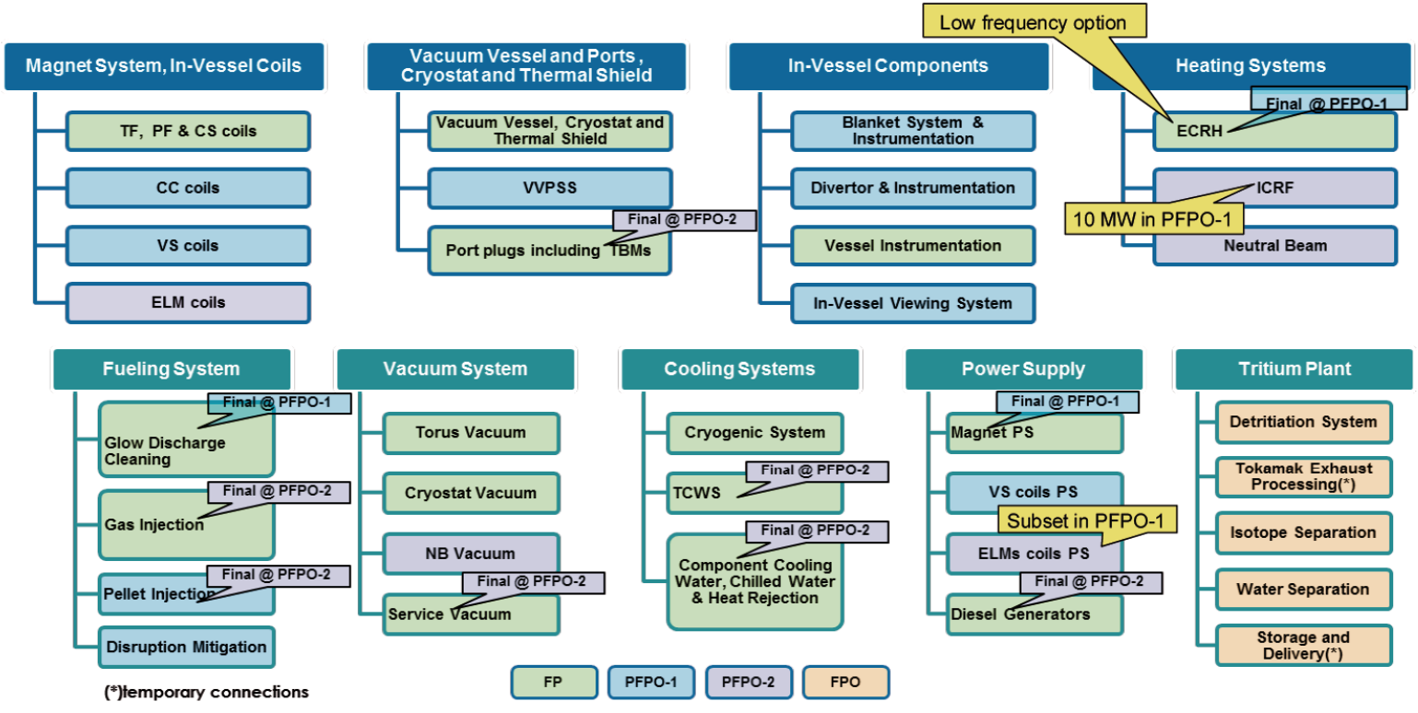
ITER Hardware Availability

Slide 41
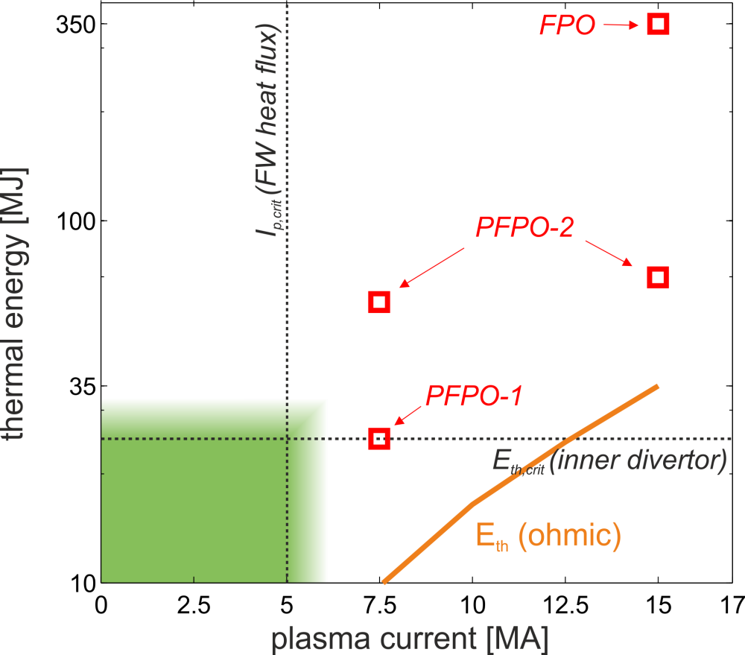
Disruption Physics and Mitigation
Disruption mitigation is necessary from early in PFPO-1
Validity of scaling projections for the mitigation will be immediately known
Operation at full field will be done in PFPO-1 specifically to test the scaling of runaway generation with B

Slide 42
Other Physics Issues Addressed in PFPO
Size scaling of L mode in hydrogen
Current and size scaling of the scrape-off layer power width in L mode
L mode divertor detachment
Fueling physics
H-mode transition and confinement scaling with size
Error field sensitivity and correction
Intrinsic rotation
…

Slide 43
ITER Will Be The First Look At Burning Plasma

