Slide 1
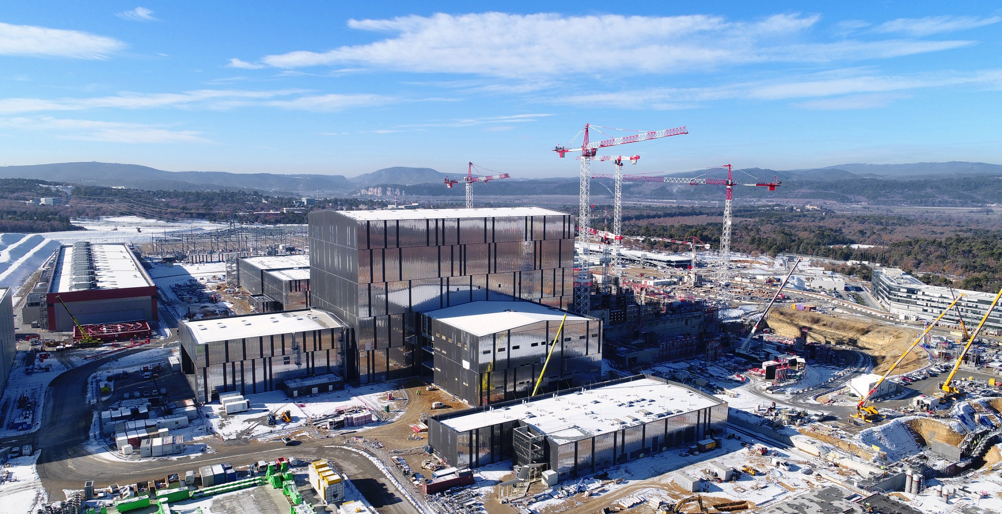
ITER
Project Management
Hans H. ALTFELD, Head of ITER Project Control Office

Slide 2
Table of Contents
ITER Project Complexity
PM: Where do we come from?
Addressing Structural Complexity
Addressing Dynamic Complexity
Addressing Issues and Risks
Addressing Complexity holistically
Summary

Slide 3
ITER Project Complexity
PM: Where do we come from?
Addressing Structural Complexity
Addressing Dynamic Complexity
Addressing Issues and Risks
Addressing Complexity holistically
Summary

Slide 4
ITER
Project Complexity
Structural Complexity
Dynamic Complexity
Risk

Slide 5
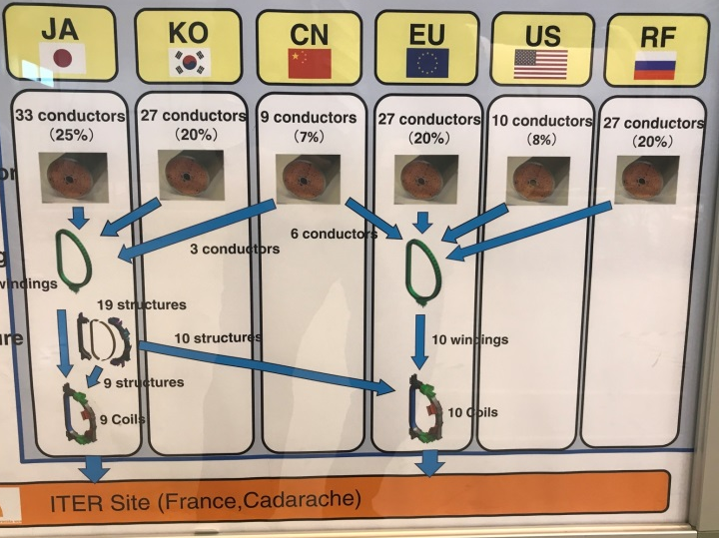
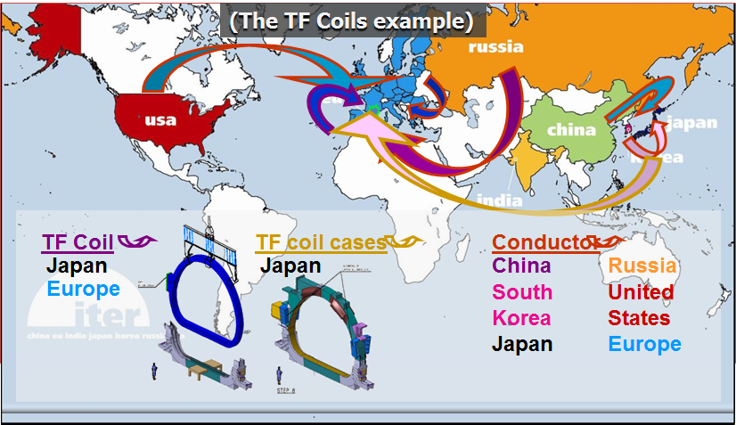
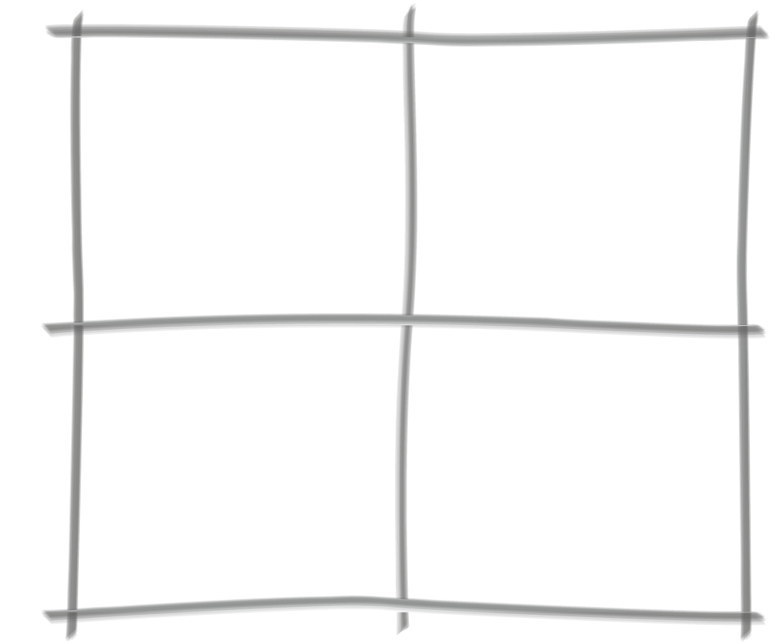
ITER
Structural Complexity
Drawings:
A380: 79,000
ITER: 250,000
Project FTEs:
A380: 6,000
ITER: 3,000
Cost of Development
ISS: 100 €bn
ITER: 20 €bn
System
of Systems
Parts:
747: 510⁶
ITER: 1010⁶
Global
Supply Chain
Interface Challenges and Systems
Cultures:
Science vs industrial
Non-nuclear vs nuclear

Slide 6
ITER
Structural Complexity
Drawings:
A380: 79,000
ITER: 250,000
Project FTEs:
A380: 6,000
ITER: 3,000
Cost of Development
ISS: 100 €bn
ITER: 20 €bn
Governance Structure(s)
System
of Systems
Parts:
747: 510⁶
ITER: 1010⁶
Global
Supply Chain
Interface Challenges and Systems
Cultures:
Science vs industrial
Non-nuclear vs nuclear

Slide 7
ITER
Structural Complexity
Drawings:
A380: 79,000
ITER: 250,000
ITER Agreement set up a structure where IO as the overall integrator does not have organizational control over the Domestic Agencies (component suppliers)
  Domestic Agencies have their own reporting and financial/ budgetary structure
  Drivers for IO (schedule progress, functional performance, overall cost optimization) and DAs (individual entity cost reduction) are not always aligned
Project FTEs:
A380: 6,000
ITER: 3,000
Cost of Development
ISS: 100 €bn
ITER: 20 €bn
Governance Structure(s)
System
of Systems
Parts:
747: 510⁶
ITER: 1010⁶
Global
Supply Chain
Interface Challenges and Systems
Cultures:
Science vs industrial
Non-nuclear vs nuclear

Slide 8
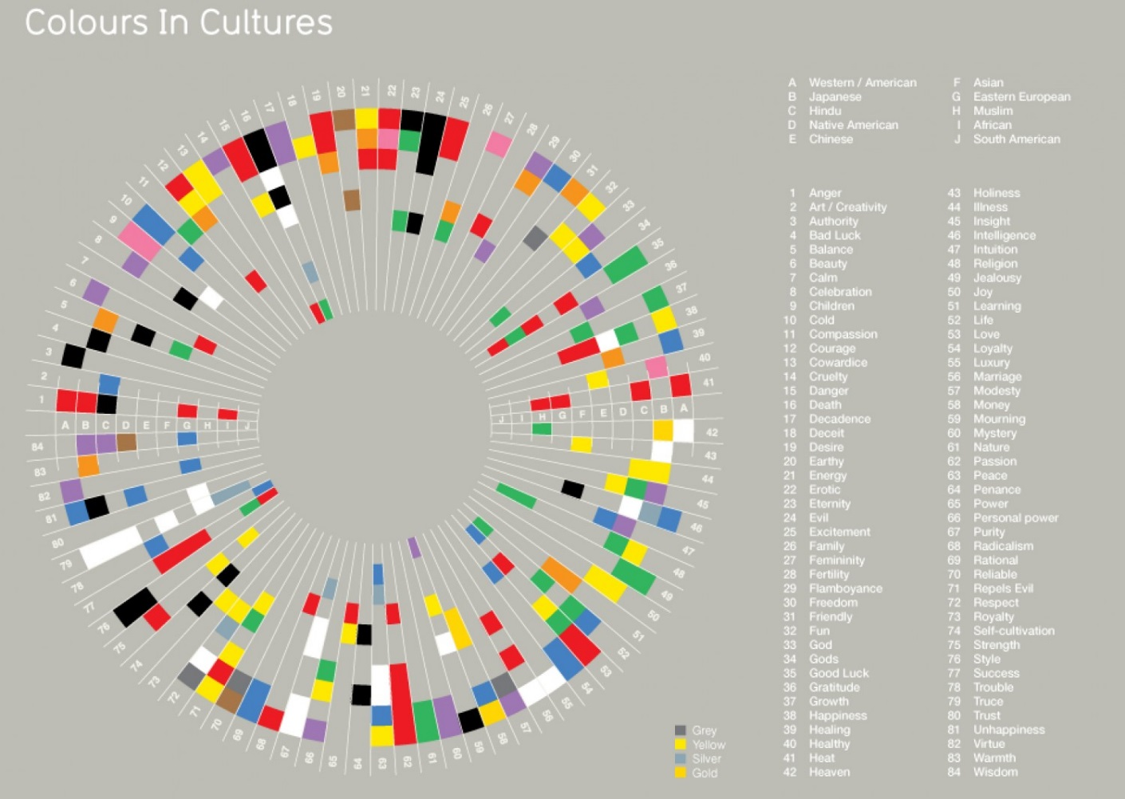
ITER
Structural Complexity
Cultures:
A380: 1 Member
ISS: 5 Members
ITER: 7 Members
Drawings:
A380: 79,000
ITER: 250,000
Project FTEs:
A380: 6,000
ITER: 3,000
Cost of Development
ISS: 100 €bn
ITER: 20 €bn
Governance Structure(s)
System
of Systems
Parts:
747: 510⁶
ITER: 1010⁶
Global
Supply Chain
Interface Challenges and Systems
Cultures:
Science vs industrial
Non-nuclear vs nuclear

Slide 9
ITER
Structural Complexity
Cultures:
A380: 1 Member
ISS: 5 Members
ITER: 7 Members
Drawings:
A380: 79,000
ITER: 250,000
Project FTEs:
A380: 6,000
ITER: 3,000
Cost of Development (ca.)
ISS: 100 €bn
ITER: 20 €bn
Governance Structure(s)
System
of Systems
Parts:
747: 510⁶
ITER: 1010⁶
Global
Supply Chain
Interface Challenges and Systems
Cultures:
Science vs industrial
Non-nuclear vs nuclear

Slide 10
ITER
Dynamic Complexity
Technology Changes
Product
Changes
Financing
Changes
Objectives
Changes
Process
Changes
People
Changes
Organization Changes

Slide 11
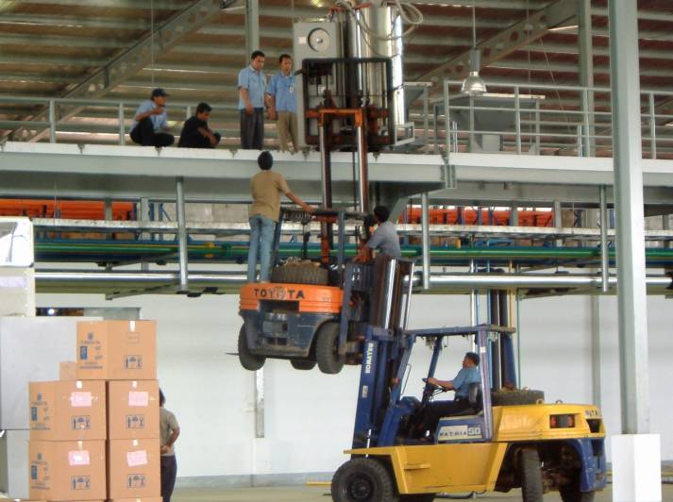
ITER
Risks (and Issues)

Slide 12
ITER
Project Complexity
High Structural Complexity
Medium Dynamic Complexity
More than medium Risk
  Significant level of Complexity!

Slide 13
ITER
Project Complexity
High Structural Complexity
Medium Dynamic Complexity
More than medium Risk
  Significant level of Complexity!
  How to manage this Complexity?

Slide 14
ITER Project Complexity
PM: Where do we come from?
Addressing Structural Complexity
Addressing Dynamic Complexity
Addressing Issues and Risks
Addressing Complexity holistically
Summary

Slide 15
<2013
Excerpt
As a result of the complex governance setup, award of fabrication contracts in the past, when design was still evolving, was
  made further complex by extremely complicated breakdown of components scope between multiple DAs and IO, resulting in complex interfaces and uncertain cost boundaries between DAs and IO
  lacking decision speed as there was no central funding mechanism for compensating impact of design changes to be cascaded to the DAs

Slide 16
2013
ITER Management Assessment (“Madia Report”)
Excerpt
lack of a strong Project Management culture
unrealistic schedule
  inadequate Systems Engineering and Design Integration
  a stove-piped organizational structure and inefficient management organization
  lack of a strong nuclear safety culture
  lack of effective IO-DA decision-making

Slide 17
2013
ITER Management Assessment (“Madia Report”)
Excerpt
lack of a strong Project Management culture
unrealistic schedule
  inadequate Systems Engineering and Design Integration
  a stove-piped organizational structure and inefficient management organization
  lack of a strong nuclear safety culture
  lack of effective IO-DA decision-making
  Massive improvements required to project manage ITER

Slide 18
2015
Action Plan presented by elect DG B. Bigot
Excerpt
Integrate IO and DAs under the leadership of the DG, while respecting the ITER Agreement:
  Provide DG with the global and ultimate technical responsibility, with DAs to participate in all key decision making processes
  Introduce an Executive Project Board
  Not only reinforce the Project Control Office and establish a Central Integration Office (CIO), but also strengthen their ties to their counterparts in the DAs
  Create integrated IO/DA(s) project teams

Slide 19
2015
Action Plan presented by elect DG B. Bigot
Excerpt
Provide DG with a central fund to finance technical changes initiated by the IO, so that technical decisions in the overall interest of the project can be taken much faster
Implement powerful coordination tools for establishing a nuclear project culture
Develop a project culture based on mutual trust, project loyalty and team spirit
Implement a new organization at the IO in support of the above
Hire senior managers with industrial background in managing complex projects

Slide 20
2015
Action Plan presented by elect DG B. Bigot
Excerpt
Provide DG with a central fund to finance technical changes initiated by the IO, so that technical decisions in the overall interest of the project can be taken much faster
Implement powerful coordination tools for establishing a nuclear project culture
Develop a project culture based on mutual trust, project loyalty and team spirit
Implement a new organization at the IO in support of the above
Hire senior managers with industrial background in managing complex projects
  Action Plan fully supported by ITER Council and DAs

Slide 21
Table of Contents
ITER Project Complexity
PM: Where do we come from?
Addressing Structural Complexity
Addressing Dynamic Complexity
Addressing Issues and Risks
Addressing Complexity holistically
Summary

Slide 22
Today
Addressing Structural Complexity
  Slicing the Elephant

Slide 23
Today
Addressing Structural Complexity
Break down of content along different dimensions, e.g.
  System
  Work
  Requirements / V&V
  Schedule
  Site
  Organization

Slide 24
Today
Addressing Structural Complexity
ITER Plant Breakdown Structure (PBS)
Break down of content along different dimensions, e.g.
  System

Slide 25
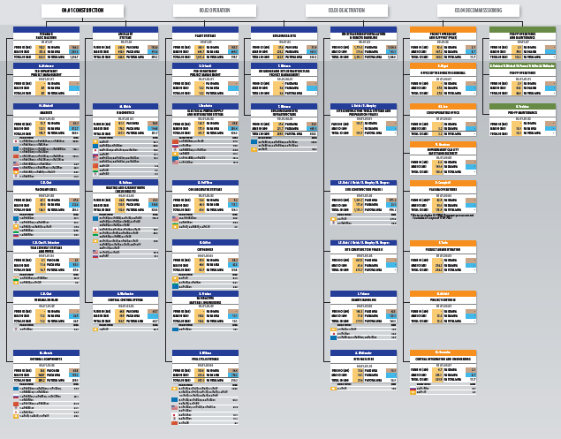
Today
Addressing Structural Complexity
ITER Work Breakdown Structure (WBS)
Break down of content along different dimensions, e.g.
  System
  Work

Slide 26
Today
Addressing Structural Complexity
ITER Requirements and V&V Management
Break down of content along different dimensions, e.g.
  System
  Work
  Requirements

Slide 27
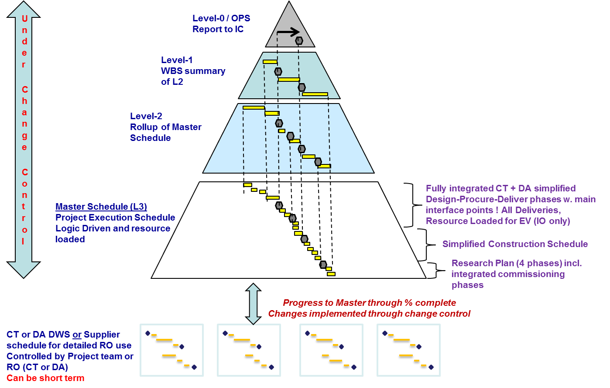
Today
Addressing Structural Complexity
ITER Schedule Governance
Break down of content along different dimensions, e.g.
  System
  Work
  Requirements
  Schedule

Slide 28
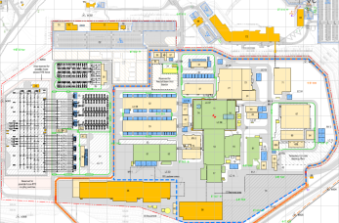
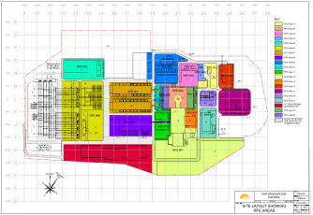
Today
Addressing Structural Complexity
ITER Geographic Breakdown Structure (GBS)
Break down of content along different dimensions, e.g.
  System
  Work
  Requirements
  Schedule
  Site

Slide 29
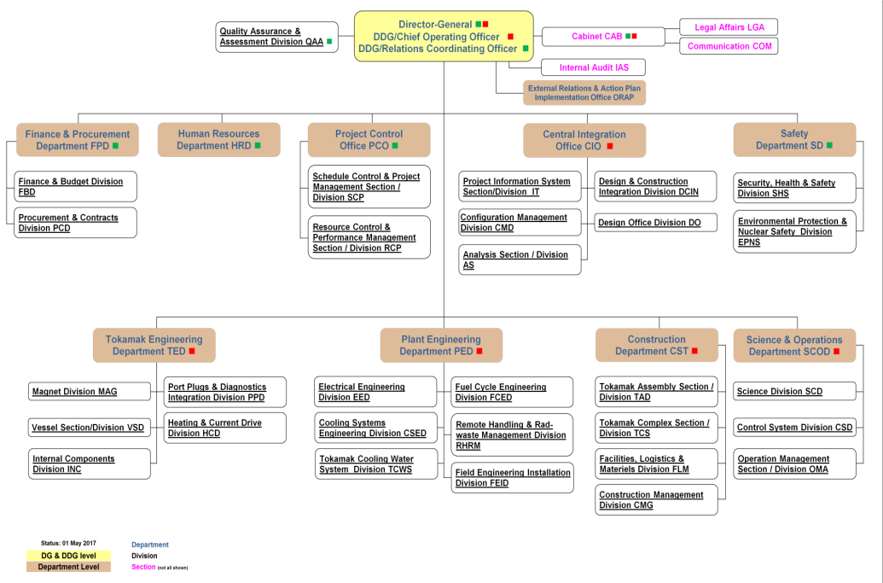
Today
Addressing Structural Complexity
ITER Organization Breakdown Structure (OBS)
Break down of content along different dimensions, e.g.
  System
  Work
  Requirements
  Schedule
  Site
  Organization

Slide 30
Today
Addressing Structural Complexity
‘Slicing the Elephant’ requires tight management and control of I³
  Interfaces managed through Interface Sheets
  Interdependencies managed through schedule governance and customer-supplier relationship monitoring tools
  Interchangeabilities managed through Configuration Management

Slide 31
Table of Contents
ITER Project Complexity
PM: Where do we come from?
Addressing Structural Complexity
Addressing Dynamic Complexity
Addressing Issues and Risks
Addressing Complexity holistically
Summary

Slide 32
Today
Addressing Dynamic Complexity
Addressing Dynamic Complexity is all about responding to change in a controlled, yet agile manner

Slide 33
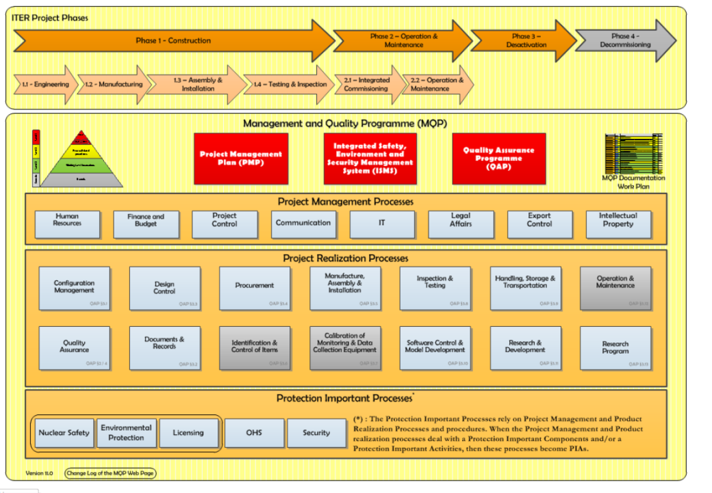
Today
Addressing Dynamic Complexity
ITER Management & Quality Program (MQP)
Addressing Dynamic Complexity is all about responding to change in a controlled, yet agile manner.
  Processes

Slide 34
Today
Addressing Dynamic Complexity
ITER Management & Quality Program (MQP)
Addressing Dynamic Complexity is all about responding to change in a controlled, yet agile manner.
  Processes

Slide 35
Today
Addressing Dynamic Complexity
ITER Management & Quality Program (MQP)
Addressing Dynamic Complexity is all about responding to change in a controlled, yet agile manner.
  Processes
  ‘Business Operating System’ now well defined

Slide 36
Today
Addressing Dynamic Complexity
Baselines
Technical Baseline
Updated Cost and Schedule Baseline approved ‘ad referendum’ in November 2016
  after review by an ITER Council Working Group on the Independent Review of the Updated Long Term Schedule and Human Resources (ICRG)
  based on best technically achievable and risk-reducing ‘4-Stage Approach’ from FP (Dec ‘25) to DT operations (Dec ‘35)
  on purpose without initial schedule or cost contingency
Addressing Dynamic Complexity is all about responding to change in a controlled, yet agile manner.
  Processes
  Change Control

Slide 37
Today
Addressing Dynamic Complexity
Baselines
Technical Baseline
Updated Cost and Schedule Baseline approved ‘ad referendum’ in November 2016
  after review by an ITER Council Working Group on the Independent Review of the Updated Long Term Schedule and Human Resources (ICRG)
  based on best technically achievable and risk-reducing ‘4-Stage Approach’ from FP (Dec ‘25) to DT operations (Dec ‘35)
  on purpose without initial schedule or cost contingency
Addressing Dynamic Complexity is all about responding to change in a controlled, yet agile manner.
  Processes
  Change Control
  Baselines serve as references against which change is controlled

Slide 38
Today
Addressing Dynamic Complexity
Decision Making Hierarchy
Addressing Dynamic Complexity is all about responding to change in a controlled, yet agile manner.
  Processes
  Change Control

Slide 39
Today
Addressing Dynamic Complexity
Decision Making Hierarchy
Addressing Dynamic Complexity is all about responding to change in a controlled, yet agile manner.
  Processes
  Change Control
  Hundreds of Change Requests have been processed and implemented

Slide 40
Today
Addressing Dynamic Complexity
Reserve Fund
covers cost of IO-directed design/ scope changes post-March 2015
1.05 Billion EUR in the Updated Baseline
at the discretion of the DG, subject to EPB consultation
~ 29% used so far/ in pipeline
Addressing Dynamic Complexity is all about responding to change in a controlled, yet agile manner.
  Processes
  Change Control
Notes:
Established in 2015 to address problems arising of IO-DA disputes over cost of changes, affecting Project progress

Slide 41
Today
Addressing Dynamic Complexity
Reserve Fund
covers cost of IO-directed design/ scope changes post-March 2015
1.05 Billion EUR in the Updated Baseline
at the discretion of the DG, subject to EPB consultation
~ 29% used so far/ in pipeline
Addressing Dynamic Complexity is all about responding to change in a controlled, yet agile manner.
  Processes
  Change Control
  Speed of decision-making has been substantially increased
Notes:
Established in 2015 to address problems arising of IO-DA disputes over cost of changes, affecting Project progress

Slide 42
Today
Addressing Dynamic Complexity
Addressing Dynamic Complexity is all about responding to change in a controlled, yet agile manner.
  Processes
  Change Control
  Effective Communication

Slide 43
Today
Addressing Dynamic Complexity
Addressing Dynamic Complexity is all about responding to change in a controlled, yet agile manner.
  Processes
  Change Control
  Effective Communication

Slide 44
Today
Addressing Dynamic Complexity
(1) Worldwide Connectivity
Addressing Dynamic Complexity is all about responding to change in a controlled, yet agile manner.
  Processes
  Change Control
  Effective Communication
  Videoconferencing intensively used as 2nd best way of communication

Slide 45
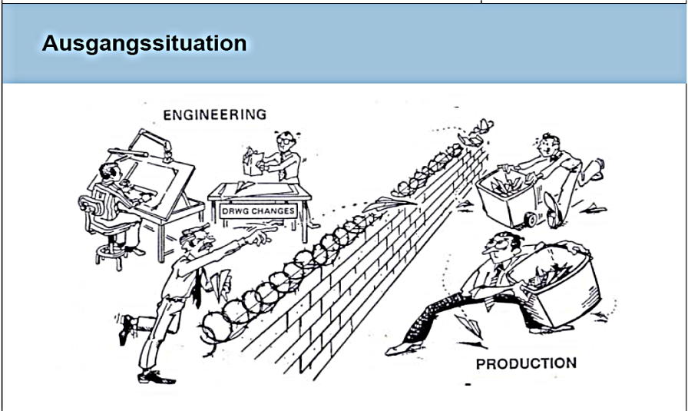
Today
Addressing Dynamic Complexity
(2) Integrated Project Teams
Addressing Dynamic Complexity is all about responding to change in a controlled, yet agile manner.
  Processes
  Change Control
  Effective Communication
ENGINEERING
CONSTRUCTION

Slide 46
Today
Addressing Dynamic Complexity
(2) Integrated Project Teams
Addressing Dynamic Complexity is all about responding to change in a controlled, yet agile manner.
  Processes
  Change Control
  Effective Communication
ENGINEERING
CONSTRUCTION

Slide 47
Today
Addressing Dynamic Complexity
(2) Integrated Project Teams
Addressing Dynamic Complexity is all about responding to change in a controlled, yet agile manner.
  Processes
  Change Control
  Effective Communication
ENGINEERING
CONSTRUCTION
  PTs introduced for a variety of deliverables (VV, BIPS, Cryo, TBM)

Slide 48

Today
Addressing Dynamic Complexity
(1) Experience-based People Selection
Addressing Dynamic Complexity is all about responding to change in a controlled, yet agile manner.
  Processes
  Change Control
  Effective Communication
  Competences of People

Slide 49

Today
Addressing Dynamic Complexity
(2) ITER Academy
Addressing Dynamic Complexity is all about responding to change in a controlled, yet agile manner.
  Processes
  Change Control
  Effective Communication
  Competences of People
Knowledge
Awareness
Behaviours
Leadership

Slide 50

Today
Addressing Dynamic Complexity
(3) Annual Performance Assessment
Addressing Dynamic Complexity is all about responding to change in a controlled, yet agile manner.
  Processes
  Change Control
  Effective Communication
  Competences of People

Slide 51
Today
Addressing Dynamic Complexity
Addressing Dynamic Complexity is all about responding to change in a controlled, yet agile manner.
  Processes
  Change Control
  Effective Communication
  Competences of People
Frequency of Change

Slide 52
Today
Addressing Dynamic Complexity
Addressing Dynamic Complexity is all about responding to change in a controlled, yet agile manner.
  Processes
  Change Control
  Effective Communication
  Competences of People
Frequency of Change
  Effective Communication and People Competences vital for ITER

Slide 53
ITER Project Complexity
PM: Where do we come from?
Addressing Structural Complexity
Addressing Dynamic Complexity
Addressing Issues and Risks
Addressing Complexity holistically
Summary

Slide 54
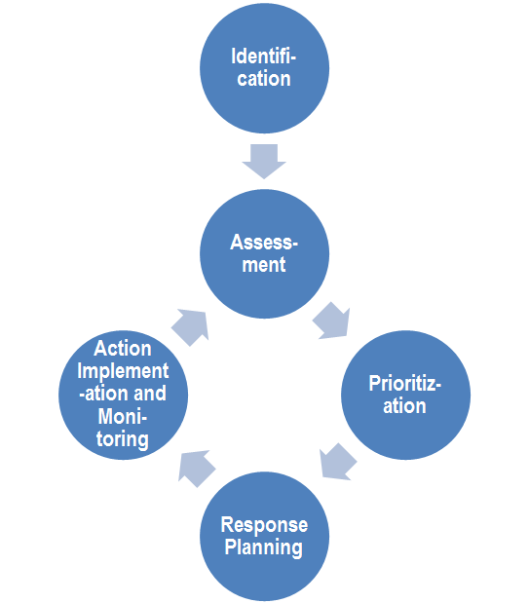
Today
Addressing Issues and Risks
ITER R&OM
ITER Project Baseline comes without any initial contingencies for cost and schedule
The Project has to identify and generate opportunities to manage issues and risks
Notes:
Established a Project Risk & Opportunities Management process for registering, tracking, managing and reporting risks and opportunities
Hierarchy of risks and risk managements
Risk mitigation measures
Assessment of probability and impact pre and post-mitigation
No cost contingency in baseline
Undistributed Budget mechanism for generating savings vis-à-vis costs, and use for risk mitigation measures/ counter-measures
Quantitative Risk Assessment modelling(schedule and cost exposure) for internal IO-DA discussion and review

Slide 55
Today
Addressing Issues and Risks
ITER R&OM
ITER Project Baseline comes without any initial contingencies for cost and schedule
The Project has to identify and generate opportunities to manage issues and risks
  Holistic IRO Management
Notes:
Established a Project Risk & Opportunities Management process for registering, tracking, managing and reporting risks and opportunities
Hierarchy of risks and risk managements
Risk mitigation measures
Assessment of probability and impact pre and post-mitigation
No cost contingency in baseline
Undistributed Budget mechanism for generating savings vis-à-vis costs, and use for risk mitigation measures/ counter-measures
Quantitative Risk Assessment modelling(schedule and cost exposure) for internal IO-DA discussion and review

Slide 56
Today
Addressing Issues and Risks
ITER R&OM
ITER Project Baseline comes without any initial contingencies for cost and schedule
The Project has to identify and generate opportunities to manage issues and risks
  Holistic IRO Management
  Professional, but classical approach
Notes:
Established a Project Risk & Opportunities Management process for registering, tracking, managing and reporting risks and opportunities
Hierarchy of risks and risk managements
Risk mitigation measures
Assessment of probability and impact pre and post-mitigation
No cost contingency in baseline
Undistributed Budget mechanism for generating savings vis-à-vis costs, and use for risk mitigation measures/ counter-measures
Quantitative Risk Assessment modelling(schedule and cost exposure) for internal IO-DA discussion and review

Slide 57
Table of Contents
ITER Project Complexity
PM: Where do we come from?
Addressing Structural Complexity
Addressing Dynamic Complexity
Addressing Issues and Risks
Addressing Complexity holistically
Summary

Slide 58
Today
Systems Engineering and Design Integration
CIO established to systematically implement
  Systems Engineering (Design Control)
  Configuration Management
  Design Integration
across the Project.
Transversal functions, such as nuclear integration and functional analysis, have been clearly defined and systematically controlled since 2017
Methods, processes, tools now are industry state-of-the-art
  Implementation Plans defined and being executed

Slide 59
Today
Product Lifecycle Management (PLM) System
Approval for introduction of PLM system in 2015
Tool customization during 2016-2017
Deployment of system kicked-off in 2017
Initially used in support of Configuration Management
  Backbone for managing technical data during ITER lifetime set up

Slide 60
Today
Project Status Reporting
Overall Project status periodically reported to EPB and IC, thereby providing the basis for recoveries and risk mitigations
Typical status report includes:
  Overall status of Project progress, including % complete
  Status of High Level Project Milestones
  Major risks and challenges
  Earned Value Management indicators – SPI and CPI
  KPIs for transversal process performance
  A robust mechanism for monitoring and reporting is in place

Slide 61
Today
External Audits
Since the Madia Report, ITER’s capabilities to manage the Project professionally have been audited at a variety of occasions, with more audits yet to come:
  Bi-annual Management Assessments (2015, 2017)
  ICRG – 2016
  Risk Management – April 2017
  Interface Freeze – September 2017
  Configuration Management – August 2018
Strong US representation in external audits/ validations
  External Audits provided much support towards better PM/SE

Slide 62
Table of Contents
ITER Project Complexity
PM: Where do we come from?
Addressing Structural Complexity
Addressing Dynamic Complexity
Addressing Issues and Risks
Addressing Complexity holistically
Summary

Slide 63
Summary
General
Thanks to substantial improvements implemented since 2015, the ITER Project is under control – from a technical, cost and schedule perspective
Deviations from baselines are constantly monitored and – where necessary – recovery or mitigation measures are implemented
Project status is reported regularly in a transparent manner to EPB and IC
Further evolutions in managing ITER are being implemented

Slide 64
Summary
General
Thanks to substantial improvements implemented since 2015, the ITER Project is under control – from a technical, cost and schedule perspective
Deviations from baselines are constantly monitored and – where necessary – recovery or mitigation measures are implemented
Project status is reported regularly in a transparent manner to EPB and IC
Further evolutions in managing ITER are being implemented
  Significant progress made, confirmed by external audits

Slide 65
Summary
General
Thanks to substantial improvements implemented since 2015, the ITER Project is under control – from a technical, cost and schedule perspective
Deviations from baselines are constantly monitored and – where necessary – recovery or mitigation measures are implemented
Project status is reported regularly in a transparent manner to EPB and IC
Further evolutions in managing ITER are being implemented
  Significant progress made, confirmed by external audits
  But more work needed to reach full adequacy of capabilities

Slide 66
Summary
Nuclear Safety
Enormous progress achieved by IO, together with the DAs, in persuading ASN (the local Nuclear Safety Regulator in France) to follow a flexible approach for regulating nuclear fusion versus fission without compromising safety requirements
Demonstrating to ASN robustness of
  propagation of safety requirements across distributed supply chain
  compliance with requirements across supply chain
Ongoing work with ASN to demonstrate safety of FOAK systems like detritiation systems

Slide 67
Summary
Nuclear Safety
Enormous progress achieved by IO, together with the DAs, in persuading ASN (the local Nuclear Safety Regulator in France) to follow a flexible approach for regulating nuclear fusion versus fission without compromising safety requirements
Demonstrating to ASN robustness of
  propagation of safety requirements across distributed supply chain
  compliance with requirements across supply chain
Ongoing work with ASN to demonstrate safety of FOAK systems like detritiation systems
  ITER sets the scene for regulations in nuclear fusion

Slide 68
Thank You!
  www.iter.org

