Slide 2



Acknowledgements
Many contributions, particularly from
Joe Minervini & PSFC Magnet Group
Dan Brunner*
Zach Hartwig
Earl Marmar
Bob Mumgaard*
Brandon Sorbom*
Dennis Whyte
* Commonwealth Fusion Systems – who will be funding the project described here

Slide 3
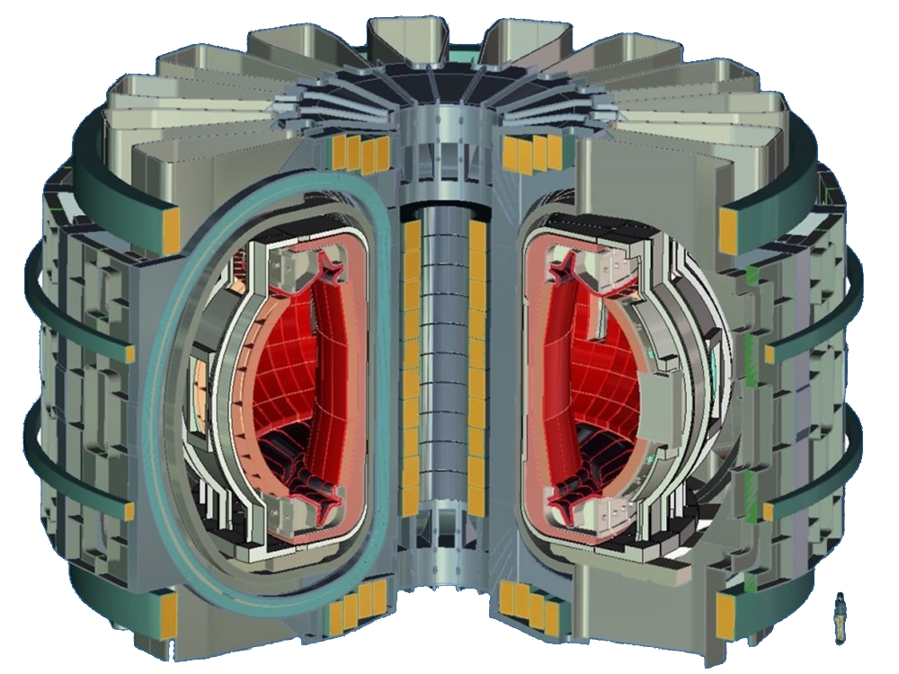
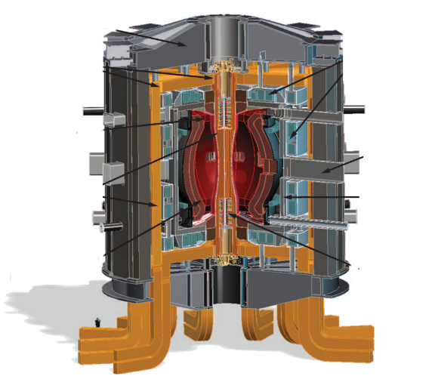
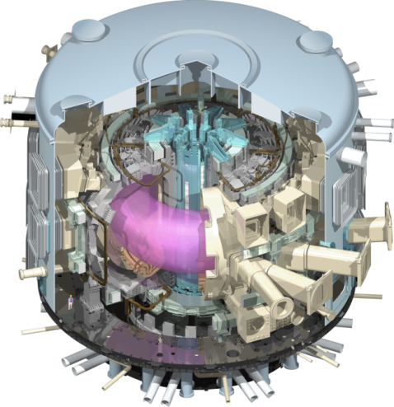
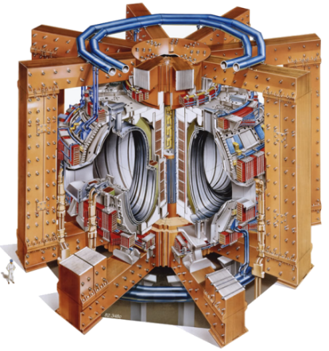
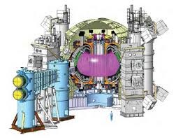
The Need For Fusion Is Clear – The World Needs Reliable Carbon-Free Energy Is There A Faster, Cheaper Path To Fusion Energy Than The One We’re On?
$50 B
$10 B ??
$30 B ??
JET
Now operating
DEMO (EU)
First power on grid in >2060
JT-60SA
Under construction, 2019
ITER
First plasma 2026
D-T 2035-2040
FNSF/Pilot (US)
2040-2045 start?
2015
2020
2025
2030
2035
2040
2045
2050

Slide 4
A Faster Path May Be Essential For Success
“At some point delay is equivalent to failure, as government and industry conclude that no solution will be forthcoming.
That is, a program carried out so slowly and deliberately as to never make a wrong step may carry more risk than one which tries to move more boldly and accepts that it will make some mistakes and follow some blind paths.”
U.S. Fusion Sciences Advisory Committee report on “priorities, gaps and opportunities” 2007

Slide 5
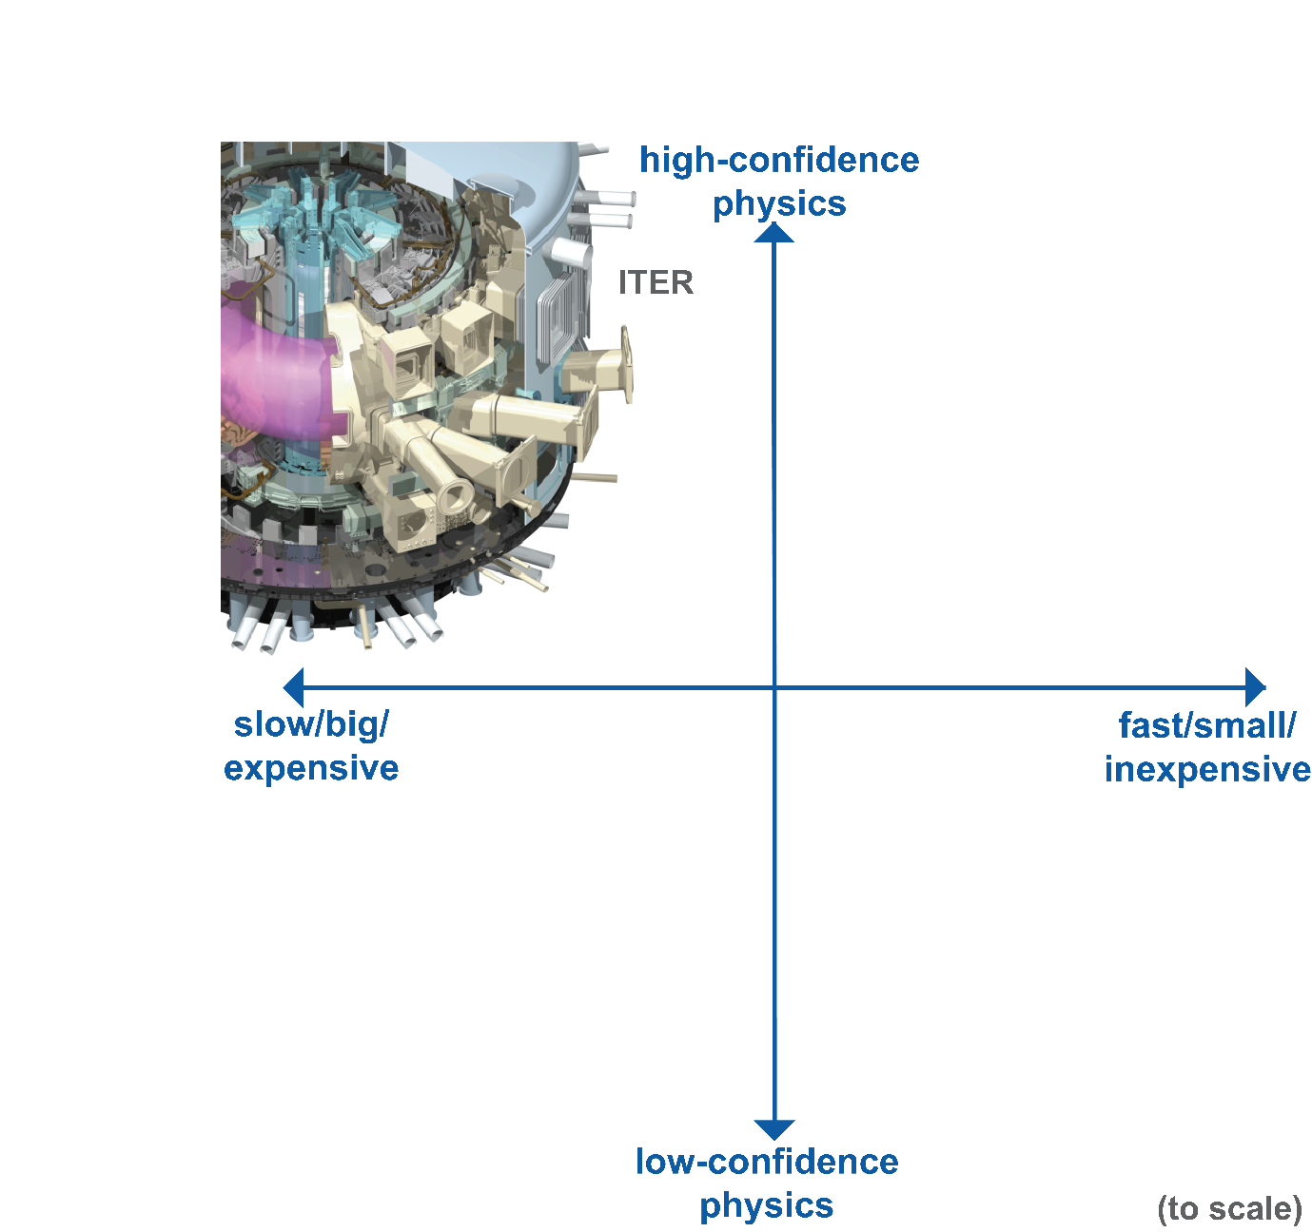
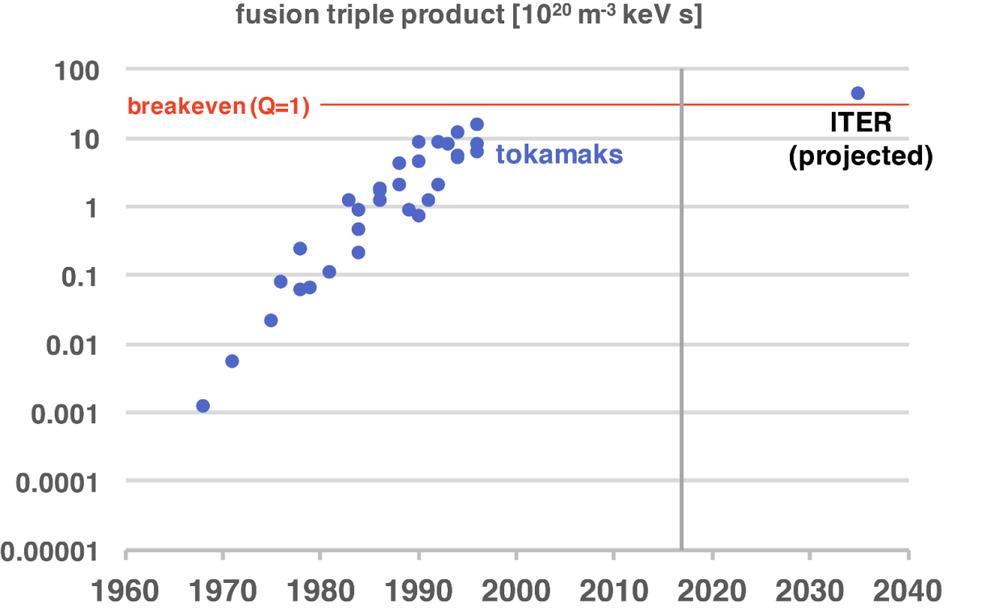
While We Understand Them Well, Tokamaks Score Poorly on Size
This was faster than Moore’s law!
Impressive and unparalleled fusion performance
Stagnating due to size & cost, not saturation due to physics
Can they be fielded in time to deal with global warming?

Slide 6
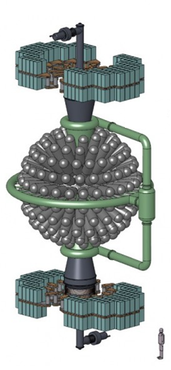
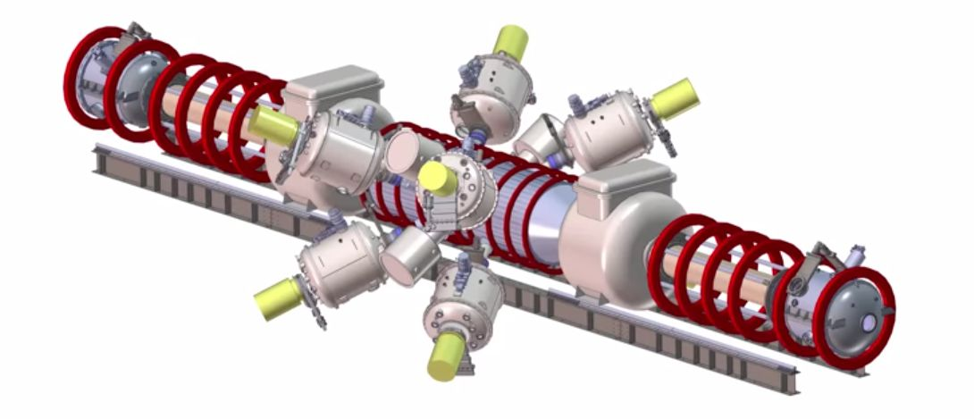


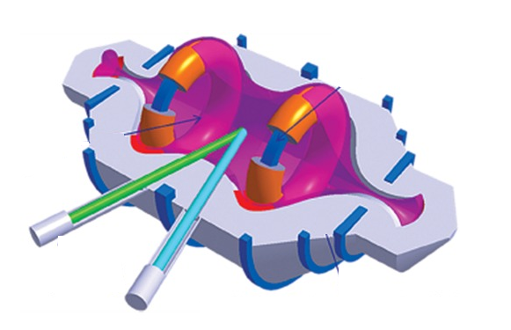


Private Companies Have Attracted $$$ On Small But Risky Concepts
Small enough to carry out without government funding
Can be built quickly
Raise the profile of fusion
Have been innovative and nimble
But – are taking a big leap into unknown physics and engineering
$ 500M
(all figures to scale)
???
$100 M

Slide 7
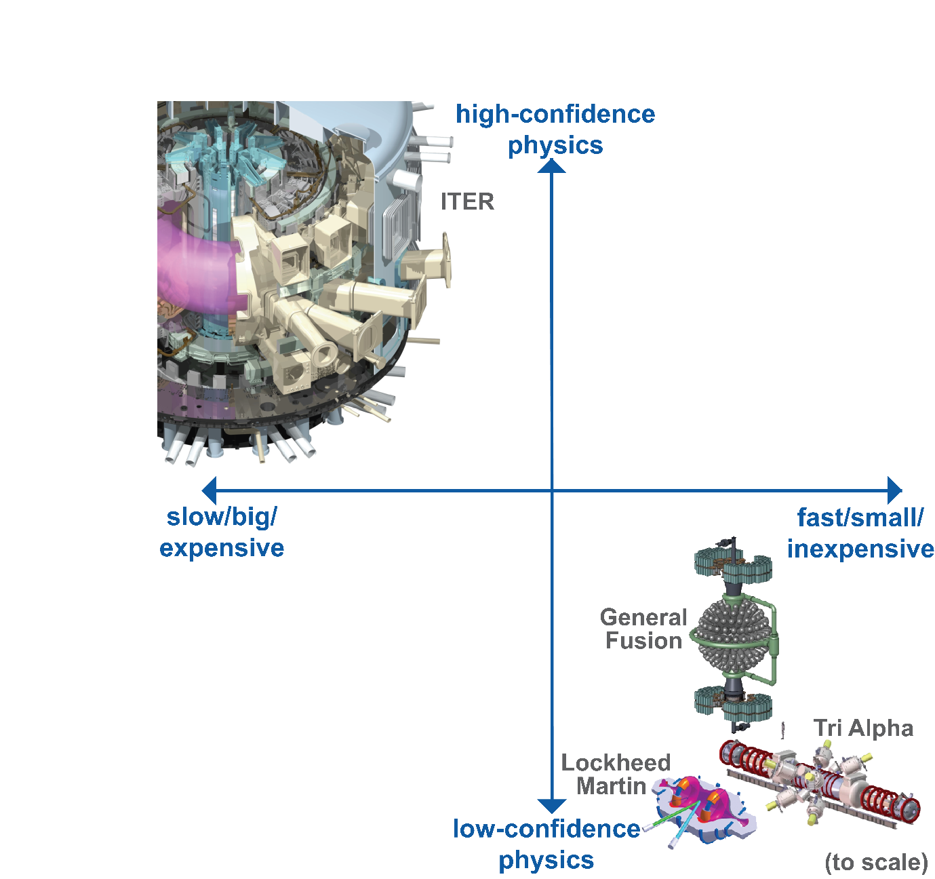
Unfortunately, These Alternates Currently Perform Poorly
This was faster than Moore’s law!
Performance is still far from what is needed

Slide 8
We Need To Consider Another Approach
Breakthroughs live up here
This was faster than Moore’s law!
We’re looking for a path which builds on the progress and knowledge built by decades of research on the tokamak
Reduced in scale to learn fast
Focused on reactors that are practical and economical

Slide 9
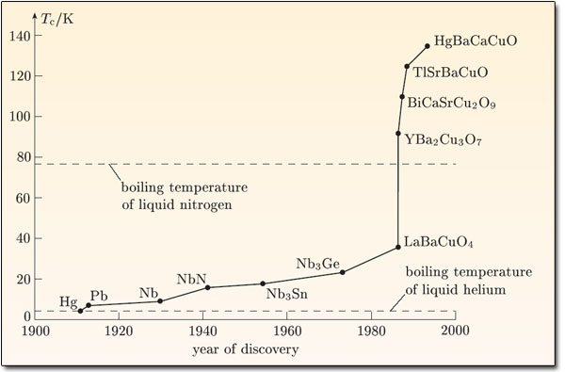
We Think The Basis For Breakthrough Is Here – High Temperature Superconductors
Discovered more than 30 years ago – 1986
Nobel prize for Bednorz & Muller 1987
High T_{C} was a surprise – theory still incomplete
Ceramic form – considered too brittle for practical applications by many

Slide 10
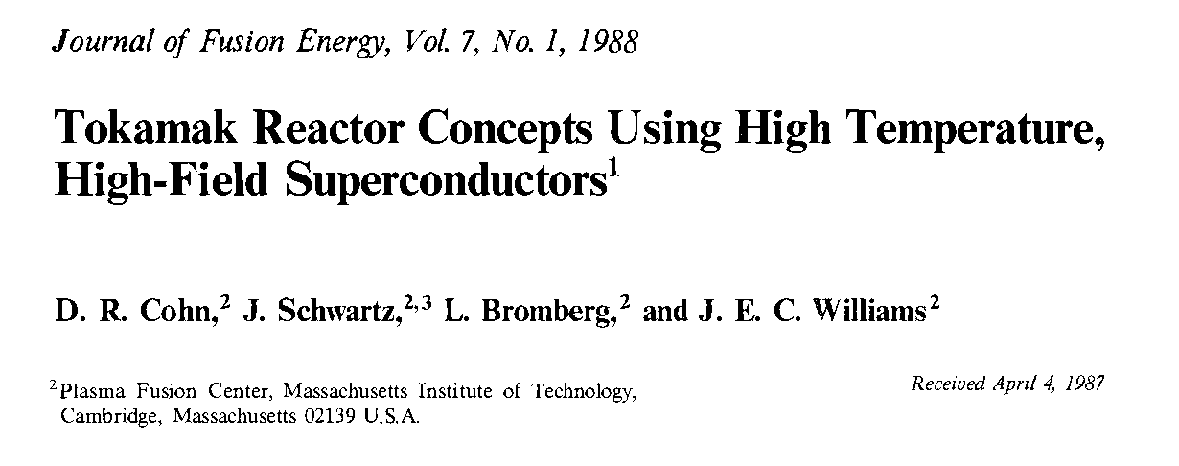
Some People Understand The Implications Right Away
The rest of us took a bit more time to appreciate the possibilities

Slide 11
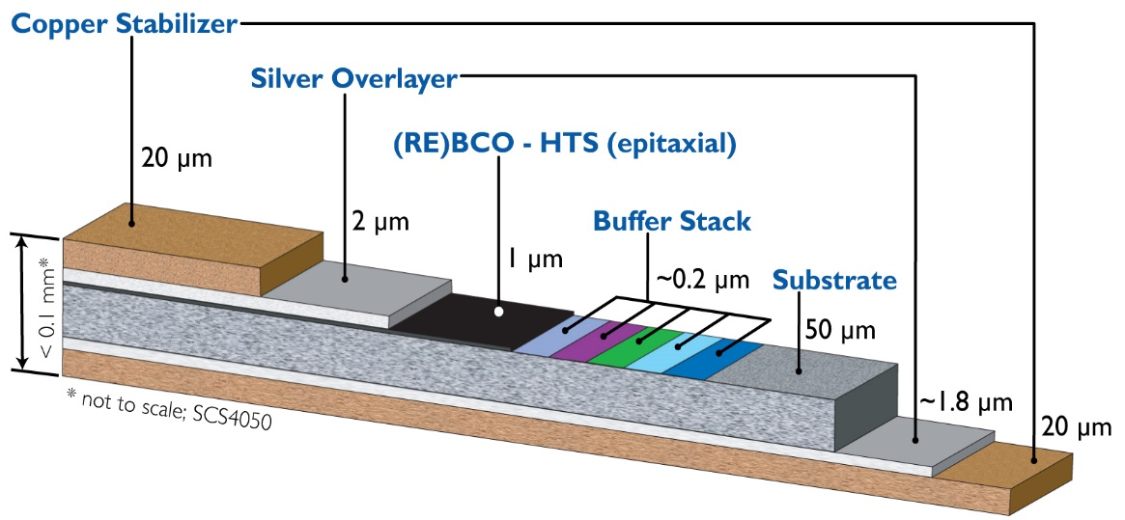
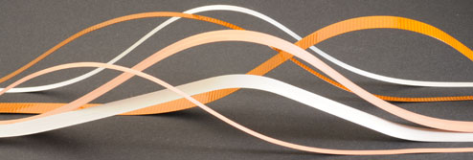








High Temperature Superconductors – Out of the Lab
Deposited as a thin film on a steel substrate
Over-coated with copper for stability

Slide 12
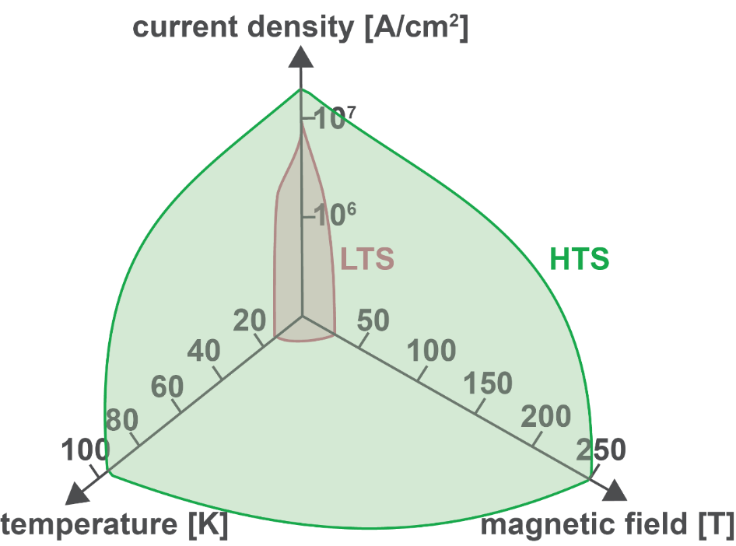
These New Superconducting Materials Are Ideal For Large-Volume, High-Field Fusion Magnets
Much wider operating space in field, current density and temperature
Higher current densities – more compact magnets with stronger structure
Strong - substrate is mainly steel
Operation at higher temperatures
New cryogenic options
Better stability
Higher heat capacity should enable magnets with demountable joints
No reaction process as part of winding

Slide 13
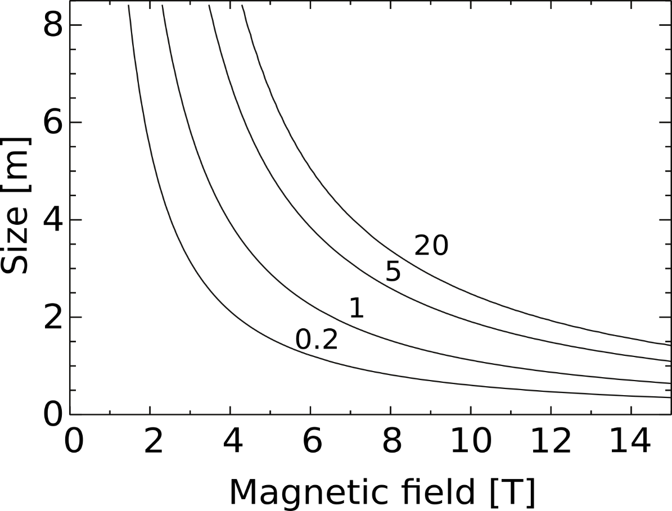
Why Do We Care? At Higher Fields, Fusion Reactors Can Be Smaller
The “size” of the plasma is properly measured in ion gyro-radii
H₉₈ scaling – Gyro-Bohm
ω_{c}τ_{E} ∝ ρ*⁻³
Using “Standard” assumptions we can map out fusion performance and see the quantitative trade-off between field and size
H₉₈ ~ 1
A ~ 3
κ ~ 1.8
q ~ 3
D/(D+T) ~ 0.5
Fusion Gain Q

Slide 14
But - With Conventional Superconductors, Machines Have To Be Big
Best LTS (Low Temperature Superconductors) is Nb₃Sn
Large-volume fusion magnets can’t have much more than 5-6 T on axis
That set the size for ITER
Requires the combined resources of the entire industrialized world to build
( ~50 years from Reykjavik summit to DT operation)
ITER
Inaccessible with LTS Magnets
Fusion Gain Q

Slide 15

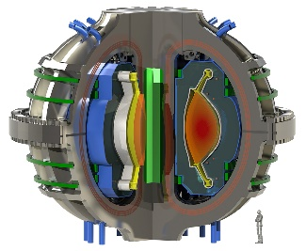
The New HTS Magnet Technology Relaxes That Constraint: We Can Go Smaller
Doubling the field allows the size to drop in half
The volume, weight decrease by a factor of 8
Enables a new class of devices
ITER
Fusion Pilot Plant Concept
ARC
P_{FUSION}
500 MW
Fusion Gain Q
ARC: Pilot Plant Concept
Sorbom et al., Fusion Engineering and Design 100, 378, 2015

Slide 16

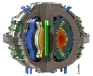

We’re Not Ready To Build A Machine in the ARC Class
SPARC: An Intermediate Step From Today’s High-Field Experiments
Consider a 12T, HTS version of AUG or DIII-D
About 1/64 volume, weight, cost of ITER
No blanket - keep size small
Pulses would be short to avoid engineering challenges associated with current drive, heat removal from first wall, nuclear “footprint”, etc.
ITER
ARC
Fusion Gain Q
SPARC

Slide 17
That Is the Aspiration: What is the Plan? The SPARC Project
Phase I
R&D & Demonstration of HTS fusion magnets at scale
Development of physics & engineering design for SPARC tokamak
Phase II
Construction & Operation of SPARC
Privately funded
Bolster fusion research and education at MIT while building a strong industrial entity (CFS) that will aim to commercialize fusion energy.

Slide 18
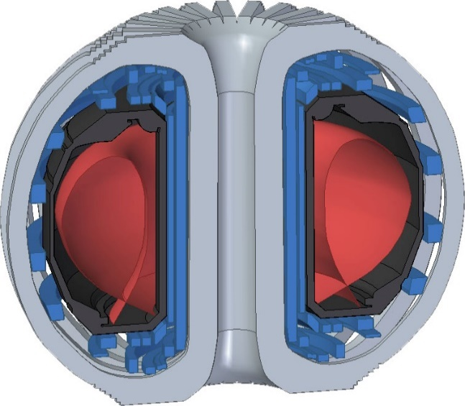
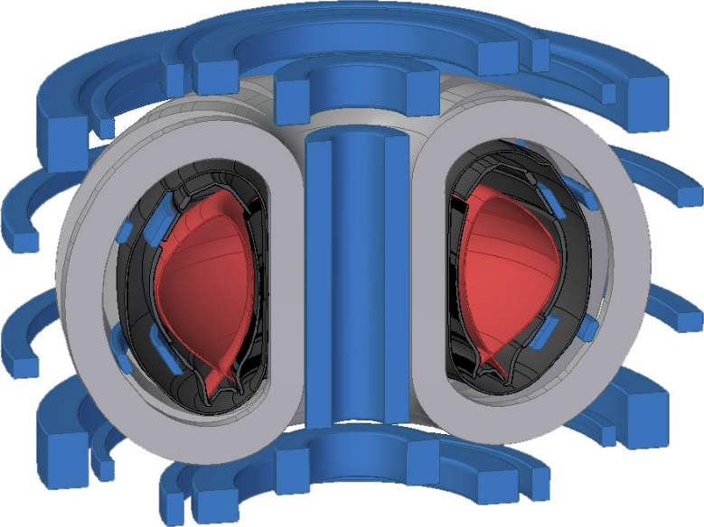
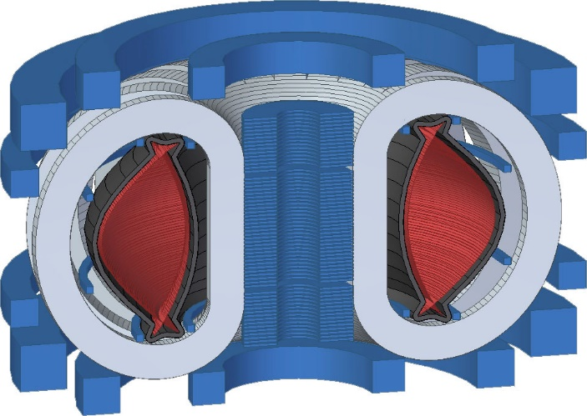

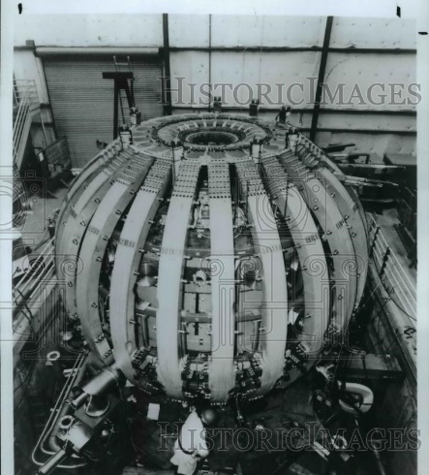
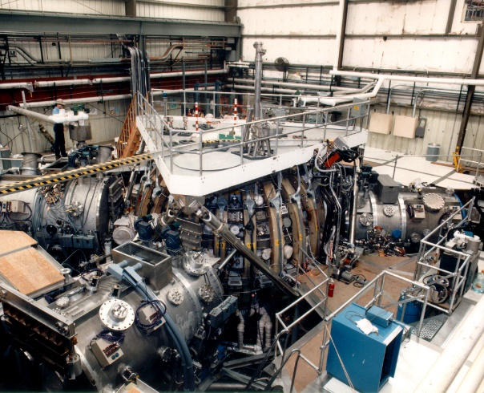
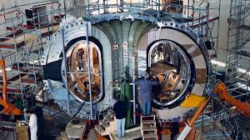
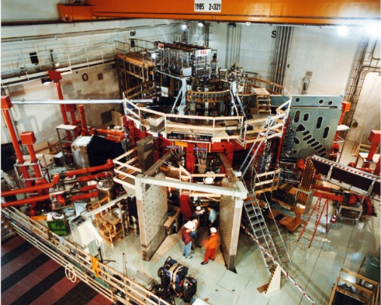
SPARC – Similar In Size To Machines We’ve Built
DIII-D, General Atomics:
1.66m, 2.1T, <2.0MA
Water cooled Cu
SPARC V0, MIT:
1.65m, 12T, 7.5MA
Cryogenic HTS
ASDEX-Upgrade, IPP Garching:
1.65m, 3.1T, 1.6MA
Water cooled Cu
To scale
There are many others at this size:
KSTAR, EAST, WEST, TEXTOR, PDX, PLT

Slide 19
SPARC Mission
Demonstrate break-even fusion energy production, Q > 2
At long last, the Kitty Hawk moment for fusion
Our hypothesis – this would be a sufficient demonstration to put fusion firmly into national energy plans and to attract investments for the next step
Demonstrate fusion-relevant HTS magnets at scale
Integrated with high-performance tokamak operation
Demonstrate high-field fusion plasma scenarios
Provide the physics basis for high-field pathway

Slide 20
SPARC V0: Nominal Starting Point for Design
SPARC V0 technical requirements:
Burn D-T fuel
Q > 2 (with headroom)
P_{fusion} > 50MW up to 100MW
Pulsed with 10s flattop burn
~1,000 D-T pulses, >10,000 D-D full-power pulses
~1 hr D-T pulse repetition rate
~15 minutes between D-D shots
DRAFT DRAFT DRAFT
Ro | 1.65 | m
a | 0.5 | m
ε | 0.33
κ | 1.8
B₀ | 12 | T
I_{P} | 7.5 | MA
B_{max} | 20.9 | T
P_{fus} | 50-100 | MW
P_{ext} | 30 | MW
Desired schedule:
R&D: 3yrs (mainly HTS magnets)
Construct: 4 yrs
Operate: 5 yrs
Decommission: 4 yrs
Desired construction cost:
<$500M

Slide 21


Note: Proposed Copper Experiments Probably Would Have Worked
Early plans for burning plasma experiments – Using compact, high-field with copper magnets
Based on current knowledge, these experiments would have succeeded
Assuming the magnet engineering could work out.
Deprecated as a dead end for fusion energy – short pulse only.
Fusion Gain Q
BPX
FIRE
Ignitor

Slide 22
SPARC: If Pulsed, Why Not Copper?
Drive HTS fusion magnet development -
Copper is intrinsically weak – body forces are hard to restrain
Note sliding joint design for 8T C-Mod
HTS tapes, high-strength steel substrate: easier to engineer into high-field magnet
Large, non-uniform temperature excursions for every shot
Thermally induced cyclic stresses can limit lifetime for copper magnet
Very difficult to get flat-top more than current diffusion time in burning plasma
Enormous power consumption for copper
FIRE required 1,000 MVA, Alternator/flywheel with 20 GJ stored energy
Prodigious L_{N2} consumption, 250,000 liters per shot (compare to 1,000 for C-Mod)
Huge footprint for power systems, L_{N2} tank farm
Very low shot rep rate (3-4 hours)
Equally low for hydrogen or deuterium operation or no-plasma power tests
SPARC fusion energy pulse compared to current record holders on JET and TFTR.

Slide 23
If The Magnets Work, How Confident Are We That The Tokamak Will Achieve These Objectives?

Slide 24
We Can Be More Confident About The Extrapolation From The ITER H-mode Confinement Database to SPARC, Than For ITER Itself
ITERDB data shown selected on the same criteria as for the H₉₈ scaling
Exception: some records don’t contain the kinetic information required to calculate ν* or ρ*

Slide 25
Moreover, We Can Find Particular Discharges That Are Close To Matching All SPARC Dimensionless Parameters (β_{N}, ν*, ρ*, q₉₅, n_{G}, ε, κ, δ_{L})
The same 20 (JET) discharges are shown in red in each plot
B_{T} = 3.0 – 4.0 T
I_{P} = 3.0 – 4.2 MA
P = 8.2 – 15.8 MW
H₉₈ = 0.82 – 1.08

Slide 26
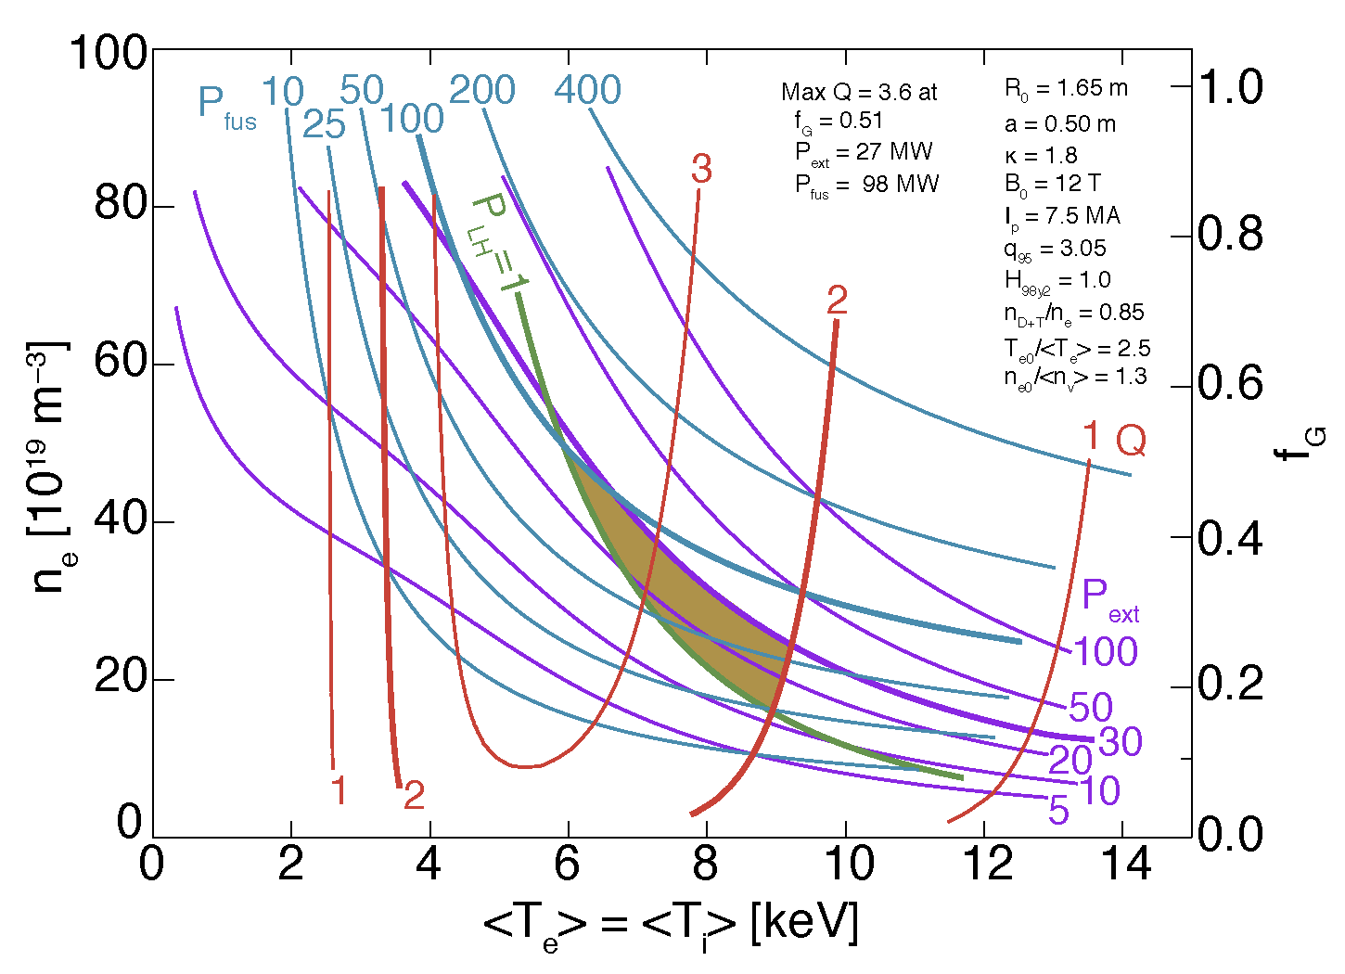
SPARC: Nominal Operating Space
Use ITER Performance Rules
H₉₈ = 1
q₉₅ > 3.
Profile peaking factors
Fuel dilution
Operating Space Defined by
P_{LOSS} > P_{LH}
Q_{FUSION} > 2
P_{HEATING} < 30 MW
P_{FUSION} < 100 MW

Slide 27
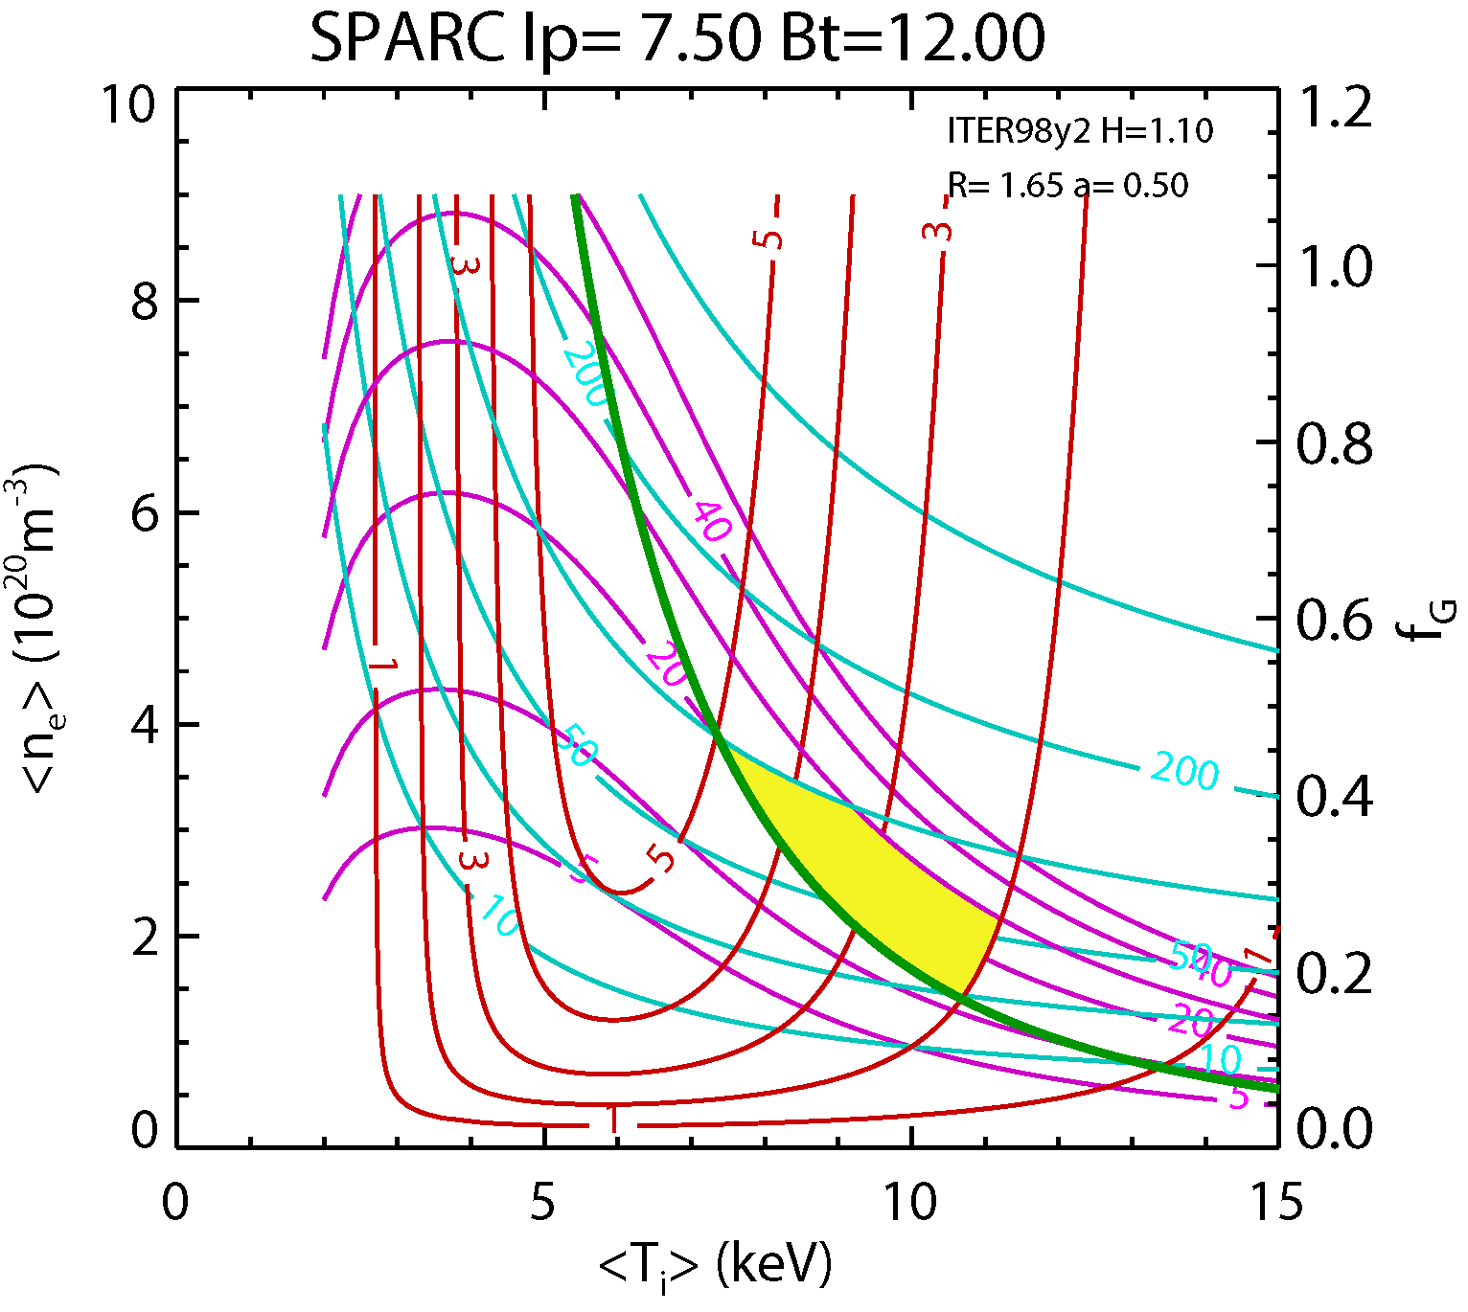
Performance Estimates Robust With Respect To Confinement Assumptions Lots of Upside on the High Side
With H₉₈ = 1: Nominal Q = 2-3.6
One standard deviation above database mean, H₉₈ = 1.1: Q up to 5
Perhaps higher in I-mode
One standard deviation below database mean, H₉₈ = 0.9: Q > 2
Under L-mode, H₈₉ = 1: Q = 1
Under slightly improved L-mode, H₈₉ = 1.4; Q = 2.6
Flat q profiles, hybrid regime should be accessible transiently

Slide 28
However, In Engineering Parameters And Fusion Power,
No Machine Like SPARC (or ITER) Has Ever Been Built
Engineering (SPARC B³R^{1.3} = 3300, for ITER = 1600, for JET = 270)
Performance
Recent C-Mod

Slide 29
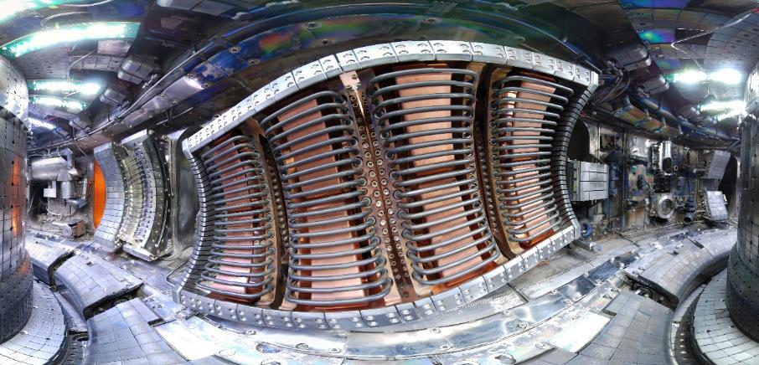
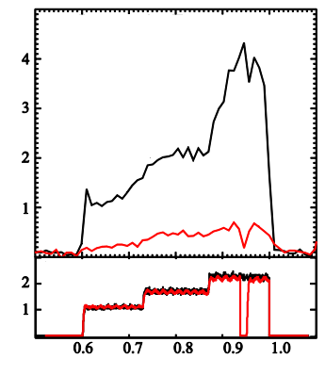
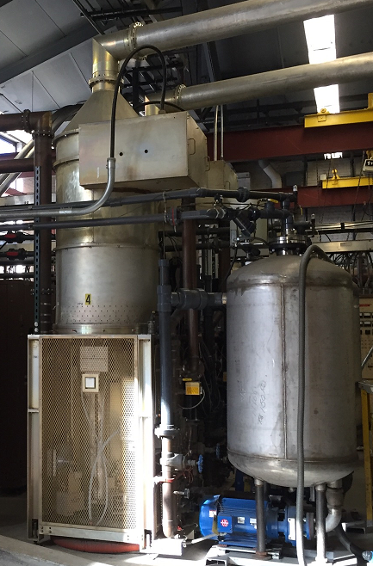
SPARC Heating - Getting Power In: 30 MW ICRF
Simplicity: Utilize a single type of heating
Proven to work on C-Mod (at required plasma density) and on DT devices (TFTR & JET)
Heating scenarios at 100-120 MHz with He³ minority or 2nd T harmonic look promising
Utilize C-Mod proven field-aligned antennas through midplane ports
Improves coupling, Minimize impurity production
Modular, commercially-sourced power and tube systems
C-Mod derived coupling and tuning systems
Flexible siting impact
Light staffing compared to other heating methods
Fast-ferrite tuners for excellent coupling
High-power high-reliability RF tubes
Standard ICRF
antenna
Impurities (spectroscopic)
C-Mod’s field aligned antenna
RF power [MW]

Slide 30
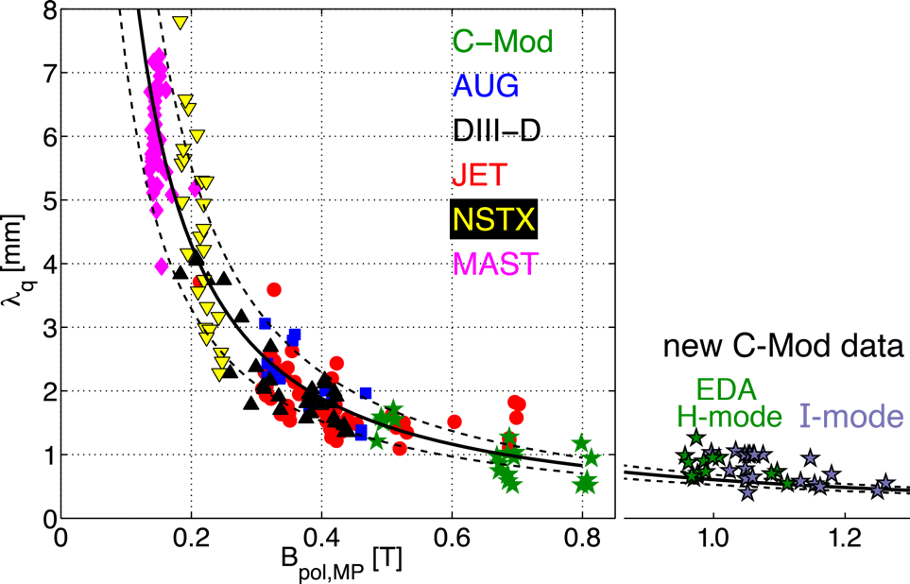
Edge Power Loading – Getting Power Out: Seems Like It Might Be A Problem
For “attached” divertor, the heat flux footprint scales like 1/B_{P}
Loading scales like PB_{P}/R
(Though recent simulations for ITER suggest a beneficial, low-ρ* dependence – we won’t count this)
Eich, et al., JNM 2011
Brunner, 2017

Slide 31
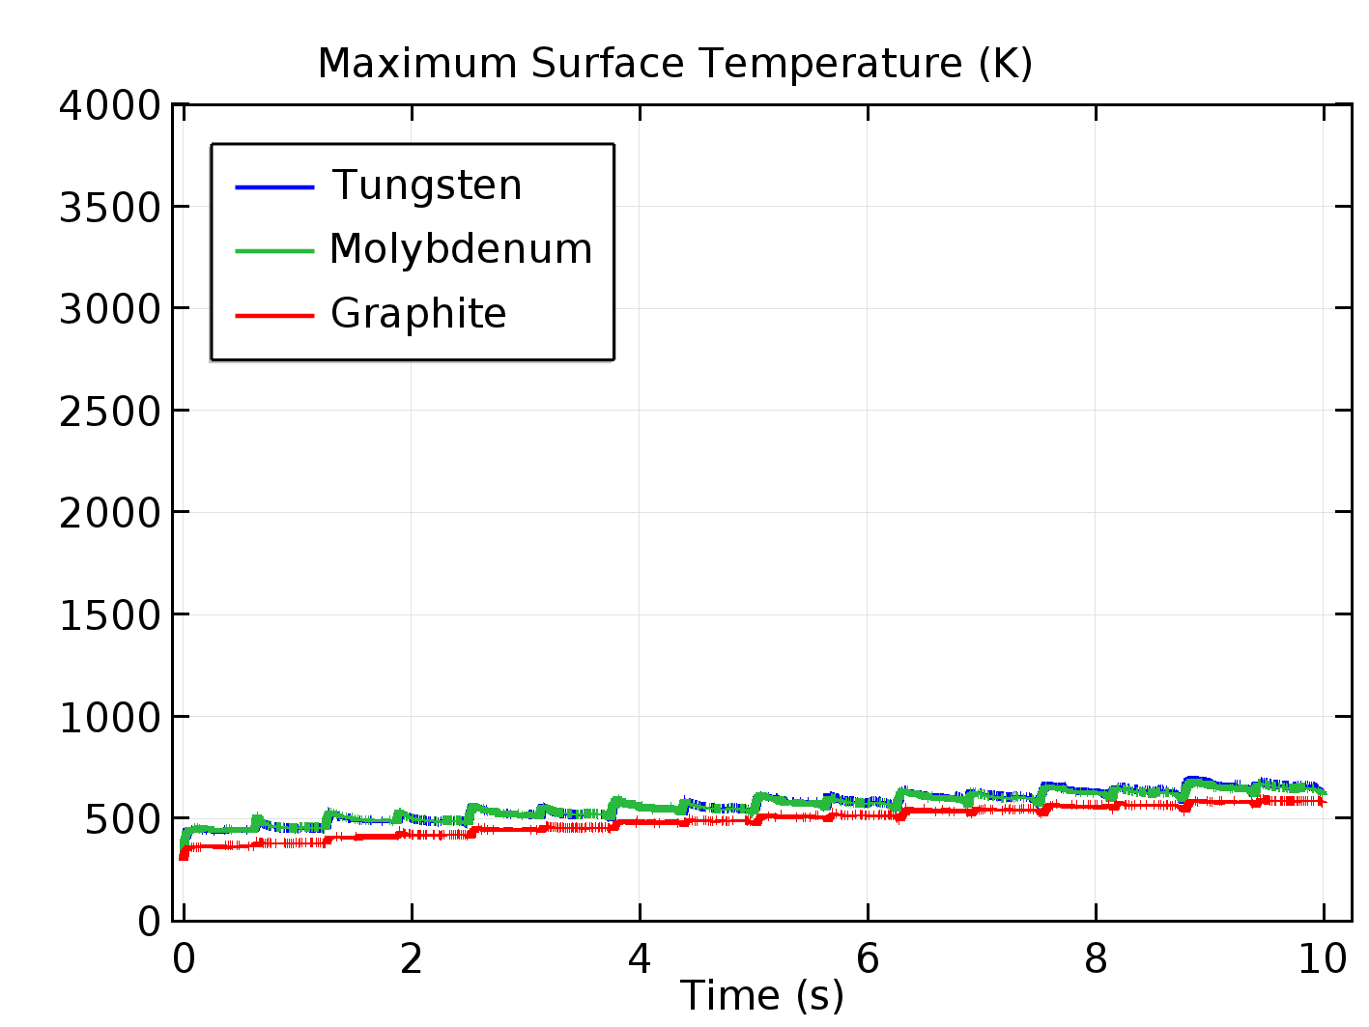
Boundary power exhaust is not a show-stopper for SPARC: Pulsed, inertially Cooled Simulations show that heat flux can be handled with aggressive strike point sweeping.
With standard (C-Mod, ITER) vertical target divertor
With no core or edge radiation (0%), graphite survives for full pulse, tungsten for 5 sec
At typical and acceptable radiation fraction (50%), all target materials easily survive full 10 s, Q = 3.3 pulse.
Radiation fractions of > 90% have been demonstrated on C-Mod, AUG, JET while maintaining good core confinement
Incorporation of an “advanced” long-legged divertor into the design is possible.
With goal of operating in detached regime – which would be “easier” at high density
50% P_{rad SOL}
90% P_{rad SOL}

Slide 32
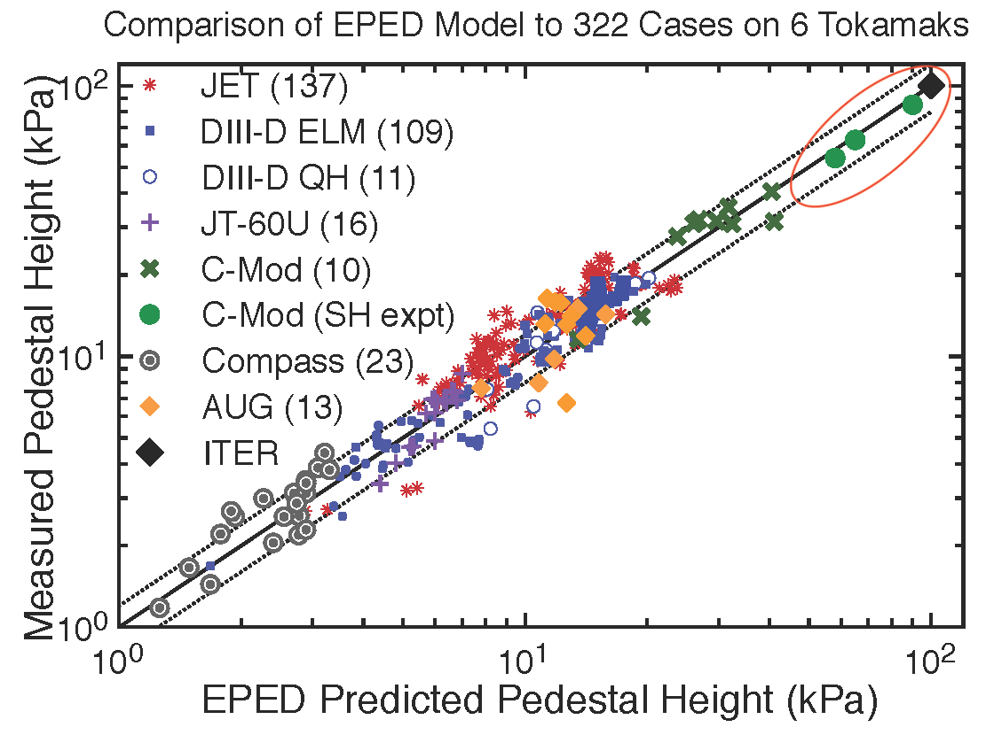
ELMs – Perhaps Less Of A Problem At High Field?
C-Mod attains ITER-like pedestal pressures without “large” ELMs
C-Mod operation naturally ELM-suppressed
EDA/QC with “normal” field direction, ion ∇B drift favorable
I-mode in “reversed” field, ion ∇B drift unfavorable
Seems like β (low) might be key
Though sometimes higher in collisionality – much of this operation is under conditions where ρ* and ν* match other devices
Generally, high field may enable high performance without pushing up against β limits in pedestal or core
Hughes, Snyder, 2017

Slide 33
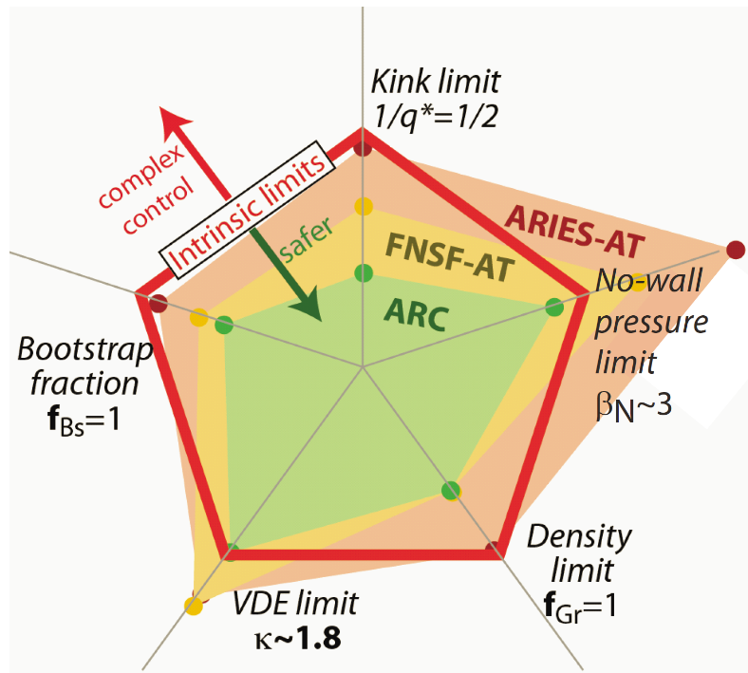
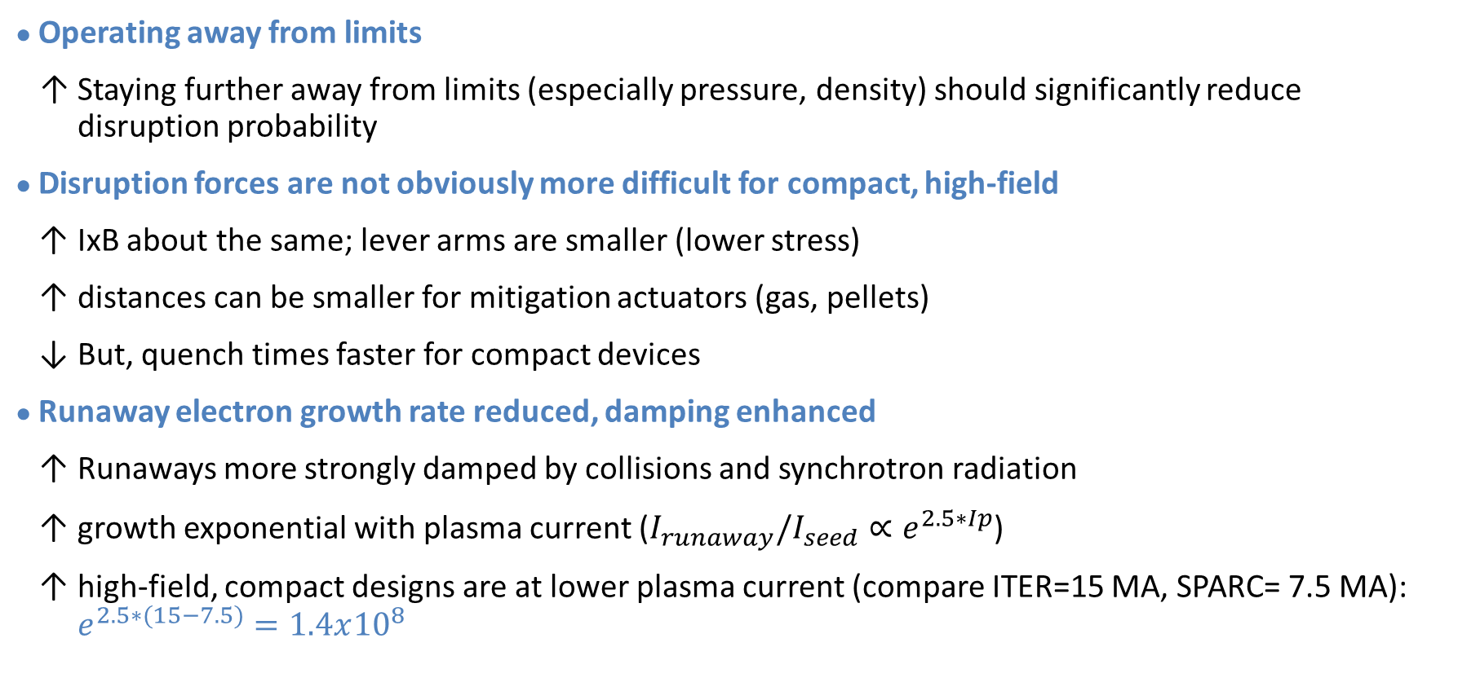
Disruptions: A Challenge For All High-Performance Tokamaks Compact, High-Field Has Some Advantages
Operating away from limits
Staying further away from limits (especially pressure, density) should significantly reduce disruption probability
Disruption forces are not obviously more difficult for compact, high-field
IxB about the same; lever arms are smaller (lower stress)
distances can be smaller for mitigation actuators (gas, pellets)
But, quench times faster for compact devices
Runaway electron growth rate reduced, damping enhanced
Runaways more strongly damped by collisions and synchrotron radiation
growth exponential with plasma current ($I_{runaway}/I_{seed}∝e^{2.5∗Ip}$)
high-field, compact designs are at lower plasma current (compare ITER=15 MA, SPARC= 7.5 MA): $e^{2.5∗(15−7.5)}=1.4x{10}^{8}$

Slide 34
Summary
Success from our research on HTS magnets and SPARC will open up a compelling path for smaller, faster, cheaper fusion development
These steps won’t cost the U.S.G. program anything
In fact, private initiatives provide opportunities that the US program can leverage
But (IMHO)…
U.S. fusion strategy should be imbued with a greater sense of urgency in our mission
The publically funded program should not stand pat for 10-20 years
windows of opportunity will close (are closing, have closed)
U.S. strategy and program elements should focus on areas of innovation, potential leadership and impact under this accelerated timeline

Slide 35
END

