Slide 1
Plasma-Materials and Divertor Options for Fusion
Presented to:
National Academy of Sciences Panel
A Strategic Plan for U.S. Burning Plasma Research
J. Rapp

Slide 2
Lifetime of divertor will deterimine fusion reactor availability
Coolant manifold
(permanent)
TF coils
Upper ports
(modules and coolant)
Blanket modules
5-6 yrs lifetime
Cost of electricity is proportional to (1/A)^{0.6}
Central ports
(modules)
Vacuum vessel
70cm
(permanent)
Cool shield
30cm
(permanent)
Divertor plates
2 yrs lifetime goal
Lower ports
(divertor)
Main driver of scheduled maintenance: divertor (and blanket)

Slide 3
Outline
Plasma-Material Interaction (PMI) challenges
Potential Plasma-Facing Materials (PFMs) and Components (PFCs)
Current status of U.S. PMI research
Facilities needed for the development of PFCs
Strategic elements to accelerate U.S. burning plasma research
A proposed high-level R&D program and roadmap for PMI

Slide 4
Outline
Plasma-Material Interaction (PMI) challenges
Potential Plasma-Facing Materials (PFMs) and Components (PFCs)
Current status of U.S. PMI research
Facilities needed for the development of PFCs
Strategic elements to accelerate U.S. burning plasma research
A proposed high-level R&D program and roadmap for PMI

Slide 5
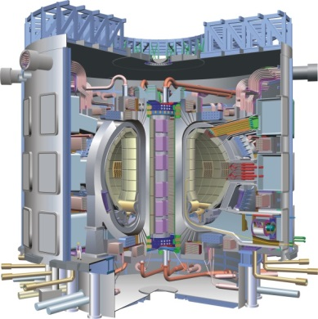
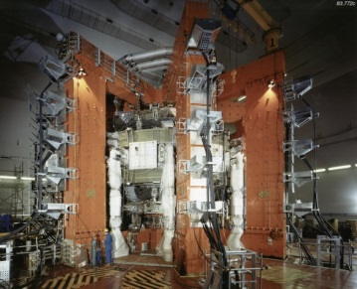
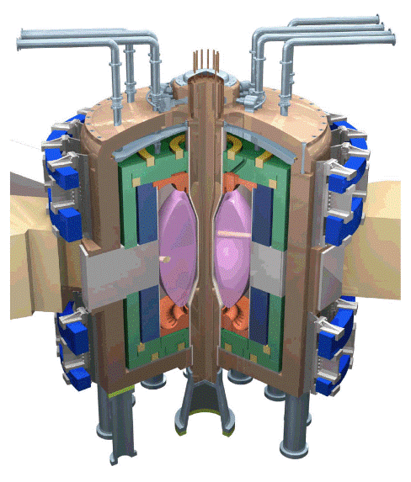
Challenges for materials: fluxes and fluence, temperatures
JET ITER FNSF Fusion Reactor
50 x divertor ion fluxes
5000 x divertor ion fluence
up to 5 x ion fluence
10⁶ x neutron fluence (1dpa)
up to 100 x neutron fluence (150dpa)
P/R about the same
5-10 x P/R

Slide 6
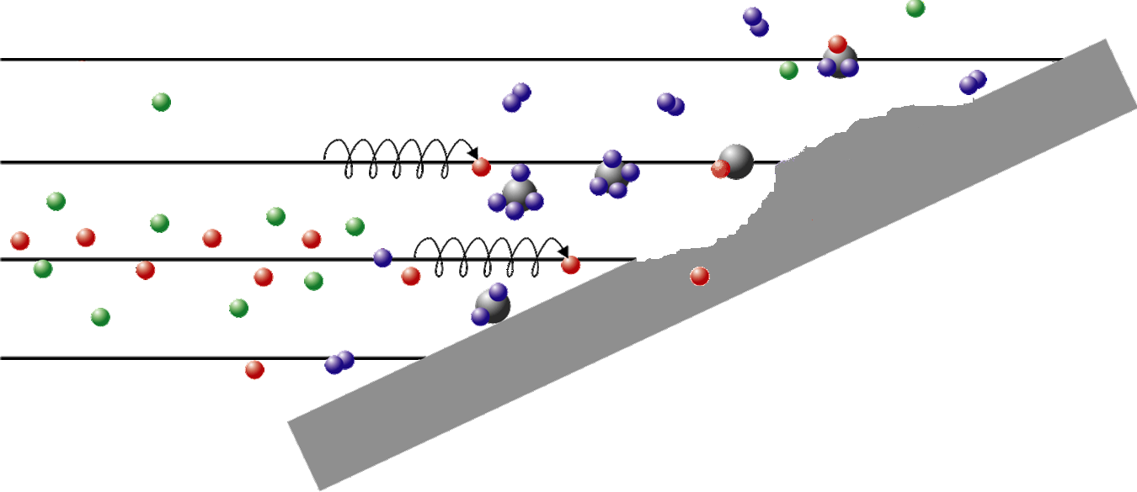
Plasma Material Interactions (PMI) in fusion reactor
Re-deposition
Co-deposition of
hydrogen
Erosion
(chemical and physical)
Ablation
Melting (metals)
Implantation
Worst case erosion rate ~ m/yr !
carbon target
Strongly Coupled regime:
Eroded material is trapped in plasma (highly collisional) near target, and re-deposited on surface due to incoming flows, electro-static acceleration and motion in magnetic field
Long exposure to damaging plasma flux ⇒ thick layers of re-deposited material
Every surface atom is displaced ~ 10⁷ times in a divertor lifetime
Material in a reactor divertor is NOT what was installed, we need a way to create and test plasma-reformed surfaces

Slide 7
Plasma Surface Interactions
Challenge: material choice for PFCs
Quite some materials have been tested as PFM over the years:
StSt (TEXT, PLT), Mo (Alcator-A, TFR), W (DOUBLET-II, ORMAK), Al (ST), Al₂O₃ (PETULA), B₄C (TFR), Be (ISX-B, JET), Au (DIVA), Ti (PDX, DITE), Li (CDX-U), TiC (W-AS), TiB₂ (ISX-B), Cu (ASDEX), C (CFC, graphite)…
PLT used a carbon limiter 50% increase in T_{e}
Following those results, C (graphite, CFC) became the material choice for most devices
Only recently the interest in high-Z PFCs is growing again, mainly because of the observed Tritium retention during TFTR and JET DT experiments.

Slide 8
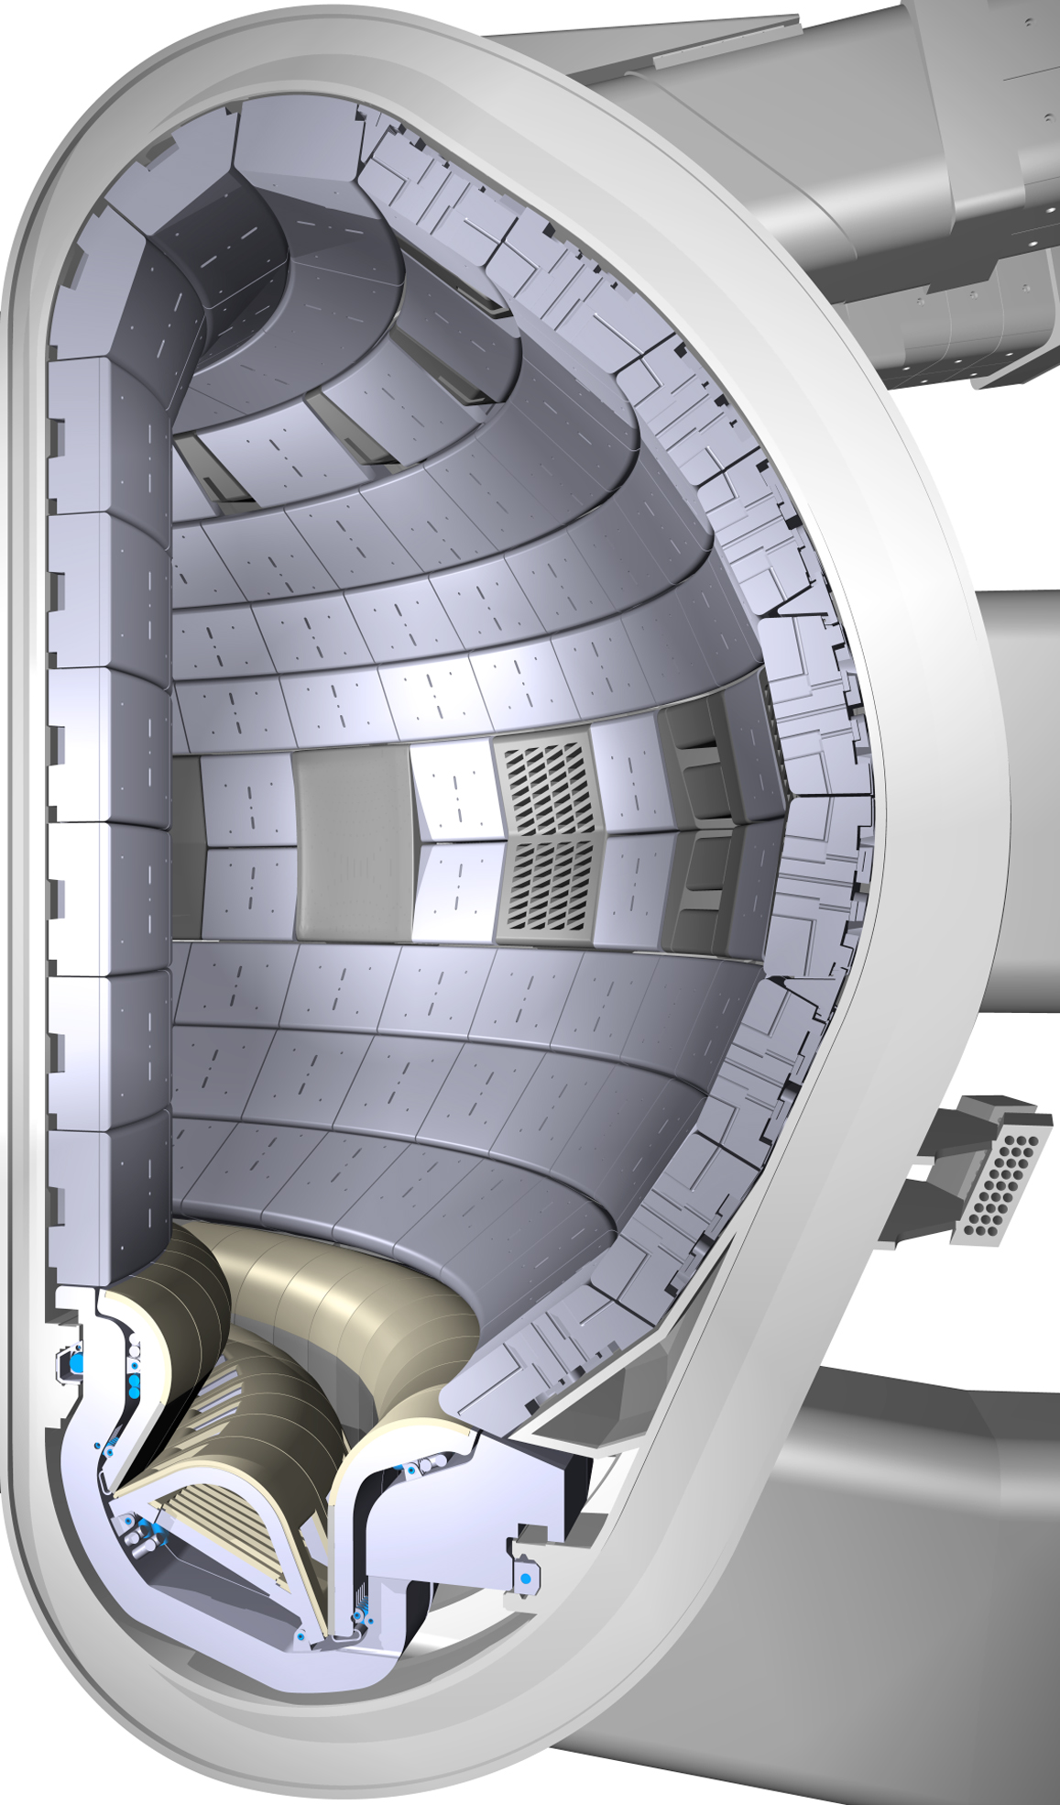
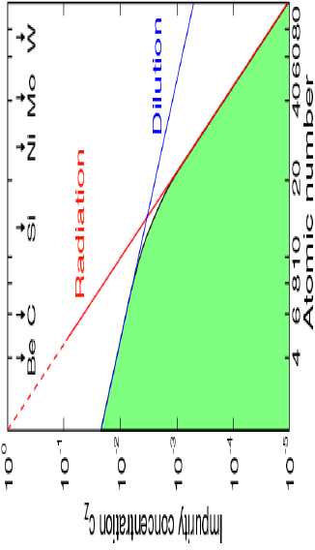
ITER, material choice
Be low radiation
C non-melting CFC
W high melting point, low erosion by D, T
Beryllium
Tungsten
Carbon, now Tungsten

Slide 9
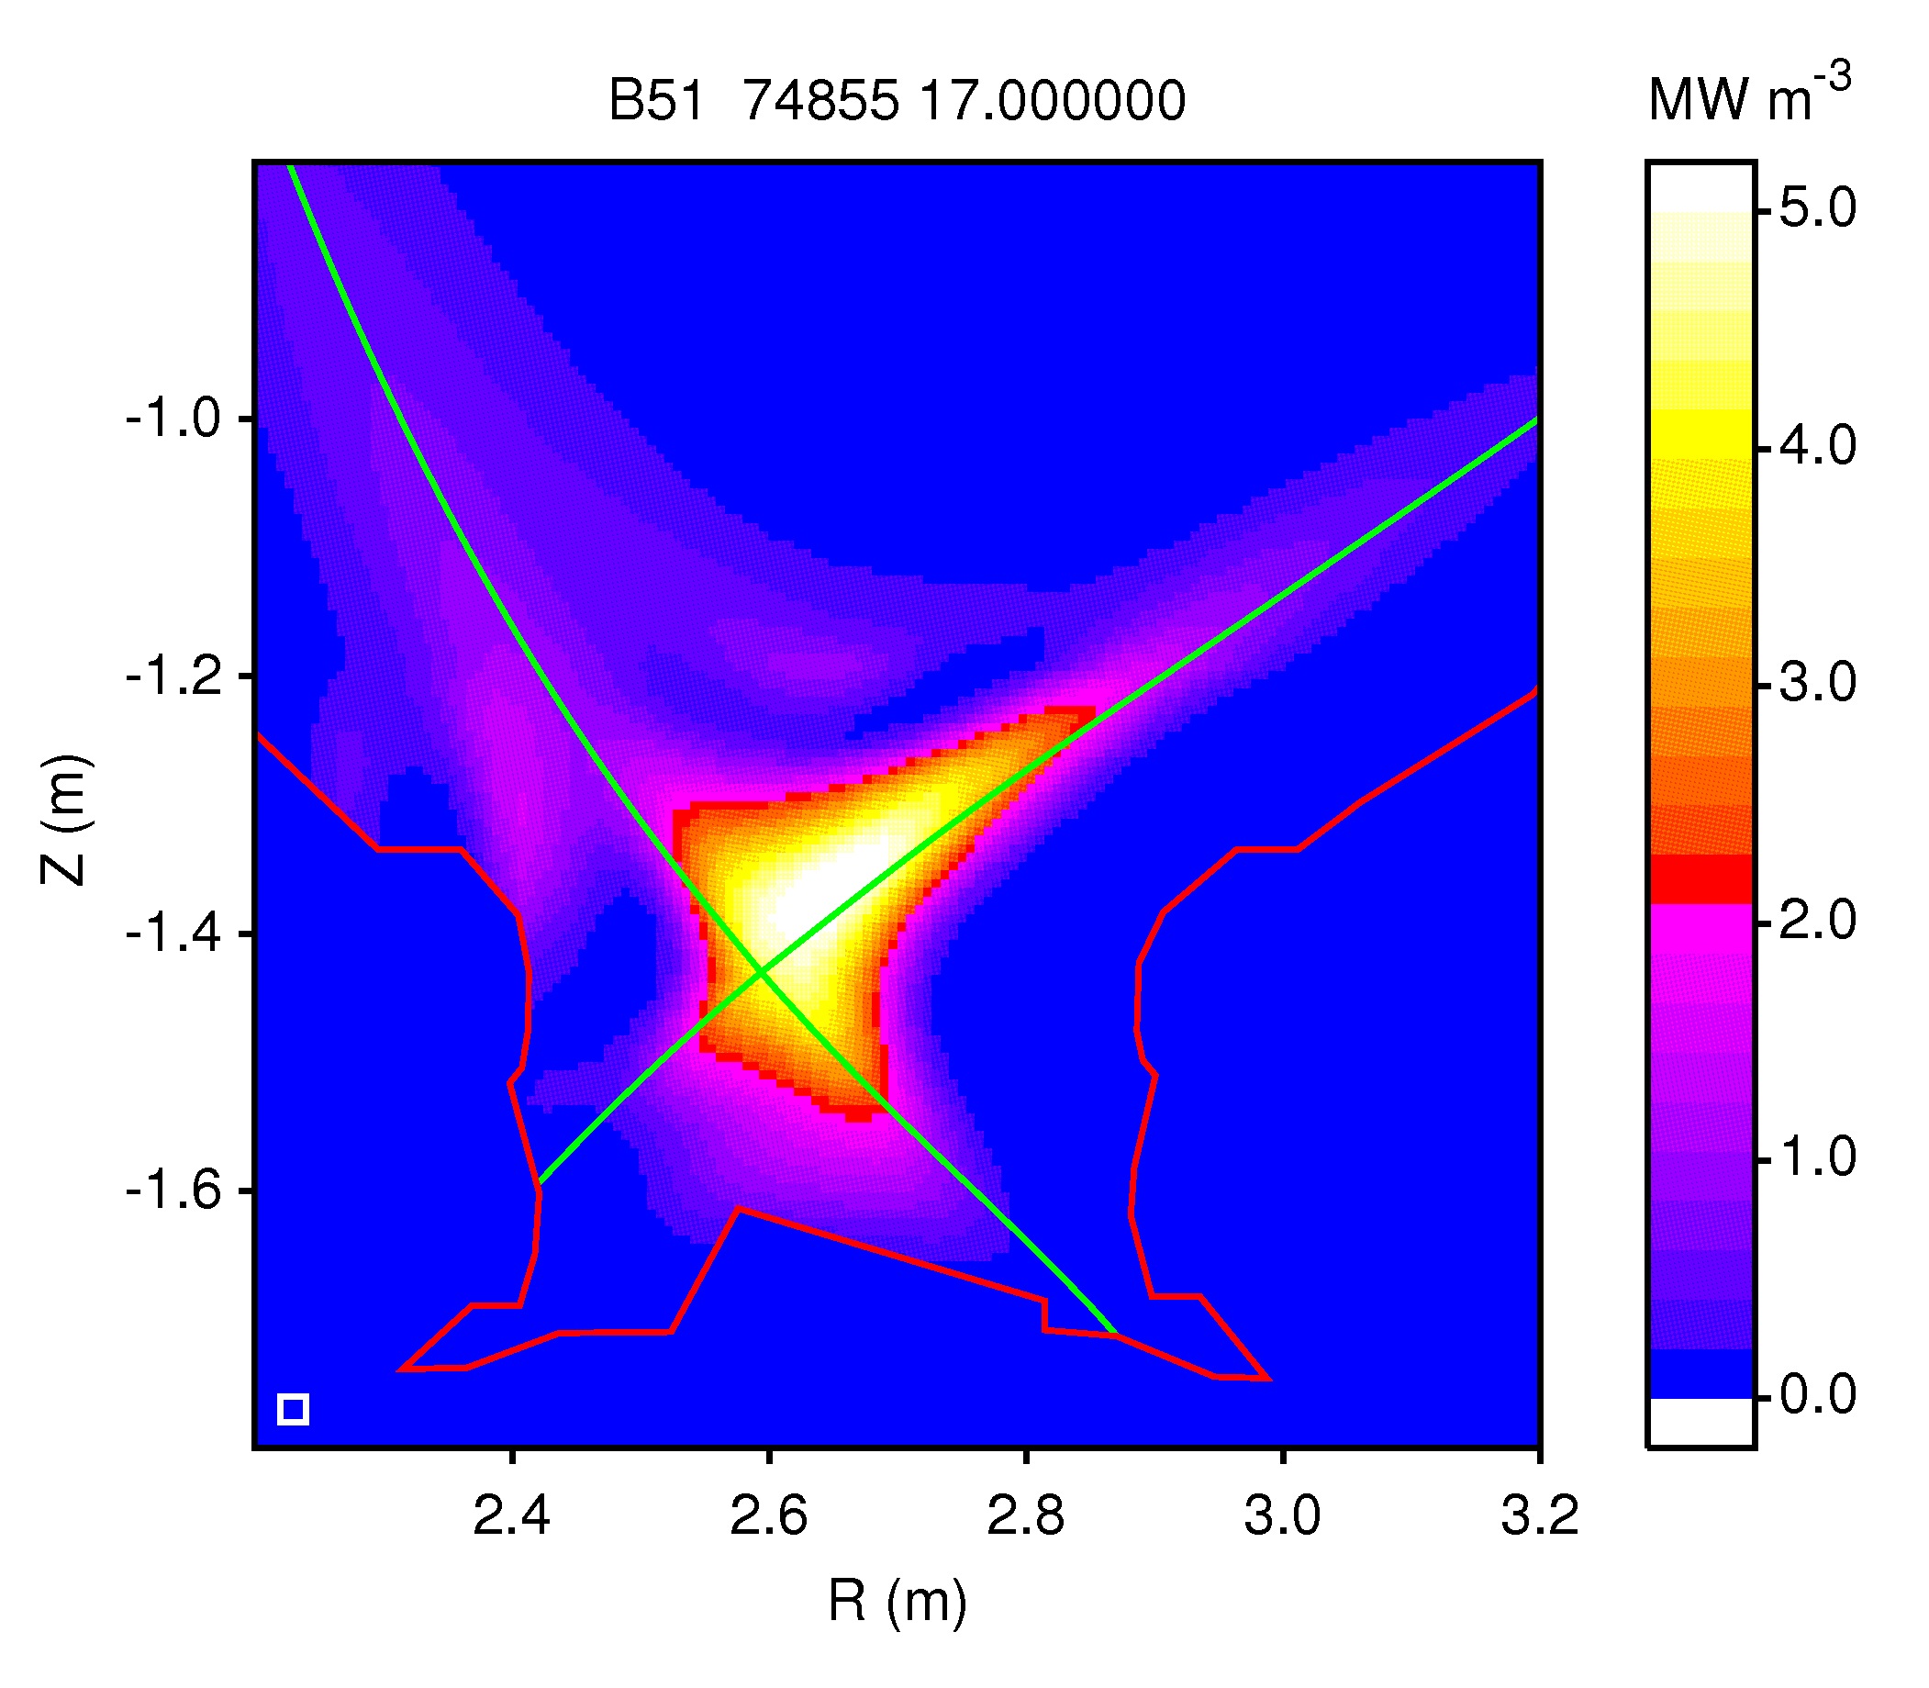
Power exhaust challenge
 | PPCS A | ARIES-ACT1 | ITER | JET | AUG
P_{heat}/R [MW/m] | 130 | 65 | 19.8 | 11.4 | 14
f*_{rad} wo br, syn rad | 0.64 | 0.67 | 0.54 | 0.76 | 0.87
P*_{heat} B/R [MW T/m] | 651 | 306 | 80 | 39 | 35
P_{LH} B/R [MW T/m] | 202 | 105
β_{N} | 3.5 | 4.75 | 1.77 | 1.6 | 3
D Maisonnier et al., FED 2006
C Kessel et al., FST 2015
Issues
A significant part of the radiation is not in the SOL, P_{SOL}/R ~ 7 has been achieved on AUG so far (ITER: P_{SOL}/R ~ 12)
High P/R for DEMO is challenge
High P_{heat}/P_{LH} does allow for significant core radiation in DEMO, ARIES-ACT1 (f_{rad, core}~ 70 - 80%); AUG has demonstrated 70% core radiation without loss of confinement
P_{SOL} B / R could be reduced to 100-200
Kallenbach, NF 2009
Kallenbach, NF 52 (2012) 122003
Rapp, DEMO workshop 2011

Slide 10
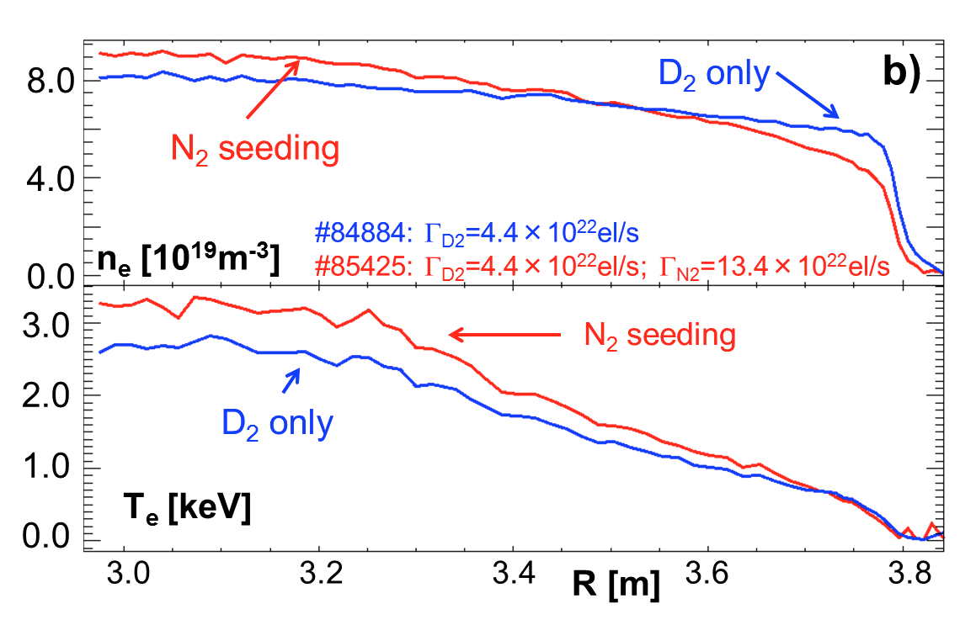
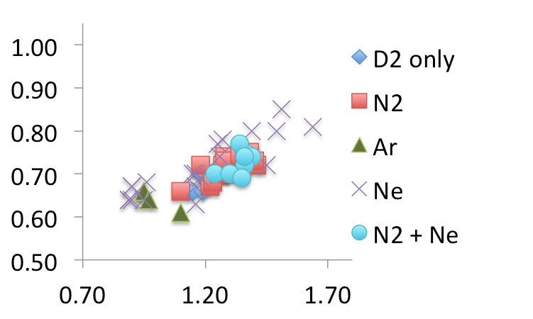
Power exhaust with impurity seeding: what about confinement?
H_{98(y,2)} has been found to be β_{N} dependent
Impurities can improve confinement
Despite β_{N} scaling and impurity effect on core confinement, it is uncertain if high H_{98(y,2)} of 1.2 or 1.6 can be reached with strongly radiating mantle and plasma core
JET
H_{98(y,2)}
M. Wischmeier, IAEA 2014
β_{N}
A. Huber, EPS 2014
AUG
H_{98(y,2)}
J. Rapp, Nucl. Fusion 52, 2012, 122002
β_{N}

Slide 11
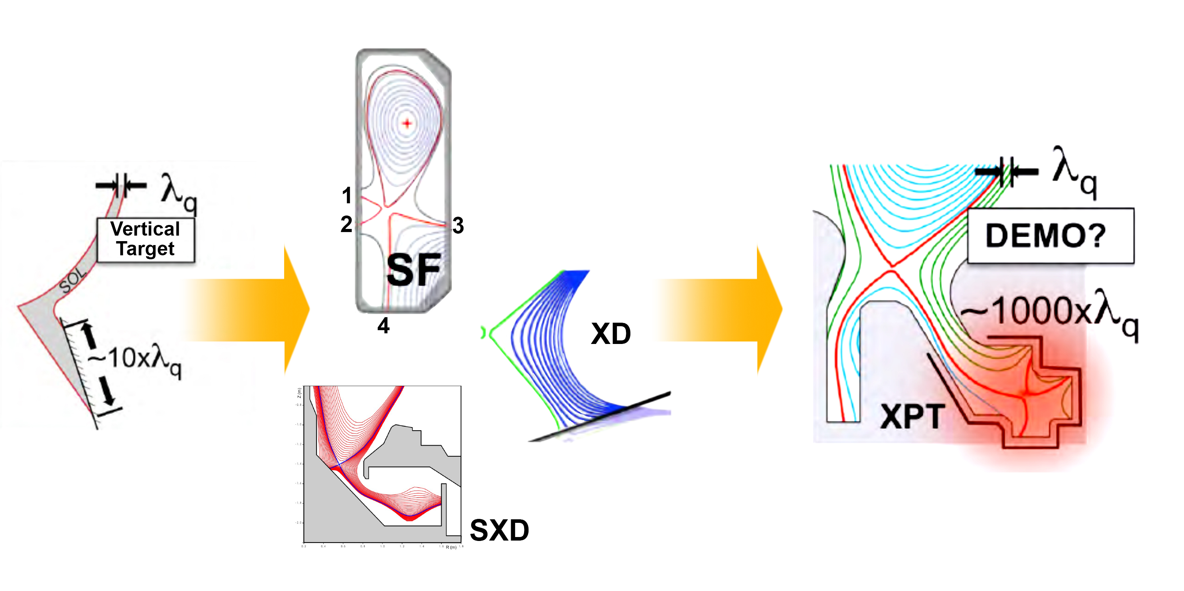
Power exhaust: advanced divertors
If radiative dissipation of power is not sufficient, advanced divertors might help.
Courtesy, B. LaBombard

Slide 12
Challenges for materials: fluxes and fluence, temperatures
JET ITER Fusion DEMO
50 x divertor ion fluxes
5000 x divertor ion fluence
up to 5 x ion fluence
10⁶ x neutron fluence (1dpa)
up to 100 x neutron fluence (150dpa)
P_{SOL} B/R about the same
3 x P_{SOL} B/R
Materials need to be developed and tested under fusion prototypic conditions:
High fluxes, high ion fluence, high neutron fluence

Slide 13
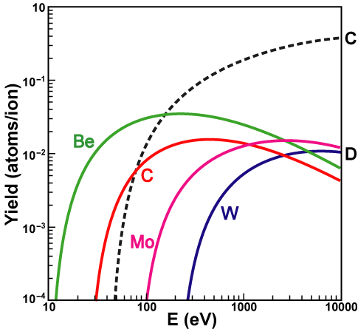
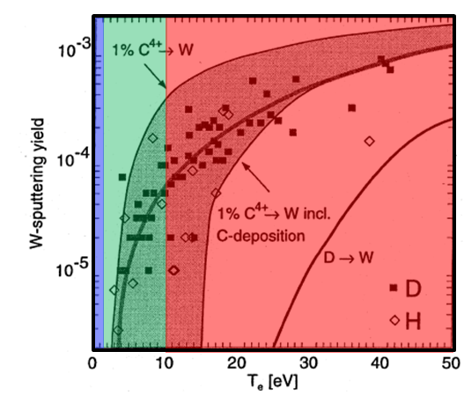
Reactor: high plasma performance and high PFC lifetime requires strong re-deposition to ensure low net erosion
Main chamber erosion due to ions and high energy CX neutrals (ITER: E_{CX} ~ 500 eV; DEMO = ??)
Divertor plasma temperature in the ~ 10 eV range where GROSS sputtering yield of tungsten drops to ~ 10 X greater than the required NET sputtering yield.
Reactor divertor lifetime ~10⁸ s requires net erosion rate of 10⁻⁶
D →X
net
erosion
~ 100 X required net yield
If re-deposition of W at main chamber is not increased, massive amounts of W migrate to divertor (t/yr) Behrisch J. Nucl. Mater 313 (2003) 388
~ 10 X
erosion
net
deposition
~ 1 X
How does W surface evolve with strong deposition of W?
Grain size, crystal structure, dust?
Krieger J. Nucl. Mater 266 (1999) 207

Slide 14
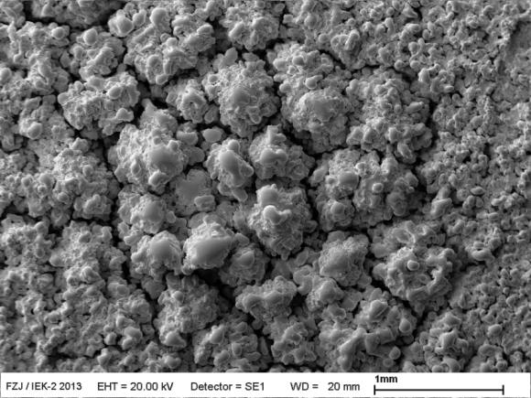
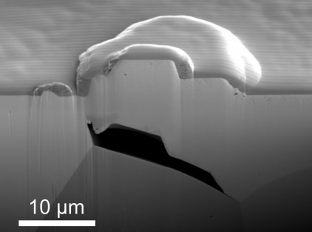
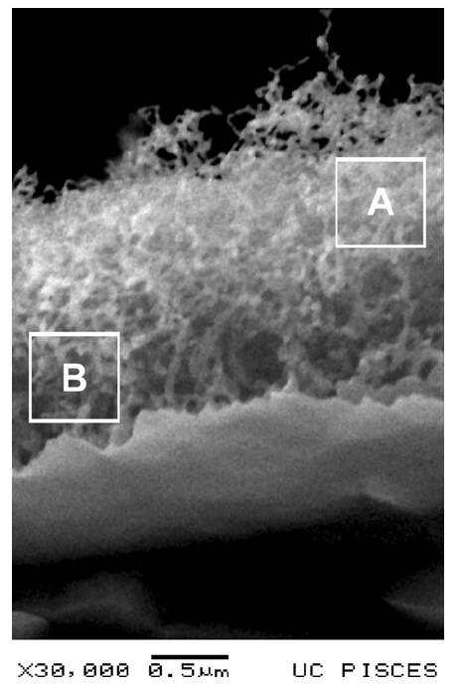
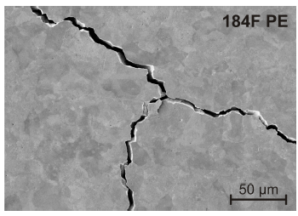

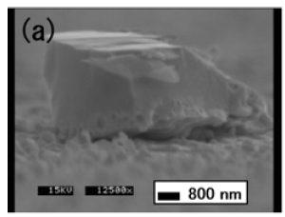
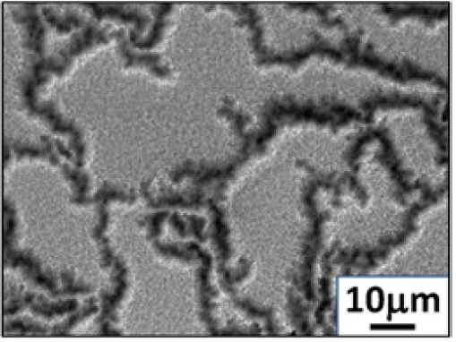
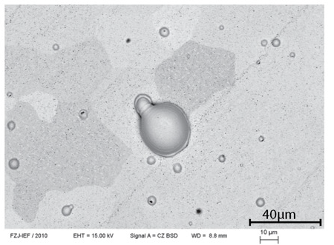
High fluence and frequent ELMs might change W erosion processes
Tungsten
100000 pulses
@ 0.3 MJ/m2
Tungsten
Tungsten
Tungsten
Tungsten
T Loewenhoff et al., Nucl. Fusion 55 (2015) 123004
S Lindig et al., Phys. Scr. T145 (2011) 014039
MJ Baldwin et al., Nucl. Fusion 48 (2008) 035001
M Wirtz et al., J. Nucl. Mater. 420 (2012) 218
High energy density plasma changes:
Surface area; Surface roughness
Surface potential (unipolar arcing may occur)
Surface temperature (loosely bound layers, He bubbles)
Surface chemical activity
Consequences:
Chemical and physical erosion yield
Relation between gross erosion and net erosion
Dust production might occur due to macroscopic erosion of surface structure and meltlayer splashing
Y Ueda et al., Fus. Sci. Technol. 52 (2007) 513
M Tokitani et al., Nucl. Fusion 51 (2011) 102001
J Coenen et al., Nucl. Fusion 51 (2011) 083008
Whole grain ejection can cause macroscopic erosion
Unipolar arcing, can possibly create W dust of nm size
Meltlayer splashing creates W dust of μm size
Neutron irradiation will likely enhance macroscopic erosion

Slide 15
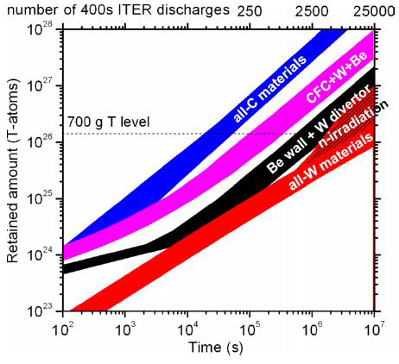
Tritium retention
Projected T-retention in ITER
Issues
Fluence dependence
Flux dependence
Effect of surface temperature
Effect of impurities (He, N, Ne, Ar) on T-transport in W
Neutron irradiation effects
Fluence dependence D retention in W
J Roth et al., J. Nucl. Mater. 390 (2009) 1
R Doerner et al., Nucl. Mater. Energy (2016)

Slide 16
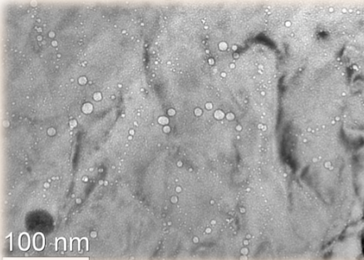
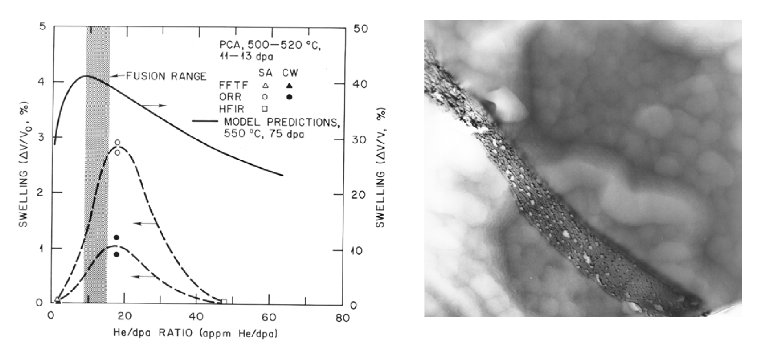
Neutron irradiation will influence PMI
Neutron irradiation damage | Consequences on PMI
Thermal conductivity | Temperature operation window, less tolerance to transient heat loads, erosion yield
Chemical composition (transmutation) | Hydrogen retention, thermal conductivity indirectly
Interstitials, vacancies, dislocations, voids | Hydrogen retention
Swelling and irradiation creep at intermediate temperatures | Tolerance in PFC alignment will become larger, hence power handling capability lower
Loss of high-temperature creep strength | Reduced temperature operation window
Ductile to Brittle Transition Temperature | Reduced temperature operation window
He, H embrittlement | Erosion and dust production will be enhanced
Synergies of micro-structural changes between neutron and plasma irradiation | Increased erosion due to increased surface roughness
14 MeV, high He/dpa
up to 150 dpa for blankets
up to 50 dpa for divertor
Accumulation of He can have major implications for the integrity of plasma-facing- and structural-components
Voids in F82H
9dpa, 380 appm He
Grain boundary
Neutron irradiation will weaken grain boundaries and possibly leading to increased macroscopic erosion

Slide 17
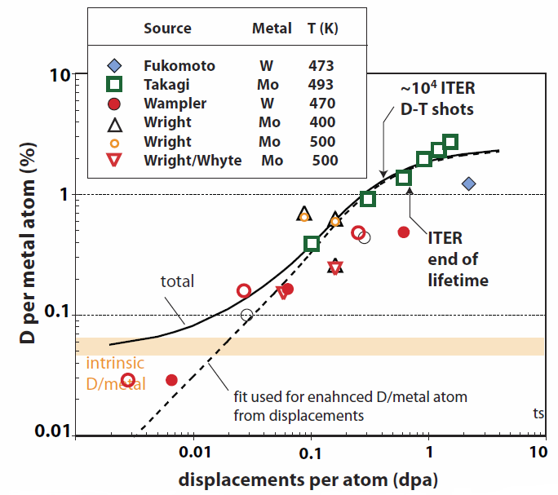
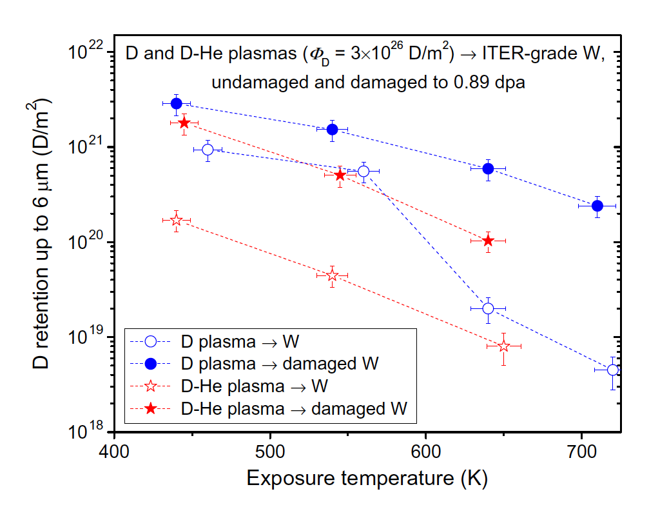
T-retention in refractory metals and impact of irradiation
Lipschultz, ITPA DivSOL 2010; HFIR: M. Shimada, et al., Nucl. Fusion 2015
Most studies today rely on high energy ion irradiation (self implantation)
Time scales of dpa creation are vastly different in those experiments
Self implantation leads to shallow damaging zones
Some studies with HFIR irradiations started (up to 0.3 dpa)
Plasma exposure is limited to low fluxes and low fluence
Deuterium retention is higher for irradiated tungsten
Deuterium retention is lower in mixed D-He plasmas
Suggests changed transport of D in the presence of He
HFIR irradiations
dpa
Suggest the need to test neutron irradiated samples at high dpa (>> 0.3 dpa)
Investigation of neutron irradiated materials with relevant He/dpa ratio is required
He
Alimov, J. Nucl.Mater. 420 (2012) 370 and other similar:
M. Baldwin et al, Nucl. Fusion (2011)
W. R. Wampler et al, Nucl. Fusion (2009)

Slide 18
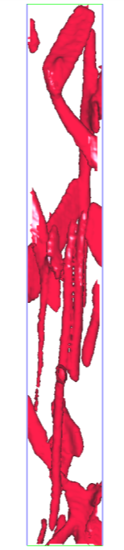
Ion irradiations important (but do not simulate neutrons)
Xu et al.,Acta Mater., 2015
W-2%Re
33 dpa ions 500°C
(Atom probe atom map)
P. Edmondson, ORNL
Pure W (99.9+%)
2.2 dpa HFIR 750°C
Now 5%Re-7%Os bulk
σ-phase interconnected ribbons
(Atom probe isodensity surface)
(Same scale)
How will tritium, helium, heat, etc., permeate this structure?
Notes:
Chad:
“Because of irradiation. Ion irradiation is the best tool, the only tool, we have for rapid-screening experiments, for single variable experiments, for mechanistic explorations. But what it can’t do, is simulate neutron irradiation. At least not without a lot more back-and-forth than we’ve done on these materials so far. Did anyone expect a tapeworm morphology of interconnected sigma-phase at two dpa?”

Slide 19
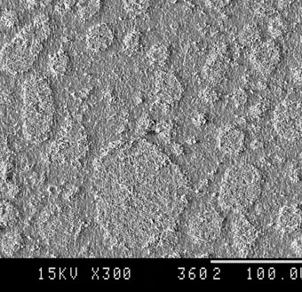
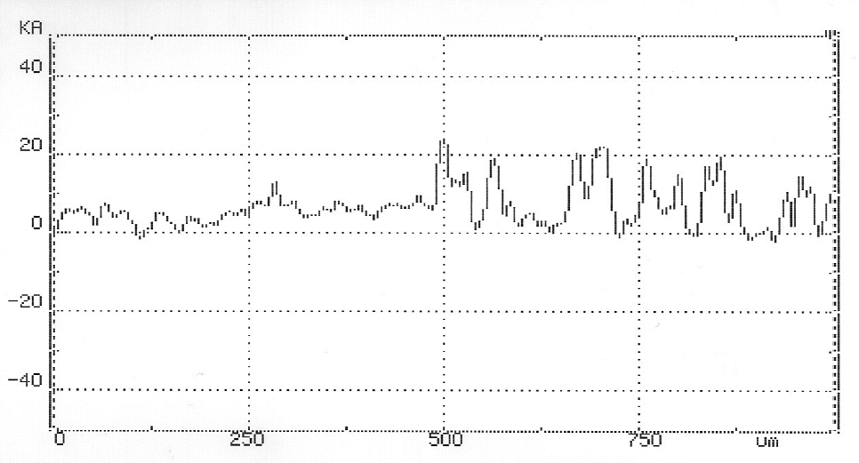
Could neutron irradiation lead to higher physical sputtering?
He ion irradiation has shown to change micro-structure in tungsten significantly (very high He/dpa, factor 100 too high).
Grazing incidence of plasma could lead to enhanced physical sputtering of roughened surface.
What is expected with neutron irradiation at relevant He/dpa ratio?
V.S. Koidan et al., IAEA 2010
Irradiation border
4
2
0
-2
-4
Δh [μm]
plasma irradiated α + plasma
27 dpa by 4 MeV He
0 250 500 750
L [μm]

Slide 20
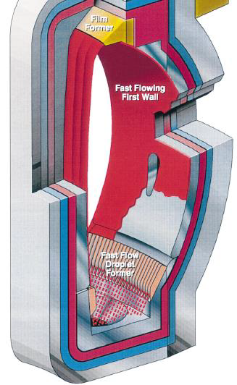
Challenges of free-flowing liquid metal PFCs
Fast flowing system: Kelvin-Helmholtz and Rayleigh-Taylor instabilities
Slow flowing system: high temperature -> evaporation
Surface composition change due to impurities
Tritium retention due to gettering by oxygen (Li)
Helium pumping
Vapor shielding
Thinning of liquid metal layer
Irradiation damage of substrate material
Corrosion
M Jaworski et al., PSI 2016, Nucl. Mater. Energy (2016)

Slide 21
Outline
Plasma-Material Interaction (PMI) challenges
Potential Plasma-Facing Materials (PFMs) and Components (PFCs)
Current status of U.S. PMI research
Facilities needed for the development of PFCs
Strategic elements to accelerate U.S. burning plasma research
A proposed high-level R&D program and roadmap for PMI

Slide 22
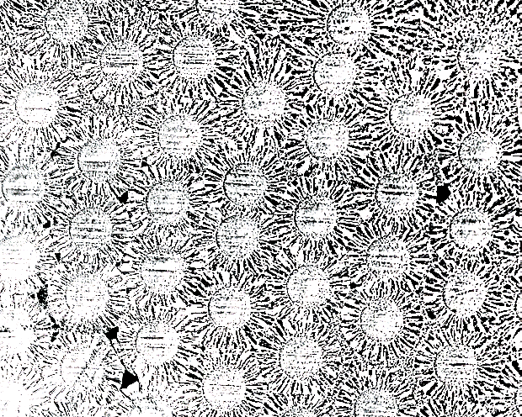
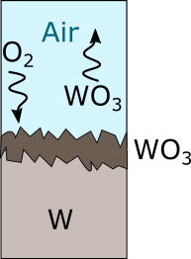
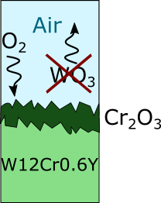
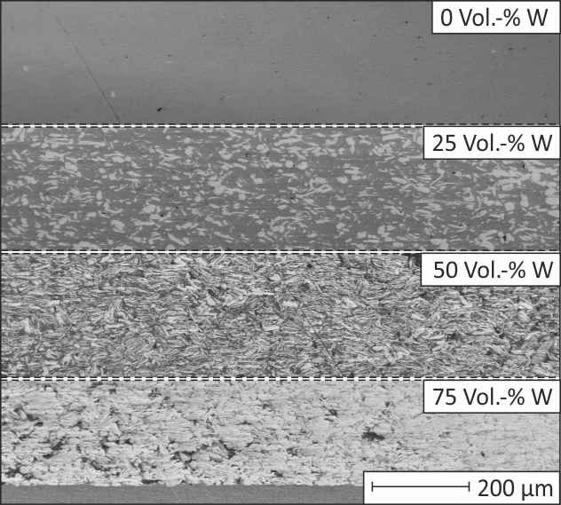
Development of materials for PFCs
Mechanically alloyed tungsten
Laminates
Fiber-reinforced composite materials
Self-passivating tungsten, “smart”, alloys
Functionally graded materials for fusion
Alternatives: ceramics
Ch. Linsmeier et al., Nucl. Fusion. 57 (2017) 092007
Ch. Linsmeier et al., Nucl. Fusion. 57 (2017) 092007
J.W. Coenen et al., Fus. Eng. Des. 1244 (2017) 964
A. Litnovsky et al., Phys. Scripta T170 (2017)

Slide 23
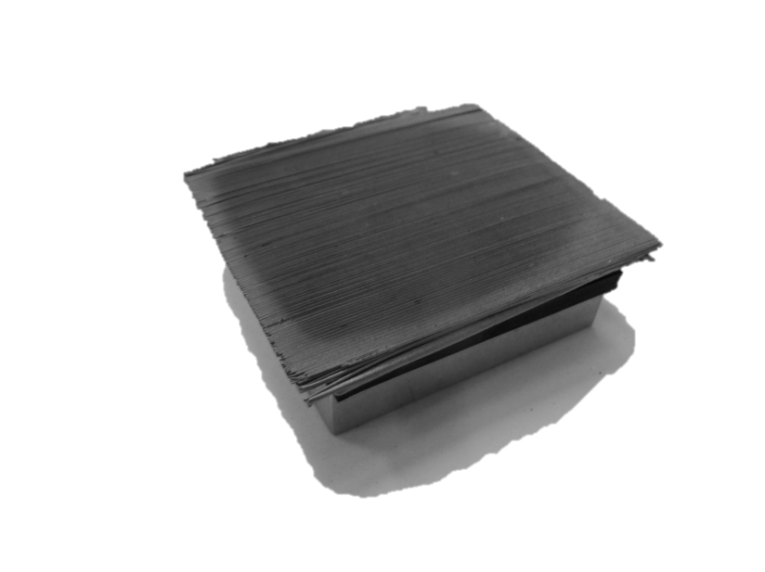

Novel composite materials: W_{f}/W
J. Riesch et al., Report Max-Planck-IPP (2013)
Pseudo-ductile behavior of tungsten fiber reinforced tungsten
Properties rely on energy dissipation mechanisms
Fiber pullout
Crack bridging
Crack deflection
Pure W fiber might not retain strength under irradiation
Can we modify fibers accordingly?
W-matrix
J.W. Coenen et al., Fus. Eng. Des. 1244 (2017) 964
Tungsten fibre

Slide 24
Exploring ceramics as PFM option
Material Properties | Pure Tungsten | Carbide CVD SiC | Isotope-separated Diborides |  | MAX Ti₃SiC₂
 |  |  | Zr¹¹B₂ | Ti¹¹B₂
Atomic Number | High | Low | Medium | Medium | Medium
Melting Point (°C) | 3,422 | 2,730 | 3245 | 3225 | ~3,000
Max. Operating Temperature (°C) | ~ 1,100 | ~1,400 (?) | Unknown | Unknown | ~ 1,000 (?)
Thermal Cond. (W/m-K) Unirr - RT/1000°C Irradiated Degradation | 180/110 Moderate | 400/80 Harsh but with NFB* | 120/100 Unknown | 96/78 Unknown | 40/50 Small
Radiation Tolerance | Poor(?) | Good | Unknown | Unknown | Fair(?)
Tritium Permeability | Medium | Low | Unknown | Unknown | Unknown
Tritium Retention | Low | High? | Unknown | Unknown | Unknown
Neutron Absorption | High | Low | Low | Low | Medium
Short-term Activation | High | Low | Medium | Medium | Medium
Long-term Activation | Low | Low | Medium | Medium | Medium
LOCA Safety | Poor | Good | Fair(?) | Fair(?) | Good

Slide 25
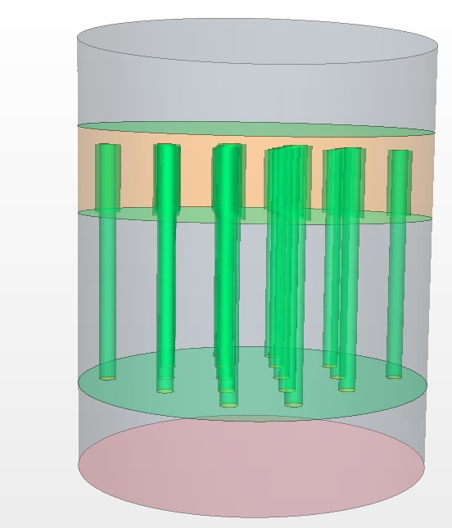
Advanced Materials enabled by new transformative technologies
Diffusion barriers,
Permeation barriers
Functionally graded materials
Self-healing materials
Additive Manufacturing
Materials-by-Design driven by
Artificial Intelligence
High heat transfer technologies
Self-passivating
materials
In-situ repair of PFCs

Slide 26
Transformative enabling technology
What is the effect of innovation?
Higher heat fluxes
Larger temperature operation window
Larger stress resilience
Better compatibility with plasma
Better accident tolerance
Diffusion barriers / permeation barriers to lower tritium retention
Defect barriers to improve irradiation resistance
What to expect in the future from innovation?
Smaller
Faster
More complex
More precise
Example for current limitation:
Atom Layer Deposition (2D-layer) possible at low speed
3D-structures possible with Additive Manufacturing as small as 50μm
Materials-by-design on a micro- or nano-structure level to enable
bulk/surface PFC properties in complex geometries in a single graded system

Slide 27
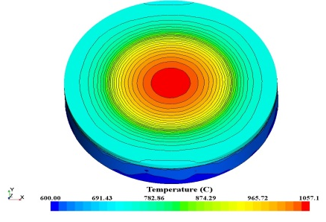
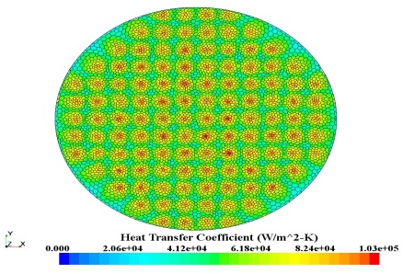
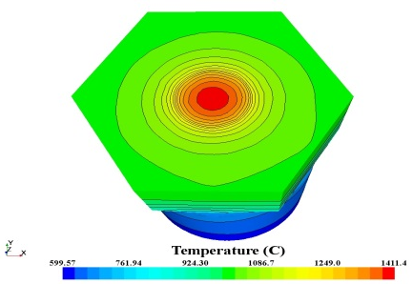
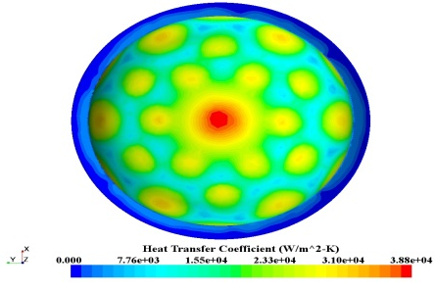
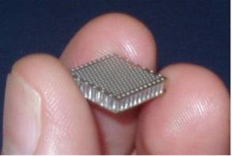
Complex heat transfer systems will be benefit from additive manufacturing
Microjets might open opportunity for power exhaust of up to 30 MW/m²
q//
Temperature
HTC
W faceplate
200 μm jets
Micro
116 jets
Outlet plenum
Advanced manufacturing
Required!
W jetbody
HEMJ
Inlet plenum
D Youchison, FST (2014)

Slide 28
Opportunities for emerging materials
Design of radiation-resistant and radiation tolerant materials enabled by additive manufacturing
Adaptive self-healing materials
Complex hierarchical composites
Complex alloys
Hybrid liquid/solid systems
Ghoniem and Williams, 2017
Flame spray
Wire EDM texture
P. Rindt, PFMC 2017

Slide 29
Outline
Plasma-Material Interaction (PMI) challenges
Potential Plasma-Facing Materials (PFMs) and Components (PFCs)
Current status of U.S. PMI research
Facilities needed for the development of PFCs
Strategic elements to accelerate U.S. burning plasma research
A proposed high-level R&D program and roadmap for PMI

Slide 30
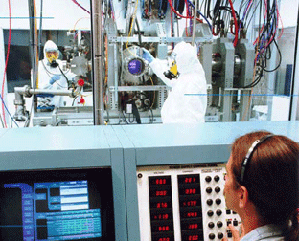
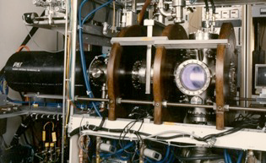
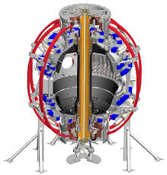
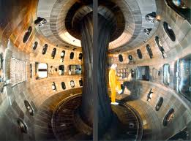


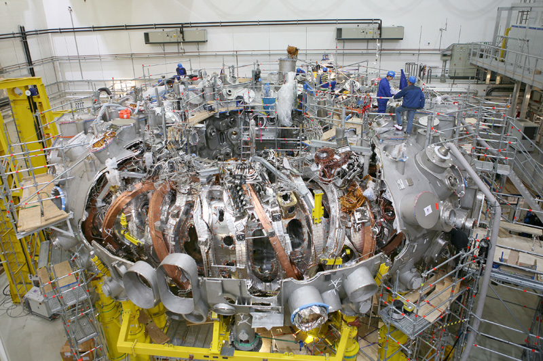
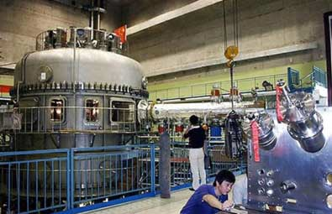
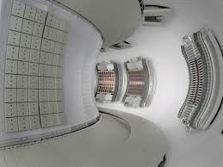
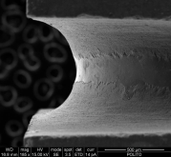
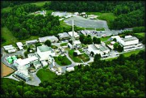
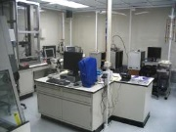
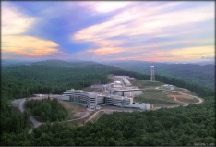
Status
U.S. PMI R&D
International PMI R&D
World-wide unique capabilities to study Be, T effects in linear devices. They are ideal for single to few effects studies and benchmarking of PMI computational models. Leadership in PMI science. | Recently, high flux, high fluence linear devices became operational (Magnum-PSI)
Various small scale devices (LTX, HIDRA) etc. offer unique capabilities to test liquid metal PFCs in particular liquid Lithium. | Liquid metals are also studied on Magnum-PSI, FTU, TJ-II and in the future on COMPASS Upgrade.
Well diagnosed divertor plasmas. Leadership in Div/SOL science. Design of devices allows in principle for testing divertor concepts to various degrees of closure. Load-lock systems (DIMES, MAPP) allow exposure of material samples. | International devices have more relevant wall and divertor materials installed: W and Be (JET, AUG, EAST, WEST). Some devices also offer unique capabilities to test new divertors (MAST, TCV), and in future COMPASS Upgrade. Furthermore DTT in Frascati on the horizon.
In collaboration with international long pulse devices, U.S. develops actively-cooled PFCs and steady-state scenarios compatible with PFMs with respect to confinement, erosion/re-deposition (dust production), T-retention. | Obviously home institutions of steady-state toroidal devices have advantage.
Excellent tools to develop nuclear materials. Leadership in material science and neutron science. World leading neutron sources. | Capabilities spread around the world. If IFMIF or DONES will be built, leadership could move to international facilities.
PISCES
TPE
LTX
W7-X
EAST
WEST

Slide 31
Outline
Plasma-Material Interaction (PMI) challenges
Potential Plasma-Facing Materials (PFMs) and Components (PFCs)
Current status of U.S. PMI research
Facilities needed for the development of PFCs
Strategic elements to accelerate U.S. burning plasma research
A proposed high-level R&D program and roadmap for PMI

Slide 32


Development of PFCs requires devices with increased capabilities to test PMI at reactor relevant level
Transport in plasma Transport in material
Classical Debye vs. Chodura sheath
Non-linear evolution of surface
as well as bulk effects
Ion implantation,
fuzz
10-100 nm
Blisters
10-50 μm
Cracks
mm
Parallel impurity transport (entrainment)

Slide 33

Increased capabilities with MPEX
MPEX planned capabilities
Steady-state magnetic field [T] | 1-2
Steady-state high power flux to target [MW/m²] | > 10
Steady-state high power plasma flux on tilted (5 degree) target [MW/m²] | 3
Target T_{e}, T_{i} [eV] | 1 - 15
Target n_{e} [m⁻³] | 10²¹ - 10¹⁹
Source T_{e}, T_{i} [eV] | 20-30
Reactor relevant ion flux [m⁻²s⁻¹] | 10²⁴
Annual fluence | 10³¹
Transients (laser, ET source, e-beam) | Under assessment
Neutron irradiated samples | Y
Test of divertor component mock-ups | Y
New plasma source concept (Helicon, EBW, ICRH) for independent control of T_{e} and T_{i} for entire divertor plasma parameter range.
W erosion at 10 eV
DEMO
MPEX
FNSF
C-mod
JT60-SA
ITER
DIII-D
JET
EAST

Slide 34
Outline
Plasma-Material Interaction (PMI) challenges
Potential Plasma-Facing Materials (PFMs) and Components (PFCs)
Current status of U.S. PMI research
Facilities needed for the development of PFCs
Strategic elements to accelerate U.S. burning plasma research
A proposed high-level R&D program and roadmap for PMI

Slide 35

Strategic elements for U.S. PMI program
An Advanced Linear Plasma Device
Fusion Prototypic Neutron Source
Whole device modeling capability to be able to make reliable predictions on power exhaust
A DTT ??

Slide 36
Outline
Plasma-Material Interaction (PMI) challenges
Potential Plasma-Facing Materials (PFMs) and Components (PFCs)
Current status of U.S. PMI research
Facilities needed for the development of PFCs
Strategic elements to accelerate U.S. burning plasma research
A proposed high-level R&D program and roadmap for PMI

Slide 37
Some milestones for PMI and PFC R&D
Long term milestones within 15 years
Contribute to second generation divertor of ITER (higher heat flux > 10 MW/m², higher fluence, few dpa)
First divertor and first wall components for US next step device (high heat flux >10 MW/m², ~10 dpa)
Second generation divertor for US next step device (high heat flux > 20 MW/m², high fluence, high dpa > 50dpa)
Short term milestones within 5 years
Build advanced linear plasma device MPEX
Down-selection between solid PFCs and liquid metal PFCs
Decision on need for a DTT (on basis of knowledge derived from experiments, modeling and theory).

Slide 38
Near term R&D priority for PMI (5 years)
Develop solid material PFC technology
Scope liquid metal PFC technology
Develop advanced manufacturing methods and tools for fusion applications as PFCs (e.g. additive manufacturing, materials by design utilizing AI)
Assess free-flowing liquid metal PFCs in LTX and NSTX-U
Assess the science of evolving surfaces with high flux, high fluence linear devices
Assess hydrogen retention in candidate materials with high flux, high fluence linear devices
Assess material migration of candidate novel PFMs in existing toroidal devices
Assess power exhaust scenarios with highly radiative plasmas and novel divertors on existing toroidal devices (DIII-D and international e.g. MAST, TCV, COMPASS Upgrade, AUG, JET, EAST, WEST)
Develop integrated (whole device) modeling tools (AToM) to interpret power exhaust experiments to enable extrapolations to high magnetic field (low λ_{q} and high P_{SOL}), essentially to required P_{SOL} B / R

Slide 39
Long term R&D priority for PMI (15 years)
Develop advanced materials for fusion (self healing, irradiation and erosion resistant)
Build low-cost fusion prototypic neutron source (e.g. accelerator driven neutron sources) for material development
Assess advanced materials under fusion prototypic conditions (high fluence, high flux, high irradiation damage)
Deploy next generation advanced solid or liquid PFCs to long pulse devices
Contribute to the design of the 2nd generation divertor for ITER
Deploy new PFC systems to US Next Step Device

Slide 40
Roadmap: PMI and divertor development
today
2020
2030
2040
Solid Materials Technol.
Liquid Metal Technol.
Advanced Materials Technol.
Existing linear devices
PISCES, TPE, P-MPEX, Magnum
National toroidal devices
LTX
NSTX-U
DIII-D
Liquid Li
Recovery
Liquid metal
Power exhaust, material migration
International short pulse toroidal devices
JET, AUG, MAST, TCV
Power exhaust
Fusion prototypic neutron source
Design
Constr.
Operations
MPEX
Construction
Operations
International long pulse toroidal devices
EAST, KSTAR, WEST, W7-X
Material migration, dust
ITER
Construction
Operations
?
DTT
Fusion Demonstration Device/FNSF
Design
Construction
Operations
Stellarator Option

