Slide 1
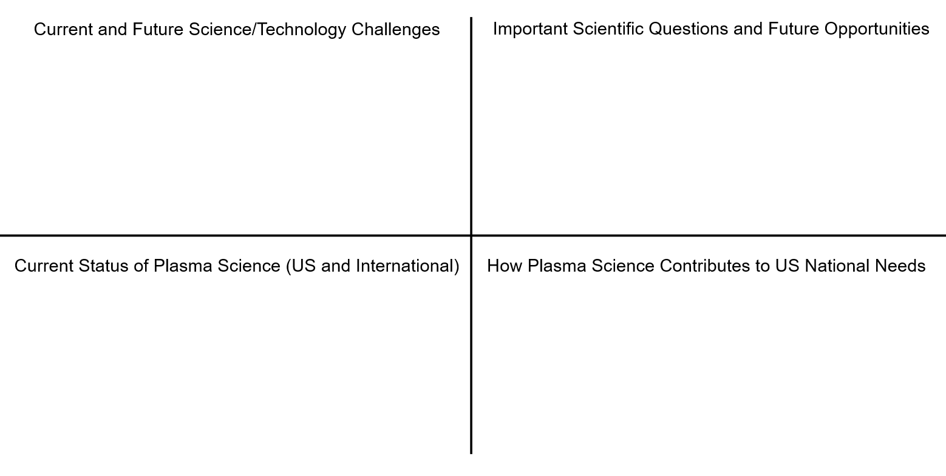
John A. Smith, University of ABC, jas@uabc.edu
TOPIC FOR DISCUSSION GOES HERE

