Slide 1
Data Science Diversity from the Perspective of a National Laboratory
Deb Agarwal
Data Science and Technology Department Head
Lawrence Berkeley National Laboratory
CRA-W Board Member

Slide 2
What Defines a Data Scientist
Is it someone who specializes in processing, analytics, or computing on data? Developing techniques to analyze data?
Is it a person in a narrow set of expertise areas (e.g. Machine Learning, Data Management, Data Visualization, Statistics,…)?
Where does computer science, applied math, computational science, etc end and data science begin?
Where does the domain science end and data science begin?
How many people can define themselves as purely a data scientist? What do they do?

Slide 3
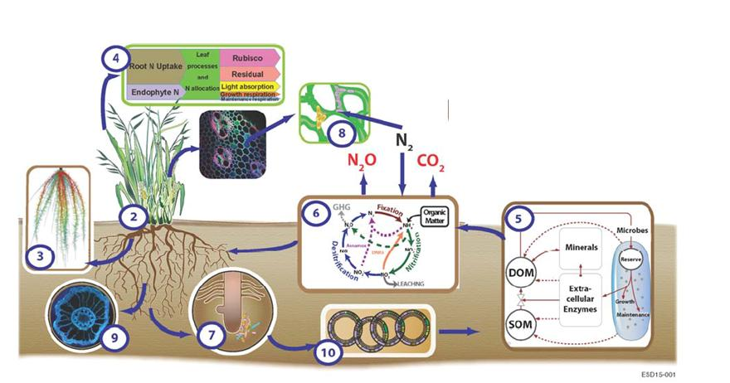
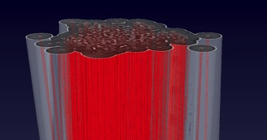
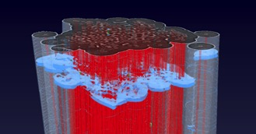
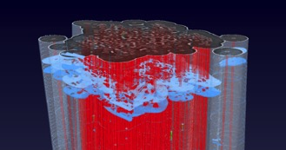
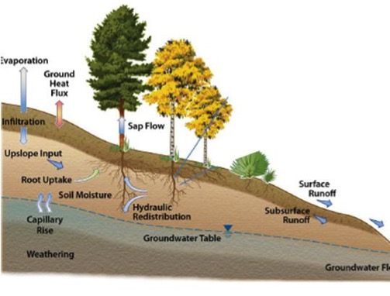
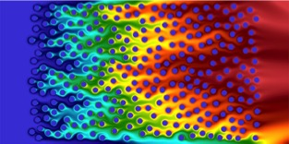
Addressing Science Data Challenges
Notes:
Experience with real problems where the challenges are broad
Data QA/QC, feature identification, re-scaling, correlation,
Most problems are multi-scale and are dealing with heterogeneous data – requires domain knowledge
Emerging problems are multi-domain
Also requires data management, machine learning, image analysis, and graph theory, visualization, workflows, usability

Slide 4









Interdisciplinary Teams are Required to Solve Science Data Challenges
Data Science
Expert - ML
Data Science +
Domain Literacy
Data Science
Expert – Data Mgmt
Domain
Experts
Data Science
Expert – HCI
Domain + Data
Science Literacy
Data Science
Expert – Math
Data Science
Expert – Vis/Img
Data Science
General
Notes:
Challenges – being able to understand each other (language and vocabulary)
Being able to understand what is interesting, underlying
Our teams we aim to have 33/33/33 Domain Expertise, Software Programmer, Data Science Expertise
Data science is fundamentally multi-disciplinary
Data science is the new distributed systems

Slide 5
Diversity Recruitment Challenges
Hard to find multi-disciplinary people
Data science with science domain literacy
Domain science with data science literacy
Need more training happening in domain-informatics
Difficult to hire diverse data scientists
Text mining/machine learning common but not what we need
Data science technique experts want to continue to specialize
Current solution
Recruit data science literate people from the domains
Train in place

Slide 6
Diversity Recruiting Successes
Berkeley Lab Data departments – 21-29% female
What has worked to attract gender diversity (anecdotal)
Personal relationship
Opportunity to participate in and advance a team
Opportunity to work for a successful woman
Confidence in supportive environment that will recognize achievements
Fair rewards based on team and development achievements
Inclusive recognition of successes
Active support and validation of capabilities
Target is achieving 50% diversity on collaborative teams
When we reached 30% the ‘guys’ were complaining they felt like the minority

Slide 7
Retention
Challenges
Subtle bias
Career and family balance important
Mentoring and promotion support uneven without conscious effort from senior management
Lose women at a higher rate than men
Successes
Strong interest in making a difference and a chance to address world challenges
Supportive environment with equal opportunity
Chance to work with strong role models
Opportunity to work on all women teams

Slide 8
Opportunities to Increase Diversity and Data Science Literacy
Increase data science literacy across all science disciplines
Build cross-disciplinary collaboration opportunities on data science to work on real problems
Create non-threatening supportive team environments
Learn to recognize and counteract bias by both men and women
Build, support, and mentor cohorts of diverse students
Supporting diversity takes direct personal attention to the issue
Critical to include aspects of HCI in the curriculum
The problems need a broad range of capabilities

