Slide 1
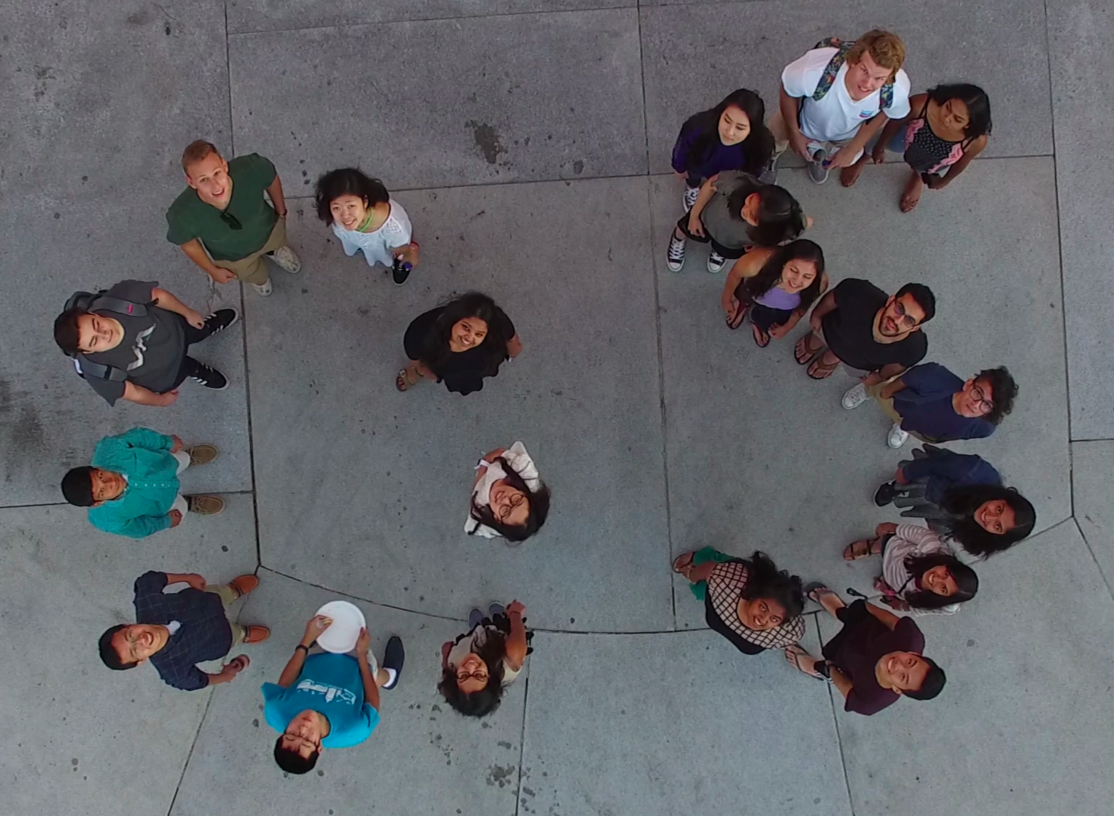
Data Science at the Heart of a
21st Century University
David Culler
University of California, Berkeley
http://data.berkeley.edu

Slide 2
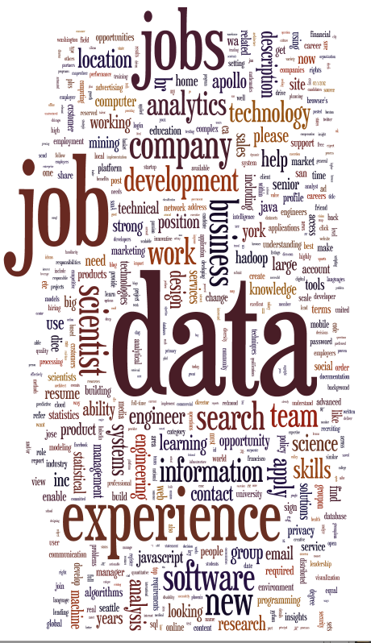
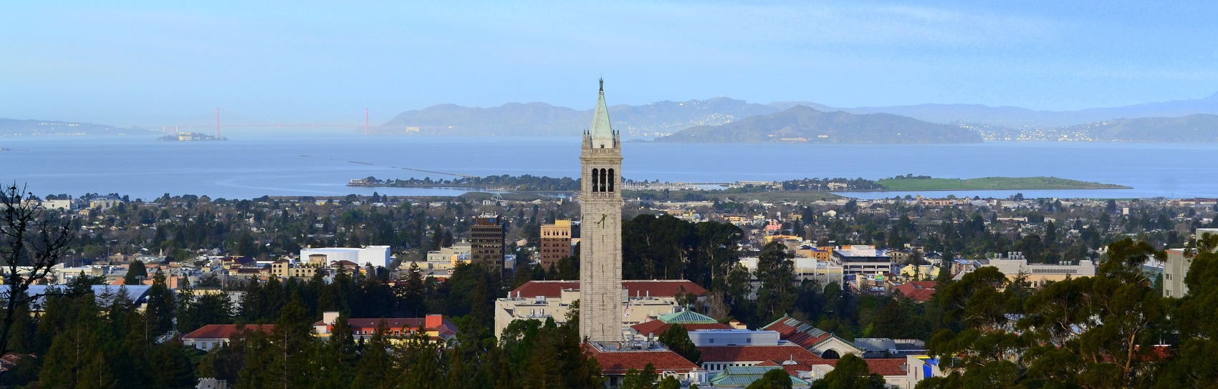
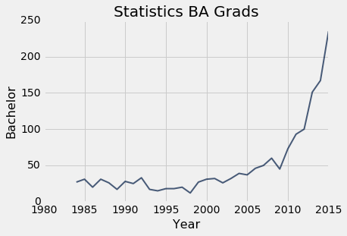
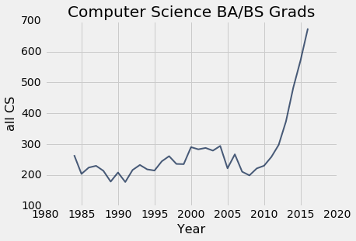
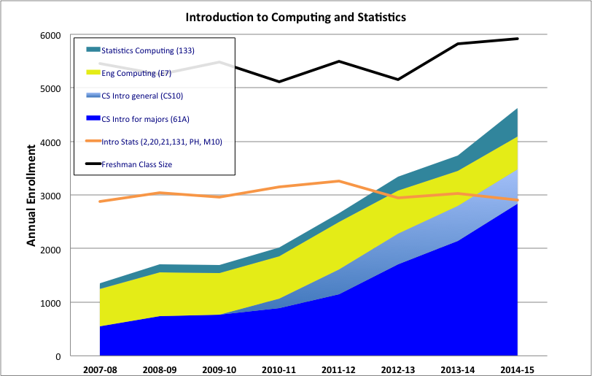

Vectors of Change

Slide 3
Data Science in the Undergrad Experience
Rolling out to the students
Today’s Majors
DS Minor
DS Major
Concentrations
Student Tracks
Experience level
Data Science Core
Soc
Biz
Connectors
Phys
CS
Data Science Foundation (CS+Stat+Critical Thinking w/ data)
Existing course
Thesis, Research
Undergrad Class
DS in field
DS focus
http://data.berkeley.edu/sites/default/files/DataScienceCurriculumSketch.pdf

Slide 4
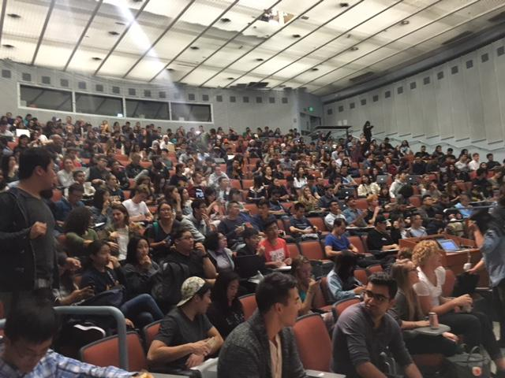
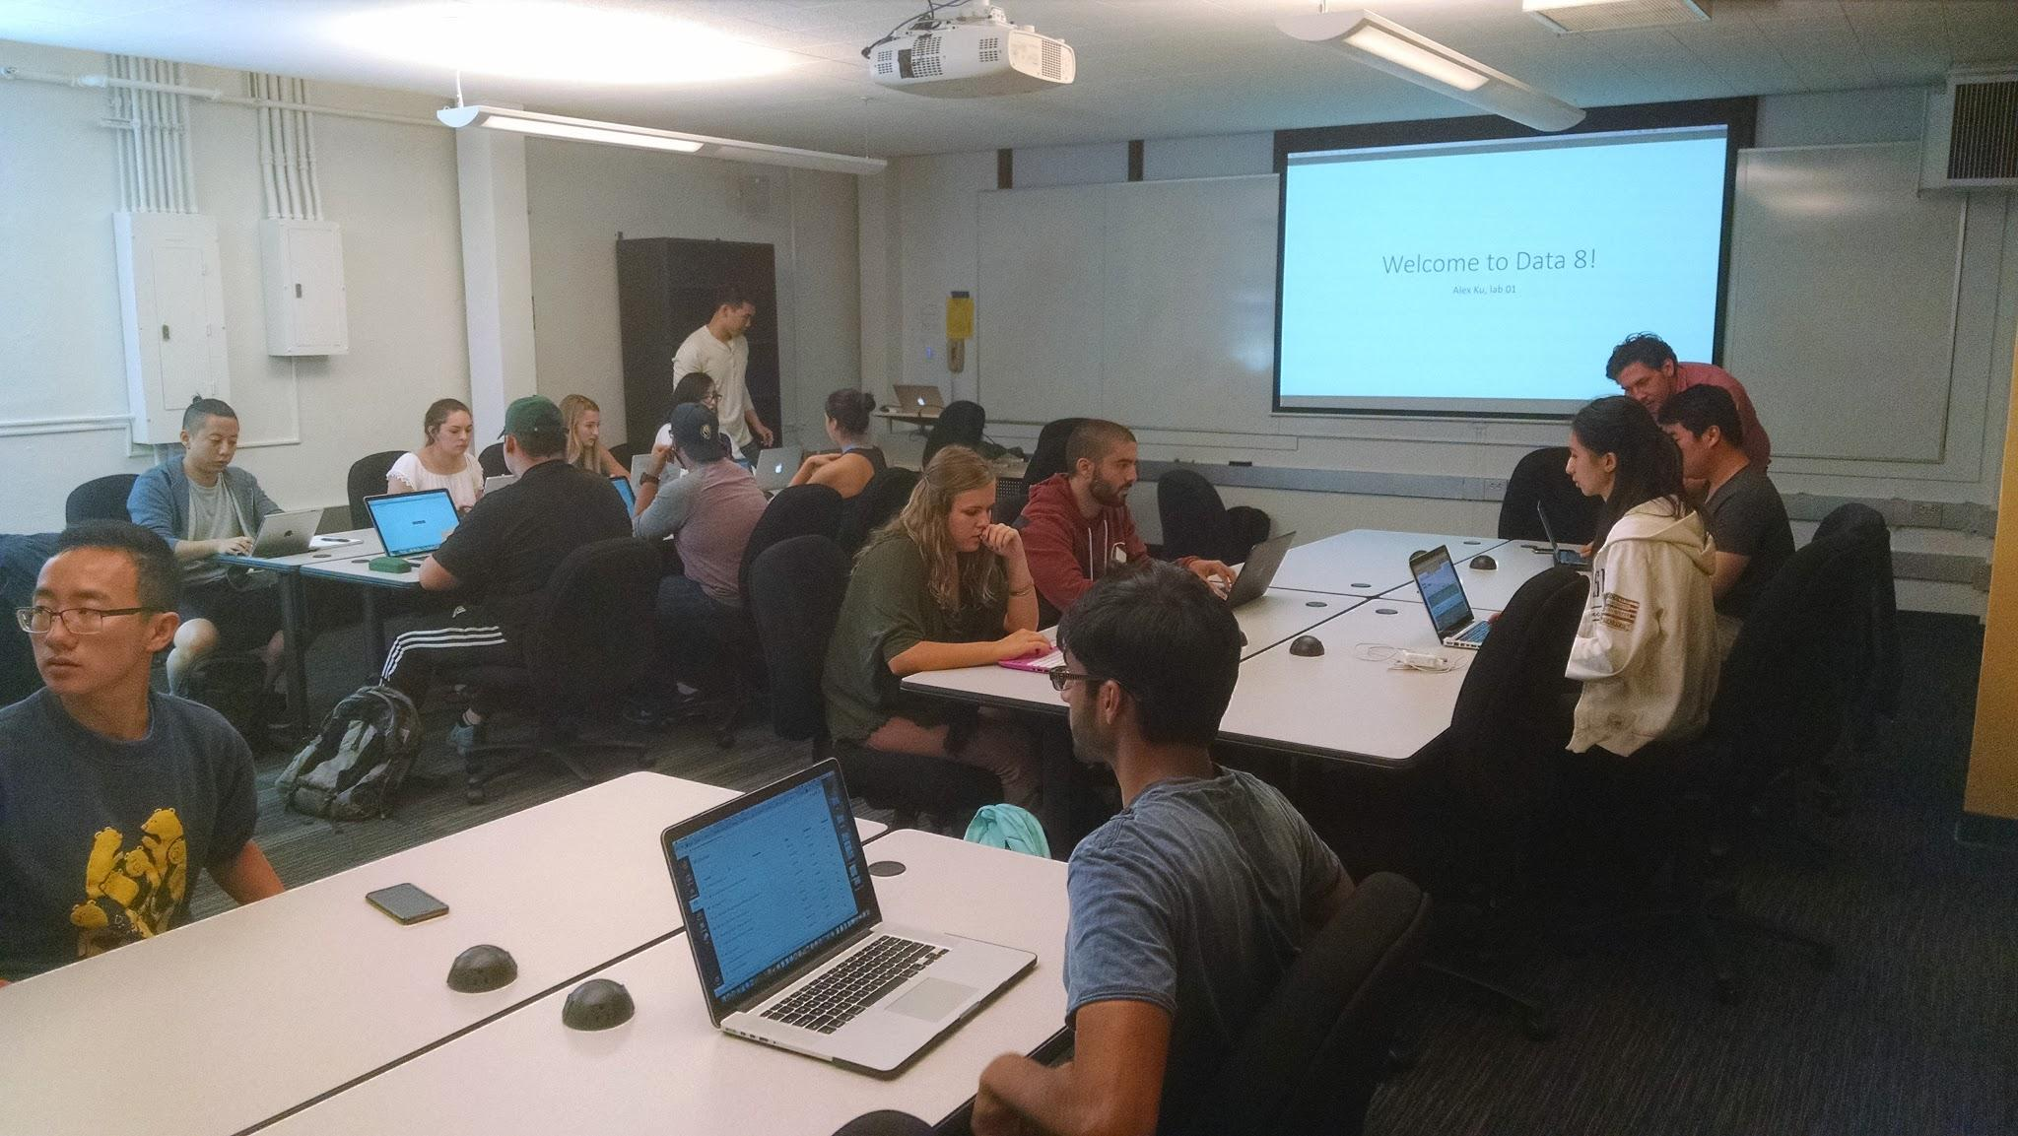
Foundations of Data Science - “Data 8”
Designed for 1st and 2nd-year students of any major
  4 units, MWF lecture + 2-hour W-F lab
  No CS or stats experience required
Students gain hands-on experience with real data while learning computing and stats concepts + programming
Strong support (OHs, HKN/CS Mentors tutoring, Data Scholars program, laptop loans, etc.)
500+ students per semester & growing
M-Tu Connectors

Slide 5













Data Science Connectors
Data Science
For Smart Cities
Data and Ethics
Children in the Developing World
Data Science, Demography & Immigration
Social Networks
Comp. Structures in Data Science
Social Data Revolution
Probability and Math Stats in Data Science
Making Sense of Cultural Data
Data Science and the Mind
Genomics and Data Science
Data Science for Cognitive Neuroscience
Notes:
DEC

Slide 6
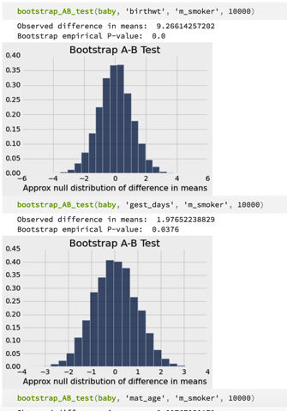
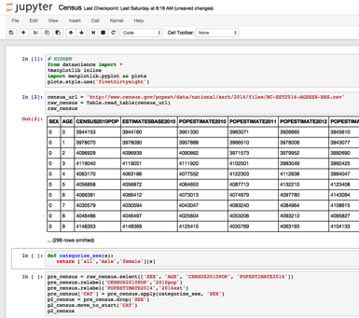


Data8 - Concepts and Computing
Fundamental co-mingling of CS & Stat concepts on real data
  Learn computing concepts by doing interesting things on data
  Learn advanced statistical concepts by observing what’s interesting
  Codify understanding of concepts symbolically
“Explorations” in visualization, privacy, personalized medicine,…
Entirely cloud-based computing environment built on Jupyter notebooks plus UCB datascience Tables
http://data8.org

Slide 7

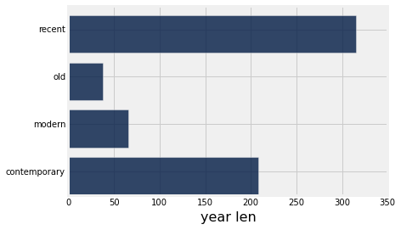
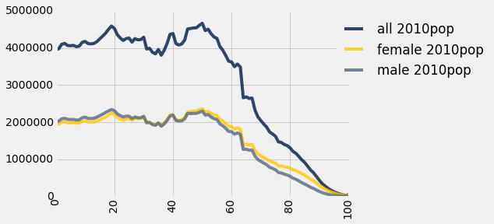
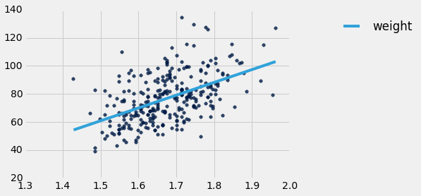
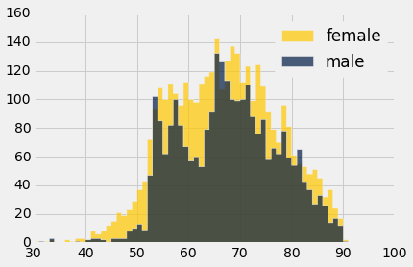
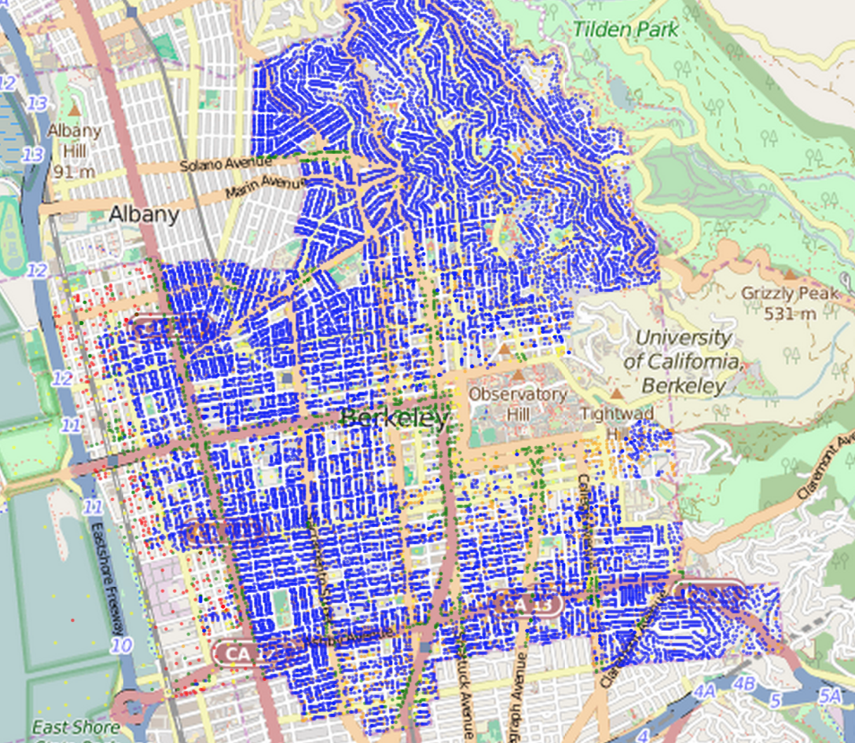
Tables (https://github.com/dsten/datascience)
ordered collection of labeled columns of anything
label
select, where, take, drop, group
stats, bin
sample
dict, record,tuple
pivot, pivot_bin
values
split
join
Numpy array
T[‘label’]
A single, simple, powerful data structure for all
Inspired by Excel, SQL, R, Pandas, Numpy, …

Slide 8

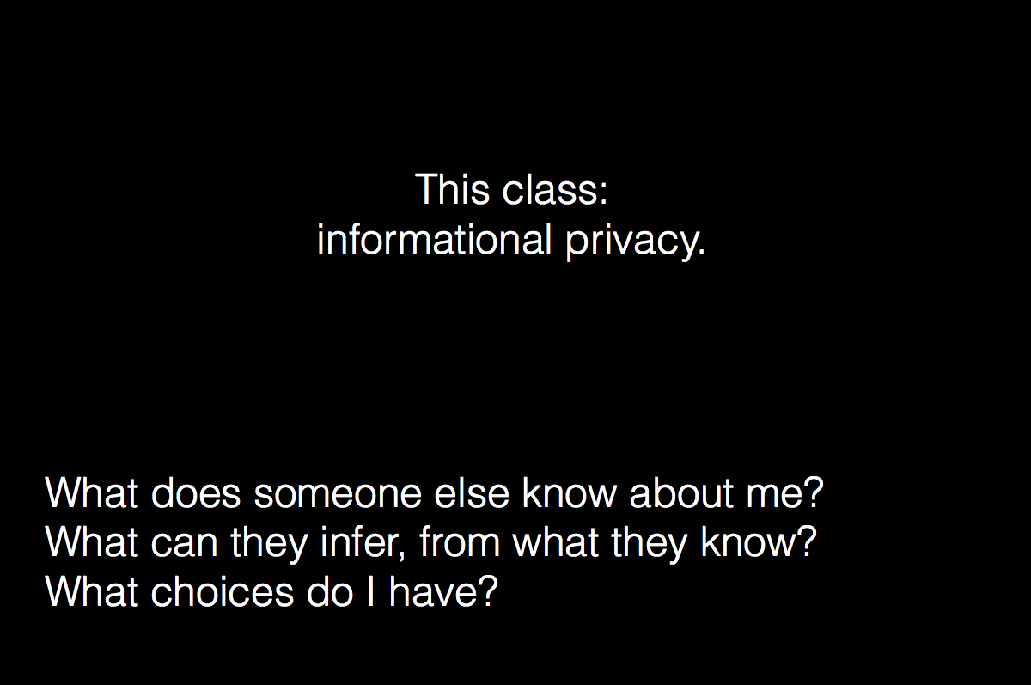
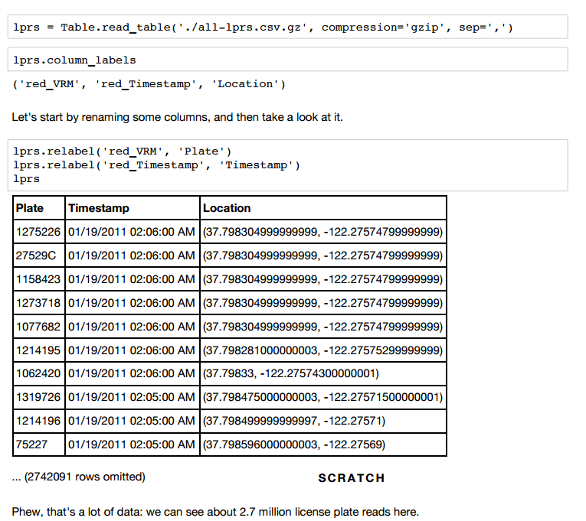
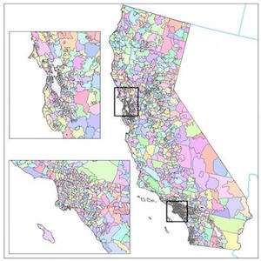
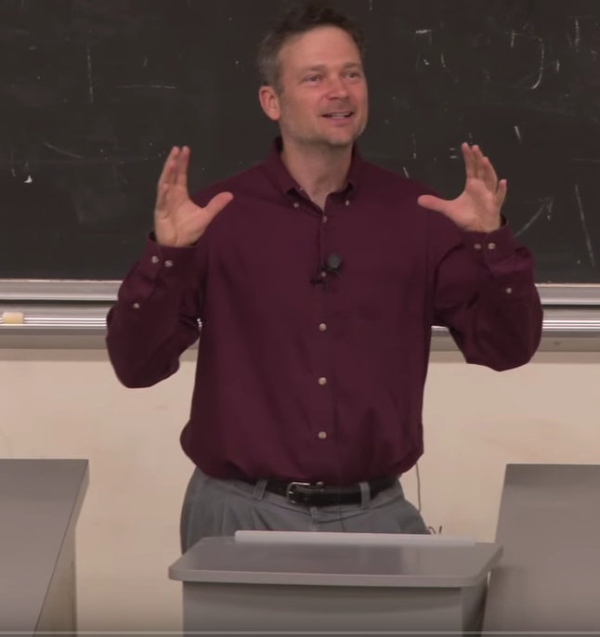
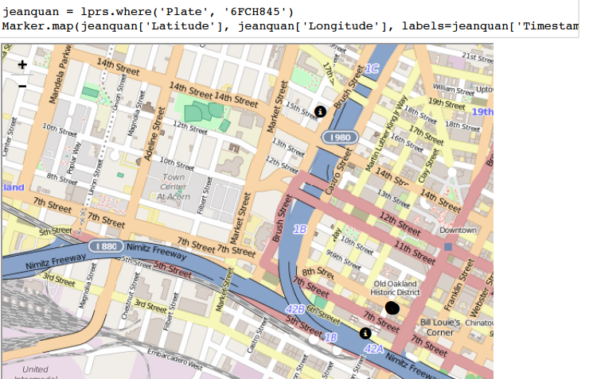
Explorations

Slide 9
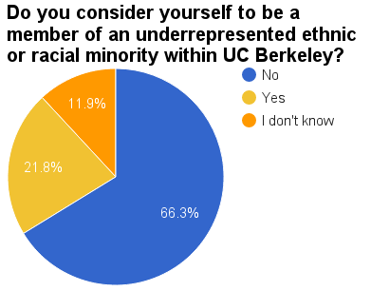
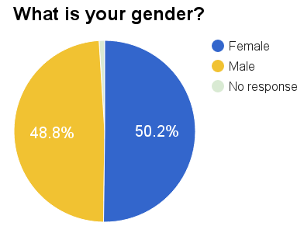
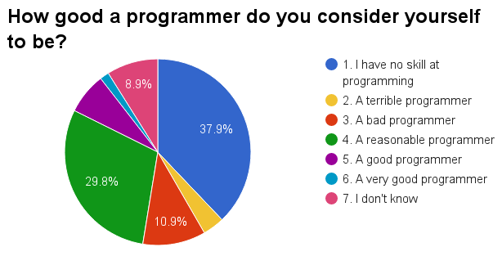
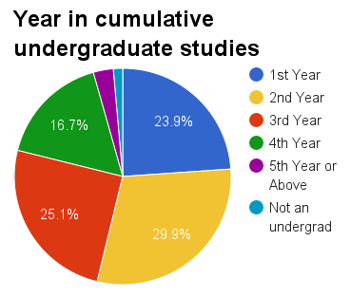
Data 8 Demographics, Fall 2016
517 students

Slide 10
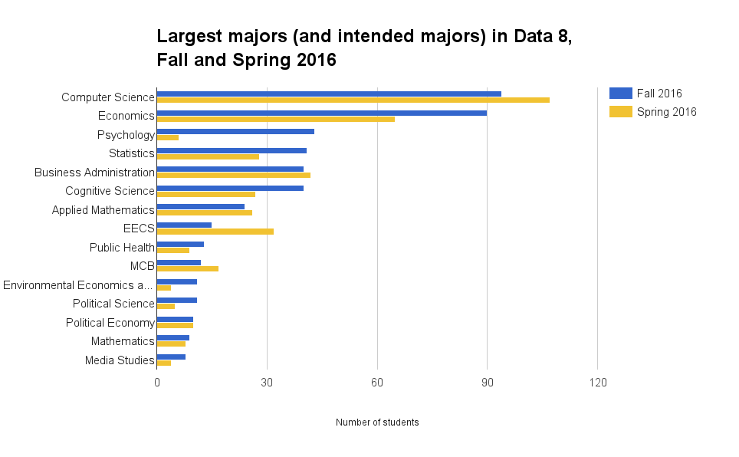
Majors composition of Data 8 (of 59 Fa16)

Slide 11
DS Major Structure
Statistical Machine Learning
Implications
Statistics Depth
CS
Depth
External Concentration
Principles and Techniques of Data Science
Mathematics
Computing
College Breadth
Electives
Foundations of Data Science

Slide 12
Refactoring an Institution
College of Letters & Science
Engineering
Professional Schools
Compu-tational
Sciences & Eng.
Arts & Humanities
Social Sciences
Biological Sciences
Math & Physical Sciences
•••
Notes:
DEC

Slide 13
The vision …
In the 21st century every college student should be prepared to understand and develop points of view based on the analysis of data as well as evaluate arguments made by others
Notes:
DEC

