Slide 1
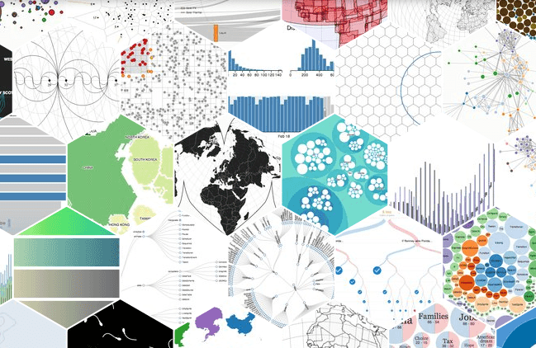
Future of Data Science: undergraduates
Data-Driven Discovery Initiative @ Moore Foundation
Chris Mentzel, Program Director

Slide 2
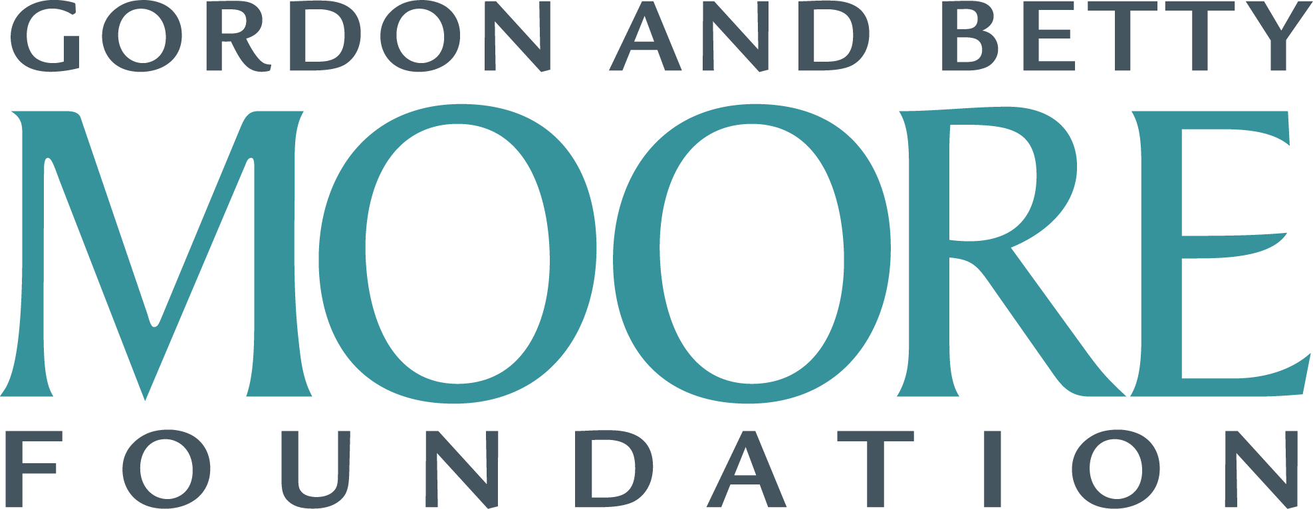

DDD’s Perspective
Patient Care
Environment
Science
SF Bay Area
Marine
Microbes
EPiQS
Data-Driven Discovery
TMT
…
||
Data Science for Research

Slide 3
Data Science / Data-Driven Research is Interdisciplinary
Applied Domains
!
Computation
Math / Stats
Notes:
Data Science for Undergrads is more than just fixing
the pipeline for research
”Foundations” are essential
Applied: CS, Stats/Math/Prob, ML
Also essential: Domains of Application integrated from the start
Understanding of the data, and the problem, aids in understanding “foundational” concepts
Can also help advance foundations, motivate new directions of research, find new ways to apply existing techniques
Beyond the sciences
Integration of domains of application will also help answer: Why should liberal arts care about DS: A: aids in critical thinking, adds additional ways in which to engage in the world, new approaches to scholarly work
Harvard / Berkeley / others thinking of DS as a new way to talk about quantitative reasoning for all undergrads.
Why learn calculus when you are not going to be a scientists or engineer? Many of the answers to that question can just as easily, if not better, answered with DS: computational thinking, statistical/ probabilistic thinking, etc…

Slide 4
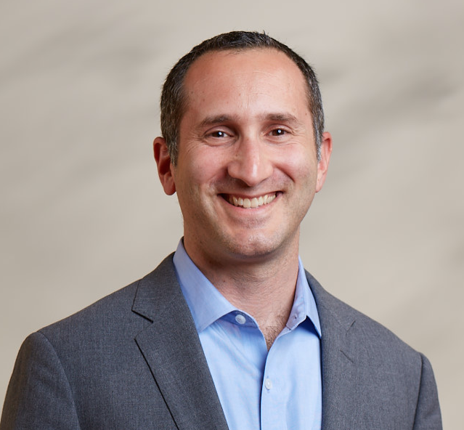
Thank you
Chris Mentzel
Program Director,
Data-Driven Discovery Initiative
@chrismentzel
www.moore.org
#MooreData

Slide 5
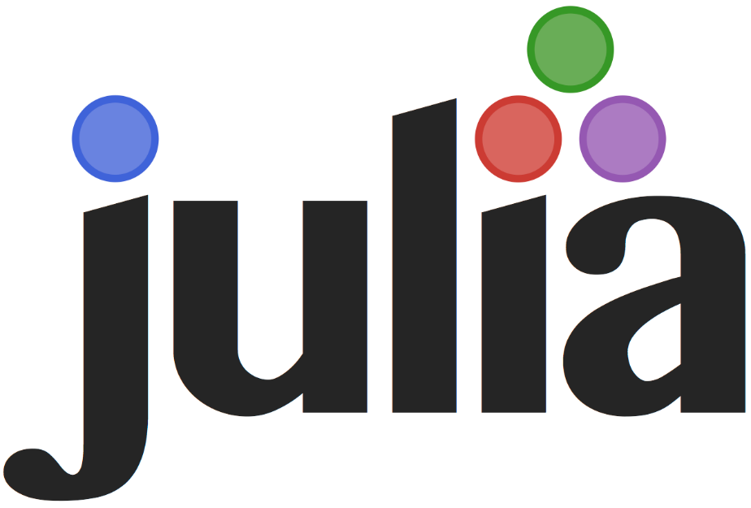
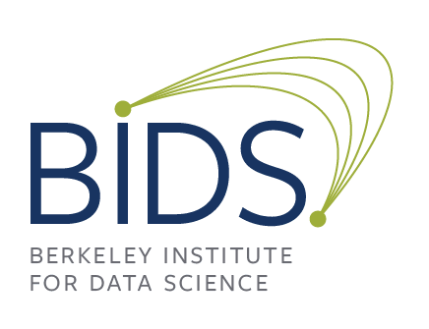
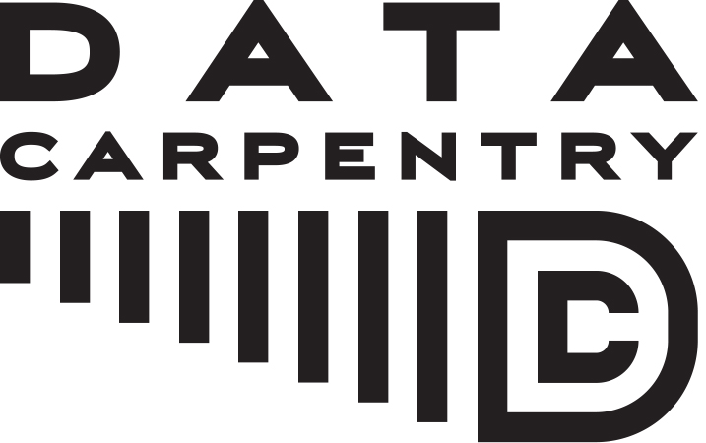
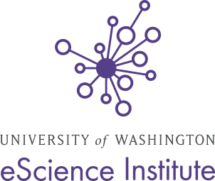
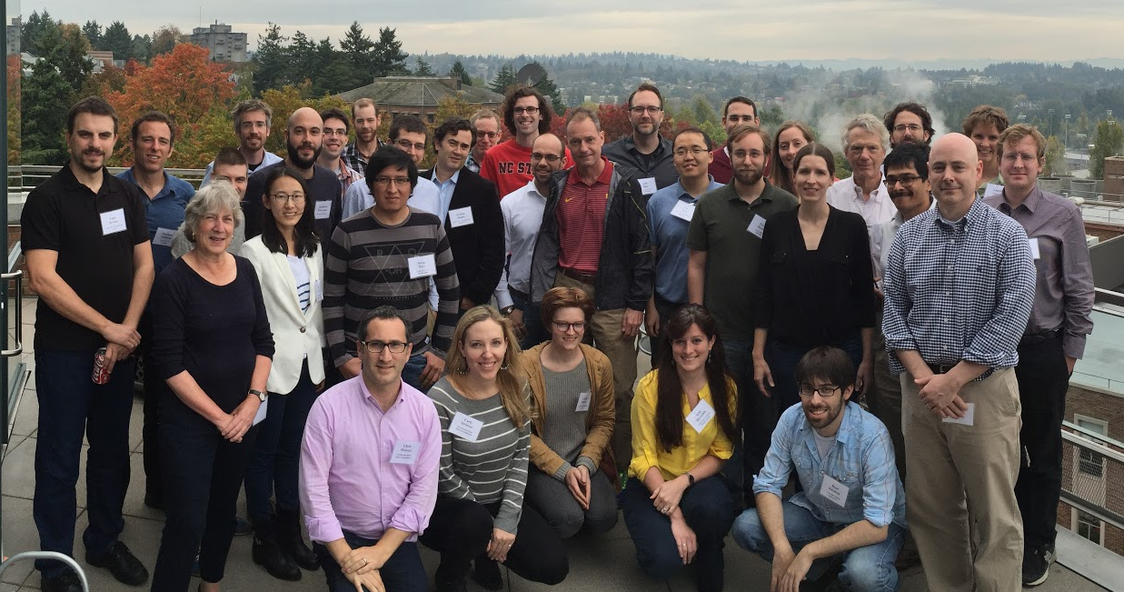
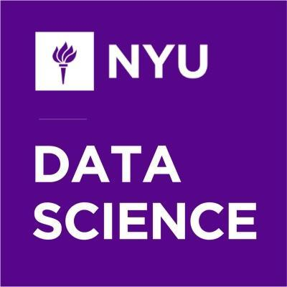
What we do / Where we spend money
$60M
2012 → 2018

Slide 6
We focus on these thematic areas
Methods
Space
Tooling
Open Science
Themes
www.msdse.org
Careers
Training
Data Science Studies

