Slide 1


Transforming Analytical Learning in the Era of Big Data An Undergraduate Summer Institute in Biostatistics University of Michigan, Ann Arbor http://bigdatasummerinstitute.com Bhramar Mukherjee bhramar@umich.edu
Notes:
It is an honor and privilege to visit this campus as the Oliver lecturer and class of 1960 speaker and talk to the very talented student body of Williams College. Rich heritage in teaching and training of Statistics undergraduates. I always have believed in my academic career this is where the “action is”. Congratulations on being named as an exemplary program by the AMS.
The talk I am about to present is going to be informal in nature, a prelude to stimulate a conversation in the room. Many of you have thought and are thinking about these issues longer, harder and in smarter ways than me, so hopefully at the end of the conversation we will all leave the room more enlightened and learn from each other.

Slide 2
Standing here at the present
Fear not for the future, weep not for the past

Slide 3
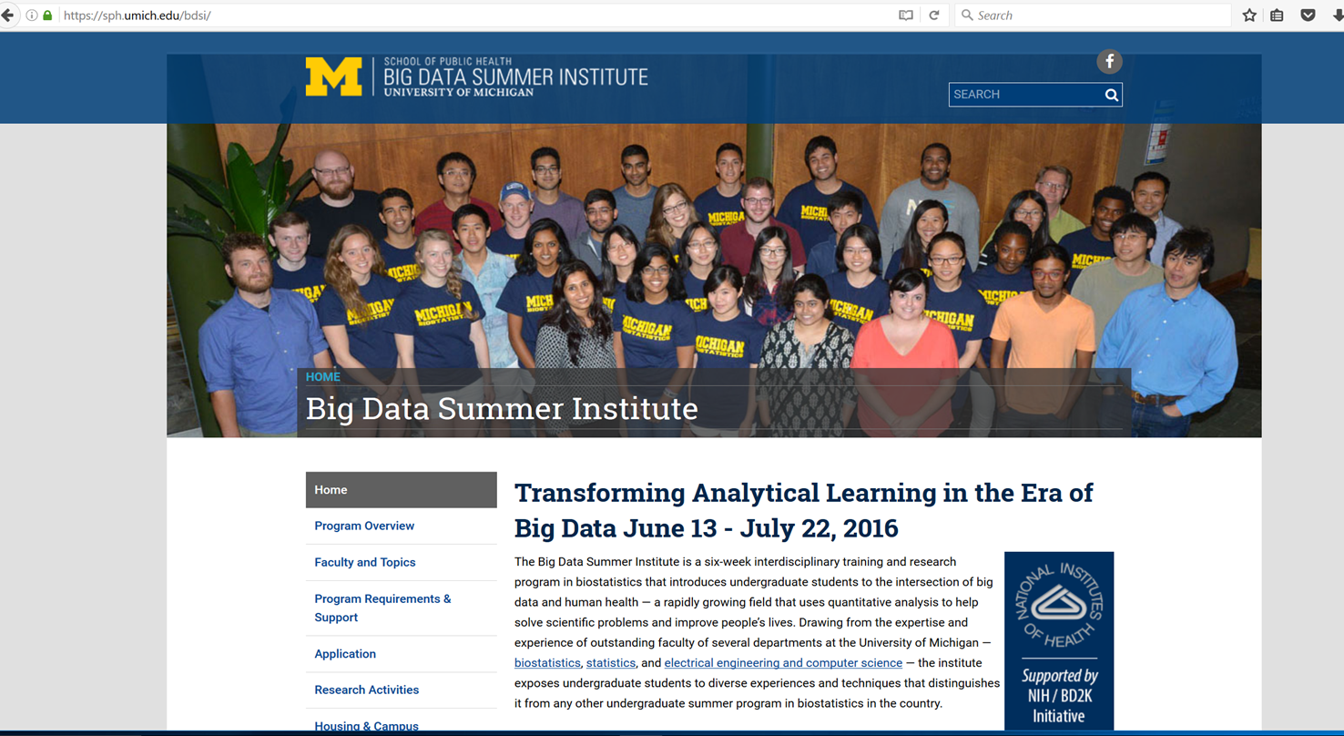
Big Data Summer Institute

Slide 4
History of the Program
Pilot offering : June 1-26, 2015 (Institutional Fundraising)
-153 Applications: 29 Admitted (Acceptance Rate: 19%)
-Female 14 (48%) Male 15 (52%)
-Freshman 4 (14%) Sophomore 6 (21%) Junior 16 (55%) Senior 3 (13%)
-Average GPA: 3.81
-URM Students: 5 (Howard University, Morehouse College, Eastern Michigan University, American University, U Mass)

Slide 5
NIH Funding R25 EB022363
BD2K Courses and Skills grant awarded in 2016
Supports 20 slots with 6 week housing and subsistence package and a modest stipend
Administrative supplement supported 16 additional slots with non-traditional background
-June 13-July 22, 2016
-230 applicants: 44 admitted (Acceptance Rate: 19%)
-Female 24 (55%) Male 20 (45%)
-Freshman 3 (7%) Sophomore 13 (30%) Junior 26 (59%) Senior 2 (4%)
-Average GPA: 3.84
-URM Students 10 (UM, USC, UCLA, Kennesaw State, UF, UW, UMD, Cornell)

Slide 6
Program Structure
9am-12noon: Morning Lectures (M, T, Th)
Data Acquisition, Database Management, R and Python Bootcamp
Reproducibility and Documentation: Rstudio: Mark-down,packrat, github
Data Structure, Data Security, Privacy and Linkage
Data Visualization
Study Design, Probability and Statistical Inference
Bias and Confounding, Missing Data, Causal Inference
Cloud, Parallel and Distributed Computing, Optimization
Bayes vs Frequentist
Sampling Methods: Markov Chain, Monte Carlo
Matrix Computation, Linear Algebra
Machine Learning, Graphical Models, Social Network Analysis,
Infectious disease modeling
Taught by faculty
in Biostatistics, Statistics, EE, CS

Slide 7
Program Structure
Hands on research experience: 2pm-5 pm (M-F)
-Divided into small groups in each project area
-Led by faculty mentors and co-mentored by graduate students
-2015: Genomics, Electronic Health Records, Brain Imaging
-2016: Genomics, Electronic Health Records, Machine Learning (Statistics), Data Mining (Computer Science)
-2017: Genomics, Imaging, EHR, Machine Learning
-Oral presentation and poster session

Slide 8
Some Sample Projects
Clustering Gene Expression Profiles in Single Cells using EM algorithm
Genome-wide association study of alcohol consumption and stress
Preservation of semantic parallels through word2vec
Streamlined approach to compare two genomic catalogs
Data curation and wrangling
From interviews to blood tests: using machine learning tools to predict chronic kidney disease
Assessing dialysis facilities: using a novel empirical null approach
Twitter sentiment analysis and stock market behavior
Temporal and spatial visualization of world’s hidden wealth: The Panama leak

Slide 9
Program Structure
Professional Development (Wednesday and Friday Morning)
-Scientific writing
-Presentation skills
-Working in a team
-Graduate school preparation
-One day professional development workshop
-Concluding symposium and dinner, External guest speaker
-Journey lectures

Slide 10
Program Structure
Networking, Team-Building, Social Events
-Connected through Facebook after admission
-Most participants staying in one residence hall
-Welcome dinner
-Canoe Trip, Detroit Institute of Arts, Tigers Game
-Trip to UM Museum of Arts, Natural History Museum, Big House
-BBQ in faculty home
-Concluding symposium and dinner

Slide 11
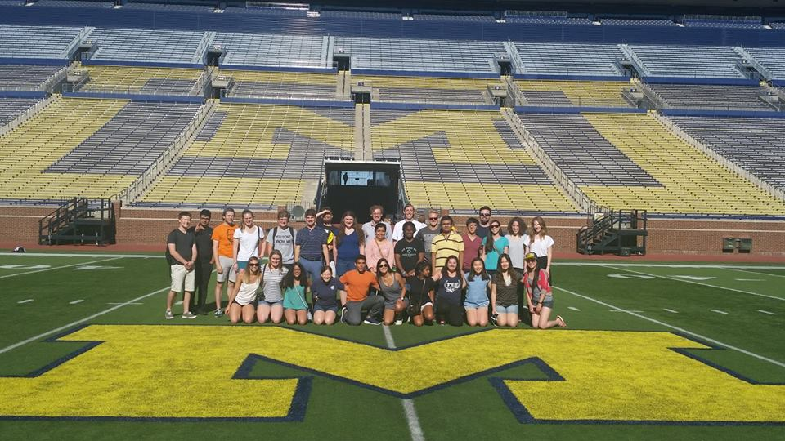
Big Data Students in the Big House

Slide 12
What do the students like about the program?
Interdisciplinary training and teaching by faculty in statistics, biostatistics, computer science, electrical engineering
Crashing servers with large scale computations
Open problems: peer learning, didactic learning, group learning, solving problems, computing in class
Journey lectures: twists and turns along the road, trepidations, confusions, taking a road less traveled by. To err is human!
Using quantitative skills to solve problems related to human health.

Slide 13
Student Comments
“As an undergraduate, you are trying to figure out where to go and how to get there. One of my favorite parts of the program were the journey lectures where you get to see how faculty started out and how they got to where they are today.”
“Working with students and professors from many backgrounds was very valuable to me. The institute exposed me to ideas from many fields that I may not have seen otherwise.”
“The institute provided us with a place to share our thoughts. I consider this to be the most valuable gift you can give someone while supporting their education, and I am so grateful.”

Slide 14
Evaluation and Placement Data
Pre and Post: Knowledge Inventory and Career Goals
Daily evaluation and adaptive modifications to program
Overall institute and symposium evaluation
Worked closely with Center for Research Learning and Teaching: Focused Discussion Groups
Follow up survey at one year mark (use Facebook group)
-2015: 12/16 juniors went to graduate school, 26/29 said they want to pursue/are attending graduate school
-2015: 90% students said BDSI was highly influential in future course choice, career planning, interest in big data.

Slide 15
Discovering Diversity and Embracing it
Competition versus Collaboration
Affirmation that confusion and the feeling of being lost is commonly prevalent in the academic population!
Safe space and brave space: We agree to disagree
Remedial courses, tutoring, not everyone knows everything
Designated mentor and resources for non-traditional cohort

Slide 16
Enhancing Diversity: Crossing Boundaries
Intellectual Diversity: Statistics, Computer Science, Mathematics, Biostatistics, Epidemiology, Nephrology, Oncology, Psychology, Philosophy, Literature
Maintaining highest academic standards: provide resources
-Enable, Equip, Empower to attain the Expectations
Diversity in Race, Gender, Culture, Health and Socioeconomic Status
-Women in data science dinner, Accommodation of special religious and health needs
-Involving diverse faculty: women faculty, international faculty, faculty of color
-Students commented on the enriching experience of being around marginalized, unnoticed groups of people in quantitative fields
-

Slide 17
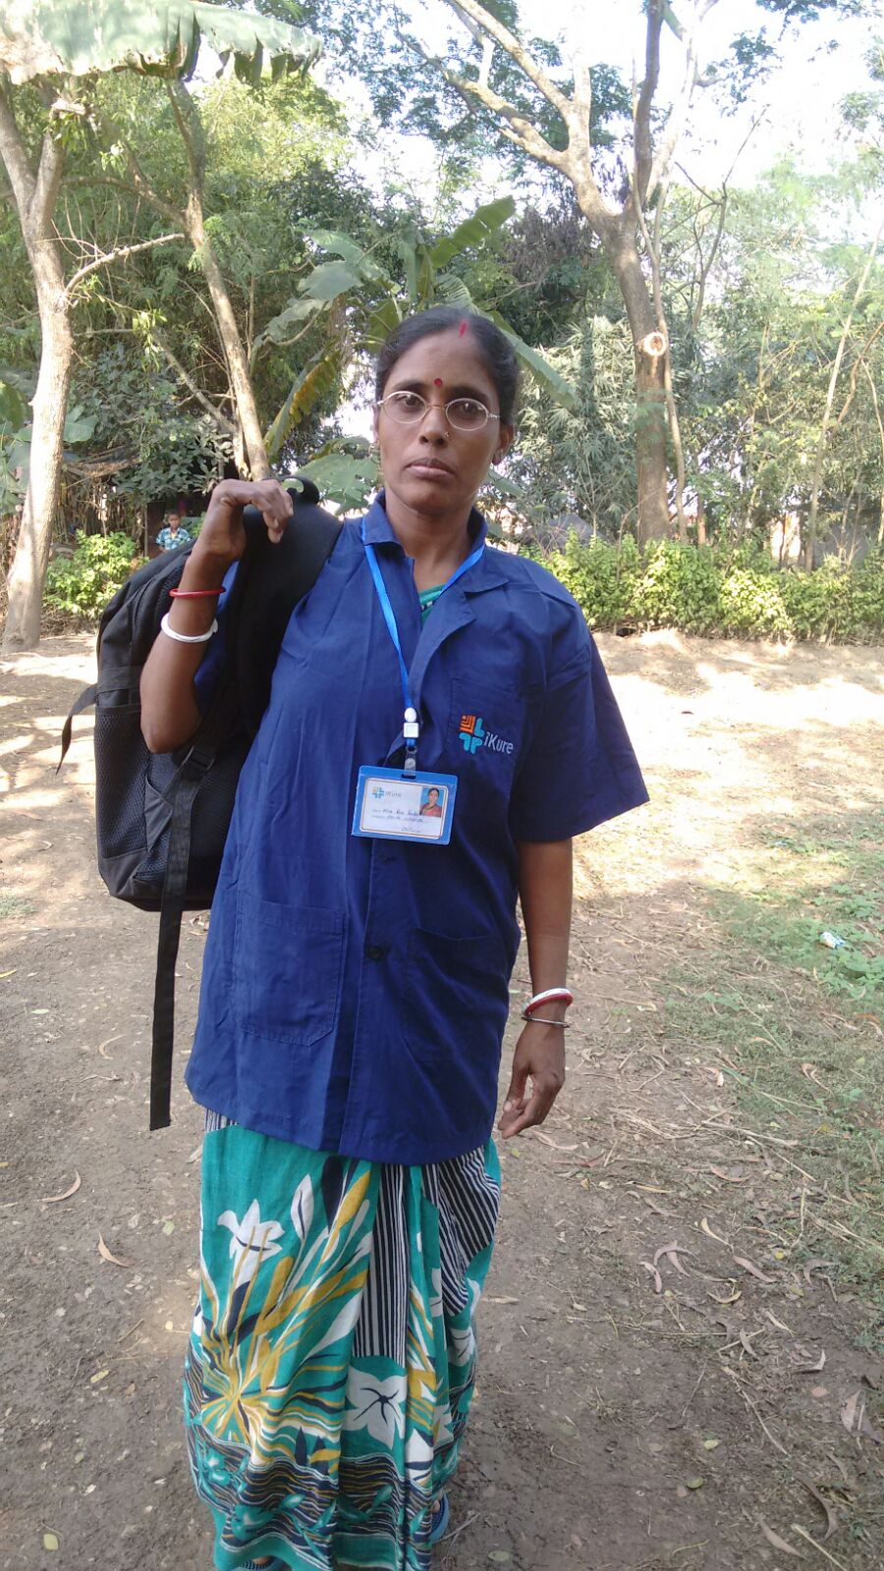
Data Science Stories
MEDIC BAG
BP MACHINE
WEIGHING MACHINE
MEASURING TAPE
URINE KIT
TABLET/SMART PHONE
NUTRIMIX & TOYS
STATIONERY- (NOTEBOOK, PEN)
APRON

Slide 18
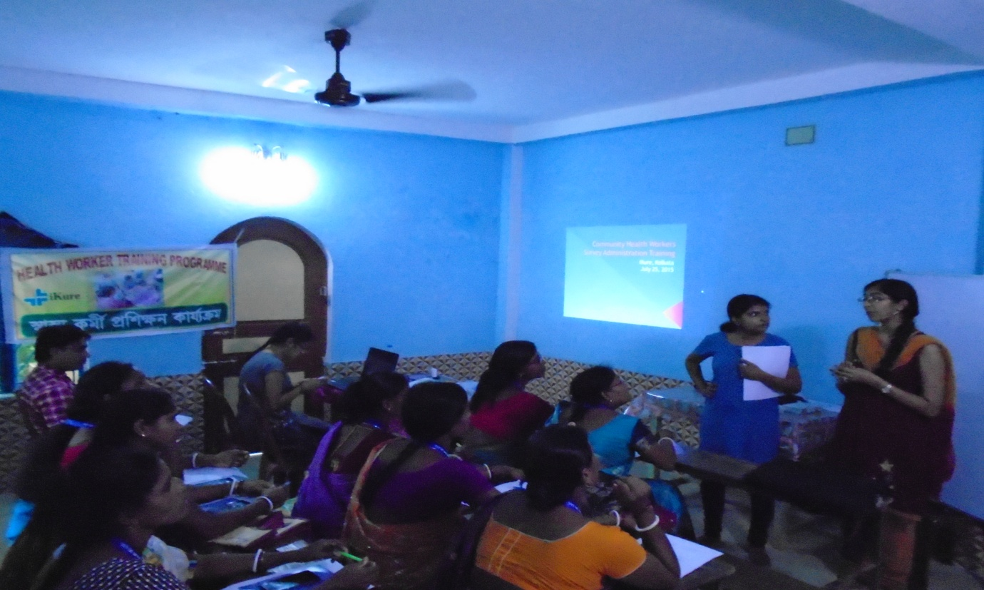
Training Community Health Workers
A CHW TRAINING SESSION

Slide 19
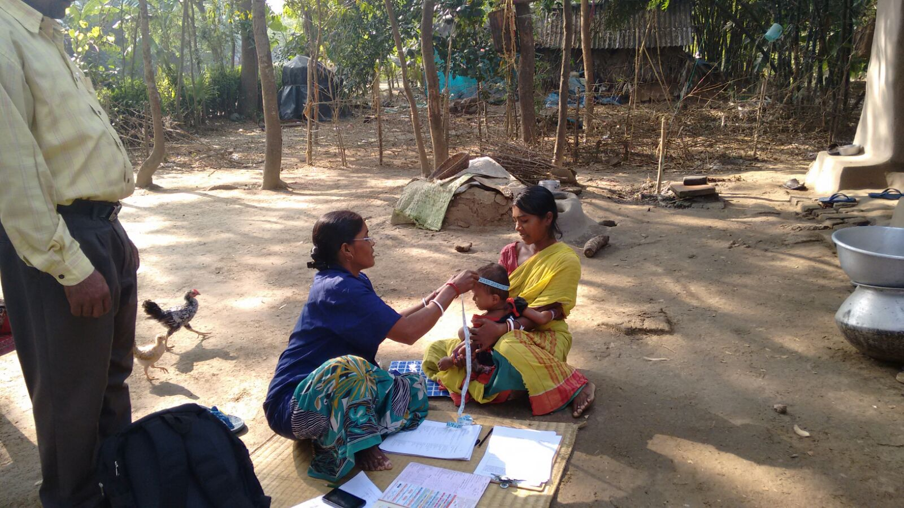
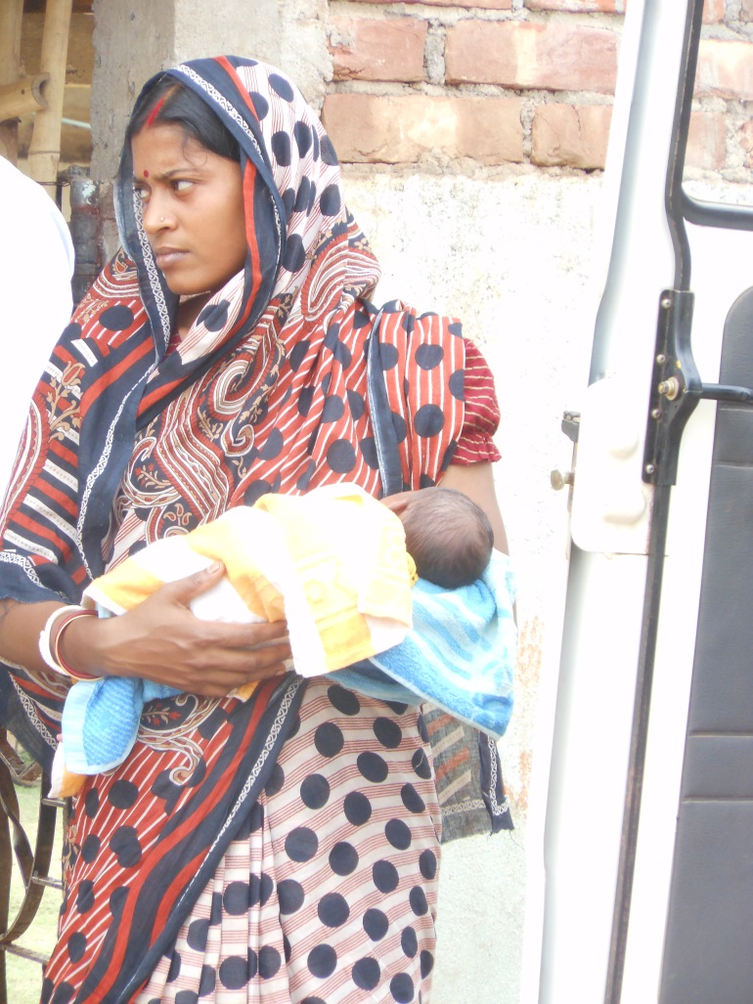
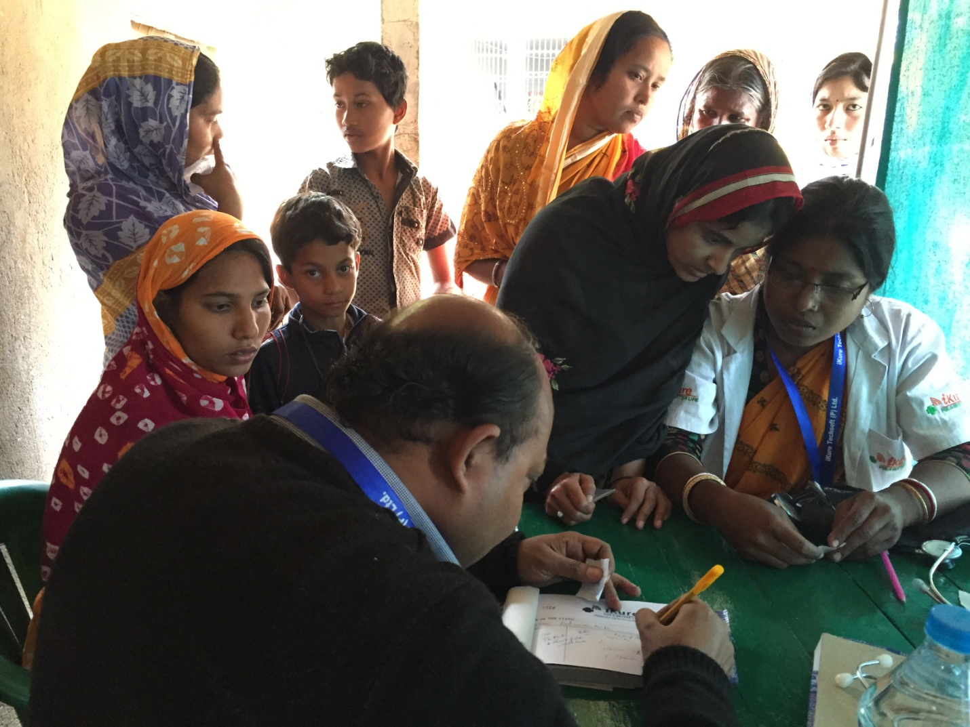
Data Collection in the Field

Slide 20
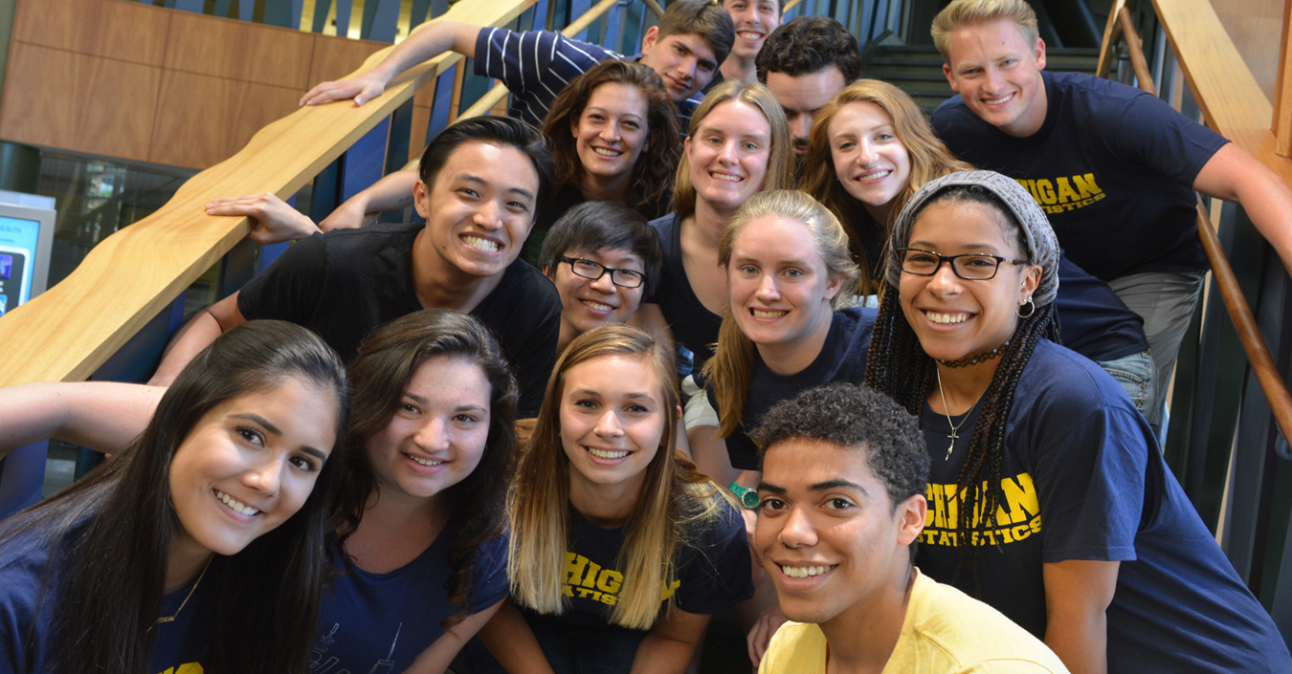
Their smiles are priceless!
Brand ambassadors to the next generation!

