Slide 1
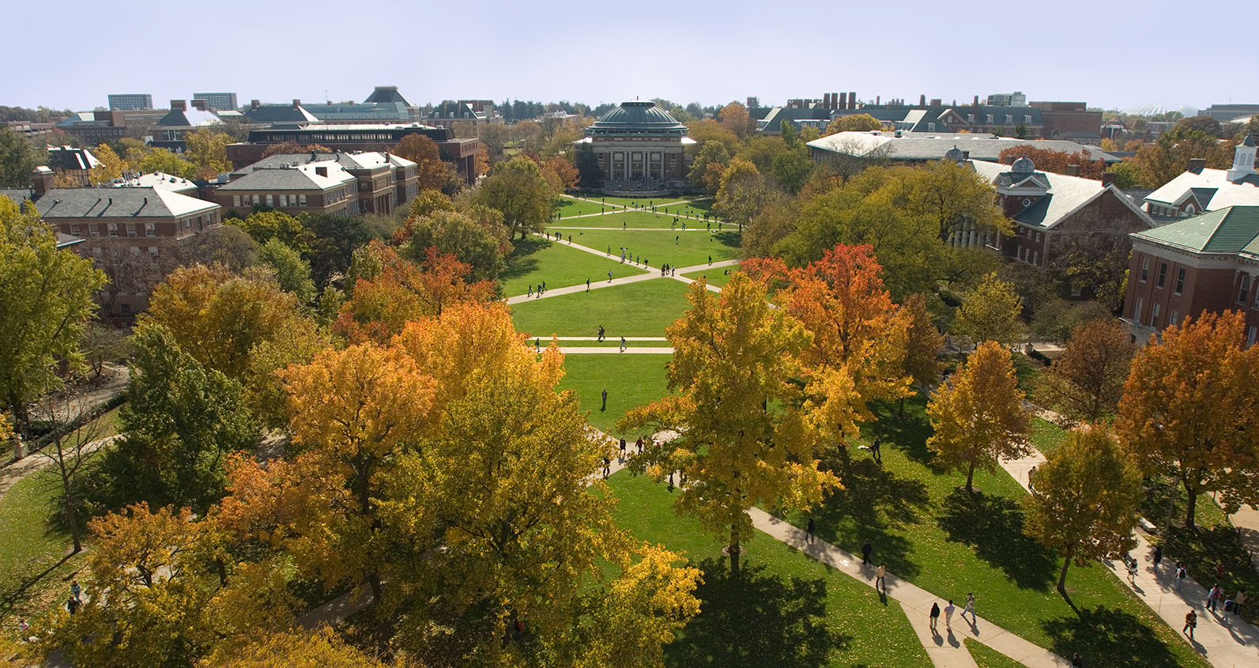
Data Science @ Illinois:
Current Undergrad Programs (and Plans)
Rob A. Rutenbar
Dept of Computer Science
University of Illinois

Slide 2
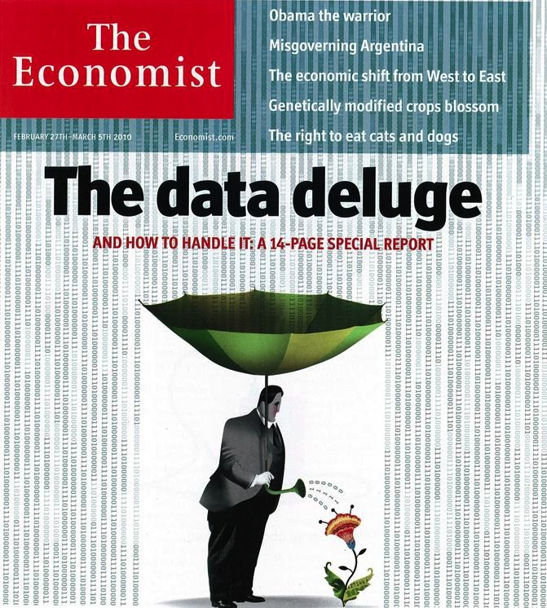
Two Broad Options for Data Science Edu
FROM the Science… TO Data
FROM [Science AND Data]
STATS
COMPUTE
STATS
COMPUTE
We have both sorts
of undergrad BS degrees
in progress at Illinois…

Slide 3
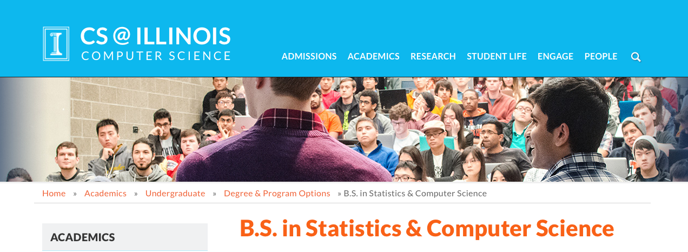
FROM the Science TO the Data…
Illinois example: BS in Statistics & CS
Statistics core (prob/stat, math foundations, etc)
Add in: CS core (programming+HW+theory+algs)
Data =“electives” chosen by students (many from CS)

Slide 4
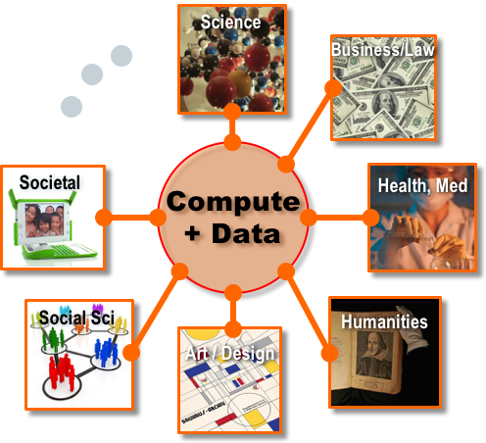
From [Science AND Data]
Idea: Connect with diverse disciplines from the start

Slide 5
Step in Direction: Illinois CS+X Degrees
They are not: Minor in CS/X. Dual degree.
They are: CS(1/2) + X(1/2)= Bachelors Degree in X
+
=
+ “X”
CS
Computer
Science
Discipline
“X”

Slide 6

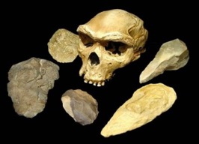

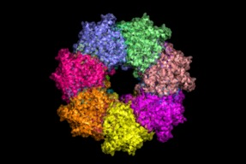
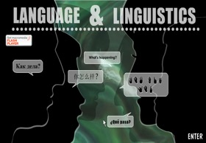
Illinois CS+X: Portfolio
CS&Math
CS&Statistics
Legacy degrees, decades old
CS+Anthropology
CS+Astronomy
Design started in 2010,
approved 2013, admits 2014
CS+Chemistry
CS+Linguistics
Fresh
admit
2016
Soph
admit
2015
Junior
admit
2014
Senior
Next
Year

Slide 7
Illinois CS+X: Traction
Anthropology
Astronomy
Linguistics
Statistics
+X
+X
+X
+X
~11%
Of students
~25%
Of students
~28%
Of students
~36%
Of students

Slide 8
Illinois CS+X: Can We Evolve to DS+X?
Huge interest to be “next X” – but clear some X’s better served by ”more data, less compute” →DS+X
11
More
X’s

Slide 9
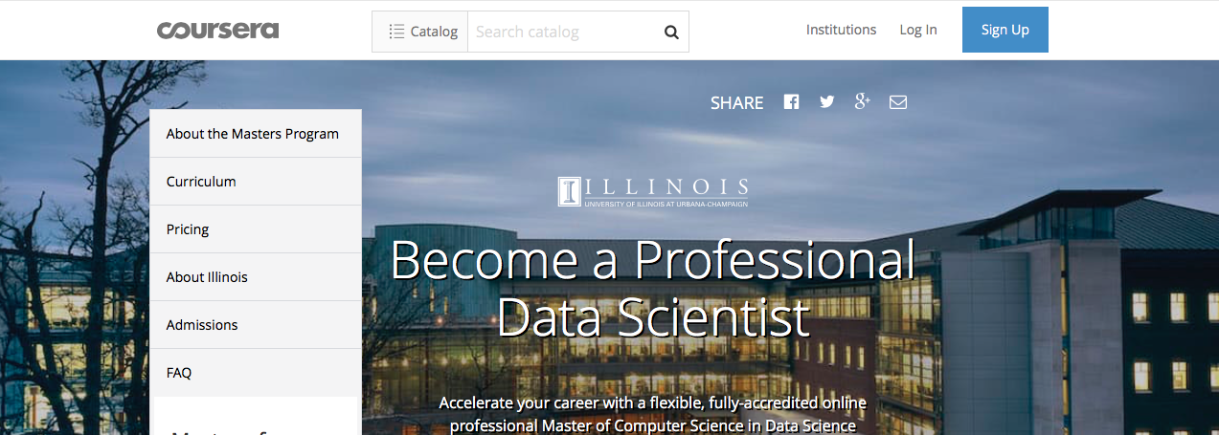
Also: Hoping to Learn from Grad Side
Illinois MCS-DS: 1st MOOC Data Sci MS, launched Fa’16
COMPUTE
STATS
I-SCHOOL
Platform (cloud)
Analytics
ML
Data life cycle
Curation
Stewardship
Prob/Stat
Adv methods
Some of this should migrate
down into CS/DS+X BS degrees

