Slide 1

Price Indexes for Clinical Trial Research: A Feasibility Study
SciSIP PI Conference, September 2012
Ernst R. Berndt Iain M. Cockburn
MIT, Boston University, and
National Bureau of Economic Research

Slide 2
What?
Analysis of trends in costs of doing clinical trials
Focus on “investigator grants” – payments to clinicians by trial sponsors
Use “hedonic” price index methods to estimate the rate of inflation in commercial clinical trials during 1989-2009, controlling for trial characteristics
Look at differences in growth rate of costs across
Therapeutic areas
Phases of clinical development
Sites in US versus abroad
Time and resource burden of protocols

Slide 3
Why? “P vs. Q”
Hard to understand trends in research productivity (e.g. new drugs/$) without controlling properly for inflation in costs of doing research

Slide 4
Things we don’t know
What’s driving up the cost of clinical development?
Increases in real effort/decreasing marginal returns: more research resources needed to solve more difficult problems?
E.g. longer duration trials, harder-to-measure endpoints, more difficult diseases, greater administrative burden
Increases in “unit costs” i.e. the prices of resources used in research?
Salaries, facilities, instrumentation, …
Public vs. private sector: NIH BRDPI index focuses on NIH-funded investigation

Slide 5
Data
225,000 records on investigator grants from MediData Solutions Inc. database
Rich dataset derived from contracts between sponsors and investigators
NB investigator grants are only 50% of total trial costs
Coded for date, location, number of patients, therapeutic class, phase of development, and “Site Work Effort”

Slide 6
Key descriptive statistics
Nominal mean total grant cost per patient grew 4X over 20 years 1989-2009
Compare to 2X growth in NIH BRDPI
“Site Work Effort” grew 3X
Sample composition:
10% Phase I+II / 70% Phase III swings to 30% Phase I+II / 50% Phase III
Over time less cardiovascular, more CNS and oncology
About 60% of sites are in US

Slide 7
Methodology
As is done routinely for e.g. computers, estimate coefficients on year dummies Z_{t} in a regression of log(P_{it}) = X_{i}β+γZ_{t}+ε_{it} where X_{i} are trial and site characteristics (Phase, SWE, number of patients at site etc.)
Back out “constant quality” price index from γ’s

Slide 8
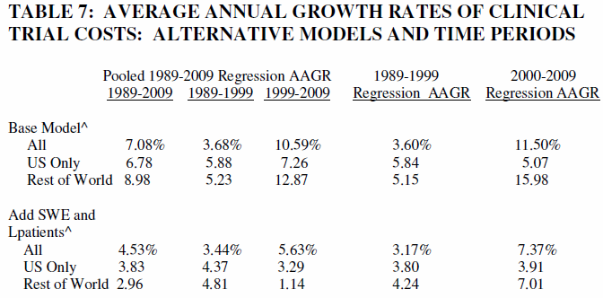
Some Preliminary Results

Slide 9
Key findings from work to date
Large impact of SWE: 10% increase in SWE associated with 5% increase in costs
Some evidence for economies of scale at the site level
Controlling for the changing characteristics of trials and sites has a dramatic impact on measured inflation
AAGR of cost-per-patient (8% p.a.) falls by 2/3 to 1/3 depending on subsetting of the data
Constant-quality index rises at roughly the same rate as NIH BRPDI
Inflation rate highest in late stage, ex-US trials with small numbers of patients per site
Significantly higher in 2000-2009 vs 1989-1999

Slide 10
Conclusions
A “constant quality” price index for private sector clinical research can be constructed from this type of data
Increases in overall expenditure reflect both more trials being done, and substantial inflation in average unit costs in this activity
Inflation in unit costs driven roughly 50% by increases in “quality” or “effort” and 50% by increases in prices of inputs e.g. wages, materials, instruments etc.
Substantial effect of increases in SWE highlights the cost impact of using more complex and more difficult protocols

