Slide 1
Killing the Golden Goose: Accelerated Generic Entry and the Incentives for High-Risk Pharmaceutical R&D
Lee Branstetter
Carnegie Mellon University & NBER
Matthew J. Higgins
Georgia Institute of Technology & NBER
SciSIP Principal Investigators’ Conference
National Academy of Sciences
Washington, DC

Slide 2
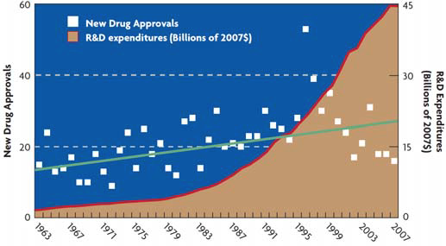
Pharmaceutical Productivity
Andrew Witty (GSK) has publicly acknowledged
movement away from “white pill, Western markets
in large part due to generic competition.
Source: Morgan Stanley (2010)

Slide 3
Research Agenda
We pose three broad questions:
Is the acceleration of (early) generic entry welfare enhancing?
Have the increases in generic entry (and penetration) lowered the incentives for pharmaceutical innovation?
Ultimately, are we trading off access (more consumer surplus) to cheaper drugs today, for less innovation (less consumer surplus) tomorrow?

Slide 4
Regulatory Background Created by the Hatch-Waxman act 1984
Patent protection
A
Patent granted
FDA approval
Patent expires
Data exclusivity
Market exclusivity
A
5 years
B
FDA approval
Generics can enter the market during two periods:
A: End of market exclusivity (“Para-III” certification)
B: During market exclusivity (“Para-IV” certification)
Only applicable to small molecule (chemical-based) drugs, large molecules (biologics-based) drugs get 12 years of data exclusivity. But there is currently no regulatory path for bio-similars to enter the U.S. market (in contrast to Europe, Omnitrope (HGH) in 2006)

Slide 5
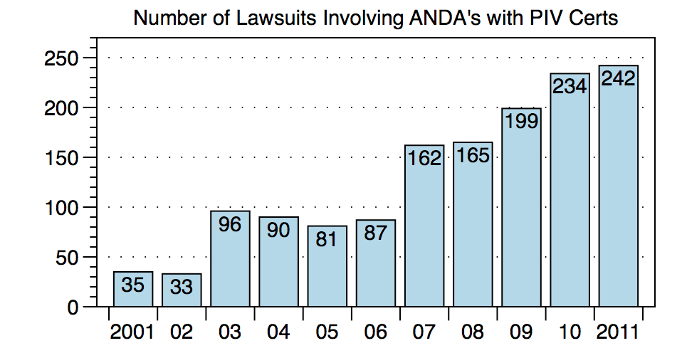
Regulatory Background Created by the Hatch-Waxman act 1984
Source: Paragraphiv.com

Slide 6
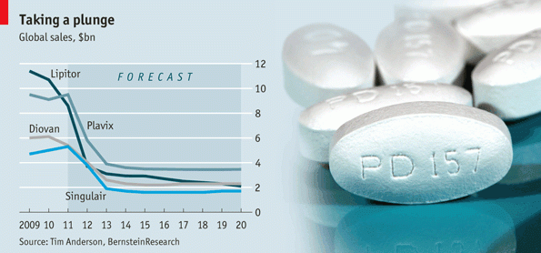
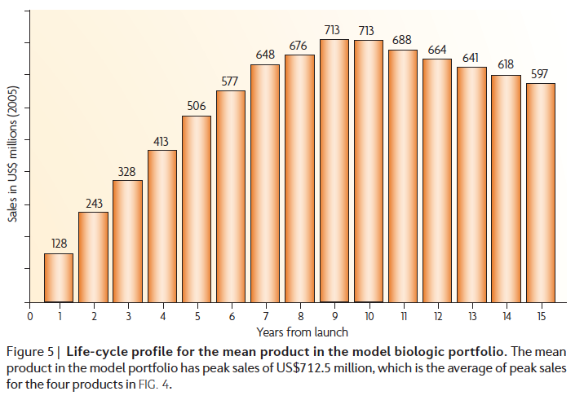
Revenue Deterioration
Source: Grabowski (2008)

Slide 7
Empirical Results: Regulation and Welfare Welfare implications with counterfactual analysis
Millions
Cumulated consumer gains of $92.9 billion
Cumulated producer loss of $14.2 billion.
Total short-run, static welfare gain of $78 billion.

Slide 8
Empirical Strategy (1) early stage innovation
Model flow of early stage innovation I_{ijt} in pre-clinical and Phase 1 for each firm i in therapeutic-market j in year t .
Sample limited to firms that had both approved products and early-stage innovations (in any ATC).
Fixed effects: firm α_{i}, therapeutic market α_{j}, year α_{t}, and interaction between therapeutic market and year, (α_{j}*α_{t}).
Models: fixed effect Poisson and negative binomial estimators (Hausman et al., 1984; Woolridge, 1999)

Slide 9
Empirical strategy (2) Rotation from Chemical-Based to Biologics-based products
Origin of Material (Pharmaprojects) used to separate I_{ijt} into either a biologic-based (BI_{ijt}) or chemical-based (CI_{ijt}) early stage innovation flow measure for each firm i in product market j in year t.
RHS is similarly separated out into biologic-based and chemicals-based D_{ijt-1} and SA_{ijt .} (Current work is splitting out P_{ijt-1}.)
Current work also considering DV as a ratio: CI/(CI + BI)
Intuition: A negative coefficient on β₁ or β₂ implies that as GP_{ijt} or G_{ijt} increase, the difference (CI_{ijt} – BI_{ijt}) is decreasing. This could result from either BI_{ijt} increasing, or CI_{ijt} decreasing or some combination of both.

Slide 10
Baseline Result Table 4
VARIABLES | Model 3 | Model 4 | Model 5
 | NBREG Fixed Effects DV: I_{ijt}
 | Coeff Std. Error | Coeff Std. Error | Coeff Std. Error
GP_{ijt} : Generic market penetration | -1.932*** (0.030) | -1.691*** (0.031) | -1.678*** (0.031)
G_{ijt} : Paragraph IV challenges | 0.037 (0.075) | 0.024 (0.070) | 0.048 (0.070)
Firm Fixed Effects | Y | Y | Y
Year Fixed Effects | Y | Y | Y
Therapeutic Fixed Effects | N | Y | Y
Year*Therapeutic Fixed Effects | N | N | Y
N | 31,970 | 31,970 | 31,970
Marginal effects:
10% increase in GP,
7.3% decrease in I

Slide 11
Results for the top therapeutic markets Table 5
VARIABLES | NBREG Fixed Effects | NBREG Fixed Effects
 | Model 3 | Model 4
 | I_{ijt} | I_{ijt}
 | Coeff Std. Error | Coeff Std. Error
GP_{ijt} : Generic market penetration | -0.794*** (0.082) | -0.333*** (0.082)
G_{ijt} : Paragraph IV challenges | -0.139 (0.117) | -0.229** (0.102)
Firm Fixed Effects | Y | Y
Year Fixed Effects | Y | Y
Therapeutic Market Fixed Effects | N | Y
N | 3,919 | 3,919
Marginal Effects
10% increase in GP,
2.2% decrease in I
10% increase in G,
3.9% decrease in I

Slide 12
Case Study: Anti-Epileptics Table 6
VARIABLES | NBREG | NBREG
 | Model 3 | Model 4
 | I_{ijt} | I_{ijt}
 | Coeff Std. Error | Coeff Std. Error
GP_{ijt} : Generic market penetration | -1.630*** (0.167) | 0.156 (0.330)
G_{ijt} : Paragraph IV challenges | 0.442 (0.587) | -0.023 (0.366)
Year Fixed Effects | Y | Y
Firm Fixed Effects | N | Y
N | 620 | 620

Slide 13
Rotation in Innovation? Table 7
VARIABLES | Model 2 | Model 3
 | dum(CI_{ijt}-BI_{ijt}) | dum(CI_{ijt}-BI_{ijt})
 | Coeff Std. Error | Coeff Std. Error
GP_{ijt} : Generic market penetration | -2.062*** (0.044) | -2.070*** (0.045)
G_{ijt} : Paragraph IV challenges | -0.082 (0.146) | -0.063 (0.147)
Firm Fixed Effects | Y | Y
Year Fixed Effects | Y | Y
Therapeutic Fixed Effects | Y | Y
Year*Therapeutic Fixed Effects | N | Y
N | 31,970 | 31,970
Ordered Logit
DV = 1, 2 or 3 if
the dum(CI – BI) is
neg, zero, pos.

Slide 14
Implications (& More Questions)
Can incentives/science policy be constructed to in a manner to ‘pull’ the industry towards specific therapeutics?
Drugs for shareholders vs. drugs for society
Consistent with what the CMU survey suggests, we find a positive relationship between basic science research (or technological opportunities) and early-stage innovation.
Can basic science research funding be used as a mechanism to “push” industry towards specific therapeutics?

Slide 15
Thank you. matt.higgins@scheller.gatech.edu

Slide 16
,
Welfare for Whom?
An illustrative pass-through calculation
Brand | |((Pb2-Pb1)/(Pb1)/(Cb2-Cb1)/(Cb1))| (Branded consumer) | |((Pg2-Pb1)/(Pb1)/(Cg2-Cb1)/(Cb1))| (Consumer switched to generics)
ALTACE | 0.55 | 1.16
COREG | 0.31 | 1.33
NORVASC | 0.13 | 1.27
Source: IMS NDTI™ and IMS NPA™, 2005-2008
Some intuition based on a pass-through calculation on copay data
(% change in price) / (% change in copay)
<1 for the patient buying branded drug after entry
>1 for the patient buying generic drug after entry
Suggestive that welfare may be being appropriated by the consumer’s agent (the insurer) or other upstream actor (retailer) – needs more careful analysis.

Slide 17
Baseline Result Table 4
VARIABLES | Model 1 | Model 2 | Model 3 | Model 4 | Model 5
 | NBREG Fixed Effects, DV: I_{ijt}
 | Coeff Std. Error | Coeff Std. Error | Coeff Std. Error | Coeff Std. Error | Coeff Std. Error
GP_{ijt} : Generic market penetration |  |  | -1.932*** (0.030) | -1.691*** (0.031) | -1.678*** (0.031)
G_{ijt} : Paragraph IV challenges |  |  | 0.037 (0.075) | 0.024 (0.070) | 0.048 (0.070)
O_{jt-1} : Technological opportunities |  | 0.003** (0.002) | 0.009*** (0.001) | 0.029*** (0.002) | 0.029*** (0.002)
Z_{ijt-1} : Technological challenges |  | 0.448*** (0.013) | 0.469*** (0.014) | 0.398*** (0.013) | 0.399*** (0.013)
D_{ijt-1} : Firm innovative cap. I | 0.103*** (0.004) | 0.106*** (0.004) | 0.090*** (0.004) | 0.094*** (0.004) | 0.098*** (0.004)
P_{ijt-1} : Firm innovative cap. II | 0.142*** (0.016) | 0.036** (0.015) | 0.074*** (0.016) | 0.028* (0.015) | 0.037*** (0.015)
SA_{ijt} : Downstream co-specialized assets | -0.010 (0.006) | -0.008 (0.006) | -0.005 (0.004) | -0.001 (0.002) | -0.001 (0.002)
S_{it} : Firm size | -0.043*** (0.003) | -0.040*** (0.003) | -0.043*** (0.003) | -0.028*** (0.003) | -0.027*** (0.003)
Firm Fixed Effects | Y | Y | Y | Y | Y
Year Fixed Effects | Y | Y | Y | Y | Y
Therapeutic Fixed Effects | Y | Y | N | Y | Y
Year*Therapeutic Fixed Effects | N | N | N | N | Y

Slide 18
Results for the top therapeutic markets Table 5
VARIABLES | NBREG Fixed Effects | NBREG Fixed Effects | NBREG Fixed Effects | NBREG Fixed Effects
 | Model 1 | Model 2 | Model 3 | Model 4
 | I_{ijt} | I_{ijt} | I_{ijt} | I_{ijt}
 | Coeff Std. Error | Coeff Std. Error | Coeff Std. Error | Coeff Std. Error
GP_{ijt} : Generic market penetration |  |  | -0.794*** (0.082) | -0.333*** (0.082)
G_{ijt} : Paragraph IV challenges |  |  | -0.139 (0.117) | -0.229** (0.102)
O_{jt-1} : Technological opportunities |  | 0.874*** (0.176) | 0.239*** (0.017) | 0.840*** (0.179)
Z_{ijt-1} : Technological challenges |  | 0.220*** (0.032) | 0.256*** (0.039) | 0.221*** (0.033)
D_{ijt-1} : Firm innovative cap. I | 0.143*** (0.015) | 0.149*** (0.015) | 0.168*** (0.016) | 0.135*** (0.016)
P_{ijt-1} : Firm innovative cap. II | 0.093* (0.051) | 0.111** (0.050) | 0.096 (0.063) | 0.097* (0.051)
SA_{ijt} : Downstream co-specialized assets | -0.006 (0.030) | -0.005 (0.028) | 0.004 (0.018) | -0.000 (0.023)
S_{it} : Firm size | -0.004 (0.011) | 0.008 (0.011) | -0.005 (0.010) | 0.016 (0.011)
Firm Fixed Effects | Y | Y | Y | Y
Year Fixed Effects | Y | Y | Y | Y
Therapeutic Market Fixed Effects | Y | Y | N | Y

Slide 19
Case Study: Anti-Epileptics Table 6
VARIABLES | NBREG | NBREG | NBREG | NBREG
 | Model 1 | Model 2 | Model 3 | Model 4
 | I_{ijt} | I_{ijt} | I_{ijt} | I_{ijt}
 | Coeff Std. Error | Coeff Std. Error | Coeff Std. Error | Coeff Std. Error
GP_{ijt} : Generic market penetration |  |  | -1.630*** (0.167) | 0.156 (0.330)
G_{ijt} : Paragraph IV challenges |  |  | 0.442 (0.587) | -0.023 (0.366)
O_{jt-1} : Technological opportunities |  | -0.238 (0.269) | -0.230 (0.250) | -0.188 (0.171)
Z_{ijt-1} : Technological challenges |  | 0.423*** (0.135) | 0.290** (0.117) | 0.141** (0.062)
D_{ijt-1} : Firm innovative cap. I | 0.137*** (0.034) | 0.445*** (0.045) | 0.288*** (0.039) | 0.116*** (0.037)
P_{ijt-1} : Firm innovative cap. II | -0.036 (0.100) | 0.464*** (0.156) | 0.561*** (0.144) | -0.084 (0.104)
SA_{ijt} : Downstream co-specialized assets | -0.335 (0.533) | 0.214 (0.714) | 0.922 (0.652) | -0.398 (0.623)
S_{it} : Firm size | 0.021 (0.016) | 0.062*** (0.014) | 0.115*** (0.015) | 0.026 (0.020)
Year Fixed Effects | Y | Y | Y | Y
Firm Fixed Effects | Y | N | N | Y

Slide 20
Rotation in Innovation? Table 7
VARIABLES | Model 1 | Model 2 | Model 3
 | dum(CI_{ijt}-BI_{ijt}) | dum(CI_{ijt}-BI_{ijt}) | dum(CI_{ijt}-BI_{ijt})
 | Coeff Std. Error | Coeff Std. Error | Coeff Std. Error
GP_{ijt} : Generic market penetration |  | -2.062*** (0.044) | -2.070*** (0.045)
G_{ijt} : Paragraph IV challenges |  | -0.082 (0.146) | -0.063 (0.147)
O_{jt-1} : Technological opportunities | 0.006** (0.002) | 0.030*** (0.002) | 0.030*** (0.002)
Z_{ijt-1} : Technological challenges | 3.111*** (0.169) | 3.065*** (0.188) | 3.095*** (0.191)
(CD_{ijt-1} - BD_{ijt-1}): difference in innovative cap. I | 1.161*** (0.058) | 1.164*** (0.058) | 1.162*** (0.058)
P_{ijt-1}: firm innovative cap. II | -0.754*** (0.072) | -0.974*** (0.073) | -0.963*** (0.073)
(CSA_{ijt} – BSA_{ijt} ): downstream co-specialized assets | -0.001*** (0.000) | -0.001*** (0.000) | -0.001*** (0.000)
S_{it} : Firm size | 0.018* (0.010) | 0.018* (0.010) | 0.021** (0.010)
Firm Fixed Effects | Y | Y | Y
Year Fixed Effects | Y | Y | Y
Therapeutic Fixed Effects | Y | Y | Y
Year*Therapeutic Fixed Effects | N | N | Y
N | 31,970 | 31,970 | 31,970

