Slide 1

Skilled Immigration and Innovation: Evidence from Enrollment Fluctuations in U.S. Doctoral Programs
NSF Science of Science Policy Principal Investigator’s Conference
Held at National Academies of Science, Washington D. C.
September 20-21, 2012
Eric T. Stuenª, Ahmed Mushfiq Mobarak^{b}, Keith E. Maskus^{c}
ª University of Idaho, College of Business and Economics
^{b} Yale University, School of Management
^{c} University of Colorado at Boulder, Department of Economics

Slide 2

Introduction
How has the U.S. maintained its status as the global leader in R&D?
  Both in university system and high-tech industry.
  Despite deficiencies in its education system
  Motivated by Freeman (2005) NBER W.P.
Large increase in international Ph.Ds, 1980-1995
  Did their presence influence research outcomes?
  May recruit compatriots, also stay as researchers

Slide 3
Overview
Criticism of foreign student program
  National security (e.g. 9/11)
  May reduce scholarships & enrollment slots for domestic students
  Immigration through program may depress wages of Ph.D. researchers in U.S. labor market (e.g. Borjas, 2005)
Key questions:
  What is the causal impact of enrolling PhD students on research?
  How substitutable are foreign and domestic students? Complementary?
  How can visa and scholarship policies best support research?

Slide 4
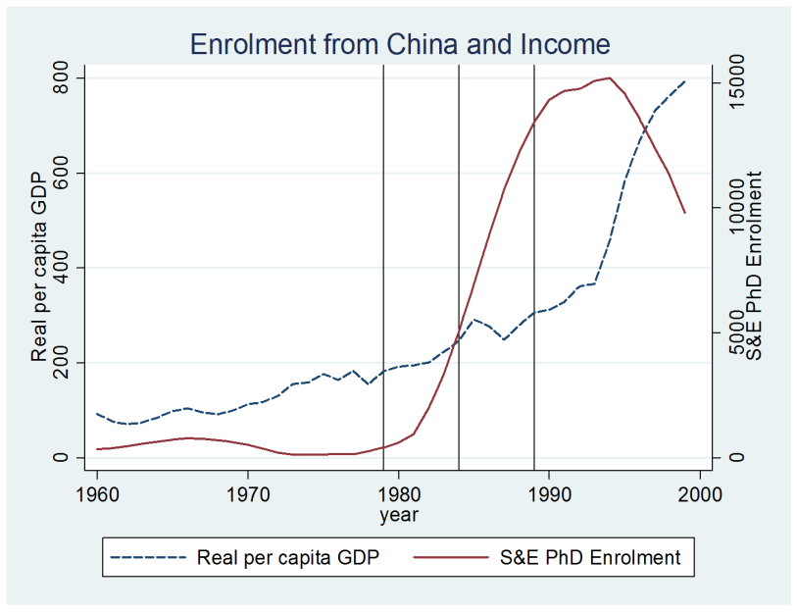
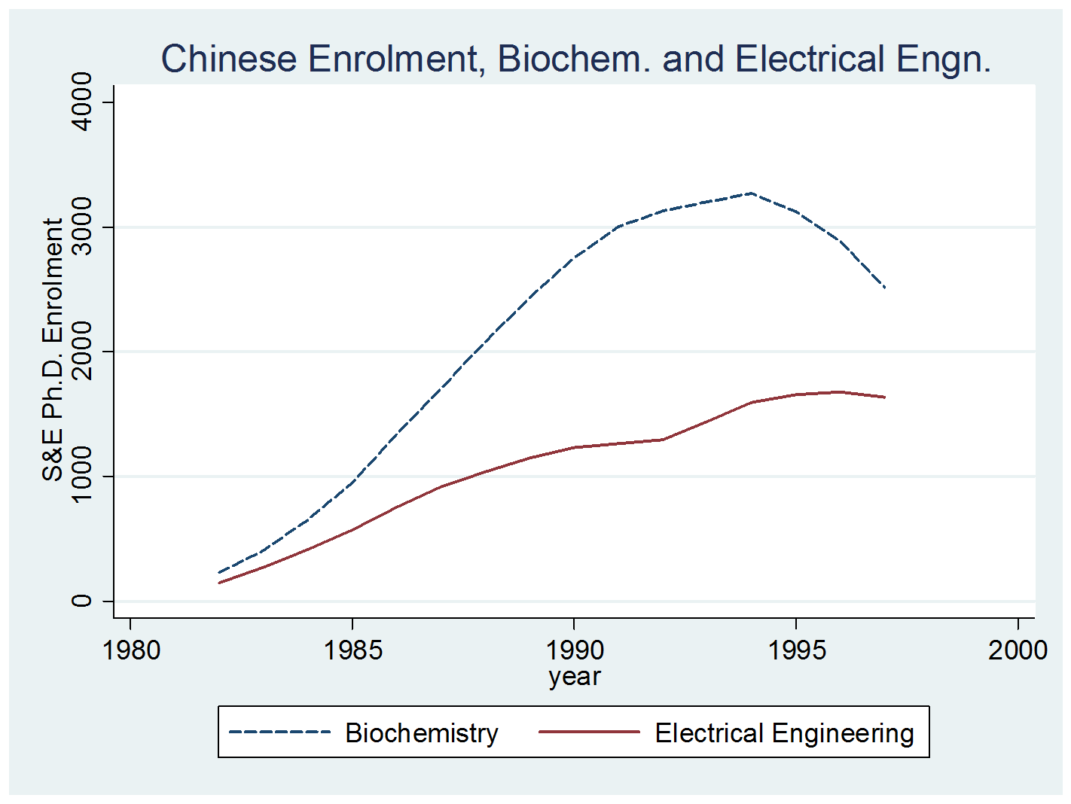
Study Design
Empirical approach
  Knowledge production function statistically linking research outcomes and inputs
  Instrumental variables created, used to identify enrollment fluctuations not influenced by unobserved inputs (E.g. Faculty quality)
  Instruments interact macro-level shocks in home regions with department-level histories of enrollment from same region
    E.g. China’s study-abroad restrictions lifted (macro-level shock), universities and fields that already were enrolling Chinese students benefited more
    Other macro shocks: GDP growth, total tertiary students abroad

Slide 5
Study Design
Develop a model of Ph.D. admissions
  Predicts that a positive shock to number of ‘poor’ applicants increases student quality more than same shock to number of ‘rich’ applicants.
Data
  Created panel covering 2300 univ.-field pairs, 1973-1998.
  PhD enrollment counts created from NSF Survey of Earned Doctorates
  S&E publications, (forward) citations from Web of Science
  R&D expenditure measures from NSF WebCASPAR
  Instruments from World Bank (GDP), UNESCO (tertiary students) and authors’ compilation (population-weighted study-abroad restrictions)

Slide 6
Estimation Method and Results
Two-stage panel fixed-effects regressions with university and field linear trends, clustered SE.
First-stage shows that instruments are powerful in predicting enrollment from US and seven foreign regions.
Selection from Table 3: Estimates of PhD student research productivity.
Dependent Variable: | Publications / Dept / year
 | (1) | (2) |  | (3) | (4)
Estimation method: | OLS | OLS |  | LIML | LIML
U.S. students | 0.164*** | 0.154*** |  | 0.837* | 0.745
 | (0.032) | (0.032) |  | (0.508) | (0.472)
International students | 0.152*** | 0.135*** |  | 0.967*** | 0.924***
 | (0.033) | (0.033) |  | (0.326) | (0.344)
Control for Department Size: Equipment R&D |  | -0.174 |  |  | -0.387
 |  | (0.303) |  |  | (0.392)
Control for Department Size: R&D incl. salary support |  | 0.478*** |  |  | -0.283
 |  | (0.154) |  |  | (0.464)
Observations | 47959 | 47959 |  | 47954 | 47954

Slide 7
Results - Overview
Estimated marginal effects of PhD Students
  International: 0.77 publications per year, leading to 27 citations
  Domestic: 0.67 publications per year, leading to 36 citations
    Differences are not statistically significant
Foreign scholarship students contribute more to productivity than foreign paying students (49 citations/year vs 31.5)
Evidence of positive association between diversity in regions of enrollment and productivity.
  Not identified as a causal relationship

Slide 8
Conclusions and Policy Implications
International and domestic students substitutable at the margin, but both groups substantially contribute to science. Support for PhD students had high returns.
Major reductions in the foreign student program would harm the scientific capacity of U.S. universities.
Current visa policy requiring F-1 applicants to demonstrate financial means hurts U.S. scientific productivity

