Slide 1
The Impact of Open Access Institutions and Policy on Life Sciences Research
Scott Stern, MIT & NBER
SciSIP Principal Investigators Conference
September 2012
1

Slide 2
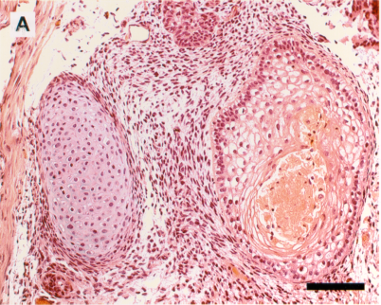
Do Open Access Institutions Matter? YES!
In conjunction with co-authors in economics and related areas, we have undertaken a systematic research program aimed at establishing the causal linkage between open-access institutions and policies and scientific progress
  A “Natural Experiments” approach to evaluate the scientific commons
  Studies cover diverse settings, including biological resource centers, mouse genetics (JAX), the Human Genome Project, and others
An accumulating body of striking evidence for the impact of open-access institutions and policies enhancing the rate and expanding the scope of follow-on scientific research
Implies a considerable benefit to the development of formal institutions and policies ensuring independent and low-cost access to certified biological materials to the scientific community, including both public and private researchers

Slide 3
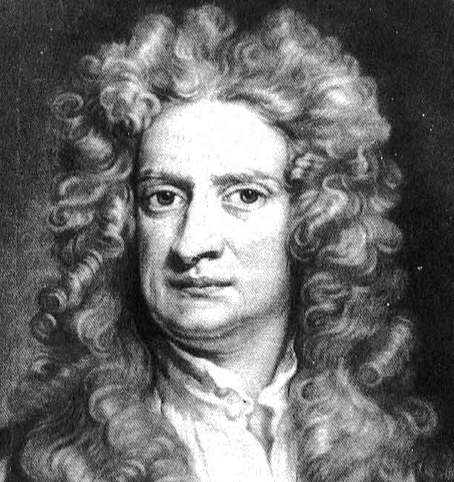
How do scientists “stand on the shoulders of giants”?
  Long-term economic growth depends on the ability to draw upon an ever-wider body of scientific & technical knowledge (Rosenberg, Mokyr, Romer, Aghion & Howitt, David & Dasgupta)
Economic historians, institutional economists, and sociologists emphasize the role of “institutions”
  however, the micro-foundations of knowledge accumulation are, by and large, still a “black box”
  many challenges to assessing impact of institutions
    knowledge flows are difficult to track
    institutions are difficult to identify & characterize
    knowledge is assigned endogenously
    (not randomly) to institutional environments

Slide 4
Overall Research Agenda
The Micro-Economics of the Scientific Commons
  How do open access institutions and policies that support a “scientific commons” contribute to the accumulation of knowledge and scientific research productivity?
  Under what conditions do researchers (and their funders) have appropriate incentives to contribute to an open-access scientific commons, and what role do institutions and policy play in that process?
A Natural Experiments Approach
  Exploit (exogenous) changes in institutions governing knowledge generation and diffusion
  Helps address the “identification problem”
  Allows us to evaluate the role of institutions on the overall use and nature of follow-on research

Slide 5
The Economics of “Standing on Shoulders”
Standing on Shoulders is a key requirement for sustained research productivity, and scientific and technical progress
  If the knowledge stock does not expand or cannot be accessed, diminishing returns will eventually arise
The production of knowledge does not guarantee its accessibility
  Knowledge transfer is usually costly (e.g., tacitness, stickiness)
  Strategic secrecy further limits the available knowledge pool
  Even if available in principle, relevant calculation is the cost of drawing from the knowledge stock versus “reinventing the wheel”
Individual incentives to contribute to institutions supporting cumulative knowledge production are limited
  Direct control rights over a material can allow researchers (or IP rights holders) to hold-up future scientific progress, particularly when downstream applications arise

Slide 6
Getting the Incentives Right
Establishing a knowledge hub (a scientific commons) within a technical community involves a collection action problem
  Private incentives are too low
  Role for public funding / cooperation among competitors
Even if funded, the incentives to participate as a depositor may be too low without explicit norms (or policy!)

Slide 7
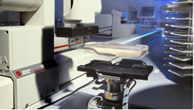





The Impact of Biological Resource Centers (with J. Furman), AER

Slide 8

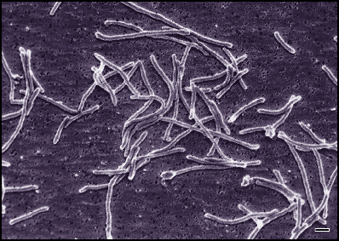

BRCs as Economic Institutions
Authentication -- The fidelity of discovered knowledge cannot be guaranteed by the initial discoverer but must be able to be replicated
  The HeLa Scandals
Long-Term Preservation -- The importance of a given piece of knowledge (and physical materials exploit that knowledge) are often only recognized long after initial discovery
  Brock’s Unlikely Bacteria (Taq)
Independent Access -- Substantial gap between private and social benefits of providing independent access to data and materials
  Gallo and the HIV Virus

Slide 9
BRCs as Economic Institutions
From an economic perspective, the establishment of BRCs is subject to an important public goods problem, and effective biomaterials policy requires appropriate incentives and policies to ensure independent and low-cost access to follow-on researchers
BRCs appear to possess characteristics that suppport the acceleration of knowledge generation and diffusion relative to alternative institutions
But, do BRCs actually enhance the diffusion of scientific knowledge? How?

Slide 10
Empirical Approach: A “Natural Experiments” Approach to Scientific Knowledge Diffusion
BRC Deposits are linked with specific scientific research articles or patents (referred to as “BRC-linked” articles)
Each BRC-linked article can be matched w/ article controls
Some BRC deposits occur long after initial publication
  even many years after discovery, control over “refrigerators” can be transferred from specific research labs to BRCs
Some post-publication deposits are arguably exogenous
  e.g., special collections “shifted” due to funding expiration at initial host institutions, faculty retirement, or faculty job change resulting in change in location of “refrigerator”
Allows us to observe variation in the impact of a single “piece” of knowledge across two distinct institutional environments

Slide 11
Empirical Framework:
Diffs-in-diffs analysis of citations received
Pre-period institutional setting
Post-period institutional setting
FC_{jt}
Exogenous SHIFT
Measure citations before & after to estimate impact of treatment on treated
“diffs-in-diffs” approach
Plot forward citations over time as a measure of scientific knowledge accumulation building on a “piece of knowledge”
Publication
FC_{jt}
FC_{jt}
Publication
FC_{jt}
Treated
FC_{jt}
Publication
FC_{jt}
FC_{jt}
Publication
FC_{jt}
Control
FC_{jt}
FC_{jt}
FC_{jt}
Notes:
Citations to articles in other scientific publications observed over time
Citations in these research areas are specific – it is unlikely that one would cite an article unless one was directly using that cell or providing an explicit comparison with the results from a particular mouse model
We identify institutional “shock” – natural experiments - to the autonomy of researchers who can choose to pursue one research area (and so cite that area) or not
These provide a source of variation by shifting the degree of autonomy associated with an article, after the article has been published
We also observe “control articles” who experience no change in autonomy subsequent to their initial disclosure through publication
This set-up allows us to observe the use of research mice in “step-by-step” research in both the pre- and post- shock period, and compare the use of a “treatment” and “control” group
We can evaluate the impact of the degree of openness on the rate and direction of follow-on research by examining how the pattern of citations to each individual mouse-article changes after the policy intervention.
Meaning of citations:
A citation in Patent X to Patent Y mean that “X represents a piece of previously existing knowledge on which Y builds”.
In practice a citation has strong competitive implications – it restricts the claims of patent Y to only those things that extend beyond the scope of Patent X.
Paper Citations:
A Paper citation is more ambiguous in its meaning.
The citation of a paper in a patent has been taken to mean that this public knowledge is being built upon by the inventor. Who again claims only the ideas above and beyond the innovation. It has been suggested that this references relate to the basicness of the patent and its so-called “science-linkage”. While this may be true it is not necessary to this analysis.
References to science in other papers has been widely studied not only in bibliometric analysis of knowledge creation but also by sociologists of science who have suggested that the process is quite political, favors friendship and so on.
Thus the two types of citation are functionally but not structurally equivalent. Nonetheless in simple terms I take them as a narrow definition of the community first of commerce and second of science.

Slide 12
How does the rate of citation of a scientific article change after the materials association with that article have been deposited in a culture collection?

Slide 13
Does BRC deposit matter for follow-on scientific research?
Negative Binomial Models | Forward Citations
 | (3-4) Marginal Effects only
BRC-Article,Post-Deposit (Marginal) | [2.248] 0.810 (0.360)
Article FE | X
Age FE | X
Calendar Year FE | X
122%
Boost
After
Deposit
Data is based on 289 items from ATCC “special collections” each of
Which is linked to citing article, and citations are measured using ISI Web of
Science. Control articles are based on “related articles”
Cond FE Neg. Bin. Models, coefficients as IRRs; bootstrapped SEs

Slide 14
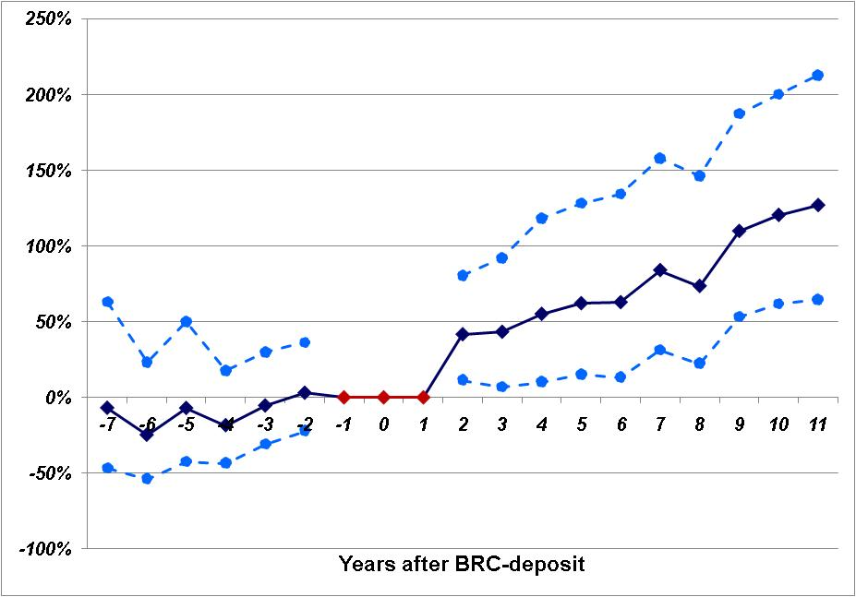
Impact of Deposit Grows Over Time and Does Not Exist Prior to Deposit
This suggests that deposit is, indeed, exogenous and that diffs-in-diffs approach usefully identifies marginal (post-deposit) effects
Conditional FE NB model

Slide 15
How do BRCs enhance research impact?
Consistent with the certification role of BRCs, the citation boost from BRC deposit is higher for articles that are initially published in a non-top-tier journal, with lead authors at less highly ranked universities, and for articles with more complex subject matter
Consistent with the role of BRCs in offering independent access and scale economies, BRC boost is associated with an expansion in the number of distinct institutions citing an article, the number of journals an article is cited in, and the geographic reach of citations.
Not simply a matter of a “mechanical” change in citation patterns, the boost associated with BRC deposit seems to enhance the citation of related articles by the same authors
Results robust to a variety of controls and alternative specs

Slide 16
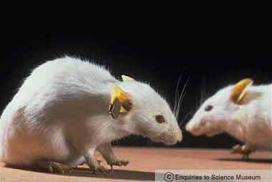

Slide 17
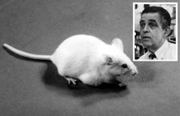
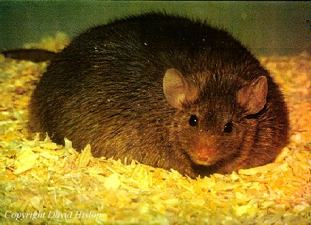
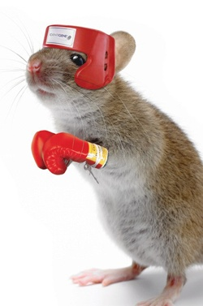

Of Mice and Academics: The Impact of Openness on Innovation (with Aghion, Dewatripont, Kolev and Murray)
A tale of three (blind, obese, diabetic, epileptic…) mice engineering technologies….
…setting to explore impact of changes (negotiated by NIH) that allowed for both greater formal access (via JAX) and lower IP restrictions
Onco transgenic mouse technology
Knock-out mouse technology
Cre-lox mouse technology

Slide 18
The Experiment: Treatment and Control Groups
 | Technology | Shock | Pre-Shock Openness | Post-Shock Openness
Cre-lox Mice | Developed by DuPont -tool to engineer mice with target gene “on or off” in specific tissue (Sauer et al. 1987) | NIH Cre-lox MoU 1998 | DuPont’s IP covered any mouse made using Cre-lox. Cre-lox mice not shared without costly license. No JAX distribution | Cre-lox mice available for all researchers at non-profit institutions for internal research JAX make mice available & manage simple licenses
Onco Mice | Developed at Harvard – transgenic tools to insert an oncogene (Stewart et al. 1987) | NIH Onco MoU 1999 | Harvard’s IP covered any mouse made using transgenic oncogenes. Onco mice not shared without costly license. JAX distribution permitted | Onco mice available for all researchers at non-profit institutions for internal research JAX make mice available & manage simple licenses
Knockout Mice | Developed by Capecchi - “knock-out” methods allow for gene to be deleted (Thomas & Capecchi 1987) | NONE | Capecchi patent on “knockout” methods but no IP claims made on scientists. < 50 patents on specific “knockout” mice (all post 1999). Mice available via JAX | NONE DIRECTLY
Spontaneous Mice | First developed by Castle at Harvard – mice selected & bred for disease states. | NONE | No IP limiting openness Mice available via JAX | NONE

Slide 19
EMPIRICAL APPROACH
Estimating Annual Forward Citations to each Mouse-Article
Pre-Shock institutional setting
Posts-Shock institutional setting
FC_{it}
Cre-lox & Onco OPENNESS SHOCKS
Articlei
FC_{it}
Cre-lox
Mouse
FC_{it}
Articlei
FC_{it}
Onco
Mouse
FC_{it}
Articlei
FC_{it}
  New/Old Last Author
  New/Old Institution…
  New/Old Key Words…
  New/Old Journal….
  Basic/Applied
Knock
Out
Mouse
FC_{it}
FC_{it}
Articlei
FC_{it}
Spontaneous
Mouse
FC_{it}
FC_{it}
Notes:
Meaning of citations:
A citation in Patent X to Patent Y mean that “X represents a piece of previously existing knowledge on which Y builds”.
In practice a citation has strong competitive implications – it restricts the claims of patent Y to only those things that extend beyond the scope of Patent X.
Paper Citations:
A Paper citation is more ambiguous in its meaning.
The citation of a paper in a patent has been taken to mean that this public knowledge is being built upon by the inventor. Who again claims only the ideas above and beyond the innovation. It has been suggested that this references relate to the basicness of the patent and its so-called “science-linkage”. While this may be true it is not necessary to this analysis.
References to science in other papers has been widely studied not only in bibliometric analysis of knowledge creation but also by sociologists of science who have suggested that the process is quite political, favors friendship and so on.
Thus the two types of citation are functionally but not structurally equivalent. Nonetheless in simple terms I take them as a narrow definition of the community first of commerce and second of science.

Slide 20
Analysis:
Effectiveness of Formal Institutions for Changing Access to Research Mice
Neg. Binomial | Last Authors |  | Key Words
 | Annual Citations with New Last Author | Annual Citations with Old Last Author | Annual Citations with New keywords | Annual Citations with Old keywords
Post Shock | 1.380*** | 1.14 | 1.260*** | 0.977
Conditional Fixed Effects for Article, Margin-Age and Margin-Calendar Year, Window Effects
26%
Boost
After
NIH
Agreement
formalizes
Access
& lowers IP
The impact of institutional change concentrated in citations by “new” last authors and in papers using new key words
Robust to “New Institution” v.“Old Institution”, Reprint Authors, Journals etc.
Murray, Aghion et al., 2009
Murray, Aghion et al., 2009

Slide 21
In other words, an increase in openess (and reduced opportunities for hold-up) in mouse genetics resulted in a significant increase in the diversity of new research lines and experimentation exploiting these novel research tools

Slide 22



Journal as Platforms: Governance

Slide 23


Empirical Strategy
Compare and contrast of two journals from the date of founding – Nature Materials & Nature Biotechnology
Both formed by the Nature Publishing Group (1997 & 2002 respectively) to serve as outlet for “dual use” knowledge in bio-technology and materials-technology respectively so “at risk” for patent-paper pairs.
Both subject to identical editorial policies and practices (from NPG parent) and professional editorial structure.
Both explicitly designed to establish new research communities e.g. ““Nature Materials provides a forum for the development of a common identity among materials scientists while encouraging researchers to cross established sub-disciplinary divides”
=> Both successful platforms - rapidly become high impact (JIF > 30) in their communities

Slide 24
The Incidence of Patent Paper Pairs, by Journal and Over Time

Slide 25
Differences-in-Differences: Impact of Patent Grant by Journal, By Same Journal versus Other Journal Citations
Dep Var = FORWARD CITATIONS BY PUBLIC/PRIVATE AUTHORS, Conditional FE Negative Binomial | Same Journal Citations | Other Journal Citations
NB PAT | 0.762 (0.053) | 1.051 (0.22)
NM PAT | 1.034 (0.198) | 1.04 (0.048)
Article Conditional Fixed Effects | Y | Y
Journal-Age Fixed Effects | Y | Y
Journal-Citation Year Fixed Effects | Y | Y

Slide 26
Patents and Open Knowledge Platforms
Academic journals function as a multi-sided platform which encourage disclosure from researchers and facilitate access by follow-on researchers
Intellectual property is a separate means by which an “upstream” researcher can influence the ways in which their discoveries are used in subsequent research
The impact of IPR within these platforms varies over time and domain
  For two of the most successful knowledge platforms in science, significant “negative” fall-out from patents in early year
  Rather than a static debate about the role of patents on scientific communities, a process of dynamic adaptation as the research community “learns to live” with formal IPR

Slide 27
Implications
Promoting an effective research environment depends on understanding the motivations and interests of researchers, and designing a research environment that makes it “easy” to participate within an open research community. By shaping the incentives and norms of the scientific community, policy actually affects overall scientific research productivity.
Institutions and rules matter, and can shape productive sharing over knowledge and over diverse research areas. Not simply enough to have good will but have to set effective policy, for both individual researchers and the organizations that fund and house their research.
Policy debate will focus not simply on the level of public investment but on the governance and rules of scientific research and the translation of publicly funded research into commercial products
An emerging body of evidence highlights the positive rate of return to formal rules encouraging openness and sharing at the earliest stages of the research process…

Slide 28





Some Commons to Think About…

