Slide 1
Big Data, Science Metrics and the Role of Science Policy
Julia Lane

Slide 2
Overview
Background and Motivation
Science metrics
Big data
Science policy

Slide 3
Overview
Background and Motivation
Science metrics
Big data
Science policy

Slide 4
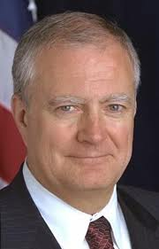

Clear evidence of interest
Policy makers: Marburger’s speech; Joel Scheraga yesterday
University Administrators: APLU and AAU
Academia: Establishment of SciSIP and SOSP

Slide 5
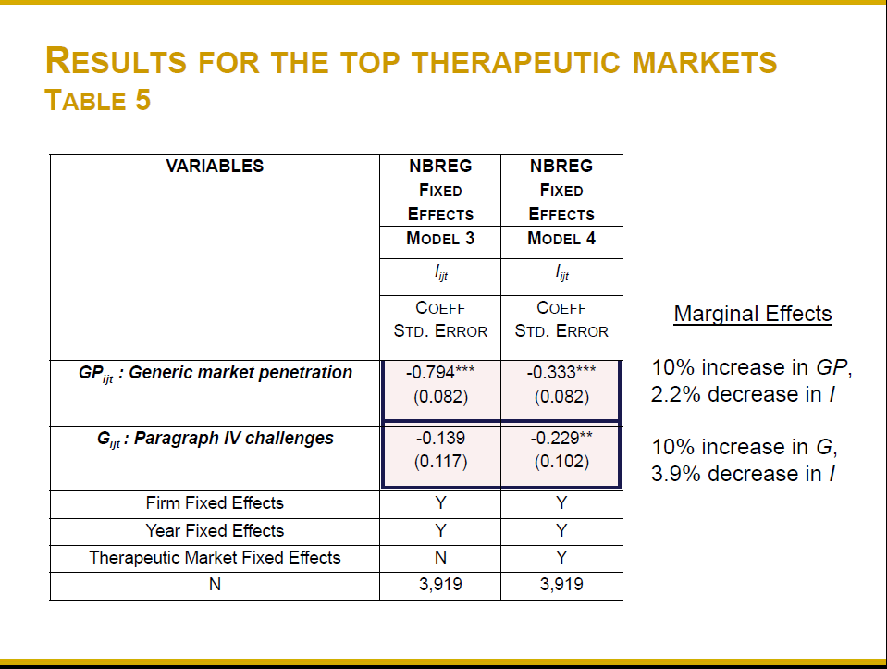
Example: Branstetter & Higgins

Slide 6
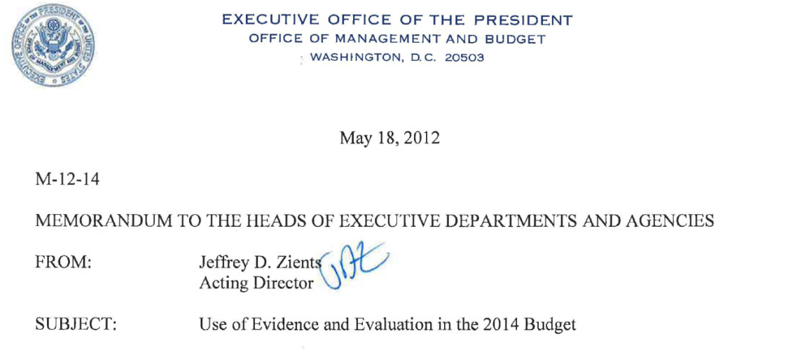
Motivation
Agencies should demonstrate the use of evidence throughout their Fiscal Year (FY) 2014 budget submissions. Budget submissions also should include a separate section on agencies' most innovative uses of evidence and evaluation, addressing some or all of the issues below….

Slide 7

Motivation
The Office of Science and Technology Policy has created a "community of practice" for agency personnel involved in designing and managing incentive prizes and has organized a Science of Science Policy working group that is developing tools aimed at establishing a more scientific, empirical evidence basis for science and technology policymaking.

Slide 8
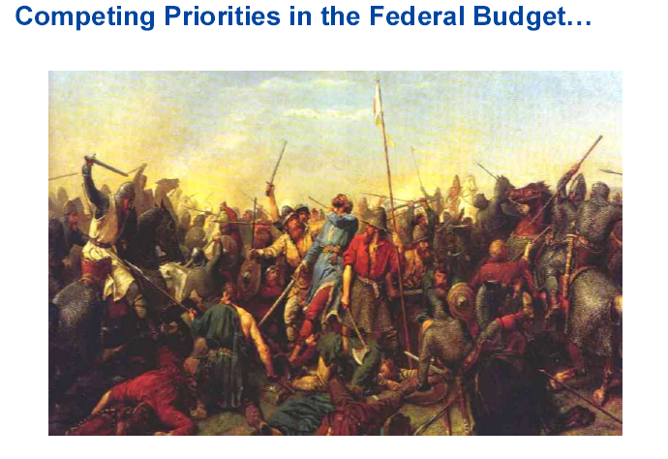
Motivation

Slide 9
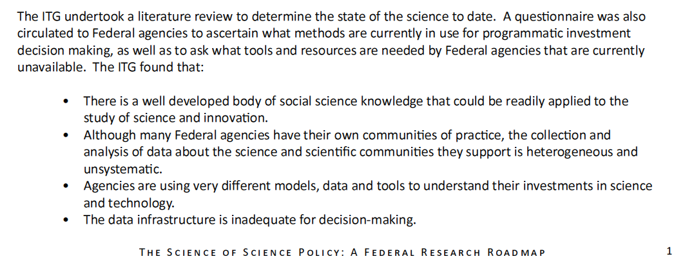
The data don’t exist

Slide 10
Overview
Background and Motivation
Science metrics
Big data
The role of science policy

Slide 11
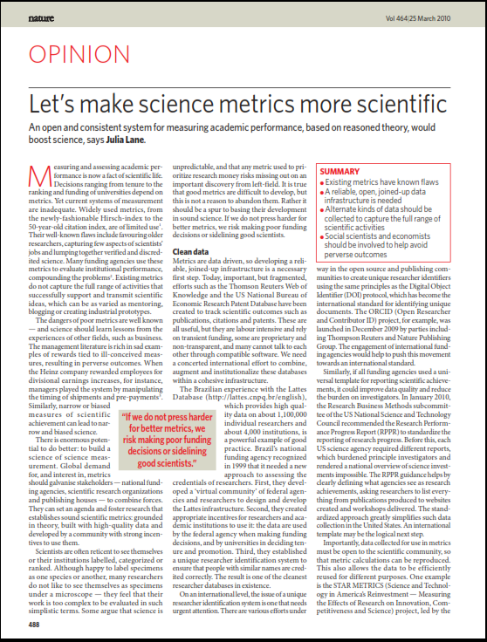
Getting it Right Matters

Slide 12
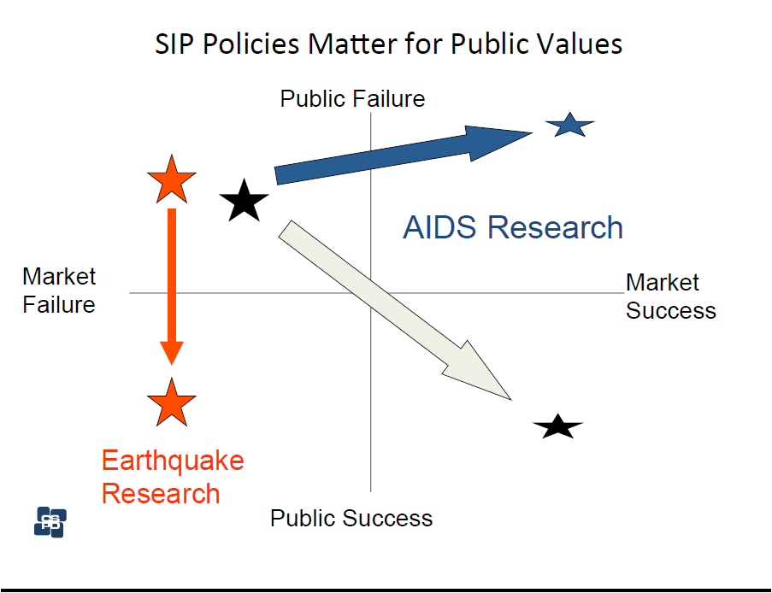
What does getting it right mean?
Theoretical framework
  Important role for SciSIP research
  Psychology, Anthropology, Sociology, Economics, Political Science…
  AND Domain scientists

Slide 13

What does getting it right mean?
Empirical Framework
  Timely
  Generalizable and replicable
  Low cost, high quality
  Big Data (in this context)
  - Disambiguated data on individuals
  Automatic data creation
  New text mining approaches….

Slide 14
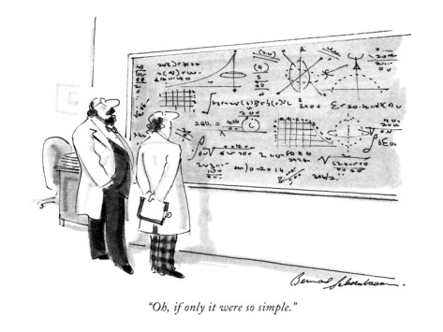

Slide 15
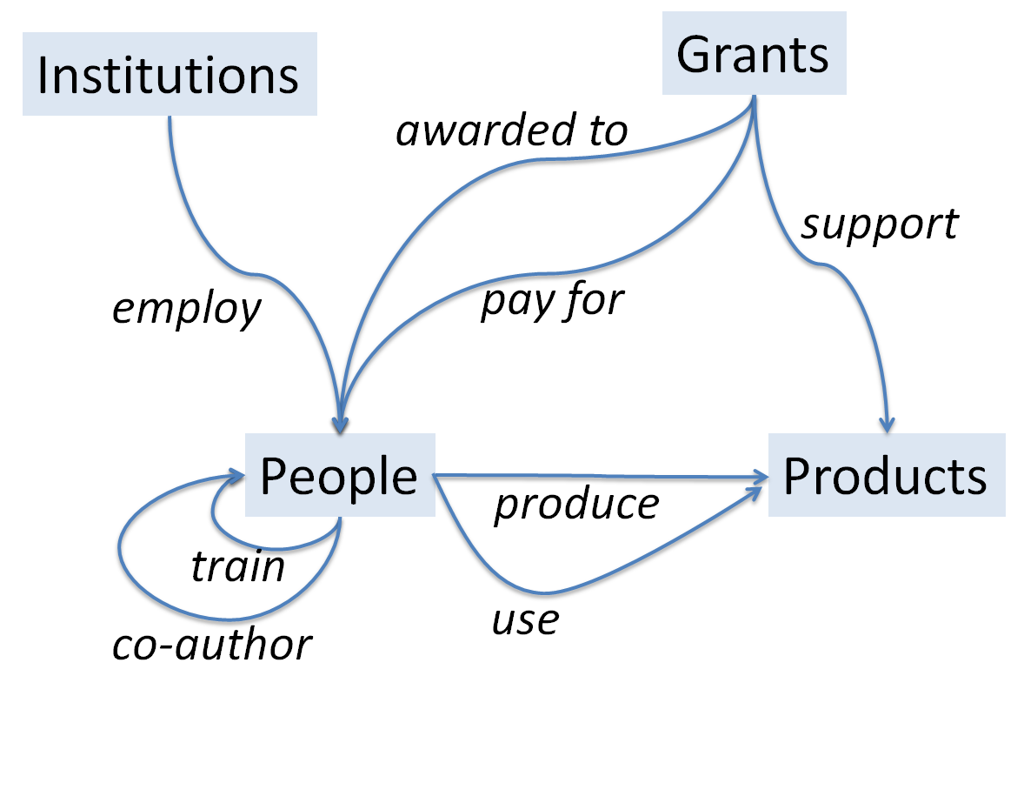
Conceptual Framework

Slide 16
Overview
Background and Motivation
Science metrics
Big data
Role of Science Policy

Slide 17
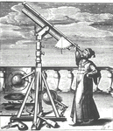


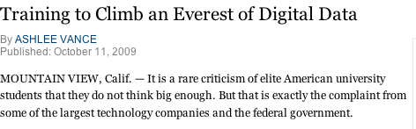
The Evolution of Science - the 4th Paradigm
Jim Gray’s paradigm
Observational Science
  Scientist gathers data by direct observation
  Scientist analyzes data
Analytical Science
  Scientist builds analytical model
  Makes predictions.
Computational Science
  Simulate analytical model
  Validate model and makes predictions
Data Exploration Science
  Data-driven science
  Data captured by instrumentsror from the web,
  or data generated by simulation
  Information extraction
  Processed by software
  Placed in a database / files
  Scientist(s)/scholar(s) analyze(s) database / files
  Access crucial

Slide 18
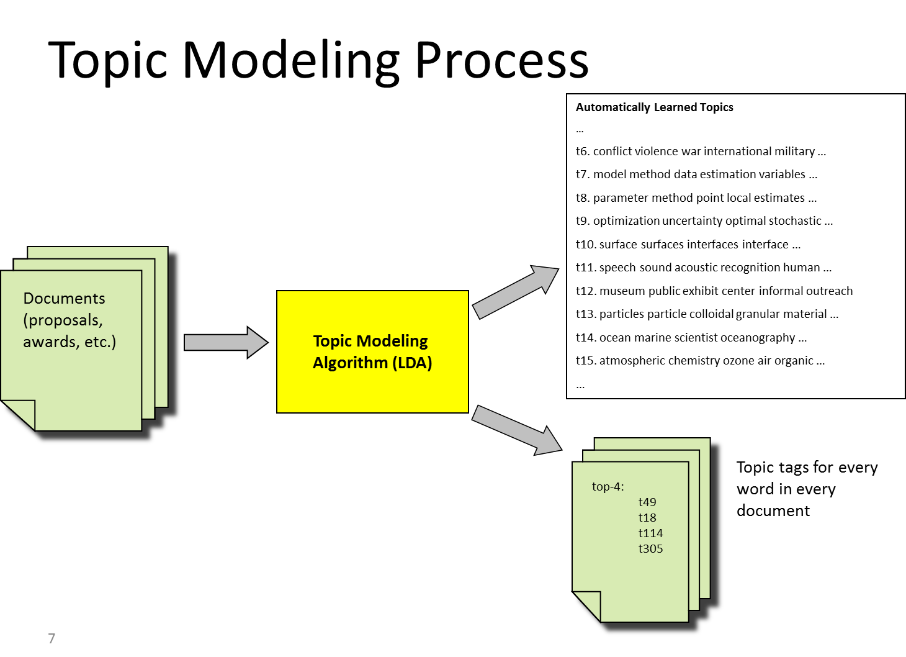

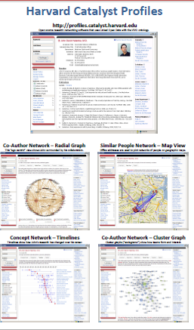
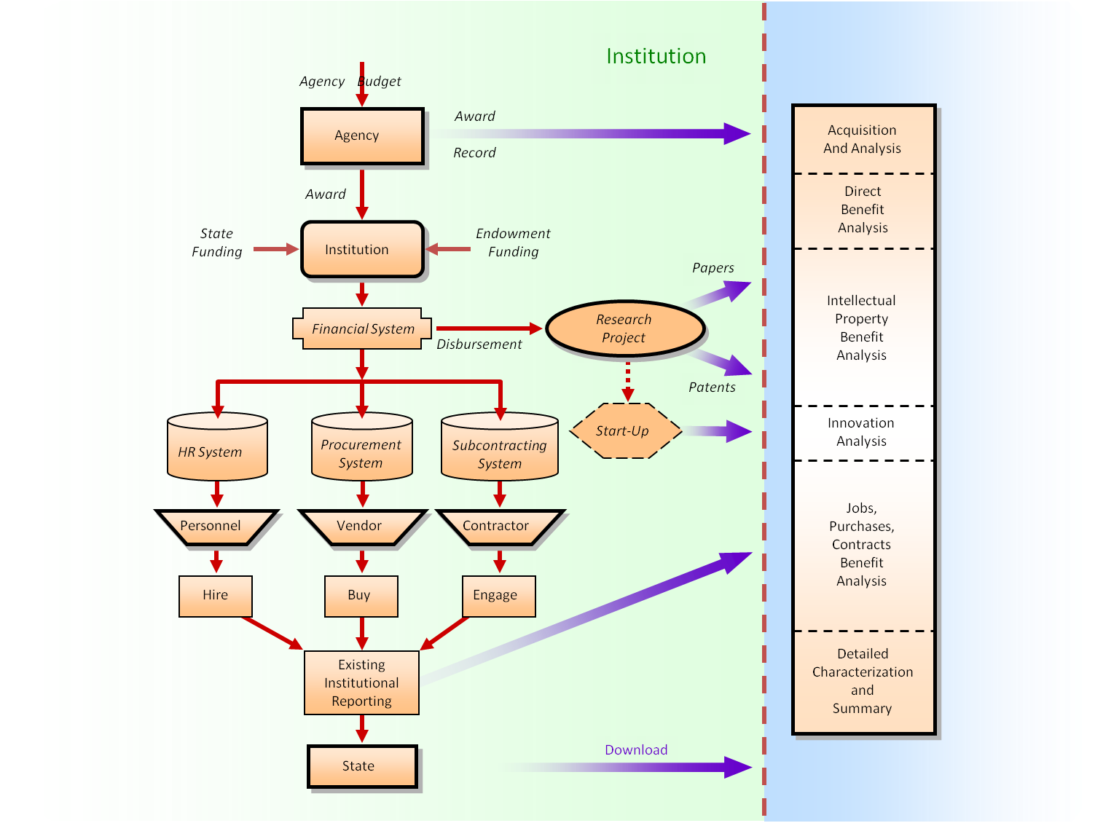
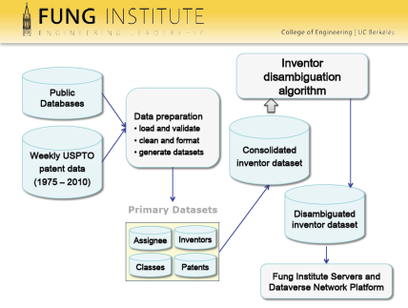
The Role of Big data
Source: Ian Foster University of Chicago

Slide 19
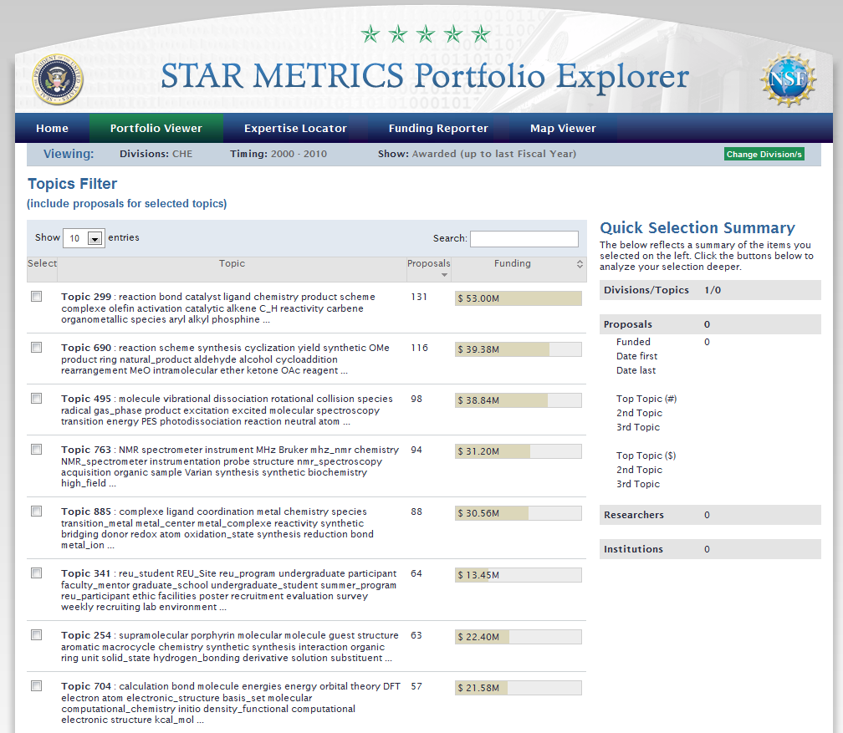
Example: Describe Science Investments
1000 topics learned from 200k submitted NSF proposals
Topics ideal for research portfolio analysis
Measure relationship between research investment and research outcomes (publications, patents)
Topic model unifies research categories across funding agencies and document genre

Slide 20
Link to Policy
Investment in angiogenesis
Publications in angiogenesis
Identify Pis and graduate students working in angiogenesis
Source: Ian Foster University of Chicago

Slide 21
Overview
Background and Motivation
Science metrics
Big data
Science policy

Slide 22
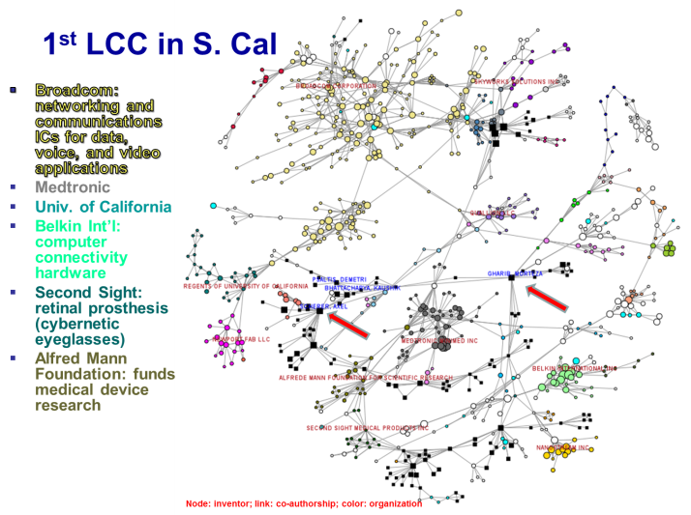
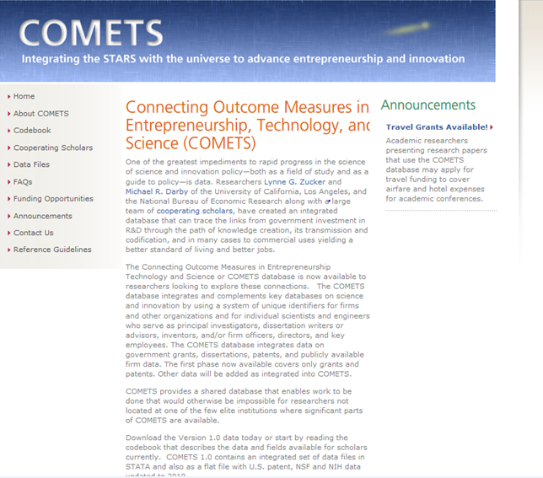
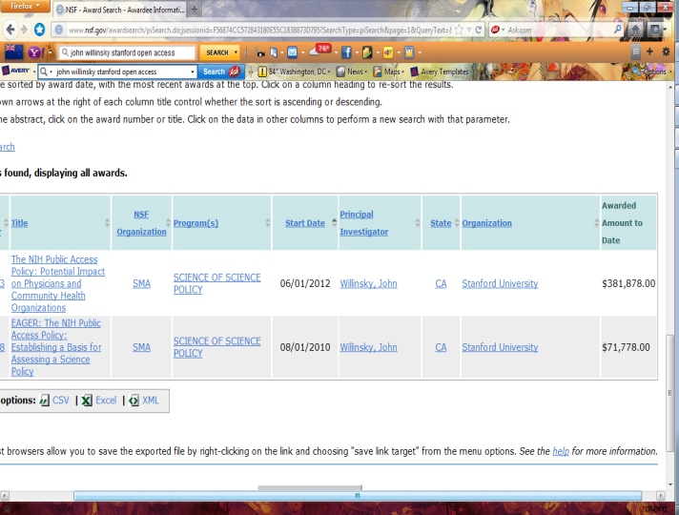
Engage SciSIP community
Patent Network Dataverse Lee Fleming Harvard
COMETS (Connecting Outcome Measures in Entrepreneurship Technology and Science): Lynne Zucker and Michael Darby UCLA
Randomized Controlled Trials John Willinsky, Stanford

Slide 23
And a reminder of why!

Slide 24
Contact Information
Julia Lane
202 374 9901
jlane@air.org

