Slide 1
Workshop on Proposed Revisions to the Common Rule in Relation to the Behavioral and Social Sciences
Risks and Harm:
Possible Extensions of Exempt/Excused
An Example from Economics, Political Science, Game Theory, Judgment and Decision
Charles R. Plott
March 21-22, 2013

Slide 2
Experimental works in the fields have major impacts on society
Airline access to major airports
Cell phone licenses
Kyoto protocols
Kidney exchange
Medicare Equipment procurement
Pollution permit markets
Network access processes (power grid, phones)
Financial bailout (toxic asset auctions)

Slide 3
Economics, Political Science, Game Theory, Decision and Judgment are among the most removed from the biomedical sciences
What potential subject risks and harm exist in these sciences?
What do the experiences of the scientific community reveal? Are other sciences similarly situated?
The questions were put to major researchers and laboratories.

Slide 4
The results suggest:
there are no risks in those areas
the language is easily misconstrued
Other social sciences might be similarly situated.
Issues of exemption (excused) should be pursued.

Slide 5
 | Economics Political Science | Society for Judgment and Decision Making
Respondents | 30 | 85
Subjects | 104,000 | 680,000
Subjects Median | 8,000 | 8,000
Adverse Incidents | 1 | 0
Reports of Harm | 0 | 73
Nature of Risk
Physical | 0
Psychological | 0
Social | 0
Informational | 0

Slide 6
 | Economics Political Science | Society for Judgment and Decision Making
Respondents | 30 | 85
Subjects | 104,000 | 680,000
Adverse Incidents | 1 | 0
Reports of Harm | 0 | 73
Subject went bankrupt and had to leave the experiment
Disappointment due to failure to earn more.

Slide 7
 | Economics Political Science | Society for Judgment and Decision Making
Respondents | 30 | 85
Subjects | 104,000 | 680,000
Adverse Incidents | 1 | 0
Reports of Harm | 0 | 73*
* 60 (from one respondent) stress due to negative feedback about personal performance
frustrated: did not understand lotteries
IAPS photographs complaint
guilt feeling after a prisoner's dilemma defection
equipment did not work
payment dissatisfaction (due to an error)
(irritated) was asked about the value of a life
mix-up on mailing revealed address to another

Slide 8
Why is there no risk or harm?
The research topics are those of daily life and carry no potential for harm
markets
committees and voting
games
processes focus (as opposed to individuals)
decisions

Slide 9
Why is there no risk or harm?
The research methods and technologies involve no risk (fmri possibly excepted).
questionnaires
computer and internet games
abstract consequences- aside from money earned have no effect on subjects.
subjects trained and tested on the rules
no confidential data collected (beyond needs for accounting)

Slide 10
If no evidence of risk or harm exist then the appropriate techniques, methods, areas and fields of the social sciences should be identified and exempted (excused).
Understanding risk and harm means recognizing when they do not exist.

Slide 11
Thank You

Slide 12
An example of an economics experiment

Slide 13
10
10
8
7
6
4
2
2
9.00
7.50
6.70
6.30
5.30
3.80
2.60
1.60

Slide 14
10
10
8
7
6
4
2
2
10
10
9
7.50
6.70
6.30
5.30
3.80
2.60
1.60
8
7
6
4
2
2

Slide 15
10
10
8
7
6
4
2
2
9.00
7.50
6.70
6.30
5.30
3.80
2.60
1.60
9
7.50
6.70
6.30
5.30
3.80
2.60
1.60

Slide 16
10
10
8
7
6
4
2
2
10
10
9.00
7.50
6.70
6.30
5.30
3.80
2.60
1.60
9
8
7.50
7
6.70
6.30
5.30
6
3.80
4
2.60
2
2
1.60

Slide 17
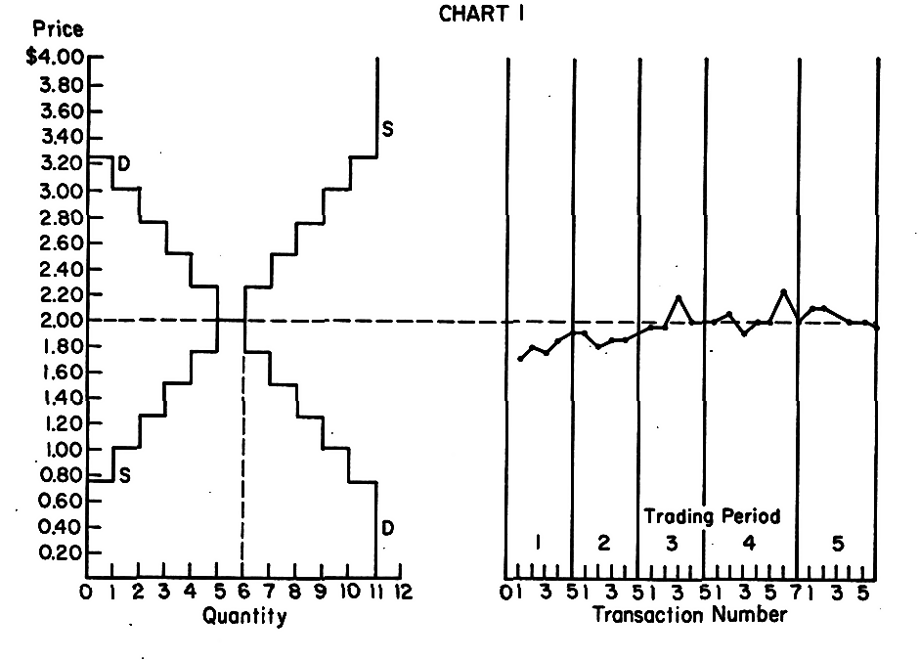
Notes:
17

Slide 18
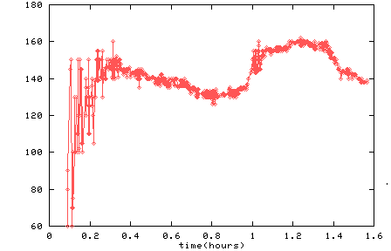
equilibrium prices predicted by model
(solid lines)
Price time series

