Slide 1
Archiving and Sharing Confidential Data in the Social Sciences
George Alter
Director, ICPSR

Slide 2
About ICPSR
Established in 1962 to share the American National Election Studies
Partnership of 21 universities
Today: More than 700 members
~400 U.S. institutions
46 national memberships
8,000 data collections
Data available 24/7 for download and online analysis

Slide 3
What we do
Mission: ICPSR provides leadership and training in data access, curation, and methods of analysis for a diverse and expanding social science research community.
Acquire and archive social science data
Distribute data to researchers
Preserve data for future generations
Provide training in quantitative methods

Slide 4

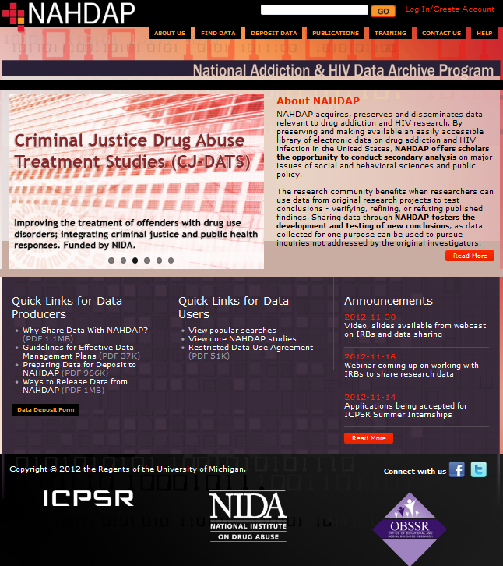

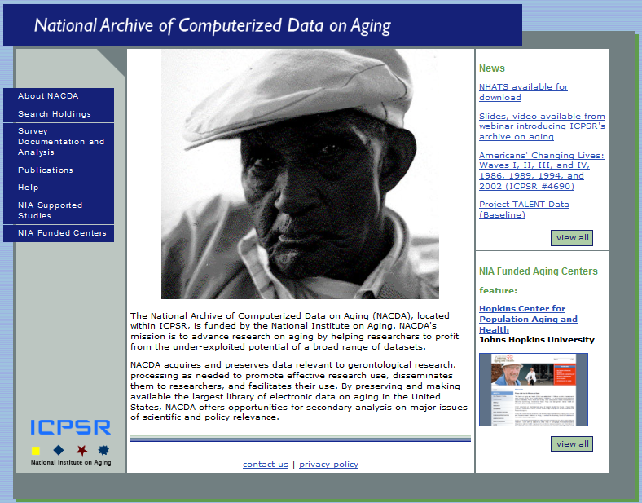
Sponsored Archives
Child Care and Early Education Research Connections
Data Sharing for Demographic Research
Health and Medical Care Archive
Measures of Effective Teaching Longitudinal Database
National Addiction & HIV Data Archive Program
National Archive of Computerized Data on Aging
National Archive of Criminal Justice Data
Resource Center for Minority Data
Substance Abuse & Mental Health Data Archive

Slide 5
Sharing Confidential Data
Disclosure risks in social science data
Protecting confidential data
Safe data
Safe places
Safe people
Safe outputs

Slide 6
Disclosure risks in social science data
Research designs can increase disclosure risk :
Geographically referenced data
Longitudinal data
Multi-level data:
Student, teacher, school, school district
Patient, clinic, community

Slide 7
Protecting Confidential Data
Safe data: Modify the data to reduce the risk of re-identification
Safe places: Physical isolation and secure technologies
Safe people: Training and Data use agreements
Safe outputs: Results are reviewed before being released to researchers

Slide 8
Safe data
Disclosure risks can be reduced by design:
Multiple sites rather than single locations
Keeping sampling locations secret
Releasing characteristics of contexts without providing locations
Responsive sampling procedures

Slide 9
Safe data
Data masking
Grouping values
Top-coding
Aggregating geographic areas
Swapping values
Suppressing unique cases
Sampling within a larger data collection
Adding “noise”
Replacing real data with synthetic data

Slide 10
Safe places
Data protection plans
Remote submission and execution
Virtual data enclave
Physical enclave

Slide 11
Data Protection Plans should address risks:
unauthorized use of account on computer
computer break-in by exploiting vulnerability
hijacking of computer by malware or botware
interception of network traffic between computers
loss of computer or media
theft of computer or media
eavesdropping of electronic output on computer screen
unauthorized viewing of paper output
We often focus too much on technology and not enough on risk.

Slide 12
Controlled environments allow review of outputs
Remote submission and execution
User submits program code or scripts, which are executed in a controlled environment
Virtual data enclave
Remote desktop technology prevents moving data to user’s local computer
Requires a data use agreement
Physical enclave
Users must travel to the data

Slide 13
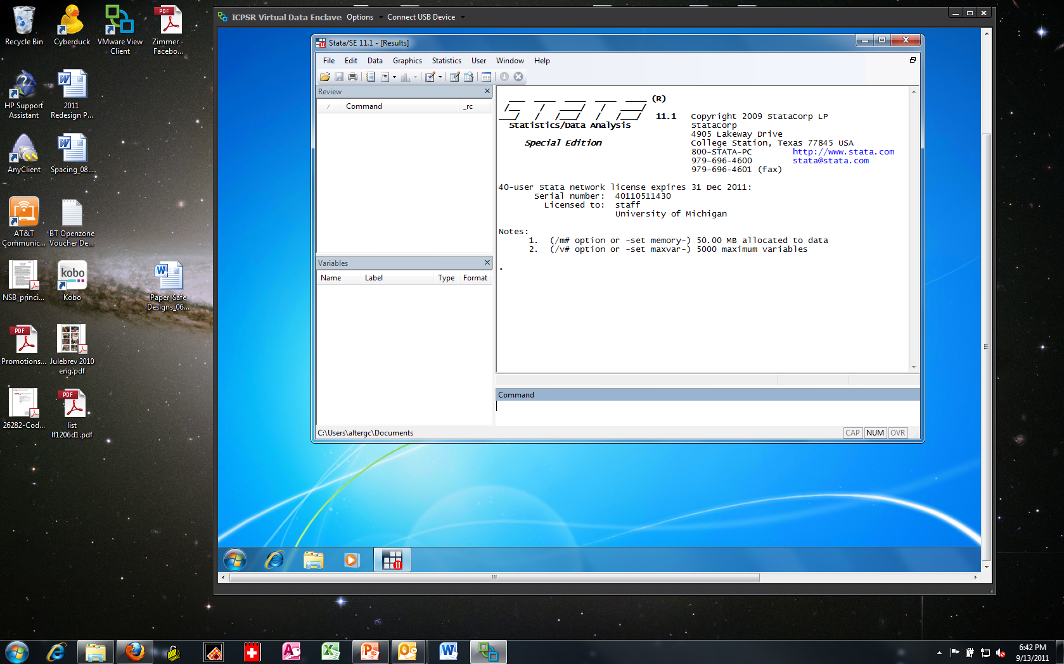
Virtual Data Enclave

Slide 14
Safe people
Data use agreements
Training

Slide 15

Interview
Data archive
Data Use Agreement
Institution
Data Protection Plan
Informed Consent
Data Dissemination Agreement
Data flow
Research Plan
Data flow
Researcher
Data flow
IRB Approval
Data producer

Slide 16
Safe people
Parts of a data use agreement at ICPSR
Research plan
IRB approval
Data protection plan
Behavior rules
Security pledge
Institutional signature

Slide 17
Data Use Agreement: Behavior rules
To avoid inadvertent disclosure of persons, families, households, neighborhoods, schools or health services by using the following
guidelines in the release of statistics derived from the dataset.
1. In no table should all cases in any row or column be found in a
single cell.
2. In no case should the total for a row or column of a cross-tabulation be fewer than ten.
3. In no case should a quantity figure be based on fewer than ten cases.
4. In no case should a quantity figure be published if one case
contributes more than 60 percent of the amount.
5. In no case should data on an identifiable case, or any of the kinds
of data listed in preceding items 1-3, be derivable through subtraction
or other calculation from the combination of tables released.

Slide 18
Data Use Agreement: Institutional Commitment
The Recipient Institution will treat allegations, by NAHDAP/ICPSR or other parties, of violations of this agreement as allegations of violations of its policies and procedures on scientific integrity and misconduct. If the allegations are confirmed, the Recipient Institution will treat the violations as it would violations of the explicit terms of its policies on scientific integrity and misconduct.

Slide 19
What are the consequences of violating the terms of use agreement for ICPSR data?
Subjects who participate in surveys and other research instruments distributed by ICPSR expect their responses to remain confidential. The data distributed by ICPSR are for statistical analysis, and they may not be used to identify specific individuals or organizations. Although ICPSR takes steps to assure that subjects cannot be identified, users are also obligated to act responsibly and not to violate the privacy of subjects intentionally or unintentionally.
If ICPSR determines that the terms of use agreement has been violated, one or more of the steps will be taken which may include:
ICPSR may revoke the existing agreement, demand the return of the data in question, and deny all future access to ICPSR data.
The violation may be reported to the Research Integrity Officer, Institutional Review Board, or Human Subjects Review Committee of the user’s institution. A range of sanctions are available to institutions including revocation of tenure and termination.
If the confidentiality of human subjects has been violated, the case may be reported to the Federal Office for Human Research Protections. This may result in an investigation of the user’s institution, which can result in institution-wide sanctions including the suspension of all research grants.
A court may award the payment of damages to any individual harmed by the breach of the agreement.

Slide 20
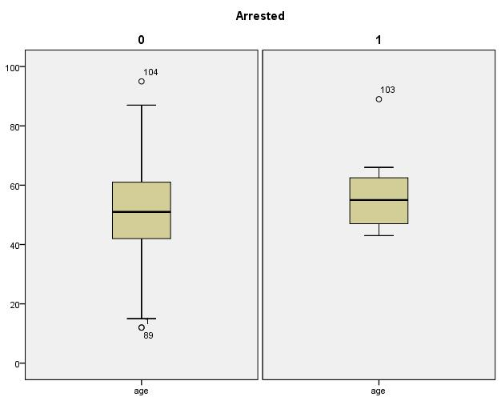
Training: Disclosure risk online tutorial
Disclosure: Graph with extreme values example
Data were collected for a sample of 104 people in a county.
Among the variables collected were age, gender, and whether the person was arrested within the last year. Box plots below show the distribution of age, one plot for those arrested and one for those who were not. The number labels are case number in the dataset.
The potential identifiability represented by outlying values is compounded here by an unusual combination that could probably be identified using public records for a county in the U.S. --someone approximately 90 years old was arrested in the sample. Including extreme values is a disclosure risk for identifiability when combined with other variables in the dataset.
Arrested in last year?
yes
no
N | 104
min age | 12
max age | 95
mean age | 51
std dev | 15
% female | 5.2
% arrested | 5.8

Slide 21
The Gradient of Risk & Restriction
High risk of disclosure, high risk of harm
High Risk Enclosed Data Center
Severity of Harm
Moderate Risk
- Strong DUA & Technology Rules
Complex Data, Some risk of disclosure & some risk of harm
Complex Data, little risk of disclosure, some risk of harm
Some Risk Data Use Agreement
Simple Data, little risk
of & from disclosure
Tiny Risk
Web Access
Risk of Disclosure

Slide 22
The IRB of the data producer should establish a data dissemination plan,
But
Many IRBs lack expertise in disclosure risk
Data persist much longer than membership of the IRB
Centers of expertise in disclosure risk should be available to advise and succeed IRBs

Slide 23
Data repositories offer secure dissemination services
Dissemination of confidential data is too burdensome for most projects
Data security technology is changing rapidly
Repositories are long-lived institutions

Slide 24
Institutions that receive data are responsible for security and behavior
IRBs of data recipients should defer to protocols established by previous IRBs
Institutions are responsible for compliance
IT security is necessary but not sufficient
Data users must understand disclosure risks and behave safely
Data users should pay the costs of access to confidential data

Slide 25
Thank you!
George Alter
altergc@umich.edu
www.icpsr.org

