Slide 1


State of the Science for Implementation Research: The role of context and strategies Laura J. Damschroder, MS, MPH March 6, 2018 Prepared for the Committee on Fostering Healthy Mental, Emotional, and Behavioral (MEB) Development. The views expressed in this presentation are our own and do not reflect the position or policy of our respective institutions listed above.
Notes:
General notes from planning call:
interested in hearing from you about barriers and facilitators to effective implementation of strategies to foster healthy mental, emotional, and behavioral development.
The committee member leading this content area is Will Aldridge from UNC at Chapel Hill.
Notes from 2/22 call:
Advancement of IS in last 10 years
*ERIC strategies and CFIR
Why CFIR/ERIC – why are they important
Status of research for each
What is status of CFIR research…state of the science and findings/processes
Ok that it’s still exploratory – five key themes? (revisit Ostrom questions)
*Interaction between CFIR and ERIC
*Are there any findings pointing to recommendations?
Implementation capacity/infrastructure available
Memo: written presentation
CDC, SAMSA, NIH (see statement of task document) → build infrastructure and IS for MH children/youth

Slide 2
Outline
Role of theory
Role of context in implementation
Notes:
As part of this focus, NCCMT has developed an online, searchable registry of methods and tools for knowledge translation in public health and provides summary statements of these methods and tools to help busy practitioners use evidence in their practice. Among the methods and tools in the registry is the Consolidated Framework for Implementation Research (CFIR) – and the summary statement for the tool has been highly accessed by NCCMT users (http://www.nccmt.ca/registry/view/eng/210.html).

Slide 3
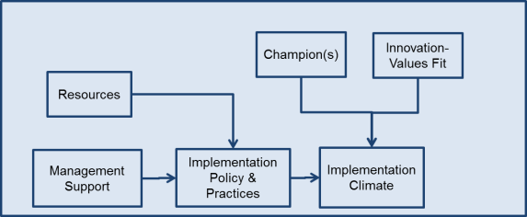
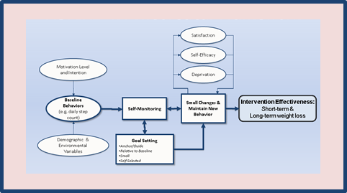
Preparing for, explaining implementation
Theory underlying implementation
Barriers and facilitators
Why did/will it work?
+
Program
Benefits
Establishing “external validity” as a priority, without compromising internal validity
Embrace and understand CONTEXT
Theory underlying
clinical innovation
Notes:
Set the stage for the role of implementation and its study – focus on context and strategies in this presentation
Main point: need both effective clinical innovation PLUS implementation success to achieve expected benefits. Avoid Type 3 error: failure to produce benefit attributed to clinical innovation, when it may not have been effectively implemented

Slide 4
Importance of theory
Provides common terms & definitions
Basic building block: theoretical constructs
Provides organizing framework to guide research
Systematically build scientific knowledge base
Context
Mechanisms of action
Relationships
Efficiently build collective knowledge
Colquhoun, H., Leeman, J., Michie, S., Lokker, C., Bragge, P., Hempel, S., … Grimshaw, J. (2014). Towards a common terminology: a simplified framework of interventions to promote and integrate evidence into health practices, systems, and policies. Implementation Science, 9, 51.
Foy R, Ovretveit J, Shekelle PG, et al. The role of theory in research to develop and evaluate the implementation of patient safety practices. Quality & safety in health care. Feb 11 2011.
Notes:
Establish role of theory – important foundation for why CFIR/ERIC ‘frameworks’ are important and their value

Slide 5
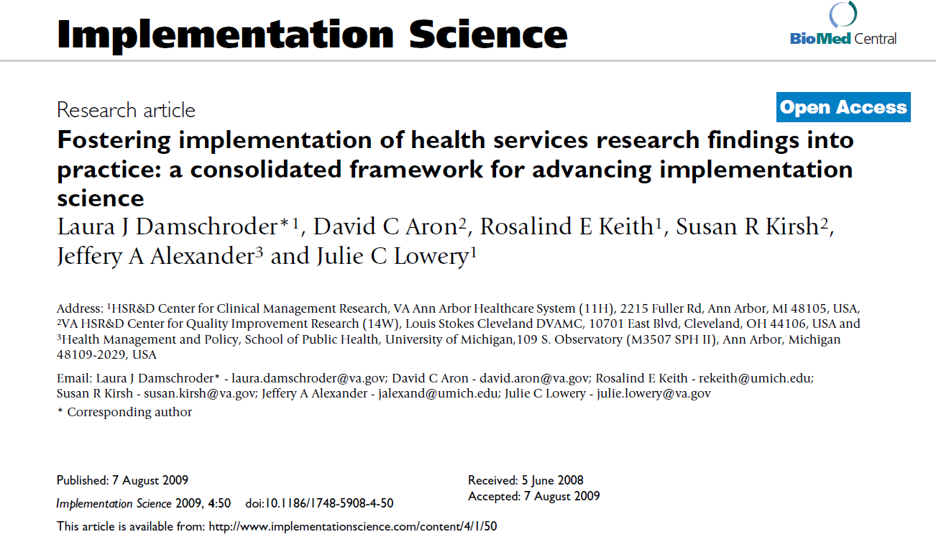
Notes:
My focus will be on CFIR, which has been cited over 2000 times in Google Scholar, which is one of the most widely used frameworks within health services research - and is used in applications outside of medical/health domain including education, natural resources, community innovations and more…

Slide 6
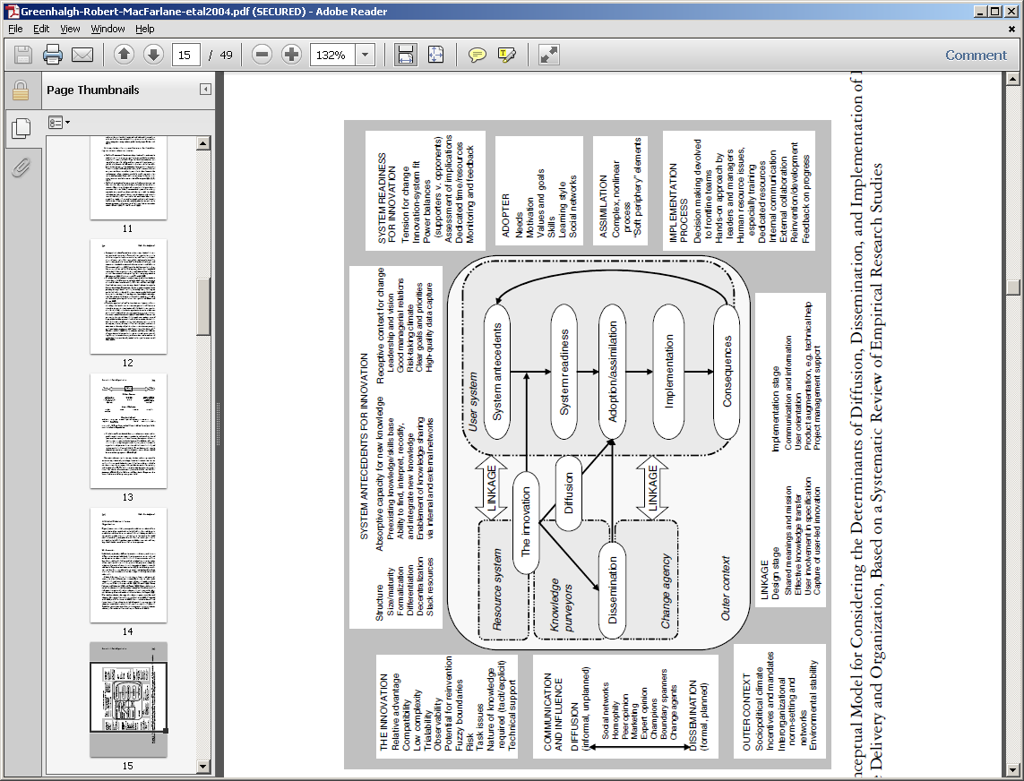
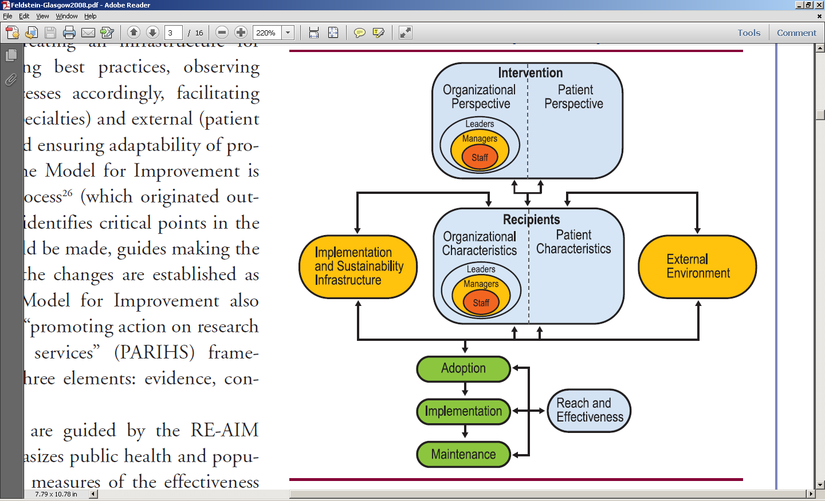
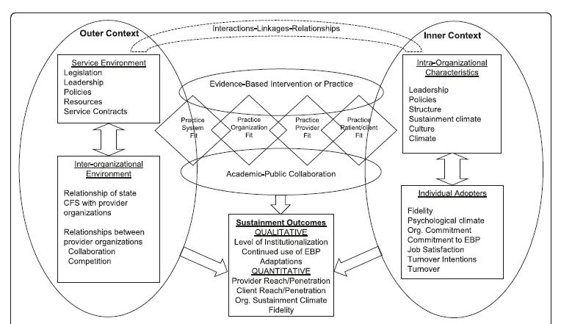
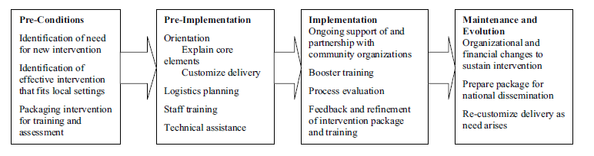
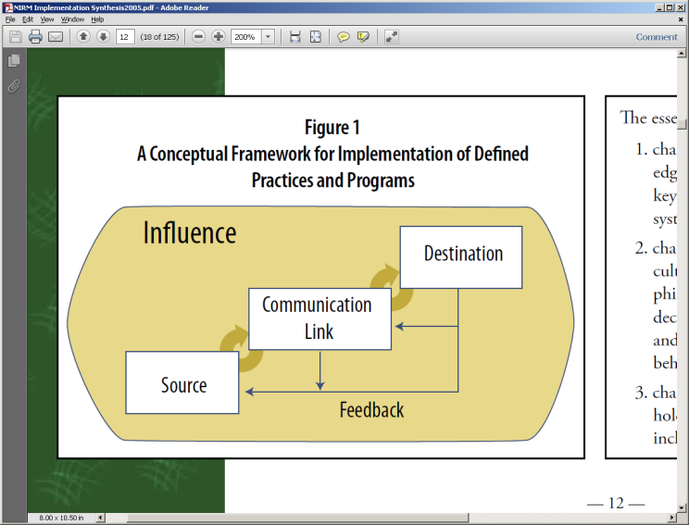
So many models, frameworks, theories…
Notes:
At the time of CFIR (leading into 2009)… plethora of frameworks

Slide 7
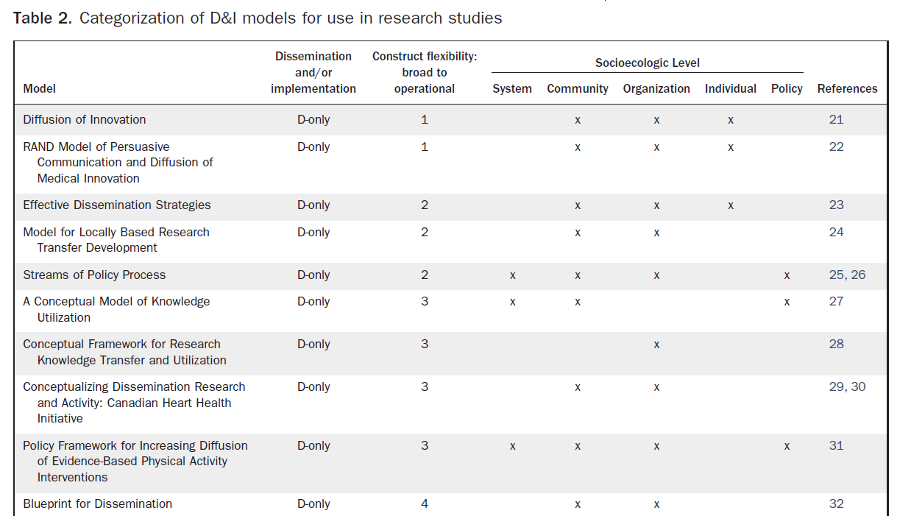
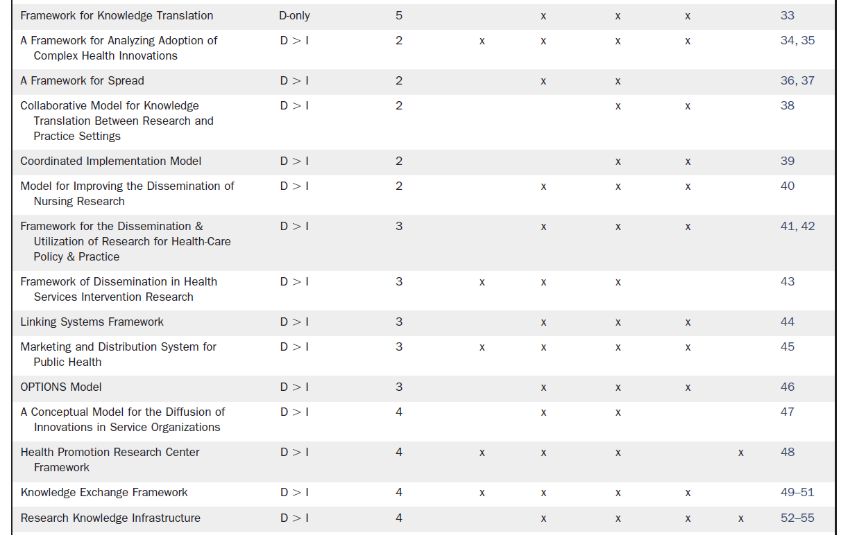
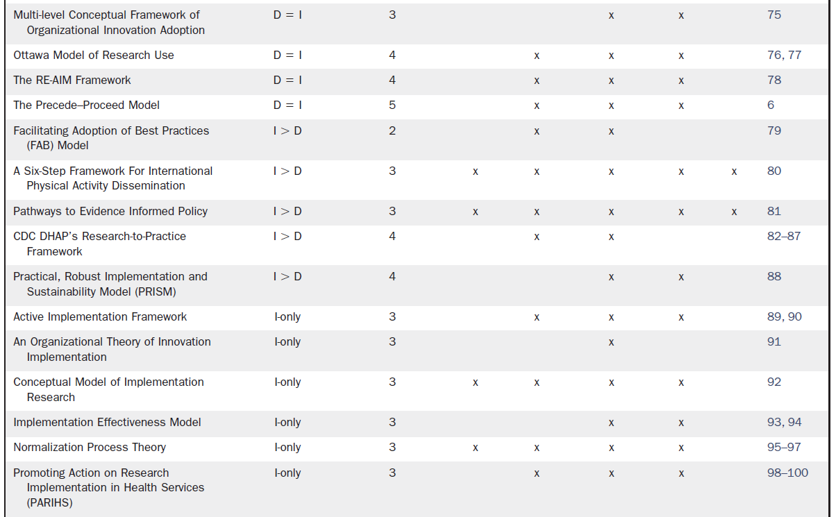
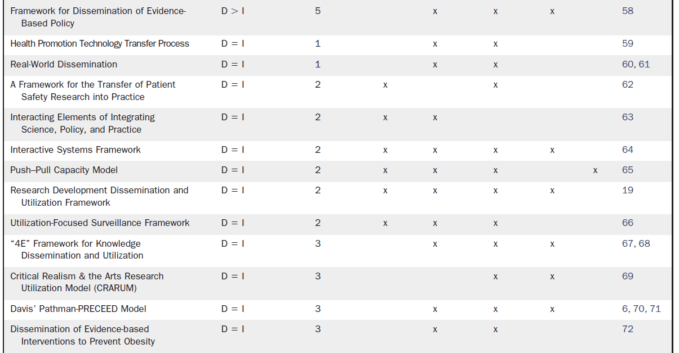
61 frameworks identified
Tabak, R. G., E. C. Khoong, D. A. Chambers, and R. C. Brownson. 2012. “Bridging research and practice: models for dissemination and implementation research.” American Journal of Preventive Medicine 43(3): 337-50.
Notes:
Even with Taback review in 2012….Taback gave CFIR one of the highest scores for operationalization – CFIR was developed to address construct identification/definition mess…

Slide 8
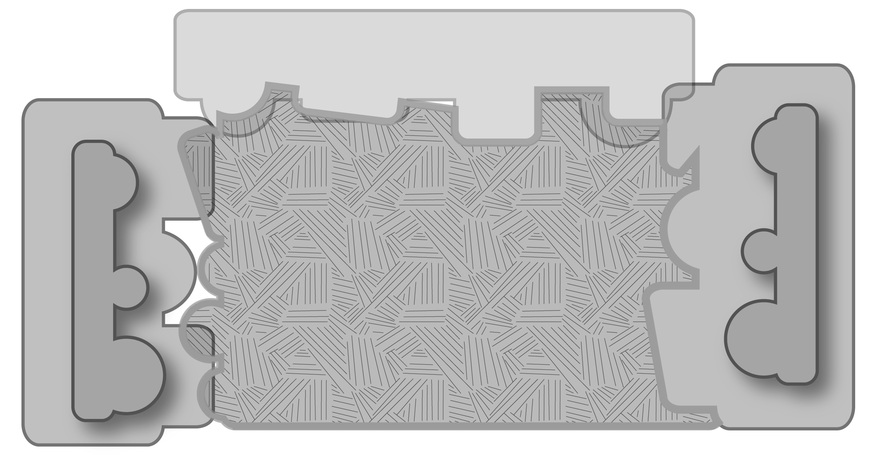
CFIR: 5 domains
Intervention
(unadapted)
Core Components
Adaptable Periphery
Notes:
Slides 8-22 quickly walk through the CFIR. These 15 slides count as about 5 slides – I can get through these in about 5 minutes. I’ll be within my allocated ~20 minutes.

Slide 9
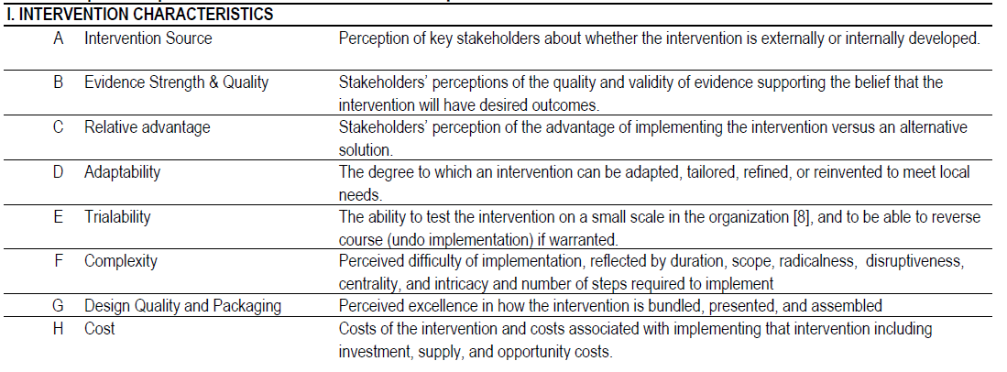
CFIR: Intervention characteristics (8 constructs)
Damschroder, L. J., D. C. Aron, R. E. Keith, S. R. Kirsh, J. A. Alexander, and J. C. Lowery. 2009. “Fostering implementation of health services research findings into practice: a consolidated framework for advancing implementation science.” Implement Sci 4..
Notes:
Comprehensive taxonomy
Promote consistent use of constructs, terminology, and definitions
Consolidate existing models and frameworks
Comprehensive in scope
Tailor use to the setting
Intervention
8 Constructs (e.g., evidence strength & quality, complexity)
Outer Setting
4 Constructs (e.g., patient needs & resources)
Inner Setting
14 constructs (e.g., leadership engagement, available resources)
Individuals Involved
5 Constructs (e.g., knowledge, self-efficacy)
Process
8 Constructs (e.g., plan, engage, champions)

Slide 10
CFIR: 5 domains
Intervention
(unadapted)
“…I was impressed with the evidence and I know from our own patients who have been successful with a similar program”
Core Components
Adaptable Periphery

Slide 11

CFIR: 5 domains
Intervention
(unadapted)
Intervention
(adapted)
Core Components
Adaptable Periphery
Adaptable Periphery
Core components
Individuals
Involved

Slide 12
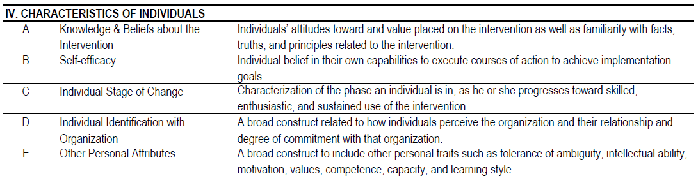
CFIR: Characteristics of individuals (5 constructs)
Damschroder, L. J., D. C. Aron, R. E. Keith, S. R. Kirsh, J. A. Alexander, and J. C. Lowery. 2009. “Fostering implementation of health services research findings into practice: a consolidated framework for advancing implementation science.” Implement Sci 4..
Notes:
Comprehensive taxonomy
Promote consistent use of constructs, terminology, and definitions
Consolidate existing models and frameworks
Comprehensive in scope
Tailor use to the setting
Intervention
8 Constructs (e.g., evidence strength & quality, complexity)
Outer Setting
4 Constructs (e.g., patient needs & resources)
Inner Setting
14 constructs (e.g., leadership engagement, available resources)
Individuals Involved
5 Constructs (e.g., knowledge, self-efficacy)
Process
8 Constructs (e.g., plan, engage, champions)

Slide 13
CFIR: 5 domains
Intervention
(unadapted)
Intervention
(adapted)
Core Components
Adaptable Periphery
Adaptable Periphery
Core components
Individuals
Involved
“I’ve heard one physician…say, ‘Aw it doesn’t work, they re-gain the weight anyway’”

Slide 14
CFIR: 5 domains
Intervention
(unadapted)
Intervention
(adapted)
Outer setting
Core Components
Adaptable Periphery
Adaptable Periphery
Core components
Individuals
Involved

Slide 15
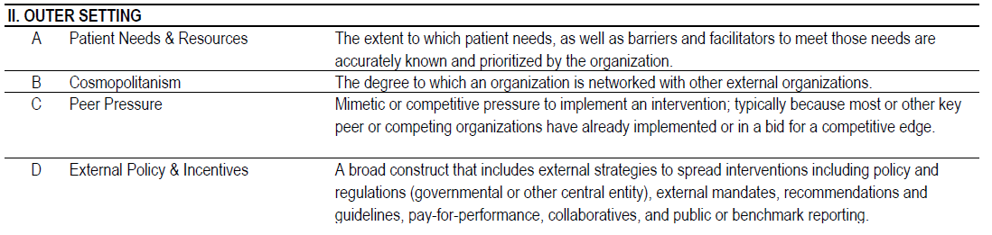
CFIR: Outer setting (4 constructs)
Damschroder, L. J., D. C. Aron, R. E. Keith, S. R. Kirsh, J. A. Alexander, and J. C. Lowery. 2009. “Fostering implementation of health services research findings into practice: a consolidated framework for advancing implementation science.” Implement Sci 4..
Notes:
Comprehensive taxonomy
Promote consistent use of constructs, terminology, and definitions
Consolidate existing models and frameworks
Comprehensive in scope
Tailor use to the setting
Intervention
8 Constructs (e.g., evidence strength & quality, complexity)
Outer Setting
4 Constructs (e.g., patient needs & resources)
Inner Setting
14 constructs (e.g., leadership engagement, available resources)
Individuals Involved
5 Constructs (e.g., knowledge, self-efficacy)
Process
8 Constructs (e.g., plan, engage, champions)

Slide 16
CFIR: 5 domains
Intervention
(unadapted)
Intervention
(adapted)
Outer setting
Core Components
Adaptable Periphery
Adaptable Periphery
“It will help us meet national performance measures…”
Core components
Individuals
Involved

Slide 17
CFIR: 5 domains
Intervention
(unadapted)
Intervention
(adapted)
Outer setting
Core Components
Adaptable Periphery
Adaptable Periphery
Core components
Individuals
Involved
Inner setting

Slide 18
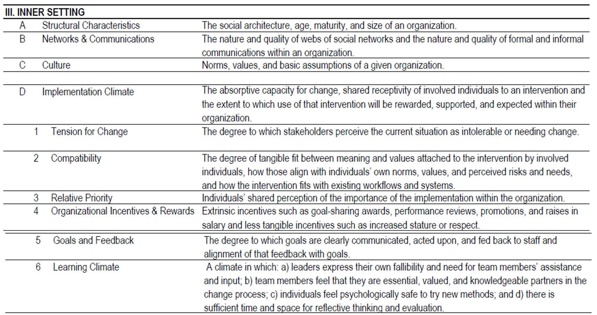
CFIR: Inner setting (14 sub/constructs)
Damschroder, L. J., D. C. Aron, R. E. Keith, S. R. Kirsh, J. A. Alexander, and J. C. Lowery. 2009. “Fostering implementation of health services research findings into practice: a consolidated framework for advancing implementation science.” Implement Sci 4..
Notes:
Comprehensive taxonomy
Promote consistent use of constructs, terminology, and definitions
Consolidate existing models and frameworks
Comprehensive in scope
Tailor use to the setting
Intervention
8 Constructs (e.g., evidence strength & quality, complexity)
Outer Setting
4 Constructs (e.g., patient needs & resources)
Inner Setting
14 constructs (e.g., leadership engagement, available resources)
Individuals Involved
5 Constructs (e.g., knowledge, self-efficacy)
Process
8 Constructs (e.g., plan, engage, champions)

Slide 19
CFIR: 5 domains
Intervention
(unadapted)
Intervention
(adapted)
Outer setting
“…the health coaching just fits right in with our disease prevention and health promotion programs, and it's such a complement…”
Core Components
Adaptable Periphery
Adaptable Periphery
Core components
Individuals
Involved
Inner setting

Slide 20
CFIR: 5 domains
Intervention
(unadapted)
Intervention
(adapted)
Outer setting
Core Components
Adaptable Periphery
Adaptable Periphery
Core components
Individuals
Involved
Inner setting
Process

Slide 21
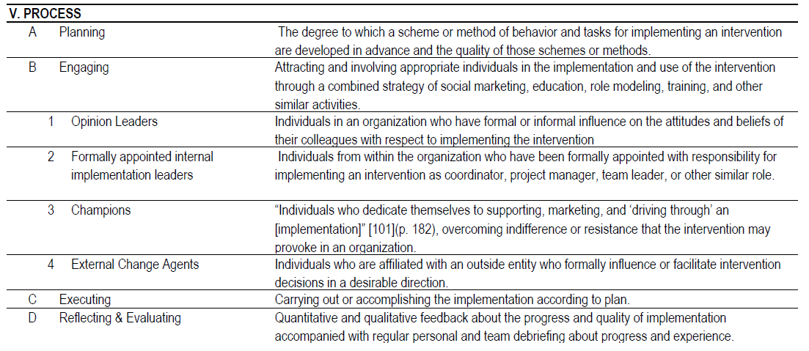
CFIR: Process (8 sub/constructs)
Damschroder, L. J., D. C. Aron, R. E. Keith, S. R. Kirsh, J. A. Alexander, and J. C. Lowery. 2009. “Fostering implementation of health services research findings into practice: a consolidated framework for advancing implementation science.” Implement Sci 4..
Notes:
Comprehensive taxonomy
Promote consistent use of constructs, terminology, and definitions
Consolidate existing models and frameworks
Comprehensive in scope
Tailor use to the setting
Intervention
8 Constructs (e.g., evidence strength & quality, complexity)
Outer Setting
4 Constructs (e.g., patient needs & resources)
Inner Setting
14 constructs (e.g., leadership engagement, available resources)
Individuals Involved
5 Constructs (e.g., knowledge, self-efficacy)
Process
8 Constructs (e.g., plan, engage, champions)

Slide 22
CFIR: 5 domains
Intervention
(unadapted)
Intervention
(adapted)
Outer setting
“… I didn't even know that was available to my patients.”
Core Components
Adaptable Periphery
Adaptable Periphery
Core components
Individuals
Involved
Inner setting
Process

Slide 23
Use of theory to guide implementation
1
Assess targeted EBP change and context
Use theory to guide assessment
Sales A, Smith J, Curran G, Kochevar L. Models, strategies, and tools. Theory in implementing evidence-based findings into health care practice. J. Gen. Intern. Med. Feb 2006;21 Suppl 2:S43-49.
Bartholomew, L. K., Parcel, G. S., & Kok, G. (1998). Intervention mapping: a process for developing theory- and evidence-based health education programs. Health Educ Behav, 25(5), 545-563.

Slide 24
Telephone lifestyle coaching program
Coaching to support lifestyle change for Veterans
Eat wisely
Be physically active
Be tobacco free
Strive for a healthy weight
Manage stress
Limit alcohol
Strong evidence-base
Clinically relevant benefits at 6 months after baseline
9,357 Veterans referred over 19 month period
Notes:
November 2011 – May 2013
57% enrolled (n=5321)
43% completed 7+ coaching sessions (n=2299)

Slide 25

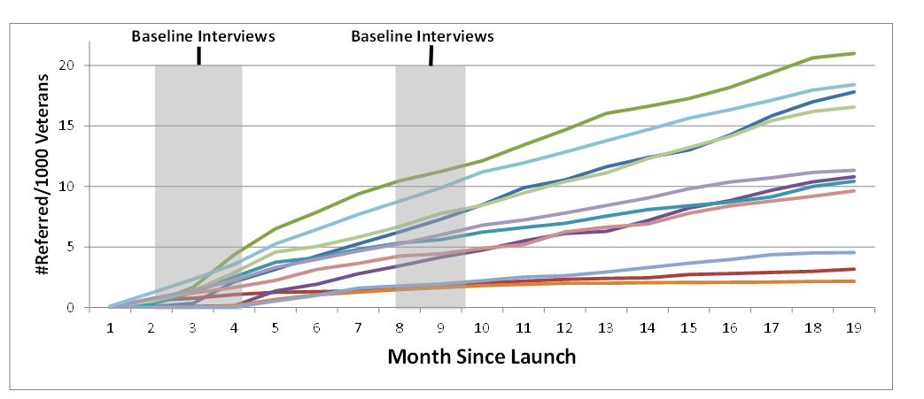
Variable referral rates
.28
Referral Rate
Time (months) since launch

Slide 26
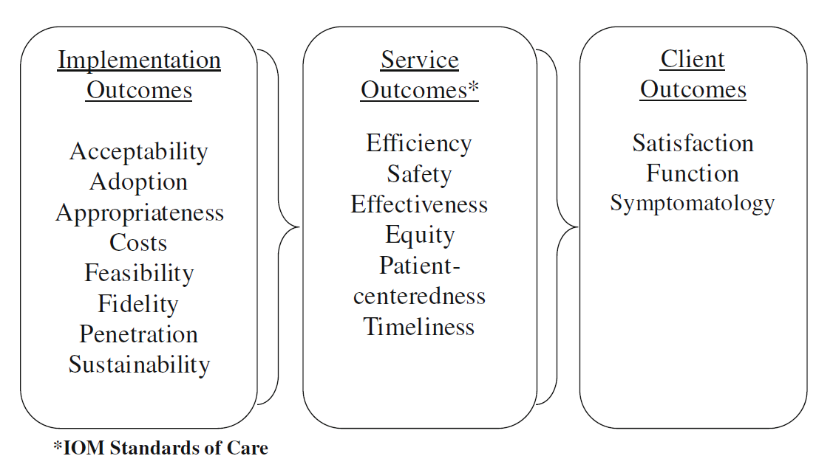
Outcomes
Rate of enrollment X Medical Center
Proctor, E., H. Silmere, R. Raghavan, P. Hovmand, G. Aarons, A. Bunger, R. Griffey, and M. Hensley, Outcomes for implementation research: conceptual distinctions, measurement challenges, and research agenda. Administration and Policy in Mental Health, 2011. 38(2): p. 65-76.

Slide 27
Use of theory to guide implementation
1
Assess targeted EBP change and context
Who needs to do what differently?
Which barriers/ facilitators need to be addressed?
Sales A, Smith J, Curran G, Kochevar L. Models, strategies, and tools. Theory in implementing evidence-based findings into health care practice. J. Gen. Intern. Med. Feb 2006;21 Suppl 2:S43-49.
Bartholomew, L. K., Parcel, G. S., & Kok, G. (1998). Intervention mapping: a process for developing theory- and evidence-based health education programs. Health Educ Behav, 25(5), 545-563.
Notes:
This is teeing you up, Bryon if you want to use this. It’s your choice.

Slide 28
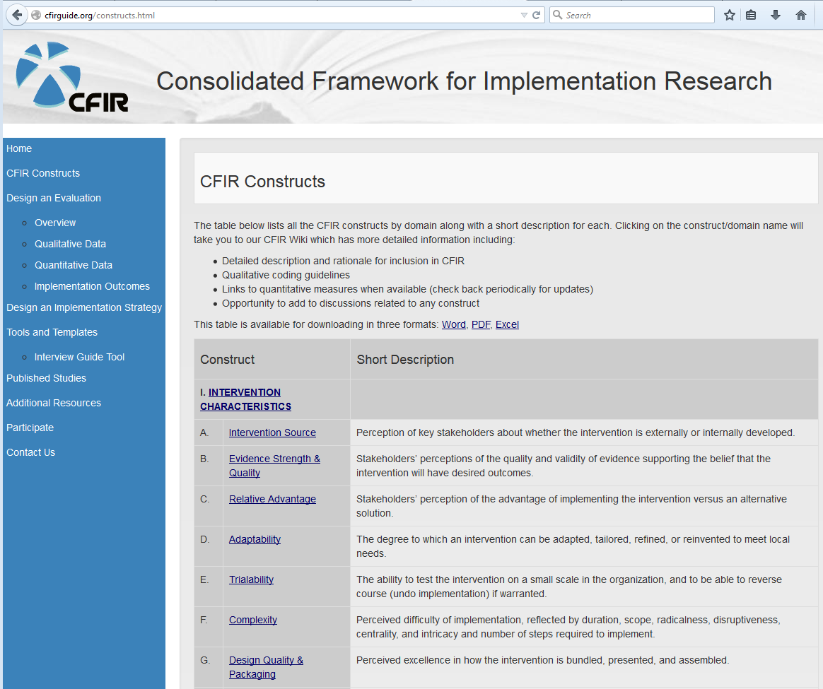
www.CFIRGuide.org

Slide 29
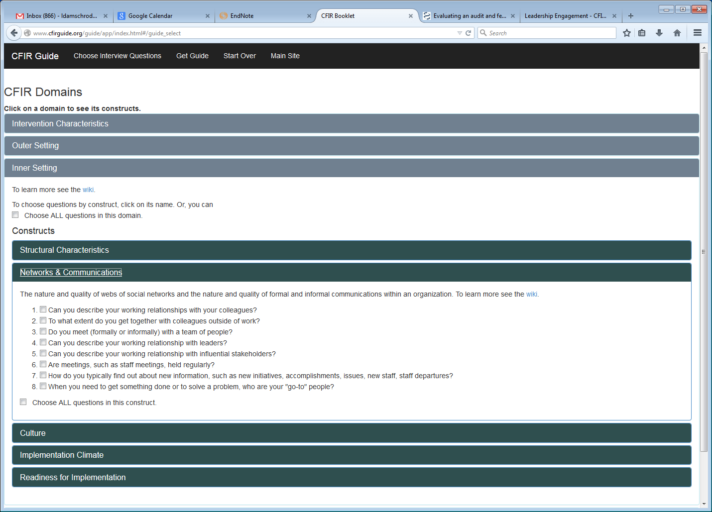
29

Slide 30
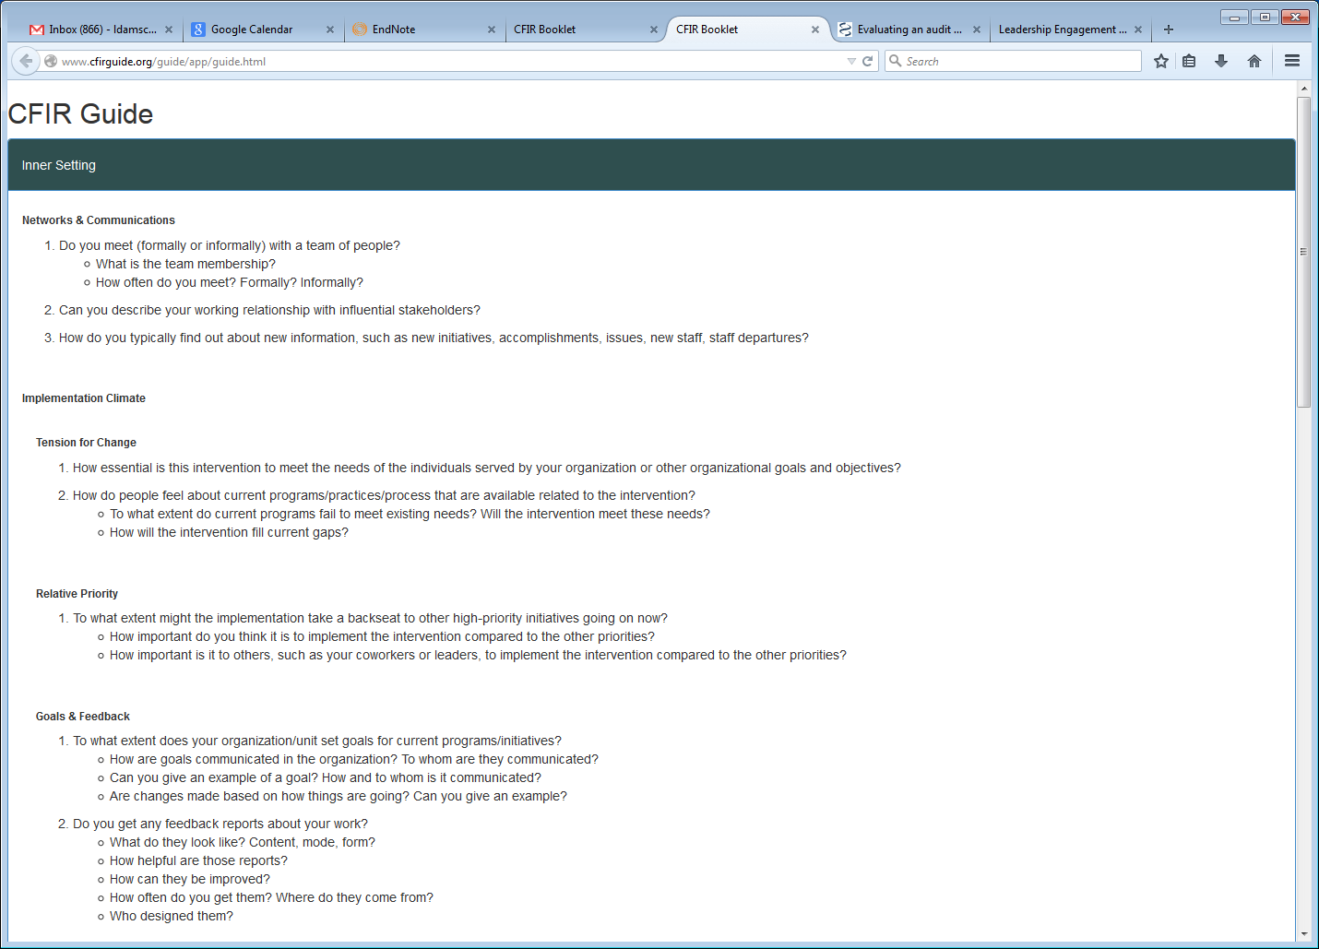
30

Slide 31
Coding and rating: compatibility
Negative Rating – e.g.,
Only providers could refer to TLC in some sites
“Our nurses are specifically forbidden to write orders …everything that gets written has to be written by a physician[…] this has formed a really labor intensive situation for practitioners.”
-2

Slide 32
Coding and rating: compatibility
Positive Rating – e.g.,
Perceived compatibility with clinical initiatives
“…this …really helps the patient to have ownership for their processes and their living, and it definitely blends very nicely with the health coaching.”
+2

Slide 33
Analysis: compatibility
Correlation: 0.55 (p=0.08)

Slide 34
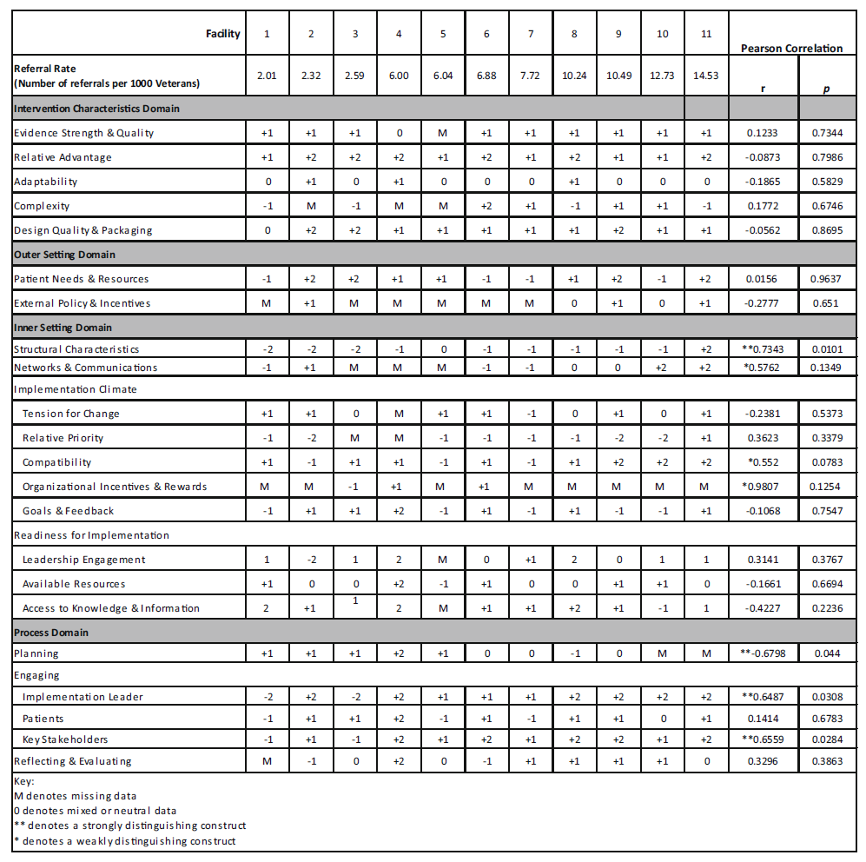
Compatibility | +1 | -1 | +1 | +1 | -1 | +1 | -1 | +1 | +2 | +2 | +2 | *0.552 | 0.0783

Slide 35
Explaining variation in referral rates
.28
Referral Rate
Time (months) since launch

Slide 36
State of science: use of theory
Little reporting of methods or logic for selecting theory or its components
Most studies use theory superficially
In background/discussion sections
Few studies clearly define and assess outcomes and link outcomes to implementation process
“…the single greatest need for … implementation models is rigorous, prospective use of the framework to guide implementation projects.”²
For example:
1. Damschroder, L., D. Aron, R. Keith, S. Kirsh, J. Alexander, and J. Lowery. 2009. “Fostering implementation of health services research findings into practice: a consolidated framework for advancing implementation science.” Implement Sci 4(1): 50.
2. Helfrich, C. D., L. J. Damschroder, H. J. Hagedorn, G. S. Daggett, A. Sahay, M. Ritchie, T. Damush, M. Guihan, P. M. Ullrich, and C. B. Stetler. 2010. “A critical synthesis of literature on the promoting action on research implementation in health services (PARIHS) framework.” Implement Sci 5(1): 82.

Slide 37
Assessment of CFIR’s value
Is terminology and language coherent?
Terminology and language of constructs appear to be coherent
Does CFIR promote comparison of results across contexts and studies over time?
Too early to tell but progressing in the right direction
Does the CFIR stimulate new theoretical developments?
Generally poor integration of the CFIR into empirical studies stymies progress

Slide 38
Recommendations
Consider how to use most meaningfully across different phases of implementation
Use prospectively to develop implementation approaches and monitor progress, as well as retrospective explanation
Integrate CFIR into all phases of research e.g., data collection
Report how CFIR constructs were selected and assessed
Link constructs with proximal implementation outcomes

Slide 39
Use of theory to guide implementation
1
2
Assess targeted EBP change and context
Develop tailored implementation strategy
Who needs to do what differently?
Which barriers/ facilitators need to be addressed?
What strategies can be used to address barriers & facilitators?
Sales A, Smith J, Curran G, Kochevar L. Models, strategies, and tools. Theory in implementing evidence-based findings into health care practice. J. Gen. Intern. Med. Feb 2006;21 Suppl 2:S43-49.
Bartholomew, L. K., Parcel, G. S., & Kok, G. (1998). Intervention mapping: a process for developing theory- and evidence-based health education programs. Health Educ Behav, 25(5), 545-563.
Notes:
This is teeing you up, Bryon if you want to use this. It’s your choice.

Slide 40

What works where and why?
Questions?
Contact:
Laura.Damschroder@va.gov
Notes:
We don’t have to use this … just a placeholder for a last slide.

